Slide 1
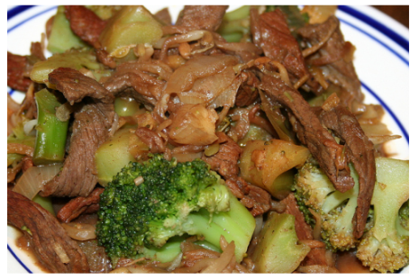
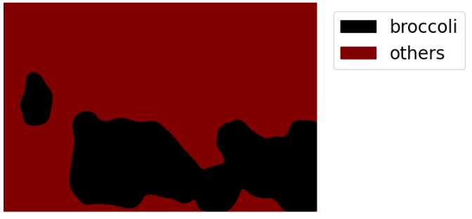

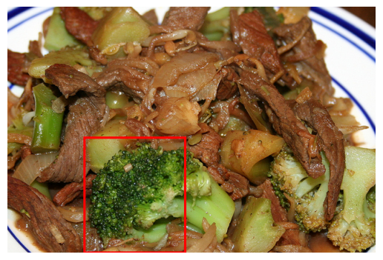
Input Image
Input Sentence
Semantic Segmentation
Basic Bounding Box Instancing
Visual Grounding Module
Output
Noun Label
“Broccoli”
Segmentation Map
Bounding Box Instances
Descriptive Sentence
“big piece of broccoli”

Slide 2

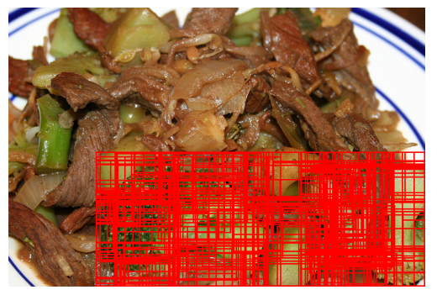
Visual Grounding Module
Preliminary
Bounding Box Selection
Region Proposal Algorithm: Selective Search
Final
Bounding Box Selection
Bounding box instances
Output Bounding Box
Descriptive Sentence
“big piece of broccoli”

Slide 3
Input Image
Input Sentence
Semantic Segmentation
Basic Bounding Box Instancing
Visual Grounding Module
Output
Noun Label
“Broccoli”
Segmentation Map
Bounding Box Instances
Descriptive Sentence
“big piece of broccoli”

Slide 4
Visual Grounding Module
Preliminary
Bounding Box Selection
Region Proposal Algorithm: Selective Search
Final
Bounding Box Selection
Bounding box instances
Output Bounding Box
Descriptive Sentence
“big piece of broccoli”

Slide 5
Image Processing Module
Image
Bounding Box Processing
Noun Labels
LSeg
Extraction
Instancing
Optimization
Bounding Boxes
Segmentation Map

Slide 6
RefCOCO+
Image
Label
Image Processing Module
Visual Grounding Module
Output Bbox
Bounding Boxes
Sentences
Ref_bbox
IoU Calculator
IoU

Slide 7
RefCOCO+
Image
Label
Semantic Segmentation
Basic Bounding Box Instancing
Visual Grounding Module
Output
IoU Score
Segmentation Map
Bounding Box Instances
Sentences
Ref_bbox

