Slide 1
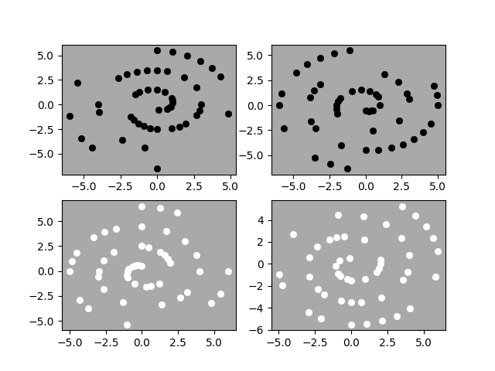
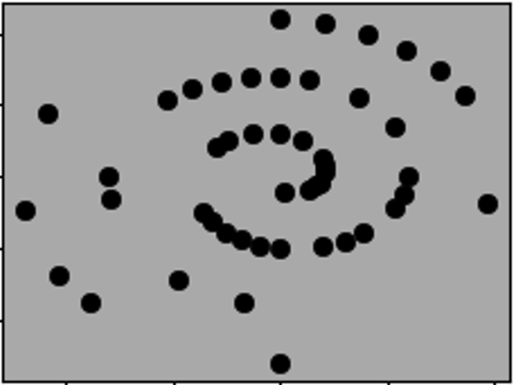
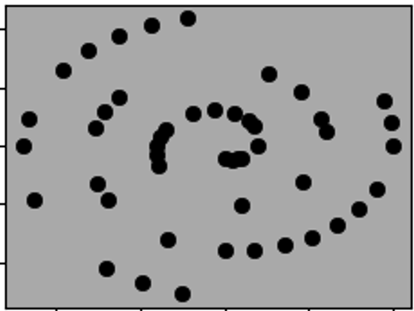
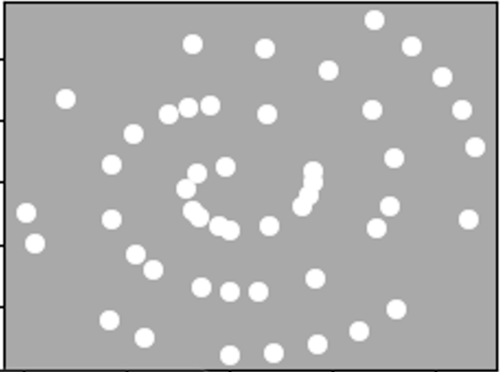
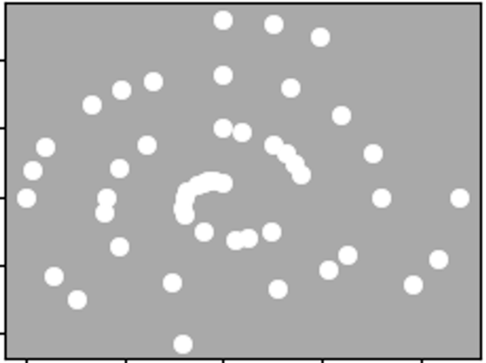

Slide 2
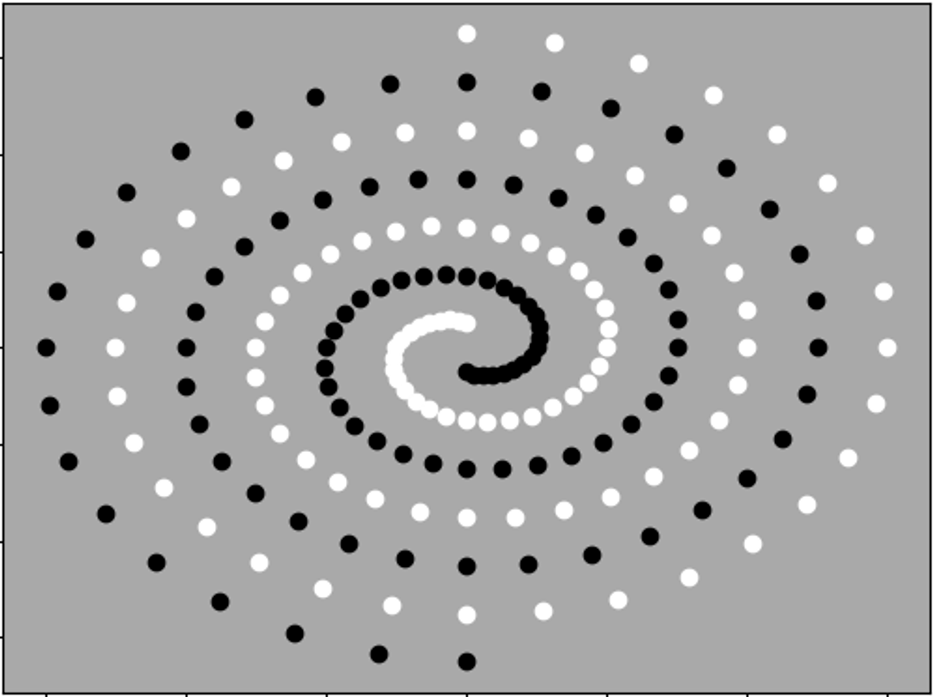
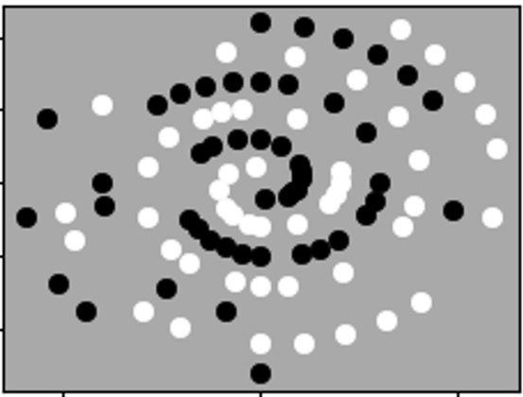
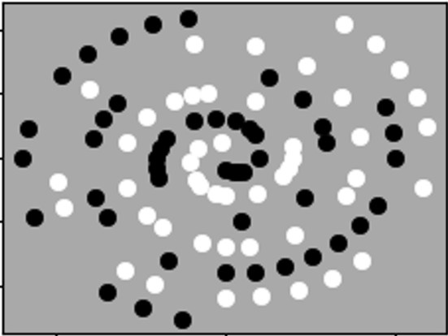
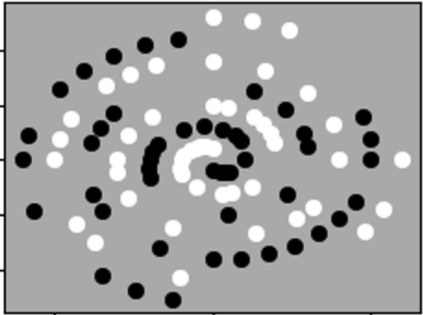
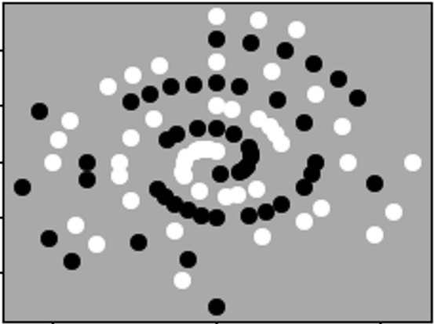




$$M_{11}$$
$$M_{12}$$
$$M_{21}$$
$$M_{22}$$

Slide 3
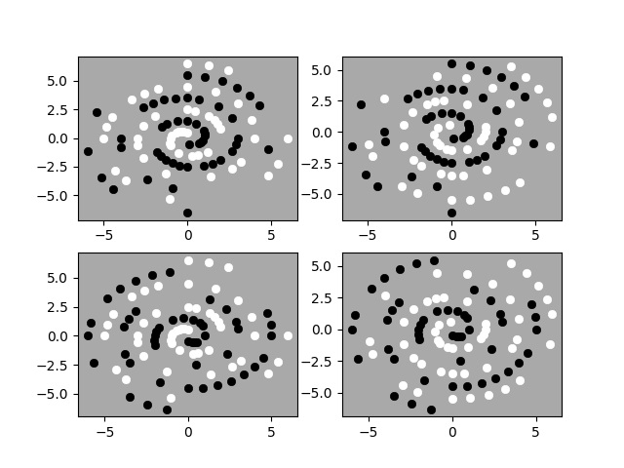

Slide 4
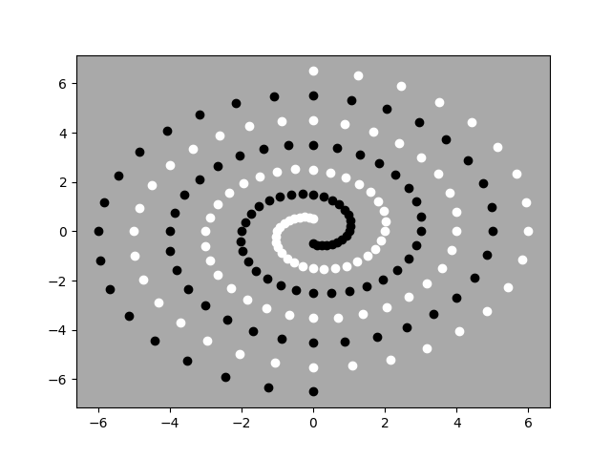

Slide 5














$$M_{11}$$
$$M_{11}$$
$$MIN$$
$$MIN$$
$$M_{12}$$
$$M_{21}$$
$$MAX$$
$$MAX$$
$$M_{21}$$
$$M_{12}$$
$$MIN$$
$$MIN$$
$$M_{22}$$
$$M_{22}$$

Slide 6
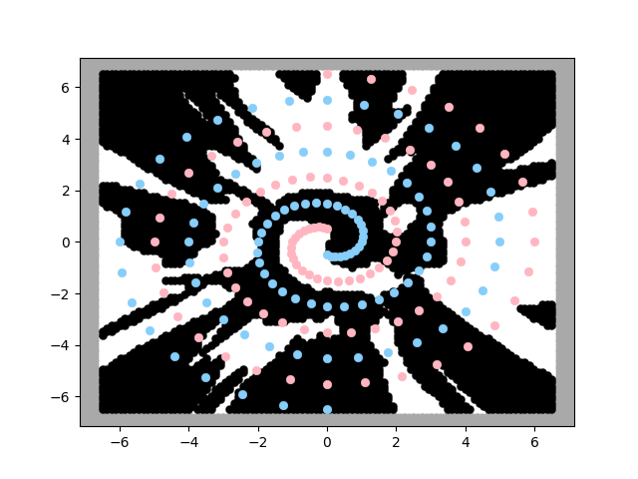
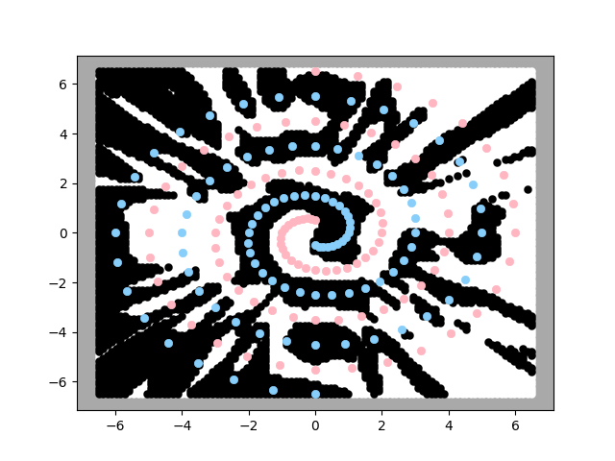
Running time=77.05s
Running time=78.20s
accuracy=0.69
accuracy=0.93

Slide 7
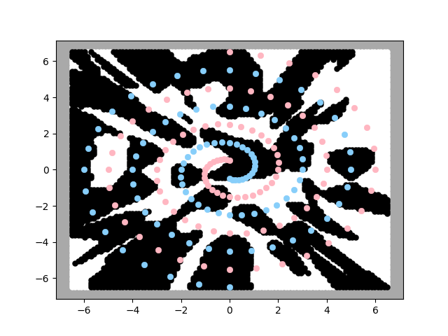
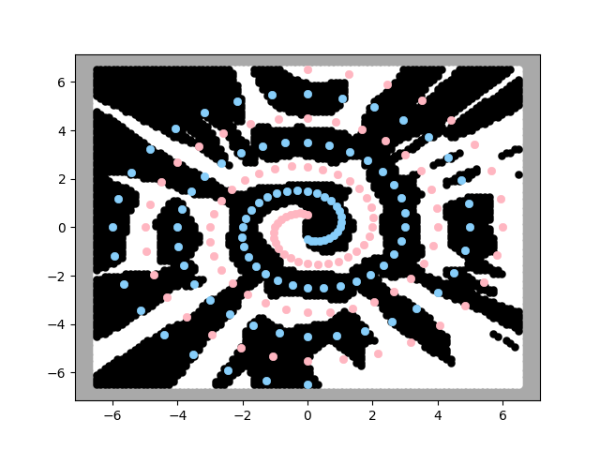
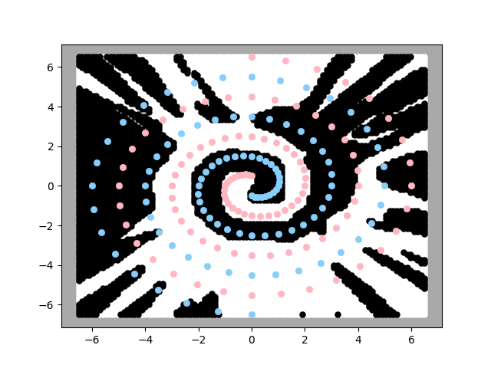
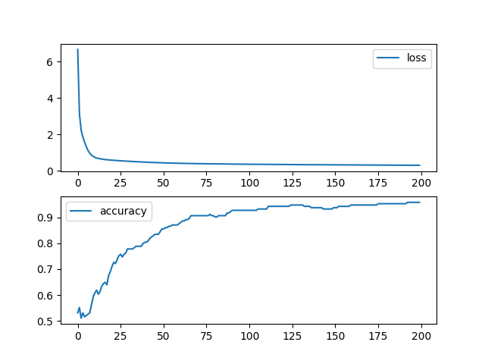
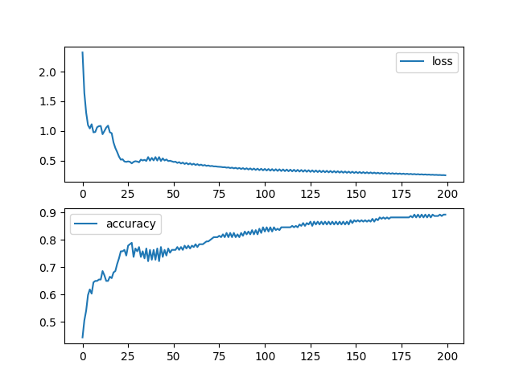
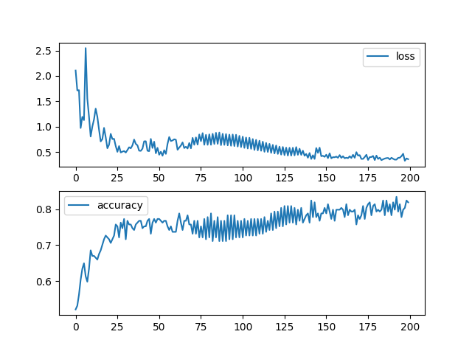
Lr=0.0001
Lr=0.0005
Lr=0.001
Running time=79.23s
Running time= 77.42s
Running time= 77.40s

