Slide 1
Strawberry
Zixuan (Mary) Liu

Slide 2
Introduction
- wrap up Unit 1 by doing the “berries” dataset.
combine data cleaning, data organization, and EDA.
Visualize and explore the data.
These data were collected from the USDA database selector: https://quickstats.nass.usda.gov
The data were stored online and then downloaded as a CSV file.

Slide 3
Data cleaning and organizing
Main Steps: - Load and select meaningful data, find the columns that can be eliminated.
Choose “STRAWBERRIES” dataset
Separate data_item, Domain and Domain Category column
Organize the data to make it more meaningful

Slide 4
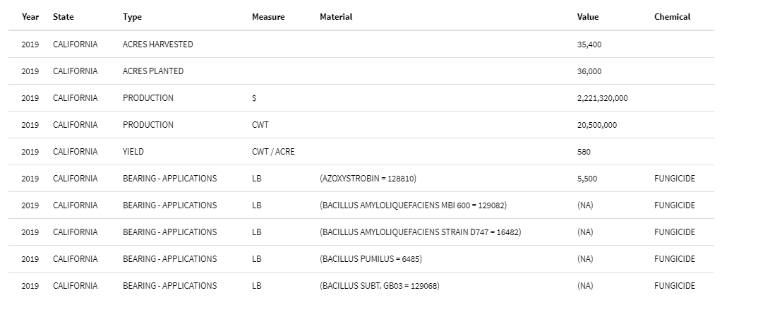
Strawberry data below after cleaning(first 10 rows)

Slide 5
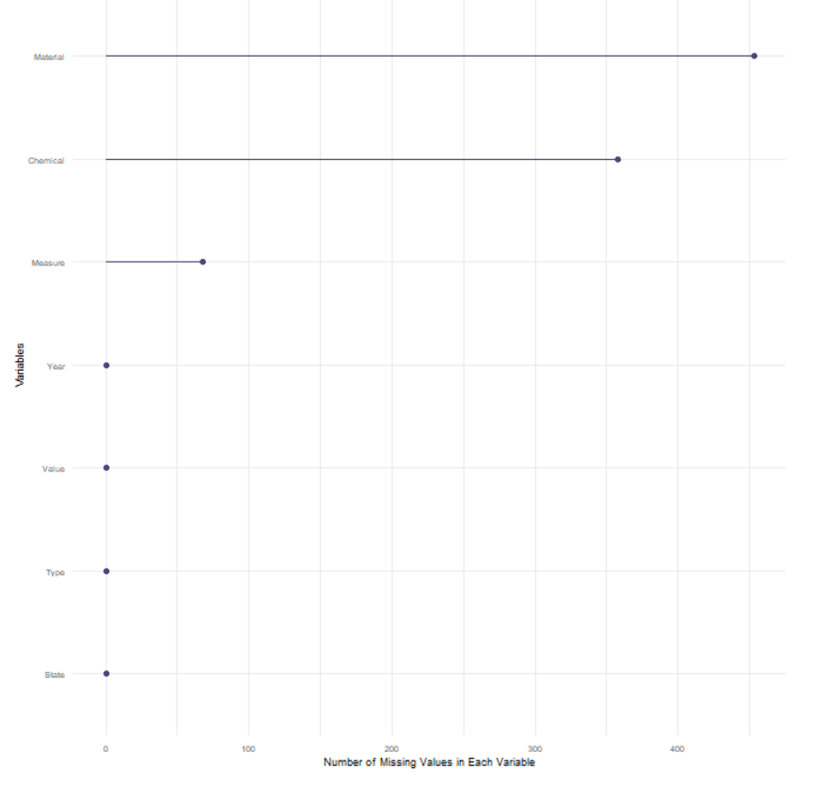
Missing Values
First, I conduct basic data reprocessing. Missing values for sberry dataset are shown in the histogram below. The plot below shows that Material, Chemical and Measure variable has missing value.

Slide 6
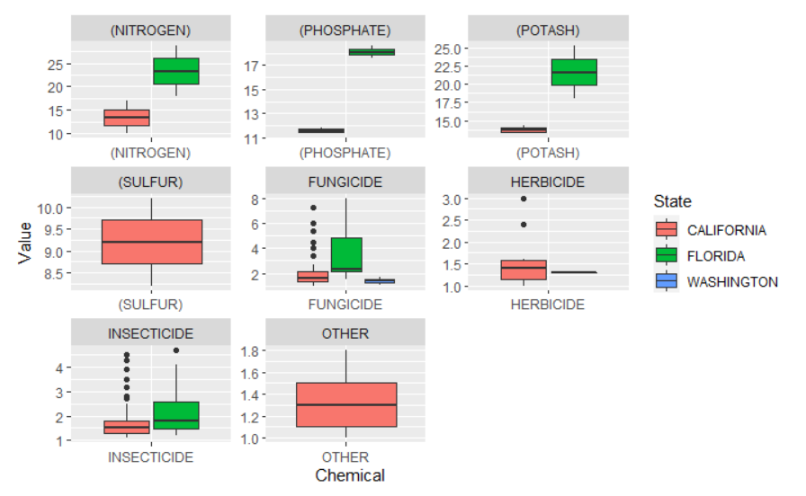
EDA(Exploratory Data Analysis)
I compared the chemical values by different states.

