Slide 1
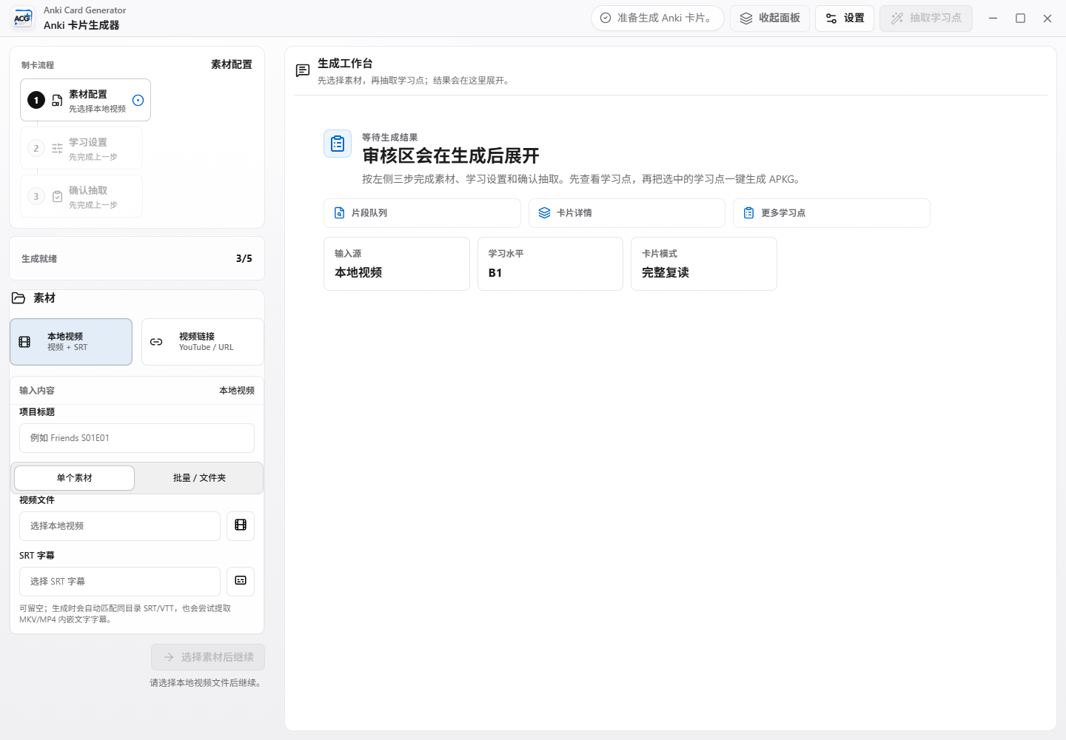
Anki Card
Generator
v0.9.4-beta release verification, Windows desktop readiness, and Browser + Local Helper roadmap.
Current conclusion: public Windows beta is usable; browser product remains a separate planned line.
v0.9.4-beta | Windows desktop release
01

Slide 2
ANKI CARD GENERATOR VERIFICATION
Release Verdict
The core product is ready for Windows beta users. The only limited item is installed WebView2 CDP automation, which is observability, not a product failure.
GitHub
About, README screenshots, Release labels
PASS
Assets
Setup exe hash matches GitHub digest and SHA256SUMS
PASS
Tests
Unit, UI, worker, Tauri build, release smoke
PASS
Install
winget/ARP shows Anki Card Generator 0.9.4
PASS
CDP
Installed WebView2 did not expose debug port
LIMITED
v0.9.4-beta | Windows desktop release
02

Slide 3
ANKI CARD GENERATOR VERIFICATION
What Users See on GitHub
Windows first
Clear checksum
Screenshots
Release assets are Windows installer, MSI, and portable zip.
SHA256SUMS lets users verify downloaded files.
README shows workspace, settings, workflow, and Anki cards.
Recommended README addition
Add a 'Choose your build' block: Windows users download current Release; macOS/Linux users follow Browser + Local Helper roadmap.
v0.9.4-beta | Windows desktop release
03

Slide 4
ANKI CARD GENERATOR VERIFICATION
Core Capability Pipeline
Input
Extract
Review
Generate
Verify
Local video + SRT or video link
AI learning points and context
User selects what becomes cards
Video, audio, TTS, explanations
APKG fields and media integrity
Validated by worker tests, Playwright UI smoke, Tauri release build, and APKG smoke verification.
v0.9.4-beta | Windows desktop release
04

Slide 5
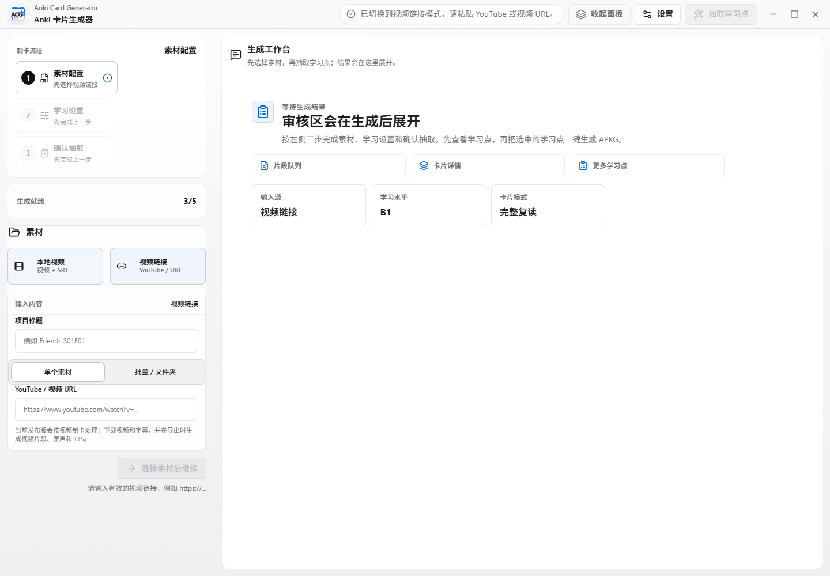
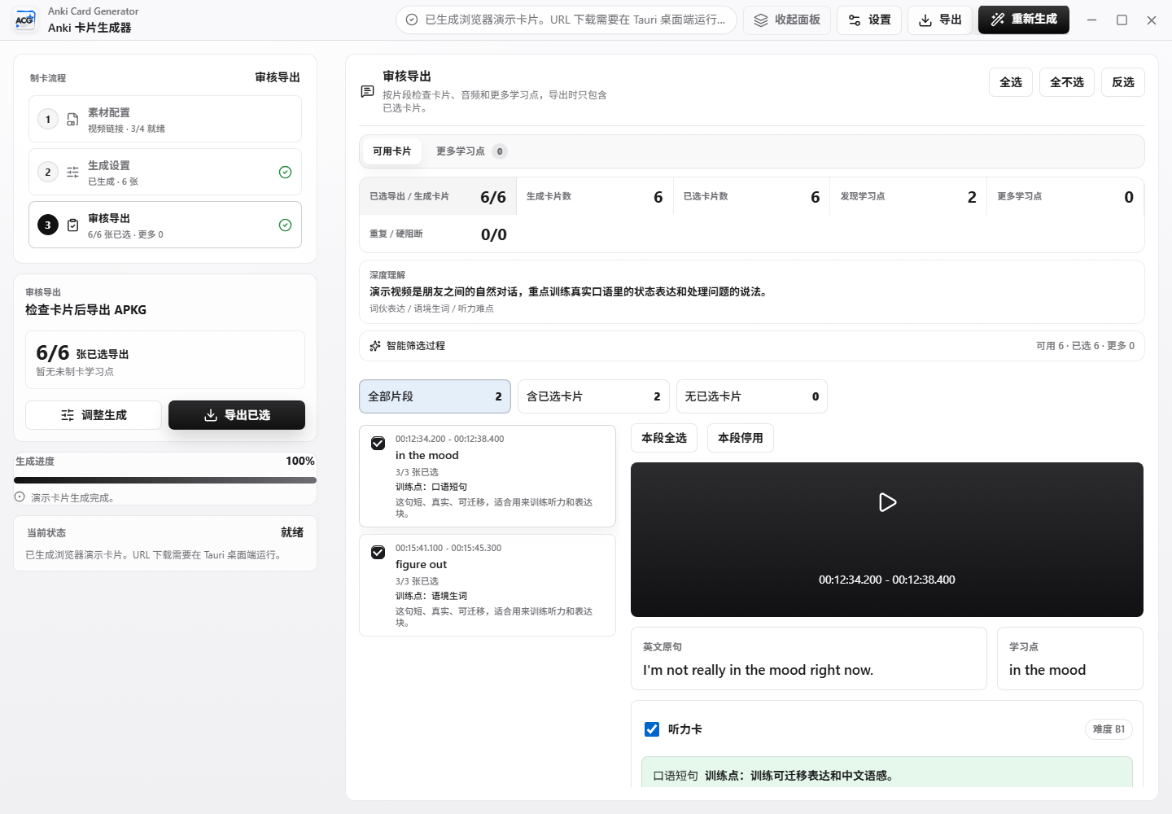
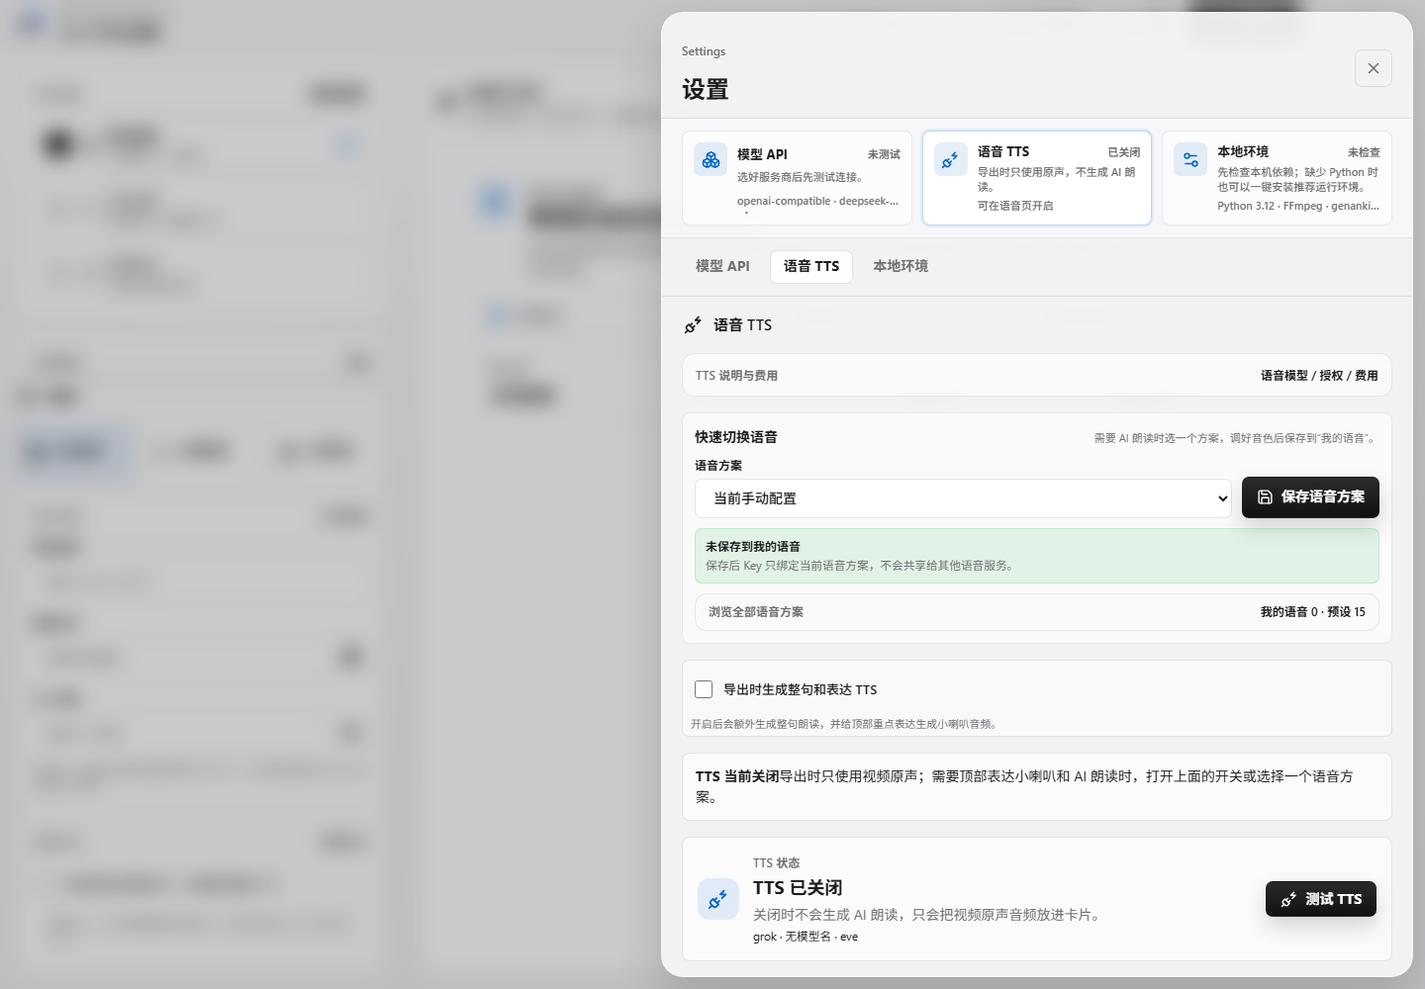
ANKI CARD GENERATOR VERIFICATION
Screenshots Tell the User Story
Public docs already show the full user journey: workspace, generation, settings, TTS, local environment, and final Anki cards.
v0.9.4-beta | Windows desktop release
05

Slide 6
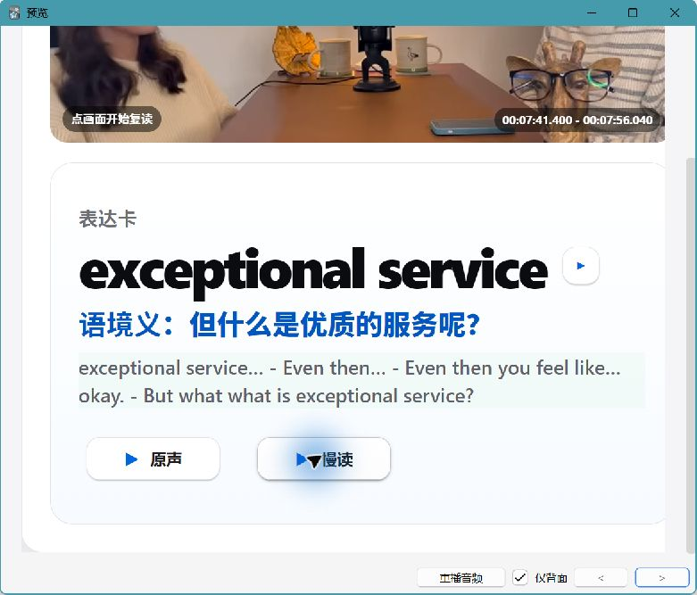
ANKI CARD GENERATOR VERIFICATION
Release Smoke Evidence
Command
npm.cmd run smoke:release
PASS
APKG
1 note / 1 card generated and verified
PASS
Media
MP4, WebM, poster, source audio, TTS audio
PASS
Integrity
No missing, invalid, or unreferenced media
PASS
The smoke test uses synthetic media and fake cached TTS, so no real API key is exposed.
v0.9.4-beta | Windows desktop release
06

Slide 7
ANKI CARD GENERATOR VERIFICATION
Compact UI Regression Is Covered
1180 x 780
Reachable CTA
Batch picker
Minimum desktop size enters compact source-panel mode.
Bottom action button stays visible or scroll-reachable.
Folder batch control can be reached and clicked.
Important nuance
Installed WebView2 did not allow CDP automation, so installed-window screenshot is limited. The layout behavior itself is covered by Playwright UI smoke.
v0.9.4-beta | Windows desktop release
07

Slide 8
ANKI CARD GENERATOR VERIFICATION
Browser + Local Helper Must Be Separate
Windows desktop
Browser web
Local helper
Tauri app owns current shipped product and native worker path.
Static UI, project flow, settings, and localhost helper calls.
Files, ffmpeg, APKG export, AnkiConnect, cache, verify.
Shared packages should stay narrow: types, card schema, and UI tokens only.
v0.9.4-beta | Windows desktop release
08

Slide 9
ANKI CARD GENERATOR VERIFICATION
Tools and Plugins Used
GitHub / gh CLI
Playwright
Release, assets, README, tags, digest
UI smoke and minimum-size reachability
documents
presentations
Word report generation
Editable PowerPoint deck
PowerShell / winget
Secret scan
Install, process, hash, smoke commands
API key and artifact boundary checks
v0.9.4-beta | Windows desktop release
09

Slide 10
ANKI CARD GENERATOR VERIFICATION
Next Goals
1. Publish clearer product routing: Windows Desktop now, Browser + Helper roadmap next.
2. Keep browser-web and local-helper in separate folders with explicit READMEs.
3. Define localhost helper API: health, settings, project, media, generate, export, verify.
4. Never upload API keys, APKGs, video/audio artifacts, test_runs, target, node_modules, or local caches.
The beta is useful now; the next leap is clean product separation.
v0.9.4-beta | Windows desktop release
10

