Slide 1
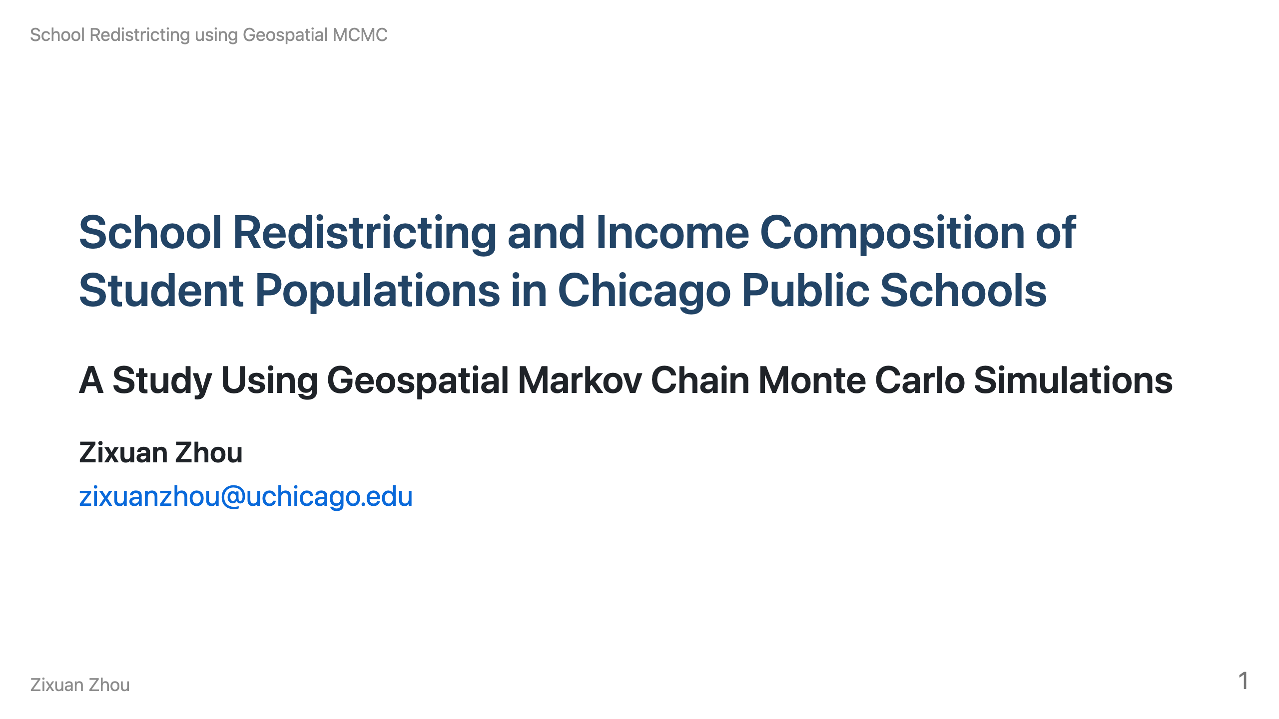
Notes:
Speaker Notes: Welcome everyone. Today I'll walk you through my research on how school district boundaries affect the potential income composition of student bodies across high schools in Chicago.

Slide 2
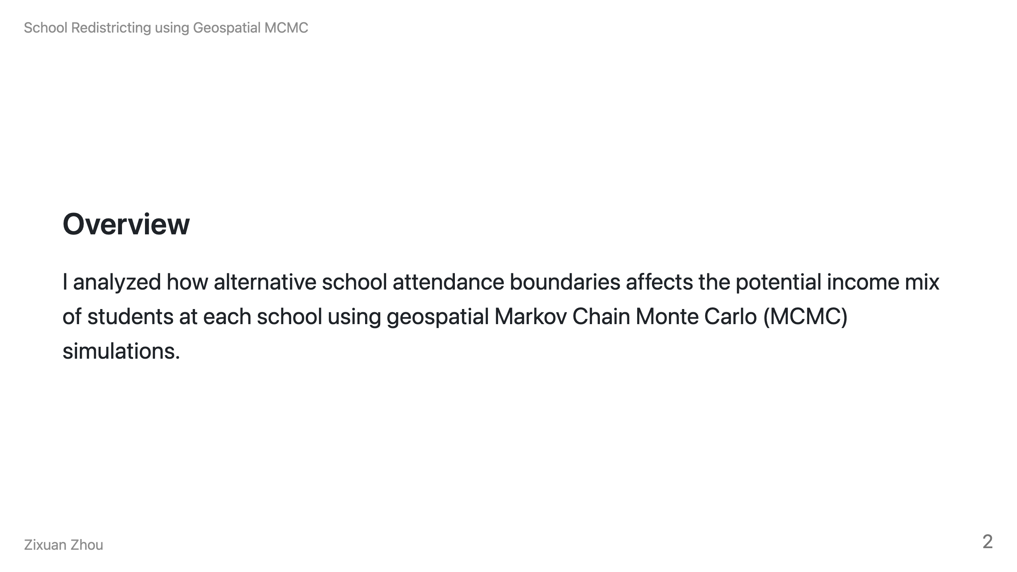
Notes:
Speaker Notes: Just to give you a TL;DR overview of my research project.

Slide 3
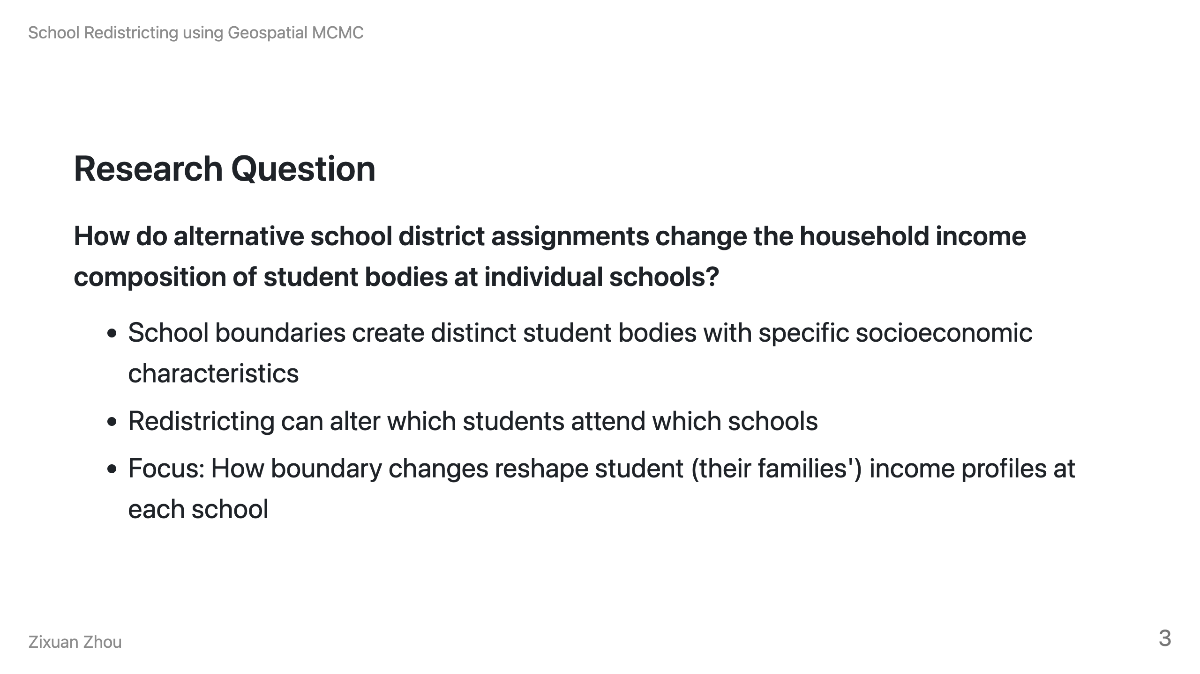
Notes:
Speaker Notes: The core question is simple but important. Enrollment to elementary and middle schools is often based on attendance boundary, each school currently serves students from specific geographic areas, creating different income mixes of students within different schools. My research investigates what happens when we redraw these boundaries - do we get more diverse student bodies or different patterns of segregation?

Slide 4
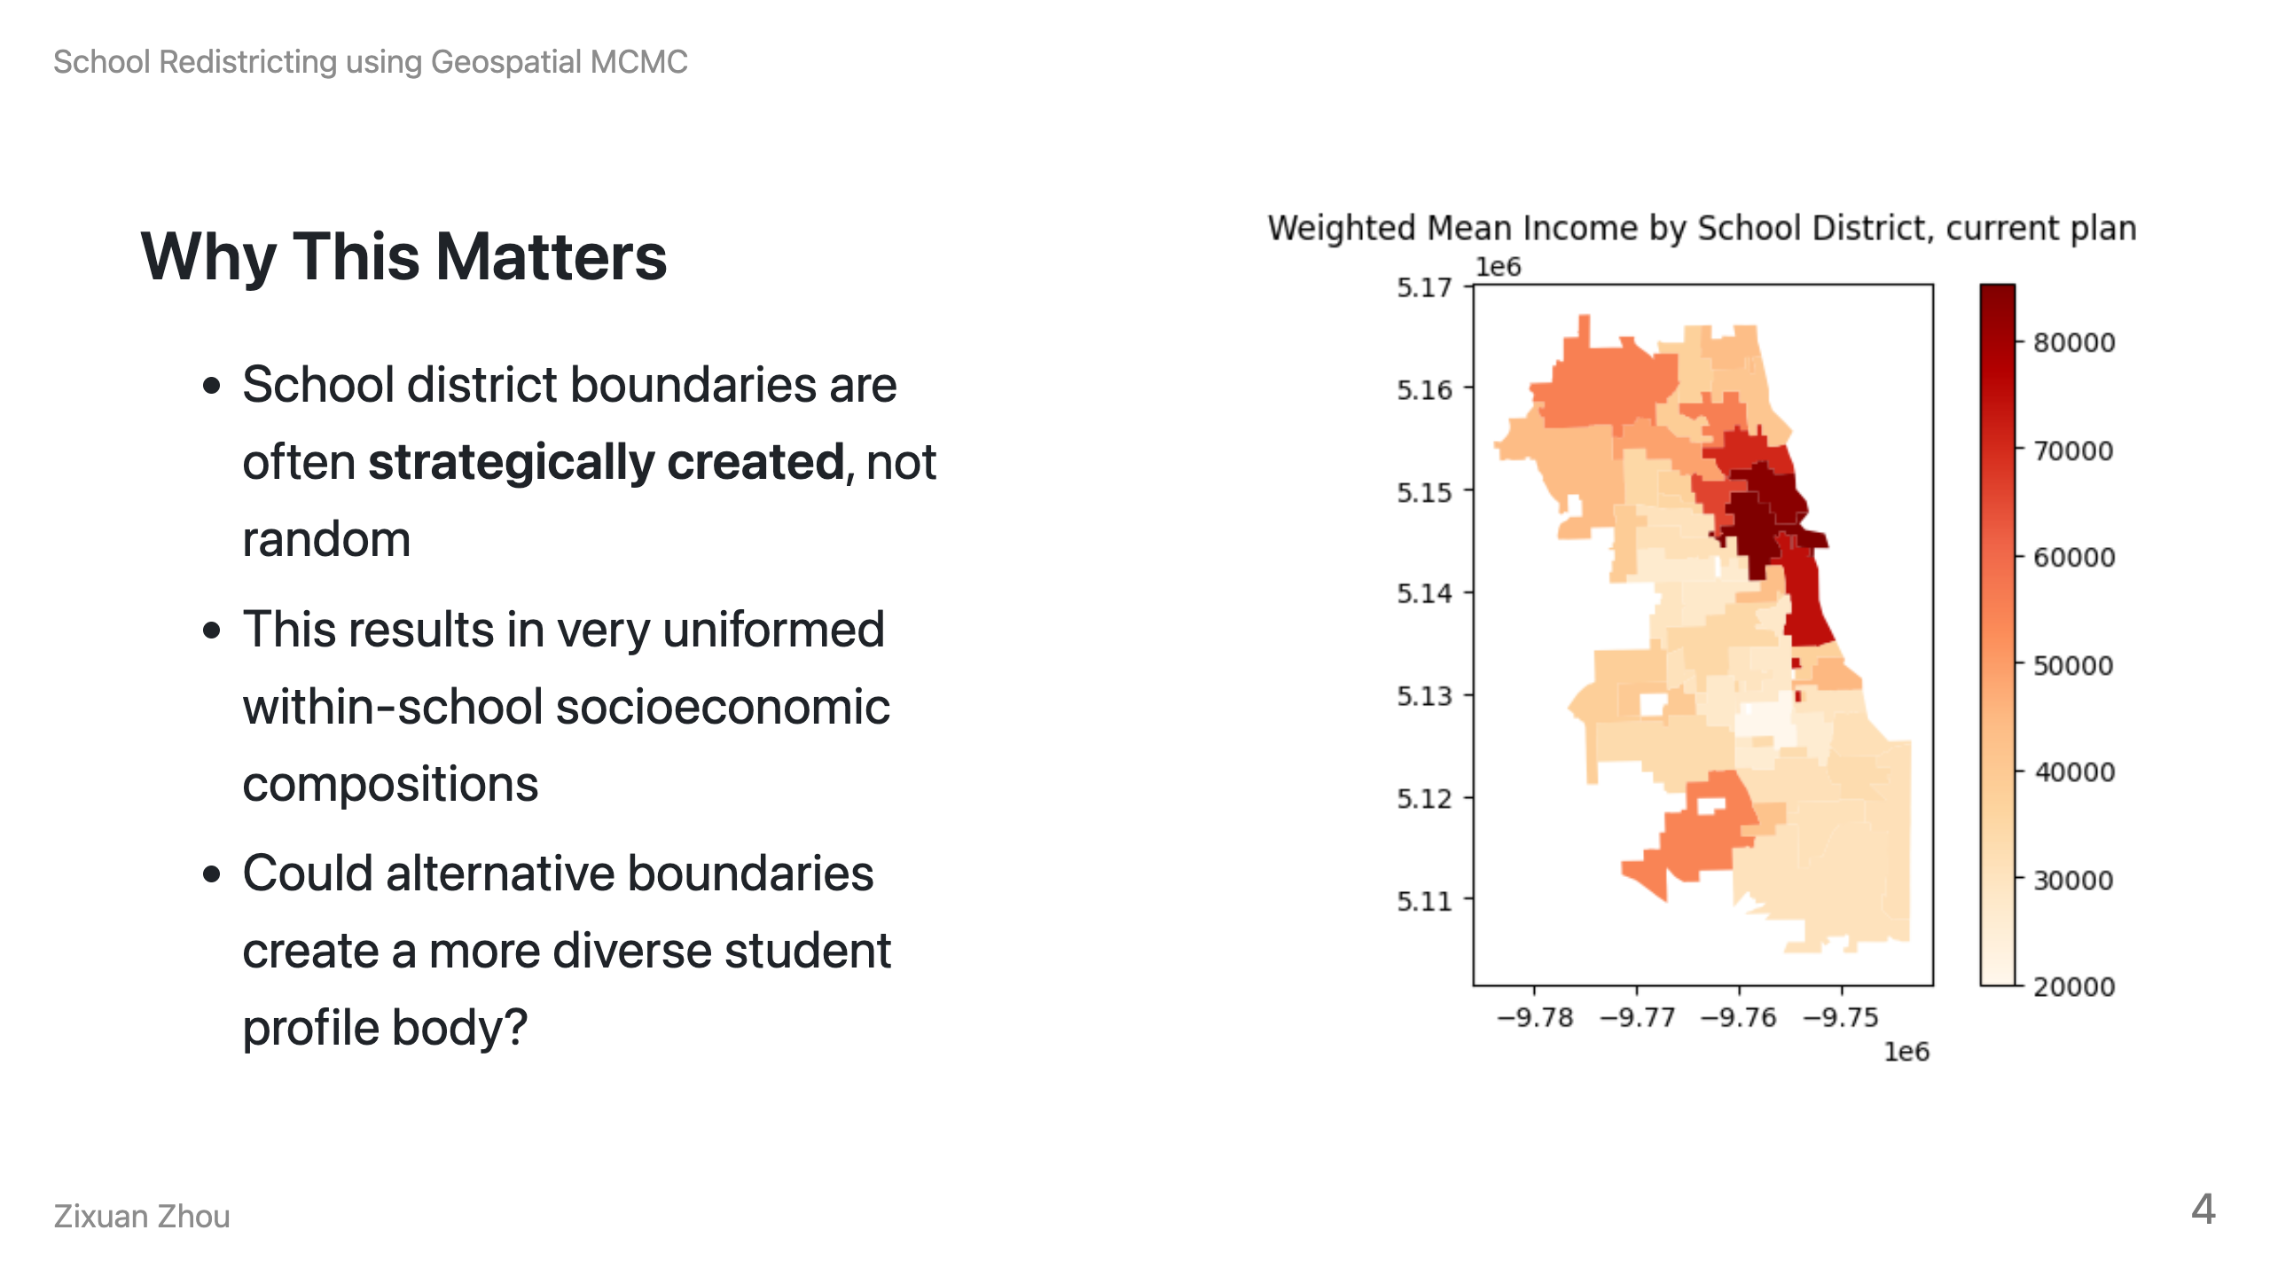
Notes:
Speaker Notes: This isn't just an academic exercise. School boundaries are political decisions that create real inequality. In many countries across the world, we see wealthy families concentrated in certain school districts while others serve predominantly lower-income students. The question is whether this is inevitable or if better boundary drawing could create more diversity in student's famlies' income profiles, and whether it would make good education more accessible to certain population.

Slide 5
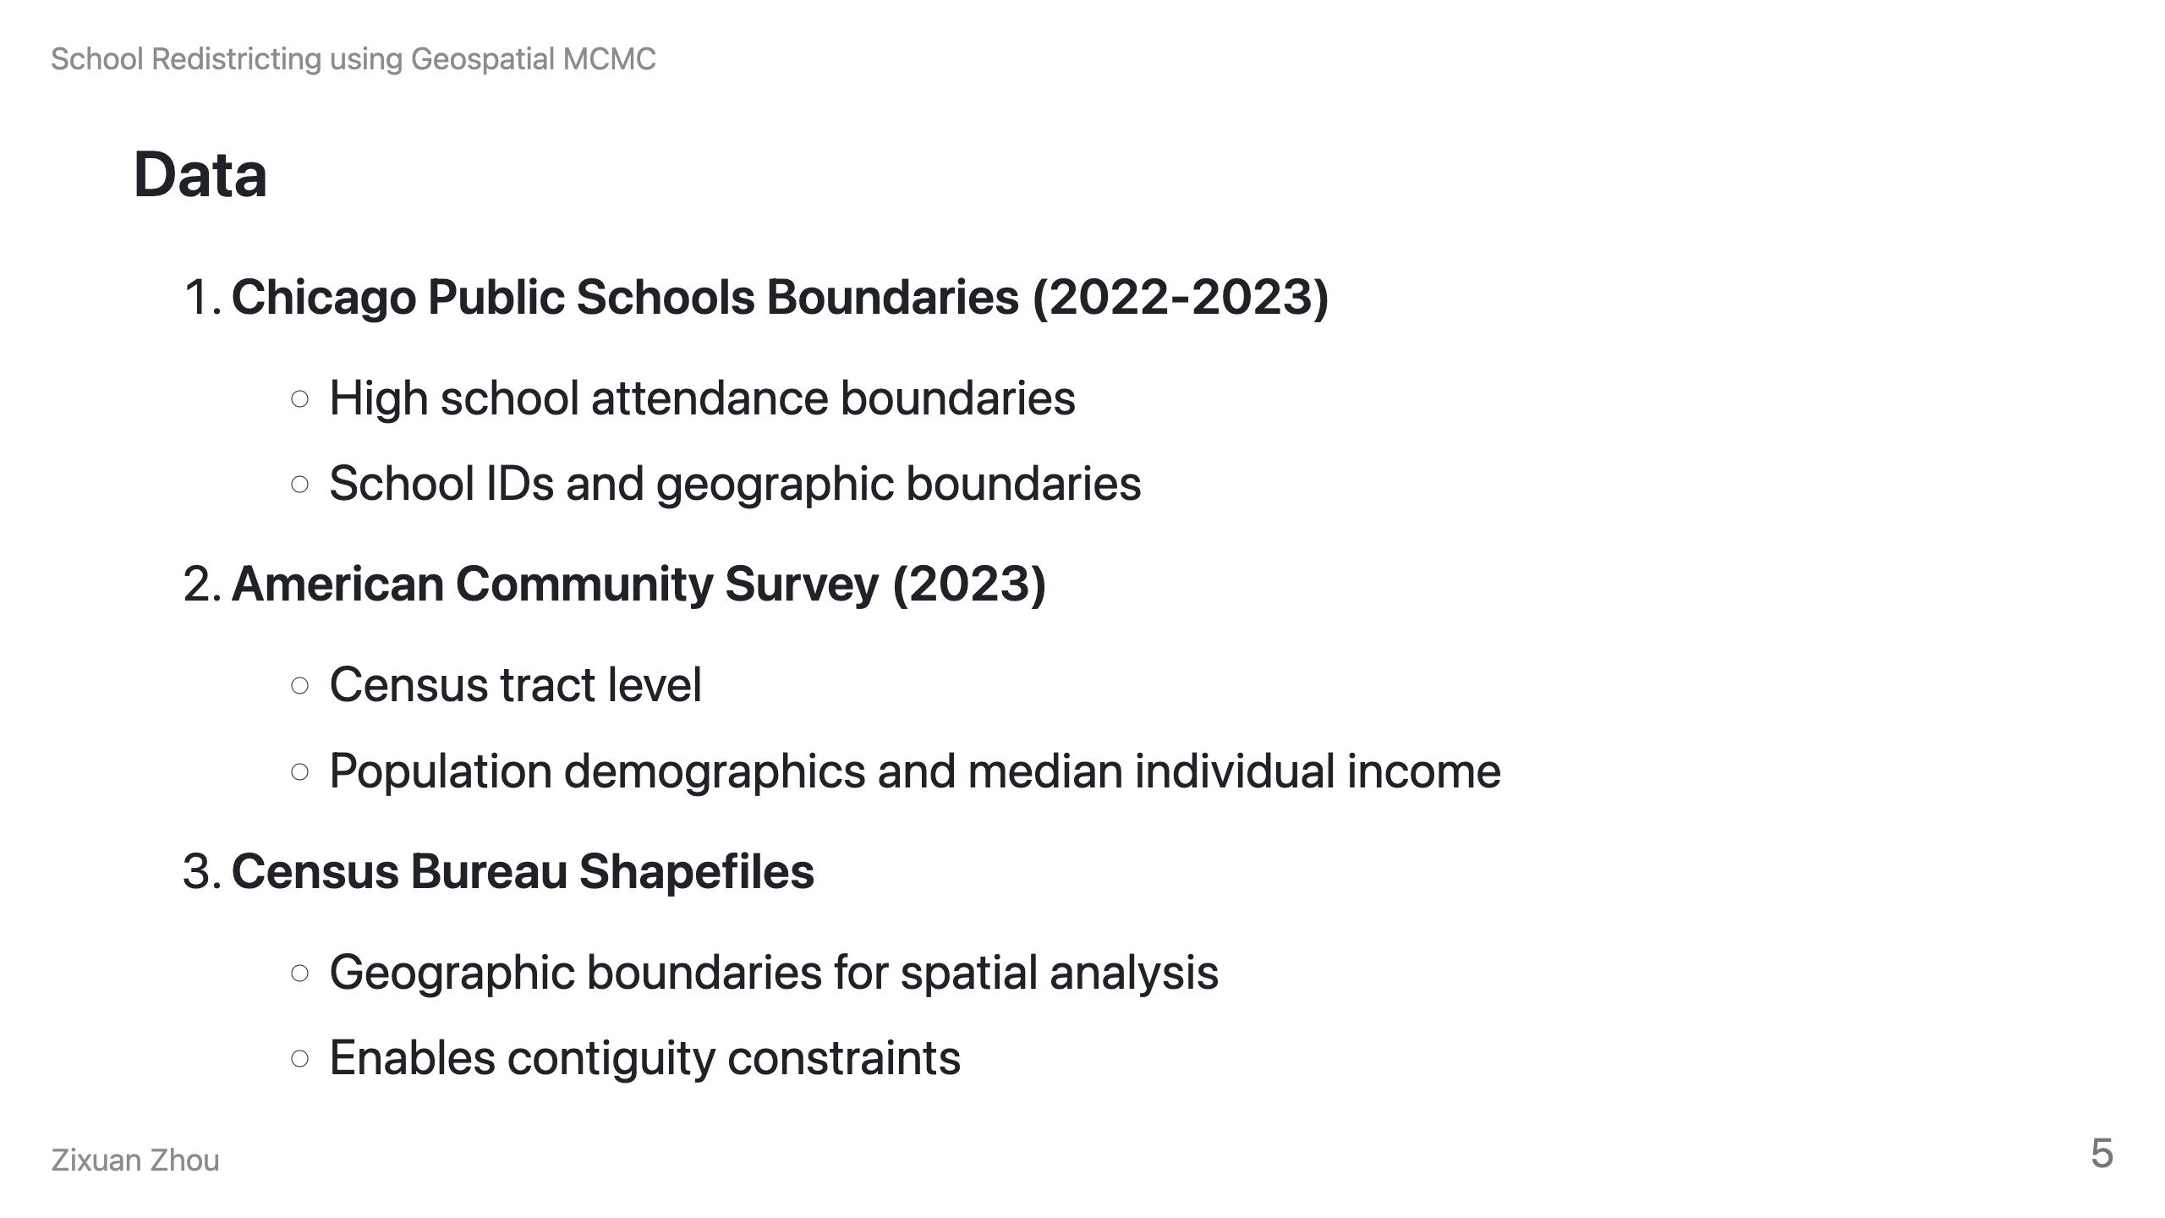
Notes:
Speaker Notes: I combined three major data sources. Chicago Public Schools provided the actual attendance boundaries. The American Community Survey gives us household income at the census tract level. And Census shapefiles let me do the geographic analysis to ensure new boundaries make geographic sense.
It may appear that we do not have a lot of data at this point, but since we will be running geospatial simulations for hundreds of thousands of times , they can still be very computationally expensive.

Slide 6
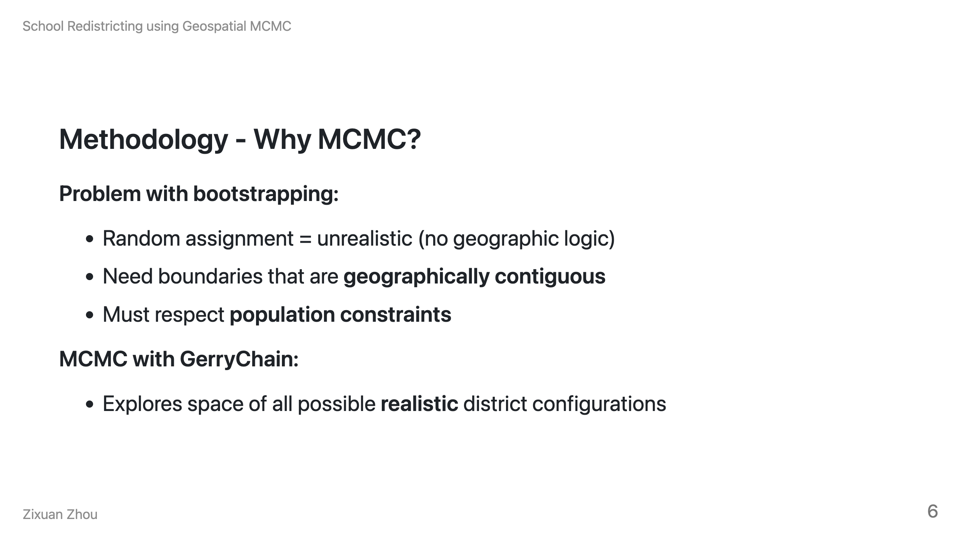
Notes:
Speaker Notes: I use Markov Chain Monte Carlo simulations to generate alternative boundaries. For school redistricting, I can't just randomly shuffle students between schools - that's not how the real world works. School boundaries need to make geographic sense. MCMC lets me systematically explore thousands of realistic alternative boundary configurations while maintaining constraints like population balance and geographic contiguity.

Slide 7
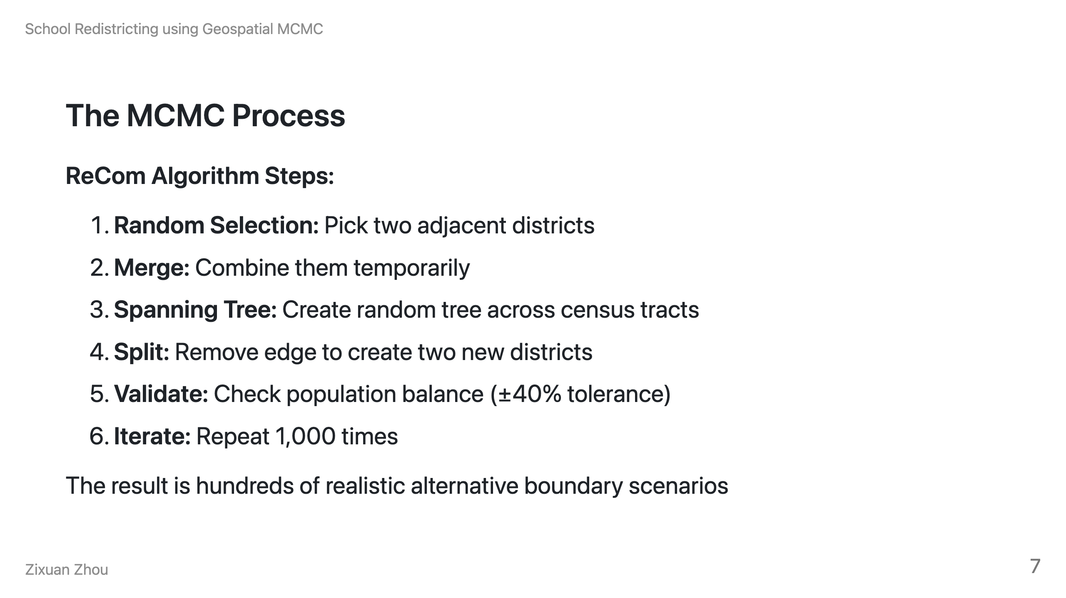
Notes:
Speaker Notes: In Python, this process is completed with the assistance of GerryChain. So GerryChain uses an algorithm called ReCom which randomly picks two neighboring districts, merges them, then splits them in a different way using graph theory. Each step creates a valid new configuration. After 1,000 steps, I have a single Markov Chain of results, and I use the final assignment as one of the many possible redistricting plans that I can analyze.

Slide 8
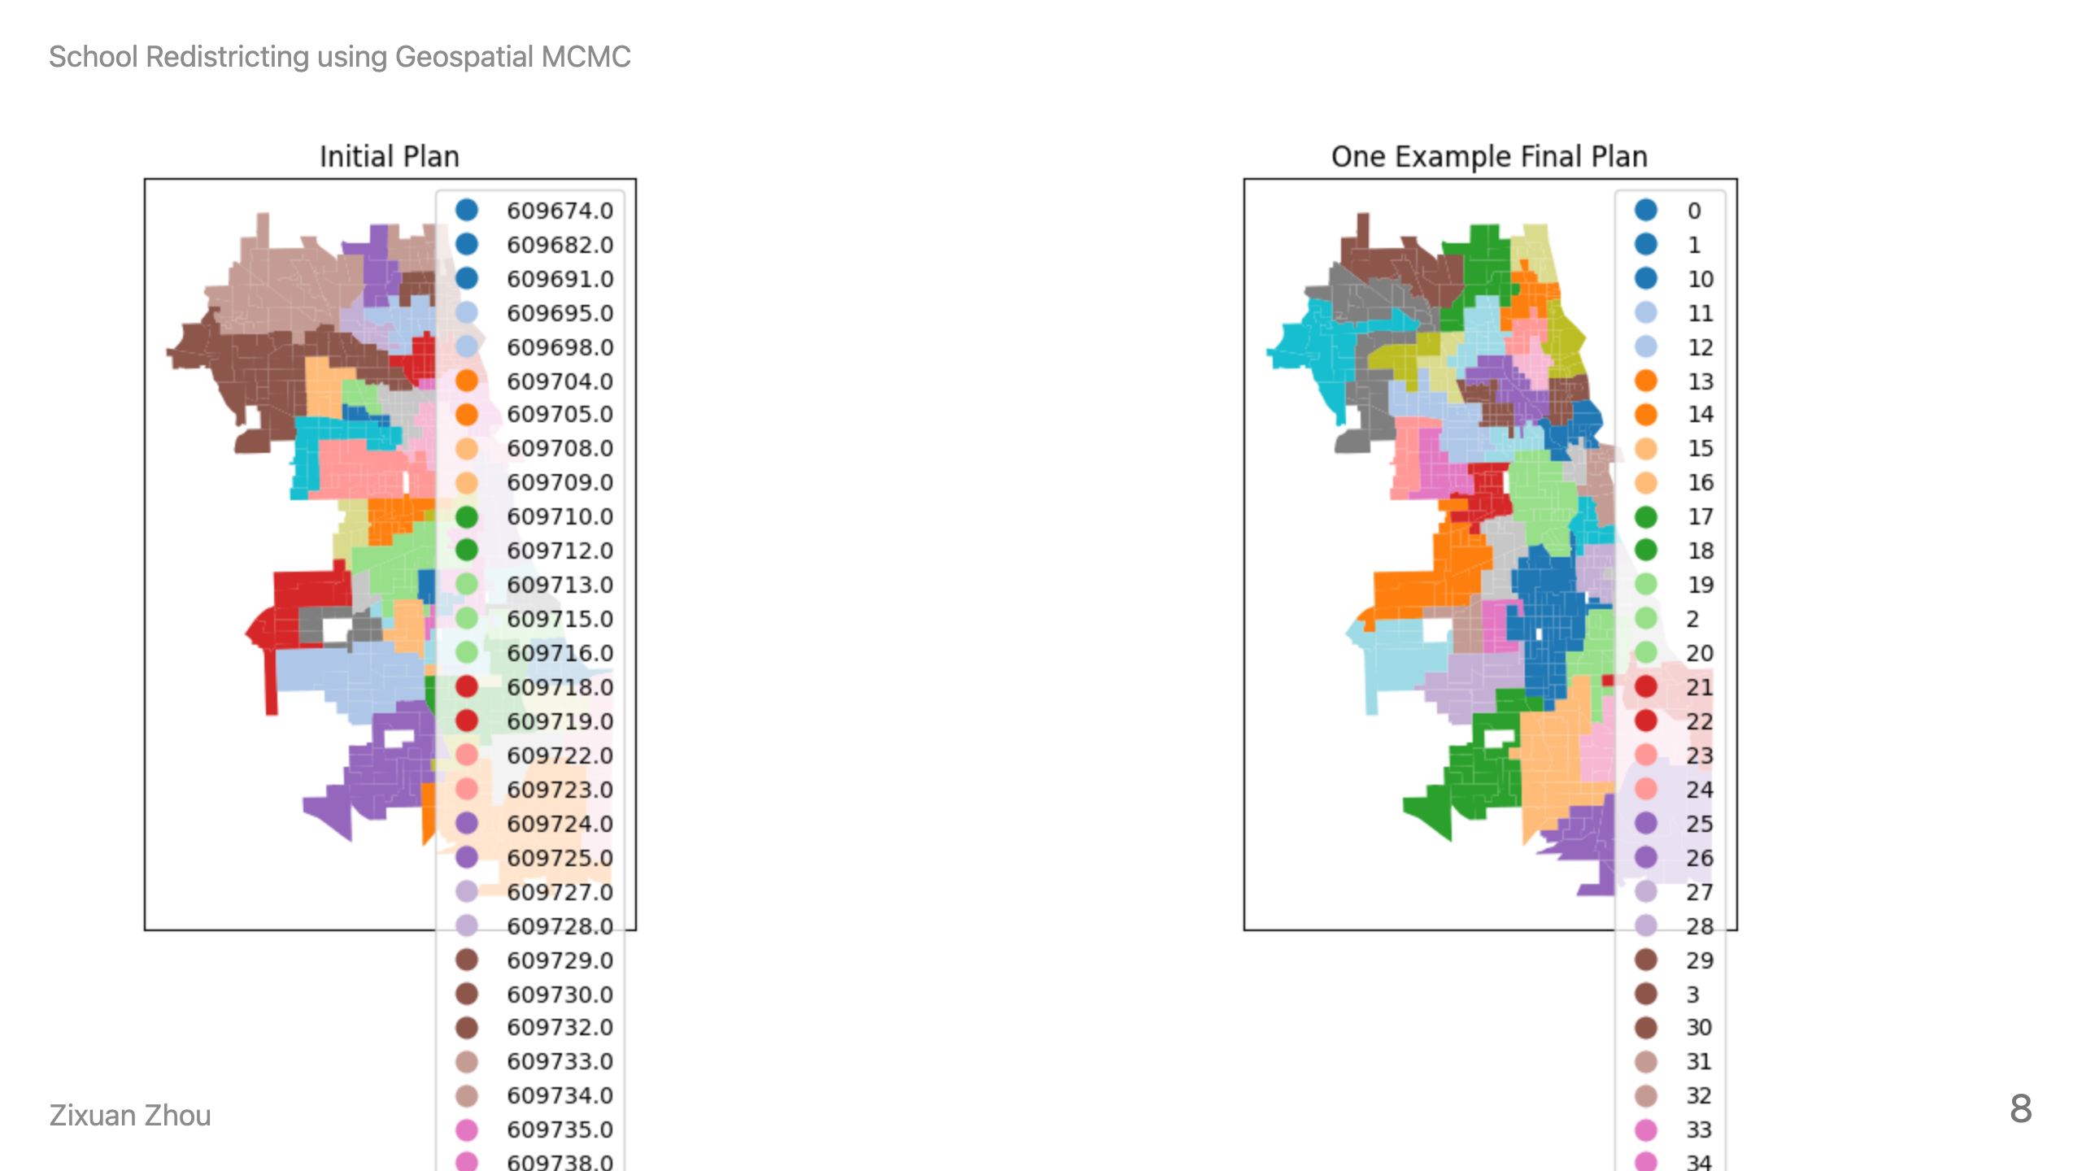
Notes:
This is an example alternative boundary configuration generated by the MCMC process. You can see how the boundaries shift to create different districts while still respecting geographic constraints (in this case, population).

Slide 9
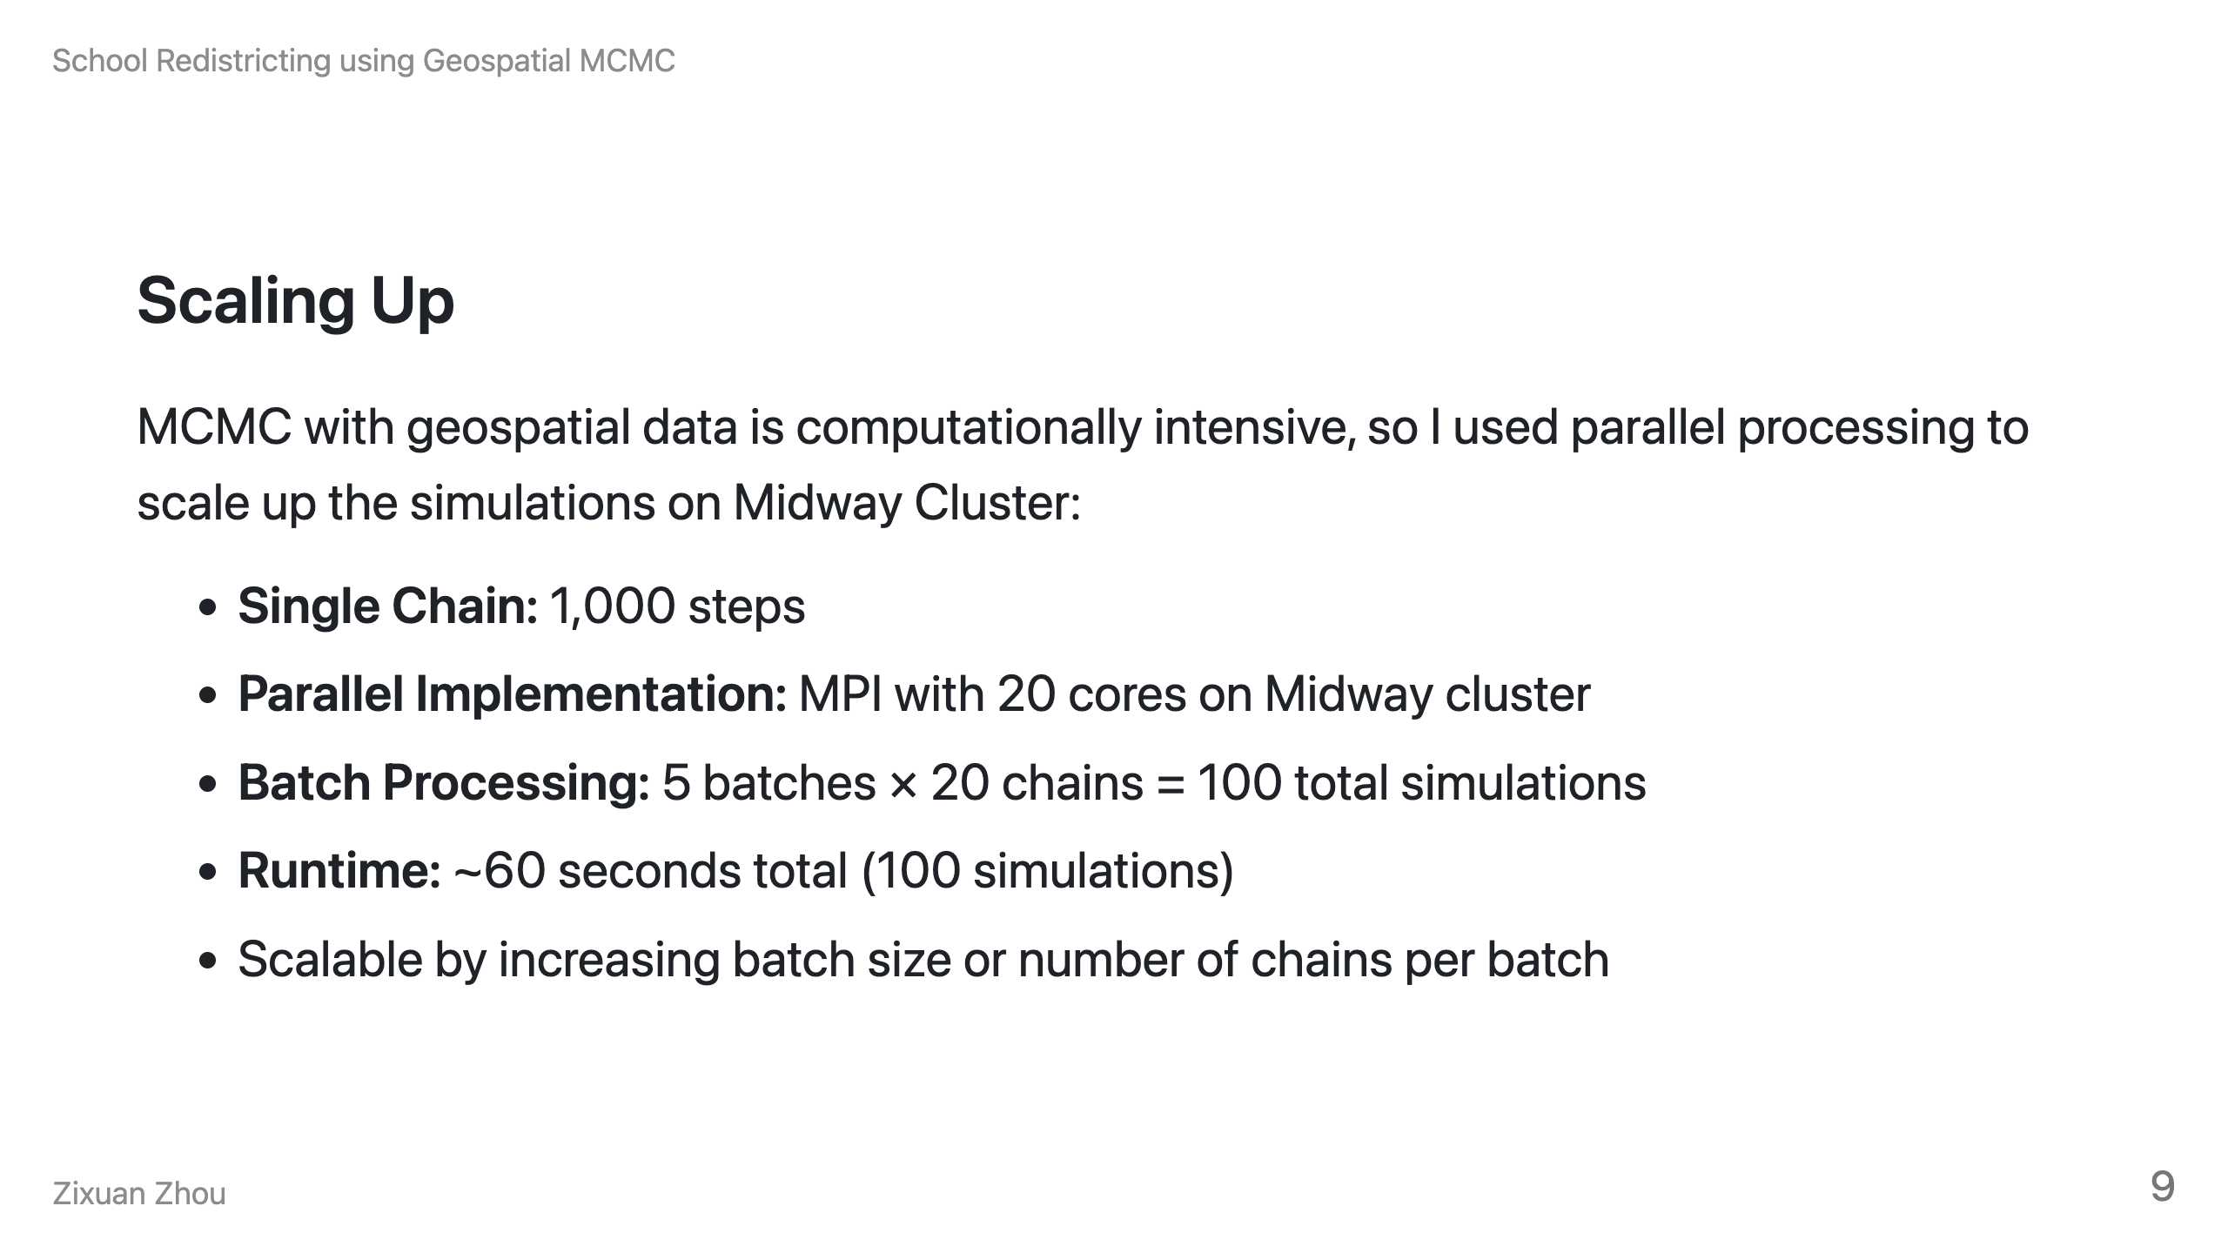
Notes:
Speaker Notes: However, if I want to search for the entire possible space of reasonable, alternative school boundary assignments, I would need to simulate the process for hundreds of thousands of times. Although the chain itself is not parallelizable, it is possible to generate multiple chains at the same time.
I eventually choose to scaled up using MPI for parallel processing. I started by testing the process locally and then brought it up to the Midway cluster. Using parallel processing with MPI, I can run 20 simulations simultaneously. To avoid any resource waste, I only simulated for 100 different chains on Midway. However, this project could easily scale up to hundreds of thousands of simulations if we increase batch number and the number of cores.
The whole process only takes about a minute, which is very efficient.

Slide 10
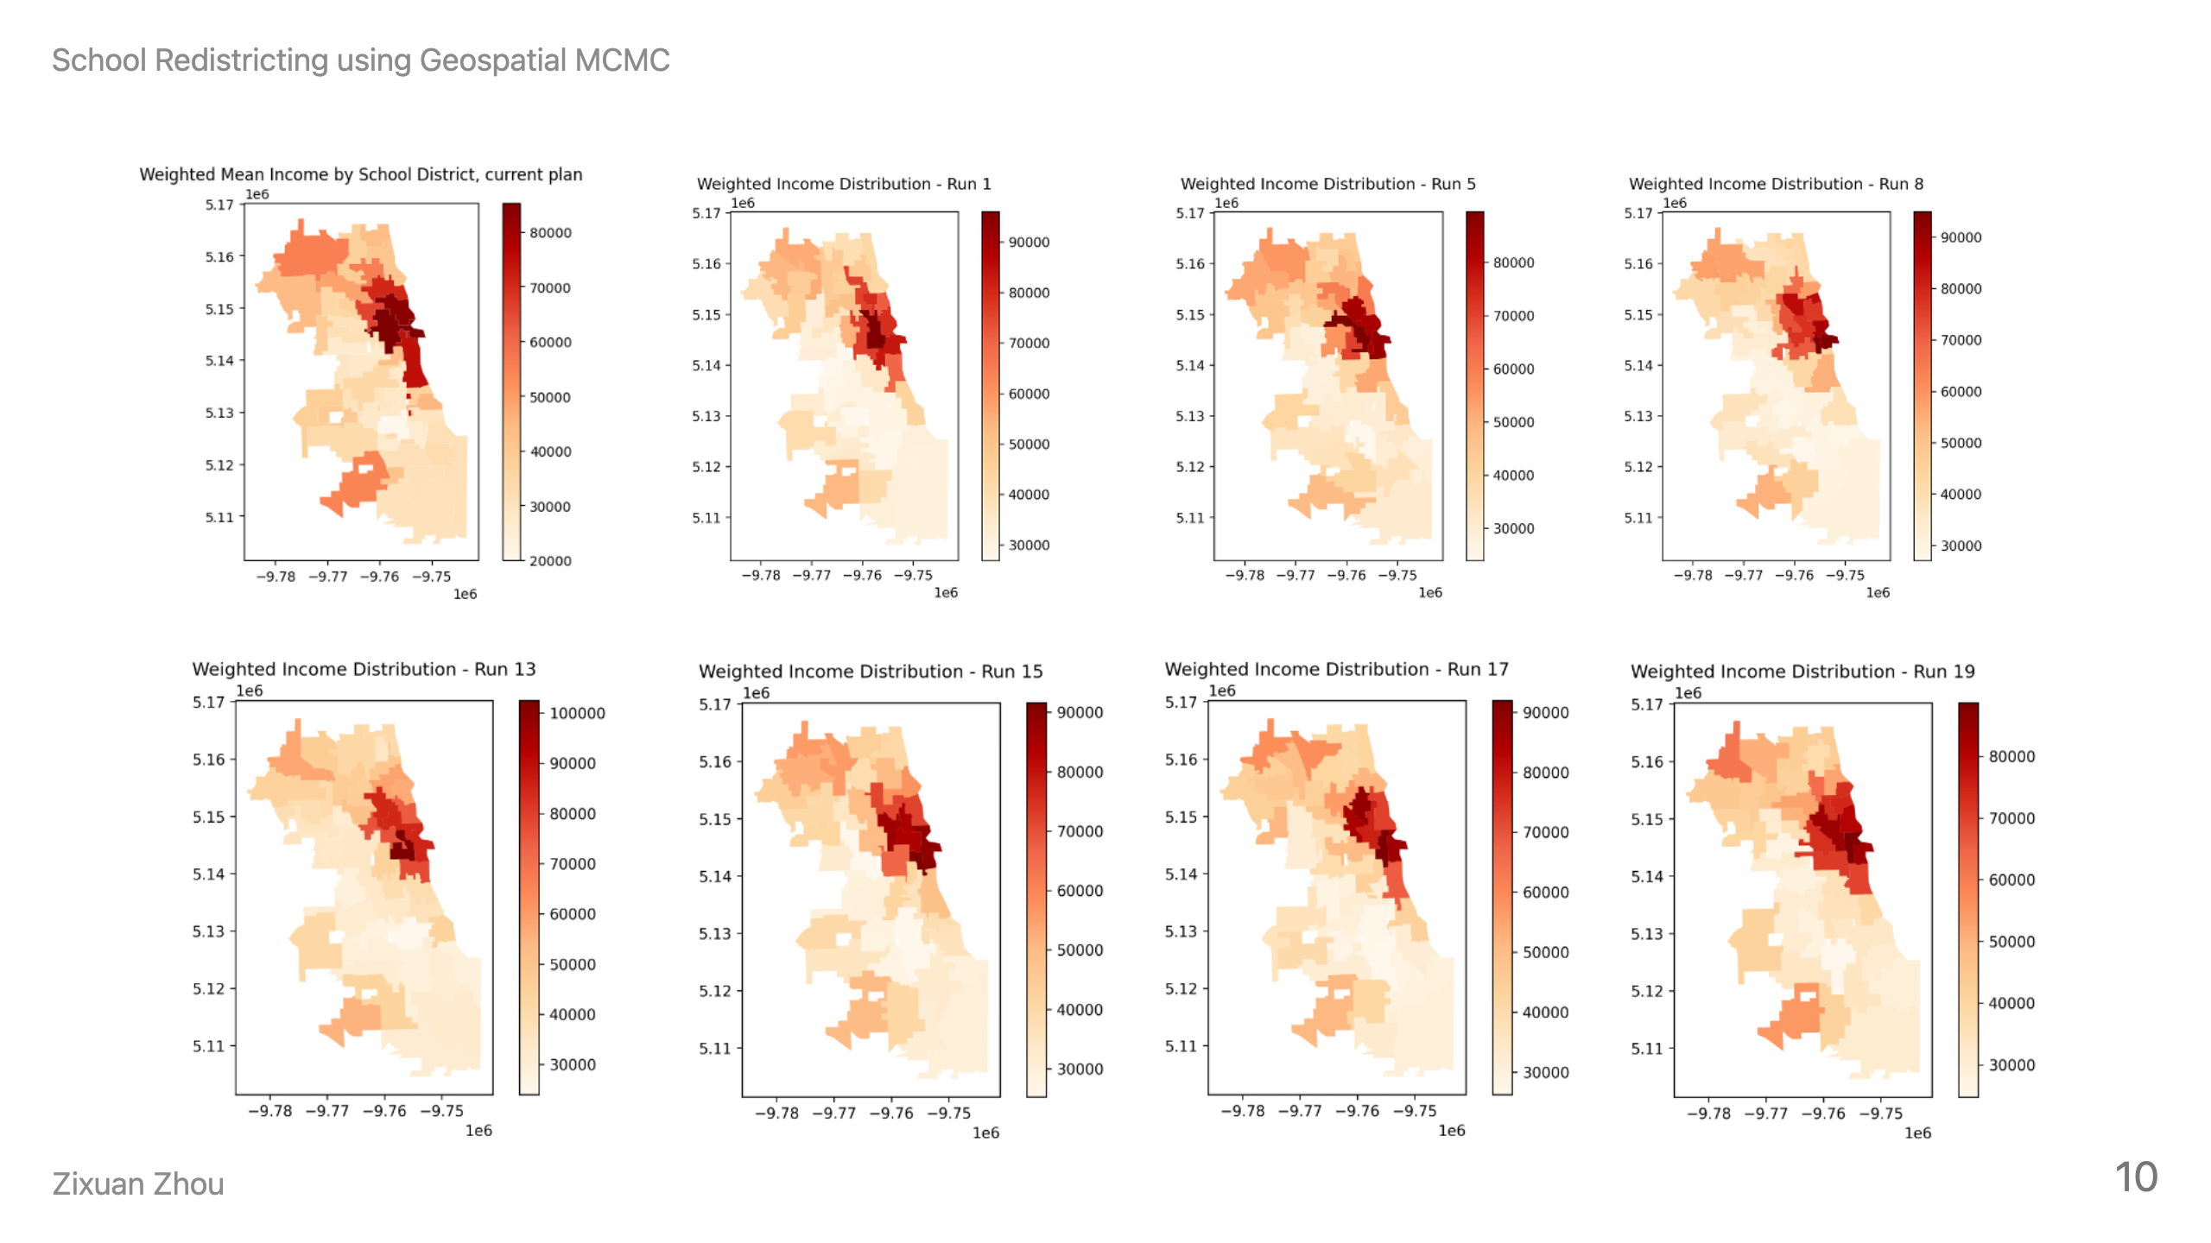
Notes:
Speaker Notes: Here is my preliminary results. This graph compares the income distributions under current boundaries (which is the top left corner) versus alternative configurations. You can see how some of the alternative boundaries create a more equitable distribution of student family incomes across schools.

Slide 11
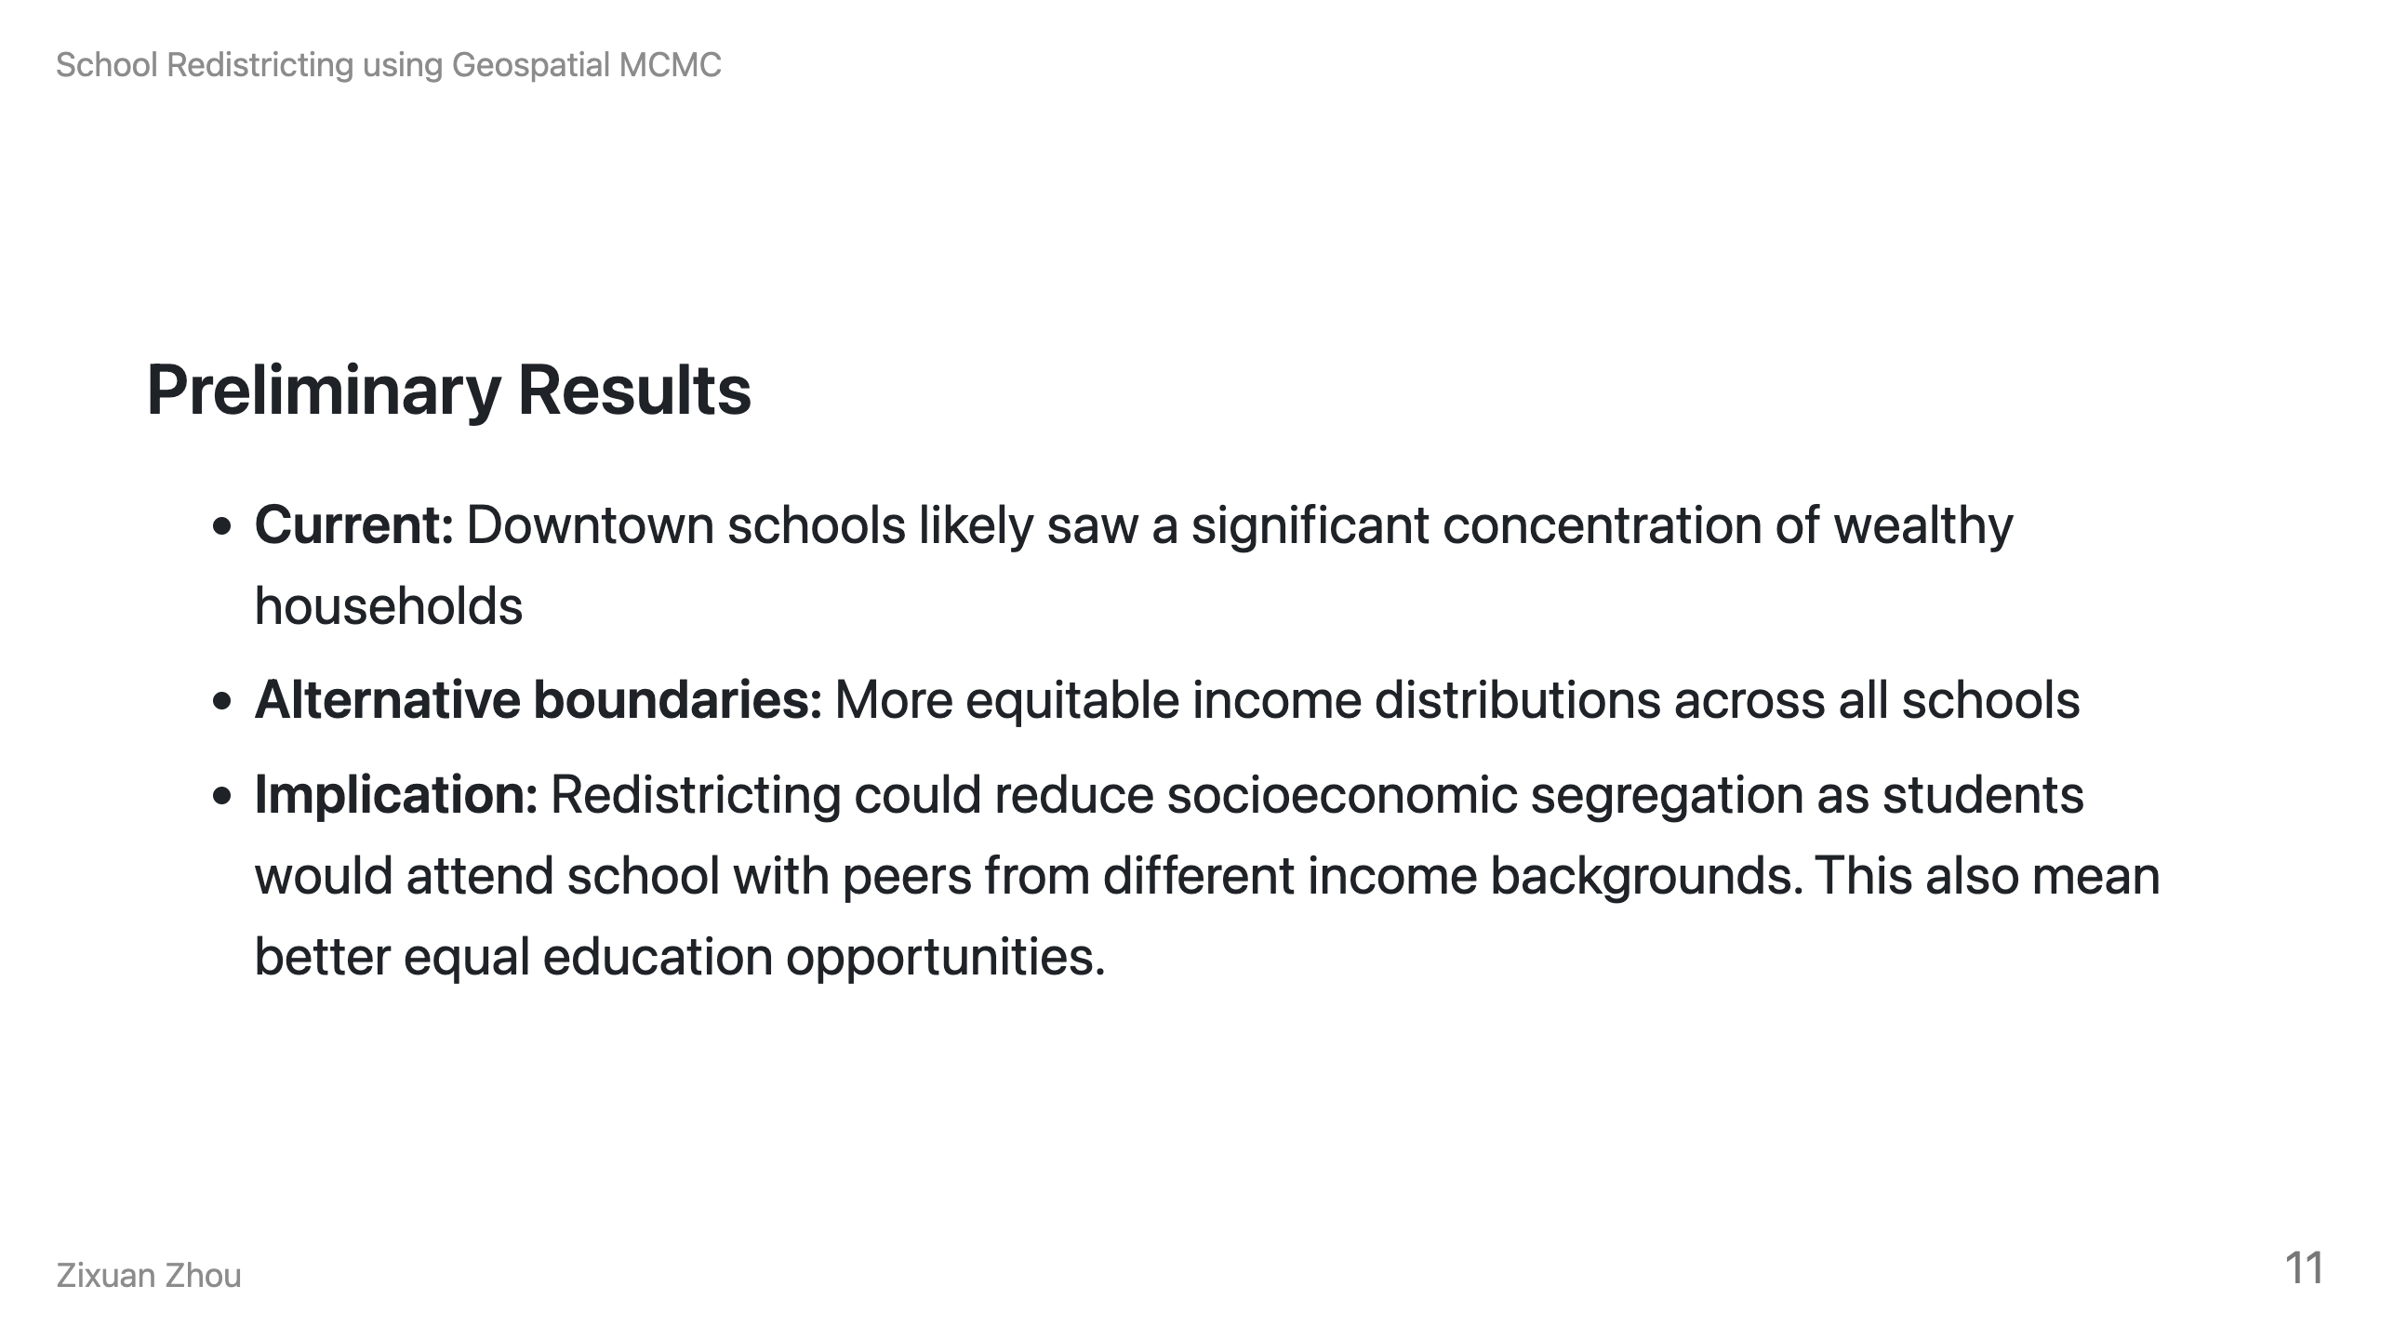
Notes:
Speaker Notes: Under current boundaries, we see clear income segregation with wealthy families concentrated in downtown school district due to spatial sorting. But the MCMC simulations show that alternative boundary configurations could create more balanced income distributions across schools. This means students would have more diverse peer groups in terms of family income. This could also lead to better educational opportunities for all students, especially those from lower income settings.

Slide 12
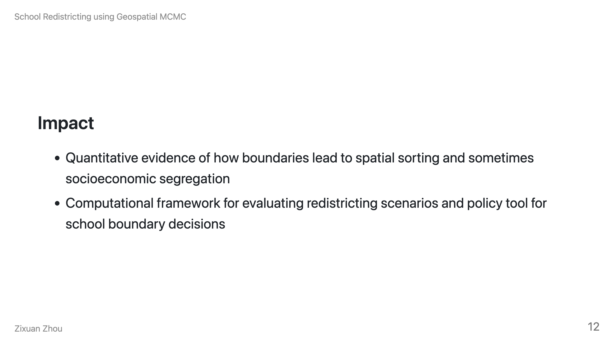
Notes:
Speaker Notes: This research provides some evidence that school boundaries may have been influencing social equity. The computational framework I've developed could be used by school boards considering boundary changes. The methodology could be applied to other cities to analyze their school district boundaries and explore more equitable alternatives.

Slide 13
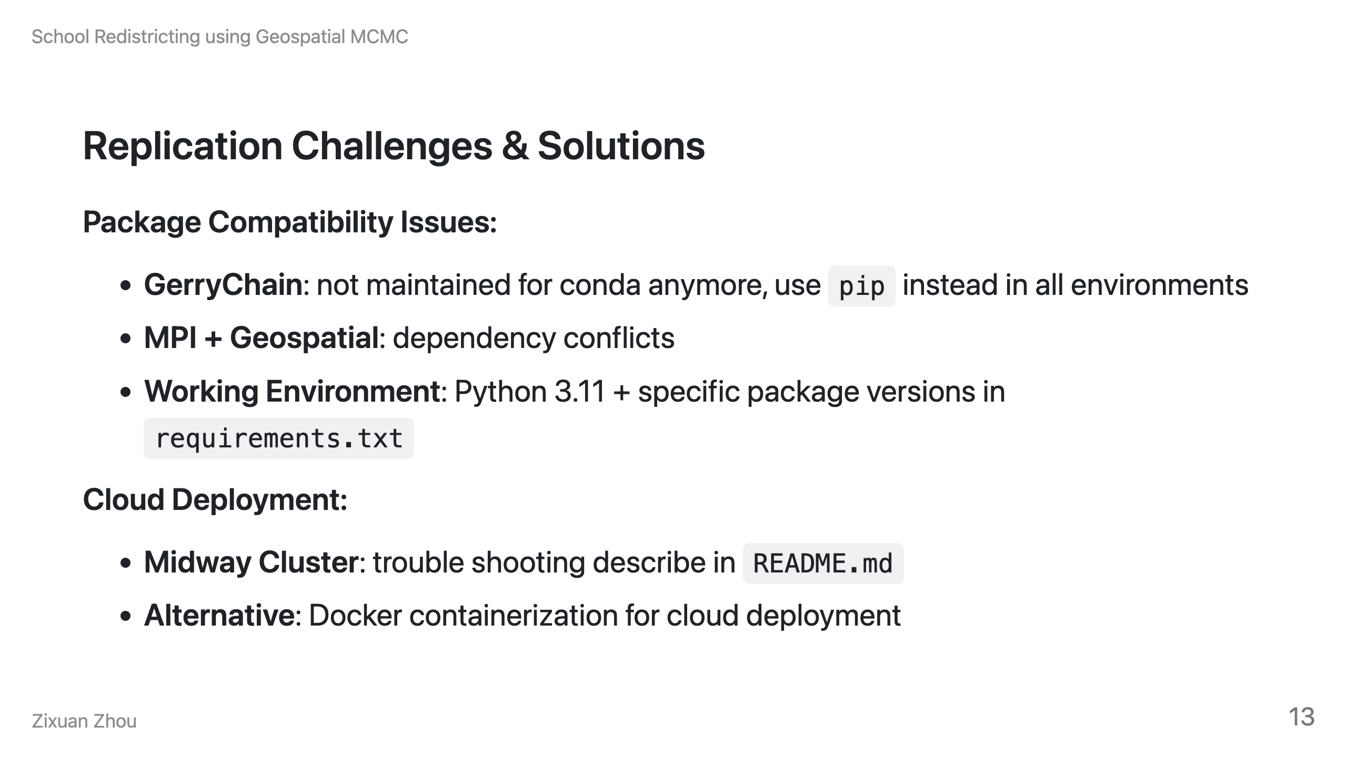
Notes:
Speaker Notes: Let me address the practical challenges you'll face if you want to replicate this work. The biggest issue is package compatibility - GerryChain creators recommend using pip even in conda environments because they no longer maintain conda support. The combination of MPI and geospatial packages sometimes creates dependency conflicts. I've solved this locally with specific versions in requirements.txt and Python 3.11. For cloud deployment, the packages are too large for simple serverless functions, so Docker containerization is necessary if you want to run it on aws. On Midway, you can follow my descriptions in the README as a starting point.

Slide 14
