Slide 1


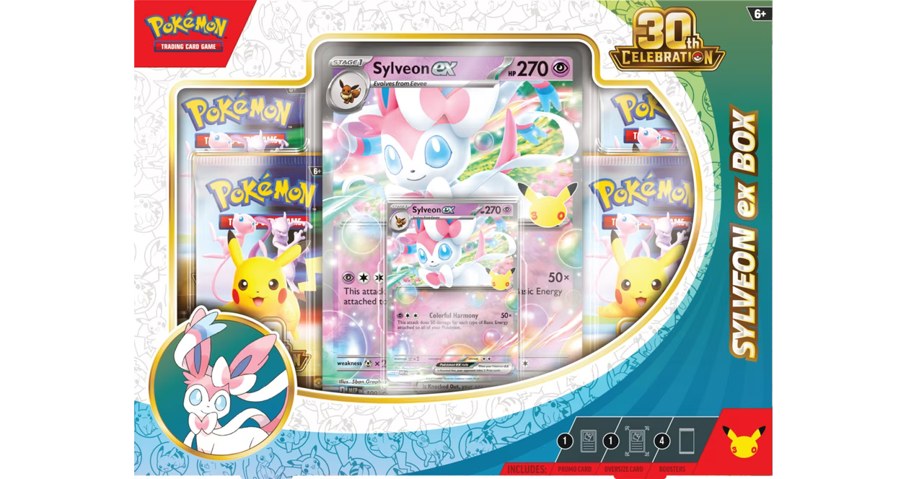

PokeVerse
High-Fidelity Prototype
A static marketplace UI for Pokémon card collectors and sellers, built for CSC 340 Milestone 2.
CUSTOMER
PROVIDER
Browse products
View product details
Cart, orders, tutorial
Buy official packs
Add inventory
List products
Manage orders
Demo focus: page-to-page navigation + realistic UI placeholders
CSC 340 • High-Fidelity Prototype • 1/3
Notes:
Introduce PokeVerse as an online marketplace for Pokémon card collectors and sellers. Emphasize that this milestone is a high-fidelity static UI prototype with no backend requirement yet.

Slide 2
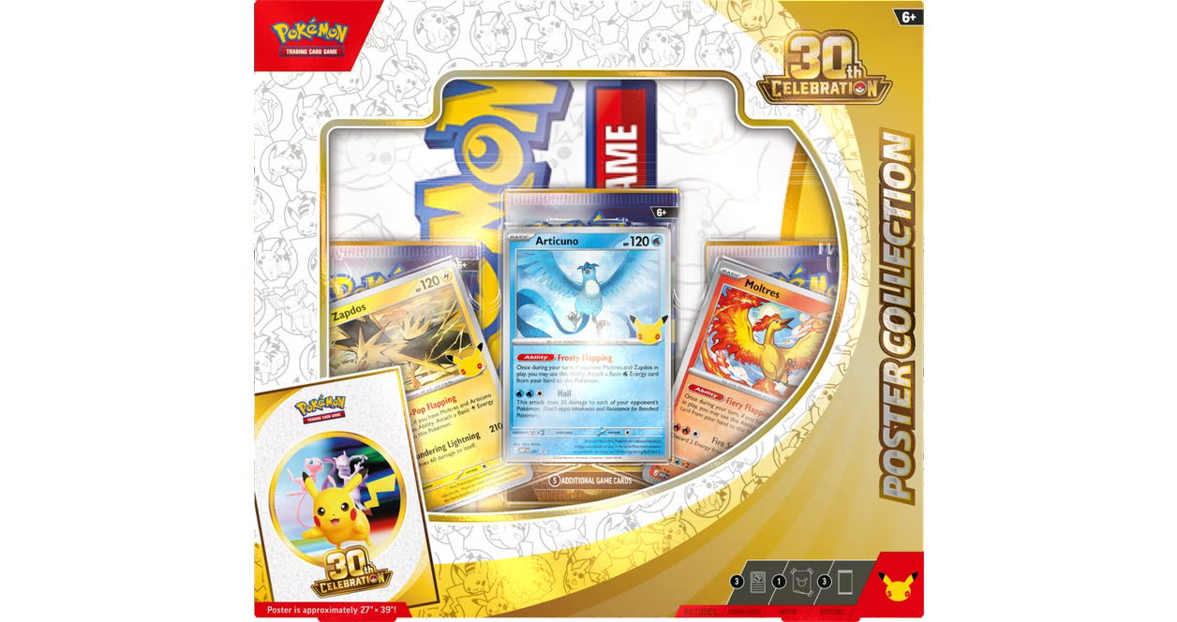

Customer prototype demo flow
Ziyad’s subsystem: hard-coded UI pages that demonstrate the customer experience.
1
Home
2
Shop Cards
3
Details
4
Cart
5
Orders + Tutorial
Entry point and search
Filters, sort, real products
Features, price, description
Review items and totals
History and learning path
Tech Sticker
Ex Box
Poster Box
Knock Out
Elite Trainer
All customer pages are navigable and use consistent product data across Home, Shop, Cart, History, and Detail pages.
CSC 340 • High-Fidelity Prototype • 2/3
Notes:
Walk through the live demo in this order: customer home, Shop Cards, one product detail page, Cart, Purchase History, and Tutorial. Mention that data is static and hard-coded for Milestone 2.

Slide 3
Seller / provider prototype demo flow
Anuraj’s subsystem: hard-coded UI pages that demonstrate the seller experience.
1
Supplier Purchase
2
Inventory
3
Create Listing
4
Orders
5
Dashboard
Choose official packs to stock
Track quantity and pack type
Price, photo, description
Review buyer purchases
Revenue and stock alerts
Seller Dashboard
Quick snapshot before listing new packs
18
$420
5
Tech Sticker
EX Box
Poster Box
Knock Out
Elite Trainer
Active listings
Mock revenue
Low stock
Ready to list
Ready to list
Ready to list
Ready to list
Ready to list
Seller pages show a complete static workflow: supplier purchase → inventory → product listing → order management → dashboard review.
CSC 340 • High-Fidelity Prototype • 3/3
Notes:
Use this slide to explain the seller/provider side. The demo starts with choosing official packs to stock, then adding those products into inventory, creating the marketplace listing, checking buyer orders, and reviewing dashboard stats. Mention that the dashboard numbers and product data are realistic placeholders for Milestone 2.

