Slide 1
SkyJourney Booker
Bastien PINA Ziyad AMZIL

Slide 2
SUMMARY
-Class Diagram -Database Design
-GUI screen samples
-Review

Slide 3
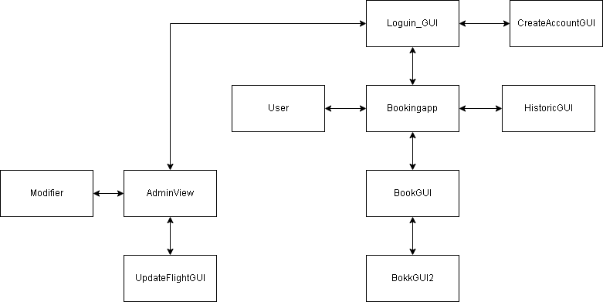
Class Diagram

Slide 4
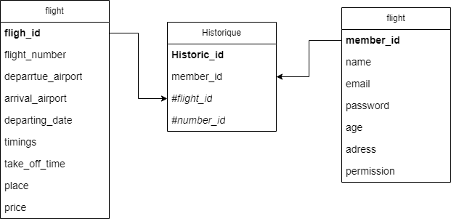
Database Design

Slide 5
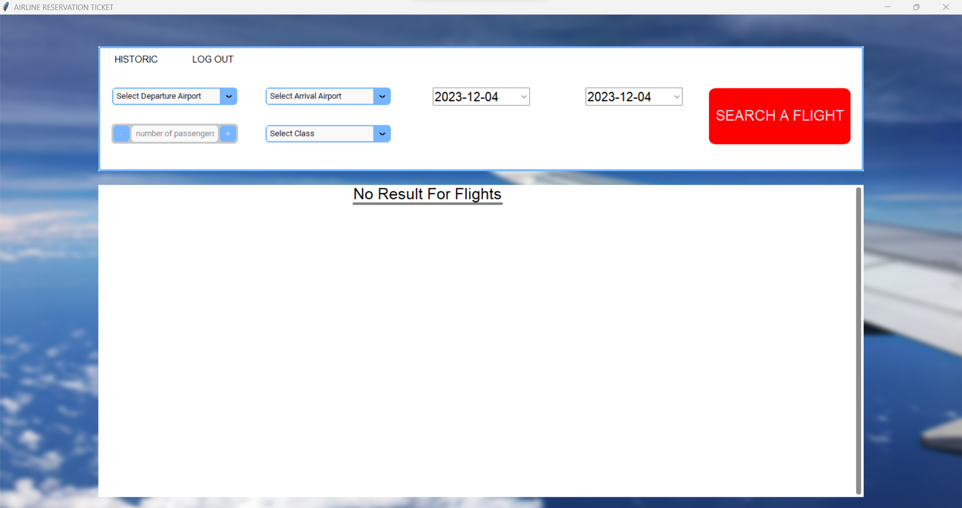
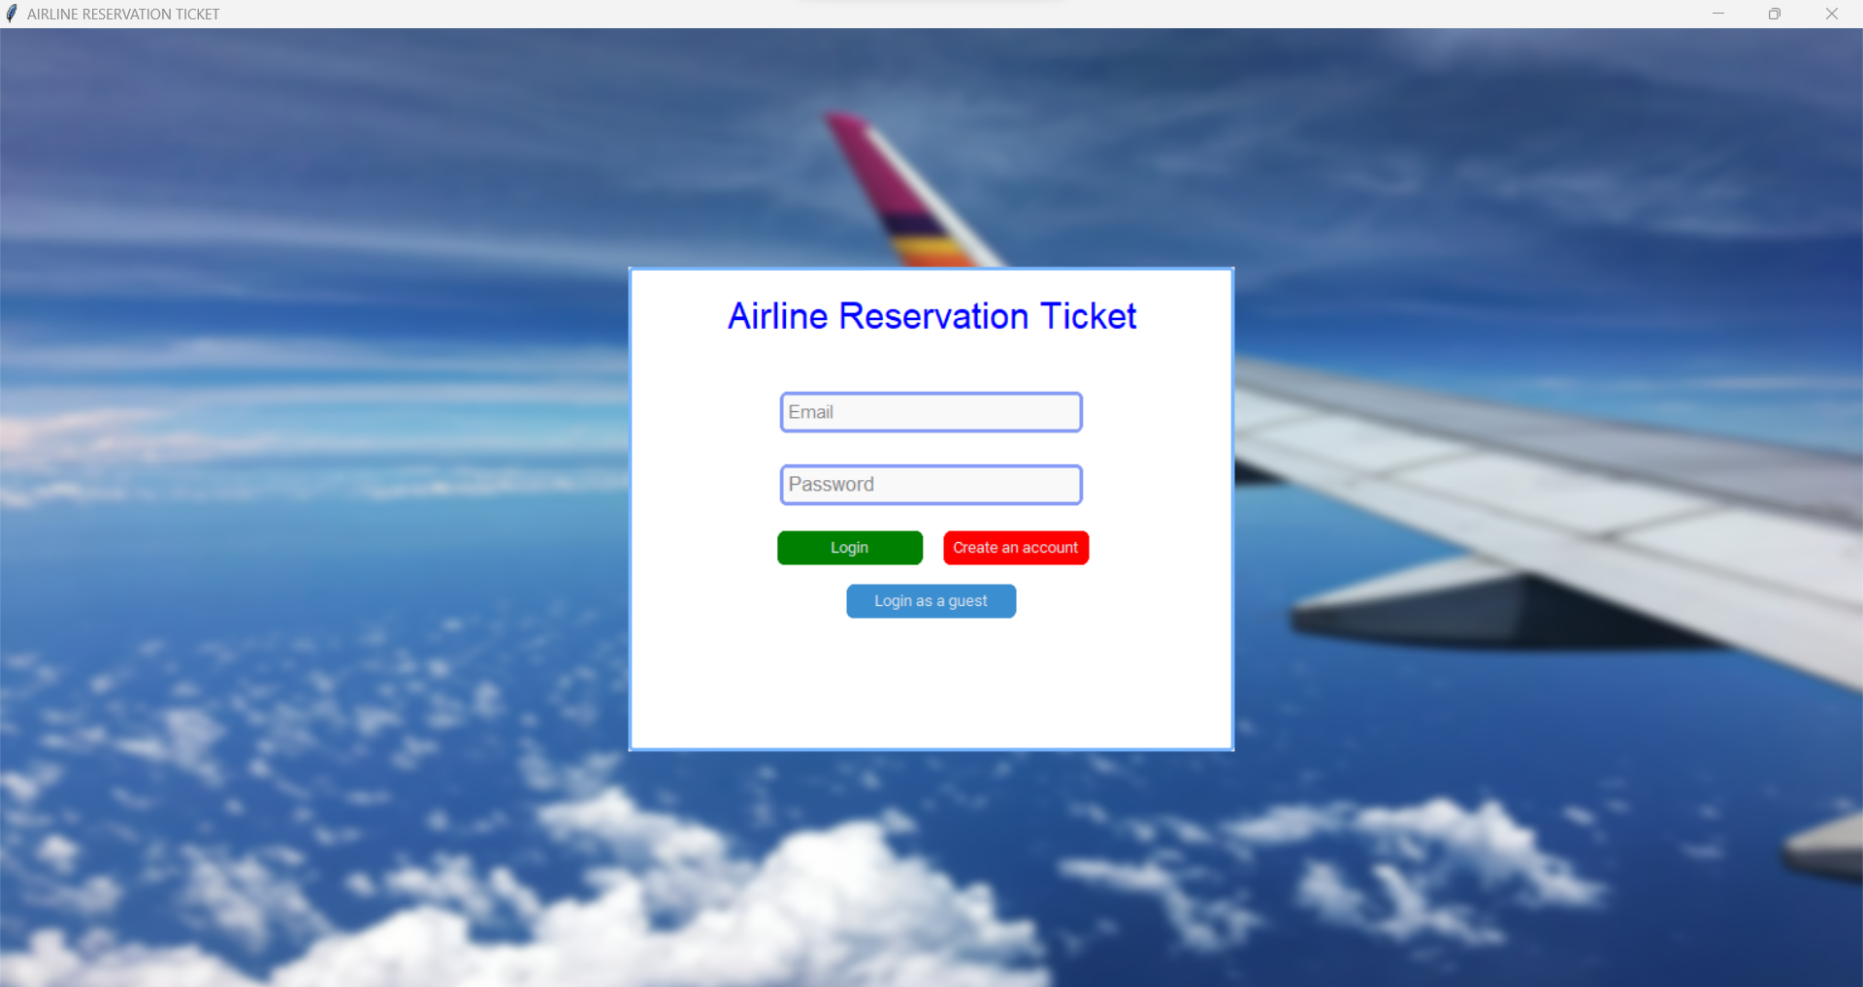
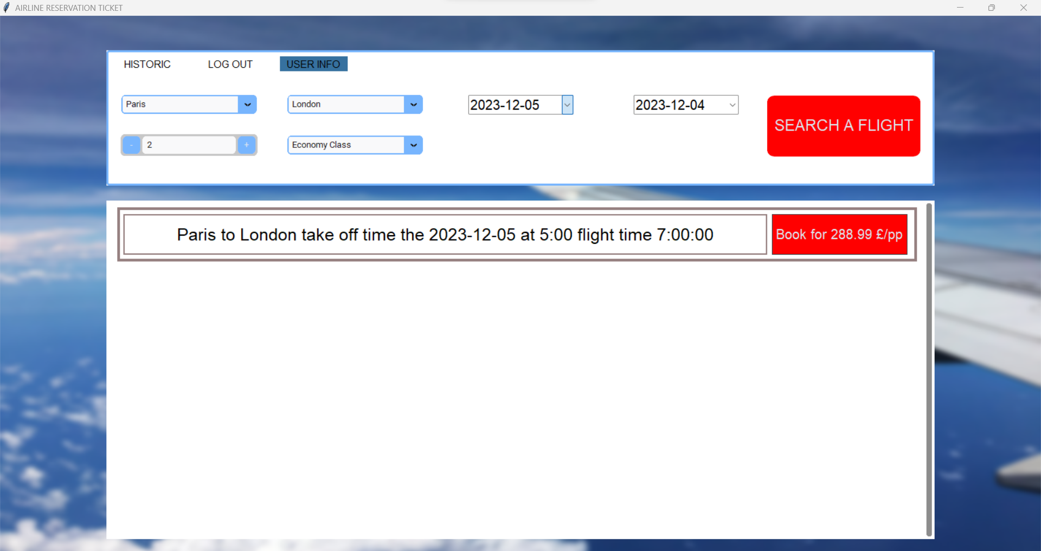
GUI screen samples

Slide 6
Review of our project
-Optimisation of the code
-Code Structure
-Better use of the class
-Exception Handling
-Database Security

Slide 7
Bibliographie
-https://customtkinter.tomschimansky.com/
-https://github.com/TomSchimansky/CustomTkinter
-https://docs.python.org/3/library/index.html

