Slide 1

INDIAN MONUMENT IMAGE
PREDICTION
Guided by: - Dr. Bhargav K Rewankar
Dr.Ravi Roogi
Team Members | UUCMS
Ananya R Sugandhi | P02DR25S126002
Chaitra Navalgund | P02DR25S126006
Lavanya Maribashetti | P02DR25S126012
Suman Palled | P02DR25S126031
Ziyakausar J Tamboli | P02DR25S126036
Vasanta Mathad | P02DR25S126037

Slide 2
Problem Statement
India has a vast number of historical monuments, but identifying them and understanding their
historical, structural, and preservation details is not always easy for common people.
Manual identification requires prior knowledge, and there is no simple system where users can
upload an image and instantly get detailed information about a monument.
Hence, there is a need for an intelligent system that can:
● Automatically recognize Indian monuments from images
● Provide meaningful historical and structural details
● Raise awareness about monument preservation

Slide 3
Objective & Scope
Objective:
To develop a deep learning-based image classification system that identifies Indian Monuments
from uploaded images and provides detailed information such as build date, materials used,
environment impact and protection methods through a user friendly interface.
Scope:
The system can be used in tourism applications and for educational purposes by students
and researchers, with future enhancements including mobile application integration and
real-time monument detection using camera input

Slide 4
Data Files Description
The dataset is taken from Kaggle:
Indian Monuments Image Dataset
Search from google
Contains images of various Indian monuments such as:
○ Taj Mahal
○ Qutub Minar
○ India Gate
○ Red Fort
Dataset is divided into:
○ Train Folder: Used to train the model
○ Test Folder: Used to evaluate model performance
Each monument has multiple labeled images
Images are pre-classified into folders representing monument names

Slide 5
Methodology
1. Data Collection
Dataset downloaded from Kaggle
Search from google
2. Data Preprocessing
Image resizing
Normalization
Label encoding
3. Model Building
Convolutional Neural Network (CNN) is used
Model trained using training dataset

Slide 6
Methodology
4. Model Testing
Accuracy evaluated using test dataset
5. Prediction Phase
User uploads an image
Model predicts monument name
6. Information Retrieval
Based on prediction, details are fetched from database
7. Output Display
Displays monument details such as:
Build Date
Materials Used
Environmental Effects
Protection Methods

Slide 7
System Requirements
Hardware Requirements
Processor: Intel i5 or above
RAM: Minimum 8 GB
Storage: 256 GB or more
Software Requirements
Operating System: Windows
Programming Language: Python
Libraries: TensorFlow, Keras, NumPy
Framework: Flask
IDE: VS Code

Slide 8
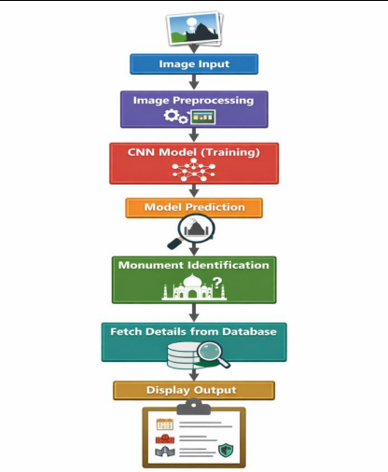
Block Diagram

Slide 9
Input Data / Output Data
Input
  Image of Indian monument (uploaded by user)
Output
  Monument Name
    Build Date
    Materials Used
    Environmental Impact
    Protection Methods

Slide 10
THANK YOU

