Slide 1


Slide 2
The Problem
How can we use new technology to improve language learning?
How can we connect students learning languages?
How can we get students interested in educational systems?
How can we use successful technology to accomplish this?

Slide 3
What is Omni?
Language learning social network
Builds off of the success of social networking
Connects language students globally
Brings language tools to the users

Slide 4
Demonstration

Slide 5
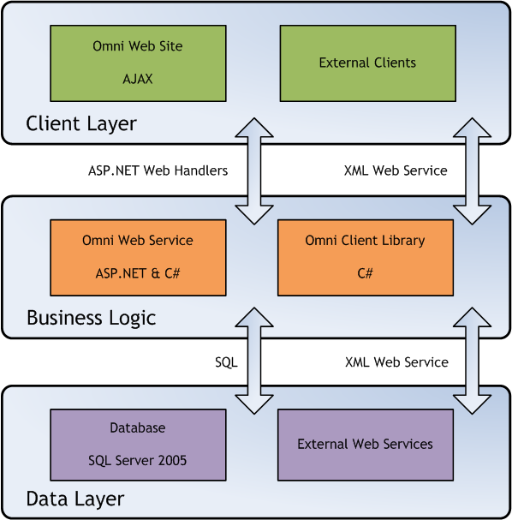
Architecture

Slide 6
Educational Application
In the classroom
Conversation partners
Exercises with real world applications
Connects language departments
For all students
Developing connections

Slide 7
Business Plan
Advertising driven
User reward system
Broadens advertiser’s exposure
Provides translator incentives
Matches web service model

Slide 8
The Future
User groups
Other types of social networks
Blogs, Wiki, IM
Benefiting from gathered translation data
Make the world a smaller place

