Slide 1




Slide 2
Topics
Duality of environmental change
Definition of Reactivity
Creating environmental change
Software framework
Unique features
Hardware/Software relationship
Business viability

Slide 3
Duality of Environmental Change
Emission Reduction Tech
Emission
Feedback
Environmental Change

Slide 4

What is Reactivity?

Slide 5
Distributed Sensing
Sensor
Sensor
Sensor
Sensor
Sensors are spatially distributed

Slide 6
Intelligent Control
Output Control
Sensor Data
Sensor Data
Sensor Data
The ability to control electronic devices based on combining a multitude of sensory data.

Slide 7
Interfaces to Reactivity
Rich User Client
Graphical representation of buildings
Easy to use, for end users
Control Panel
Facilitates administrative tasks
Rule-chain manipulation
Mobile Web Client
Similar to rich client, but mobile
Windows Sidebar Gadgets
Simple interface
Allows viewing data and control
Accessible anywhere

Slide 8
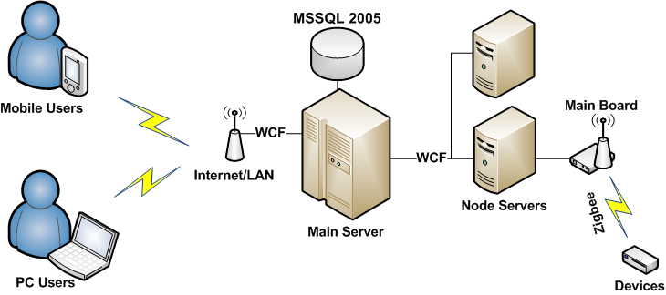
Hardware/Software Relationship

Slide 9
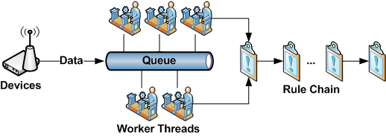
Rule Chain Structure

Slide 10
Revision 0.2 Hardware
Temperature
Luminosity
RFID
Motion
Acceleration
AC Power

Slide 11
Cost Flexibility
USB
Wi-Fi
High Performance
ZigBee
Data over Powerline
Low Performance
Low Cost
High Cost

Slide 12
Business Viability
Leverage for software created by flexibility of hardware
Can interface to any hardware that can support protocol
Low cost for meeting standards
EPA
OSHA

Slide 13
Thank you for your time!

