Slide 1

Capstone Project: Coursera Applied Data Science
Open a Supermarket in Philadelphia
Ziyang liu
2020/07/24

Slide 2

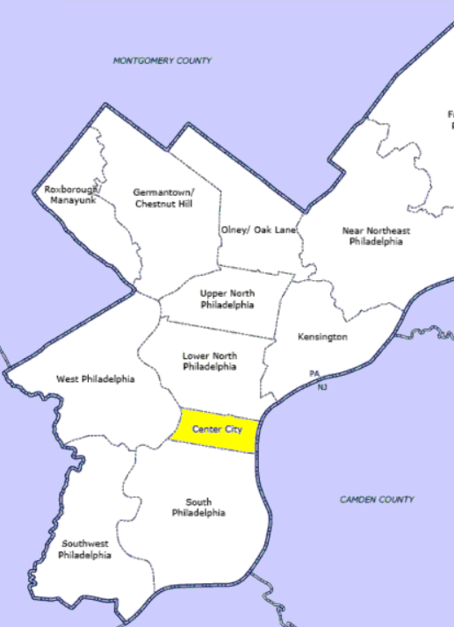
Introduction
Philadelphia, colloquially Philly, is the largest city in the U.S. state of Pennsylvania, and the sixth-most populous U.S. city with a 2019 estimated population of 1,584,064.
Philadelphia is the center of economic activity in Pennsylvania with the headquarters of five Fortune 1000 companies located within city limits. As of 2019, the Philadelphia metropolitan area is estimated to produce a gross metropolitan product (GMP) of $490 billion, an increase from the $445 billion calculated by the Bureau of Economic Analysis for 2017, representing the eighth largest U.S. metropolitan economy.

Slide 3
Introduction
Supermarkets are the most important aspect of food production and distribution as they are the interface between supply and demand. It increase local consumption and also provide food with lower prices to residents.
The success of opening a supermarket hinges on various aspects, one of the most important, is to choose the ideal location.

Slide 4
Business Issue
This project aims to use machine learning techniques to find the best place to open a shopping mall in Philadelphia.
The target people are businessmen, investors or even local government, who want to make profit via building a supermarket. It will also benefit local residents.

Slide 5
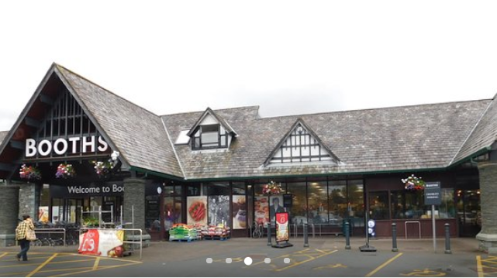
Data
Neighborhood Information
Geographic Coordinates
Venue Data
Existing Supermarkets

Slide 6
Data Source
The neighborhood data is available on https://en.wikipedia.org/wiki/Category:Neighborhoods_in_Philadelphia
We use Foursquare API to access venue data, coordinates and other data.

