Slide 1
Lumen Platform
A platform for research agents: one engine, many producers and consumers
Team 15: HE RONG, LI ZHUOYANG, LIU ZIYANG, LU YI, PENG XUJIAN
Graduate Certificate in Architecting Scalable Systems, practice module, 26 October 2026
https://lumen.54-179-112-87.sslip.io
Notes:
Good morning. We are Team 15. Our project is Lumen Platform. Research teams now give work to language-model agents, and each team builds the same parts again. Lumen Platform builds these parts once and lets producers publish agents and consumers ask questions. Everything we show today runs at the public address on this slide. You can open it during the talk. Timing: overview 3 minutes, conduct 2, logical 9, physical 9, DevOps 7, demo 10.

Slide 2
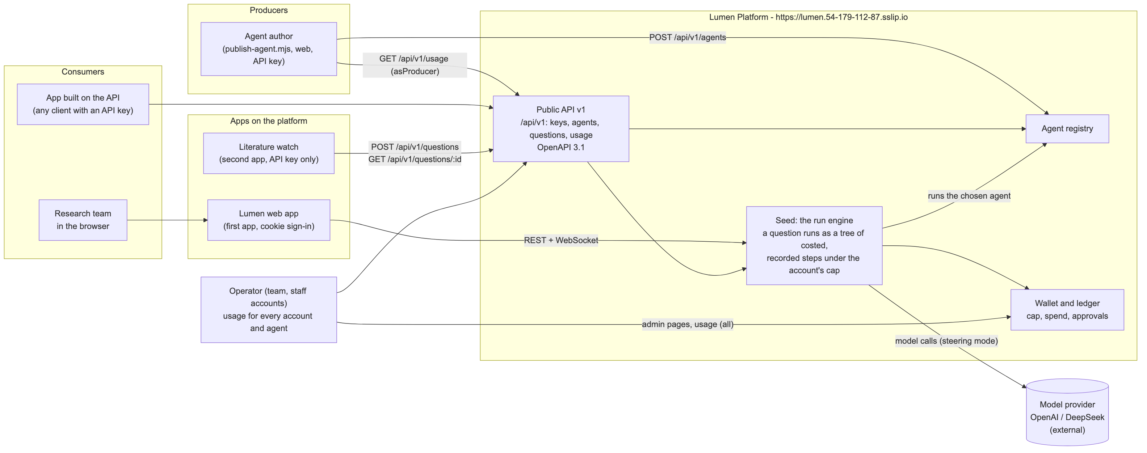
Every team rebuilds the same agent parts
Step record with cost
Spending cap
Sandbox for commands
Live view of the run
Notes:
The business problem: every team that runs agents builds a step record with costs, a spending cap, a sandbox and a live view. Our answer is platform thinking. The seed is the run engine: a question runs as a tree of costed, recorded steps under the account cap. Producers are agent authors: they publish an agent in the registry. Consumers are research teams in the web app, and apps that call the public API with a key. The operator is the team, with staff accounts. Two apps run on the platform: the Lumen web app and the literature watch, which uses only the API.

Slide 3
Scope: six use cases, five services, one public host
In scope (status on 20 October 2026)
Out of scope
Use case | Actor | Status
UC1 Publish an agent | Producer | Verified on host
UC2 Ask with a chosen agent (API) | Consumer | Verified on host
UC3 API keys, scopes, 429 | Consumer | Verified on host
UC4 Approve a step over the cap | Consumer | Deployed
UC5 Usage per account and agent | Operator, producer | Verified on host
UC6 Literature watch (second app) | Consumer | Verified on host
Payouts to producers
More than one region
Model training
Mobile client
Moved to phase 2: stream and model-gateway services, one database per service, EKS
Notes:
Scope. Six use cases from the proposal. UC1, UC2, UC3, UC5 and UC6 are verified on the public host: an API key published an agent, asked with it, read the answer and the usage, and hit the rate limit with 429 after 21 requests; the literature watch ran end to end. UC4, approval over the cap, is deployed from the billing slice. Out of scope from the proposal: producer payouts, multi-region, training, mobile. Moved to phase 2 during the project: the separate stream and model-gateway services, one database per service, and EKS. The limitations slide at the end gives the reasons.

Slide 4
Project conduct: status, milestones, effort
Done and deployed
Five services on k3s with HTTPS; HPA and KEDA; API v1, registry and watch verified; worker-kill tested
Pipeline
Run 39441445313 passed all 7 stages. The run before it was stopped by the image scan
Outstanding
A model key with a low spending limit (workers in demo mode now); progress report [TEAM TO FILL]
 | HE RONG | LI ZHUOYANG | LIU ZIYANG | LU YI | PENG XUJIAN
Owns | billing, chart, AWS, CI/CD | worker, queues | session, contracts, demo | identity, ingress, keys | project, registry, k6, watch
Hours | [TEAM TO FILL] | [TEAM TO FILL] | [TEAM TO FILL] | [TEAM TO FILL] | [TEAM TO FILL]
Proposal v1 1 Oct → v2 and review 6 Oct → platform commits 20 Oct → demo 26 Oct → report 16 Nov
Notes:
Status. The five services run on the public host with HTTPS and autoscaling. The public API, the registry and the literature watch are verified on the host, and a worker was deleted during a question, gracefully and by force. Pipeline run 39441445313 passed every stage; the run before it was stopped by the image scan. Outstanding: the workers still run in demo mode, so we add a model key with a low spending limit before the presentation; and the progress report. Milestones: proposal v1 on 1 October, v2 and the lecturer review on 6 October, the platform commits on 20 October, this demo on 26 October, the report on 16 November. The proposal estimated 10 person-days per member. [TEAM TO FILL: actual hours per member before the talk.]

Slide 5
Key decisions in the logical architecture
AD-01 Slices become services
Five services from existing slices; reuse, not rewrite
AD-02 Turns on RabbitMQ
QueueWorker replaces the in-process worker; kernel unchanged
AD-03 One queue per depth
Waiting parents cannot block their children
AD-04 Session writes the trace
Worker reports over HTTP; a dead worker loses nothing
AD-05 Steer fanout
Every worker pod gets steers; no routing table
AD-06 One shared database
Fast to build; split per service is phase 2
AD-07 API v1 with keys
SHA-256 keys, scopes, 60/min per key, OpenAPI
AD-08 Agent = instructions
Chosen per question; no untrusted code
Notes:
Eight decisions shape the logical view. AD-01: each service is an existing slice with a new entry point, so we spent our time on the calls between processes. AD-02: a turn crosses on a durable RabbitMQ queue; the kernel takes a Worker port and we give it a QueueWorker. AD-03: one queue per task depth. A parent turn keeps its slot while its children run; with one queue, parents can fill every slot. AD-04: only session writes the trace, so a dead worker loses nothing. AD-05: steers go on a fanout. AD-06, in amber, is the main trade-off: one shared database. AD-07: a versioned API with hashed keys and scopes. AD-08: an agent is a set of instructions for the lead, not remote code.

Slide 6
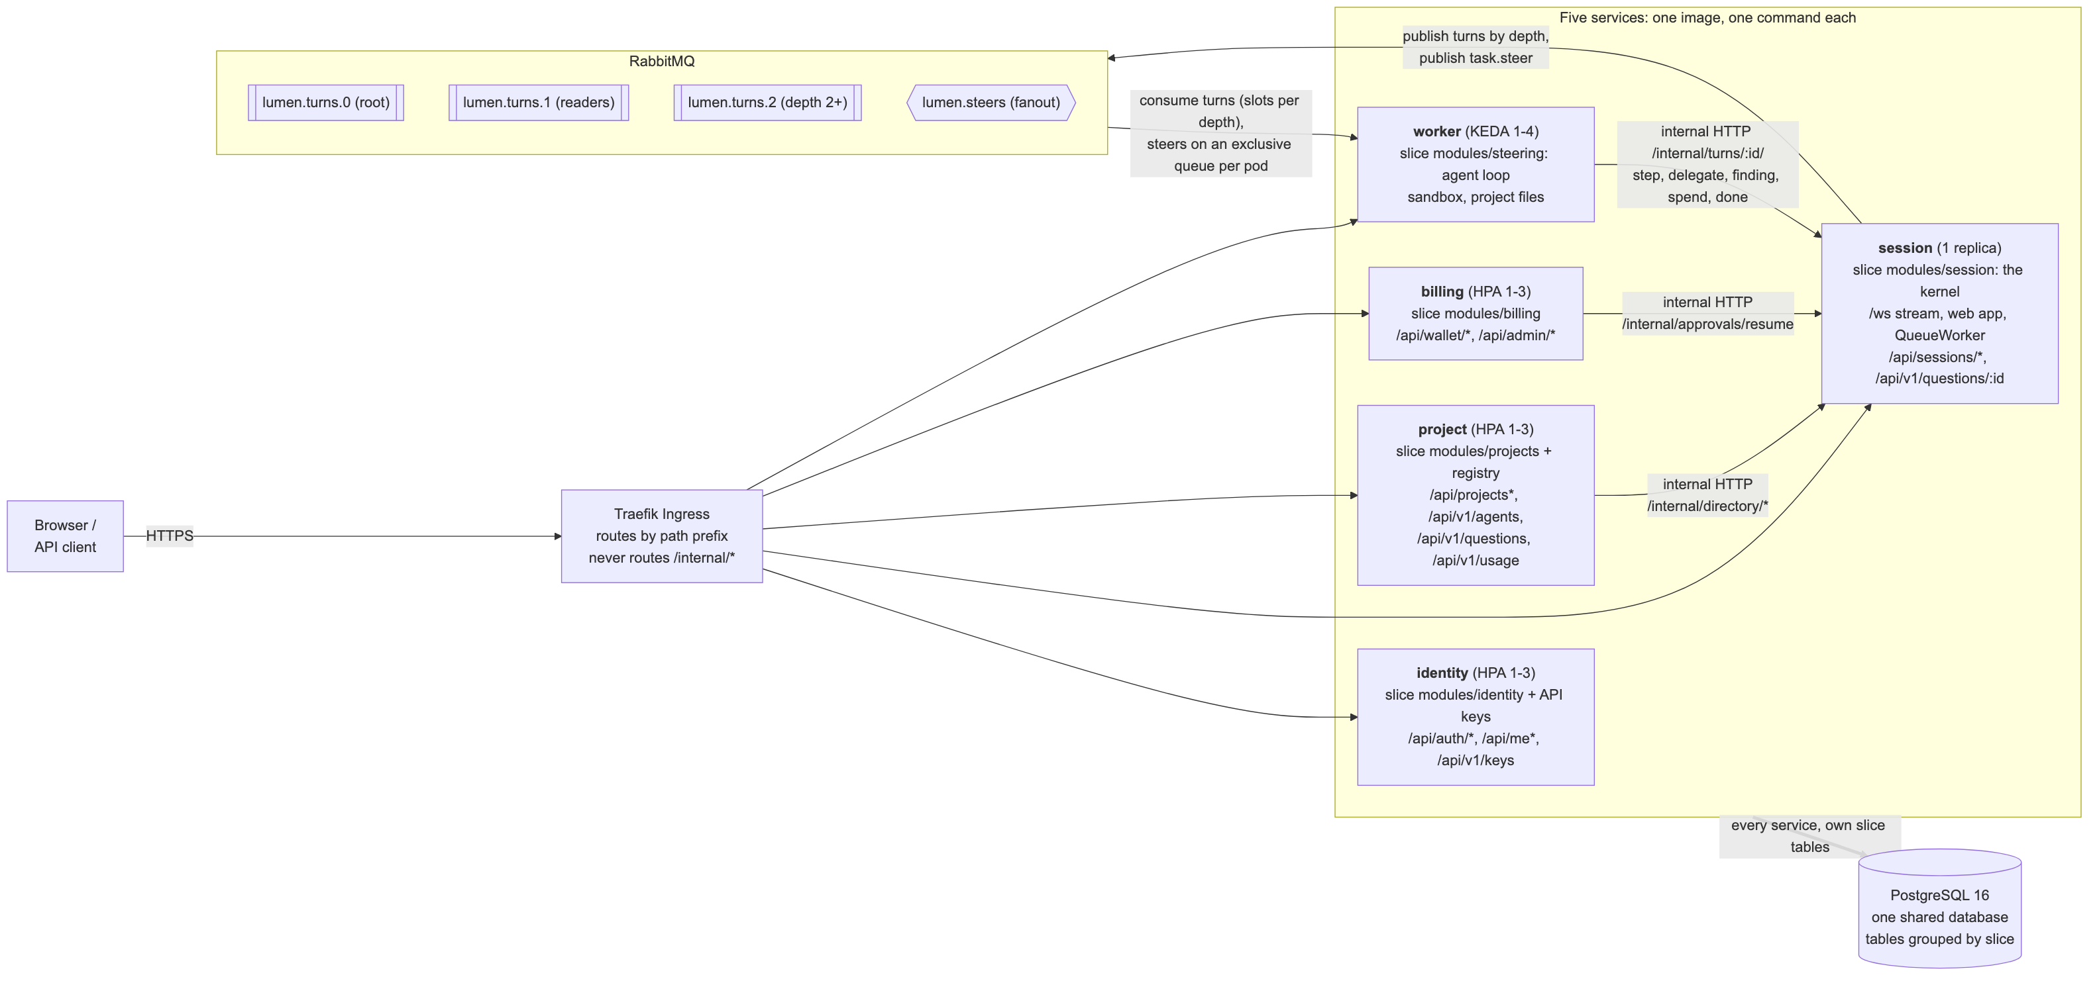
Five services, two queues of work, one database
Notes:
Traefik routes by path prefix to five services and never routes /internal. Identity, project and billing scale on CPU. Session holds the kernel, the live WebSocket stream and the web app; it has one replica. The worker runs the agent loop and scales on queue length. Session publishes turns by depth and steers on a fanout. Workers report each step back to session over internal HTTP with a shared key. Project and worker reach the running kernel through the session directory; billing resumes approved tasks. All five share one PostgreSQL database; tables are grouped by slice.

Slide 7
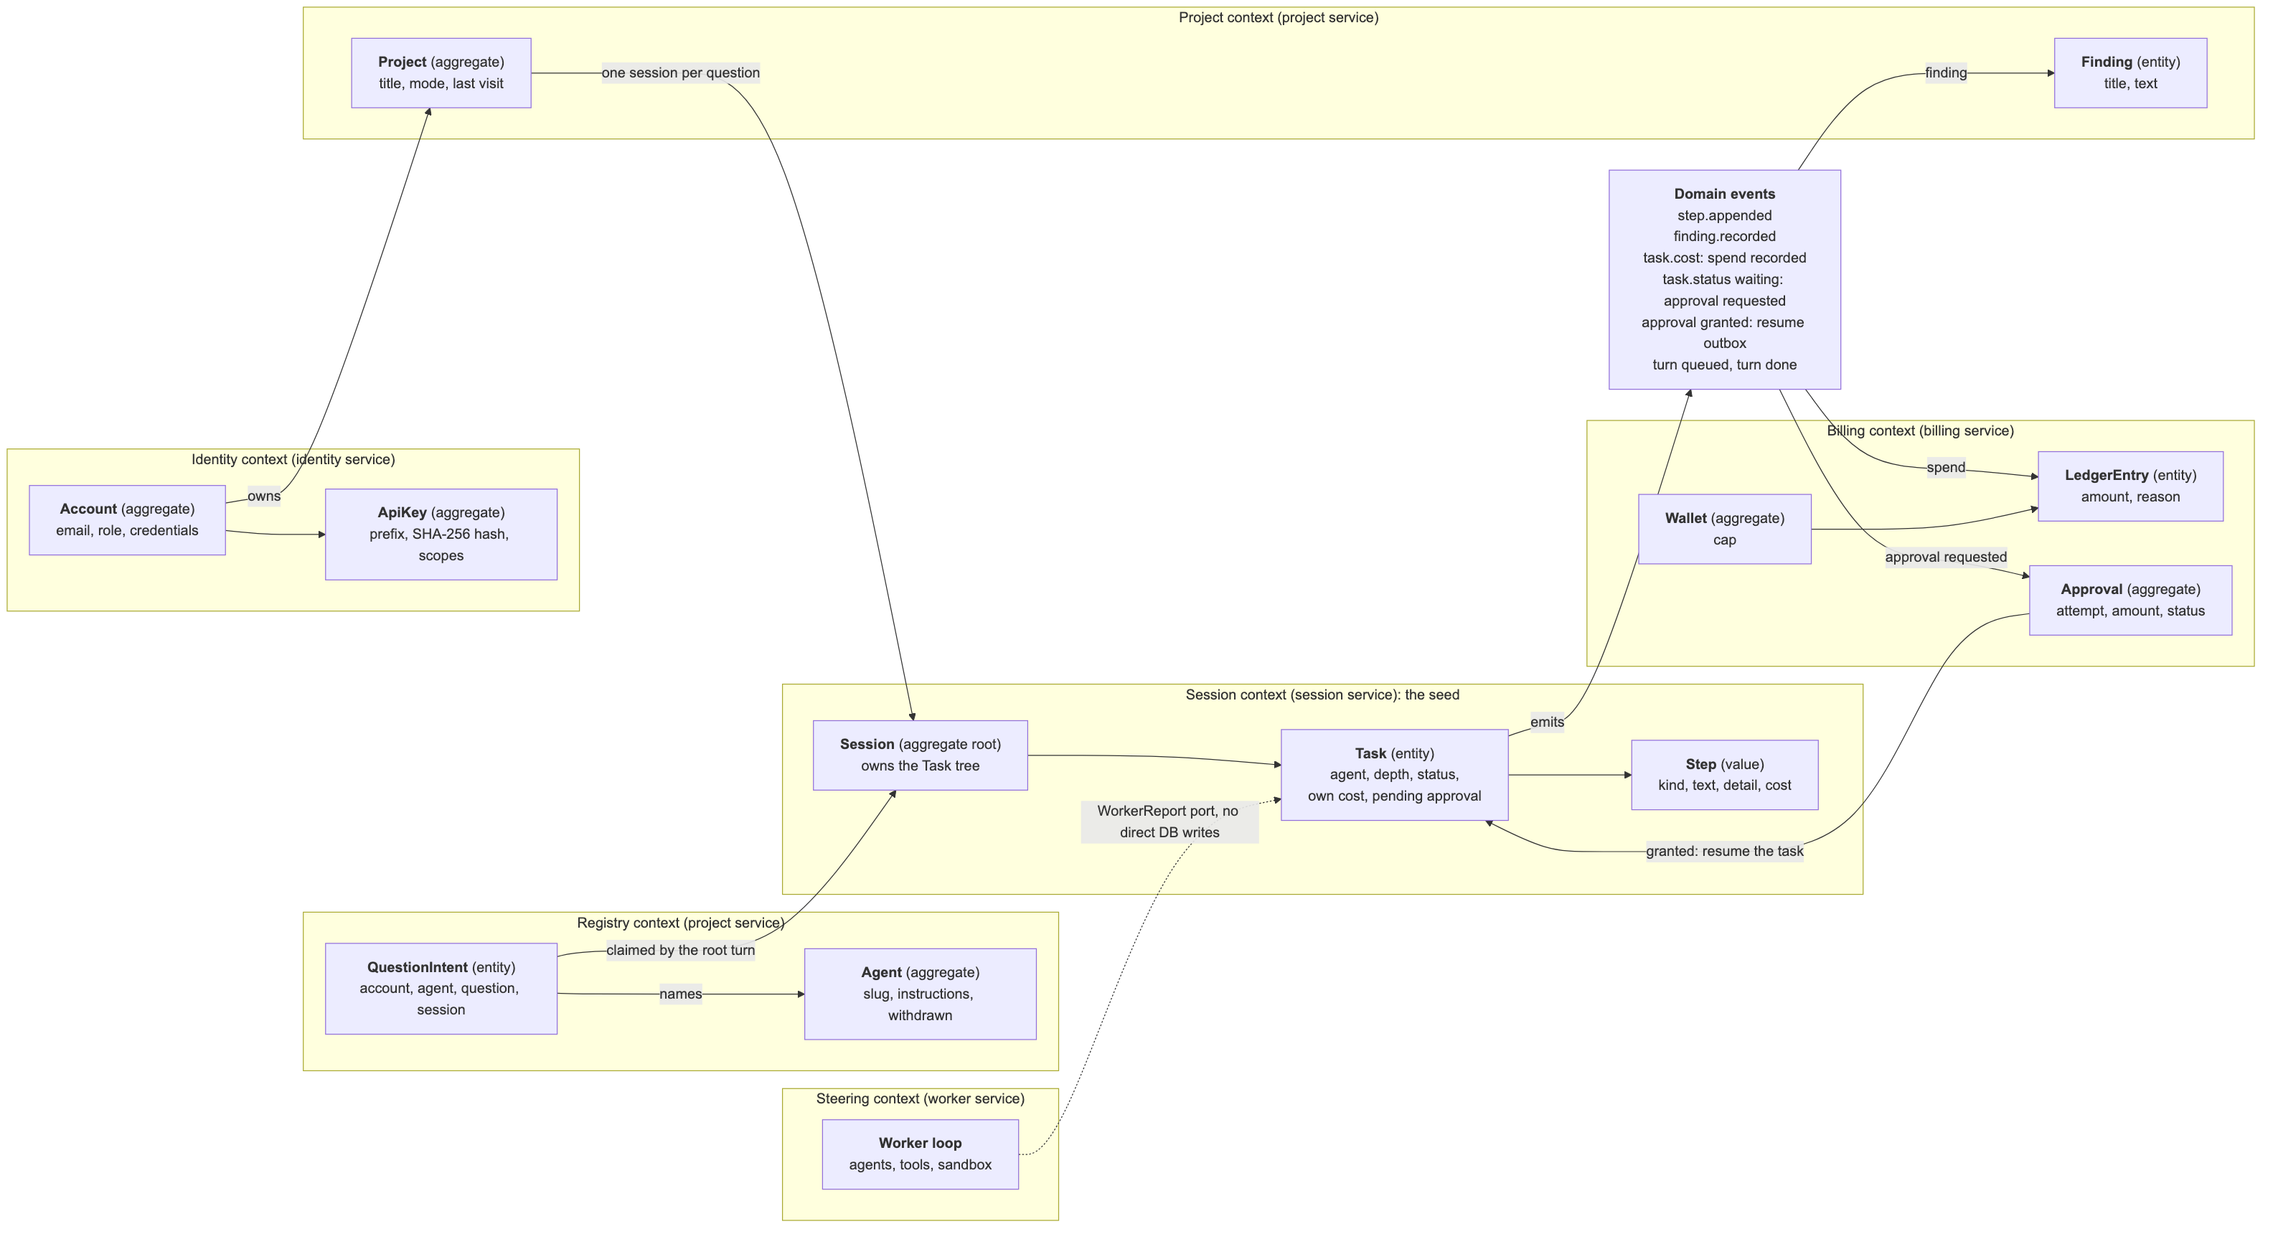
Domain-driven design: contexts, aggregates, events
Notes:
Each slice is a bounded context and each service hosts one or two. The seed is the Session context: the Session aggregate owns the Task tree, and steps are values. Billing owns Wallet, LedgerEntry and Approval. Identity owns Account and ApiKey. The Registry owns Agent and the question intent. Contexts talk through ports, not each other's code: the kernel asks a BudgetGuard that billing implements; the worker loop knows only the WorkerReport port. Domain events: step.appended, finding.recorded, task.cost, task.status waiting, approval granted through an outbox row, turn queued and turn done.

Slide 8
How producers and consumers use the platform
1
Producer
POST /api/v1/agents (slug, instructions)
API keys
lmn_<prefix>_<secret>, shown once, stored as SHA-256. Five scopes. Only on /api/v1. 60 a minute, burst 20, then 429.
2
Consumer
GET /api/v1/agents
3
Consumer
POST /api/v1/questions {question, agent}
4
Platform
Worker claims the intent; lead runs with the agent's instructions
~210 lines
The whole literature watch. No database, model, sandbox or billing of its own.
5
Consumer
GET /api/v1/questions/:id: answer, findings, cost
6
Producer, operator
GET /api/v1/usage: sessions, cost, median time
Notes:
This is how the platform meets producers and consumers. A producer publishes an agent with a slug and instructions. A consumer lists agents and asks a question with a chosen agent. The question writes an intent row first, because the root turn can reach a worker before the project request returns; the worker claims the intent and puts the agent instructions in front of the question. The consumer reads the answer, findings and cost. Producers and the operator read usage. Keys are shown once and stored only as a hash, with scopes and a per-key rate limit. The literature watch shows the benefit of building on the platform: about 210 lines of code for a complete app.

Slide 9
Key decisions in the physical architecture
AD-09 k3s on one EC2, not EKS
About USD 1.3 a day; same chart on k3d and AWS; one node is one failure domain
AD-10 Traefik is the gateway
Path routing, TLS, /api/auth rate limit; no gateway service
AD-11 Two autoscalers
HPA on CPU for identity, project, billing; KEDA on queue length for worker
AD-12 No image registry
Image tagged with the commit SHA, copied by scp, imported into k3s
AD-13 Secrets made in the cluster
DB, RabbitMQ and internal keys never leave the cluster
AD-14 sslip.io + Let's Encrypt
Real certificate, stable name, no domain to buy
Notes:
Six decisions shape the physical view. AD-09 is the big trade-off: one t3.medium with k3s instead of EKS, for cost and time; the same Helm chart runs on a laptop with k3d and on AWS, and can run on EKS later. AD-10: Traefik, which ships with k3s, is our gateway. AD-11: request load shows in CPU, agent load shows in the queues first, so the worker scales with KEDA. AD-12: no registry; the pipeline copies the image. AD-13: the chart generates the core secrets inside the cluster. AD-14: sslip.io and Let's Encrypt give a real HTTPS address for free.

Slide 10
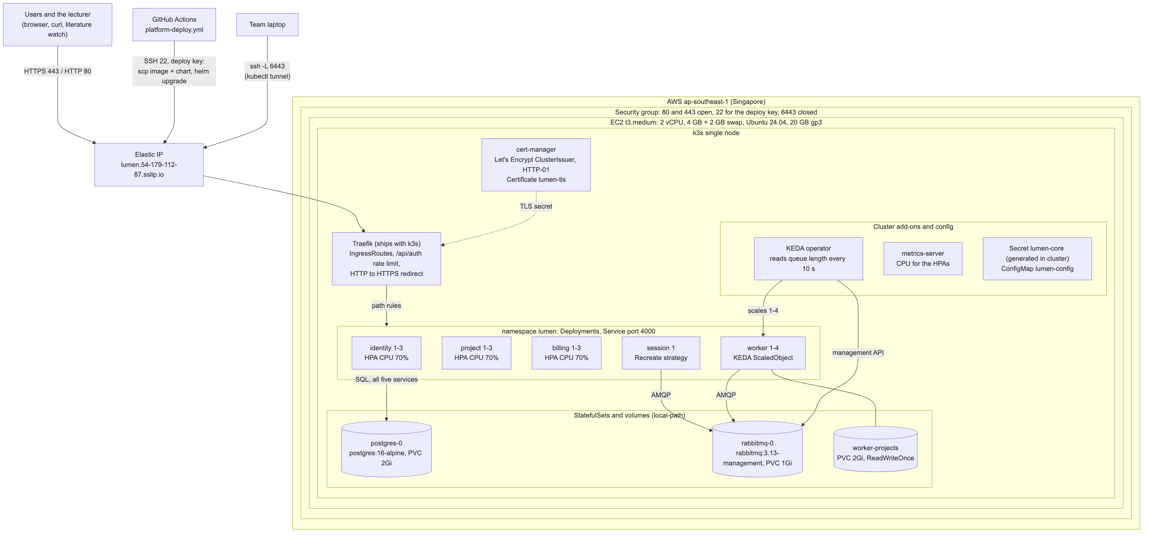
Physical deployment on AWS ap-southeast-1
Notes:
One EC2 t3.medium in Singapore: 2 vCPU, 4 GB plus 2 GB swap, a 20 GB disk, an Elastic IP. The security group opens 80 and 443; SSH is for the deploy key; the Kubernetes API port is closed, so kubectl goes through an SSH tunnel. k3s runs Traefik, cert-manager issues the Let's Encrypt certificate. Five Deployments: identity, project and billing with HPA from 1 to 3; session with 1 replica and the Recreate strategy; worker with KEDA from 1 to 4. PostgreSQL and RabbitMQ are StatefulSets with volumes. GitHub Actions deploys over SSH.

Slide 11
Persistence design
Data group | Store | Key controls
Accounts, auth sessions | PostgreSQL | scrypt hashes; HTTP-only cookie; Origin check
API keys | PostgreSQL | SHA-256 of the key only; scopes; revoke
Agents, question intents | PostgreSQL | Withdrawn, never deleted; claim with SKIP LOCKED
Sessions, tasks, steps, findings | PostgreSQL | Owner or staff only; JSONB step detail
Wallet, ledger, approvals | PostgreSQL | numeric(12,6); approval outbox with a lease
Turns and steers | RabbitMQ | Durable, persistent, acknowledged after /done
Project files | PVC 2Gi, ReadWriteOnce | One node only; EFS or S3 on EKS
Notes:
All persistent data is in one PostgreSQL 16 database on a 2 GB volume; each slice owns its tables, and the migration prefix shows the owner. Money is numeric and every total is a SUM in SQL. Concurrency uses the database: an approval decision locks its row, the approval delivery is an outbox with a 30-second lease and SKIP LOCKED, and the question intent is claimed the same way. A waiting task keeps its blocked operation in JSONB, so a restart loses nothing. Turns live in RabbitMQ and are acknowledged only after the worker reports done. Project files are on a ReadWriteOnce volume, which works only on one node.

Slide 12
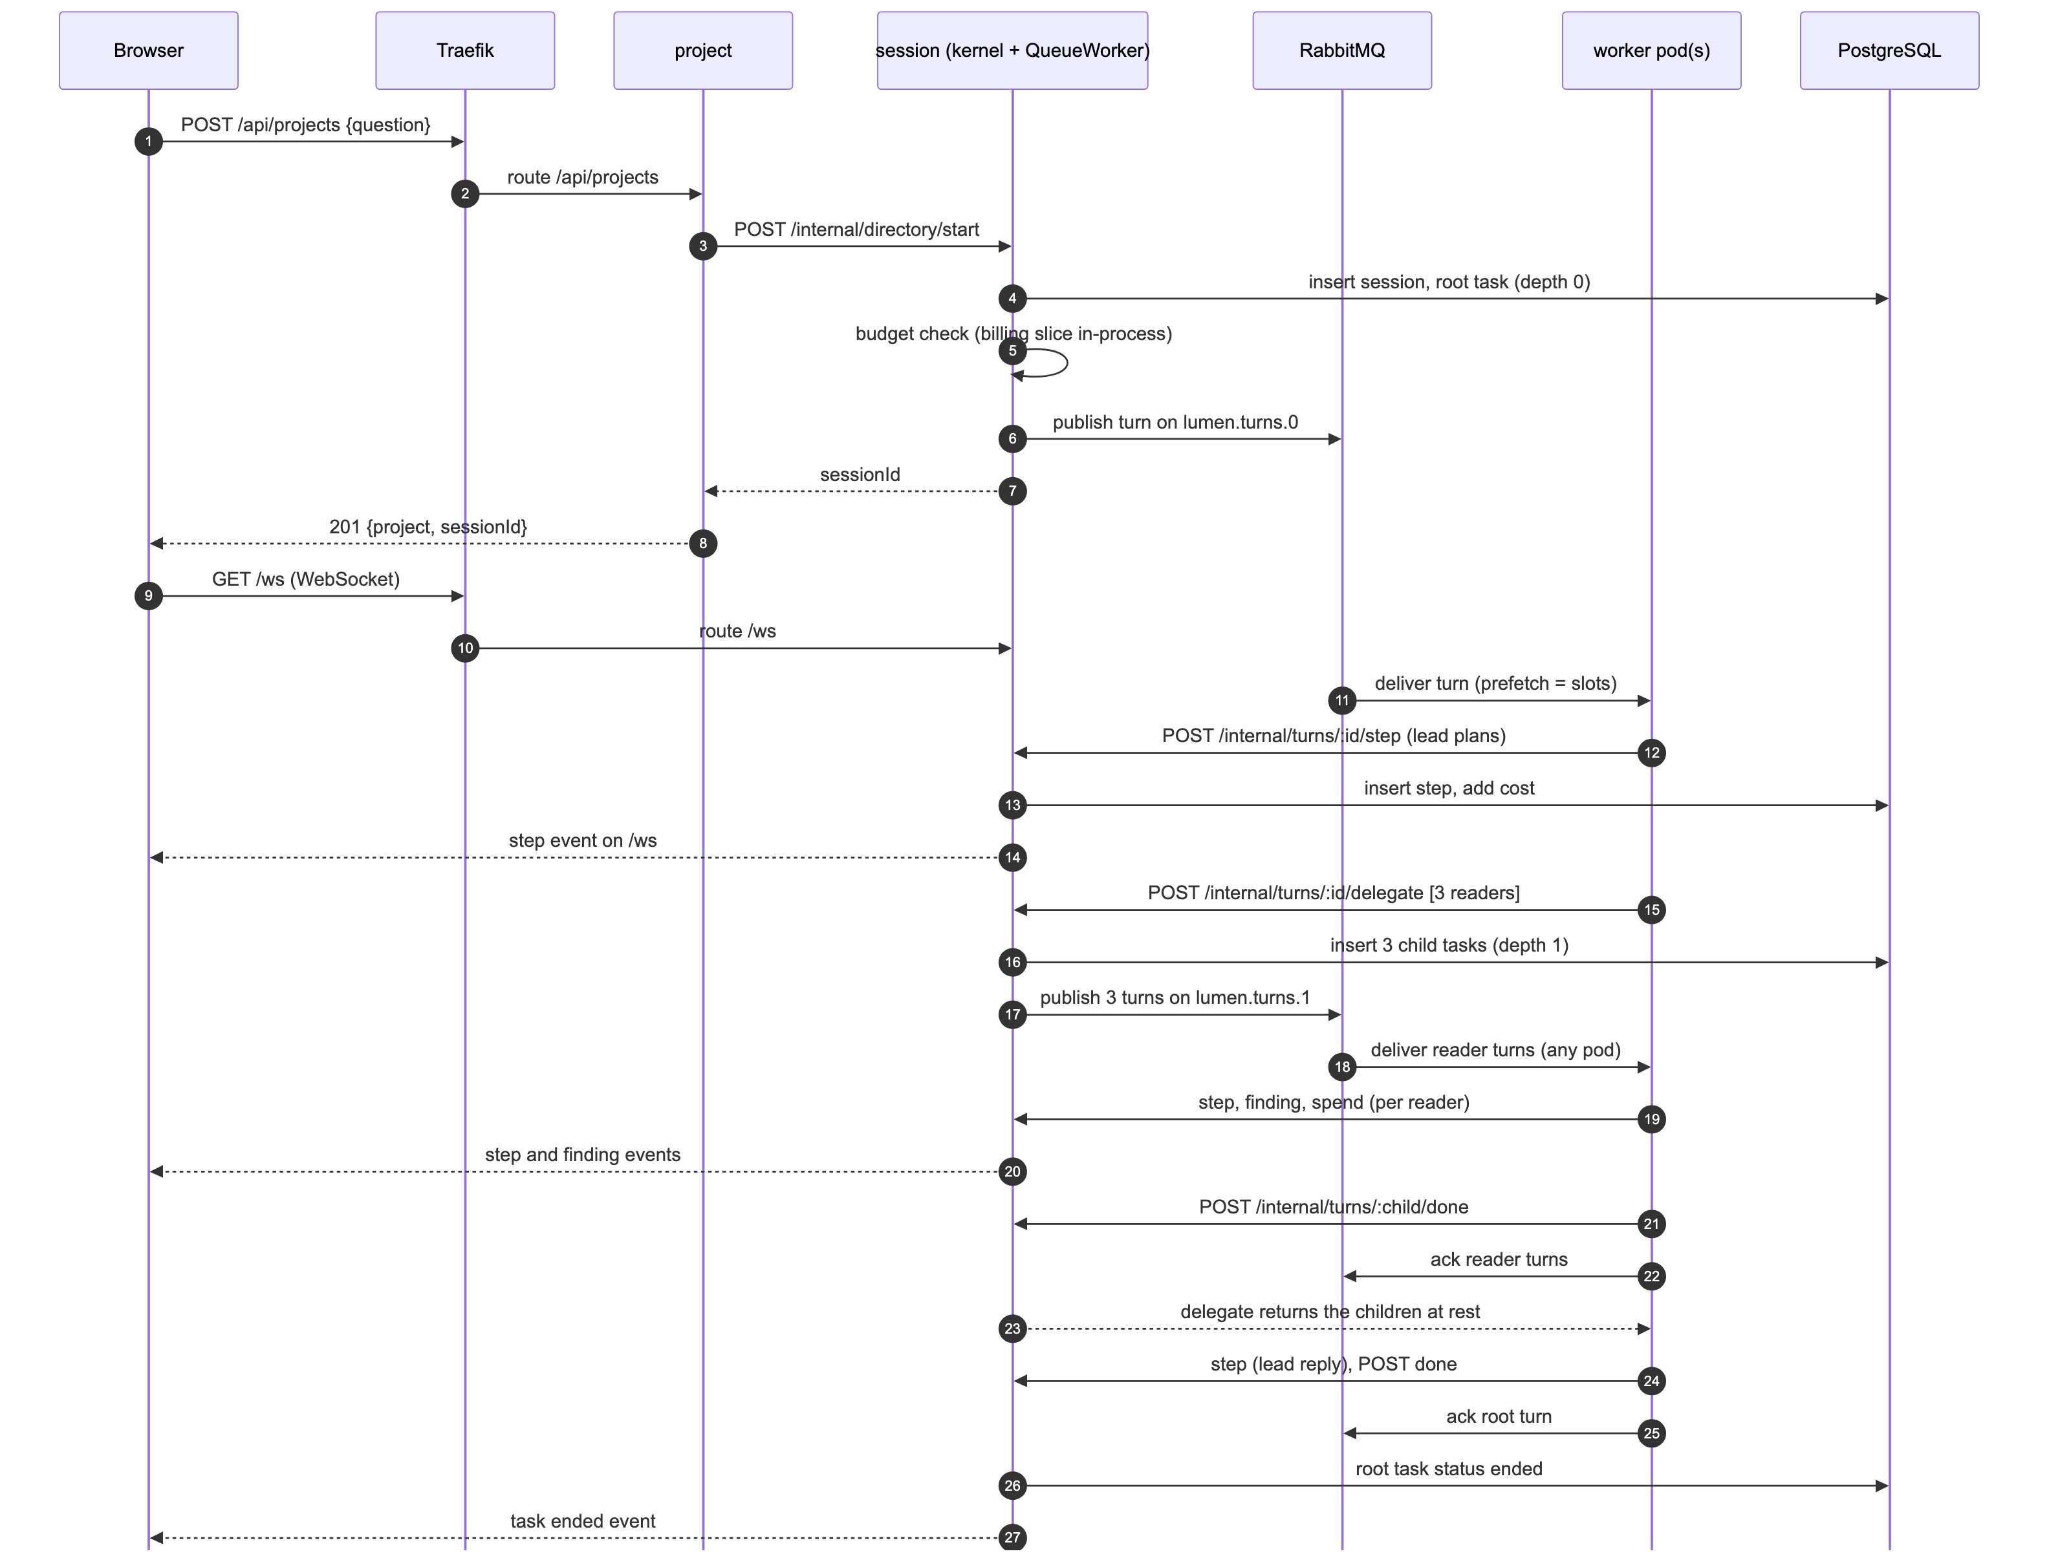
Use case: one question with a chosen agent
Through the API
keyGuard checks key, rate, scope
askRoutes writes the intent, then injects POST /api/projects
QueueWorker publishes the root turn on lumen.turns.0
Worker claims the intent; RemoteReport sends each step to session
delegate puts 3 readers on lumen.turns.1: any pod takes them
GET /api/v1/questions/:id returns answer and cost
Notes:
The architecturally representative use case: asking a question with a chosen agent. The key guard resolves the key, checks the rate and the scope. The ask route writes the intent row and creates the project with the same request the web app sends. Session opens the root task, checks the budget, and QueueWorker publishes the turn. A worker takes it, claims the intent, and runs the lead with the agent instructions. Every step goes back to session over internal HTTP; session writes it and streams it. Delegate opens three readers as new turns on the depth-1 queue, so any pod can run them; this fan-out is what makes the worker scale. The report also details a second use case: a step over the cap that waits for approval.

Slide 13
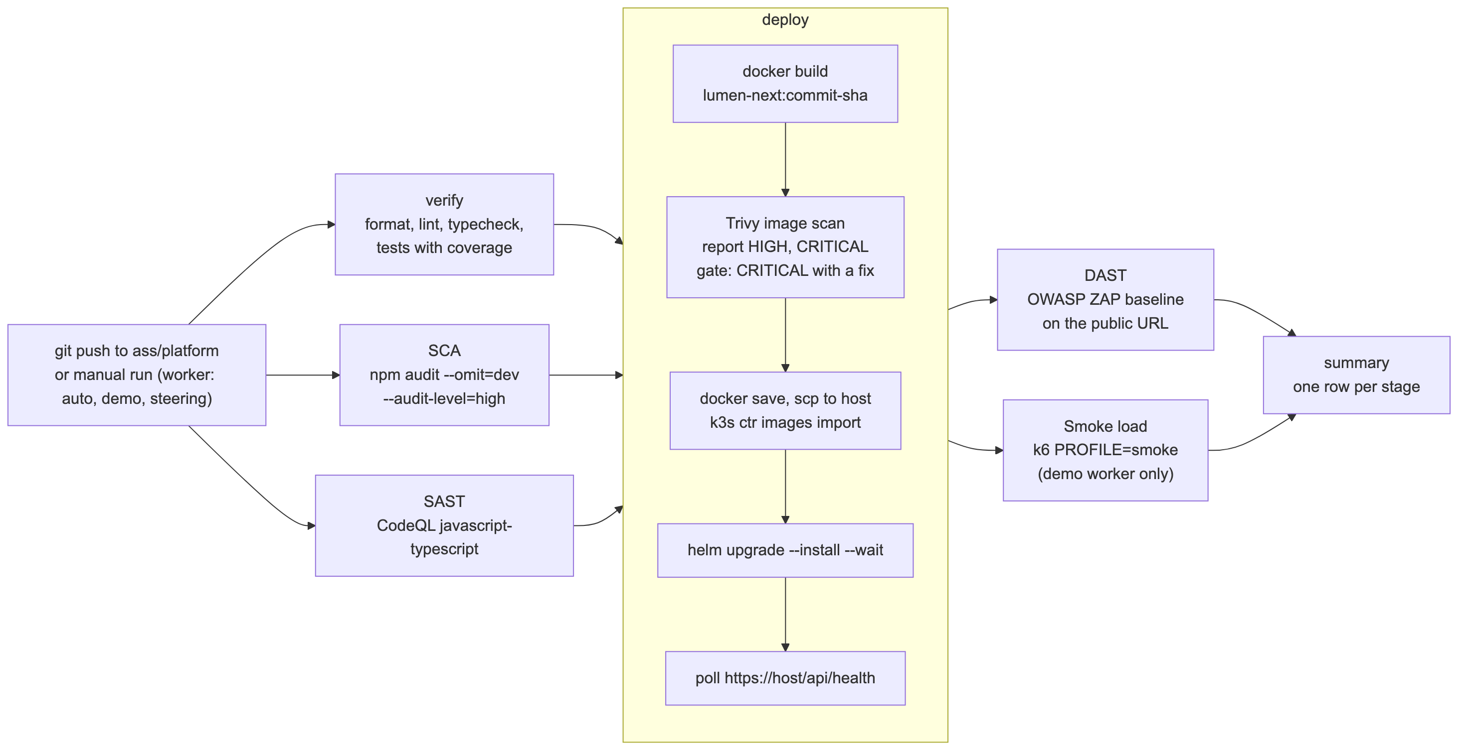
Source control and the DevSecOps pipeline
Branches
main: the monolith, kept green
ass/platform: integration; a merge is a deploy
One branch and one PR per member
Artefacts
Image lumen-next:<commit sha>
CodeQL, Trivy, ZAP, k6 reports kept per run
Notes:
One monorepo. main holds the monolith, which another module grades, so it stays green. ass/platform is the integration branch; each member works on one branch and opens one pull request. A slice change goes to main first. The pipeline: on every push, verify, SCA with npm audit and SAST with CodeQL run in parallel. Deploy builds one image tagged with the commit, scans it with Trivy and stops on a critical issue with a fix, copies it to the host, runs helm upgrade with wait, and polls the public health check. Then DAST with the ZAP baseline and a smoke load with k6, only in demo worker mode so a push never pays for model calls. Run 39441445313 passed every stage in 12 and a half minutes: SCA 33 seconds, SAST about 3 minutes, verify 5 minutes, deploy 5 and a half minutes including the image scan, DAST 1 minute 40, smoke load 1 minute 15.

Slide 14
Technical findings and issues
Deadlock with one queue
Waiting parents held every slot. Fix: one queue per depth.
Agent choice races the turn
The root turn can start before the API call returns. Fix: intent row first.
KEDA waits 300 s to scale in
Chart sets a 60 s window, so the demo shows scale-in.
Image scan stopped a deploy
5 critical CVEs (perl-base, docker.io). Fix: platform image without Docker, patched at build.
Lint on new folders
k6 script and watch app are in no tsconfig: ignore entries needed.
Supply chain
Trivy action tags were force-pushed in 2026: pinned to a commit.
Notes:
Findings. First, a deadlock: a parent keeps its worker slot while its children run, so one queue could fill every slot with waiting parents. One queue per depth fixed it. Second, a race: the root turn can reach a worker before the API call that created it returns, so we write the agent choice first as an intent row. Third, KEDA's default scale-in wait is five minutes; we set one minute. Fourth, the pipeline stopped a vulnerable image: run 39439752963 found 5 critical CVEs, in perl-base and in the docker.io package that the monolith carries for its sandbox. The gate failed the deploy before the image reached the host. The fix was a separate platform image without Docker, with security updates installed at build; the next run passed. Fifth, new JavaScript folders outside every tsconfig broke lint. Sixth, the Trivy action had tags force-pushed with malicious code this year, so we pin it to a commit.

Slide 15
The public address and its certificate
1
curl -sI $LUMEN_URL/
curl -sv ... | grep -E 'subject:|issuer:|expire date:'
curl $LUMEN_URL/api/health
Watch for
The padlock and the Let's Encrypt issuer
Health answers from the session service
GitHub: run 39441445313, every stage passed
Workers in demo mode until the model key is set: placeholder answers
Notes:
Open the public address in the browser and show the lock. The script prints the certificate subject, issuer and expiry, then the health check. Then show run 39441445313 of the Platform deploy workflow on GitHub: every stage passed, and a merge is a deploy. Note for the audience: the workers run in demo mode until we set a model key, so answers are placeholders that show the input the worker received; the steps, costs, queues and scaling are real. [TEAM: if the model key with a low spending limit is set by then, say so instead.]

Slide 16
Every service is running
2
ssh ubuntu@<host> kubectl get pods,svc -n lumen
Watch for
identity, project, session, worker, billing
postgres-0 and rabbitmq-0 StatefulSets
kubectl only through SSH: port 6443 is closed
Notes:
All pods are ready: the five services, PostgreSQL and RabbitMQ. kubectl runs on the host over SSH, because the Kubernetes API is not public.

Slide 17
Sign up and sign in
3
POST /api/auth/signup {email, displayName, password}
POST /api/auth/signout
POST /api/auth/password {email, password}
GET /api/me
Watch for
The identity service handles every call
Cookie lumen_session; Origin header checked
The password shows as $PASSWORD, never in clear
Notes:
A new demo account signs up, signs out and signs in with the password. All of this is the identity service. The cookie works on every service, because each one resolves it over the shared database.

Slide 18
Create a project with a question
4
POST /api/projects
{"question": "How many permutations of length 5
avoid the pattern 132?", "mode": "explore"}
Watch for
201 with the project id and the session id
The root turn is already on lumen.turns.0
Project calls session over internal HTTP
Notes:
We ask a question. The project service creates the project and asks session to start the session over internal HTTP. The answer comes back at once with the session id; the work runs on the queue.

Slide 19
Watch the steps arrive from the workers
5
GET /api/sessions/$SESSION
| jq '.tasks[] | {agent, depth, status}'
Watch for
Lead at depth 0, three readers at depth 1
Each step: worker → /internal/turns → session
The browser gets the same steps over /ws
Notes:
The script follows the session and prints each step as it lands. The lead plans, delegates to three readers, and replies. Each step was written by a worker pod and reported to session. In the browser the same steps arrive over the WebSocket.

Slide 20
Turns on the queues: one queue per task depth
6
kubectl exec rabbitmq-0 -- rabbitmqctl list_queues \
name messages messages_unacknowledged consumers
Watch for
lumen.turns.0 root, .1 readers, .2 deeper
Unacknowledged = turns in a worker's hands
Why per depth: waiting parents cannot starve children
Notes:
We ask one more question and look at the queues at once. There are three queues, one per depth. Messages that are unacknowledged are in a worker's hands. This is decision AD-03 in action.

Slide 21
Load: k6 in the background, the workers scale out
7
k6 run -e LUMEN_URL=$URL -e PROFILE=short deploy/k8s/load/ask.js &
kubectl get scaledobject,hpa,pods -n lumen
135
questions, all at rest
6.1 s
median time to rest (p95 9.3 s)
0.00 %
failed of 1,040 requests
1 → 4
workers in about 40 s
Notes:
Now the load. k6 runs the short profile in the background: up to 10 virtual users for about two minutes, against workers in demo mode, so no model is called and it costs nothing. Watch the ScaledObject and the pods: KEDA adds workers when a queue holds more than 5 turns. The chart is our recorded run on the public host on 20 October: the workers went from 1 to 4 in about 40 seconds; 135 questions all came to rest; the median time to rest was 6.1 seconds and p95 9.3 seconds; no request failed. If the live run is slow, use this slide as the backup.

Slide 22
Kill a worker during a run
8
kubectl delete pod/worker-... -n lumen --wait=false
Watch for
Tested: graceful delete, question ended as normal
Tested: hard kill, ended in 12.6 s; turns redelivered
Hard kill cost USD 0.08 vs 0.03: turns ran twice
Notes:
We ask another question and delete a worker pod while it holds a turn. The turn was not acknowledged, so RabbitMQ gives it to another worker, and the question still finishes. We tested both cases on the public host. A graceful delete: the pod finished its turns in hand and the question ended with USD 0.03 and 3 findings, the same as an undisturbed question. A hard kill: the unacknowledged turns went back on their queues, the new pod took them, and the question ended 12.6 seconds after it started, but with USD 0.08 and 8 findings, because the redelivered turns ran again from their start. That is limitation AISS-04.

Slide 23
The load test ends; the workers scale back in
9
wait $K6_PID; tail -5 k6.log
kubectl get scaledobject,hpa,pods -n lumen
Watch for
k6 summary: questions, time to rest, failures
Workers return to 1 after the 60 s window
Recorded run: 4 → 2 → 1 within about a minute
Notes:
The short k6 profile ends after about two minutes. The script prints the k6 summary. Once the queues are empty, KEDA scales the workers back to one after the 60-second window. In the recorded run the workers went from 4 to 1 within about a minute.

Slide 24
A second app on the platform: the literature watch
10
LUMEN_URL=$URL LUMEN_API_KEY=$LUMEN_API_KEY \
WATCH_FILE=watches.json node apps/watch/watch.mjs
Watch for
Only the public API and a key
Agent literature-scout, published by a producer
Verified on host: ended, USD 0.01, 5 s, exit 0
Notes:
The second app. The literature watch uses only the public API with a scoped key. It asks with the agent literature-scout, which a producer published, polls for the answer and prints a digest with the cost. On the public host it ran end to end: status ended, USD 0.01, 5 seconds, exit code 0. The step needs LUMEN_API_KEY set; without it the script skips the step. [TEAM: set the key in the shell before the talk.]

Slide 25
The wallet: what the demo questions cost
11
GET /api/wallet
→ {"spent": {...}, "cap": {...}}
Watch for
Every step is costed against the cap
Billing service, ledger in numeric(12,6)
Summary: questions, worker peak, p95, spend
Notes:
Last, the wallet. Every step was costed and recorded in the ledger, and checked against the account cap. The script ends with one summary line: the number of questions, the peak worker count, the k6 p95 time to rest, and the spend against the cap.

Slide 26
Limitations and next steps
Known limitations
Next steps
AISS-01 Session has one replica: running questions end on a restart
AISS-02 One shared database for five services
AISS-03 One EC2 node: no node autoscaling
AISS-04 A redelivered turn runs again from its start
AISS-05/06 No network policies; no tracing or metrics stack
Demo mode Workers run without a model key until the talk
Stream service and task state in the database, then several session replicas
One schema and user per service, then one database each
EKS with node autoscaling; EFS for files
Idempotent turns (hard kill: USD 0.08 vs 0.03)
Network policies; OpenTelemetry
Thank you. Questions? · https://lumen.54-179-112-87.sslip.io
Notes:
We close with what we know is not done, before you point it out. Session has one replica, because the kernel keeps running tasks in memory; the fix is the stream service from the proposal and the task state in the database. All five services share one database; the fix is one schema per service, then one database each. One EC2 node; the same chart moves to EKS with node autoscaling. A redelivered turn runs again from the start; turns must become idempotent. And no network policies or tracing yet. AISS-11, the public API not yet on the host, is closed: it is verified. Before the talk we add a model key with a low spending limit, so the answers are real. The report lists thirteen limitations, AISS-01 to AISS-13, each with an owner and a resolution. Thank you; we are happy to take questions.

