Slide 1
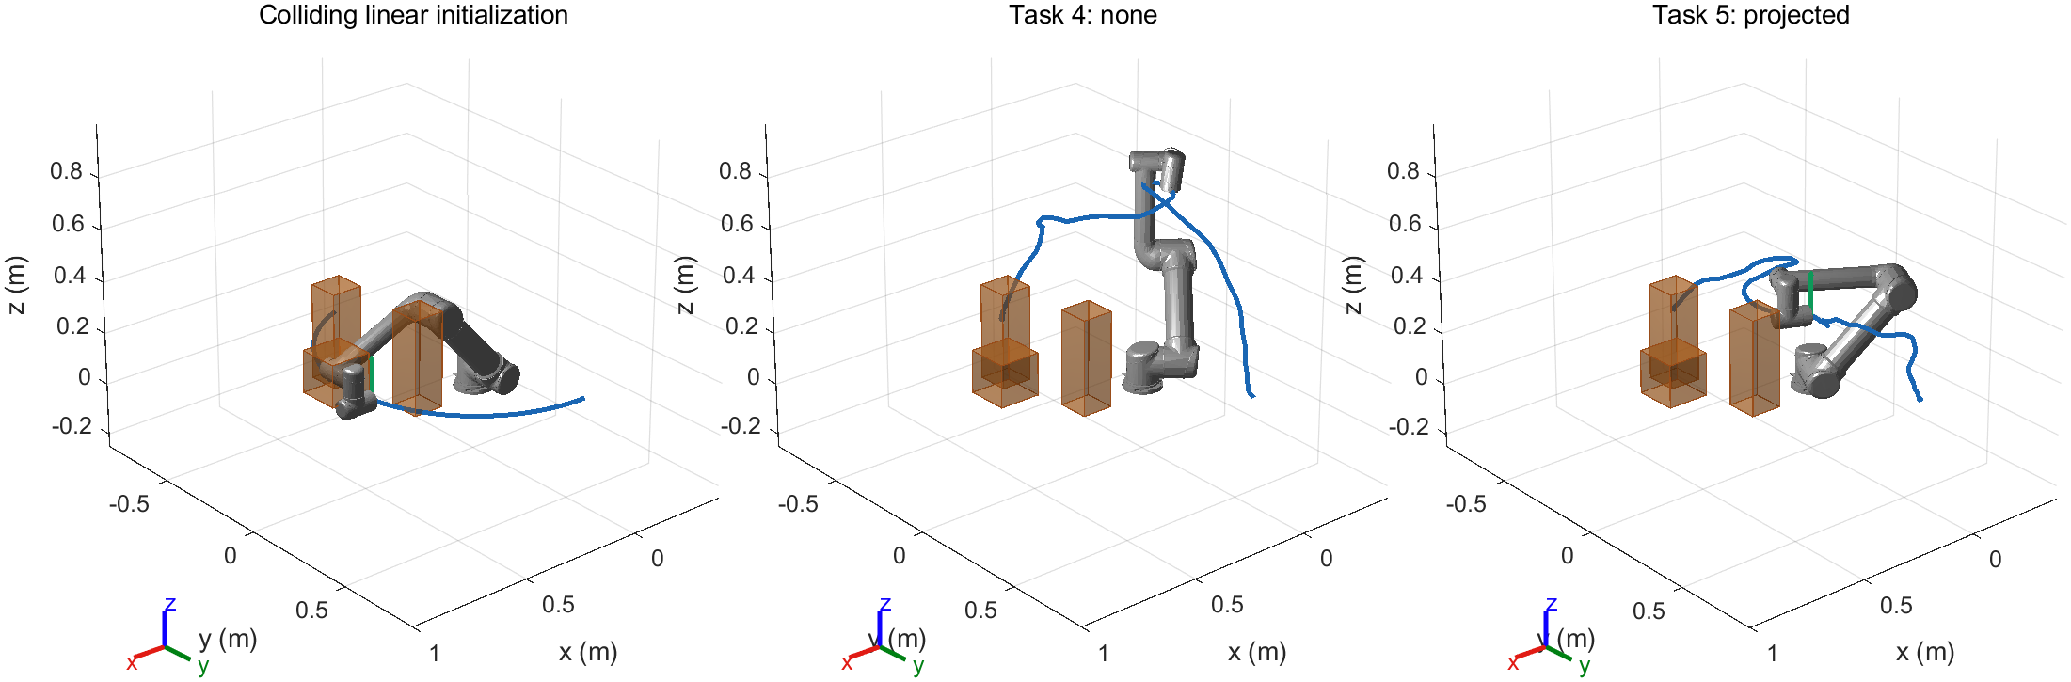
UR5 transfer around three obstacles
Same upright endpoints and colliding linear initialization for both conditions
Development demo: seed 5113; formal results on slide 3
Variant: side pillars move inward 40 mm; right pillar becomes taller
Notes:
这一页说明场景和对照设计。主场景包含中央方块和两侧错列障碍；变体压缩侧向空间。两组使用完全相同的直立端点，必须从有碰撞的关节线性插值开始。设计时的可行性参考路径没有提供给优化器。
Sources: docs/TASK45_METHODS.md; demos/main/*/seed_*/input_checkpoint.mat

Slide 2
Upright constraint and acceptance
Tool y axis aligned with world +z; free rotation about that axis
J_ori = lambda sum_t ||R(q_t)e_y - e_z||_1 Delta s
Selected method: Penalty + PoE Jacobian projection; lambda = 1000
Acceptance: tilt <= 5 deg; conservative clearance >= 35 mm
Fixed endpoints; joint limits; zero world and self collisions
Dense verification: <= 0.0125 rad per joint step; discrete checks
Notes:
姿态要求是工具 y 轴朝向世界正 z，不锁死所有旋转自由度。我们按预定顺序测试罚项权重。最终模式是 projected。若采用投影，必须说明这是对原 STOMP 的工程扩展：使用 PoE 方向 Jacobian、阻尼最小二乘和一度内部目标；失败候选被拒绝。成功标签同时受姿态、间距、端点、限位和实际碰撞检查控制。
Sources: docs/TASK45_METHODS.md; frozen_config.json; matlab/+memberC/projectTrajectory.m

Slide 3
Formal success and uprightness
Scene / condition | Success | Time median (s) | Max tilt median (deg)
main / Task 4 | 10/10 | 9.45 | 108.37
main / Task 5 | 0/10 | 149.18 | -
variant / Task 4 | 10/10 | 8.58 | 117.24
variant / Task 5 | 0/10 | 140.08 | -
Common successful pairs: main: n=0; variant: n=0
Upright check: 20/20 constrained runs; penalty-only ablation: 0/10 successful
Seeds 5120-5129; 50 complete + 1 interrupted. Time: complete cases; tilt: successes.
Notes:
这一页只引用正式实验。成功率分母包括失败运行；规划时间中位数也包含失败。角度中位数仅统计成功运行，因此不能把这列直接当作所有种子的配对比较。真正配对的质量比较只用共同成功种子，并标明样本数。不同姿态权重的总代价不能直接比较。完整结果还包含间距、路径长度、平滑度和失败标签，均能追溯到原始 CSV。如有技术中断，完成的名义运行与全部尝试分母分别列出，中断原记录保留；它不是优化器失败原因的证明。
Sources: formal/study_summary.json; formal/all_runs.csv; attempt_accounting.json; docs/TASK45_RESULTS.md

Slide 4
Member C contribution and limits
Added: obstacle scenes, upright mechanism, unified acceptance
Independent replay, paired experiments, figures and animations
Reused: Task 1-3 PoE model, sphere envelopes and STOMP stages
Limits: self collision is enforced only at acceptance
Discrete checks; finite seed sample; no payload or dynamics
Animation progress is a path parameter, not physical time
Reproduce: run_task45 | run_task45_benchmark | verify_task45
Notes:
贡献边界要讲清楚：队友已经完成 PoE、球包络和原始 STOMP 计算阶段；我们新增的是 Task 4-5 场景、直立机制、统一验收、独立复核、配对实验和交付材料。验证是离散加密检查，不是连续安全证明。动画没有动力学时间含义，也没有对杯子或其他载荷建模。所有正式失败保留，不能只展示成功演示。
Sources: docs/TASK45_METHODS.md; independent_audit.json; demos/exports/export_manifest.json

