Slide 1
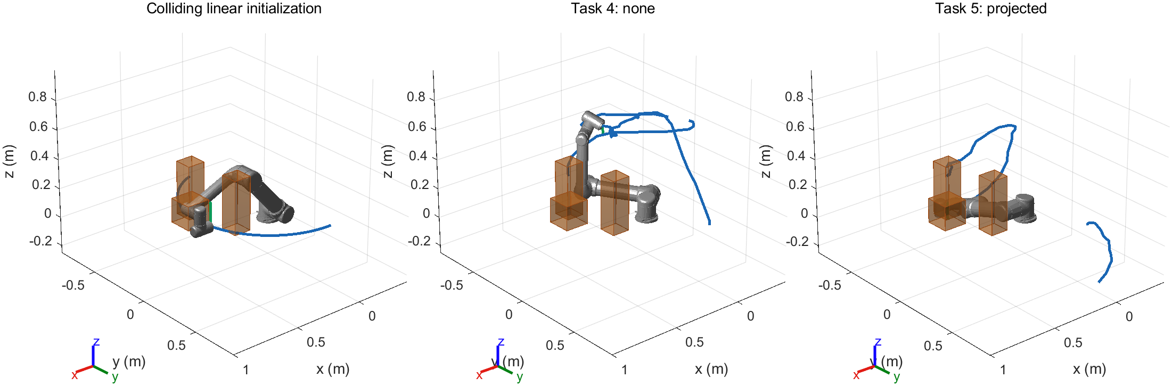
UR5 multi-obstacle transfer
Same upright endpoints and colliding linear initialization
Variant: side pillars move inward 40 mm and the right pillar becomes taller
Notes:
主场景包含中央方块和两根错列立柱，变体压缩侧向空间。两组端点、初始化、场景和计算预算相同。参考可行路径只用于场景设计，没有作为规划器的初始化或输出。Task 4 允许倾斜，Task 5 要求工具 y 轴直立。
Sources: V2 demos/*/*/seed_*/input_checkpoint.mat; frozen_config.json

Slide 2
Self-collision handling in V2
V1: all 20 projected paths were upright, but all self-collided
Tool y aligned with world +z, with yaw free.
V1 omitted self-collision from its objective.
V2: self-collision penalty and actual mesh rejection during updates
Feasible candidates take priority over lower cost.
Task 5 retains the PoE direction projection and orientation penalty.
Final gates: tilt <= 5 deg, proxy gap >= 35 mm, zero world and self collisions
Notes:
V1 正式实验 0/20 的直接原因是自碰撞，不是直立误差超限。原代价缺少自碰撞，投影只能控制方向。V2 在两组中同时加入自碰撞软代价和实际网格筛选，并允许可行候选以较高代价被接受。胶囊可能保守重叠，软目标按端点间距校准，最终网格验收条件完全不变。重启种子间隔改为十万，避免原版相邻种子复用随机流。
Sources: docs/TASK5_V1_FAILURE_ANALYSIS.md; upgrades/task45_v2/matlab/+memberC/plan.m; stompTrajCost.m

Slide 3
Fresh formal results
Scene / mode | Success | Median time (s) | Median max tilt (deg)
main / Task 4 | 10/10 | 30.53 | 126.55
main / Task 5 | 10/10 | 52.46 | 0.93
main / penalty only | 0/10 | 301.48 | -
variant / Task 4 | 10/10 | 29.83 | 134.52
variant / Task 5 | 10/10 | 48.44 | 0.95
Common successful pairs: main n=10, variant n=10
Task 5 upright: 20/20. Self-collision failures: 0/20.
Fresh seeds 5200-5209. All failures counted. Time includes failures, tilt uses successes.
Notes:
这页只展示冻结后使用全新种子的正式结果。所有失败都进入成功率和耗时统计，倾角质量列只统计成功路径。两套场景的配对质量比较只使用共同成功种子，并显示样本数。V1 与 V2 用的是不同种子集，因此只报告描述性的成功数变化，不宣称跨版本显著性或速度提升。
Sources: formal/study_summary.json; formal/all_runs.csv; formal/independent_audit.json

Slide 4
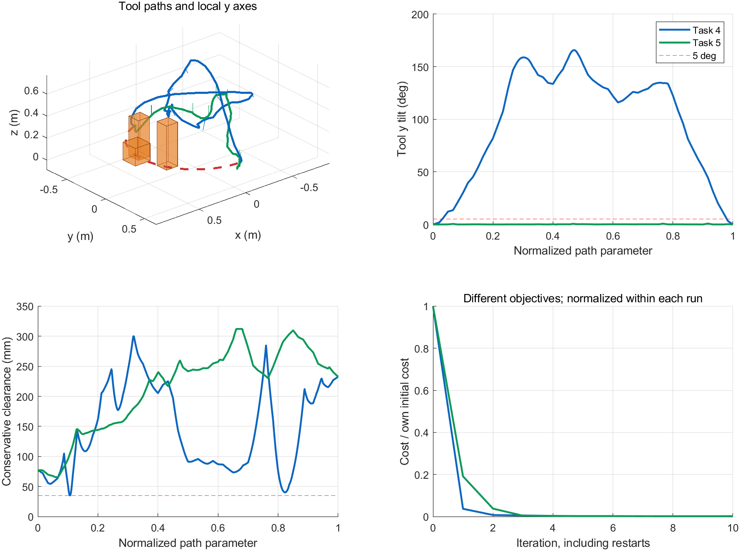
Member C contribution and limits
Added
Scenes, upright constraint, self-aware updates, fresh-seed study and replay
Reused
Task 1-3 PoE model, sphere envelopes and STOMP stages
Limits
Discrete checks, finite seeds, no payload or dynamics
Run: addpath scripts; run_task45_v2(...) Verify: verify_task45_v2(runRoot)
Notes:
我们的贡献是 Task 4-5 多障碍场景、直立约束、自碰撞感知更新、独立复核、正式配对实验和交付材料。队友的 PoE、球包络及原 STOMP 阶段继续复用。验证属于加密离散检查，不是连续碰撞证明。动画展示路径进度，不代表机械臂执行时间，也没有杯子载荷或动力学模型。原 V1 失败数据保留，新的成功结果没有覆盖旧证据。
Sources: V2 demos/exports/variant/paired_comparison.fig; formal/independent_audit.json; docs/TASK45_V2_RESULTS.md

