Slide 1
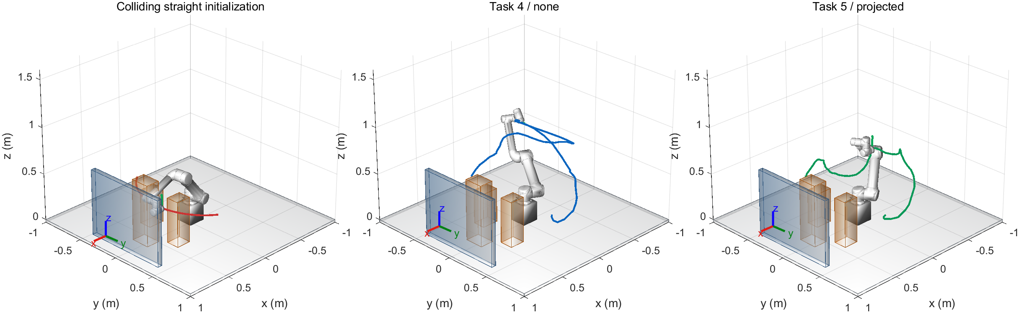
Task 4: a mounted UR5 workcell
92 / 181
initial states collide
Same endpoints and straight initialization for both tasks
1
Notes:
主讲约35秒。For Task 4, I built a more challenging UR5 workcell on top of our team's STOMP and PoE implementation. The robot stands on a twenty-centimetre pedestal above a table. A central rack, two equipment boxes and a rear guard obstruct the transfer. Both endpoints are valid, but the shared straight joint-space initialization collides at ninety-two of one hundred and eighty-one checked states. The feasible reference path was kept separate and never used to initialize the planner.
中文：展示非平凡初值。五个环境体积包括桌面；安装底座属于机器人模型。参考路径仅用于可行性证明。
Sources: docs/TASK45_V3_RESULTS.md; artifacts/runs/task45_v3/geometry_probe.json; demos/exports/workcell/initial_and_planned.fig

Slide 2
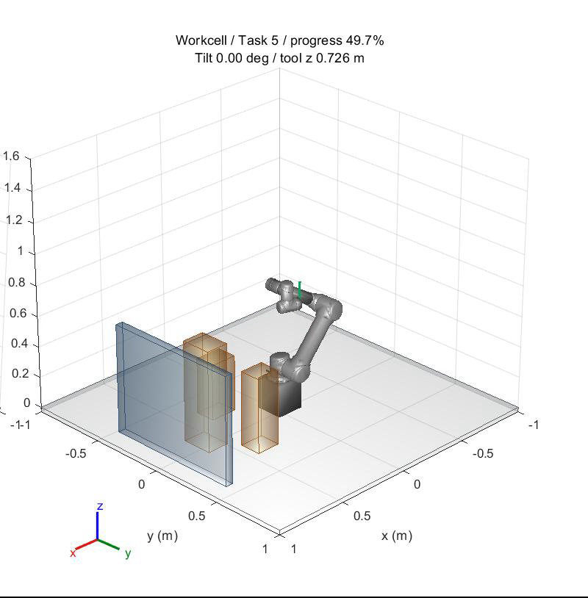
Task 5: upright tool direction
Tool y aligns with world +z
Yaw remains free
Direction penalty, lambda = 1000
Damped Jacobian projection
Self-collision cost and rejection
Maximum accepted tilt: 5 degrees
Conservative clearance: 35 mm
Click video to play / 10 s
2
Notes:
主讲约45秒，包含10秒视频。For Task 5, I keep the same scene, endpoints and base planning settings. The tool's y-axis must follow the world's positive z-axis, while yaw remains free. I add an orientation penalty and use a damped Jacobian projection to correct sampled waypoints and proposed updates. Projection only corrects orientation, so I also add self-collision costs and reject invalid candidates. Final acceptance checks the dense path for joint limits, unchanged endpoints, world and self collisions, and a thirty-five-millimetre conservative clearance. Task 5 additionally requires at most five degrees of tilt.
中文：单击视频。投影不保证碰撞可行，端点、限位、世界和自碰撞仍需独立验收。5度和35毫米为自定标准。
Sources: upgrades/task45_v3/matlab/+memberC/projectTrajectory.m; directionJacobian.m; validatePath.m; V3 demo Task5 seed5300

Slide 3
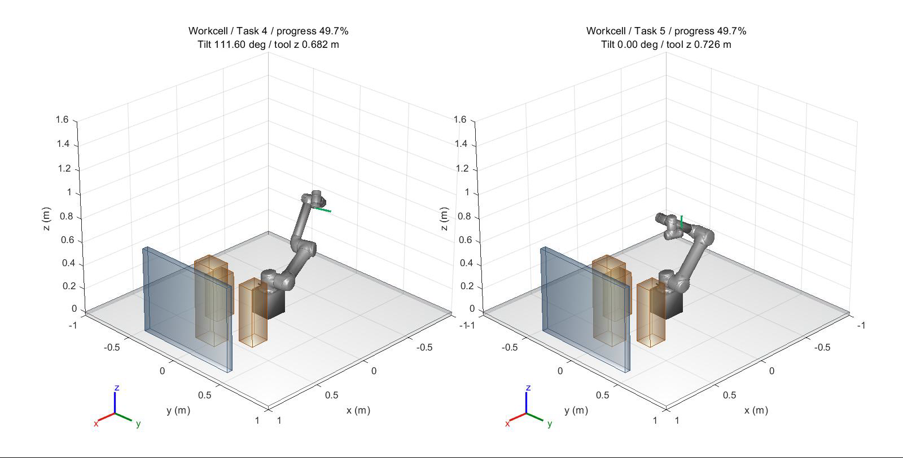
Same problem, different tool orientation
Demo maximum tilt: 120.29 degrees (Task 4) / 0.930 degrees (Task 5)
Seed 5300. Normalized path progress, without an execution-time model.
3
Notes:
主讲约35秒，包含10秒视频。This paired demonstration uses the same development seed. The blue Task 4 path avoids obstacles but allows the tool to tilt. The green Task 5 path also avoids obstacles and remains upright. The maximum tilt in this demonstration changes from about one hundred and twenty degrees to less than one degree. Both videos show normalized path progress, rather than physical execution time. This is a visual example; the next slide summarizes all held-out runs.
中文：演示种子5300在开发阶段确定。这里的最大角不是正式样本最坏值。两边的播放进度同步不代表机器人执行速度。
Sources: artifacts/runs/task45_v3/demos/workcell/Task4/seed_5300/summary.json; Task5/seed_5300/summary.json; paired_motion.avi

Slide 4
Held-out results and contribution
Condition | Success | Median time (s) | Worst tilt (deg) | Min proxy gap (mm)
Task 4 | 20/20 | 30.42 | 169.591 | 35.41
Task 5 | 20/20 | 68.19 | 0.997 | 35.23
20 paired seeds. Every successful path also passes the 0.00625 rad check.
My contribution: scene, upright projection, self-collision handling,
paired experiments and independent verification.
V4/V5 extensions in backup slides. Discrete geometry checks; no payload dynamics.
4
Notes:
主讲约45秒。We then froze the configuration and evaluated twenty held-out paired seeds. Both tasks succeeded in all twenty runs. The worst Task 5 tilt was about zero point nine nine seven degrees, with at least thirty-five point two three millimetres of conservative clearance. The upright condition required more computation. My contribution includes the workcell, upright projection, self-collision handling and independent replay validation. I also evaluated feasible refinement and tangent sampling. The later adaptive sampler had fewer successes, so I kept it experimental. These results are dense geometric checks, without payload dynamics or a continuous collision guarantee.
中文：正式种子5400–5419，开发5300–5302。时间包含写盘，双进程共享机器。Q只在相同定义内比较。额外加密极值用于本表。
Sources: V3 formal/study_summary.json; fine_validation.json; formal_audit.json; docs/TASK45_V3_RESULTS.md

Slide 5
Project overview: Tasks 1 to 5
Task | What changes | Evidence
1 | Complete KINOVA STOMP | Original scene, collision-free animation
2 | Replace KINOVA with UR5 | UR5 planning under the same framework
3 | Replace planning FK with PoE | All-body accuracy and timing comparison
4 | Design a harder UR5 workcell | Colliding initialization and planned route
5 | Keep the tool direction upright | Same-problem constrained comparison
Reuse the team baseline. Member C adds Tasks 4–5 and the later ablations.
5
Notes:
备份。五项任务的递进关系：功能补全、换机器人、换FK、换复杂场景、加方向约束。具体三人姓名按组内确认填写，不能从函数名推断所有贡献归属。
Sources: ../EE5112_Project-2_AY26-27.pdf pp.1–2; docs/HANDOFF_MEMBER_C.md; docs/METHODS.md

Slide 6
STOMP iteration in this implementation
Stage | Operation | Relevant function
Sample | Correlated, antithetic perturbations | stompSamples
Evaluate | World / self / direction / smoothness | stompTrajCost
Weight | Lower local cost gets higher probability | stompUpdateProb
Update | Weighted actual noise, then smoothing | stompDTheta / stompUpdateTheta
Accept | Limits, projection and feasibility gates | memberC.plan / validatePath
Optimize internal waypoints. Keep the endpoints fixed. No global-optimality guarantee.
6
Notes:
备份。先解释Θ为6×61。采样具有路点相关性，概率逐路点归一化，限位/投影后重新计算实际扰动。候选比验收通过还差一步，不能只凭总代价下降声明成功。
Sources: matlab/stompSamples.m; stompUpdateProb.m; stompDTheta.m; stompUpdateTheta.m; upgrades/task45_v3/matlab/+memberC/plan.m

Slide 7
PoE forward kinematics
S = [a; -a cross p]
T(q) = exp([S1]q1) ... exp([Sn]qn) M
Check | Saved Task 3 baseline
All-body position error | 6.65e-16 m over 200 configurations
Task 2 vs Task 3 path difference | 0 rad in the fixed-seed run
Same all-body workload speed ratio | 22.85x (original Linux machine)
Cache screws and prefixes once. Timing depends on machine and workload.
7
Notes:
备份。a与p必须统一到空间坐标；q=0的M不同于非零home。固定body不占活动关节变量。原机器22.85倍，本机Windows27.22倍，不能混用。规划代价PoE链不含getTransform，但独立验证/显示可使用MATLAB模型。
Sources: docs/METHODS.md; docs/VALIDATION.md; artifacts/runs/final_r2023b/Task3/fk_accuracy.csv; fk_benchmark.csv

Slide 8
Direction constraint and projection
y(q) = R(q) e_y
Tilt = acos(clamp(y(q).T e_z, -1, 1))
J_y(:,i) = omega_i cross y
delta_q = J_y.T (J_y J_y.T + mu^2 I)^(-1) (e_z - y)
Projection setting | Value
Damping / internal tolerance | 0.001 / 1 degree
Steps / component update cap | 20 / 0.15 rad
Final dense tilt tolerance | 5 degrees
8
Notes:
备份。单方向通常为2个独立约束，yaw自由。反向时使用确定性正交修正。投影只改内部点，保持限位；失败候选不参与接受。投影后的路径仍需世界/自碰撞检查。
Sources: upgrades/task45_v3/matlab/+memberC/directionJacobian.m; projectTrajectory.m; validatePath.m

Slide 9
What changed across the iterations
Version | Main change | Observed result
V1 | Penalty + direction projection | Projected Task 5: 0/20, self collisions
V2 | Self-collision handling, feasible incumbent | Task 5: 20/20 across two cases
V3 | Mounted table workcell | Task 4 and Task 5: 20/20 each
V4 | Feasible refinement + tangent sampling | Four arms: 10/10 each
V5 | Energy control + adaptive ablation | 71/75, four margin failures
Different scenes and seeds prevent causal cross-version speed claims.
9
Notes:
备份。V1不是姿态失败而是自碰撞。V3补足桌面与安装合理性。V4/V5的baseline与ambient本身已是Task5约束组。旧版本和失败继续保留。
Sources: docs/TASK5_V1_FAILURE_ANALYSIS.md; docs/TASK45_V2_RESULTS.md; TASK45_V3_RESULTS.md; TASK45_V4_RESULTS.md; TASK45_V5_RESULTS.md

Slide 10
V4: refinement and tangent sampling
Task 5 arm | Success | Median time (s) | Median final Q
baseline | 10/10 | 49.96 | 10.15
anytime | 10/10 | 94.94 | 9.88
tangent | 10/10 | 39.88 | 9.76
combined | 10/10 | 89.12 | 9.39
Combined vs baseline: median paired Q reduction 15.36% (n=10)
7 wins, 3 losses. Median paired extra time: 37.77 s.
Q = joint length + 5 x smoothness + soft 45 mm clearance preference
10
Notes:
备份。四组都是Task5。anytime只优化自己的可行incumbent，Q严格下降且每次通过验收。75%切空间+25%普通采样仍经过非线性投影。15.36%为十个配对比例中位数，不是两组中位数相除。
Sources: docs/TASK45_V4_RESULTS.md; artifacts/runs/task45_v4/study_summary.json; upgrades/task45_v4/matlab/+memberC/qualityCost.m

Slide 11
V5: three cases, five sampling strategies
Task 5 arm | Workcell | Endpoints | Layout | Time (s) | Final Q
ambient | 4/5 | 5/5 | 5/5 | 103.57 | 8.64
energy_control | 5/5 | 5/5 | 5/5 | 92.94 | 8.78
fixed50 | 5/5 | 4/5 | 5/5 | 151.12 | 9.04
fixed75 | 5/5 | 5/5 | 5/5 | 90.80 | 9.03
adaptive | 4/5 | 4/5 | 5/5 | 98.86 | 8.39
Fixed75: 15/15. Adaptive: 13/15. Keep adaptive experimental.
Time uses all runs. Q uses successes. Adaptive vs fixed75: 4.60% paired Q reduction, n=13.
11
Notes:
备份。冻结后5800–5804，每场景每组5次。Q只对共同成功配对比较。adaptive与fixed50的对照才隔离反馈，二者refinement都固定50%。n=5很小，不能确立普遍可靠性排名。
Sources: docs/TASK45_V5_RESULTS.md; artifacts/runs/task45_v5/study_summary.json; formal/**/summary.json

Slide 12
Four V5 failures miss the clearance gate
Case / arm / seed | Proxy gap (mm) | Tilt (deg)
workcell / ambient / 5800 | 30.13 | 0.152
workcell / adaptive / 5801 | 30.42 | 0.511
endpoints / fixed50 / 5800 | 34.22 | 0.083
endpoints / adaptive / 5801 | 33.53 | 0.858
Required conservative gap: 35 mm. All four tilts are below 1 degree.
Soft-cost feedback can disagree with dense feasibility.
This is a plausible mechanism, without causal proof from these runs.
12
Notes:
备份。直接失败分类均proxy_margin，与V1的self_collision不同。有限预算/局部非凸搜索是机制背景，不能声称控制器震荡已被证明导致失败，也不能把保守余量失败直接说成实际撞障碍。
Sources: docs/TASK45_V5_RESULTS.md; V5 formalFailures; formal_audit.json

Slide 13
Energy control isolates a sampling effect
Sampler | Pre RMS (rad) | Post RMS (rad) | Corrections / point
ambient | 0.3761 | 0.3417 | 2.6578
energy control | 0.3371 | 0.3051 | 2.3019
fixed75 | 0.3371 | 0.3273 | 0.7119
Fixed75 vs control: median correction reduction 68.04%
Match scalar input norm before nonlinear projection.
30 paired batches reuse five seeds over six central paths.
Formal planning shows no consistent Q advantage over the energy control.
13
Notes:
备份。这不是等协方差/投影后等方差。最大标量能量差3.55e-14 rad²。修正步数少不自动等于整体规划更快或更优。正式fixed75相对energy_control配对Q中位数-0.31%，7胜8负。
Sources: docs/TASK45_V5_METHODS_ZH.md; V5 sampling_ablation.json; sampling_ablation_audit.json; study_summary.json

Slide 14
Demo profiles from the saved dense paths
Development seed 5300. Native charts retain the full saved CSV data.
14
Notes:
备份。这里是演示路径的nominal dense CSV，正式表使用额外fine check。原始数据完整保存在图表内嵌工作簿，横轴为归一化路径进度。红线分别为5度/35毫米门槛。
Sources: artifacts/runs/task45_v3/demos/workcell/Task4/seed_5300/dense_validation.csv; Task5/seed_5300/dense_validation.csv

Slide 15
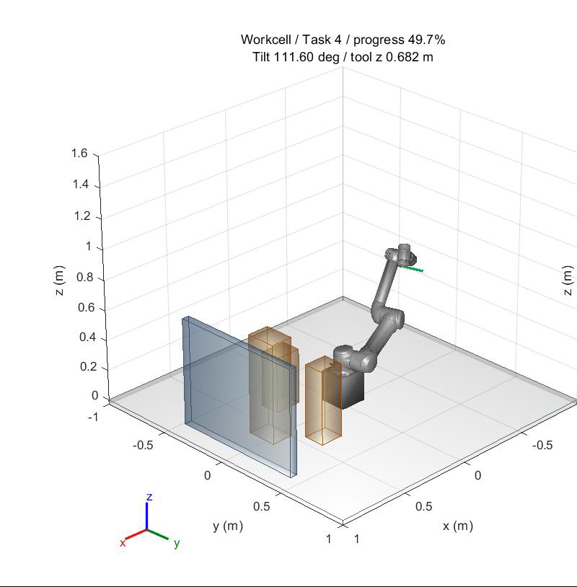
Task 4 standalone motion
World and self-collision checks pass.
Tool orientation remains free.
Demo maximum tilt: 120.29 degrees.
Click video / 10 s
Same seed, endpoints and workcell as the main comparison.
15
Notes:
备份。单独播放Task4。通过碰撞验收并不代表保持直立。该图不含执行时间或杯子模型。
Sources: V3 demos/workcell/Task4/seed_5300/summary.json; task4_motion.avi

Slide 16
Evidence, contribution and remaining limits
Evidence | Scope
V3 formal / demo replay | 40 paths, 804 checkpoints / 2 paths, 20 checkpoints
V4 formal replay | 40 paths, 1365 checkpoints
V5 formal replay | 75 paths, 3005 checkpoints
Finer geometric check | Successful final paths at 0.00625 rad joint increments
Member C: workcell, upright and self-collision extensions,
controlled experiments, independent verification and delivery.
Discrete checks only. No payload geometry, dynamics, hardware execution or global guarantee.
16
Notes:
备份。NumPy验证FK而非碰撞。Git compact正式数据只支持最终路径复核，完整formal随机记录在本机。保留所有失败和旧版本。下一步优先完成全组报告/贡献/总时长整合，不再启动算法版本。
Sources: V3/V4/V5 formal_audit.json; fine_validation.json; README_TASK45_V5.md; docs/TASK45_V5_RESULTS.md

