Slide 1
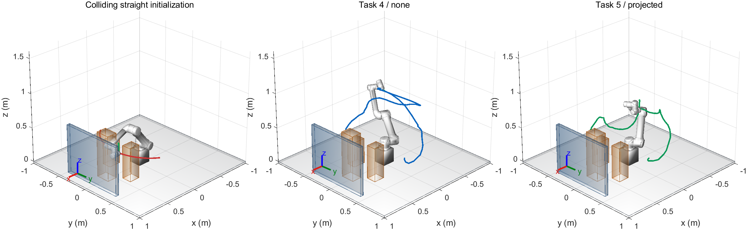
Task 4: a mounted UR5 workcell
92 / 181
initial states collide
Same endpoints and straight initialization for both tasks
1
Notes:
主讲约35秒。For Task 4, I built a more challenging UR5 workcell on top of our team's STOMP and PoE implementation. The robot stands on a twenty-centimetre pedestal above a table. A central rack, two equipment boxes and a rear guard obstruct the transfer. Both endpoints are valid, but the shared straight joint-space initialization collides at ninety-two of one hundred and eighty-one checked states. The feasible reference path was kept separate and never used to initialize the planner.
中文：展示非平凡初值。五个环境体积包括桌面；安装底座属于机器人模型。参考路径仅用于可行性证明。
Sources: docs/TASK45_V3_RESULTS.md; artifacts/runs/task45_v3/geometry_probe.json; demos/exports/workcell/initial_and_planned.fig

Slide 2
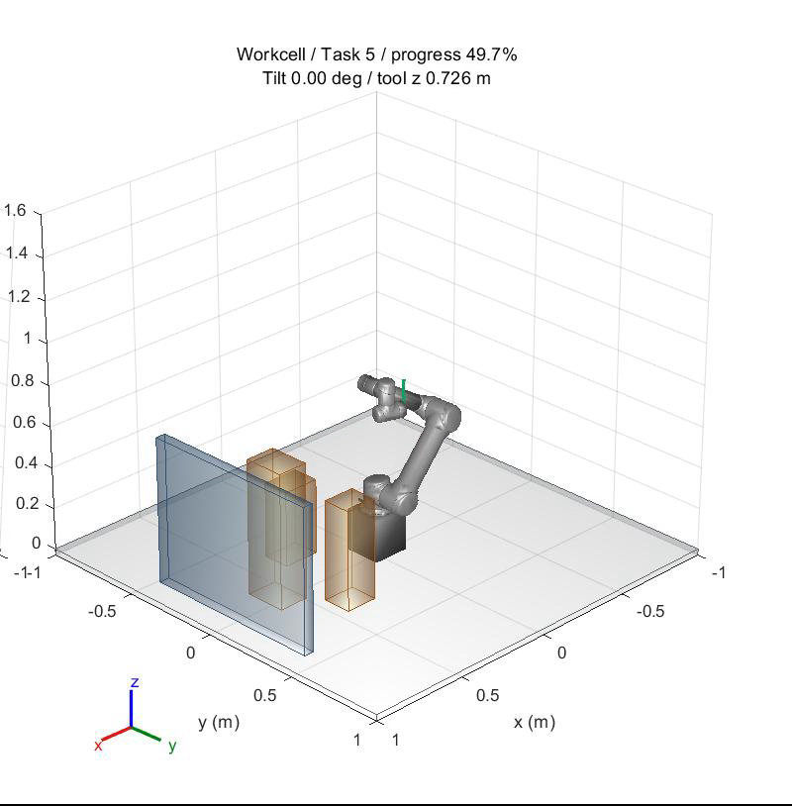
Task 5: upright tool direction
Tool y aligns with world +z
Yaw remains free
Direction penalty, lambda = 1000
Damped Jacobian projection
Self-collision cost and rejection
Maximum accepted tilt: 5 degrees
Conservative clearance: 35 mm
Click video to play / 10 s
2
Notes:
主讲约45秒，包含10秒视频。For Task 5, I keep the same scene, endpoints and base planning settings. The tool's y-axis must follow the world's positive z-axis, while yaw remains free. I add an orientation penalty and use a damped Jacobian projection to correct sampled waypoints and proposed updates. Projection only corrects orientation, so I also add self-collision costs and reject invalid candidates. Final acceptance checks the dense path for joint limits, unchanged endpoints, world and self collisions, and a thirty-five-millimetre conservative clearance. Task 5 additionally requires at most five degrees of tilt.
中文：单击视频。投影不保证碰撞可行，端点、限位、世界和自碰撞仍需独立验收。5度和35毫米为自定标准。
Sources: upgrades/task45_v3/matlab/+memberC/projectTrajectory.m; directionJacobian.m; validatePath.m; V3 demo Task5 seed5300

Slide 3
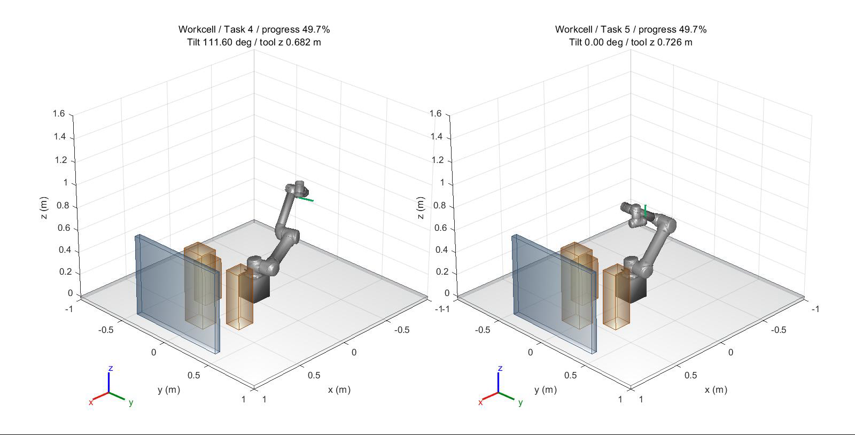
Same problem, different tool orientation
Demo maximum tilt: 120.29 degrees (Task 4) / 0.930 degrees (Task 5)
Seed 5300. Normalized path progress, without an execution-time model.
3
Notes:
主讲约35秒，包含10秒视频。This paired demonstration uses the same development seed. The blue Task 4 path avoids obstacles but allows the tool to tilt. The green Task 5 path also avoids obstacles and remains upright. The maximum tilt in this demonstration changes from about one hundred and twenty degrees to less than one degree. Both videos show normalized path progress, rather than physical execution time. This is a visual example; the next slide summarizes all held-out runs.
中文：演示种子5300在开发阶段确定。这里的最大角不是正式样本最坏值。两边的播放进度同步不代表机器人执行速度。
Sources: artifacts/runs/task45_v3/demos/workcell/Task4/seed_5300/summary.json; Task5/seed_5300/summary.json; paired_motion.avi

Slide 4
Held-out results and contribution
Condition | Success | Median time (s) | Worst tilt (deg) | Min proxy gap (mm)
Task 4 | 20/20 | 30.42 | 169.591 | 35.41
Task 5 | 20/20 | 68.19 | 0.997 | 35.23
20 paired seeds. Every successful path also passes the 0.00625 rad check.
My contribution: scene, upright projection, self-collision handling,
paired experiments and independent verification.
V4/V5 extensions in backup slides. Discrete geometry checks; no payload dynamics.
4
Notes:
主讲约45秒。We then froze the configuration and evaluated twenty held-out paired seeds. Both tasks succeeded in all twenty runs. The worst Task 5 tilt was about zero point nine nine seven degrees, with at least thirty-five point two three millimetres of conservative clearance. The upright condition required more computation. My contribution includes the workcell, upright projection, self-collision handling and independent replay validation. I also evaluated feasible refinement and tangent sampling. The later adaptive sampler had fewer successes, so I kept it experimental. These results are dense geometric checks, without payload dynamics or a continuous collision guarantee.
中文：正式种子5400–5419，开发5300–5302。时间包含写盘，双进程共享机器。Q只在相同定义内比较。额外加密极值用于本表。
Sources: V3 formal/study_summary.json; fine_validation.json; formal_audit.json; docs/TASK45_V3_RESULTS.md

