Slide 1
Session Topic
PHP
Object Oriented Programming

Slide 2
PHP History
PHP is a successor to a product named PHP/FI. Created in 1994 by Rasmus Lerdorf written with C
PHP/FI = Personal Home Page Tools/Forms Interpreter
June of 1995, Rasmus released the source code for PHP Tools to the public.
Andi Gutmans and Zeev Suraski of Tel Aviv, Israel and Resmus do collaboration and developed Hypertext Preprocessor 1997
PHP 3 released on 1998 (OOP introduced)

Slide 3
PHP History
PHP 4 released on 2000 (Zend Engine Added)
The Zend Engine provides memory and resource management, and other standard services for the PHP language
http://www.zend.com/products/zend_engine/in_depth
PHP 5 released on 2004
PHP 6 (Not released, Most Covered in 5.3 & 5.4)
PHP 7 released on 2015
http://php.net/manual/en/history.php.php

Slide 4
What is this?
Data structure with data types and operations.
OOP Features
Abstraction
Encapsulation
Inheritance
Polymorphism

Slide 5
Abstraction
Its main goal is to handle complexity by hiding unnecessary details from the user
a programmer hides all but the relevant data about an object in order to reduce complexity and increase efficiency
Coffee Maker
Account Software Return Salary

Slide 6
Encapsulation
Wrapping up data member and method together into a single unit (i.e. Class)
Encapsulation is like your bag in which you can keep your pen, book etc
Encapsulation is a technique used to protect the information in an object from the other object.

Slide 7
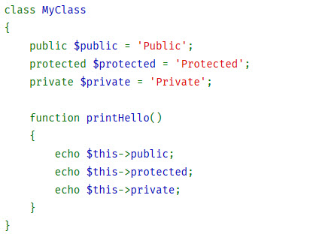
Encapsulation

Slide 8
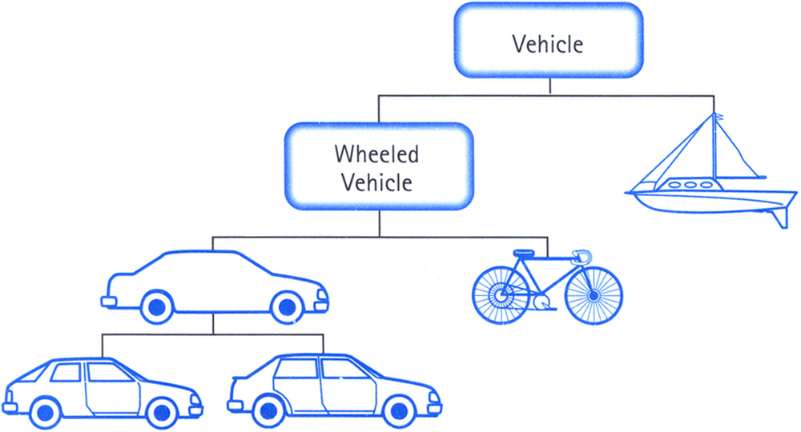
Inheritance
Inheritance is the mechanism by which an object acquires the some/all properties of another object.

Slide 9
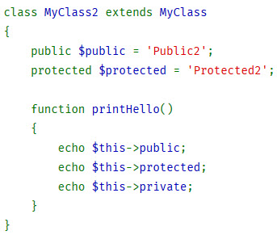
Inheritance

Slide 10
Polymorphism
According to the Polymorphism principle, methods in different classes that do similar things should have the same name.
Example: Vehicle Gear 1,2,3,4,back

Slide 11
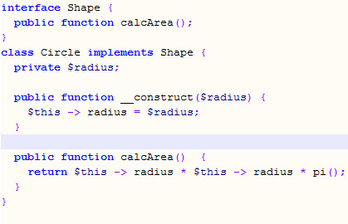
Polymorphism

Slide 12
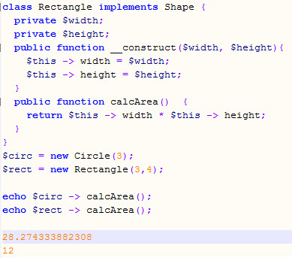
Polymorphism

Slide 13
Polymorphism
Overloading
  Static, Compilation time
Overriding
  Dynamic, Runtime

Slide 14
Overloading
Overloading in PHP provides means to dynamically "create" properties and methods
The overloading methods are invoked when interacting with properties or methods that have not been declared or are not visible in the current scope
PHP's interpretation of "overloading" is different than most object oriented languages
All overloading methods must be defined as public

Slide 15
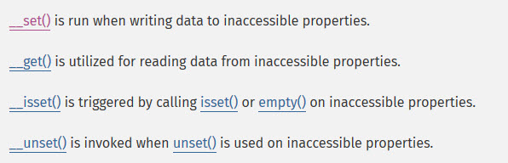
Property overloading

Slide 16

Method overloading

Slide 17
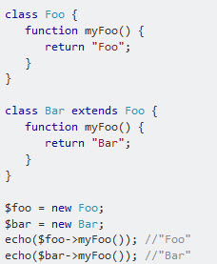
Overriding

Slide 18
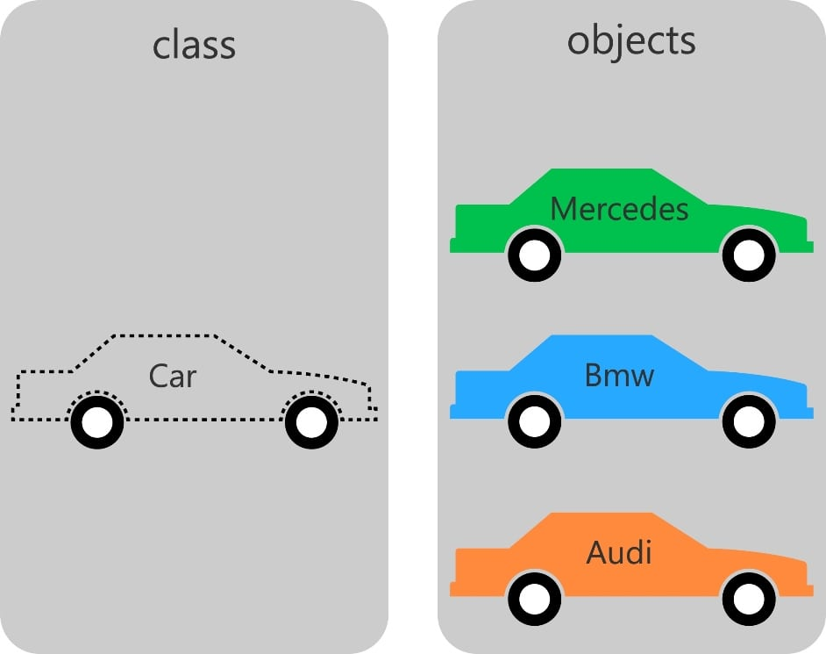
OOP Basic
Class
  Properties
  Methods
Object

Slide 19
Properties
Public
Protected
Private

Slide 20
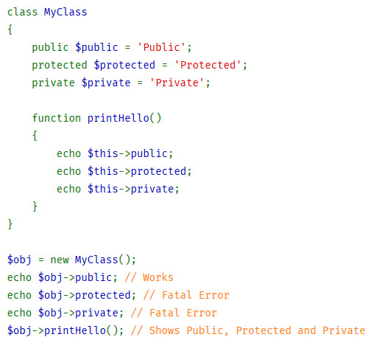
Properties

Slide 21
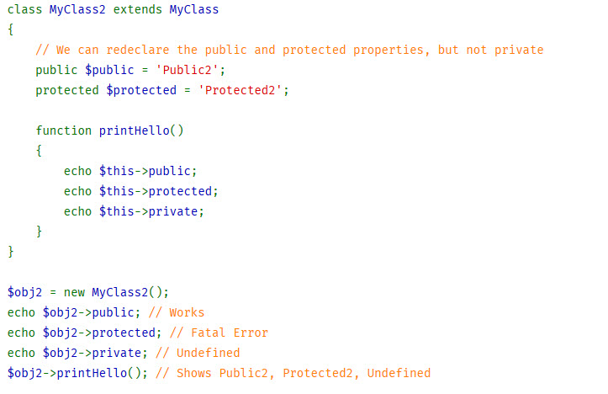
Properties

Slide 22
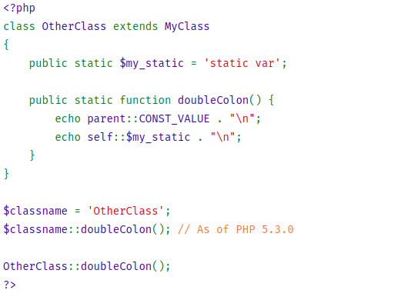
Scope Resolution(::) & Static

Slide 23
Abstract Class
Can not be instantiated
Just Define Method without body
Child class must explain Abstract Method body
Signatures of the methods must match
Method can be defined same or less restriction
Can write normal method with body detail at abstract class

Slide 24
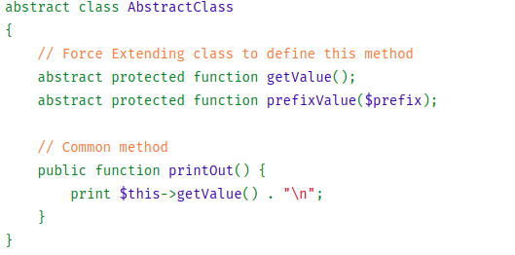

Slide 25
Interfaces
All method must be public
interface keyword replacing the class
Just Method signature without body content
All methods in the interface must be implemented within a class
Class can implement more than one interface.

Slide 26
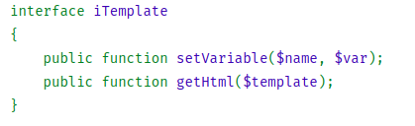

Slide 27
Namespace
Name collisions between code
Ability to alias for long chain of text
Improve readability
Can use classes, interfaces, functions and constants etc under a name space
On PHP 7 > Added Group use Declarations

Slide 28
Traits
PHP 5.4.0, PHP implements a method of code reuse called Traits.
Reduced some limitations of single inheritance
A Trait is similar to a class
Not possible to instantiate a Trait

Slide 29
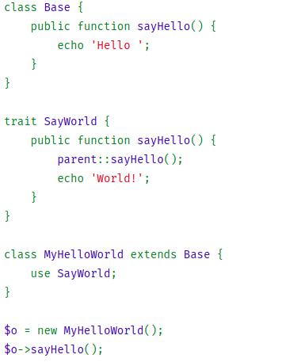

Slide 30
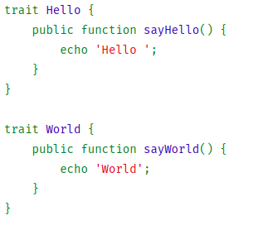
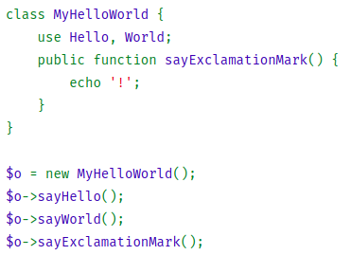
Multiple Trait

Slide 31
Magic Methods
__get()
__set();
__isset();
__construct();
__destruct();

Slide 32
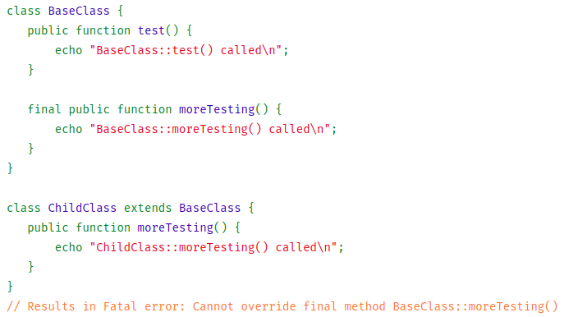
Final Keyword
prevents child classes from overriding a method

Slide 33
Session Ended
Thanks for your valuable presence

