Slide 1

Oil capacity DASHBOARD
By Zi Yen Ler

Slide 2
requirement
Create an initial interactive dashboard prototype based on the dataset provided by the BP Statistical Review of World Energy for analysis.
The dataset should ideally be stored in a data storage solution for rapid querying of the dataset.
The dataset will be used by multiple business users across the different departments in the company.
This is to allow business users to study trends in global demand and supply of energy.

Slide 3
Example dataset
The dataset provides consumption, reserve and production data for oil, gas, coal, nuclear energy, hydroelectricity and renewables (solar, wind, geothermal, biofuels).
The dataset is broken down based on region and countries for historical period till present (1965-present).
The measurement for the different energy type differ e.g. oil uses barrels and tonnes and renewables use Twh and Mtoe.
The data is stored in excel .xls file.

Slide 4
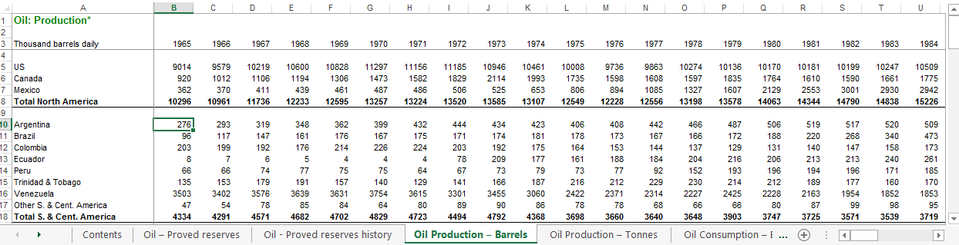
Example dataset

Slide 5
PROPOSED SOLUTION

Slide 6
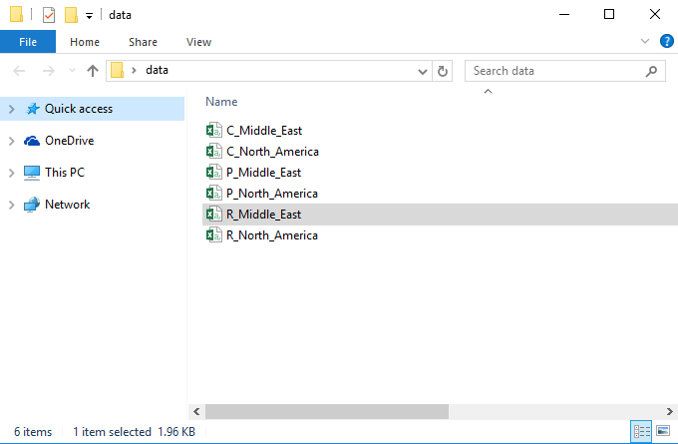
Step 1: transform to input format suitable for ssis

Slide 7
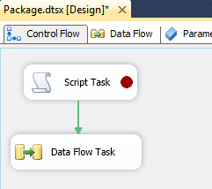
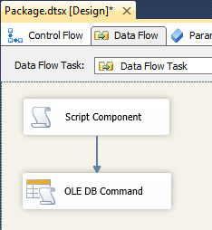
Step 2: execute etl
It consists of three steps:
Script Tasks: The script processes each .csv file and convert them
into Data objects stored in a DataTable structure.
Script Component: The script takes the DataTable structure and
produces the output pipeline buffer.
OLE DB Command: This executes a stored procedure to populate
move the data in the output pipeline buffer to the SQL Server
database.

Slide 8
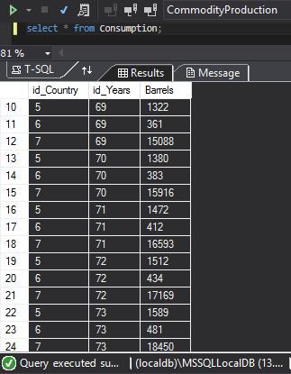
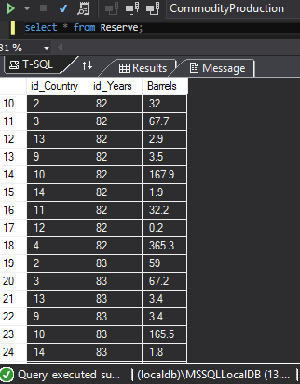
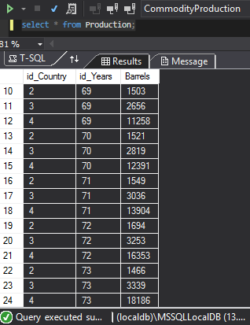

Slide 9
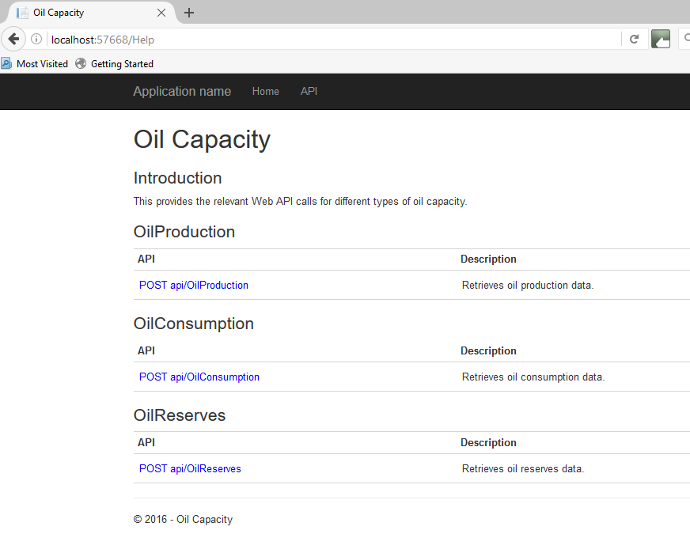
Step 3: data exposed through web api

Slide 10
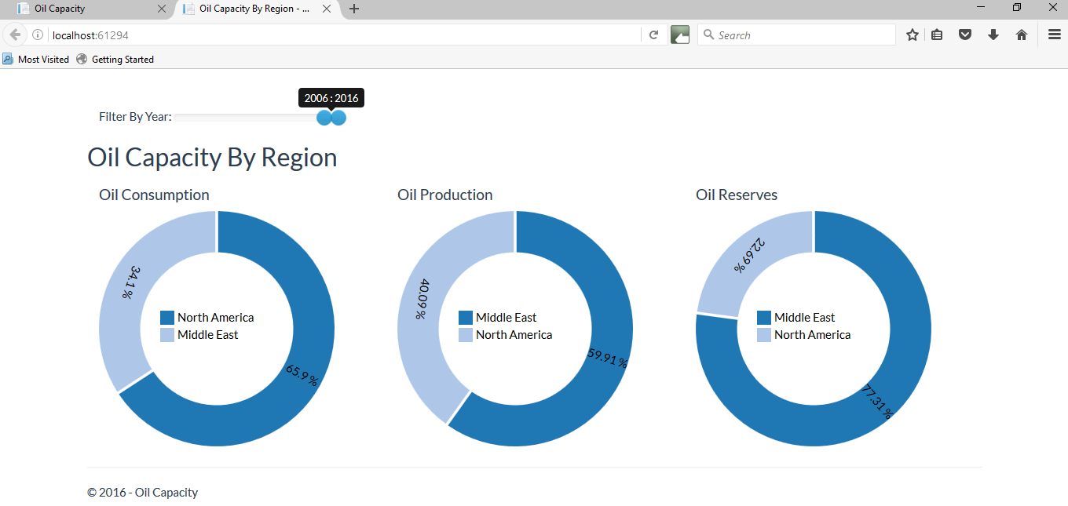
STEP 4: WEB API RETURN REQUEST BASED ON WEB REQUEST FROM DASHBOARD TOOL

Slide 11
Q & a

