Slide 1
YOLOv8: Revolutionizing Car License Plate Detection
A Deep Dive into Computer Vision for Automated License Plate Recognition
Presented by student E72-23 Zuhriddinov Ziyodbek

Slide 2
Table of Contents
01
The Power of YOLOv8
02
YOLOv8 Architecture
03
Data Acquisition and Preprocessing
04
Model Training and Evaluation
05
Deployment and Integration
06
Challenges and Limitations
07
Case Study
08
Future Directions

Slide 3
The Power of YOLOv8
YOLOv8, a state-of-the-art object detection model, offers superior accuracy and speed for various applications.
Accurately identifying license plates in diverse conditions (lighting, angles, obstructions) is complex.
YOLOv8's real-time processing capability surpasses traditional methods in efficiency and precision.
Automated toll collection, parking management, security systems and traffic monitoring benefit from YOLOv8's accuracy.
YOLOv8’s advancements pave the way for smarter, safer, and more efficient transportation systems.

Slide 4
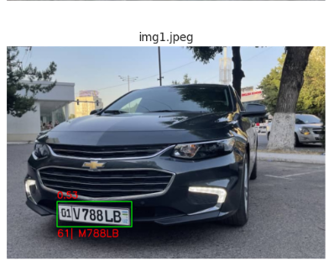
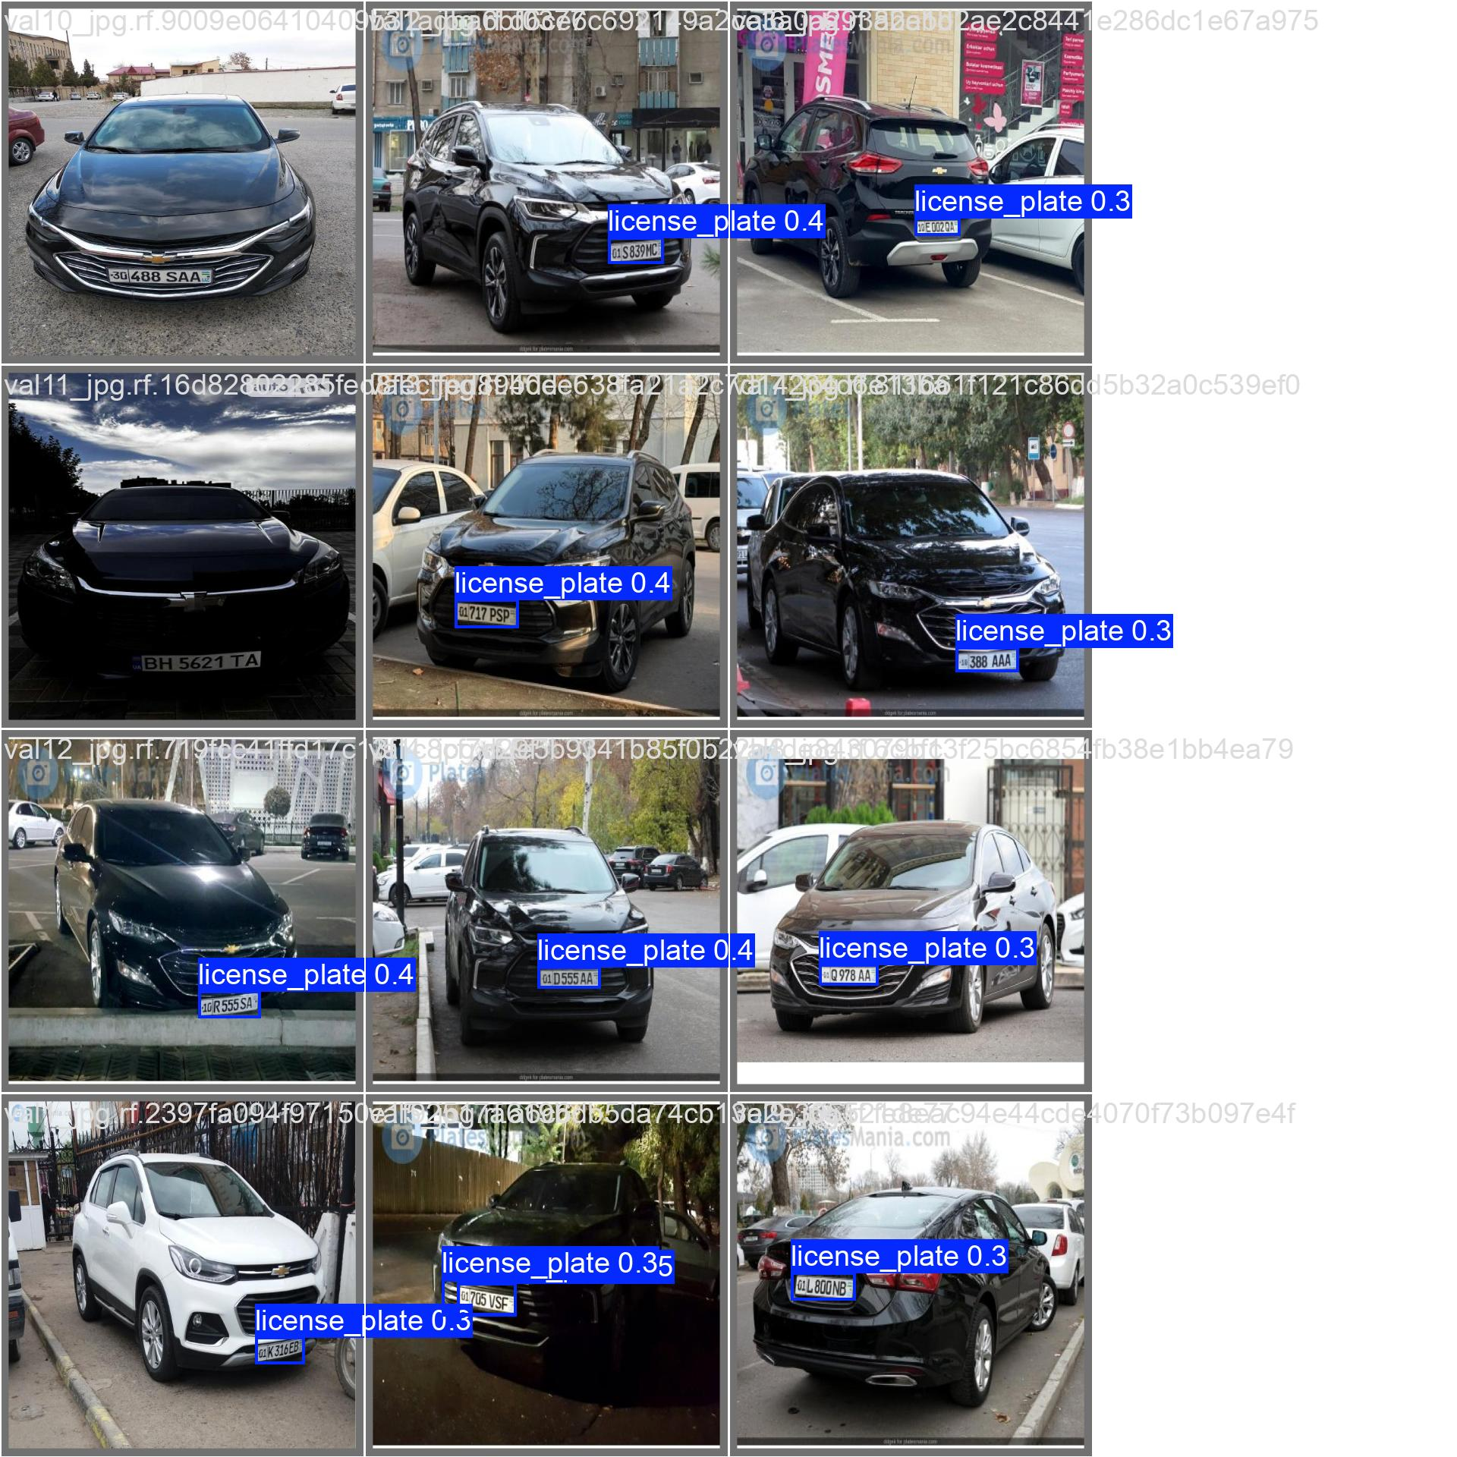
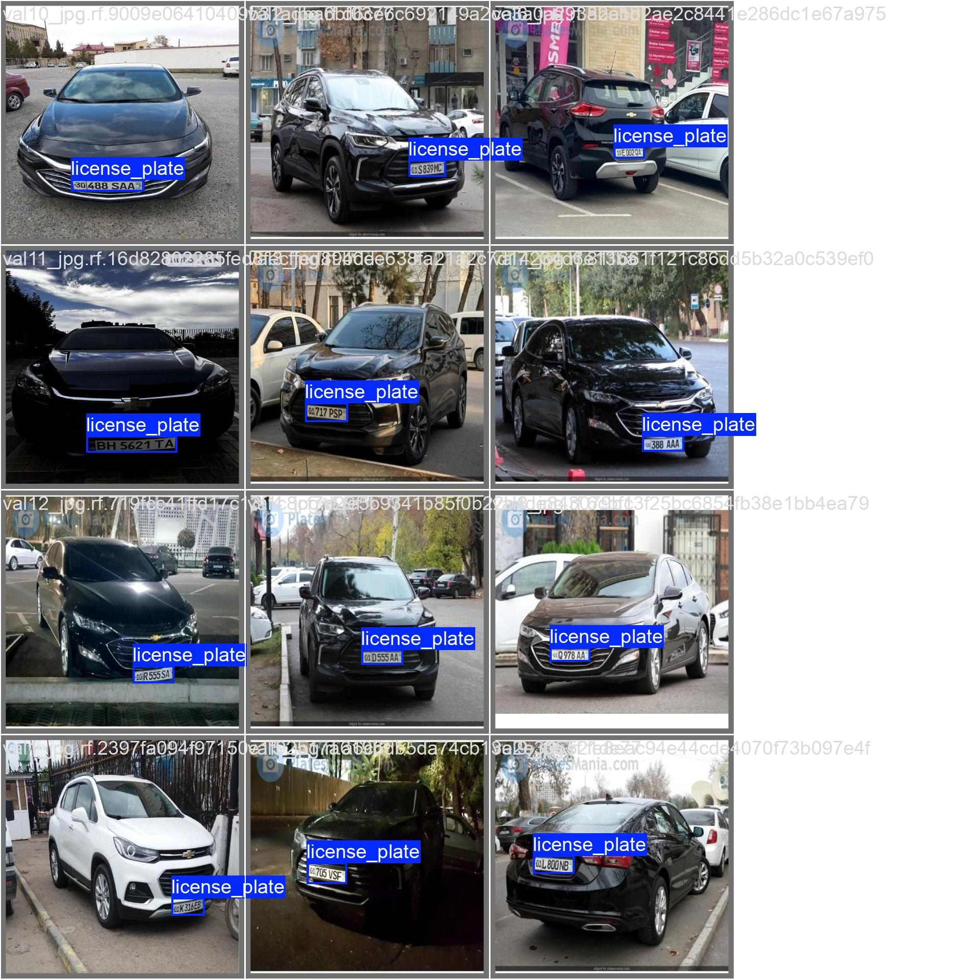
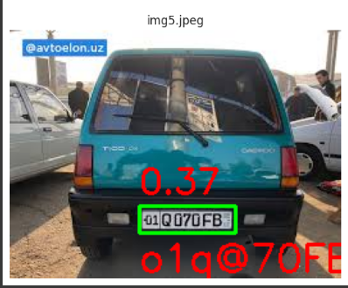
YOLOv8 Architecture results

Slide 5
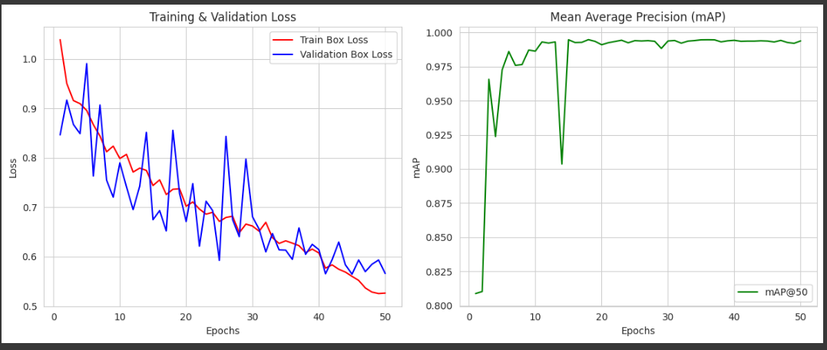
6
YOLOv8 Architecture results & Mean average presicion

Slide 6
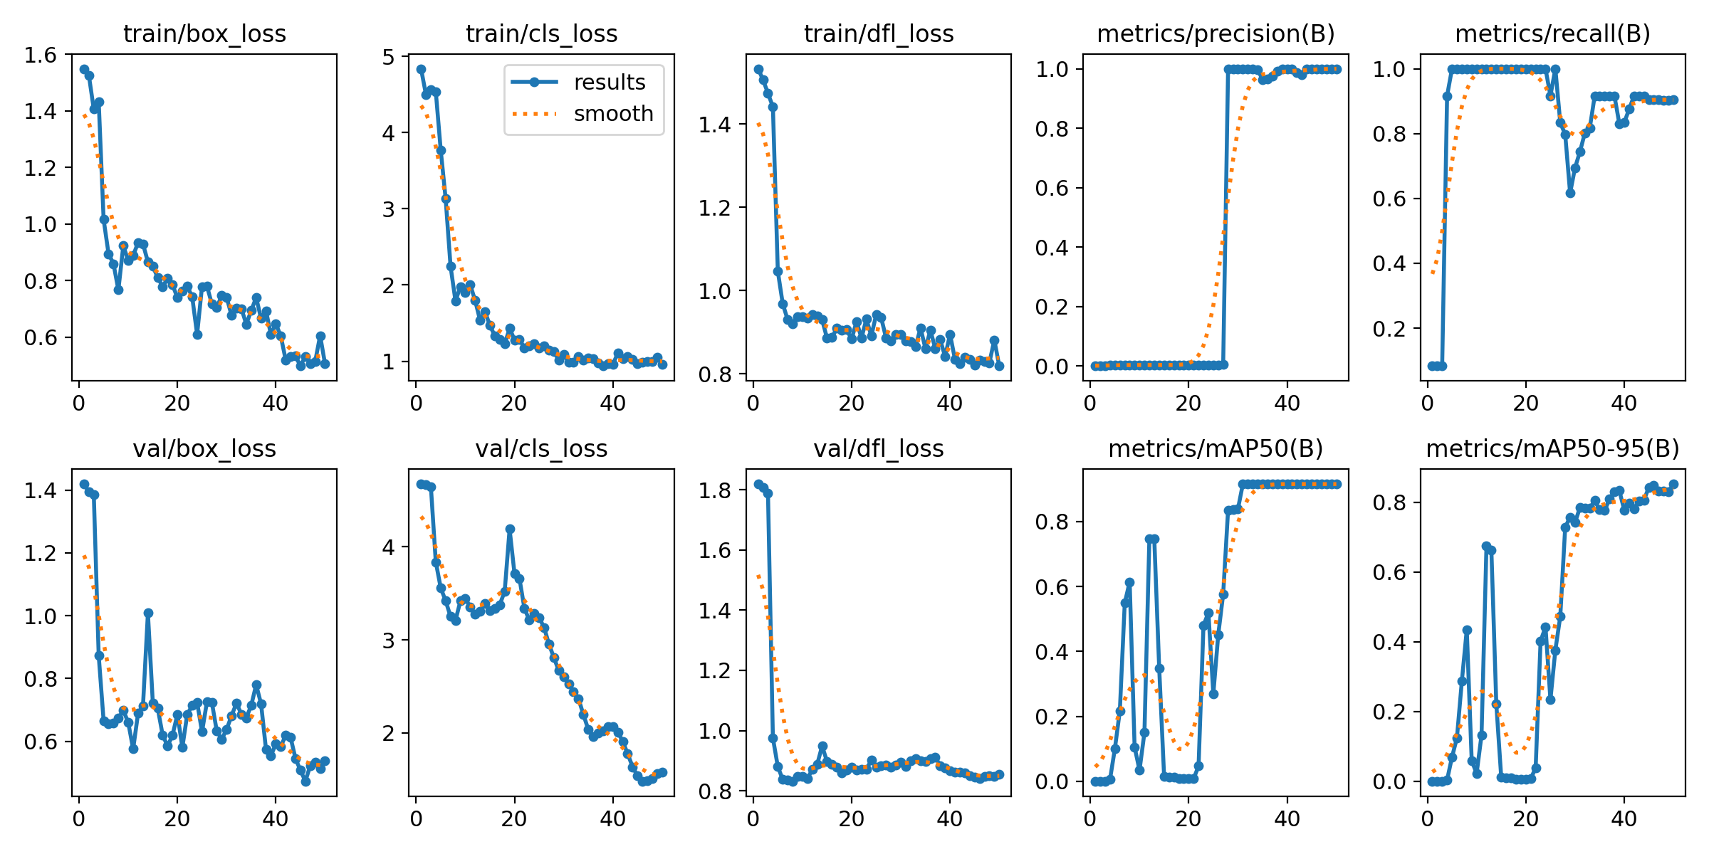
7
Model Training and Evaluation

Slide 7
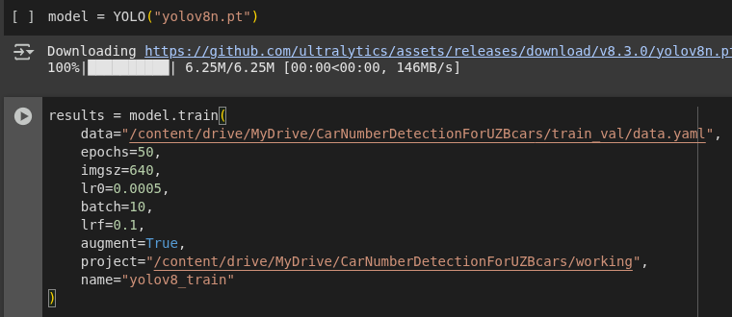
Deployment and Integration

Slide 8
Challenges and Limitations
During the process of selecting the optimal model, as well as collecting and labeling data, some challenges were encountered. Initially, the YOLOv5 model was used; however, the results were not satisfactory. As a result, the YOLOv8 model was adopted instead. It was further fine-tuned to better fit the specific requirements of the task, leading to improved performance.

Slide 9
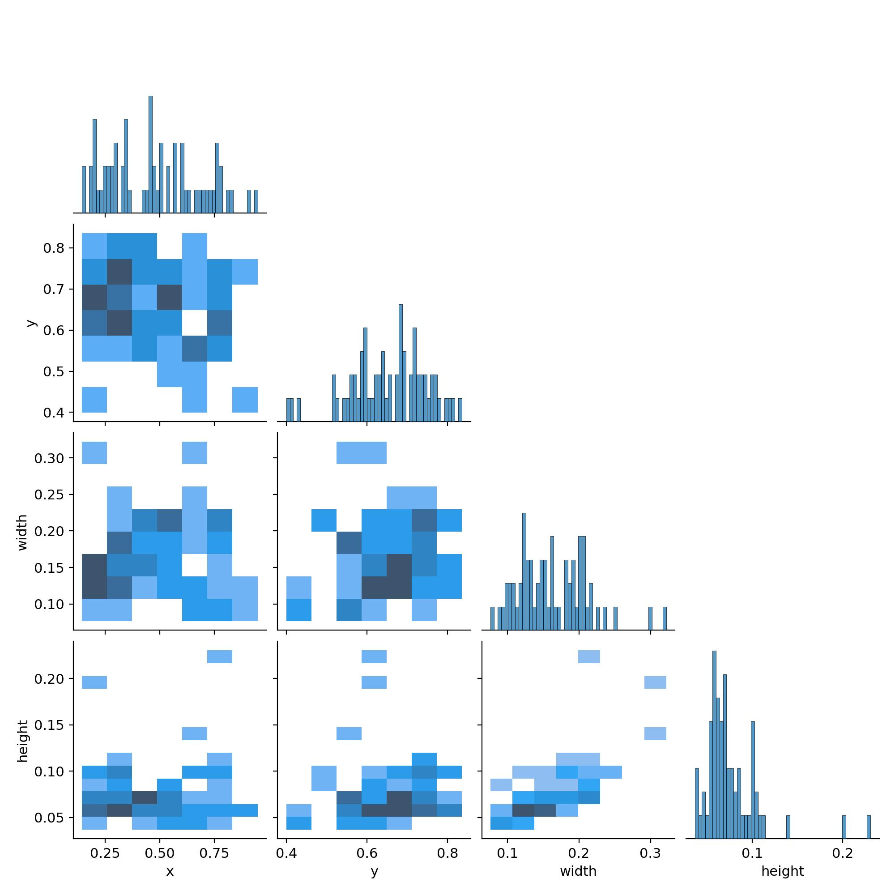
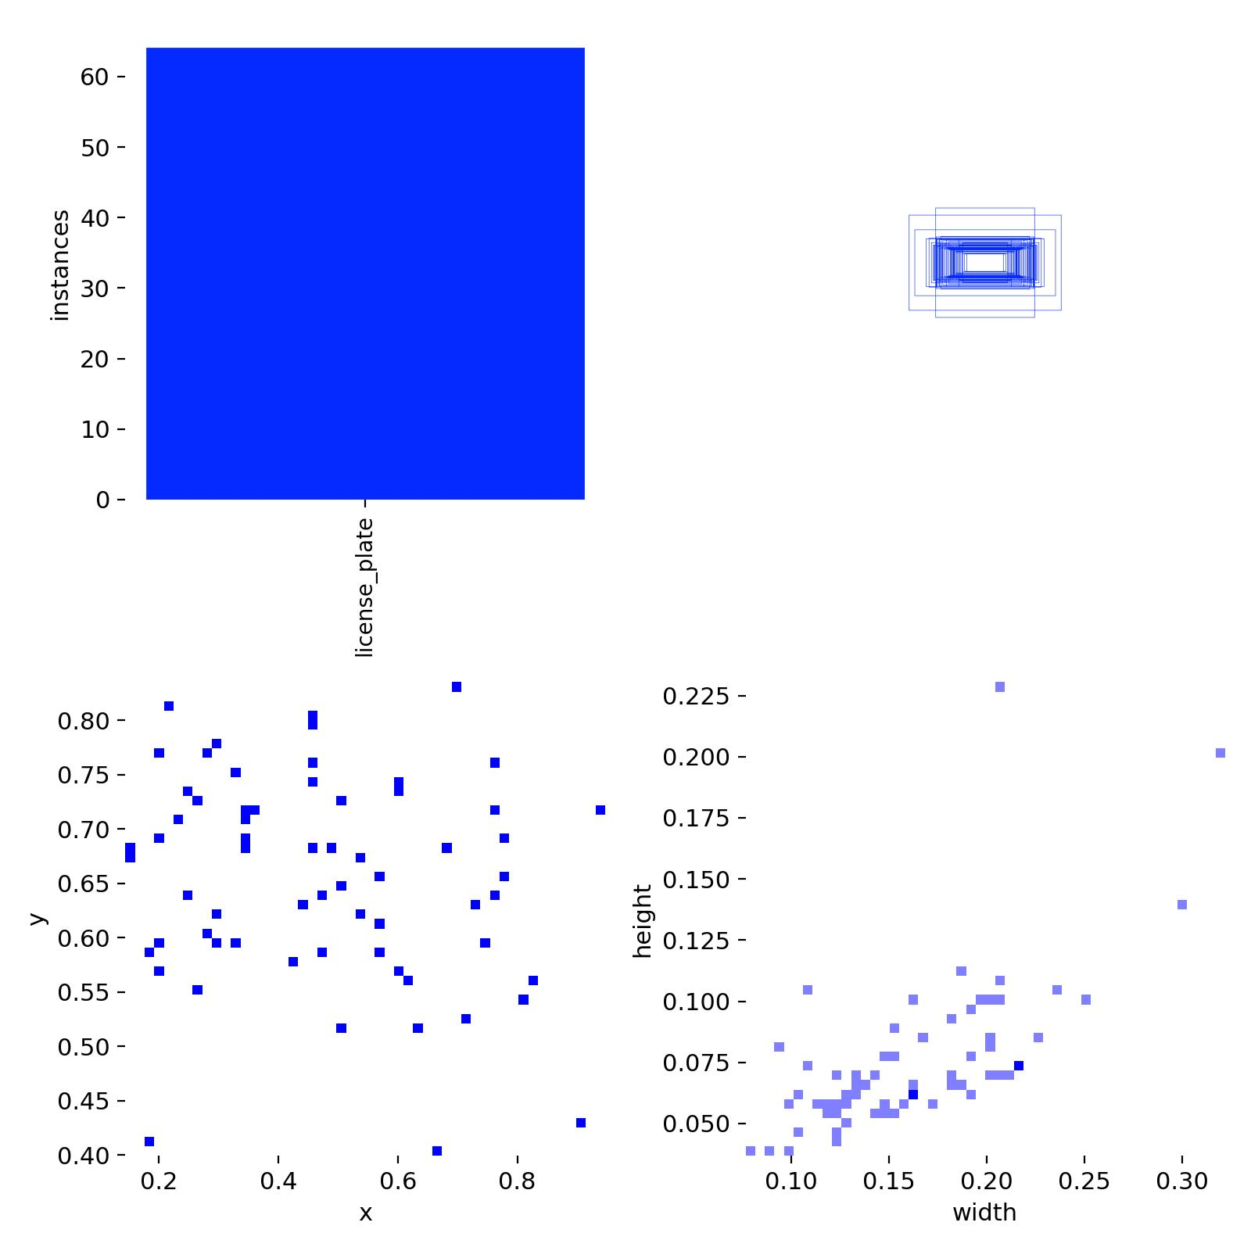
Case Study

Slide 10
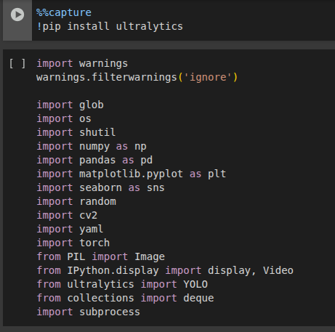
Used Libraries

Slide 11
Future Directions
In future work, we plan to expand the dataset with more diverse and high-quality labeled images to further improve model accuracy. Additional efforts will be made to enhance the labeling process using semi-automated tools to reduce manual errors and save time. We also aim to experiment with other advanced object detection architectures and optimization techniques to achieve even better real-time performance. Finally, deploying the model in real-world environments and continuously refining it based on real-time feedback will be key steps toward a fully robust and reliable system.

Slide 12
Q&A
Q1: Why was YOLOv5 not sufficient for your project? A: Although YOLOv5 is a powerful model, it did not provide the desired accuracy for our specific dataset and use case. Therefore, we switched to YOLOv8 for better results.
Q2: What improvements did YOLOv8 bring? A: YOLOv8 offered better detection accuracy and more flexibility for fine-tuning. It also performed more reliably during real-time inference.
Q3: What were the main challenges during data labeling? A: The main challenges included ensuring consistency and accuracy in annotations, as well as the time-consuming nature of manual labeling.
Q4: How do you plan to improve the model further? A: By increasing the dataset size, using better labeling tools, and testing other detection models. We also plan to deploy and evaluate the model in real-world scenarios.

Slide 13
Thank You
Thank you for your time and interest in YOLOv8 for license plate detection. We hope this presentation has been insightful.

