Slide 1
A Systematic Comparison of 1D PURe and MLP: From Predictive Power to Model Transparency

Slide 2
Architecture
Layer | MLP | 1D-PURe | Dim. Size
Input Layer | FC Layer | FC Layer | Dep. Dataset
 | ReLU | ReLU
Hidden Layer 1 | FC Layer | FC Layer | 128
 | ReLU
Hidden Layer 2 | FC Layer | PU Layer residual connection | 128
 | ReLU
Hidden Layer 3 | FC Layer | FC Layer | 128
 | ReLU
Hidden Layer 4 | FC Layer | FC Layer | 128
 | ReLU
Hidden Layer 5 | FC Layer | PU Layer residual connection | 128
 | ReLU
Hidden Layer 6 | FC Layer | FC Layer | 128
 | ReLU
Output Layer | FC Layer | FC Layer | 1
x
ReLu(x) + 1
log
Summation Unit
exp
Product Unit
FC Layer: Fully Connected Layer
PU Layer: Product Unit Layer
All networks are real-valued

Slide 3
Dataset
1. Friedman 1 (Synthetic Dataset)
a synthetic regression problem specifically chosen to evaluate the model's ability to capture complex non-linear feature interactions.
Objective: To predict a target value based on non-linear combinations of input features.
Dimensions: 10 independent features (x0 to x9).
Key Interaction: The target y is determined by the interaction between x0 and x1 through the sine function:
y = 10sin(pi x0 x1) + 20(x2 - 0.5)^2 + 10x3 + 5x4 + epsilon.
Noise and Redundancy: Features x5 to x9 are independent of the target, serving as noise to test the model's feature selection and robustness.
Split Ratio: 70% Training, 15% Validation, and 15% Testing. (Total Samples: 10,000)

Slide 4
Dataset
2. Concrete Compressive Strength (Engineering Dataset)
The Concrete dataset represents a real-world civil engineering problem characterized by highly non-linear relationships.
Objective: To predict the compressive strength of concrete based on its composition and age.
Dimensions: 8 physical and chemical features.
Features: Includes Cement, Blast Furnace Slag, Fly Ash, Water, Superplasticizer, Coarse Aggregate, Fine Aggregate, and Age.
Split Ratio: 60% Training, 20% Validation, and 20% Testing. (Total Samples: 1,030)

Slide 5
Dataset
3. California Housing (Large-scale Economic Dataset)
The California Housing dataset provides a large-scale real-world benchmark based on 1990 U.S. Census data.
Objective: To predict the median house value for California districts.
Dimensions: 8 economic and geographic features.
Features: Includes Median Income (MedInc), House Age, Average Rooms, Average Bedrooms, Population, Average Occupancy, Latitude, and Longitude.
Split Ratio: 80% Training, 10% Validation, and 10% Testing. (Total Samples: 20,640)

Slide 6
Experimental Setup
Initialization: The second residual block of 1D-PURe is Zero- Initialization, while the rest are Kaiming-Initialization.
Training Epochs: 100 epochs.
Batch Size: 128.
Learning Rate: 0.001
Loss Function: Mean Squared Error (MSE)
Repeated Trials: Every experimental configuration is repeated for 5 independent runs.
Statistical Reporting: Results are reported as the mean and standard deviation across these 5 runs
Best Model Preservation: The final model weights saved for testing are those that achieved the lowest Val. Loss.

Slide 7
1. Experiment: Benchmark Performance and Robustness Analysis
Dual-Condition Testing: Predictive performance is evaluated on the test set under both clean and Gaussian noise-corrupted (sigma=0.05) environments.
Dataset | Model | Params | MSE Mean (σ=0.00) | MSE Std (σ=0.00) | MSE Mean (σ=0.05) | MSE Std (σ=0.05)
Friedman | MLP | 100,609 | 0.001995 | 0.000374 | 0.006604 | 0.000433
 | 1D PURe | 100,353 | 0.001601 | 0.000148 | 0.006217 | 0.000181
Concrete | MLP | 100,353 | 0.111775 | 0.004146 | 0.127535 | 0.006818
 | 1D PURe | 100,097 | 0.109536 | 0.001479 | 0.126479 | 0.002846
California | MLP | 100,353 | 0.211723 | 0.010814 | 0.291812 | 0.011277
 | 1D PURe | 100,097 | 0.196769 | 0.007504 | 0.277661 | 0.009518

Slide 8
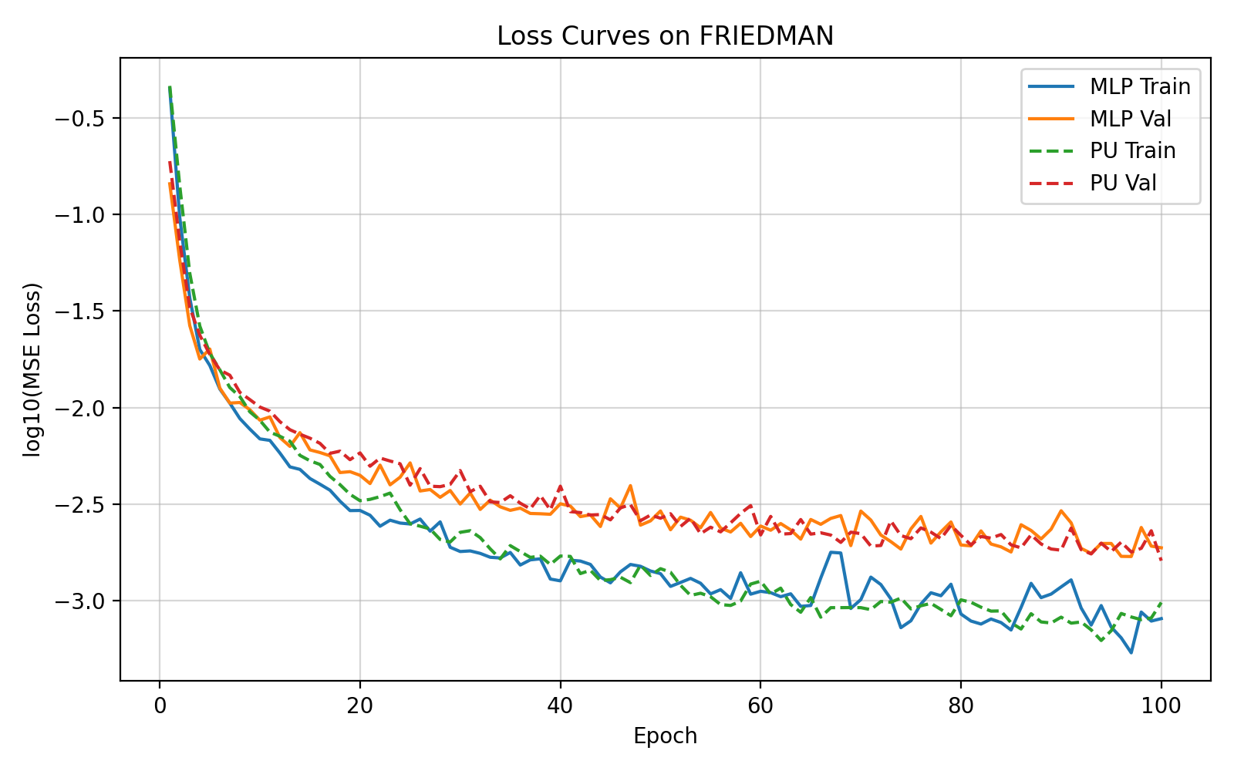
1. Experiment: Benchmark Performance and Robustness Analysis
The PU validation curve (red dashed line) exhibits significant stability after 60 epochs, consistently tracking below or at the same level as the MLP validation curve (orange solid line). This suggests that the PU model possesses superior generalization capability on this dataset and demonstrates enhanced robustness to hyperparameters or noise.

Slide 9
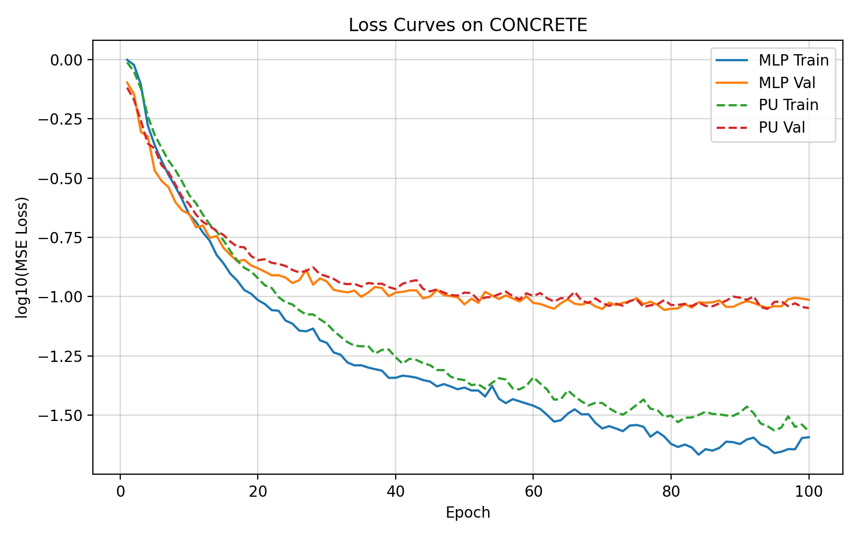
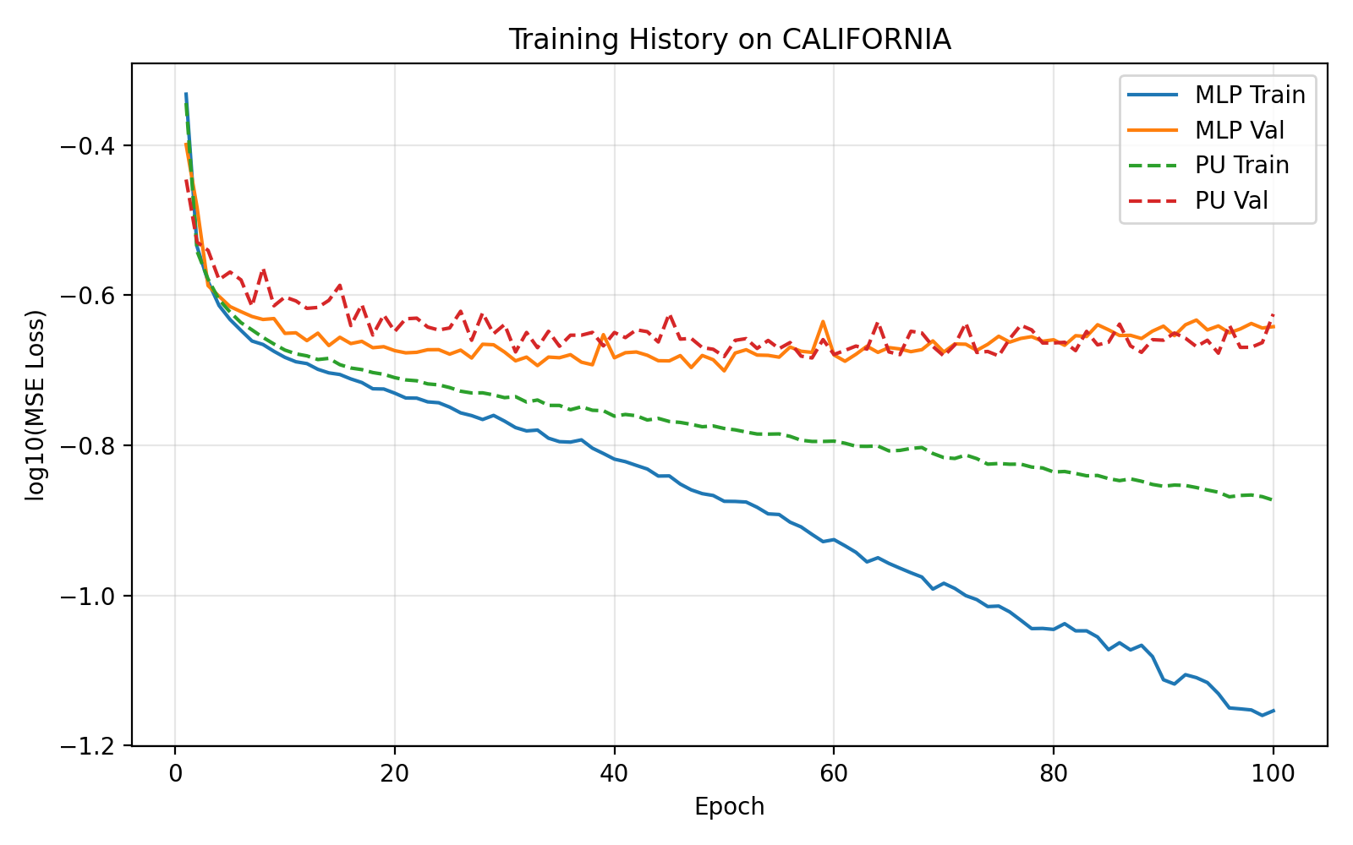
1. Experiment: Benchmark Performance and Robustness Analysis
MLP achieves lower training loss but suffers from significant overfitting. In contrast, the PU network performs better on the validation set, demonstrating superior generalization and robustness.

Slide 10
2.1 Experiment: Beyond the Black Box: Scientific Interpretability
Ground Truth Establishment: The Friedman 1 synthetic dataset is utilized, which contains a known non-linear interaction between features x0 and x1 (10 sin(pi x0 x1)).
Comprehensive Interaction Scanning: The model evaluates all 45 possible feature pairs among the 10 input features to calculate their interaction scores.
Metric 1: Average Rank: This measures the average position of the ground-truth (x0, x1) interaction in a list sorted by interaction strength; a value closer to 1.0 indicates higher precision.
Metric 2: Signal-to-Noise Ratio (Ratio): This is calculated as the interaction score of the true (x0, x1) pair divided by the average score of the remaining 44 "noise" pairs.
Metric 3: Perfect Rate: This tracks the frequency (out of 5 runs) that the model successfully identifies (x0, x1) as the top-ranked interaction.
Statistical Verification: All metrics are averaged over 5 independent runs to ensure the identified logic is consistent and not a result of random initialization.

Slide 11
2.1 Experiment: Beyond the Black Box: Scientific Interpretability
Metric | MLP (Baseline) | 1D PURe (Ours) | Improvement/Observation
Average Rank | 1.0 / 45 | 1.0 / 45 | Both models perfectly identified (x0, x1).
Signal-to-Noise Ratio | 1.04 | 1.11 | 1D PURe provides a clearer signal with less noise.
Perfect Rate | 100% | 100% | Both models achieved 5/5 successful identifications.
Identical Precision: Both architectures demonstrated a 100% success rate in ranking the ground-truth (x0, x1) interaction as the most significant feature pair among 45 candidates.
Enhanced Signal Clarity: 1D PURe achieved a higher Signal-to-Noise Ratio (1.11) compared to the MLP (1.04), indicating that the 1D PURe model suppresses spurious or random correlations more effectively.
Architectural Trustworthiness: The results confirm that 1D PURe's predictive performance is rooted in a faithful reconstruction of the underlying mathematical logic of the data.

Slide 12
2.2 Experiment: Beyond the Black Box: Scientific Interpretability
Method: Decomposes model output into main effects and pairwise interactions using SHAP Interaction Values.
Visualization: Generates side-by-side Interaction Heatmaps for both MLP and 1D PURe using standardized test samples.

Slide 13
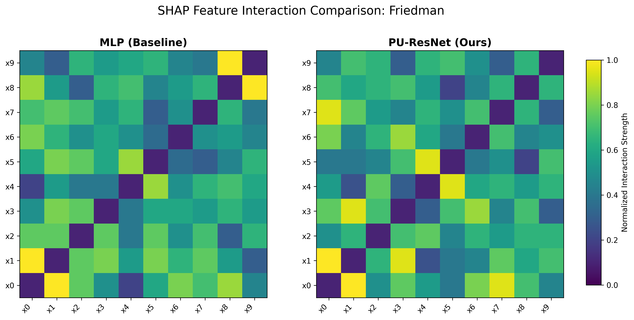
2.2 Experiment: Beyond the Black Box: Scientific Interpretability

Slide 14
2.2 Experiment: Beyond the Black Box: Scientific Interpretability
Precision in Key Interactions: 1D PURe accurately identifies the core feature dependencies (e.g., x0, x1) with high interaction strengths (near 1.0), whereas MLP produces a "blurred" effect, spreading strength across unrelated features.
Effective Noise Suppression: 1D PURe successfully suppresses irrelevant interactions to near-zero levels (dark purple regions, < 0.2). In contrast, the MLP baseline shows significant background noise, with many non-interactive pairs appearing in the 0.4–0.6 range.
Robustness against Spurious Correlations: The MLP erroneously assigns a maximum strength of 1.0 to unrelated pairs (such as x_8-x_9), indicating a tendency to overfit to noise. 1D PURe maintains a cleaner, more sparse structure that better reflects the true underlying logic of the Friedman dataset.

Slide 15
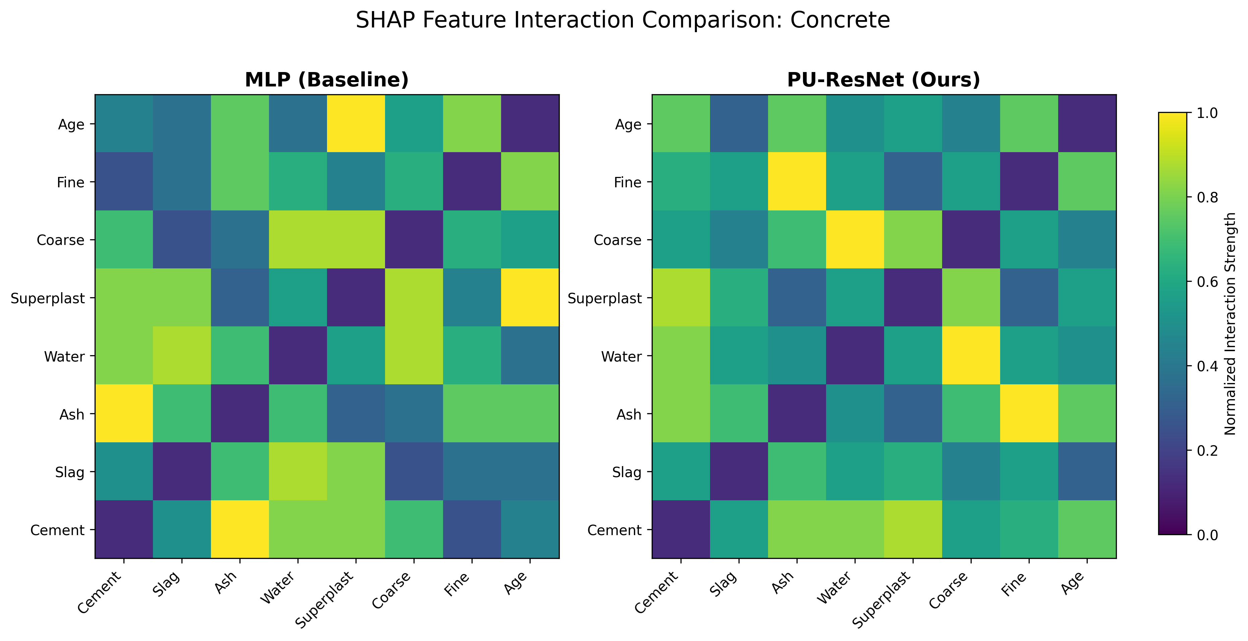
2.2 Experiment: Beyond the Black Box: Scientific Interpretability

Slide 16
2.2 Experiment: Beyond the Black Box: Scientific Interpretability
Better Alignment with Domain Logic: 1D PURe identifies more structured and physically relevant feature interactions (such as the strong coupling between Ash-Fine and Water-Coarse), whereas the MLP’s interactions appear more fragmented across the grid.
Suppression of Spurious Correlations: The MLP erroneously highlights certain isolated pairs like Superplast-Age with maximum intensity (yellow); 1D PURe suppresses these likely noisy or spurious interactions, showing a more concentrated focus on key material property relationships.
Enhanced Contrast and Clarity: 1D PURe maintains much lower interaction strengths (dark purple, < 0.2) for irrelevant feature pairs compared to the MLP. This result indicates a higher signal-to-noise ratio and a superior ability to decouple independent features in real-world physical datasets.

Slide 17
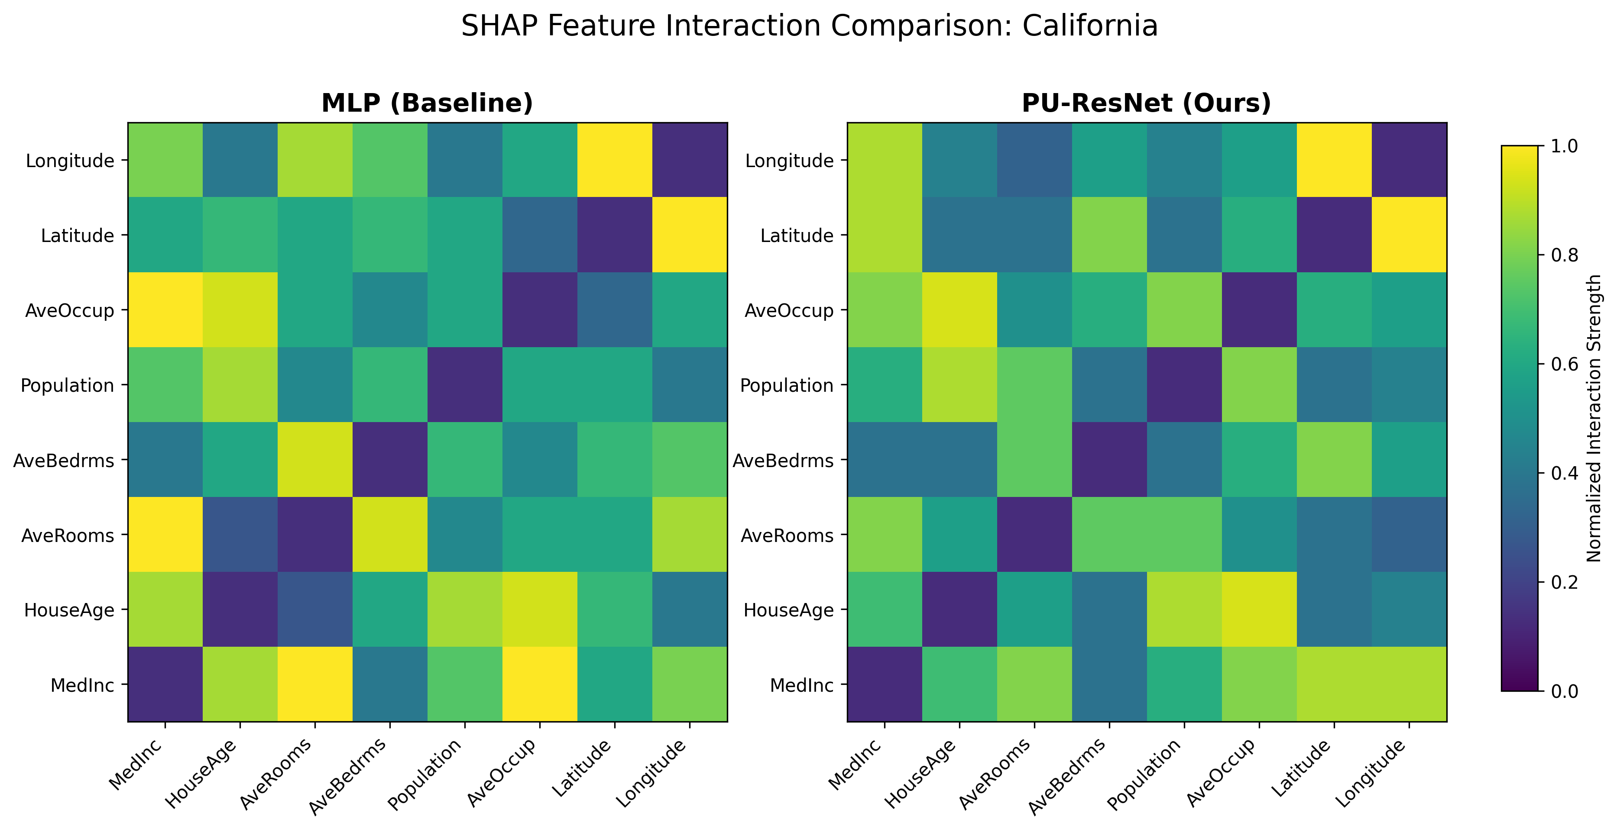
2.2 Experiment: Beyond the Black Box: Scientific Interpretability

Slide 18
2.2 Experiment: Beyond the Black Box: Scientific Interpretability
Precision on Geographic and Demographic Links: 1D PURe pinpoints specific high-strength interactions (near 1.0) such as Latitude-Longitude and HouseAge-AveOccup with much greater clarity. In contrast, the MLP exhibits a diffuse, "over-connected" pattern that lacks focus on these distinct logical drivers.
Global Noise Suppression: 1D PURe significantly clarifies the model's logic by suppressing irrelevant feature interactions to the 0.2–0.4 range (darker blue/purple). Conversely, the MLP baseline shows widespread spurious interactions in the 0.6–0.8 range (green/yellow) across nearly the entire feature space.
Enhanced Structural Sparsity: By producing a sparser interaction map, 1D PURe successfully distinguishes the primary drivers of housing value from secondary factors. The MLP’s dense, high-intensity map suggests it struggles to decouple independent features, leading to a less interpretable representation of the data.

Slide 19
3. Experiment: Limit Pressure Testing (Sample Efficiency) Proves
Training Data Fractions: Models are trained on progressively increasing subsets of the training data: 5%, 10%, 20%, 40%, 60% and 80% on . (Total Samples: 1,030)
Fraction | MLP Mean | MLP Std | PU Mean | PU Std | Diff (M-P) | P-Value | Sig.
5% | 0.4197 | 0.0579 | 0.3292 | 0.0508 | 0.0905 | 4.79e-02 | *
10% | 0.3505 | 0.0561 | 0.2794 | 0.0434 | 0.0711 | 2.10e-02 | *
20% | 0.3230 | 0.0577 | 0.2592 | 0.0228 | 0.0638 | 2.57e-02 | *
40% | 0.2317 | 0.0245 | 0.1889 | 0.0211 | 0.0428 | 3.53e-02 | *
60% | 0.1747 | 0.0261 | 0.1439 | 0.0142 | 0.0309 | 1.10e-01 | ns
80% | 0.1371 | 0.0082 | 0.1264 | 0.0062 | 0.0107 | 1.56e-01 | ns

Slide 20
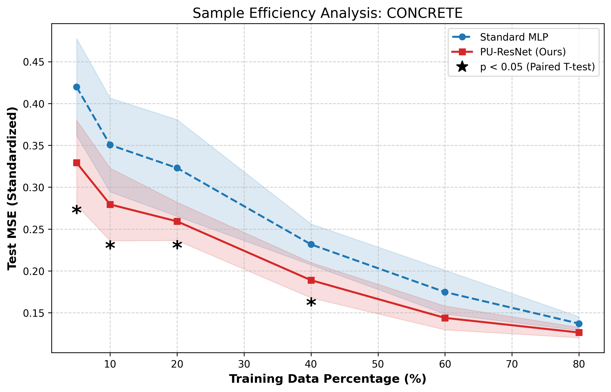
3. Experiment: Limit Pressure Testing (Sample Efficiency) Proves

Slide 21
3. Experiment: Limit Pressure Testing (Sample Efficiency) Proves
Superior Sample Efficiency in Data-Scarce Regimes: 1D PURe demonstrates a statistically significant advantage (p < 0.05) over the standard MLP when training data is limited (from 5% to 40%). This confirms that the proposed model is more efficient at extracting meaningful patterns from smaller datasets.
Performance Convergence at Scale: The disappearance of significance at higher data percentages (60% and 80%) suggests performance convergence. This is a normal phenomenon in machine learning where baseline models eventually catch up as they are provided with sufficient data to overcome their architectural limitations.
Consistently Lower Error Margin: Despite the narrowing gap at the tail end, 1D PURe maintains a consistently lower mean MSE throughout the entire range. This indicates that while the statistical "gap" closes, the proposed model remains the more robust and high-performing choice across all scenarios.

Slide 22
Complex-Valued

Slide 23
The rest of the network architecture remains essentially unchanged; only all operations (summation units) are converted to the complex domain.
To keep the number of trainable parameters comparable to the real-valued case, the hidden layer size is reduced from 128 to 64.
The training parameters and the initialization scheme remain unchanged.
x
ReLU(x.real)+sqrt(0.5) + j(ReLU(x.real) + sqrt(0.5))
log
Summation Unit
exp
Complex-Valued Product Unit

Slide 24
1. Experiment: Benchmark Performance and Robustness Analysis
Complex-Valued
Dataset | Model | Params | MSE Mean (σ=0.00) | MSE Std (σ=0.00) | MSE Mean (σ=0.05) | MSE Std (σ=0.05)
Friedman | COMPLEX_MLP | 25,729 | 0.001906 | 0.000241 | 0.006608 | 0.000200
 | COMPLEX_PURe | 25,601 | 0.001300 | 0.000189 | 0.005818 | 0.000200
Concrete | COMPLEX_MLP | 25,601 | 0.113029 | 0.009028 | 0.130445 | 0.008275
 | COMPLEX_PURe | 25,473 | 0.109166 | 0.003519 | 0.125794 | 0.004093
California | COMPLEX_MLP | 25,601 | 0.192596 | 0.013928 | 0.260932 | 0.012865
 | COMPLEX_PURe | 25,473 | 0.186881 | 0.004324 | 0.248382 | 0.005276

Slide 25
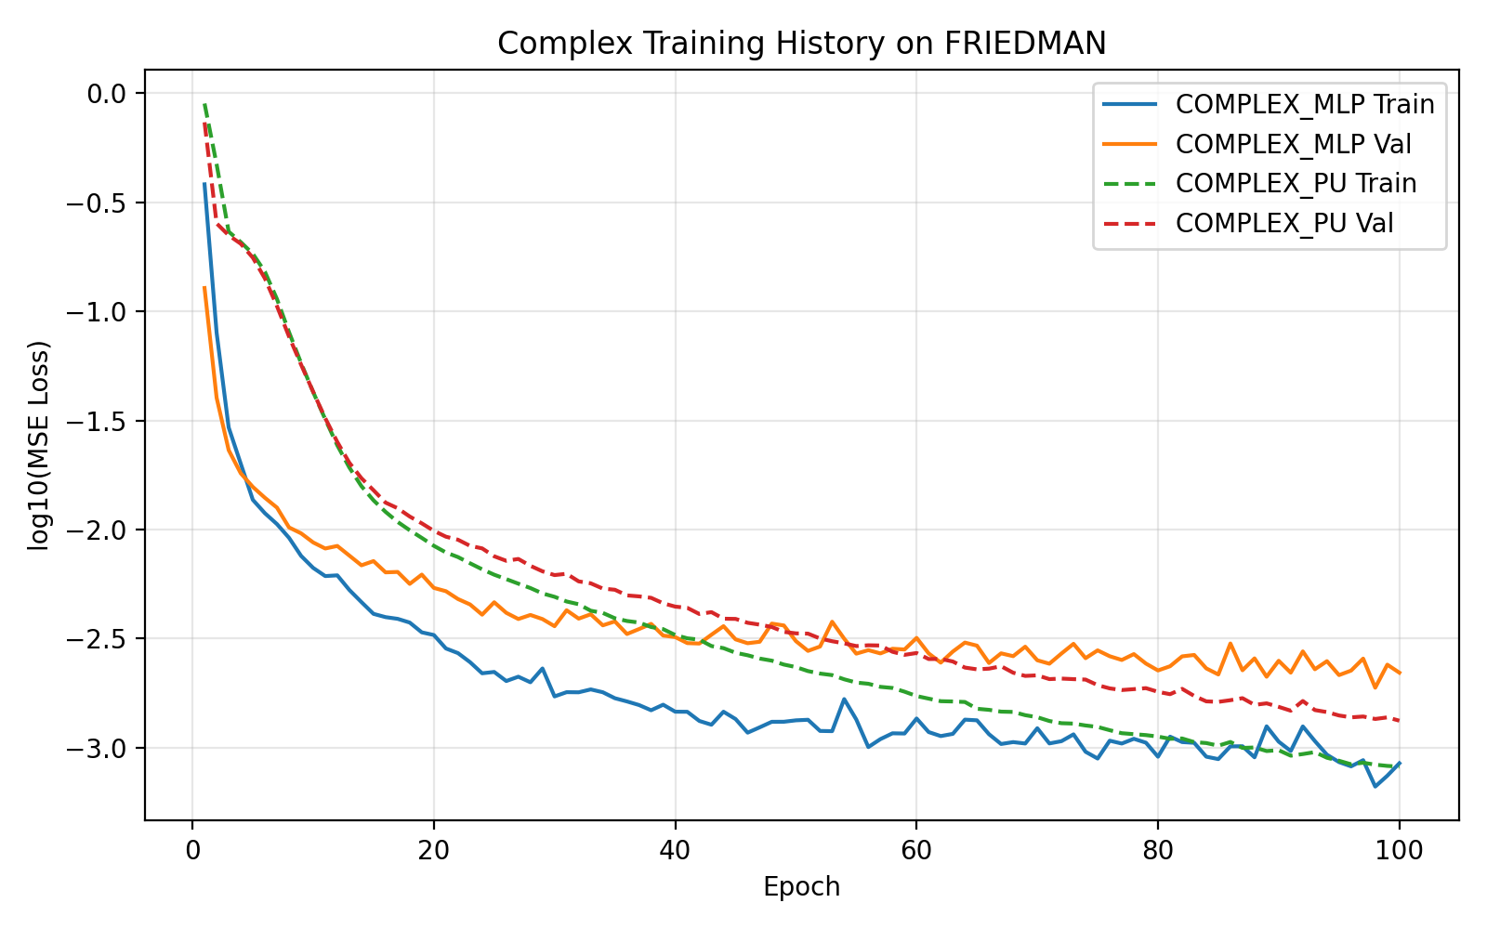
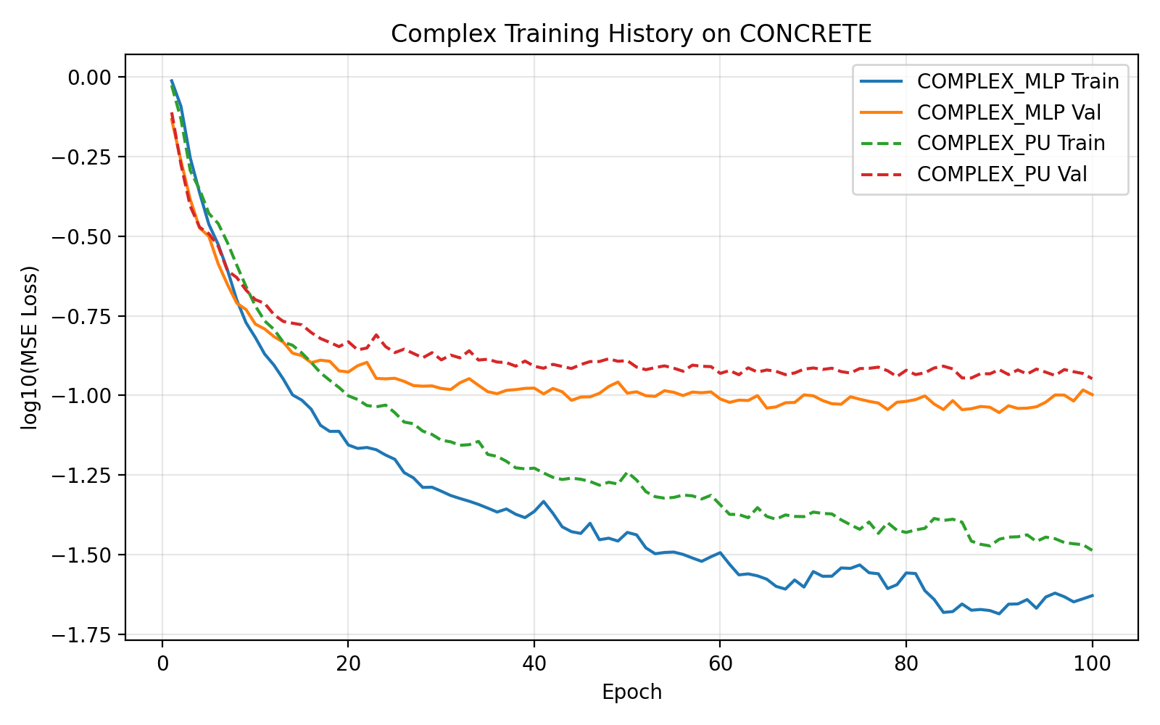
1. Experiment: Benchmark Performance and Robustness Analysis
Complex-Valued

Slide 26
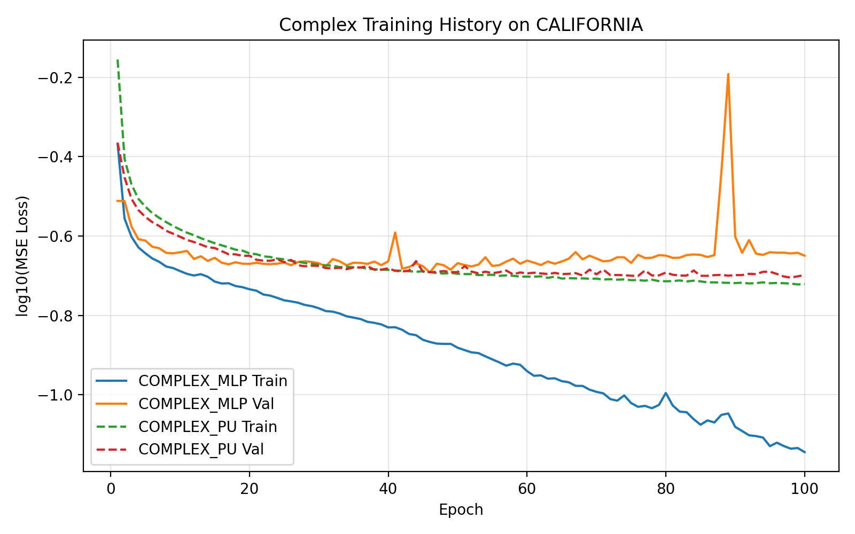
1. Experiment: Benchmark Performance and Robustness Analysis
Complex-Valued

Slide 27
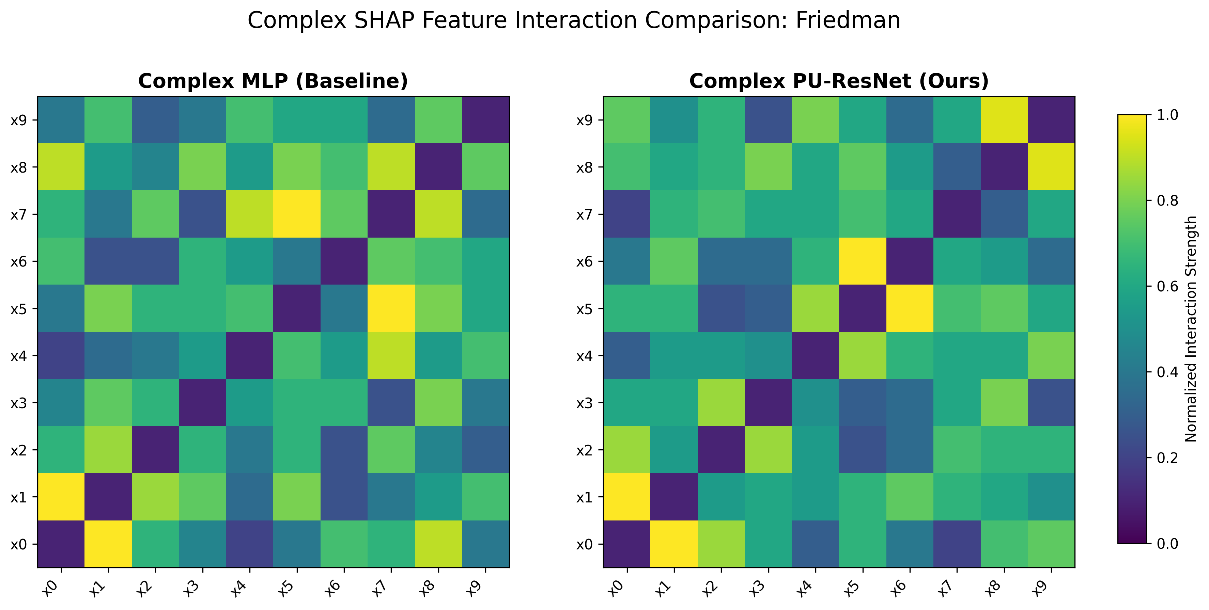
2.2 Experiment: Beyond the Black Box: Scientific Interpretability
Complex-Valued

Slide 28
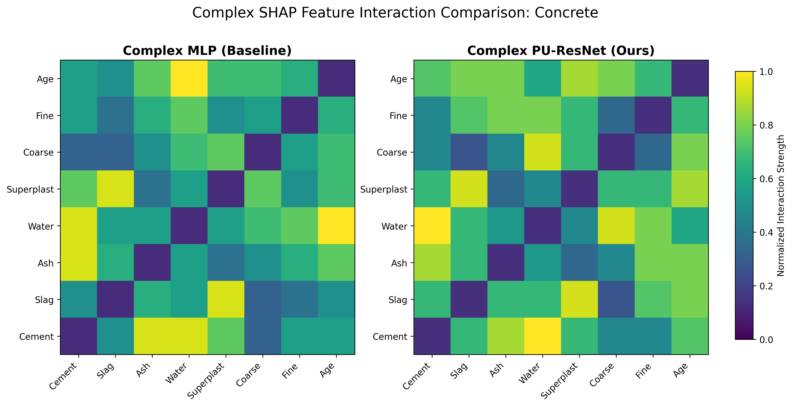
2.2 Experiment: Beyond the Black Box: Scientific Interpretability
Complex-Valued

Slide 29
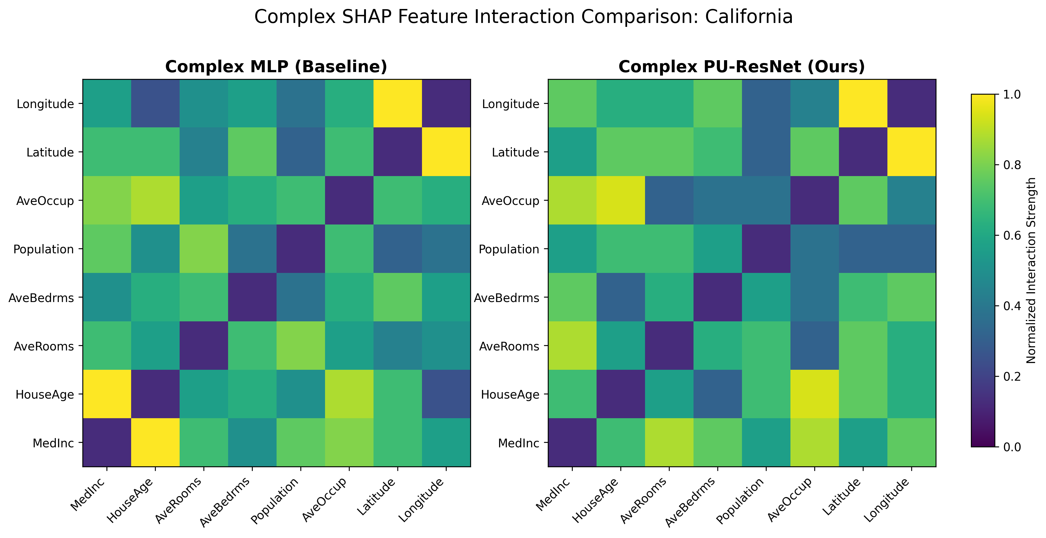
2.2 Experiment: Beyond the Black Box: Scientific Interpretability
Complex-Valued

Slide 30
3. Experiment: Limit Pressure Testing (Sample Efficiency) Proves
Complex-Valued
Fraction | MLP Mean | MLP Std | PU Mean | PU Std | Diff (M-P) | P-Value | Sig.
5% | 0.386242 | 0.059394 | 0.297562 | 0.039310 | 0.088680 | 3.61e-03 | **
10% | 0.330914 | 0.059373 | 0.263410 | 0.047146 | 0.067504 | 1.82e-03 | **
20% | 0.322714 | 0.057889 | 0.257844 | 0.038322 | 0.064870 | 2.86e-02 | *
40% | 0.201049 | 0.033587 | 0.167163 | 0.018356 | 0.033885 | 3.59e-02 | *
60% | 0.146688 | 0.023615 | 0.131636 | 0.014880 | 0.015052 | 1.49e-01 | ns
80% | 0.135495 | 0.006025 | 0.123164 | 0.007285 | 0.012331 | 1.26e-01 | ns

Slide 31
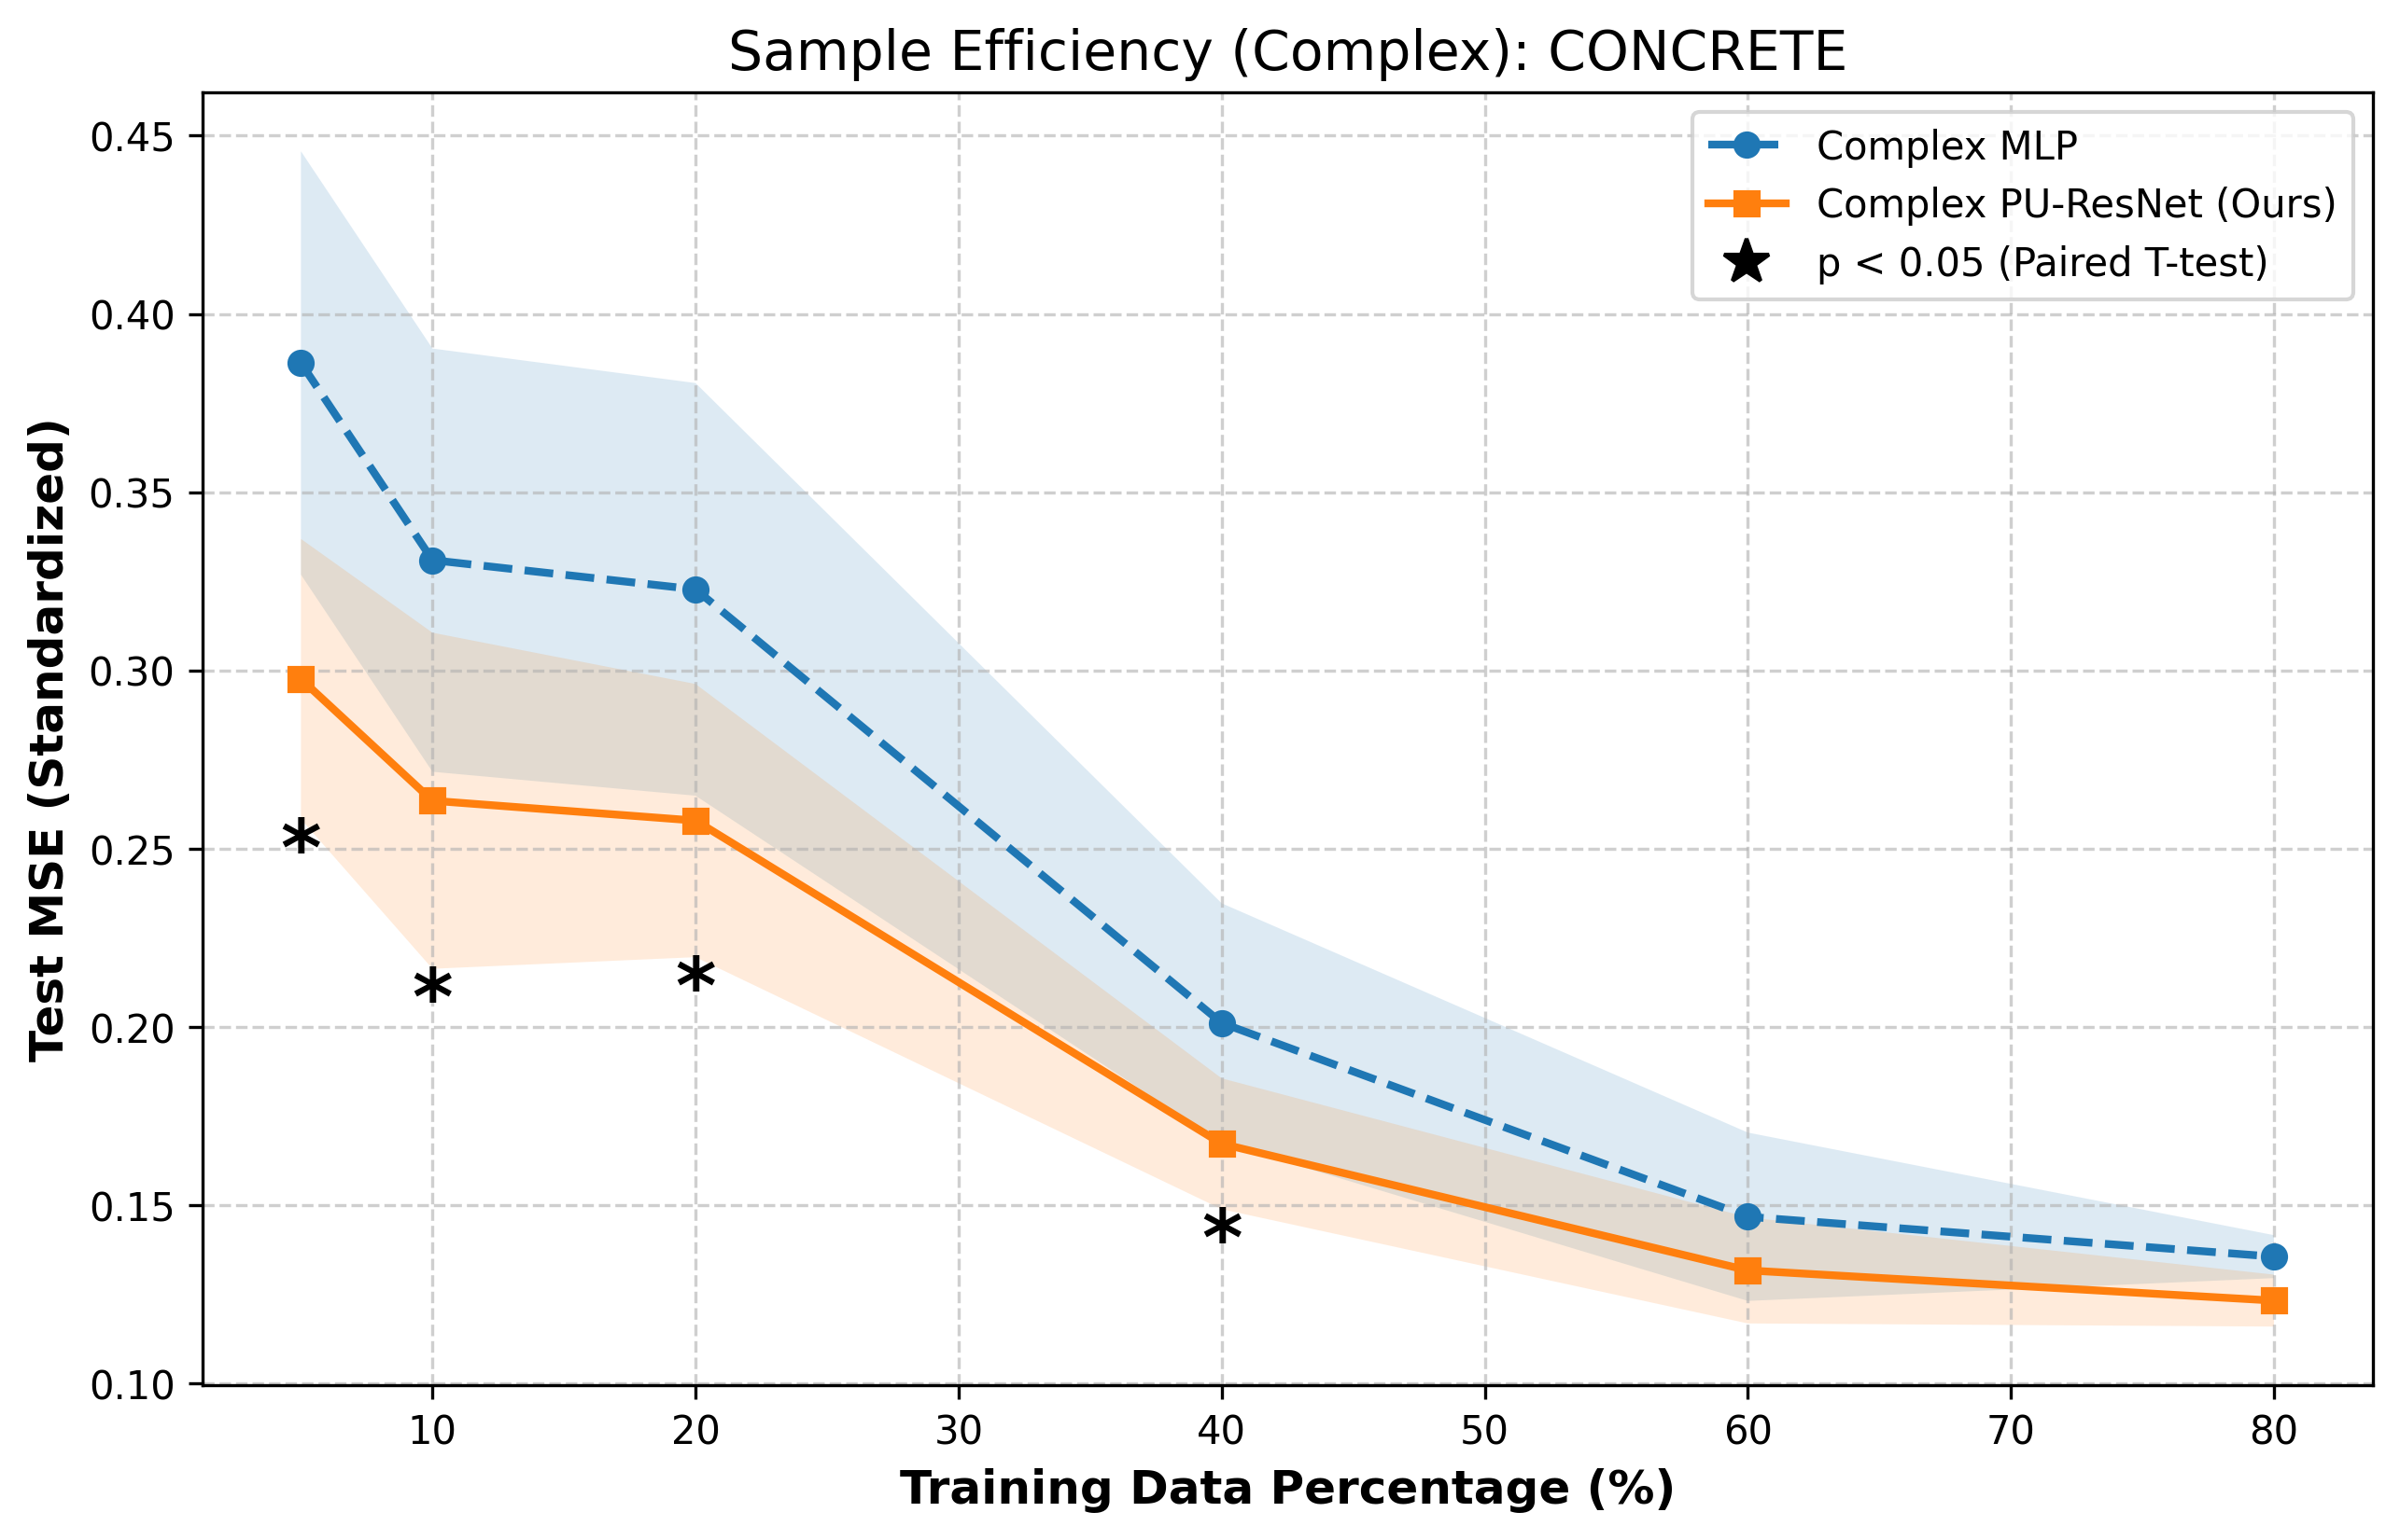
3. Experiment: Limit Pressure Testing (Sample Efficiency) Proves

