Slide 1
Chapter 4: Threads

Slide 2
Chapter 4: Threads
Overview
Implementation of Thread
Multithreading Models
Threading issues
Operating System Examples

Slide 3
Overview
To build parallel programs, such as:
  Parallel execution on a multiprocessor
  Web server to handle multiple simultaneous web requests
We will need to:
  Create several processes that can execute in parallel
  The OS will then schedule these processes in parallel

Slide 4

Processes Overheads
A full process includes numerous things:
  an address space (defining all the code and data pages)
  OS resources and accounting information
  a “thread of control”,
    defines where the process is currently executing
    That is the PC and registers
Creating a new process is costly
  all of the structures (e.g., page tables) that must be allocated
Communicating between processes is costly
  most communication goes through the OS

Slide 5
Need “Lightweight” Processes
What’s similar in these processes?
  They all share the same code and data (address space)
  They all share the same privileges
  They share almost everything in the process
What don’t they share?
  Each has its own PC, registers, and stack pointer
Idea: why don’t we separate the idea of process (address space, accounting, etc.) from that of the minimal “thread of control” (PC, SP, registers)?

Slide 6
Threads and Processes
Most operating systems therefore support two entities:
  the process,
    which defines the address space and general process attributes
  the thread,
    which defines a sequential execution stream within a process
Threads are the unit of scheduling
Processes are containers in which threads execute

Slide 7
Overview
A traditional process is basic unit of program concurrent execution
  It is a basic unit to own resources
  It is a basic unit of CPU scheduling
So, a traditional process is called heavyweight process
However, most modern OS separate the two attributes of process
  Process is a unit to own resources
  Thread is a basic unit of CPU utilization
So , a thread is called a lightweight process

Slide 8
Overview
A thread (or lightweight process) is a basic unit of CPU utilization
  program counter
  register set
  stack space
A thread shares with its peer threads its:
  code section
  data section
  operating-system resources, such as open files and signals
  collectively known as a task.

Slide 9
Overview
Many software packages running on modern PCs are multithreaded
An application is typically implemented as a separate process with several threads of control.
  A web server might have one thread display images or text while another thread retrieves data from the network
  A word processor may have one thread for displaying graphics, another thread for reading keystrokes from the user, and a third thread for performing spelling and grammar checking in the background.

Slide 10
Overview
There are also situations where a single application may be required to perform several similar tasks.
  E.g. a web server accepts client requests for web pages, images, sound, and so forth.
If the web server ran as a traditional process, it would be able to service only one client at a time with its single process.
  A client might wait a long time to be serviced
  It may be more efficient for one process that contains several threads to serve the same purpose
Multithread the web server
  One thread listening for client requests
  Create another thread to service the request when request coming.

Slide 11

Single and Multithreaded Processes

Slide 12

Multithreaded Server Architecture

Slide 13
Threads vs. Processes
A thread has no data segment or heap
A thread cannot live on its own, it must live within a process
There can be more than one thread in a process
Inexpensive creation
Inexpensive context switching
If a thread dies, its stack is reclaimed
A process has code/data/heap & other segments
There must be at least one thread in a process
Threads within a process share code/data/heap, share I/O, but each has its own stack & registers
Expensive creation
Expensive context switching
If a process dies, its resources are reclaimed & all threads die

Slide 14
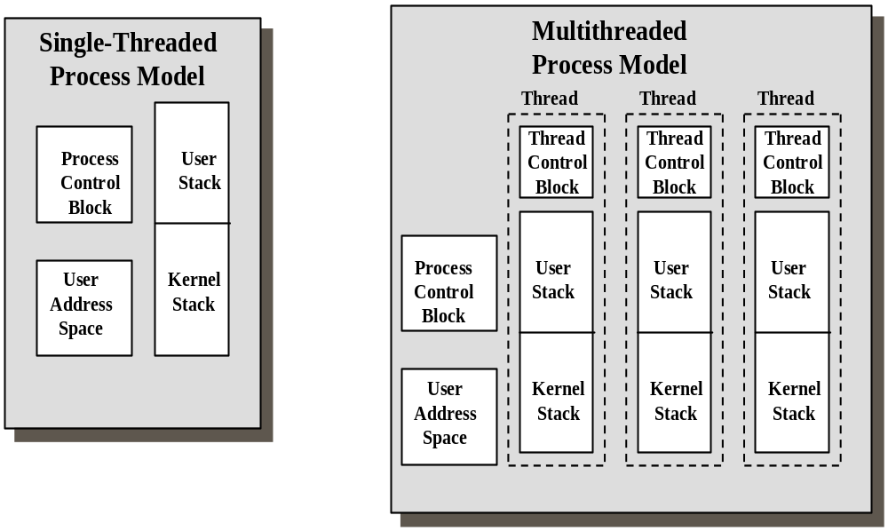

Slide 15
Separating Threads and Processes
Concurrency (multithreading) is useful for:
  improving program structure
  handling concurrent events (e.g., web requests)
  building parallel programs
  Resource sharing
  Multiprocessor utilization
Is multithreading useful even on a single processor?

Slide 16
多线程在单处理器上有用吗？
有用
  提高响应能力：
  即使在单核CPU上，操作系统也会通过时间片轮转的方式，快速地在多个线程之间进行切换。
  简化异步事件：
  在单线程模型中处理多个I/O任务，通常需要使用非阻塞I/O等机制，编写一个复杂的事件循环。使用多线程，可以为每个需要等待的连接或任务创建一个线程。当它在等待数据时，操作系统会挂起这个线程，并切换到其他就绪的线程去执行。
  模块化：
  将程序的不同功能模块放在独立的线程中，是一种优秀的软件设计实践

Slide 17
Benefits
Responsiveness（响应性）
Resource Sharing（资源共享）
Economy(overhead)（经济）
Scalability（可扩展性）

Slide 18
Implementation of thread
Kernel-supported threads
  Supported directly by the operating system
User-level threads
  supported above the kernel, via a set of library calls at the user level

Slide 19
User-Level Threads
Thread management done by user-level threads library
  The library provides support for thread creation, scheduling, and management with no support from the kernel
Each thread is represented simply by:
  PC（程序计数器）-保存线程当前正在执行的指令地址
  Registers（寄存器）-保存线程的计算状态，确保回复后能继续运算
  Stack（栈）-存储函数调用链、局部变量、返回地址等
  Small control block（线程控制块）-包含线程管理信息
All thread operations are at the user-level:
  Creating a new thread
  switching between threads
  synchronizing between threads

Slide 20
User-Level Threads
the thread scheduler is part of a library, outside the kernel
thread context switching and scheduling is done by the library

Slide 21
User-Level Threads
Can either use cooperative（协作） or preemptive（抢占） threads
  cooperative threads are implemented by：
    自愿让出CPU：运行结束后会自愿让出CPU
    无中断：运行中的线程不会被迫终止
    确定性：现成切换只在明确调用点时发生
    CreateThread(), DestroyThread(), Yield(), Suspend(), etc.
  preemptive threads are implemented with a timer (signal)
    强制切换：操作系统通过定时器终端强制收回CPU
    透明性：现成无需修改代码即可被抢占
    公平性：防止单个线程垄断CPU
    where the timer handler decides which thread to run next

Slide 22
User-Level Threads
选择协作式当：
  资源极度受限的嵌入式系统
  需要完全可预测的执行时序
  所有代码都可信且经过严格测试
选择抢占式当：
  通用计算环境
  运行不可信或第三方代码
  需要保证系统响应性和公平性
  Windows/Linux/macOS：完全抢占式，但提供线程优先级和亲和性控制
  早期MacOS：使用协作式多任务，导致响应性问题
  实时系统：可能使用协作式以获得更可预测的性能

Slide 23
User-Level Threads
Three primary thread libraries:
  POSIX Pthreads
  Win32 threads
  Java threads

Slide 24
Example User Thread Interface
t = thread_fork(initial context):
create a new thread of control;
thread_stop():
stop the calling thread, sometimes called thread_block;
thread_start(t): start the named thread;
thread_yield(): voluntarily give up the processor;
thread_exit():
terminate the calling thread, sometimes called thread_destroy;

Slide 25
Kernel Threads
Supported by the Kernel
  Thread is the unit of CPU scheduling
  用户态下，CPU调度的单元是？
Examples
  Windows XP/2000
  Solaris
  Linux
  Tru64 UNIX
  Mac OS X

Slide 26
User-Level vs. Kernel Threads
User-Level
Managed by application
Kernel not aware of thread
Context switching cheap
Create as many as needed
Must be used with care
Kernel-Level
Managed by kernel
Consumes kernel resources
Context switching expensive
Number limited by kernel resources
Simpler to use
Key issue: kernel threads provide virtual processors to user-level threads, but if all of kthreads block, then all user-level threads will block even if the program logic allows them to proceed

Slide 27
为什么需要内核线程的“桥梁”作用？
执行系统调用的过程：
  用户线程执行read()系统调用
  CPU切换到内核态，找到空闲的内核线程
  内核线程代表用户线程执行实际的磁盘读取
  数据准备好后，返回用户态，继续执行用户线程
用户线程自己无法完成真正的上下文切换：
  1. 保存所有寄存器（包括特权寄存器）
  2. 切换页表- 仅内核能执行
  3. 更新内核栈指针
  4. 处理挂起的中断
  5. 恢复新线程的上下文

Slide 28
Multithreading Models
Many-to-One
One-to-One
Many-to-Many
Two level model

Slide 29
Many-to-One
Many user-level threads mapped to single kernel thread
Examples:
  Solaris Green Threads
  GNU Portable Threads

Slide 30
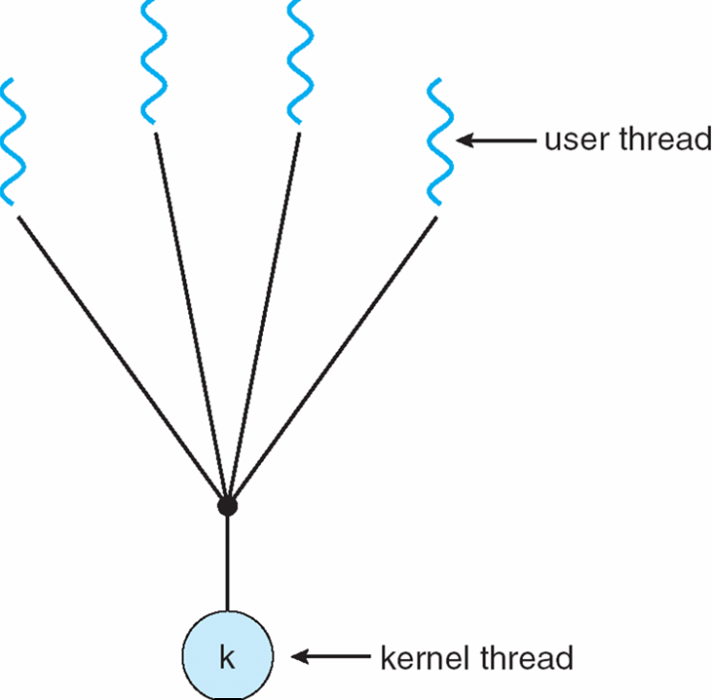

Many-to-One Model
Many user-level threads mapped to single kernel thread
  No parallel execution of threads - can’t exploit multiple CPUs
  All threads block when one uses synchronous I/O

Slide 31
One-to-One
Each user-level thread maps to kernel thread
Examples
  Windows NT/XP/2000
  Linux
  Solaris 9 and later

Slide 32
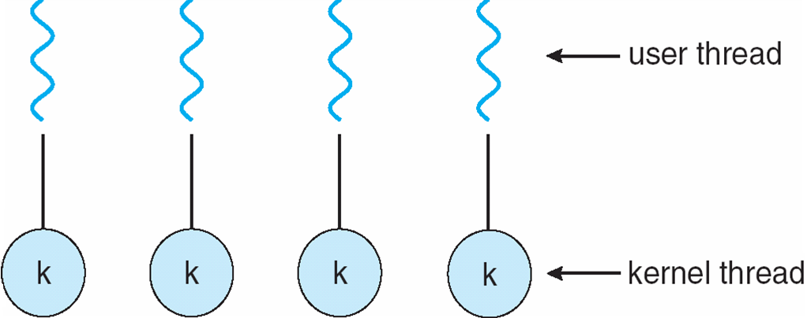

One-to-one Model
More concurrency
Better multiprocessor performance
Each user thread requires creation of kernel thread
Each thread requires kernel resources; limits number of total threads

Slide 33
Many-to-Many Model
Allows many user level threads to be mapped to many kernel threads
Allows the operating system to create a sufficient number of kernel threads
Examples
  Solaris prior to version 9
  Windows NT/2000 with the ThreadFiber package

Slide 34

Many-to-Many Model
If U<k? No benefits of multithreading
If U>k, some threads may have to wait for an Kthread to run
  Active thread - executing on an Kthread
  Runnable thread - waiting for an Kthread
A thread gives up control of Kthread under the following:
  – synchronization, lower priority, yielding, time slicing

Slide 35
Two-level Model
Similar to M:N(M>=N), except that it allows a user thread to be bound to kernel thread
Examples
  IRIX
  HP-UX
  Tru64 UNIX
  Solaris 8 and earlier

Slide 36
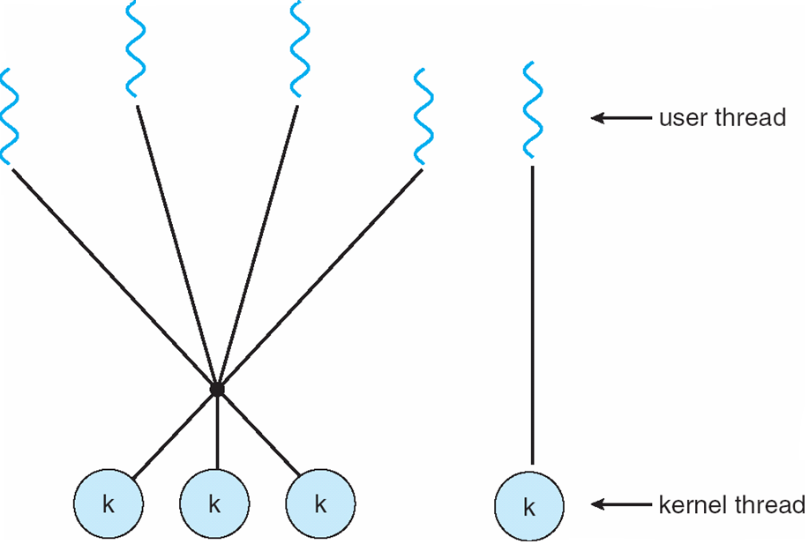
Two-level Model
Supports both bound and unbound threads
  Bound threads - permanently mapped to a single, dedicated kthread
  Unbound threads - may move among kthreads in set
Thread creation, scheduling, synchronization done in user space

Slide 37
Thread Libraries
Thread library provides programmer with API for creating and managing threads
Two primary ways of implementing
  Library entirely in user space
  Kernel-level library supported by the OS
Examples:
  POSIX Pthreads
  Win32 threads
  Java thread

Slide 38
Pthreads
May be provided either as user-level or kernel-level
A POSIX standard (IEEE 1003.1c) API for thread creation and synchronization
API specifies behavior of the thread library, implementation is up to development of the library
Common in UNIX operating systems (Solaris, Linux, Mac OS X)

Slide 39
Win32 Threads
Win32 API is the primary API for Microsoft OS (Win95,98,NT,2000,XP )
A kernel-level library on windows systems

Slide 40
Java Threads
Java threads are managed by the JVM
Typically implemented using the threads model provided by underlying OS
Java threads may be created by:
  Extending Thread class
  Implementing the Runnable interface
Notes:
java.lang 包中定义了Thread 类和Runnable接口
Java Threads有两种创建方法
扩展Thread类，并重置它的RUN（）方法
定义一个类，实现Runnable接口

Slide 41

Java Thread States

Slide 42
Threading Issues
Semantics of fork() and exec() system calls
Thread cancellation of target thread
  Asynchronous or deferred
Signal handling
Thread pools
Thread-specific data
Scheduler activations

Slide 43
Semantics of fork() and exec()
The semantics of fork() and exec() system calls change in a multithreaded program.
If one thread calls fork(), does the new process duplicate only the calling thread or all threads?
Some UNIX have chosen to have two versions of fork():
  One duplicates all threads
  Another duplicates only the thread calling fork()
The exec() typically works in the same way as described in Chapter 3.
  If a thread calls exec(), the program specified in the parameter to exec() will replace the entire process----including all threads.

Slide 44
Thread Cancellation
Terminating a thread before it has finished
  E.g. a user presses a button on a web browser that stops a web page from loading any further
  Usually, a web page is loaded using several threads----each image is loaded in a separate thread, when the browser is closed, all threads loading the page are canceled.
Two general approaches:
  Asynchronous cancellation（异步撤销） terminates the target thread immediately ？？
  Deferred cancellation（延迟撤销） allows the target thread to periodically check if it should be cancelled, allowing it an opportunity to terminate itself in an orderly fashion.

Slide 45
Signal Handling
Signals are used in UNIX systems to notify a process that a particular event has occurred.
A signal handler is used to process signals, follow the same pattern:
  Signal is generated by particular event
  Signal is delivered to a process
  Signal is handled once received

Slide 46
Signal Handling(Cont.)
Handling signals in a single-threaded program is straightforward
  Signals are always delivered to a process
In a multithreaded program, where should a signal be delivered?
  The following options exist:
    Deliver the signal to the thread to which the signal applies
    Deliver the signal to every thread in the process
    Deliver the signal to certain threads in the process
    Assign a specific thread to receive all signals for the process

Slide 47
Thread Pools
Create a number of threads at process startup and place them into a pool where they await work.
Advantages:
  Usually slightly faster to service a request with an existing thread than create a new thread
  Limits the number of threads that exist at any one point
Notes:
系统在创建进程的时候,就为其创建几个线程,放在线程池中备用:当需要的时候直接使用,这样会比较快,另外还可限制应用中的线程数目.

Slide 48
Thread Specific Data
Threads belonging to a process share the data of the process.
Sometimes, each thread might need its own copy of certain data----thread specific data
  E.g. in a transaction processing system, we might service each transaction in a separate thread, so we need thread specific data
Most thread libraries (Win32, Pthread, Java) provide some form of support for thread specific data

Slide 49
Scheduler Activations
Many OS implementing M:M or Two-level models place an intermediate data structure between the user and kernel threads-----lightweight process(LWP)轻量级进程
To the user-thread library, the LWP appears to be a virtual processor（虚拟处理器） on which the application can schedule a user thread to run
Each LWP is attached to a kernel thread, and it is kernel threads that OS schedules to run on physical processors.
If a kernel thread blocks, the LWP blocks as well, and the user-level thread attached to the LWP also blocks.

Slide 50
Scheduler Activations
Scheduler activation is one scheme for communication between the user-thread library and the kernel.
Scheduler activations provide upcalls （回调）- a communication mechanism from the kernel to the thread library
Upcalls are handled by the thread library with an upcall handler（回调处理程序）, and an upcall handler must run on a virtual processor(LWP).

Slide 51
Scheduler Activations
时间点 | 内核线程状态 | 用户线程状态 | 发生了什么
I/O前 | 运行ULT-A | 运行中 | 正常执行
检测风险 | 运行ULT-A | 运行中 | 线程库发现I/O会阻塞
救援窗口 | 运行ULT-A | 保存状态 | 保存上下文，注册回调
切换 | 运行ULT-B | 等待I/O | 调度其他就绪线程
I进行中 | 运行ULT-B | 等待I/O | I/O在后台进行，CPU不空闲
I/O完成 | 运行ULT-B | 就绪状态 | 回调通知，标记为可运行
恢复 | 运行ULT-A | 运行中 | 最终恢复执行

Slide 52
Operating System Examples
Windows XP Threads
Linux Threads
Solaris threads

Slide 53
Windows XP Threads
Implements the one-to-one mapping, kernel-level
Each thread contains
  A thread id
  Register set
  Separate user and kernel stacks
  Private data storage area
The register set, stacks, and private storage area are known as the context（上下文） of the threads

Slide 54
Windows XP Threads
The primary data structures of a thread include:
  ETHREAD (executive thread block)（执行线程块）
  KTHREAD (kernel thread block)（内核线程块）
  TEB (thread environment block)（线程环境块）

Slide 55
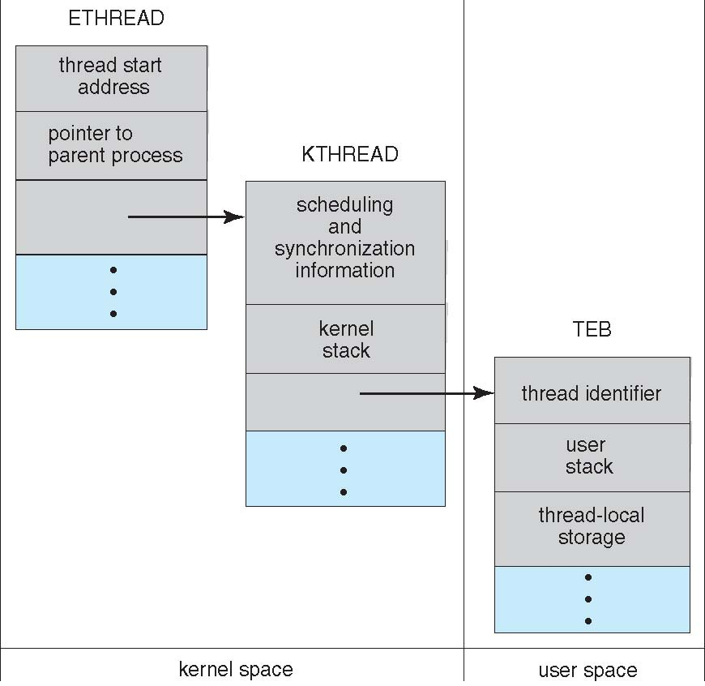
Windows XP Threads

Slide 56
Process Control Block (PCB)
Process ID (PID)
This is an abstract view
Windows implementation of PCB is split in multiple data structures
Parent PID
…
Next Process Block
PCB
List of open files
Handle Table
Image File Name
Thread Control Block (TCB)
List of Thread
Control Blocks
Next TCB
…
Program Counter
Registers
…

Slide 57
Windows Process and Thread Internals
Process environment block
Thread environment block
Process address space
System address space
Process block
(EPROCESS)
Win32 process block
Handle table
Thread block
(ETHREAD)
...
KTHREAD
Notes:
Each Windows process is represented by an executive process (EPROCESS) block. Besides containing many attributes relating to a process, an EPROCESS block contains and points to a number of other related data structures. For example, each process has one or more threads represented by executive thread (ETHREAD) blocks. (Thread data structures are explained in the section “Thread Internals” later in this chapter.) The EPROCESS block and its related data structures exist in system space, with the exception of the process environment block (PEB), which exists in the process address space (because it contains information that is modified by user-mode code).
In addition to the EPROCESS block, the Windows subsystem process (Csrss) maintains a parallel structure for each Windows process that executes a Windows program. Also, the kernel-mode part of the Windows subsystem (Win32k.sys) has a per-process data structure that is created the first time a thread calls a Windows USER or GDI function that is implemented in kernel mode.

Slide 58
Windows Processes & Threads
Internal Data Structures
Access Token
Process
Object
VAD
VAD
VAD
Files, share memory section, synchronization objects
Virtual Address Space Descriptors
Handle Table
object
object
Thread
Thread
Thread
. . .
Access Token
Notes:
In addition to a private address space and one or more threads, each process has a security identification and a list of open handles to objects such as files, shared memory sections, or one of the synchronization objects such as mutexes, events, or semaphores, as illustrated in this slide.
Every process has a security context that is stored in an object called an access token. The process access token contains the security identification and credentials for the process. By default, threads don’t have their own access token, but they can obtain one, thus allowing individual threads to impersonate the security context of another process—including processes running on a remote Windows system—without affecting other threads in the process. The virtual address descriptors (VADs) are data structures that the memory manager uses to keep track of the virtual addresses the process is using.

Slide 59
Windows XP Threads
interrupt
quantum expired
init
terminated
admitted
ready
scheduler
dispatch
running
exit
waiting
I/O or event
completion
waiting for
I/O or event
Notes:
Newly created threads start there live in “init” state. After appropriate data structures are initialized (thread control block - TCB), the thread’s state is changed to “ready”. From “ready” state, a thread may get selected for execution and its state is changed by the scheduler to “running”. For a given system, there is exactly one thread in “running” state per processing unit (note that a CPU might have multiple processing units - multicore/hyperthreading).
When the “running” thread issues an I/O request, it might block and change its state into “waiting”. Alternatively, a “running” thread’s time slice (quantum) may expire, in which case the thread’s state is changed back to “ready”. A “waiting” thread can move into “ready” state once the reason for its blocking disappears (I.e.; the I/O operation completes). Finally, a “running” thread might execute its last instruction - in which case its state changes to “terminated”.
Operating systems often use heuristics to determine which one of the threads in “ready” state to select for execution. The Windows OS uses a priority-based scheme and maintains 32 ready queues of different priorities.

Slide 60
CPU Switch from Thread to Thread
Thread T₁
Thread T₂
Interrupt or system call
executing
Save state into TCB₁
ready or
waiting
Reload state from TCB₂
Interrupt or system call
ready or
waiting
executing
Save state into TCB₂
Reload state from TCB₁
ready or
waiting
executing
Notes:
From a processor’s point of view, it executes instructions load from memory dictated by the changing values of the program counter. Over time, the program counter may refer to code in different programs. Each of these programs in execution forms a process with one or multiple threads.
When a thread whose state was “running” is interrupted, the current values of program counter and processor registers are saved in the corresponding thread control block and the the state of the thread is changed to “waiting” or “ready”. The OS is now free to put some other thread in the running state. The program counter and context data for this thread are loaded into the processor register and the thread begins execution.
There might be extra processing required if a context switch happens between threads in different processes. In this case, the mapping of virtual to physical addresses has to updated - which means that the memory management unit (MMU) has to be re-programmed.

Slide 61
Linux Threads
Linux does not distinguish between processes and threads
Linux refers to them as tasks rather than threads
Thread creation is done through clone() system call
clone() allows a child task to share the address space of the parent task (process)
Notes:
clone()不是创建调用进程的复制,而是创建一个独立进程以共享原来调用进程的地址空间,使clone的任务能像独立线程一样工作

Slide 62
Linux Threads
When fork(), a task is created, along with a copy of all the associated data structures of the parent process
When clone(), a task is created, no copying of data structures, the task points to the data structures of the parent

Slide 63
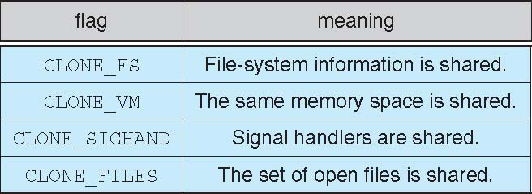
Linux Threads
clone() allows a child task to share the address space of the parent task (process)
Flags determine how much sharing is to take place between the parent and child
If no flag is set when clone(), no sharing take place, resulting in functionality similar to fork()

Slide 64
Solaris threads
Solaris is a version of UNIX with support for threads at the kernel and user levels, symmetric multiprocessing, and real-time scheduling.

Slide 65
Threads Support in Solaris
Solaris supports
  Kernel threads
  Lightweight Processes
  User Level Threads
LWP – (lightweight processes)intermediate level between user-level threads and kernel-level threads.

Slide 66

Solaris threads
Notes:
Solaris 8 以及之前的版本采用此模型， Solaris 9 以及之后的版本采用one-to-one模型

Slide 67
Solaris threads
Kernel Threads
  The only objects scheduled within the system
LWP
  Each process contains at least one LWP
  The thread library multiplexes（多路复用） user-level threads on the pool of LWPs for the process
  Without LWPs, user threads would contend at system call
User Threads
  Managed and scheduled by the thread library
  May be either bound or unbound

Slide 68
LWP
LWP is supported by kernel, it is kernel data structure
LWP is virtual execution environment for user threads。
  When a user thread issues a system call, its register states are put in the stack of LWP
Each process contains at least one LWP
Each LWP is connected to exactly one kernel-level thread.
轻量级线程(LWP)是一种由内核支持的用户线程

Slide 69
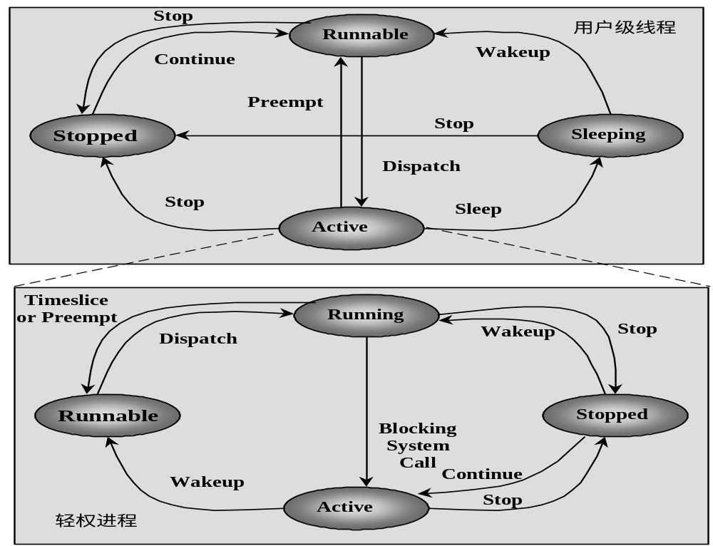
Solaris: User Threads and LWP
Notes:
LWP是每个用户线程的虚拟执行环境
LWP允许进程内的线程互相独立地进行系统调用。

Slide 70
Resources required for different threads in Solaris
Kernel thread: small data structure and a stack; thread switching relatively fast.
LWP: a register set for the user-thread it is running, accounting and memory information, switching between LWPs is relatively slow.
User-level thread: only need stack and program counter; no kernel involvement means fast switching.
Kernel only sees the LWPs that support user-level threads.

Slide 71
Solaris threads
User level threads may be either bound or unbound
Bound
  A user thread is permanently attached to a LWP
All unbound threads in an application are multiplexed onto the pool of available for the application
  Threads are unbound by default .
The thread library adjusts LWPs in the pool
  The thread library ages LWPs and deletes them when they are unused for a long time, typically about 5 minutes.

Slide 72
例题
在下面的叙述中，正确的是（ ）。
A.引入线程后，处理机只在线程间切换。
B.引入线程后，处理机仍在进程间切换。
C.线程的切换，不会引起进程的切换。
D.线程的切换，可能引起进程的切换。
答案： D

Slide 73
例题
若系统中只有用户级线程，则处理机调度单位是( )。
A.线程
B.进程
C.程序
D.作业
答案： B
如果系统只有用户态线程，则线程对操作系统不可见，操作系统只能调度进程。如果系统中有内核态线程，则操作系统可以按线程进行调度。

Slide 74
例题
一个进程执行过程中不可能对应( )。
A.一个PCB
B.一个JCB
C.多个PCB
D.一个程序
答案： C

Slide 75
例题
【多选】在下面的叙述中，不正确的是（ ）。
A.同一进程内的线程可并发执行，不同进程的线程只能串行执行。
B.同一进程内的线程只能串行执行，不同进程的线程可并发执行。
C.同一进程或不同进程内的线程都只能串行执行。
D.同一进程或不同进程内的线程都可以并发执行。
答案： ABC

Slide 76
例题
【多选】下面是关于线程的叙述，其中正确的是（ ）。
A.线程自己拥有一点资源，但它可以使用所属进程的资源。
B.由于同一进程中的多个线程具有相同的地址空间，所以它们间的同步和通信也易于实现。
C.进程创建与线程创建的时空开销不相同。
D.进程切换与线程切换的时空开销相同。
答案： ABC

Slide 77
例题
【简答】进程和线程的主要区别是什么？
答案：进程是系统资源分配的独立单位，而线程是可调度运行的独立单位。

Slide 78
例题
【简答】什么是线程？进程和线程是什么关系？
答案：线程可定义为进程内的一个执行单位，或者定义为进程内的一个可调度实体。
在具有多线程机制的操作系统中，处理机调度的基本单位不是进程而是线程。一个进程可以有多个线程，而且至少有一个可执行线程。
进程和线程的关系是：
(1) 线程是进程的一个组成部分；
(2) 进程的多个线程都在进程的地址空间活动；
(3) 资源是分给进程的，而不是分给线程的，线程在执行中需要资源时，系统从进程的资源配额中扣除并分配给它；
(4) 处理机调度的基本单位是线程，线程之间竞争处理机，真正在处理机上运行的是线程；
(5) 线程在执行过程中，需要同步。

Slide 79
例题
【简答】简述引进线程的好处
答案： (1) 以线程作为系统调度的基本单位，减少了系统的时空开销。以进程为系统调度的基本单位的系统中，进程的切换是很频繁的。在切换中由于要保留当时的运行环境，还要设置新选中的进程的运行环境，这既花费了处理机的时间，又增加了主存的空间，从而也限制了系统进程的数量和进程的切换速度。
(2) 引进线程提高了系统的并行能力。线程作为进程内的一个可执行实体，减少了并行粒度。线程作为调度的基本单位而不是资源分配的基本单位，调度更为容易，而且采用线程提高系统的并行能力比采用进程更为有效。
(3) 同一进程的线程共享进程的用户地址空间，所以同一进程的线程间的通信更容易实现。

Slide 80
End of Chapter 4

