Slide 1


软 件 工 程 课 程
Chapter 1: 概述
Xi'an Jiaotong University
王 鸽
西安交通大学 计算机学院
gewang@xjtu.edu.cn

Slide 2
Chapter 1 Outline
Software Development and Systems Analysis and Design（软件开发和系统分析与设计）
Systems Development Lifecycle（系统开发生命周期）
Iterative Development（迭代开发）
Introduction to Ridgeline Mountain Outfitters
Developing RMO’s Tradeshow Systems
Where You are Headed—The Rest of the Book
© 2012 Cengage Learning. All Rights Reserved. This edition is intended for use outside of the U.S. only, with content that may be different from the U.S. Edition.
May not be scanned, copied, duplicated, or posted to a publicly accessible website, in whole or in part.
Notes:
本章提纲：
软件开发和系统分析与设计
系统开发生命周期
迭代开发
Ridgeline Mountain Outfitters简介
开发RMO的贸易展示系统
你要往哪里去——书的其余部分

Slide 3
Learning Objectives
After reading this chapter, you should be able to:
Describe the purpose（目的） of systems analysis and design in the development of information systems
Describe the characteristics（特点） of iterative systems development
Explain the six core processes （6个核心过程）of the Systems Development Life Cycle
© 2012 Cengage Learning. All Rights Reserved. This edition is intended for use outside of the U.S. only, with content that may be different from the U.S. Edition.
May not be scanned, copied, duplicated, or posted to a publicly accessible website, in whole or in part.
Notes:
目标：
描述信息系统开发中系统分析和设计的目的
描述迭代系统开发的特点
解释系统开发生命周期的六个核心过程

Slide 4
Learning Objectives
Identify key documents（关键文档） that are used in planning a project
Identify key diagrams（关键图表） used in systems analysis and systems design
Explain the utility of identifying use cases（用例） in systems development
Explain the utility of identifying object classes（对象类） in systems development
© 2012 Cengage Learning. All Rights Reserved. This edition is intended for use outside of the U.S. only, with content that may be different from the U.S. Edition.
May not be scanned, copied, duplicated, or posted to a publicly accessible website, in whole or in part.
Notes:
确定在计划项目时使用的关键文档
识别系统分析和系统设计中使用的关键图表
解释在系统开发中识别用例的效用
解释在系统开发中识别对象类的效用

Slide 5
Chapter 1 Outline
Software Development and Systems Analysis and Design（软件开发和系统分析与设计）
Systems Development Lifecycle
Iterative Development
Introduction to Ridgeline Mountain Outfitters
Developing RMO’s Tradeshow Systems
Where You are Headed—The Rest of the Book
© 2012 Cengage Learning. All Rights Reserved. This edition is intended for use outside of the U.S. only, with content that may be different from the U.S. Edition.
May not be scanned, copied, duplicated, or posted to a publicly accessible website, in whole or in part.
Notes:
第一部分：软件开发和系统分析与设计

Slide 6
Software Development and Systems Analysis and Design
Computer application (app，计算机应用程序) – a computer software program（软件程序） that executes on a computing device to carry out a specific set of functions
Modest scope
Information system （信息系统）– a set of interrelated components（组件） that collects, processes, stores, and provides as output the information needed to complete business tasks
Broader in scope than “app”（范围比app更广）
Includes database（数据库） and related manual processes（手动过程）
© 2012 Cengage Learning. All Rights Reserved. This edition is intended for use outside of the U.S. only, with content that may be different from the U.S. Edition.
May not be scanned, copied, duplicated, or posted to a publicly accessible website, in whole or in part.
Notes:
计算机应用程序(app) -在计算设备上执行的计算机软件程序，以执行一组特定的功能 适度的功能范围
信息系统——一组相互关联的组件，它们收集、处理、存储并提供完成业务任务所需的信息作为输出
范围比“app”更广 包括数据库和相关的手动过程

Slide 7
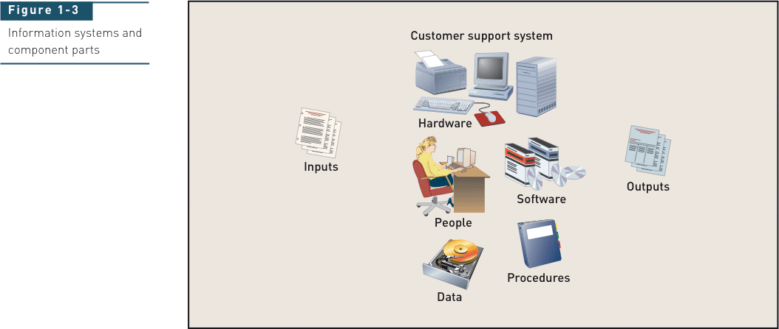
Information Systems and Component Parts

Slide 8
Information Systems and Component Parts
App

Slide 9
Information Systems and Component Parts
Information system

Slide 10
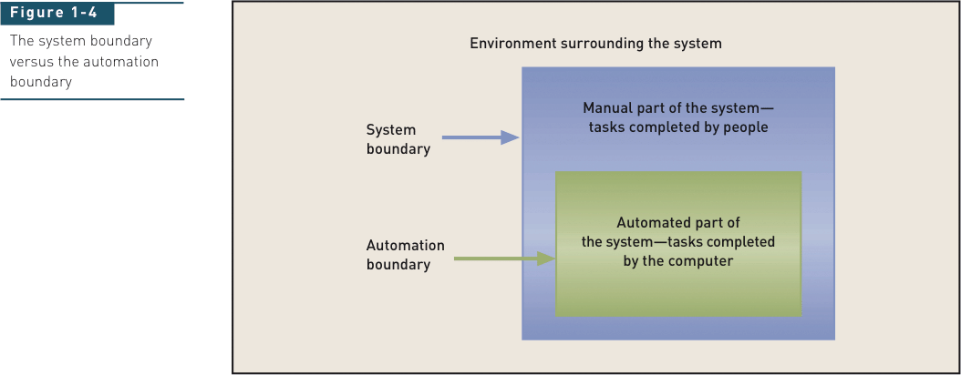
System Boundary vs. Automation Boundary
Notes:
系统边界
自动化边界

Slide 11
Software Development and Systems Analysis and Design
Project – a planned undertaking that has a beginning and end and that produces some definite result
Used to develop an information system（用于开发信息系统）
Requires knowledge of systems analysis（系统分析） and systems design（系统设计） tools and techniques
© 2012 Cengage Learning. All Rights Reserved. This edition is intended for use outside of the U.S. only, with content that may be different from the U.S. Edition.
May not be scanned, copied, duplicated, or posted to a publicly accessible website, in whole or in part.
Notes:
项目-一个有计划的任务，有开始和结束，并产生一些明确的结果 用于开发信息系统 需要系统分析和系统设计工具和技术的知识

Slide 12
Software Development and Systems Analysis and Design
Systems analysis – those activities that enable a person to understand（理解） and specify（指定） what an information system should accomplish
应该做什么？
Systems design – those activities that enable a person to define（定义） and describe（描述） in detail the system that solves the need
应该如何做？
© 2012 Cengage Learning. All Rights Reserved. This edition is intended for use outside of the U.S. only, with content that may be different from the U.S. Edition.
May not be scanned, copied, duplicated, or posted to a publicly accessible website, in whole or in part.
Notes:
系统分析——那些使人能够理解和指定信息系统应该完成什么的活动
系统设计——那些使人能够详细定义和描述解决需求的系统的活动

Slide 13
The Analyst as a Business Problem Solver
Has computer technology knowledge and programming expertise（编程知识）
Understands business problems（理解业务问题）
Uses logical methods for solving problems（用逻辑方法解决问题）
Has fundamental curiosity（好奇心）
Wants to make things better（企图心）
Is more of a business problem solver than a technical programmer（是业务问题解决者，而不是程序员）
Notes:
这门课更多的是教大家称为分析师来解决业务问题：
具备计算机技术知识和编程专业知识
理解业务问题
用逻辑方法解决问题
有基本的好奇心
想让事情变得更好
更多的是业务问题解决者而不是技术程序员

Slide 14
Analyst’s Approach to Problem Solving
1. Research and understand the problem（理解问题）
2. Verify benefits of solving problem outweigh the costs（验证收益大于成本）
3. Define the requirements for solving the problem
（定义解决问题的所需）
4. Develop a set of possible solutions (提出可行方案)
5. Decide which solution is best and recommend
（决定哪个方案最好）
6. Define the details of the chosen solution（决定细节）
7. Implement the solution（实施方案）
8. Monitor to ensure desired results（过程监督）
Notes:
分析师解决问题的方法：
研究并理解问题
验证收益大于成本
定义解决问题的所需
提出一系列可行方案
决定哪个方案最好
决定方案细节
实施方案
监督以获得想要的结果

Slide 15
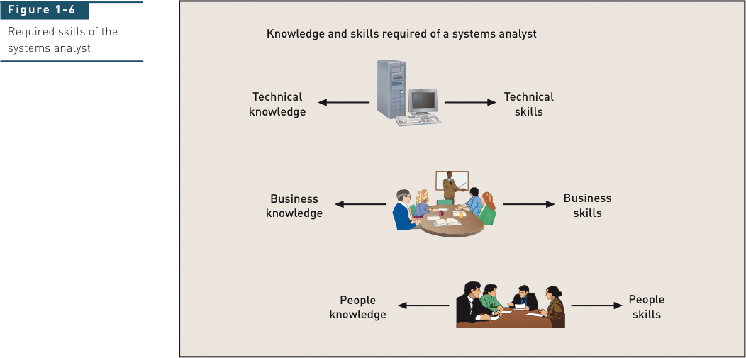
Required Skills of the Systems Analyst
技术技能
商业技能
管理技能
Notes:
需要的技能：
技术技能
商业技能
管理技能

Slide 16
Integrity and Ethics （诚信与道德要求）
Analyst has access to confidential information（机密信息）, such as salary, an organization’s planned projects, security systems, and so on.
Must keep information private
Any impropriety can ruin an analyst’s career
Analyst plans security in systems to protect confidential information
Notes:
诚信与道德要求：
分析师可以访问机密信息，例如工资、组织计划的项目、安全系统等等。
必须保密信息
任何不当行为都可能毁掉分析师的职业生涯
分析人员在系统中规划安全以保护机密信息

Slide 17
Chapter 1 Outline
Software Development and Systems Analysis and Design
Systems Development Lifecycle（系统开发生命周期）
Iterative Development
Introduction to Ridgeline Mountain Outfitters
Developing RMO’s Tradeshow Systems
Where You are Headed—The Rest of the Book
© 2012 Cengage Learning. All Rights Reserved. This edition is intended for use outside of the U.S. only, with content that may be different from the U.S. Edition.
May not be scanned, copied, duplicated, or posted to a publicly accessible website, in whole or in part.
Notes:
第二部分：系统开发生命周期

Slide 18
Systems Development Lifecycle
System development lifecycle (SDLC，系统开发生命周期) – the entire process consisting of all activities required to build, launch, and maintain an information system
确定问题和需求：Identify the problem or need and obtain approval
计划和监控项目（做什么、怎么做和谁来做）：Plan and monitor the project
发现和理解问题：Discover and understand the details of the problem or need
设计能解决问题的系统组件：Design the system components that solve the problem or satisfy the need
建立、测试和整合系统组件：Build, test, and integrate system components
完成系统测试与部署：Complete system tests and then deploy the solution
以上为实施系统开发生命周期（SDLC）的6个核心过程
© 2012 Cengage Learning. All Rights Reserved. This edition is intended for use outside of the U.S. only, with content that may be different from the U.S. Edition.
May not be scanned, copied, duplicated, or posted to a publicly accessible website, in whole or in part.
Notes:
系统开发生命周期(SDLC)——由构建、启动和维护信息系统所需的所有活动组成的整个过程

Slide 19
Traditional Predictive Approach to the SDLC
Project planning（项目计划） – initiate, ensure feasibility, plan schedule, obtain approval for project
Analysis （分析）– understand business needs and processing requirements
Design（设计） – define solution system based on requirements and analysis decisions
Implementation （实施）– construct, test, train users, and install new system
Support （支持）– keep system running and improve
Notes:
系统开发生命周期的传统预测方法：
项目计划-启动，确保可行性，计划进度，获得项目批准 分析-了解业务需求和处理要求 设计-基于需求和分析决策来定义解决方案系统 实施-构建，测试，培训用户，并安装新系统 支持-保持系统运行和改进

Slide 20
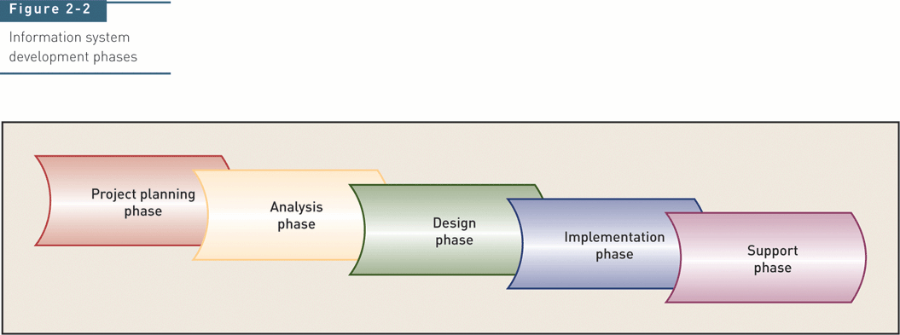
Information System Development Phases
Notes:
信息系统开发阶段阶段：
计划-》分析-》设计-》实现-》支持

Slide 21
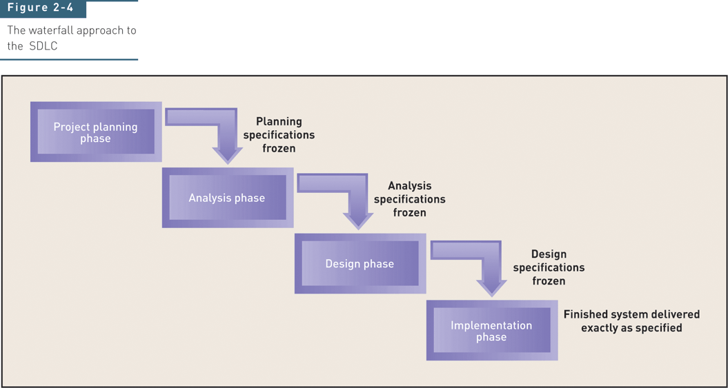
“Waterfall” Approach to the SDLC：瀑布式
Notes:
瀑布式的系统开发生命周期：
计划-》分析-》设计-》实现-》支持

Slide 22
“Waterfall” Approach to the SDLC：瀑布式
“瀑布式”开发方法好不好？可能存在哪些问题？
1）“一蹴而就”：难以适应复杂项目与变化
2）项目进行缓慢，难以快速看到成效

Slide 23
Chapter 1 Outline
Software Development and Systems Analysis and Design
Systems Development Lifecycle
Iterative Development（迭代式开发）
Introduction to Ridgeline Mountain Outfitters
Developing RMO’s Tradeshow Systems
Where You are Headed—The Rest of the Book
© 2012 Cengage Learning. All Rights Reserved. This edition is intended for use outside of the U.S. only, with content that may be different from the U.S. Edition.
May not be scanned, copied, duplicated, or posted to a publicly accessible website, in whole or in part.
Notes:
第三部分：迭代式开发

Slide 24
Overview (continued)
Agile development （敏捷开发）– an information system development process that emphasizes flexibility to anticipate new requirements during development
Fast on feet; responsive to change
Iterative development（迭代开发） -- an approach to system development in which the system is “grown” piece by piece through multiple iterations
Complete small part of system (mini-project), then repeat processes to refine and add more, then repeat to refine and add more, until done
© 2012 Cengage Learning. All Rights Reserved. This edition is intended for use outside of the U.S. only, with content that may be different from the U.S. Edition.
May not be scanned, copied, duplicated, or posted to a publicly accessible website, in whole or in part.
Notes:
敏捷开发(敏捷开发)——一种信息系统开发过程，强调在开发过程中预测新需求的灵活性 反应敏捷;对变化作出反应
迭代开发(迭代开发)——系统开发的一种方法，在这种方法中，系统通过多次迭代一点一点地“成长”
完成系统的一小部分(小项目)，然后重复这个过程来提炼和添加更多，然后重复提炼和添加更多，直到完成

Slide 25
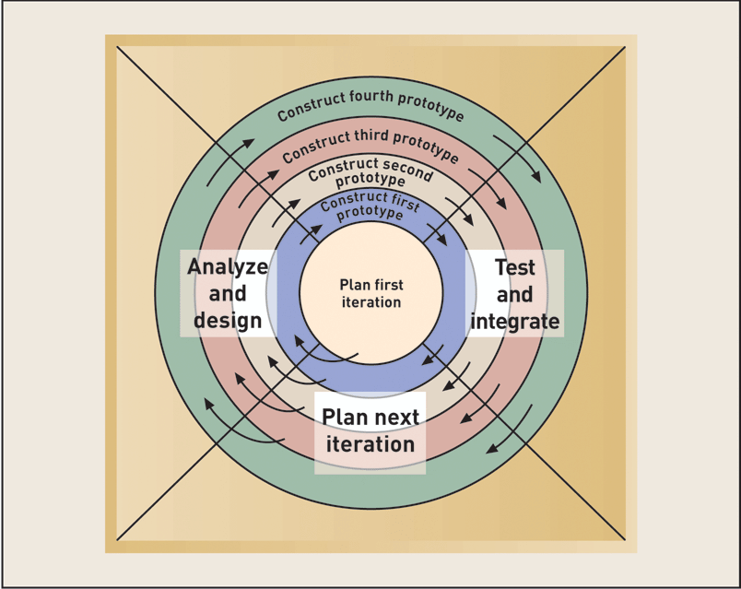
The Spiral Life Cycle Model （螺旋生命周期模型）
Notes:
螺旋生命周期模型

Slide 26
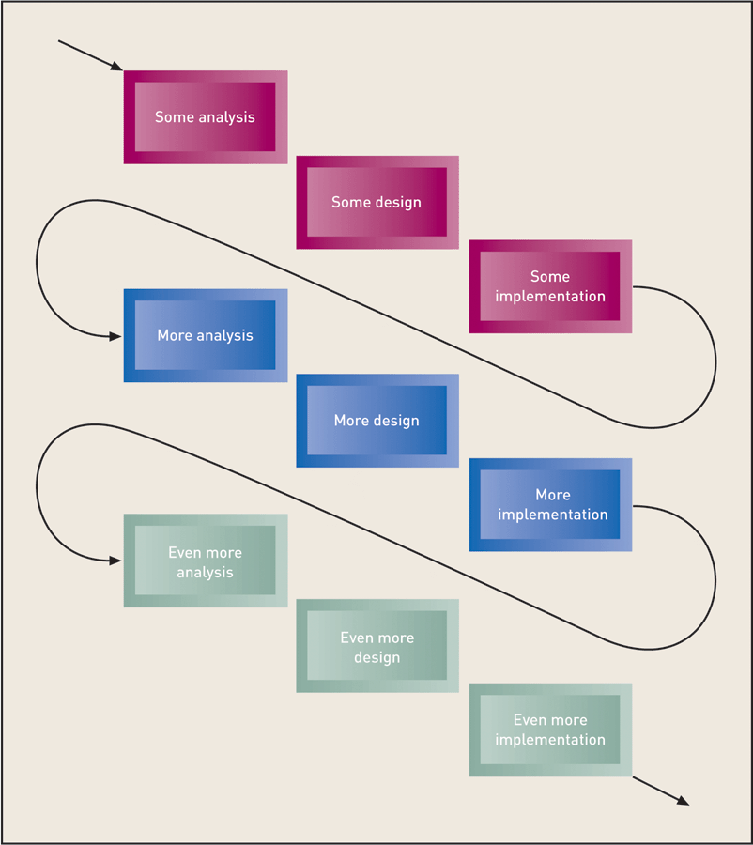
Iteration of System Development Activities 系统开发活动的迭代
Notes:
系统开发活动的迭代

Slide 27
Iterative and Agile Systems Development Lifecycle (SDLC)
© 2012 Cengage Learning. All Rights Reserved. This edition is intended for use outside of the U.S. only, with content that may be different from the U.S. Edition.
May not be scanned, copied, duplicated, or posted to a publicly accessible website, in whole or in part.
Notes:
迭代和敏捷系统开发生命周期(SDLC)

Slide 28
Two Approaches to System Development
Traditional approach （传统方法）
Also called structured system development（结构化系统开发）
Structured analysis and design technique (SADT，结构化分析与设计)
Object-oriented approach（面向对象的方法）
Views information system as collection of interacting objects that work together to accomplish tasks（将信息系统视为互相作用的对象的集合）
Notes:
系统开发的两种方法
传统的方法 也称为结构化系统开发 结构化分析与设计技术(SADT) 包括信息工程(IE)
面向对象的方法 将信息系统视为相互作用的对象的集合，这些对象一起工作以完成任务

Slide 29
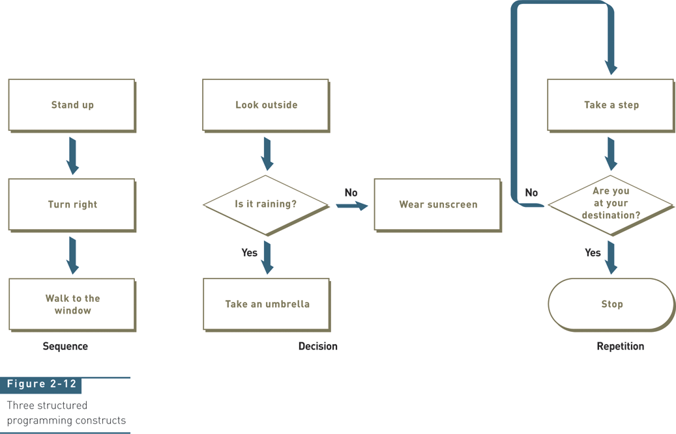
Three Structured Programming Constructs（结构化编程）
循环
顺序
判断
结构化流程图要注意：
1、有始有终
2、单入单出
Notes:
三种结构化编程结构：
顺序
判断
循环

Slide 30
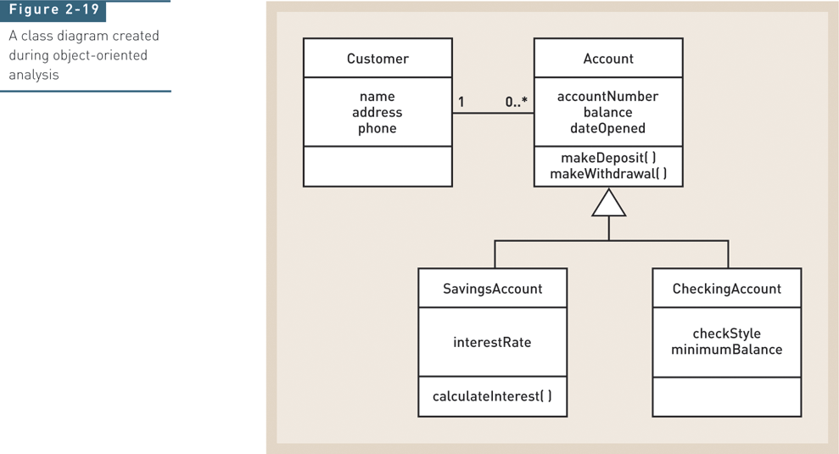
Class Diagram Created During OO Analysis（面向对象）
Notes:
面向对象分析期间创建的类图

Slide 31
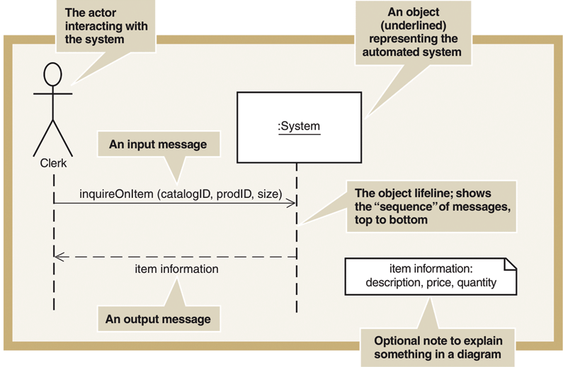
System Sequence Diagram
(SSD，系统顺序图)
Notes:
系统顺序图(SSD)表示法

Slide 32
Chapter 1 Outline
Software Development and Systems Analysis and Design
Systems Development Lifecycle
Iterative Development
Introduction to Ridgeline Mountain Outfitters
Developing RMO’s Tradeshow Systems
Where You are Headed—The Rest of the Book
© 2012 Cengage Learning. All Rights Reserved. This edition is intended for use outside of the U.S. only, with content that may be different from the U.S. Edition.
May not be scanned, copied, duplicated, or posted to a publicly accessible website, in whole or in part.
Notes:
Ridgeline Mountain Outfitters简介

Slide 33
Ridgeline Mountain Outfitters (RMO)
RMO是一家大型零售公司，专门生产不同种类的户外运动服装和相关配饰。
最初，RMO在犹他州等地区把衣服卖给当地的服装店
20世纪80年代后期到90年代早期，它通过邮寄和电话订购直接向顾客销售服装
2018年，它零售商店收入为6700万美元，电话订购和邮购达到1000万美元，网购销售额达到了2亿美元
© 2012 Cengage Learning. All Rights Reserved. This edition is intended for use outside of the U.S. only, with content that may be different from the U.S. Edition.
May not be scanned, copied, duplicated, or posted to a publicly accessible website, in whole or in part.

Slide 34
Ridgeline Mountain Outfitters (RMO)
© 2012 Cengage Learning. All Rights Reserved. This edition is intended for use outside of the U.S. only, with content that may be different from the U.S. Edition.
May not be scanned, copied, duplicated, or posted to a publicly accessible website, in whole or in part.

Slide 35
Ridgeline Mountain Outfitters (RMO)
背景：
为了保证生产线的现代化，RMO的采购代理人会参加世界各地的服装展和面料展。
过去，这些代理人想要订购RMO的商品时，需要在展览中与销售人员交换联系信息，等回到办公室后在通过电子邮件和电话进一步制定合同和购买订单。
为了迅速完成订单，RMO启动了一个项目：开发一个系统来收集和跟进它的代理人信息和待销售商品
© 2012 Cengage Learning. All Rights Reserved. This edition is intended for use outside of the U.S. only, with content that may be different from the U.S. Edition.
May not be scanned, copied, duplicated, or posted to a publicly accessible website, in whole or in part.

Slide 36
RMO Tradeshow System
Problem-- purchasing agents attend apparel and fabric trade shows around the world to order new products from suppliers（采购代理从供应商处订购新产品）
Need– information system (app) to collect and track information about suppliers and new products while at tradeshows（收集供应商和产品信息）
Tradeshow Project– is proposed
Supplier information subsystem（供应商信息子系统）
Product information subsystem（产品信息子系统）
© 2012 Cengage Learning. All Rights Reserved. This edition is intended for use outside of the U.S. only, with content that may be different from the U.S. Edition.
May not be scanned, copied, duplicated, or posted to a publicly accessible website, in whole or in part.
Notes:
问题——采购代理参加世界各地的服装和面料贸易展，从供应商那里订购新产品
需求——在贸易展览过程中，信息系统(应用程序)收集和跟踪有关供应商和新产品的信息
贸易展项目-被提议 供应商信息子系统
产品信息子系统

Slide 37
Pre-Project Activities
Identify the problem and document the objective of the system (core process 1)
Preliminary investigation（初步调查）
System Vision Document（系统愿景文档）
Obtain approval to commence the project (core process 1)
Meet with key stakeholders, including executive management（与利益相关者会面）
Decision reached, approve plan and budget（做出计划与预算决定）
© 2012 Cengage Learning. All Rights Reserved. This edition is intended for use outside of the U.S. only, with content that may be different from the U.S. Edition.
May not be scanned, copied, duplicated, or posted to a publicly accessible website, in whole or in part.
Notes:
项目前期工作：
识别问题并记录系统的目标(核心过程1) 初步调查 系统愿景文档
获得项目启动批准(核心过程1)
与主要利益相关者会面，包括执行管理层 作出决定，批准计划和预算

Slide 38
System Vision Document Problem description： 为什么要做？ System capabilities： 做什么？ Business benefits： 能带来什么收益？
© 2012 Cengage Learning. All Rights Reserved. This edition is intended for use outside of the U.S. only, with content that may be different from the U.S. Edition.
May not be scanned, copied, duplicated, or posted to a publicly accessible website, in whole or in part.
Notes:
问题描述（为什么要做）
系统功能（做什么）
业务收益（能带来什么收益）

Slide 39
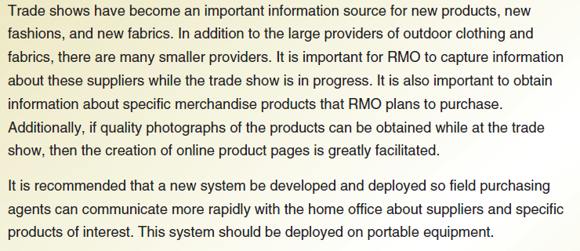
Problem Description
为什么要做？
区域代理商能够更快速地与供应商和感兴趣的产品进行沟通
© 2012 Cengage Learning. All Rights Reserved. This edition is intended for use outside of the U.S. only, with content that may be different from the U.S. Edition.
May not be scanned, copied, duplicated, or posted to a publicly accessible website, in whole or in part.
Notes:
为什么要做？区域代理商能够更快速地与供应商和感兴趣的产品进行沟通

Slide 40
System Capabilities
做什么？
收集和记录信息（供应商关键信息，产品信息），通过平台来沟通
© 2012 Cengage Learning. All Rights Reserved. This edition is intended for use outside of the U.S. only, with content that may be different from the U.S. Edition.
May not be scanned, copied, duplicated, or posted to a publicly accessible website, in whole or in part.
Notes:
做什么？收集和记录信息（供应商关键信息，产品信息），通过网络来沟通

Slide 41
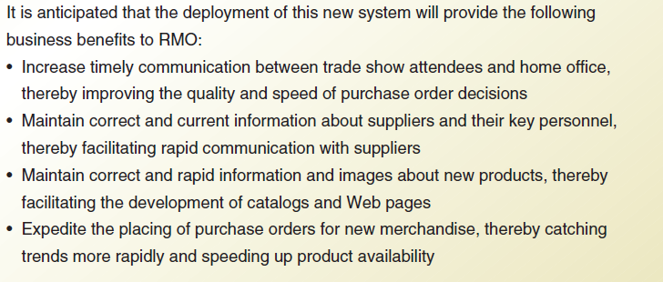
Business Benefits
能带来什么收益？
维护客户关系，更好地管理订单
© 2012 Cengage Learning. All Rights Reserved. This edition is intended for use outside of the U.S. only, with content that may be different from the U.S. Edition.
May not be scanned, copied, duplicated, or posted to a publicly accessible website, in whole or in part.
Notes:
能带来什么收益？维护客户关系，更好地管理订单

Slide 42
Ridgeline Mountain Outfitters (RMO)
“RMO贸易展览系统”立项了！
开启第1个迭代：
我们计划用6天时间完成本次迭代，来展示SDLC的所有核心过程
© 2012 Cengage Learning. All Rights Reserved. This edition is intended for use outside of the U.S. only, with content that may be different from the U.S. Edition.
May not be scanned, copied, duplicated, or posted to a publicly accessible website, in whole or in part.

Slide 43
Day 1 Activities
Core Process 2: Plan the Project（计划项目）
Determine the major components (functional areas) that are needed（确定主要组件）
Supplier information subsystem（供应商信息子系统）
Product information subsystem（产品信息子系统）
Define the iterations and assign each function to an iteration（将每个功能分配给每个迭代）
Decide to do Supplier subsystem first（先做供应商子系统）
Plan one iteration as it is small and straight forward
Determine team members and responsibilities（确定团队成员和职责）
© 2012 Cengage Learning. All Rights Reserved. This edition is intended for use outside of the U.S. only, with content that may be different from the U.S. Edition.
May not be scanned, copied, duplicated, or posted to a publicly accessible website, in whole or in part.
Notes:
核心过程2:计划项目
确定需要的主要组件(功能区域) 供应商信息子系统 产品信息子系统
定义迭代并将每个功能分配给每个迭代 决定先做供应商子系统 计划一次迭代，因为它是小而直接的
确定团队成员和职责

Slide 44
Work Breakdown Structure for Iteration（工作分解结构，基于SDLC后四个核心过程） 1. 发现并理解问题各个方面的细节 2.设计问题解决方案的组成部分（界面，数据库，结构等） 3. 代码实现各个组件 4. 进行系统级测试和部署
© 2012 Cengage Learning. All Rights Reserved. This edition is intended for use outside of the U.S. only, with content that may be different from the U.S. Edition.
May not be scanned, copied, duplicated, or posted to a publicly accessible website, in whole or in part.
Notes:
工作分解结构（基于SDLC中的后面四个核心过程）
1. 发现并理解问题各个方面的细节（与相关人员会谈）
2.设计问题解决方案的组成部分（界面，数据库，结构等）
3. 代码实现各个组件
4. 进行系统级测试和部署

Slide 45
Work Sequence Draft for Iteration （工作顺序草案） Elaborates on Work Breakdown Structure （详细阐述工作分解结构）
© 2012 Cengage Learning. All Rights Reserved. This edition is intended for use outside of the U.S. only, with content that may be different from the U.S. Edition.
May not be scanned, copied, duplicated, or posted to a publicly accessible website, in whole or in part.
Notes:
工作顺序草案（详细阐述工作分解结构）

Slide 46
Work Sequence Draft for Iteration （工作顺序草案）
三重优点：
它帮助团队组织工作，在编程开始之前就有足够的时间来考虑如何设计。
它提供了一个衡量标准来看这个迭代是否符合日程要求。
如果项目可能会延误，那么项目的领导者能够提早开始组织资源来帮助完成项目。
© 2012 Cengage Learning. All Rights Reserved. This edition is intended for use outside of the U.S. only, with content that may be different from the U.S. Edition.
May not be scanned, copied, duplicated, or posted to a publicly accessible website, in whole or in part.

Slide 47
Day 2 Activities
Core Process 3: Discover and Understand Details（发现和理解细节）
Do preliminary fact-finding to understand requirements（了解需求）
Develop a preliminary list of use cases（用例） and a use case diagram（用例图）
Develop a preliminary list of classes（类） and a class diagram（类图）
© 2012 Cengage Learning. All Rights Reserved. This edition is intended for use outside of the U.S. only, with content that may be different from the U.S. Edition.
May not be scanned, copied, duplicated, or posted to a publicly accessible website, in whole or in part.
Notes:
核心过程3:发现和理解细节
进行初步的事实调查以了解需求
开发用例的初步列表和用例图
开发一个类的初步列表和类图

Slide 48
Day 2 Activities
Core Process 3: Discover and Understand Details（发现和理解细节）
Do preliminary fact-finding to understand requirements（了解需求）
采访核心用户
观察工作过程
回顾现存的文件和系统
调查其他公司和其他系统
© 2012 Cengage Learning. All Rights Reserved. This edition is intended for use outside of the U.S. only, with content that may be different from the U.S. Edition.
May not be scanned, copied, duplicated, or posted to a publicly accessible website, in whole or in part.
Notes:
其中，进行初步的事实调查以了解需求，包括

Slide 49
Day 2 Activities
Core Process 3: Discover and Understand Details
Do preliminary fact-finding to understand requirements
Develop a preliminary list of use cases（用例） and a use case diagram（用例图）
用例记录了一个简单的用户触发商业活动和系统对这个活动的回应
© 2012 Cengage Learning. All Rights Reserved. This edition is intended for use outside of the U.S. only, with content that may be different from the U.S. Edition.
May not be scanned, copied, duplicated, or posted to a publicly accessible website, in whole or in part.
Notes:
开发用例的初步列表和用例图

Slide 50
Identify Use Cases Both subsystems
动词短语
© 2012 Cengage Learning. All Rights Reserved. This edition is intended for use outside of the U.S. only, with content that may be different from the U.S. Edition.
May not be scanned, copied, duplicated, or posted to a publicly accessible website, in whole or in part.

Slide 51
Day 2 Activities
Core Process 3: Discover and Understand Details
Do preliminary fact-finding to understand requirements
Develop a preliminary list of use cases and a use case diagram
Develop a preliminary list of classes（类） and a class diagram（类图）
寻找能描述事物类别的名词
© 2012 Cengage Learning. All Rights Reserved. This edition is intended for use outside of the U.S. only, with content that may be different from the U.S. Edition.
May not be scanned, copied, duplicated, or posted to a publicly accessible website, in whole or in part.
Notes:
开发一个类的初步列表和类图

Slide 52
Identify Object Classes Both subsystems
名词
© 2012 Cengage Learning. All Rights Reserved. This edition is intended for use outside of the U.S. only, with content that may be different from the U.S. Edition.
May not be scanned, copied, duplicated, or posted to a publicly accessible website, in whole or in part.

Slide 53
Preliminary Class Diagram Both subsystems
除了提供对象类列表外，分析员经常会绘制一个类、属性和它们与另外的类之间的关系图，称为类图：
© 2012 Cengage Learning. All Rights Reserved. This edition is intended for use outside of the U.S. only, with content that may be different from the U.S. Edition.
May not be scanned, copied, duplicated, or posted to a publicly accessible website, in whole or in part.

Slide 54
Day 3 Activities
Core Process 3: Discover and Understand Details（发现和理解细节）
Do in-depth fact-finding to understand requirements
Understand and document the detailed workflow of each use case
Core Process 4: Design System Components（设计系统组件）
Define the user experience with screens and reports（用屏幕展示和报告给用户直观体验）
© 2012 Cengage Learning. All Rights Reserved. This edition is intended for use outside of the U.S. only, with content that may be different from the U.S. Edition.
May not be scanned, copied, duplicated, or posted to a publicly accessible website, in whole or in part.
Notes:
核心过程3:发现和理解细节 进行深入的事实调查以了解需求 理解并记录每个用例的详细工作流程
核心流程4:设计系统组件 用屏幕展示和报告给出用户体验

Slide 55
Day 3 Activities
Core Process 3: Discover and Understand Details （发现和理解细节）
Do in-depth fact-finding to understand requirements（事实调查）
Understand and document the detailed workflow of each use case（了解用例工作流程）
Core Process 4: Design System Components
Define the user experience with screens and reports
© 2012 Cengage Learning. All Rights Reserved. This edition is intended for use outside of the U.S. only, with content that may be different from the U.S. Edition.
May not be scanned, copied, duplicated, or posted to a publicly accessible website, in whole or in part.
Notes:
核心过程3:发现和理解细节
进行深入的事实调查以了解需求 理解并记录每个用例的详细工作流程

Slide 56
Details Focus on Supplier Information Subsystem （供应商信息子系统细节）
Use cases:
Look up supplier（查找供应商）
Enter/update supplier information（输入/更新供应商信息）
Lookup contact information（查找联系信息）
Enter/update contract information（输入/更新合同信息）
© 2012 Cengage Learning. All Rights Reserved. This edition is intended for use outside of the U.S. only, with content that may be different from the U.S. Edition.
May not be scanned, copied, duplicated, or posted to a publicly accessible website, in whole or in part.
Notes:
供应商信息子系统细节
用例: 查找供应商
输入/更新供应商信息 查找联系信息 输入/更新合同信息

Slide 57
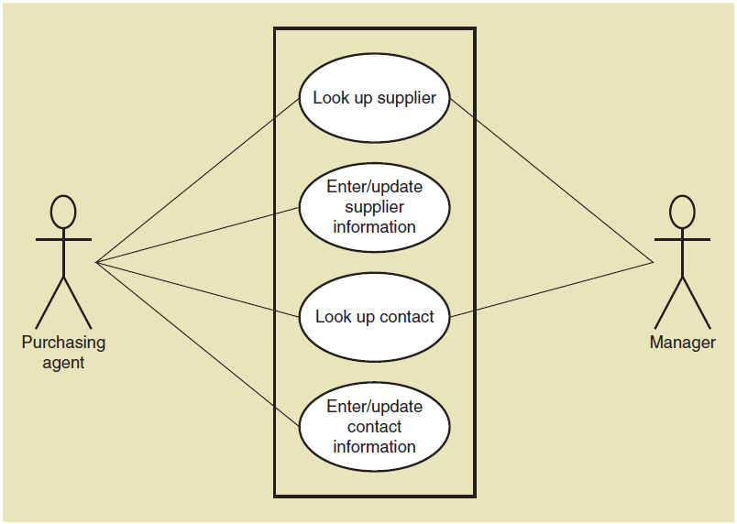
Use Case Diagram（用例图） Supplier information subsystem
© 2012 Cengage Learning. All Rights Reserved. This edition is intended for use outside of the U.S. only, with content that may be different from the U.S. Edition.
May not be scanned, copied, duplicated, or posted to a publicly accessible website, in whole or in part.
Notes:
购买代理人 管理者

Slide 58
Activity Diagram (Workflow) 开发工作流图： 记录一个用例的细节 Look up supplier use case 1. 椭圆代表任务，菱形代表决策点 2. 穿越中心线的箭头代表了系统和用户之间的相互作用
© 2012 Cengage Learning. All Rights Reserved. This edition is intended for use outside of the U.S. only, with content that may be different from the U.S. Edition.
May not be scanned, copied, duplicated, or posted to a publicly accessible website, in whole or in part.

Slide 59
Day 3 Activities
Core Process 3: Discover and Understand Details
Do in-depth fact-finding to understand requirements
Understand and document the detailed workflow of each use case
Core Process 4: Design System Components（设计系统组件）
Define the user experience with screens and reports（用屏幕和报告定义用户体验）
© 2012 Cengage Learning. All Rights Reserved. This edition is intended for use outside of the U.S. only, with content that may be different from the U.S. Edition.
May not be scanned, copied, duplicated, or posted to a publicly accessible website, in whole or in part.
Notes:
核心流程4:设计系统组件

Slide 60
Draft Screen Layout Look up supplier use case
© 2012 Cengage Learning. All Rights Reserved. This edition is intended for use outside of the U.S. only, with content that may be different from the U.S. Edition.
May not be scanned, copied, duplicated, or posted to a publicly accessible website, in whole or in part.
Notes:
屏幕布局草稿
查找供应商

Slide 61
Day 4 Activities
Core Process 4: Design System Components
Design the database (设计数据库)
Table design（表）
Key and index identification（主键、索引）
Attribute types（属性）
Referential integrity（参照完整性）
Design the system’s high level structure（高层结构）
Browser, Windows, or Smart phone（网页/单机/移动环境）
Architectural configuration (组件)
Design class diagram （设计类图）
Subsystem architectural design（系统结构）
© 2012 Cengage Learning. All Rights Reserved. This edition is intended for use outside of the U.S. only, with content that may be different from the U.S. Edition.
May not be scanned, copied, duplicated, or posted to a publicly accessible website, in whole or in part.
Notes:
核心流程4:设计系统组件
设计数据库(模式)
表设计 键和索引标识 属性类型 参照完整性
设计系统的高层结构 浏览器、Windows或智能手机 体系结构配置(组件) 设计类图 子系统体系结构设计

Slide 62
Database Schema
© 2012 Cengage Learning. All Rights Reserved. This edition is intended for use outside of the U.S. only, with content that may be different from the U.S. Edition.
May not be scanned, copied, duplicated, or posted to a publicly accessible website, in whole or in part.

Slide 63
Day 4 Activities
Core Process 4: Design System Components
Design the database (设计数据库)
Table design（表）
Key and index identification（主键、索引）
Attribute types（属性）
Referential integrity（参照完整性）
Design the system’s high level structure（高层结构）
Browser, Windows, or Smart phone（网页/单机/移动环境）
Architectural configuration (组件)
Design class diagram （设计类图）
Subsystem architectural design（系统结构）
© 2012 Cengage Learning. All Rights Reserved. This edition is intended for use outside of the U.S. only, with content that may be different from the U.S. Edition.
May not be scanned, copied, duplicated, or posted to a publicly accessible website, in whole or in part.
Notes:
核心流程4:设计系统组件
设计数据库(模式)
表设计 键和索引标识 属性类型 参照完整性
设计系统的高层结构 浏览器、Windows或智能手机 体系结构配置(组件) 设计类图 子系统体系结构设计

Slide 64
Architectural Configuration Diagram
© 2012 Cengage Learning. All Rights Reserved. This edition is intended for use outside of the U.S. only, with content that may be different from the U.S. Edition.
May not be scanned, copied, duplicated, or posted to a publicly accessible website, in whole or in part.
Notes:
体系结构配置图

Slide 65
Preliminary Design Class Diagram Includes View Layer（视图层） Classes and Domain Layer（域层） Classes Need to add Utility Classes（工具类） as well
© 2012 Cengage Learning. All Rights Reserved. This edition is intended for use outside of the U.S. only, with content that may be different from the U.S. Edition.
May not be scanned, copied, duplicated, or posted to a publicly accessible website, in whole or in part.
Notes:
初步设计类图
包括视图层类和域层类（业务层类）
还需要添加实用工具类

Slide 66
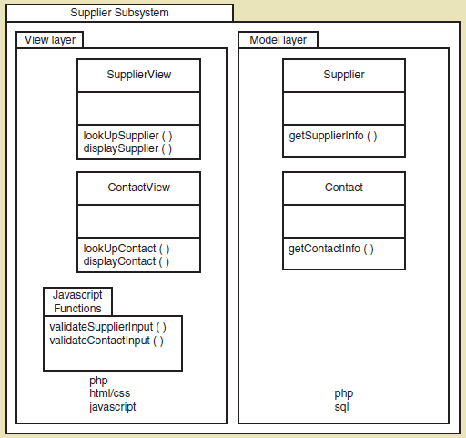
Subsystem Architectural Design Diagram （子系统架构设计图）
© 2012 Cengage Learning. All Rights Reserved. This edition is intended for use outside of the U.S. only, with content that may be different from the U.S. Edition.
May not be scanned, copied, duplicated, or posted to a publicly accessible website, in whole or in part.
Notes:
子系统架构设计图

Slide 67
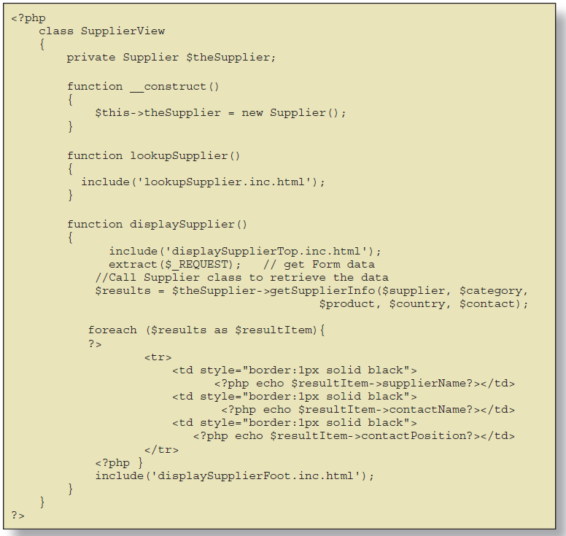
Code Example for One Class
© 2012 Cengage Learning. All Rights Reserved. This edition is intended for use outside of the U.S. only, with content that may be different from the U.S. Edition.
May not be scanned, copied, duplicated, or posted to a publicly accessible website, in whole or in part.
Notes:
一个代码例子

Slide 68
Notes on Managing the Project （项目管理须知）
Lots of design diagrams shown（设计图表展示了）
Design in a complex activity with multiple levels
High level architectural（高级架构）
Low level detailed design（底层详细设计）
One diagram builds on/complements another（一个图表建立在另一个图表的基础上）
Programming is also done concurrently（编程是并发完成的）
You don’t design everything then code（不需要设计所有东西再编码）
You do some design, some coding, some design, some coding（设计，编码，设计，编码迭代循环）
© 2012 Cengage Learning. All Rights Reserved. This edition is intended for use outside of the U.S. only, with content that may be different from the U.S. Edition.
May not be scanned, copied, duplicated, or posted to a publicly accessible website, in whole or in part.
Notes:
项目管理须知
许多设计图表 设计具有多个层次的复杂活动 高级架构 低层详细设计 一个图表建立在另一个图表的基础上 并不是所有的东西都用图表表示，尤其是对于一个小项目。
编程也是并发完成的 你不需要设计所有的东西然后再编码 你做一些设计，一些编码，一些设计，一些编码

Slide 69
Day 5 Activities
Core Process 4: Design System Components（设计系统组件）
Continue with design details（继续设计细节）
Proceed use case by use case（推进用例）
Core Process 5: Build, Test, and Integrate System Components（构建、测试和集成系统组件）
Continue programming (继续编程)
Build use case by use case（逐个用例来构建）
Perform unit and integration tests（执行单元和集成测试）
© 2012 Cengage Learning. All Rights Reserved. This edition is intended for use outside of the U.S. only, with content that may be different from the U.S. Edition.
May not be scanned, copied, duplicated, or posted to a publicly accessible website, in whole or in part.
Notes:
核心流程4:设计系统组件 继续设计细节
一个用例接一个用例
核心过程5:构建、测试和集成系统组件 继续编程 逐个用例来构建 执行单元和集成测试

Slide 70
Workflow of Testing Tasks 测试任务流程
© 2012 Cengage Learning. All Rights Reserved. This edition is intended for use outside of the U.S. only, with content that may be different from the U.S. Edition.
May not be scanned, copied, duplicated, or posted to a publicly accessible website, in whole or in part.
Notes:
测试任务流程
开始-》创建测试数据-》进行测试-》如果有错误-》修复错误

Slide 71
Day 6 Activities
Core Process 6: Complete System Testing and Deploy System （完成系统测试和部署系统）
Perform system functional testing（执行系统功能测试）
Perform user acceptance testing（执行用户验收测试）
Possibly deploy part of system（可能部署系统的一部分进行测试）
© 2012 Cengage Learning. All Rights Reserved. This edition is intended for use outside of the U.S. only, with content that may be different from the U.S. Edition.
May not be scanned, copied, duplicated, or posted to a publicly accessible website, in whole or in part.
Notes:
核心流程6:完成系统测试和部署系统
执行系统功能测试 执行用户验收测试 可能部署系统的一部分

Slide 72
Screen Capture for Look up supplier use case（查找供应商界面）
© 2012 Cengage Learning. All Rights Reserved. This edition is intended for use outside of the U.S. only, with content that may be different from the U.S. Edition.
May not be scanned, copied, duplicated, or posted to a publicly accessible website, in whole or in part.
Notes:
查找供应商用例的屏幕截图

Slide 73
First Iteration Recap （第一次迭代回顾）
This was a 6 day iteration of small project
Most iterations are longer (2 to 4 weeks)
This project might be 2 iterations
Most projects have many more iterations （大多数项目都有更多迭代）
End users need to be involved, particularly in day 1, 2, 3 and 6.（终端用户需要参与进来）
Days 4 and 5 involved design and programming concurrently.（设计与编程同步进行）
Lots of time was spent programming along with design (not emphasized here)
© 2012 Cengage Learning. All Rights Reserved. This edition is intended for use outside of the U.S. only, with content that may be different from the U.S. Edition.
May not be scanned, copied, duplicated, or posted to a publicly accessible website, in whole or in part.
Notes:
第一次迭代回顾
这是一个为期6天的小项目迭代 大多数迭代都更长(2到4周) 这个项目可能有2个迭代 大多数项目都有更多的迭代
终端用户需要参与进来，特别是在第1、2、3和6天。
第4天和第5天同时涉及设计和编程。
很多时间都花在了编程和设计上

Slide 74
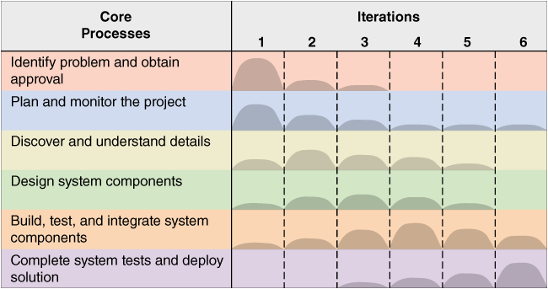
This Book is about Activities and Tasks in the SDLC
© 2012 Cengage Learning. All Rights Reserved. This edition is intended for use outside of the U.S. only, with content that may be different from the U.S. Edition.
May not be scanned, copied, duplicated, or posted to a publicly accessible website, in whole or in part.
Notes:
这本书是关于系统开发生命周期中的活动和任务

Slide 75
Chapter 1 Outline
Software Development and Systems Analysis and Design
Systems Development Lifecycle
Iterative Development
Introduction to Ridgeline Mountain Outfitters
Developing RMO’s Tradeshow Systems
Where You are Headed—The Rest of the Book（书的其余章节）
© 2012 Cengage Learning. All Rights Reserved. This edition is intended for use outside of the U.S. only, with content that may be different from the U.S. Edition.
May not be scanned, copied, duplicated, or posted to a publicly accessible website, in whole or in part.
Notes:
最后一部分：书的其余部分

Slide 76
Where You Are Headed
Chapter 1: From Beginning to End（从开始到结束）
Small project overview emphasizing analysis and design and iterative development（系统开发生命周期）
Done!
Chapter 2: Investigating System Requirements（需求）
More about core process 3: Systems analysis activities
Chapter 3: Use Cases（用例）
Techniques for Identifying and modeling use cases for systems analysis
© 2012 Cengage Learning. All Rights Reserved. This edition is intended for use outside of the U.S. only, with content that may be different from the U.S. Edition.
May not be scanned, copied, duplicated, or posted to a publicly accessible website, in whole or in part.
Notes:
第一章:从开始到结束 小项目概述，强调分析、设计和迭代开发 完成了!
第二章:调查系统需求 更多关于核心流程3:系统分析活动
第3章:用例
为系统分析识别和建模用例的技术

Slide 77
Where You Are Headed
Chapter 4: Domain Modeling（域建模）
Techniques for Identifying and modeling domain classes for systems analysis
Chapter 5: Extending the Requirements Models（扩展需求模型）
Modeling more details about use cases and domain classes for systems analysis
© 2012 Cengage Learning. All Rights Reserved. This edition is intended for use outside of the U.S. only, with content that may be different from the U.S. Edition.
May not be scanned, copied, duplicated, or posted to a publicly accessible website, in whole or in part.
Notes:
第4章:域建模 为系统分析识别和建模领域类的技术
第5章:扩展需求模型 为系统分析建模关于用例和领域类的更多细节
以上主要解决的是需求

Slide 78
Where You Are Headed
Chapter 6: Essentials of Design（设计）
More about core process 4: system design activities
Chapter 7: Designing User and System Interfaces（接口）
Human computer interaction, user interface design principles, outputs and reports, system interfaces
Chapter 8: Approaches to System Development（系统开发）
More about the SDLC, models, tools, techniques, and agile methodologies
Chapter 9: Project Planning and Project Management（项目计划和项目管理）
© 2012 Cengage Learning. All Rights Reserved. This edition is intended for use outside of the U.S. only, with content that may be different from the U.S. Edition.
May not be scanned, copied, duplicated, or posted to a publicly accessible website, in whole or in part.
Notes:
第六章:设计要点 更多关于核心流程4:系统设计活动
第七章:设计用户和系统接口 人机交互，用户界面设计原理，输出和报告，系统接口
以上主要是设计
第8章:系统开发方法 更多关于SDLC、模型、工具、技术和敏捷方法的内容
第9章:项目计划和项目管理 关于核心进程1和2的更多信息
以上更多是开发方法和项目管理

Slide 79
Where You Are Headed
Chapter 10: Object-Oriented Design: Principles（面向对象设计原则）
Design principles, design models, and designing use cases
Chapter 11: Object-Oriented Design: Use Case Realization（面向对象设计）
Three layer design and design patterns
Chapter 12: Databases, Controls, and Security（数据库、控件和安全性）
More about database design and protecting the integrity of the system.
© 2012 Cengage Learning. All Rights Reserved. This edition is intended for use outside of the U.S. only, with content that may be different from the U.S. Edition.
May not be scanned, copied, duplicated, or posted to a publicly accessible website, in whole or in part.
Notes:
第10章:面向对象设计原则 设计原则、设计模型和设计用例
第11章:面向对象设计:用例实现 三层设计和设计模式
第12章:数据库、控件和安全性 更多关于数据库的设计和保护系统的完整性。

Slide 80
Summary
This text is about developing information systems that solve an organization need
Chapter 1 takes you through the whole process for one small information system
System development involves 6 core processes, known as the SDLC（6个核心过程）
The rest of the text elaborates on the basic processes shown in chapter 1
© 2012 Cengage Learning. All Rights Reserved. This edition is intended for use outside of the U.S. only, with content that may be different from the U.S. Edition.
May not be scanned, copied, duplicated, or posted to a publicly accessible website, in whole or in part.
Notes:
本章小结：
我们解决的是开发信息系统来解决一个组织的需求
第1章介绍一个小型信息系统的整个过程
系统开发涉及6个核心过程，称为系统开发生命周期（SDLC）
正文的其余部分详细阐述了第1章所示的基本过程

Slide 81
Summary
Terms to review and know include:
Computer application（计算机应用）
Information system（信息系统）
Systems analysis（系统分析）
System design（系统设计）
System development lifecycle (SDLC，系统开发生命周期)
Information system development process (methodology，信息系统开发过程)
Agile development（敏捷开发）
Iterative development（迭代开发）
© 2012 Cengage Learning. All Rights Reserved. This edition is intended for use outside of the U.S. only, with content that may be different from the U.S. Edition.
May not be scanned, copied, duplicated, or posted to a publicly accessible website, in whole or in part.
Notes:
需要复习和了解的术语包括: 计算机应用 信息系统 系统分析 系统设计 系统开发生命周期(SDLC)
信息系统开发过程(方法论) 敏捷开发 迭代开发

