Slide 1
INTRODUCTION TO
SYSTEMS ANALYSIS AND DESIGN:
AN AGILE, ITERATIVE APPROACH
SATZINGER | JACKSON | BURD
CHAPTER 3
Chapter 3

Slide 2
Use Cases
Chapter 3
Introduction to Systems
Analysis and Design:
An Agile, Iteractive Approach
6th Ed
Satzinger, Jackson & Burd
© 2012 Cengage Learning. All Rights Reserved. This edition is intended for use outside of the U.S. only, with content that may be different from the U.S. Edition.
May not be scanned, copied, duplicated, or posted to a publicly accessible website, in whole or in part.
Notes:
用例

Slide 3
Chapter 3 Outline
Use Cases and User Goals（用例和用户目标）
Use Cases and Event Decomposition（用例和事件分解）
Use Cases and CRUD（用例和CRUD）
Use Cases in the Ridgeline Mountain Outfitters Case（RMO中的用例）
Use Case Diagrams（用例图）
© 2012 Cengage Learning. All Rights Reserved. This edition is intended for use outside of the U.S. only, with content that may be different from the U.S. Edition.
May not be scanned, copied, duplicated, or posted to a publicly accessible website, in whole or in part.
Notes:
用例和用户目标
用例和事件分解
用例和CRUD
RMO案例中的用例
用例图

Slide 4
Learning Objectives
Explain why identifying use cases is the key to defining functional requirements（为什么确定用例是定义功能性需求的关键）
Describe the two techniques for identifying use cases（确定用例的两种技术）
Apply the user goal technique to identify use cases（将用户目标技术运用于确定用例）
Apply the event decomposition technique to identify use cases（将事件分解技术运用于确定用例）
© 2012 Cengage Learning. All Rights Reserved. This edition is intended for use outside of the U.S. only, with content that may be different from the U.S. Edition.
May not be scanned, copied, duplicated, or posted to a publicly accessible website, in whole or in part.
Notes:
学习目标：
阐述为什么确定用例是定义功能需求的关键
描述确定用例的两种技术
将用户目标技术运用于确定用例
将事件分解技术运用于确定用例
将CRUD技术运用于确认和细化用例列表
描述用例图的符号和作用
通过参与者和子系统画用例图

Slide 5
Learning Objectives
Apply the CRUD technique to validate and refine the list of use cases（将CRUD技术运用于确认和细化用例列表）
Describe the notation and purpose for the use case diagram（描述用例图的符号和作用）
Draw use case diagrams by actor and by subsystem（通过参与者和子系统画用例图）
© 2012 Cengage Learning. All Rights Reserved. This edition is intended for use outside of the U.S. only, with content that may be different from the U.S. Edition.
May not be scanned, copied, duplicated, or posted to a publicly accessible website, in whole or in part.
Notes:
学习目标：
阐述为什么确定用例是定义功能需求的关键
描述确定用例的两种技术
将用户目标技术运用于确定用例
将事件分解技术运用于确定用例
将CRUD技术运用于确认和细化用例列表
描述用例图的符号和作用
通过参与者和子系统画用例图

Slide 6
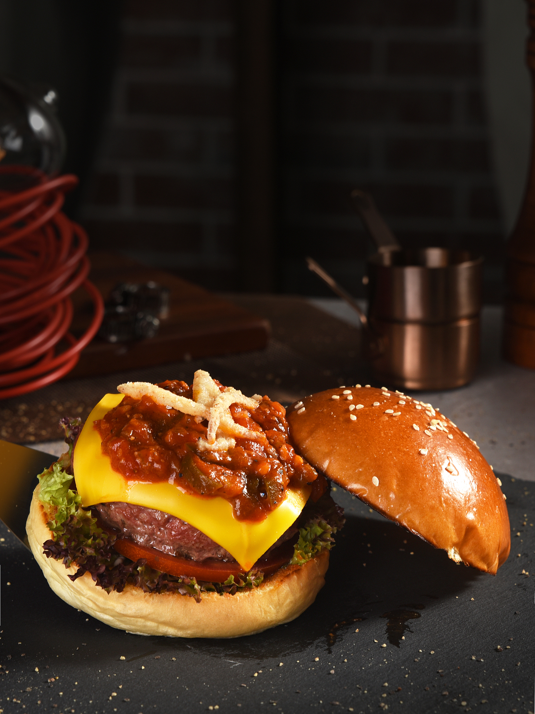
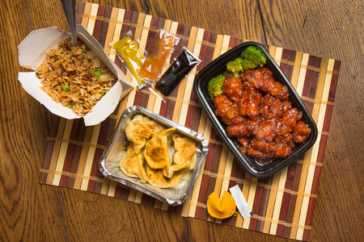
开篇案例：Waiters on Call
Waiters on Call是在2008年由Sue和Tom Bickford开创的一项餐厅送餐服务。

Slide 7
开篇案例：Waiters on Call
当业务逐渐扩大时，Bickford兄弟意识到他们需要一套专门的计算机系统来支持运营：
记录顾客订餐需求
餐厅查看顾客订单
为司机派单
司机更新空闲时间
顾客修改订单需求
……

Slide 8
Overview
Chapter 2 provided an overview of systems analysis activities, functional and non-functional requirements, modeling, and information gathering techniques（第2章概述了系统分析活动、功能和非功能需求、建模和信息收集技术）
This chapter focuses on identifying and modeling the key aspect of functional requirements– use cases（本章着重于识别和建模功能需求的关键方面——用例）
© 2012 Cengage Learning. All Rights Reserved. This edition is intended for use outside of the U.S. only, with content that may be different from the U.S. Edition.
May not be scanned, copied, duplicated, or posted to a publicly accessible website, in whole or in part.
Notes:
本章概述：
第2章概述了系统分析活动、功能和非功能需求、建模和信息收集技术
本章着重于识别和建模功能需求的关键方面——用例
在第一章的RMO展销系统中，一些用例是查找供应商、输入/更新产品信息、输入/更新联系信息
在本章的开头案例“随叫随到的服务员”中，用例的示例有:记录订单、记录交货、更新订单、签到司机、核对司机收据、产生当天的存款

Slide 9
Overview
In the RMO Tradeshow System from Chapter 1, some use cases are Look up supplier, Enter/update product information, Enter/Update contact information（在第一章的RMO展销系统中，一些用例是查找供应商、输入/更新产品信息、输入/更新联系信息）
In this chapter’s opening case Waiters on Call, examples of use cases are Record an order, Record delivery, Update an order, Sign in driver, Reconcile driver receipts, Produce end of day deposit slip, and Produce weekly sales reports（在本章的开头案例“随叫随到的服务员”中，用例的示例有:记录订单、记录交货、更新订单、签到司机、核对司机收据、产生当天的存款）
© 2012 Cengage Learning. All Rights Reserved. This edition is intended for use outside of the U.S. only, with content that may be different from the U.S. Edition.
May not be scanned, copied, duplicated, or posted to a publicly accessible website, in whole or in part.
Notes:
本章概述：
第2章概述了系统分析活动、功能和非功能需求、建模和信息收集技术
本章着重于识别和建模功能需求的关键方面——用例
在第一章的RMO展销系统中，一些用例是查找供应商、输入/更新产品信息、输入/更新联系信息
在本章的开头案例“随叫随到的服务员”中，用例的示例有:记录订单、记录交货、更新订单、签到司机、核对司机收据、产生当天的存款

Slide 10
Chapter 3 Outline
Use Cases and User Goals（用例和用户目标）
Use Cases and Event Decomposition
Use Cases and CRUD
Use Cases in the Ridgeline Mountain Outfitters Case
Use Case Diagrams
© 2012 Cengage Learning. All Rights Reserved. This edition is intended for use outside of the U.S. only, with content that may be different from the U.S. Edition.
May not be scanned, copied, duplicated, or posted to a publicly accessible website, in whole or in part.
Notes:
用例和用户目标

Slide 11
Use Cases
Use case（用例）— an activity that the system performs, usually in response to a request by a user（系统执行的活动，通常是对用户请求的响应）
Use cases define functional requirements(用例定义功能需求)
Analysts decompose the system into a set of use cases (functional decomposition) （分析人员将系统分解为一组用例）
© 2012 Cengage Learning. All Rights Reserved. This edition is intended for use outside of the U.S. only, with content that may be different from the U.S. Edition.
May not be scanned, copied, duplicated, or posted to a publicly accessible website, in whole or in part.
Notes:
用例——系统执行的活动，通常是对用户请求的响应
用例定义功能需求
分析人员将系统分解为一组用例(功能分解)
识别用例的两种技术
1)用户目标技术
2)事件分解技术
用动词名词命名每个用例
用例: 什么人

Slide 12
Use Cases
Two techniques for Identifying use cases（识别用例的两种技术）
1) User goal technique（用户目标技术）
2) Event decomposition technique（事件分解技术）
Name each use case using Verb-Noun（动词-名词）
用例：do something
© 2012 Cengage Learning. All Rights Reserved. This edition is intended for use outside of the U.S. only, with content that may be different from the U.S. Edition.
May not be scanned, copied, duplicated, or posted to a publicly accessible website, in whole or in part.
Notes:
用例——系统执行的活动，通常是对用户请求的响应
用例定义功能需求
分析人员将系统分解为一组用例(功能分解)
识别用例的两种技术
1)用户目标技术
2)事件分解技术
用动词名词命名每个用例
用例: 什么人

Slide 13
1) User Goal Technique（用户目标技术）
Identify all of the potential categories of users of the system（识别系统的所有潜在用户类别）
Interview and ask them to describe the tasks the computer can help them with （请他们描述本系统可以帮助他们完成的任务）
Probe further to refine the tasks into specific user goals, “I need to Ship items, Track a shipment, Create a return” （进一步将任务细化为特定的用户目标，“我需要发送物品、跟踪发货、创建退货”）
This technique is the most common in industry
Simple and effective
© 2012 Cengage Learning. All Rights Reserved. This edition is intended for use outside of the U.S. only, with content that may be different from the U.S. Edition.
May not be scanned, copied, duplicated, or posted to a publicly accessible website, in whole or in part.
Notes:
1)用户目标技术:
识别系统的所有潜在用户类别
请他们描述计算机可以帮助他们完成的任务
进一步将任务细化为特定的用户目标，“我需要发送物品、跟踪发货、创建退货”。
这种技术在工业中最为常见 简单有效

Slide 14
1) User Goal Technique: Specific Steps
Identify all the potential users for the new system（定义新系统所有的潜在用户）
Classify the potential users in terms of their functional role (e.g., shipping, marketing, sales)（根据潜在用户的功能角色进行分类：运输、营销、销售）
Further classify potential users by organizational level (e.g., operational, management, executive)（通过组织的层次进一步将潜在用户分类：运营、管理、执行）
© 2012 Cengage Learning. All Rights Reserved. This edition is intended for use outside of the U.S. only, with content that may be different from the U.S. Edition.
May not be scanned, copied, duplicated, or posted to a publicly accessible website, in whole or in part.
Notes:
定义新系统所有的潜在用户
根据潜在用户的功能角色进行分类（运输，营销，销售）
通过组织的层次进一步将潜在用户分类（运营、管理、执行）

Slide 15
1) User Goal Technique Specific Steps
For each type of user, interview them to find a list of specific goals they will have when using the new system (current goals and innovative functions to add value)（采访用户收集系统目标）
Create a list of preliminary use cases organized by type of user（创建按用户类型组织的主要用例列表）
Look for duplicates with similar use case names and resolve inconsistencies（寻找相似的用例名称去掉重复用例）
© 2012 Cengage Learning. All Rights Reserved. This edition is intended for use outside of the U.S. only, with content that may be different from the U.S. Edition.
May not be scanned, copied, duplicated, or posted to a publicly accessible website, in whole or in part.
Notes:
4. 针对每种用户进行采访，并发现他们使用这个新系统时的一系列特定目标。
5. 创建按用户类型组织的主要用例列表
6. 寻找相似用例名字的重复之处并解决矛盾

Slide 16
1) User Goal Technique Specific Steps
Identify where different types of users need the same use cases（确定不同类型用户在哪里需要相同的用例）
Review the completed list with each type of user and then with interested stakeholders（与每种类型的利益相关者检查用例列表）
© 2012 Cengage Learning. All Rights Reserved. This edition is intended for use outside of the U.S. only, with content that may be different from the U.S. Edition.
May not be scanned, copied, duplicated, or posted to a publicly accessible website, in whole or in part.
Notes:
7.确定不同类型的用户在哪里需要相同的用例
8.与每种类型的用户一起检查完整的列表，然后与感兴趣的利益相关者一起检查

Slide 17
1) User Goal Technique Some RMO CSMS Users and Goals
somebody
do something
© 2012 Cengage Learning. All Rights Reserved. This edition is intended for use outside of the U.S. only, with content that may be different from the U.S. Edition.
May not be scanned, copied, duplicated, or posted to a publicly accessible website, in whole or in part.
Notes:
潜在用户 -> 查询产品，加载购物车，查看产品评价
市场部经理 -> 添加/更新产品信息，添加/更新促销，销售历史记录
运输人员 -> 运输产品，跟踪运输，处理产品退货

Slide 18
Chapter 3 Outline
Use Cases and User Goals
Use Cases and Event Decomposition（用例和事件分解）
Use Cases and CRUD
Use Cases in the Ridgeline Mountain Outfitters Case
Use Case Diagrams
© 2012 Cengage Learning. All Rights Reserved. This edition is intended for use outside of the U.S. only, with content that may be different from the U.S. Edition.
May not be scanned, copied, duplicated, or posted to a publicly accessible website, in whole or in part.
Notes:
用例和事件分解

Slide 19
2) Event Decomposition Technique（事件分解技术）
More Comprehensive and Complete Technique（更全面和完整的技术）
Identify the events that occur to which the system must respond. （确定系统必须响应的事件）
For each event, name a use case (verb-noun) that describes what the system does when the event occurs（对于每个事件，命名一个用例：动词-名词）
Event（事件）– something that occurs at a specific time and place, can be described, and should be remembered by the system（在特定时间和地点发生的事情）
© 2012 Cengage Learning. All Rights Reserved. This edition is intended for use outside of the U.S. only, with content that may be different from the U.S. Edition.
May not be scanned, copied, duplicated, or posted to a publicly accessible website, in whole or in part.
Notes:
2)事件分解技术
更全面和完整的技术： 确定系统必须响应的事件。 对于每个事件，命名一个用例(动词-名词)，描述当事件发生时系统所做的事情
事件-在特定时间和地点发生的事情，可以被描述，并且应该被系统记住

Slide 20
2) Event Decomposition Technique
用户提出了三个需求，哪一个是合适的用例？
A: 在表格中输入一个顾客姓名
B：增加新顾客信息
C：增加新顾客、删除顾客、跟踪预期付款的顾客、联系以前的顾客
用来确定用例的合适细节级别是基本业务流程（ Elementary Business Process, EBP ）。
基本业务流程是由一个人在特定地点为了响应交易事件所执行的一项任务，它增加了可衡量的业务价值，保持了系统与数据的稳定和一致。
© 2012 Cengage Learning. All Rights Reserved. This edition is intended for use outside of the U.S. only, with content that may be different from the U.S. Edition.
May not be scanned, copied, duplicated, or posted to a publicly accessible website, in whole or in part.

Slide 21
Types of Events
External Event：外部事件
an event that occurs outside the system, usually initiated by an external agent or actor
Temporal Event：时间事件
an event that occurs as a result of reaching a point in time
State Event：状态事件（内部事件）
an event that occurs when something happens inside the system that triggers some process
reorder point is reached for inventory item
© 2012 Cengage Learning. All Rights Reserved. This edition is intended for use outside of the U.S. only, with content that may be different from the U.S. Edition.
May not be scanned, copied, duplicated, or posted to a publicly accessible website, in whole or in part.
Notes:
外部事件:外部事件发生在系统外部的事件，通常由外部代理或参与者发起
时间事件:时间事件由于到达某个时间点而发生的事件
状态事件:状态事件(内部事件):当系统内部发生某些事情时发生的事件（库存物品到达重新订购点）

Slide 22
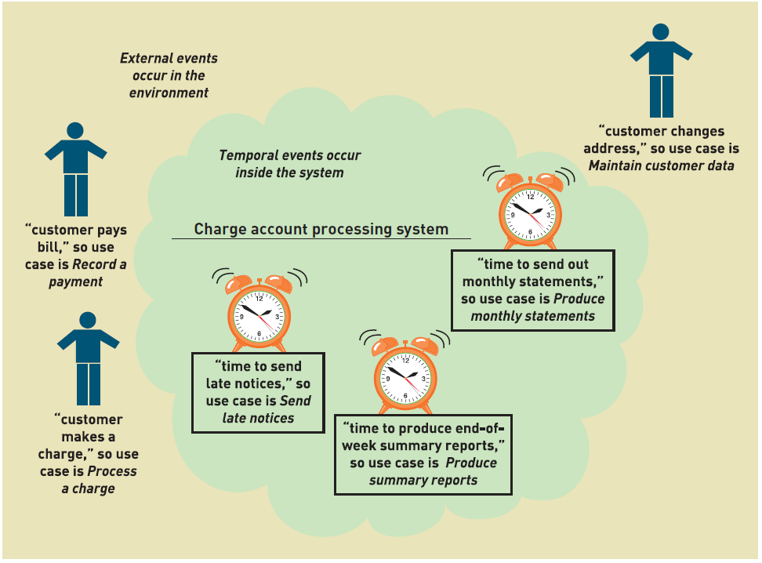
Events and Use Cases
© 2012 Cengage Learning. All Rights Reserved. This edition is intended for use outside of the U.S. only, with content that may be different from the U.S. Edition.
May not be scanned, copied, duplicated, or posted to a publicly accessible website, in whole or in part.
Notes:
环境中发生的外部事件（用户付款）
发生在系统内部的时间事件（发出月度账单，延迟通知，周总结报告）

Slide 23
External Event Checklist （外部事件清单）
External agent or actor wants something resulting in a transaction（外部代理需要导致交易的结果）
Customer buys a product（顾客购买产品）
External agent or actor wants some information（外部代理需要信息）
Customer wants to know product details（客户查看产品细节）
External data changed and needs to be updated（外部数据需要更新）
Customer has new address and phone（客户有新地址电话）
Management wants some information（管理层想要信息）
Sales manager wants update on production plans（销售经理想要最新的生产计划）
© 2012 Cengage Learning. All Rights Reserved. This edition is intended for use outside of the U.S. only, with content that may be different from the U.S. Edition.
May not be scanned, copied, duplicated, or posted to a publicly accessible website, in whole or in part.
Notes:
外部事件清单：
外部代理或参与者想要交易的结果 顾客购买产品
外部代理或参与者需要一些信息 客户想知道产品细节
外部数据发生变化，需要更新 客户有新的地址和电话
管理层想要一些信息 销售经理想要最新的生产计划

Slide 24
Temporal Event Checklist （时间事件清单）
Internal outputs needed at points in time（在某时间点进行内部输出）
Management reports (summary)（管理报告）
Operational reports (detailed transactions)（运营报告）
Internal statements and documents (including payroll)（内部报表及文件，如工资单）
External outputs needed at points of time（在特定时间需要外部输出）
Statements, status reports, bills, reminders（报表、报告、账单、提醒）
© 2012 Cengage Learning. All Rights Reserved. This edition is intended for use outside of the U.S. only, with content that may be different from the U.S. Edition.
May not be scanned, copied, duplicated, or posted to a publicly accessible website, in whole or in part.
Notes:
时间事件清单：
在时间点需要的内部输出 管理报告 运营报告(详细交易)
内部报表及文件(包括工资单)
在特定时间点需要外部输出 报表，状态报告，账单，提醒

Slide 25
Finding the actual event that affects the system（查找影响系统的实际事件）
© 2012 Cengage Learning. All Rights Reserved. This edition is intended for use outside of the U.S. only, with content that may be different from the U.S. Edition.
May not be scanned, copied, duplicated, or posted to a publicly accessible website, in whole or in part.
Notes:
查找影响系统的实际事件
客户想要一件新的T恤
客户开车去商场
客户试了一件T恤
客户又去了沃尔玛
客户在沃尔玛又试了一件
客户买了一件（实际影响系统的事件）

Slide 26
Tracing a sequence of transactions resulting in many events（跟踪导致许多事件的交易序列）
© 2012 Cengage Learning. All Rights Reserved. This edition is intended for use outside of the U.S. only, with content that may be different from the U.S. Edition.
May not be scanned, copied, duplicated, or posted to a publicly accessible website, in whole or in part.
Notes:
跟踪导致许多事件的交易序列
客户想要一本产品目录
客户想要查看有那些产品
客户下了一个订单
客户改变或者取消了订单
客户想要查看订单状态
客户更新账户信息
客户进行退货

Slide 27
Perfect Technology Assumption（理想技术假设）
理想技术假设：只有在最佳条件下系统才需要做出响应，这样的事件才应该在分析阶段考虑进去
© 2012 Cengage Learning. All Rights Reserved. This edition is intended for use outside of the U.S. only, with content that may be different from the U.S. Edition.
May not be scanned, copied, duplicated, or posted to a publicly accessible website, in whole or in part.
Notes:
理想技术假设：
设备不会损坏、处理和存储能力没有限制、用户操作完全遵照系统要求且没有误操作
在考虑设计问题之前，不要太担心一下这些问题：
用户想登录系统
用户想要修改密码
用户想要改变偏好设置
系统崩了，需要数据库恢复
备份数据库
需要用户来更改密码

Slide 28
Event Decomposition Technique: Specific Steps
Consider the external events in the system environment that require a response from the system by using the checklist（考虑系统环境中的外部事件，需要从系统获得响应）
For each external event, identify and name the use case that the system requires（对于每个外部事件，设计用例）
Consider the temporal events that require a response from the system by using the checklist （考虑需要系统响应的时间事件）
For each temporal event, identify and name the use case that the system requires and then establish the point of time that will trigger the use case（对于时间事件，设计用例，建立触发用例的时间点）
© 2012 Cengage Learning. All Rights Reserved. This edition is intended for use outside of the U.S. only, with content that may be different from the U.S. Edition.
May not be scanned, copied, duplicated, or posted to a publicly accessible website, in whole or in part.
Notes:
事件分解技术:具体步骤
1. 考虑系统环境中的外部事件，这些事件需要从系统获得响应
2. 对于每个外部事件，识别并命名系统需要的用例
3. 考虑需要系统响应的时间事件
4. 对于每个时间事件，识别并命名系统需要的用例，然后建立将触发用例的时间点

Slide 29
Event Decomposition Technique: Specific Steps (continued)
Consider the state events（状态事件） that the system might respond to, particularly if it is a real-time system in which devices or internal state changes trigger use cases.（设置状态事件的触发用例）
For each state event, identify and name the use case that the system requires and then define the state change.（设计状态事件的状态改变）
When events and use cases are defined, check to see if they are required by using the perfect technology assumption. Do not include events that involve such system controls as login, logout, change password, and backup or restore the database, as these are put in later.（检查完美技术假设。不涉及登陆、注销、更改密码、备份数据库等事件，这些事件稍后添加）
© 2012 Cengage Learning. All Rights Reserved. This edition is intended for use outside of the U.S. only, with content that may be different from the U.S. Edition.
May not be scanned, copied, duplicated, or posted to a publicly accessible website, in whole or in part.
Notes:
5. 考虑系统可能响应的状态事件，特别是如果它是一个实时系统，其中设备或内部状态更改触发用例。
6. 对于每个状态事件，识别并命名系统需要的用例，然后定义状态更改。
7. 定义事件和用例后，检查是否需要使用完美的技术假设。不要包含涉及诸如登录、注销、更改密码以及备份或恢复数据库等系统控制的事件，因为这些事件将在稍后添加。

Slide 30
Event Decomposition Technique: Benefits
Events are broader than user goal: Capture temporal and state events（事件比用户目标更广泛：捕获时间和状态事件）
Help decompose at the right level of analysis: an elementary business process (EBP)（基本业务流程）
EBP is a fundamental business process performed by one person, in one place, in response to a business event（EBP是基本的业务流程）
Uses perfect technology assumption to make sure functions that support the users work are identified and not additional functions for security and system controls（使用完美技术假设来识别用例）
© 2012 Cengage Learning. All Rights Reserved. This edition is intended for use outside of the U.S. only, with content that may be different from the U.S. Edition.
May not be scanned, copied, duplicated, or posted to a publicly accessible website, in whole or in part.
Notes:
事件分解技术的好处：
事件比用户目标更广泛:捕获时间和状态事件
帮助在正确的分析级别进行分解:基本业务流程(EBP)
EBP是一个基本的业务流程，由一个人在一个地方执行，以响应业务事件
使用完美的技术假设来确保识别支持用户工作的功能，而不是用于安全和系统控制的附加功能

Slide 31

主观题
10分
List events occurred on the first day when you registered yourself for the university.
注册新生账号
办理学生卡
办理住宿
购买新书
…
正常使用主观题需2.0以上版本雨课堂
作答
Notes:
列出你在大学注册第一天发生的事件。

Slide 32
主观题
10分
在学生管理系统中哪些属于外部事件、临时事件和内部事件？
注册新生账号
办理学生卡
办理住宿
购买新书
外部事件
统计学生期末成绩
统计每月跑操时长
时间事件
当学生旷课3次以上
当学生挂科6门以上
内部（状态）事件
正常使用主观题需2.0以上版本雨课堂
作答

Slide 33
Chapter 3 Outline
Use Cases and User Goals
Use Cases and Event Decomposition
Use Cases and CRUD（用例和CRUD）
Use Cases in the Ridgeline Mountain Outfitters Case
Use Case Diagrams
© 2012 Cengage Learning. All Rights Reserved. This edition is intended for use outside of the U.S. only, with content that may be different from the U.S. Edition.
May not be scanned, copied, duplicated, or posted to a publicly accessible website, in whole or in part.
Notes:
用例和CRUD

Slide 34
Use Cases and CRUD Technique
CRUD is Create（增）, Read/Report（查）, Update（改）, and Delete (删)
Technique to validate, refine or cross-check us cases（验证、改进或交叉检查用例的技术）
信息系统中最常用、最普遍的功能：
增、删、改、查、统
© 2012 Cengage Learning. All Rights Reserved. This edition is intended for use outside of the U.S. only, with content that may be different from the U.S. Edition.
May not be scanned, copied, duplicated, or posted to a publicly accessible website, in whole or in part.
Notes:
CRUD是创建、读取/报告、更新和删除(存档)
通常在数据库中引入
验证、改进或交叉检查用例的技术

Slide 35
Use Cases and CRUD Technique
For Customer domain class, verify that there are use cases that create, read/report, update, and delete (archive) the domain class
© 2012 Cengage Learning. All Rights Reserved. This edition is intended for use outside of the U.S. only, with content that may be different from the U.S. Edition.
May not be scanned, copied, duplicated, or posted to a publicly accessible website, in whole or in part.
Notes:
例子：对于Customer域类，验证是否存在创建、读取/报告、更新和删除(存档)域类的用例

Slide 36
CRUD Technique Steps
Identify all the data entities or domain classes involved in the new system. (more in Chapter 4)（确定所有包含在新系统中的数据实体或域类）
For each type of data (data entity or domain class), verify that a use case has been identified that creates a new instance, updates existing instances, reads or reports values of instances, and deletes (archives) an instance.（对于每种数据来说，要核实已确定的用例，包括创建一个新实例、更新现有的实例、读取或报告实例的价值以及删除（存储）实例）
© 2012 Cengage Learning. All Rights Reserved. This edition is intended for use outside of the U.S. only, with content that may be different from the U.S. Edition.
May not be scanned, copied, duplicated, or posted to a publicly accessible website, in whole or in part.
Notes:
CRUD技术步骤：
确定所有包含在新系统中的数据实体或域类
对于每种数据来说（数据实体或域类），要核实已确定的用例，包括创建一个新实例、更新现有的实例、读取或报告实例的价值以及删除（存储）实例

Slide 37
CRUD Technique Steps
If a needed use case has been overlooked, add a new use case and then identify the stakeholders.（如果一个必须的用例被忽视了，那么需要添加一个新用例然后确定利益相关者）
With integrated applications, make sure it is clear which application is responsible for adding and maintaining the data and which system merely uses the data.（通过已整合的应用来保证能清晰地指出哪个应用是负责添加和维护数据的，而哪个系统仅仅是使用数据的）
© 2012 Cengage Learning. All Rights Reserved. This edition is intended for use outside of the U.S. only, with content that may be different from the U.S. Edition.
May not be scanned, copied, duplicated, or posted to a publicly accessible website, in whole or in part.
Notes:
CRUD技术步骤：
3. 如果一个必须的用例被忽视了，那么需要添加一个新用例然后确定利益相关者
4. 通过已整合的应用来保证能清晰地指出哪个应用是负责添加和维护数据的，而哪个系统仅仅是使用数据的

Slide 38
CRUD Technique Use Case vs. Domain Class Table
To summarize CRUD analysis results, create a matrix of use cases and domain classes indicating which use case C, R, U, or D a domain class
© 2012 Cengage Learning. All Rights Reserved. This edition is intended for use outside of the U.S. only, with content that may be different from the U.S. Edition.
May not be scanned, copied, duplicated, or posted to a publicly accessible website, in whole or in part.
Notes:
为了总结CRUD分析结果，创建一个用例和领域类的矩阵，表明哪个用例C、R、U或D是领域类
C：创建
R：读取/报告
U：更新
D：删除

Slide 39
Use Cases and Brief Use Case Descriptions
Brief use case description is often a one sentence description showing the main steps in a use case
© 2012 Cengage Learning. All Rights Reserved. This edition is intended for use outside of the U.S. only, with content that may be different from the U.S. Edition.
May not be scanned, copied, duplicated, or posted to a publicly accessible website, in whole or in part.
Notes:
简短的用例描述通常是一个句子描述，显示用例中的主要步骤
创建消费者账户：用户输入新的客户帐号数据，系统分配帐号、创建客户记录、创建帐号记录

Slide 40
Chapter 3 Outline
Use Cases and User Goals
Use Cases and Event Decomposition
Use Cases and CRUD
Use Cases in the Ridgeline Mountain Outfitters Case（RMO中的用例）
Use Case Diagrams
© 2012 Cengage Learning. All Rights Reserved. This edition is intended for use outside of the U.S. only, with content that may be different from the U.S. Edition.
May not be scanned, copied, duplicated, or posted to a publicly accessible website, in whole or in part.
Notes:
RMO案例中的用例

Slide 41
RMO CSMS Project Use Cases
CSMS销售子系统
© 2012 Cengage Learning. All Rights Reserved. This edition is intended for use outside of the U.S. only, with content that may be different from the U.S. Edition.
May not be scanned, copied, duplicated, or posted to a publicly accessible website, in whole or in part.
Notes:
CSMS销售子系统用例
查询商品（客户，顾客服务代表，店铺销售代表）
查看产品评价和评分
查看配件组合
添加购物车
清空购物车
付款…

Slide 42
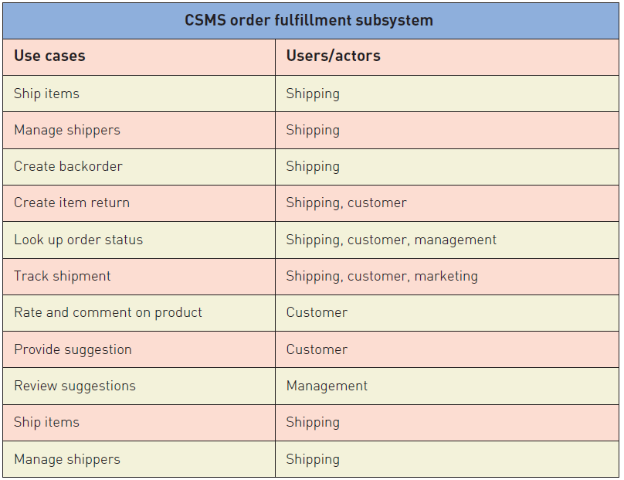
RMO CSMS Project Use Cases
CSMS订单执行子系统
© 2012 Cengage Learning. All Rights Reserved. This edition is intended for use outside of the U.S. only, with content that may be different from the U.S. Edition.
May not be scanned, copied, duplicated, or posted to a publicly accessible website, in whole or in part.
Notes:
CSMS订单执行子系统
运输商品（运输）
管理运输者
处理延期交货订单
创建产品退货
查看订单状态

Slide 43
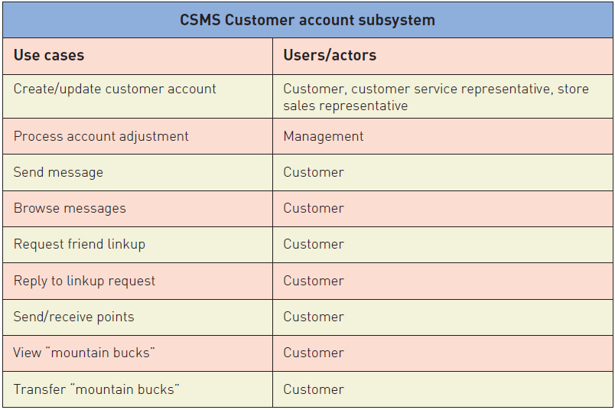
RMO CSMS Project Use Cases
CSMS顾客账户子系统
© 2012 Cengage Learning. All Rights Reserved. This edition is intended for use outside of the U.S. only, with content that may be different from the U.S. Edition.
May not be scanned, copied, duplicated, or posted to a publicly accessible website, in whole or in part.
Notes:
CSMS顾客账户子系统
创建顾客账户
处理账户更改
发送消息
查询消息
请求好友链接

Slide 44
RMO CSMS Project Use Cases
CSMS市场营销子系统
© 2012 Cengage Learning. All Rights Reserved. This edition is intended for use outside of the U.S. only, with content that may be different from the U.S. Edition.
May not be scanned, copied, duplicated, or posted to a publicly accessible website, in whole or in part.
Notes:
市场营销子系统
添加/更新产品信息（推销）
添加/更新促销
添加/更新配饰组合
添加/更新业务伙伴链接
报告子系统
产生每日交易总结报告
产生销售历史报告
产生销售趋势报告
产生客户使用报告
产生运输历史报告
产生促销效果报告
产生业务合作伙伴活动报告

Slide 45
Chapter 3 Outline
Use Cases and User Goals
Use Cases and Event Decomposition
Use Cases and CRUD
Use Cases in the Ridgeline Mountain Outfitters Case
Use Case Diagrams（用例图）
© 2012 Cengage Learning. All Rights Reserved. This edition is intended for use outside of the U.S. only, with content that may be different from the U.S. Edition.
May not be scanned, copied, duplicated, or posted to a publicly accessible website, in whole or in part.
Notes:
用例图

Slide 46
Use Case Diagrams
Use case diagram（用例图）— a UML model used to graphically show uses cases and their relationships to actors（一种UML模型，用于图形化地显示用例及其与参与者的关系）
Recall UML is Unified Modeling Language（统一建模语言）, the standard for diagrams and terminology for developing information systems
Automation boundary（自动化边界）— the boundary between the computerized portion of the application and the users who operate the application（应用程序的计算机化部分和操作应用程序的用户之间的边界）
© 2012 Cengage Learning. All Rights Reserved. This edition is intended for use outside of the U.S. only, with content that may be different from the U.S. Edition.
May not be scanned, copied, duplicated, or posted to a publicly accessible website, in whole or in part.
Notes:
用例图——一种UML模型，用于图形化地显示用例及其与参与者的关系
UML是统一建模语言，是用于开发信息系统的图和术语的标准
自动化边界——应用程序的计算机化部分和操作应用程序的用户之间的边界

Slide 47
Use Case Diagrams Symbols
© 2012 Cengage Learning. All Rights Reserved. This edition is intended for use outside of the U.S. only, with content that may be different from the U.S. Edition.
May not be scanned, copied, duplicated, or posted to a publicly accessible website, in whole or in part.
Notes:
演员是一个简笔画，通常是指使用系统的真人
连接线显示哪些参与者参与用例

Slide 48
Use Case Diagrams Draw for each subsystem
© 2012 Cengage Learning. All Rights Reserved. This edition is intended for use outside of the U.S. only, with content that may be different from the U.S. Edition.
May not be scanned, copied, duplicated, or posted to a publicly accessible website, in whole or in part.
Notes:
给每一个子系统单独画

Slide 49
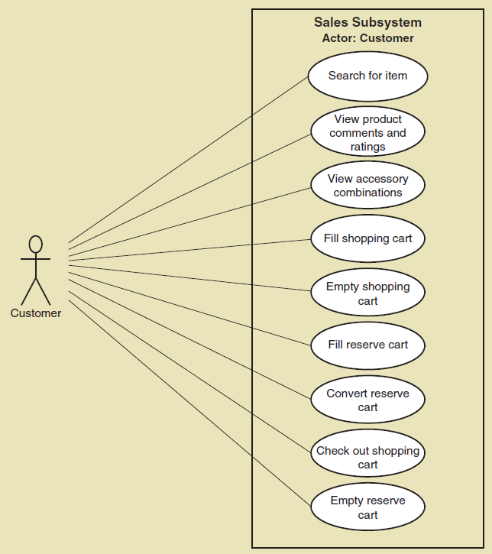
Use Case Diagrams Draw for actor, such as customer
© 2012 Cengage Learning. All Rights Reserved. This edition is intended for use outside of the U.S. only, with content that may be different from the U.S. Edition.
May not be scanned, copied, duplicated, or posted to a publicly accessible website, in whole or in part.
Notes:
为每个角色绘制，如客户

Slide 50
Use Case Diagrams Draw for internal RMO actors
© 2012 Cengage Learning. All Rights Reserved. This edition is intended for use outside of the U.S. only, with content that may be different from the U.S. Edition.
May not be scanned, copied, duplicated, or posted to a publicly accessible website, in whole or in part.
Notes:
绘制内部RMO参与者

Slide 51
Use Case Diagrams The <<Includes>> relationship
A relationship between use cases where one use case is stereotypically included within the other use case— like a called subroutine. Arrow points to subroutine
© 2012 Cengage Learning. All Rights Reserved. This edition is intended for use outside of the U.S. only, with content that may be different from the U.S. Edition.
May not be scanned, copied, duplicated, or posted to a publicly accessible website, in whole or in part.
Notes:
用例之间的关系，其中一个用例通常包含在另一个用例中——就像一个被称为子例程的用例。箭头指向子程序

Slide 52
Use Case Diagrams The <<Extend>> relationship
当执行A用例时，有些情况下，会执行B用例，有些情况下不会执行B用例
这种情况就是B用例<<扩展>>了A用例
<<extend>>
排队等候
预订座位
<<include>>
客户
查询座位信息

Slide 53
Use Case Diagrams The <<Extend>> relationship
当执行A用例时，必须执行B用例才完整
这种情况就是A用例<<包含>>了A用例
<<extend>>
排队等候
预订座位
<<include>>
客户
查询座位信息

Slide 54
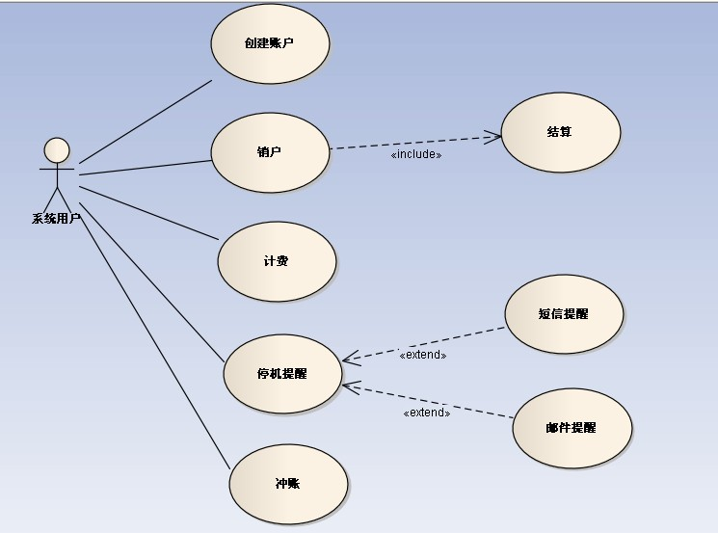
An Use Case Diagram Example
Notes:
销户 -> 结算 （include包含关系）
停机提醒 —>短信/邮件提醒 （extend扩展关系）

Slide 55
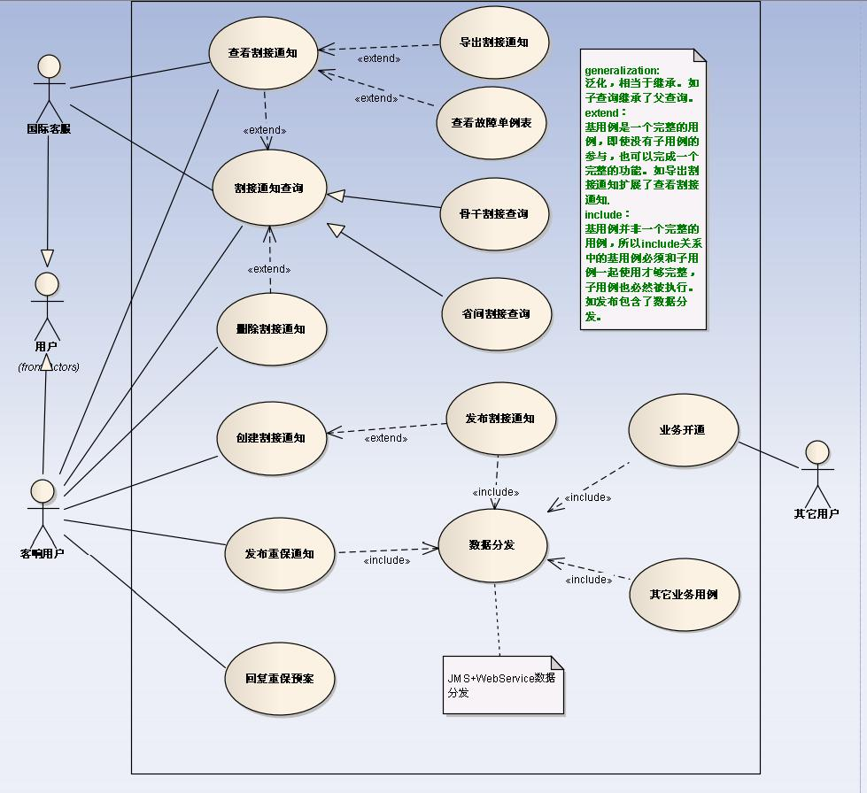

Slide 56
Use Case Diagrams: Steps
Identify all the stakeholders and users who would benefit by seeing a use case diagram（确定相关人员）
Determine what each stakeholder or user needs to review in a use case diagram: each subsystem, for each type of user, for use cases that are of interest（确定相关人员想在用例图中看到什么）
For each potential communication need, select the use cases and actors to show and draw the use case diagram. There are many software packages that can be used to draw use case diagrams（选择要显示的用例和参与者，并绘制用例图）
Carefully name each use case diagram（命名每个用例图） and then note how and when the diagram should be used to review use cases with stakeholders and users
Introduction to Systems Analysis and Design, 6th Edition
© 2012 Cengage Learning. All Rights Reserved. This edition is intended for use outside of the U.S. only, with content that may be different from the U.S. Edition.
May not be scanned, copied, duplicated, or posted to a publicly accessible website, in whole or in part.
Notes:
确定所有将通过查看用例图而受益的相关人员和用户
确定每个相关人员或用户需要在用例图中检查什么: 每个子系统，针对每种类型的用户，针对感兴趣的用例
对于每个潜在的通信需求，选择要显示的用例和参与者，并绘制用例图。有许多软件包可用于绘制用例图
仔细地命名每个用例图，然后注意如何以及何时应该使用图来与相关人员和用户一起检查用例

Slide 57
Summary
This chapter is the first of three that focuses on modeling functional requirements as a part of systems analysis（本章是将功能需求建模作为系统分析一部分的三章中的第一章）
Use cases are the functions identified, the activities the system carries out usually in response to a user request（用例是识别的功能，系统通常为响应用户请求而执行的活动）
Two techniques for identifying use cases are the user goal technique and the event decomposition technique识别用例的两种技术是用户目标技术和事件分解技术
Introduction to Systems Analysis and Design, 6th Edition
© 2012 Cengage Learning. All Rights Reserved. This edition is intended for use outside of the U.S. only, with content that may be different from the U.S. Edition.
May not be scanned, copied, duplicated, or posted to a publicly accessible website, in whole or in part.
Notes:
本章是将功能需求建模作为系统分析一部分的三章中的第一章
用例是识别的功能，系统通常为响应用户请求而执行的活动
识别用例的两种技术是用户目标技术和事件分解技术

Slide 58
Summary
The user goal technique begins by identifying end users called actors and asking what specific goals they have when interacting with the system（用户目标技术首先确定被称为参与者的最终用户，并询问他们在与系统交互时具有哪些特定的目标）
The event decomposition technique begins by identifying events that occur that require the system to respond. （事件分解技术首先识别需要系统响应的事件）
Introduction to Systems Analysis and Design, 6th Edition
© 2012 Cengage Learning. All Rights Reserved. This edition is intended for use outside of the U.S. only, with content that may be different from the U.S. Edition.
May not be scanned, copied, duplicated, or posted to a publicly accessible website, in whole or in part.
Notes:
用户目标技术首先确定被称为参与者的最终用户，并询问他们在与系统交互时具有哪些特定的目标
事件分解技术首先识别需要系统响应的事件

Slide 59
Summary
Three types of events include external, temporal, and state events（三种类型的事件包括外部事件、时间事件和状态事件）
Brief use case descriptions are written for use cases（简短的用例描述是为用例编写的）
The CRUD technique is used to validate and refine the use cases identified （CRUD技术用于验证和细化已识别的用例）
The use case diagram is the UML diagram used to show the use cases and the actors（用例图是用来显示用例和参与者的UML图）
Introduction to Systems Analysis and Design, 6th Edition
© 2012 Cengage Learning. All Rights Reserved. This edition is intended for use outside of the U.S. only, with content that may be different from the U.S. Edition.
May not be scanned, copied, duplicated, or posted to a publicly accessible website, in whole or in part.
Notes:
三种类型的事件包括外部事件、时间事件和状态事件
简短的用例描述是为用例编写的
CRUD技术用于验证和细化已识别的用例
用例图是用来显示用例和参与者的UML图

Slide 60
Summary
The use case diagram shows the actors, the automation boundary, the uses cases that involve each actor, and the <<includes>> <<extend>>relationship. （用例图显示了参与者、自动化边界、涉及每个参与者的用例，以及<<包括>> <<扩展>>关系。）
A variety of use case diagrams are draw depending on the presentation needs of the analysis（根据分析的表示需要绘制各种用例图）
Introduction to Systems Analysis and Design, 6th Edition
© 2012 Cengage Learning. All Rights Reserved. This edition is intended for use outside of the U.S. only, with content that may be different from the U.S. Edition.
May not be scanned, copied, duplicated, or posted to a publicly accessible website, in whole or in part.
Notes:
用例图显示了参与者、自动化边界、涉及每个参与者的用例，以及<<包括>> <<扩展>>关系。
根据分析的表示需要绘制各种用例图

