Slide 1
INTRODUCTION TO
SYSTEMS ANALYSIS AND DESIGN:
AN AGILE, ITERATIVE APPROACH
SATZINGER | JACKSON | BURD
CHAPTER 7
Chapter 7
Systems Analysis and Design in a Changing World, 6th Edition

Slide 2
Designing the User and System Interfaces
Chapter 7
Introduction to Systems
Analysis and Design:
An Agile, Iteractive Approach
6th Ed
Satzinger, Jackson & Burd
Notes:
设计用户和系统界面

Slide 3
Chapter 7 Outline
User and System Interfaces（用户界面和系统界面）
Understanding the User Interface（理解用户界面）
User-Interface Design Concepts（用户界面的设计概念）
The Transition from Analysis to User-Interface Design（从分析到用户界面设计的转换）
Introduction to Systems Analysis and Design, 6th Edition
© 2012 Cengage Learning. All Rights Reserved. This edition is intended for use outside of the U.S. only, with content that may be different from the U.S. Edition.
May not be scanned, copied, duplicated, or posted to a publicly accessible website, in whole or in part.
Notes:
用户界面和系统界面
理解用户界面
用户界面的设计概念
从分析到用户界面设计的转换

Slide 4
Chapter 7 Outline
User-Interface Design（用户界面设计）
Identifying System Interfaces（确定系统界面）
Designing System Inputs（设计系统输入）
Designing System Outputs（设计系统输出）
Introduction to Systems Analysis and Design, 6th Edition
© 2012 Cengage Learning. All Rights Reserved. This edition is intended for use outside of the U.S. only, with content that may be different from the U.S. Edition.
May not be scanned, copied, duplicated, or posted to a publicly accessible website, in whole or in part.
Notes:
用户界面设计
确定系统界面
设计系统输入
设计系统输出

Slide 5
Learning Objectives
Describe the difference between user interfaces（用户界面） and system interfaces（系统界面）
Describe the historical development of the field of human-computer interaction (人机交互领域的发展)
Discuss how visibility（可视性） and affordance（提示性） affect usability
Describe user-interface guidelines（用户界面的指导规则） that apply to all types of user-interface types and additional guidelines specific to Web pages and mobile applications
Introduction to Systems Analysis and Design, 6th Edition
© 2012 Cengage Learning. All Rights Reserved. This edition is intended for use outside of the U.S. only, with content that may be different from the U.S. Edition.
May not be scanned, copied, duplicated, or posted to a publicly accessible website, in whole or in part.
Notes:
描述用户界面与系统界面的区别
描述人机交互领域的历史发展
讨论可视性和提示性如何影响可用性
用户界面中的指导原则

Slide 6
Learning Objectives (continued)
Create storyboards（创建故事脚本） to show the sequence of forms used in a dialog
Discuss examples of system interfaces found in information systems（讨论系统接口）
Define system inputs and outputs（定义输入输出） based on the requirements of the application program
Design printed and on-screen reports appropriate for recipients（设计适合收件人的报告）
Introduction to Systems Analysis and Design, 6th Edition
© 2012 Cengage Learning. All Rights Reserved. This edition is intended for use outside of the U.S. only, with content that may be different from the U.S. Edition.
May not be scanned, copied, duplicated, or posted to a publicly accessible website, in whole or in part.
Notes:
创建故事脚本来显示用在会话中表格的顺序
讨论信息系统中系统接口的例子
基于应用程序定义系统输入与输出
设计适合收件人的报告

Slide 7
Overview
Information systems interact with people and other systems（信息系统与人和其他系统相互作用）
Poorly designed user interface can make the information system unusable（设计不良用户界面会使信息系统无法使用）
Poorly designed system interfaces are a source of errors and inefficiency（设计不良的系统接口是错误和低效率的根源）
User and system interfaces involve both inputs and outputs and involve a large number of stakeholders（用户和系统接口涉及输入和输出，并涉及大量利益相关者）
Introduction to Systems Analysis and Design, 6th Edition
© 2012 Cengage Learning. All Rights Reserved. This edition is intended for use outside of the U.S. only, with content that may be different from the U.S. Edition.
May not be scanned, copied, duplicated, or posted to a publicly accessible website, in whole or in part.
Notes:
信息系统与人和其他系统相互作用
设计不良的用户界面会使信息系统无法使用
设计不良的系统接口是错误和低效率的根源
用户和系统接口涉及输入和输出，并涉及大量利益相关者

Slide 8
Chapter 7 Outline
User and System Interfaces（用户界面和系统界面）
Understanding the User Interface
User-Interface Design Concepts
The Transition from Analysis to User-Interface Design
User-Interface Design
Identifying System Interfaces
Designing System Inputs
Designing System Outputs
Introduction to Systems Analysis and Design, 6th Edition
© 2012 Cengage Learning. All Rights Reserved. This edition is intended for use outside of the U.S. only, with content that may be different from the U.S. Edition.
May not be scanned, copied, duplicated, or posted to a publicly accessible website, in whole or in part.
Notes:
用户界面和系统界面

Slide 9
User Interfaces and System Interfaces
User Interface （用户界面）– inputs and outputs that directly involve a human user/actor（直接涉及人类用户的输入输出）
System Interface（系统接口） – the inputs and outputs that require minimal human intervention（输入和输出需要最少的人为干预）
  Inputs captured automatically（自动捕获输入）
  Outputs direct to other systems （直接输出到其他系统）
  Printed and distributed outputs (打印和分发输出)
© 2012 Cengage Learning. All Rights Reserved. This edition is intended for use outside of the U.S. only, with content that may be different from the U.S. Edition.
May not be scanned, copied, duplicated, or posted to a publicly accessible website, in whole or in part.
Notes:
用户界面——直接涉及人类用户/参与者的输入和输出
参与者和系统之间进行对话
系统接口-输入和输出需要最少的人为干预
自动捕获输入
直接输出到其他系统
打印和分发输出(报表、报告)

Slide 10
Chapter 7 Outline
User and System Interfaces
Understanding the User Interface（理解用户界面）
User-Interface Design Concepts
The Transition from Analysis to User-Interface Design
User-Interface Design
Identifying System Interfaces
Designing System Inputs
Designing System Outputs
Introduction to Systems Analysis and Design, 6th Edition
© 2012 Cengage Learning. All Rights Reserved. This edition is intended for use outside of the U.S. only, with content that may be different from the U.S. Edition.
May not be scanned, copied, duplicated, or posted to a publicly accessible website, in whole or in part.
Notes:
理解用户界面

Slide 11
User Centered Design
Design techniques that embody the view that the user interface is the system to the user（从用户的角度看，用户界面就是整个系统。界面后的程序、数据库、硬件都是不相关的）
Principles of User Centered Design（三个重要原则）
  Focus early on users and their work（及早关注用户及其工作）
  Evaluate designs to ensure usability（评价设计以确保其可用性）
  Use iterative development（使用迭代开发方法）
Introduction to Systems Analysis and Design, 6th Edition
© 2012 Cengage Learning. All Rights Reserved. This edition is intended for use outside of the U.S. only, with content that may be different from the U.S. Edition.
May not be scanned, copied, duplicated, or posted to a publicly accessible website, in whole or in part.
Notes:
以用户为中心的设计：
从用户的视角看，用户界面就是整个系统。界面后面的程序、数据库、硬件都是不相关的。
三个重要原则：
及早关注用户及其工作
评价设计已确保其可用性
使用迭代开发方法

Slide 12
Chapter 7 Outline
User and System Interfaces
Understanding the User Interface
User-Interface Design Concepts（用户界面的设计概念）
The Transition from Analysis to User-Interface Design
User-Interface Design
Identifying System Interfaces
Designing System Inputs
Designing System Outputs
Introduction to Systems Analysis and Design, 6th Edition
© 2012 Cengage Learning. All Rights Reserved. This edition is intended for use outside of the U.S. only, with content that may be different from the U.S. Edition.
May not be scanned, copied, duplicated, or posted to a publicly accessible website, in whole or in part.
Notes:
用户界面的设计概念

Slide 13
User Interface Design Concepts
Human-Computer Interaction (HCI)人机交互
  A field of study concerned with the efficiency and effectiveness of user interaction with computer systems, human-oriented input and output technology, and psychological aspects of user interfaces
Visibility and Affordance可视性和提示性
  To be usable, a control must be visible to the user and its appearance should suggest its functionality
Introduction to Systems Analysis and Design, 6th Edition
© 2012 Cengage Learning. All Rights Reserved. This edition is intended for use outside of the U.S. only, with content that may be different from the U.S. Edition.
May not be scanned, copied, duplicated, or posted to a publicly accessible website, in whole or in part.
Notes:
用户界面的设计概念
人机交互(HCI)
一个研究用户与计算机系统交互的效率和有效性的领域，以人为本的输入和输出技术，以及用户界面的心理方面
可视性和提示性
为了可用，控件必须对用户可见，其外观应该表明其功能

Slide 14
User Interface Design Guidelines
Design for Consistency（一致性）
Provide Shortcuts（快捷方式）
Provide Feedback（反馈）
Dialogs Should Yield Closure（完整的对话）
Error Handling that Provides Guidance（错误处理）
Easy Reversal of Actions（撤销）
Reduce Short Term Memory Load（减轻短期记忆负担）
Introduction to Systems Analysis and Design, 6th Edition
© 2012 Cengage Learning. All Rights Reserved. This edition is intended for use outside of the U.S. only, with content that may be different from the U.S. Edition.
May not be scanned, copied, duplicated, or posted to a publicly accessible website, in whole or in part.
Notes:
一致性：功能和外观的一致性（office不同的软件，却有一致性的菜单设计）
快捷方式
反馈（声音相应，可见的反馈）
完整的对话（每一次对话应该有明确的次序——开始、处理、结束）
错误处理
撤销
减轻短期记忆负担

Slide 15
Chapter 7 Outline
User and System Interfaces
Understanding the User Interface
User-Interface Design Concepts
The Transition from Analysis to User-Interface Design（从分析到用户界面设计的转换）
User-Interface Design
Identifying System Interfaces
Designing System Inputs
Designing System Outputs
Introduction to Systems Analysis and Design, 6th Edition
© 2012 Cengage Learning. All Rights Reserved. This edition is intended for use outside of the U.S. only, with content that may be different from the U.S. Edition.
May not be scanned, copied, duplicated, or posted to a publicly accessible website, in whole or in part.
Notes:
从分析到用户界面设计的转换

Slide 16
Use Cases and the Menu Hierarchy
Menus are a typical way to organize access to use case functionality（菜单是组织对用例功能访问的典型方式）
Different types of users might have different menus（不同类型的用户可能有不同的菜单）
Useful to design an overall menu hierarchy and then subsets for different users（可用于设计整体菜单层次结构，然后为不同用户设计子集）
Introduction to Systems Analysis and Design, 6th Edition
© 2012 Cengage Learning. All Rights Reserved. This edition is intended for use outside of the U.S. only, with content that may be different from the U.S. Edition.
May not be scanned, copied, duplicated, or posted to a publicly accessible website, in whole or in part.
Notes:
菜单是组织对用例功能访问的典型方式
不同类型的用户可能有不同的菜单
可用于设计整体菜单层次结构，然后为不同用户设计子集

Slide 17
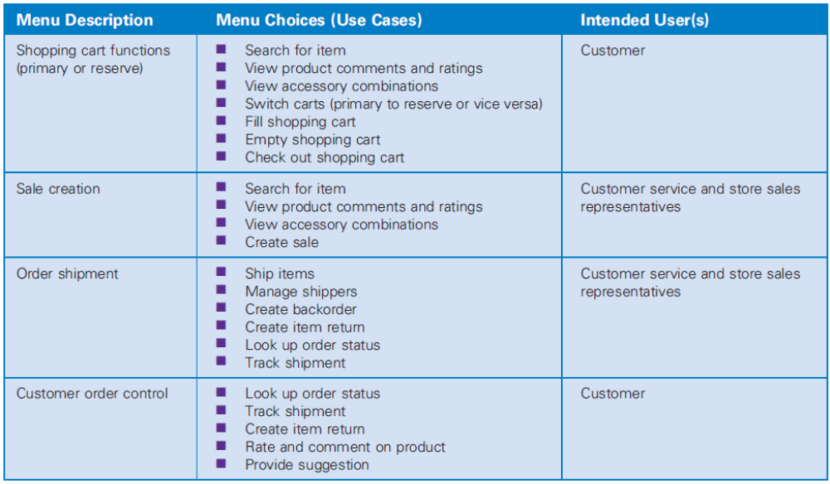
RMO Use Cases
Grouped into First Cut Menu Hierarchy
Introduction to Systems Analysis and Design, 6th Edition
© 2012 Cengage Learning. All Rights Reserved. This edition is intended for use outside of the U.S. only, with content that may be different from the U.S. Edition.
May not be scanned, copied, duplicated, or posted to a publicly accessible website, in whole or in part.
Notes:
菜单层次
购物车功能 ：查找产品，查看产品评价，查看配件，切换购物车，加入购物车，清空购物车，付款
寻找产品
查看产品评价和评分
查看配件组合
转换购物车
加入购物车
清空购物车
购买

Slide 18
Guidelines for Windows and Forms
Interface Layout and Formatting（设计窗体和表格）
  Consistency, labels and headings, distribution and order, fonts and colors（一致性、标签和标题、分布和顺序、字体与颜色）
Data Entry（数据输入）
  Text box, list box, combo box, radio buttons, check boxes（文本框、列表框、组合框、单选按钮、复选框）
Navigation and Support Controls（导航）
  Minimize, maximize, close, scroll bars, resize（最大最小化、关闭、滚动条、调整大小）
Introduction to Systems Analysis and Design, 6th Edition
© 2012 Cengage Learning. All Rights Reserved. This edition is intended for use outside of the U.S. only, with content that may be different from the U.S. Edition.
May not be scanned, copied, duplicated, or posted to a publicly accessible website, in whole or in part.
Notes:
设计窗体和表格：
界面布局和格式化（一致性，标签和标题，分布与组织，字体与颜色）
数据输入（文本框，列表框，组合框，单选按钮，复选框）
导航与支持空间（最大最小化，关闭，滚动条，调整大小）

Slide 19
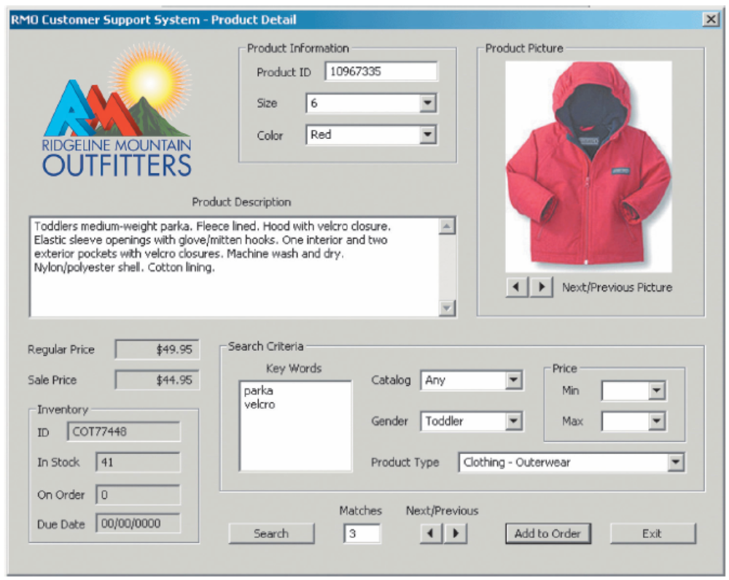
RMO Windows Form
Systems Analysis and Design in a Changing World, 6th Edition
© 2012 Cengage Learning. All Rights Reserved. This edition is intended for use outside of the U.S. only, with content that may be different from the U.S. Edition.
May not be scanned, copied, duplicated, or posted to a publicly accessible website, in whole or in part.

Slide 20
Chapter 7 Outline
User and System Interfaces
Understanding the User Interface
User-Interface Design Concepts
The Transition from Analysis to User-Interface Design
User-Interface Design（用户界面设计）
Identifying System Interfaces
Designing System Inputs
Designing System Outputs
Introduction to Systems Analysis and Design, 6th Edition
© 2012 Cengage Learning. All Rights Reserved. This edition is intended for use outside of the U.S. only, with content that may be different from the U.S. Edition.
May not be scanned, copied, duplicated, or posted to a publicly accessible website, in whole or in part.
Notes:
用户界面设计

Slide 21
Guidelines for Web Browser
User Interfaces
Consistency（一致性）
  Cascading Style Sheets (CSS) – Web page encoding standard that enables a Web site designer to specify parts of a page that will always look the same and parts that will vary by task or audience
Performance Considerations（性能考虑）
  Sensitive to network connection, amount of information transmitted, type of information transmitted
Pictures, Video, and Sound（图片、视频和声音）
  Powerful, but compatibility issues arise
Users with Disabilities（残疾用户）
  Assistive technologies -- software (such as text-to-speech and voice-recognition utilities) that adapts user interfaces to the special needs of persons with disabilities
Introduction to Systems Analysis and Design, 6th Edition
© 2012 Cengage Learning. All Rights Reserved. This edition is intended for use outside of the U.S. only, with content that may be different from the U.S. Edition.
May not be scanned, copied, duplicated, or posted to a publicly accessible website, in whole or in part.
Notes:
网络浏览器用户界面的指导原则
一致性（一个网站的外观和设计应该具有一致性）
层叠样式表(CSS)——Web页面编码标准，它使Web站点设计人员能够指定页面中看起来始终相同的部分，以及根据任务或受众而变化的部分
性能考虑（对网络连接、传输的信息量、传输的信息类型敏感）
图片，视频和声音（兼容性问题）
残疾用户（辅助技术——使用户界面适应残疾人特殊需求的软件(如文本转语音和语音识别实用程序)）

Slide 22
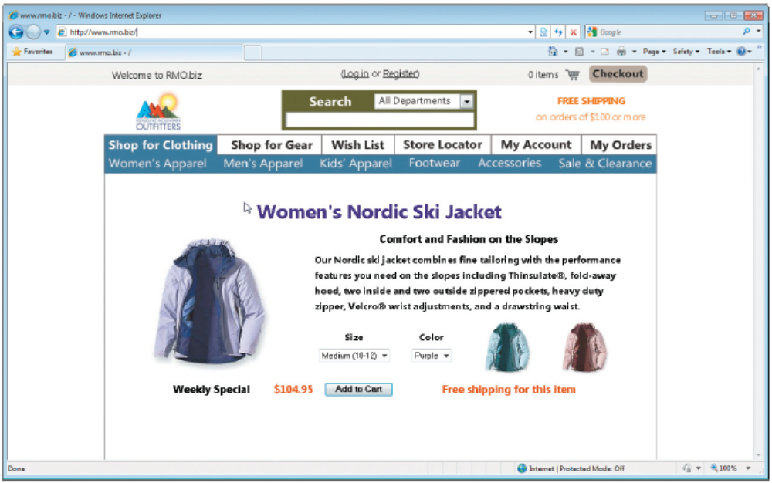
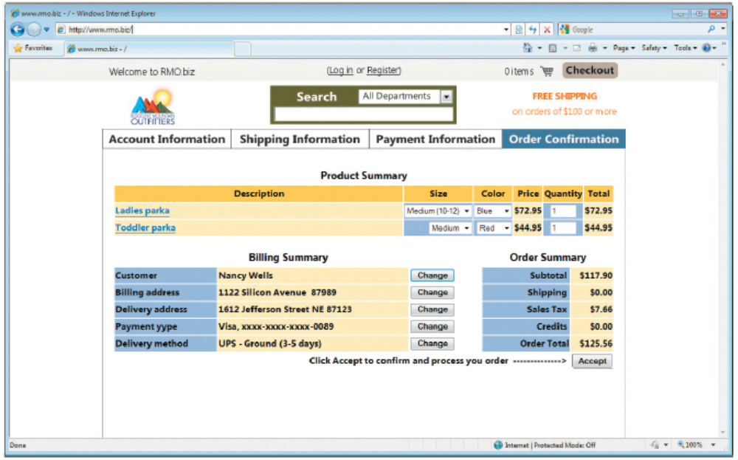
RMO Example
Using CSS for Consistency
Introduction to Systems Analysis and Design, 6th Edition
© 2012 Cengage Learning. All Rights Reserved. This edition is intended for use outside of the U.S. only, with content that may be different from the U.S. Edition.
May not be scanned, copied, duplicated, or posted to a publicly accessible website, in whole or in part.
Notes:
使用CSS实现一致性

Slide 23
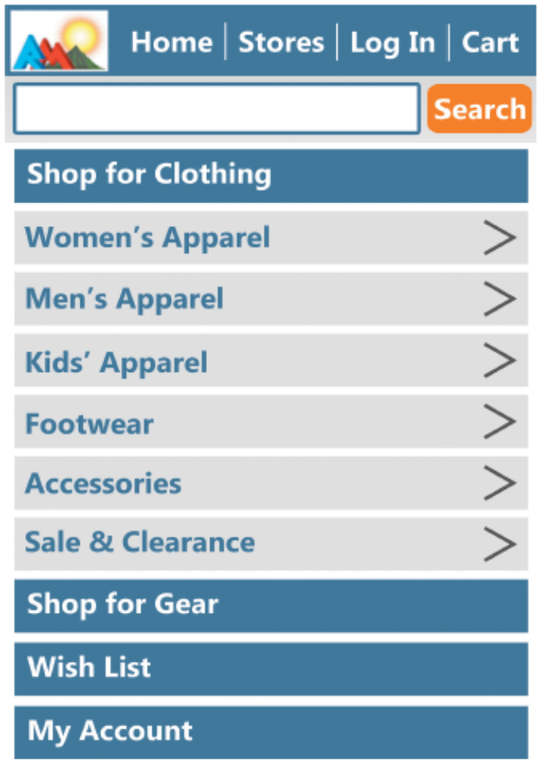
Guidelines for Handheld Devices
（手持设备附加原则）
Challenges
  Small screen size, small keyboards and touch screens, limited network capacity, app design guidelines and toolkits（小屏幕、小键盘、触摸屏、有限的网络容量）
Introduction to Systems Analysis and Design, 6th Edition
© 2012 Cengage Learning. All Rights Reserved. This edition is intended for use outside of the U.S. only, with content that may be different from the U.S. Edition.
May not be scanned, copied, duplicated, or posted to a publicly accessible website, in whole or in part.
Notes:
手持设备的附加原则
小屏幕
小键盘和触摸屏
有限的网络容量

Slide 24
人机界面设计指南
一般交互指南：涉及信息显示、数据输入和系统整体控制
保持一致性。
提供有意义的反馈。
在执行有较大破坏性的动作之前要求用户确认。
允许取消绝大多数操作。
减少在两次操作之间必须记忆的信息量。
提高对话、移动和思考的效率。
允许犯错误。
按功能对动作分类，并据此设计屏幕布局。
提供对用户工作内容敏感的帮助设施
用简单动词或动词短语作为命令名。

Slide 25
人机界面设计指南
信息显示指南：多种不同方式“显示”信息：用文字、图形和声音；按位置、移动和大小；使用颜色、分辨率和省略。
只显示与当前工作内容有关的信息。
不要用数据淹没用户，应该用便于用户迅速吸取信息的方式来表示数据。
使用一致的标记、标准的缩写和可预知的颜色。
允许用户保持可视化的语境。
产生有意义的出错信息。
使用大小写、缩进和文本分组以帮助理解。
使用窗口分隔不同类型的信息。
使用“模拟”显示方式表示信息，使信息更容易被用户提取。
高效率地使用显示屏。

Slide 26
人机界面设计指南
数据输入指南：用户的大部分时间用在选择命令、输入数据和向系统提供输入。
尽量减少用户的输入动作。
保持信息显示和数据输入之间的一致性。
允许用户自定义输入。
交互应该是灵活的，并且可调整成用户最喜欢的输入方式。
使在当前动作语境中不适用的命令不起作用。
让用户控制交互流。

Slide 27
Chapter 7 Outline
User and System Interfaces
Understanding the User Interface
User-Interface Design Concepts
The Transition from Analysis to User-Interface Design
User-Interface Design
Identifying System Interfaces（确定系统界面）
Designing System Inputs
Designing System Outputs
Introduction to Systems Analysis and Design, 6th Edition
© 2012 Cengage Learning. All Rights Reserved. This edition is intended for use outside of the U.S. only, with content that may be different from the U.S. Edition.
May not be scanned, copied, duplicated, or posted to a publicly accessible website, in whole or in part.
Notes:
确定系统界面

Slide 28
Identifying System Interfaces
Inputs/outputs with minimal human intervention
Inputs from and outputs to other systems（与其他系统交互的输入和输出）
  These are direct interfaces with other information systems, normally formatted as network messages.
Highly automated inputs and outputs（高自动化的输入和输出）
  These are captured by devices (such as scanners) or generated by persons who start a process that proceeds without further human intervention.
Inputs and outputs to external databases（外部数据库的输入和输出）
  These can supply input to or accept output from a system.
Introduction to Systems Analysis and Design, 6th Edition
© 2012 Cengage Learning. All Rights Reserved. This edition is intended for use outside of the U.S. only, with content that may be different from the U.S. Edition.
May not be scanned, copied, duplicated, or posted to a publicly accessible website, in whole or in part.
Notes:
系统界面：不需任何用户干预或用户干预很少的输入和输出
信息系统完整的输入和输出：
来自于其他系统的输入和流向其他系统的输出
这些是与其他信息系统的直接接口，通常格式化为网络消息。
高自动化的输入和输出
这些信息由设备(如扫描仪)捕获，或由启动流程的人员生成，该流程无需进一步的人为干预。
来自外部数据库的输入和输出
它们可以向系统提供输入或从系统接受输出。

Slide 29
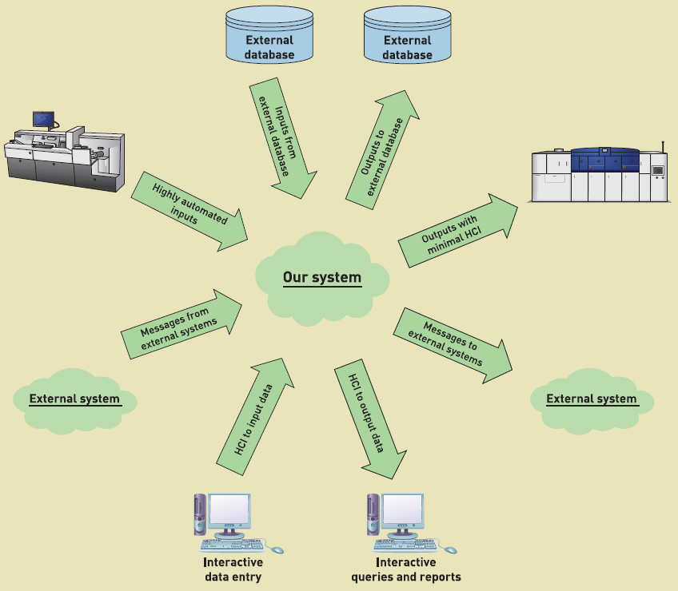
Identifying System Interfaces
人机交互输入
外部系统输入
自动化的输入
外部数据库
人机交互输出
外部系统输出
自动化的输出
外部数据库
Systems Analysis and Design in a Changing World, 6th Edition
© 2012 Cengage Learning. All Rights Reserved. This edition is intended for use outside of the U.S. only, with content that may be different from the U.S. Edition.
May not be scanned, copied, duplicated, or posted to a publicly accessible website, in whole or in part.
Notes:
人机交互输入
外部系统输入
自动化的输入
外部数据库

Slide 30
Chapter 7 Outline
User and System Interfaces
Understanding the User Interface
User-Interface Design Concepts
The Transition from Analysis to User-Interface Design
User-Interface Design
Identifying System Interfaces
Designing System Inputs（设计系统输入）
Designing System Outputs（设计系统输出）
Introduction to Systems Analysis and Design, 6th Edition
© 2012 Cengage Learning. All Rights Reserved. This edition is intended for use outside of the U.S. only, with content that may be different from the U.S. Edition.
May not be scanned, copied, duplicated, or posted to a publicly accessible website, in whole or in part.
Notes:
设计系统输入
设计系统输出

Slide 31
System Inputs
Primary Objective is Error Free Input（主要目标是无错误输入）
  Use electronic devices wherever possible（尽可能使用电子设备和自动输入）
  Avoid human involvement as much as possible（尽可能避免人工干预）
  If information is already available in electronic form, use it instead of re-entering information（如果可以从某个电子表导出，尽可能导出而不是重新输入）
  Validate and correct information at time and location entered（在输入信息里，对数据进行验证）
Introduction to Systems Analysis and Design, 6th Edition
© 2012 Cengage Learning. All Rights Reserved. This edition is intended for use outside of the U.S. only, with content that may be different from the U.S. Edition.
May not be scanned, copied, duplicated, or posted to a publicly accessible website, in whole or in part.
Notes:
系统输入：
主要目标是无错误输入
尽可能使用电子设备和自动输入
尽可能避免人工干预
如果信息可以从某个电子表淡出得到，那么使用电子表单而不要重新输入这些信息
在输入信息是，对数据进行验证和更正
设备：
磁条阅读器，条形码，光电字符识别，射频识别，触摸屏，电子币，书写板，语音识别

Slide 32
System Inputs
Device Examples（设备举例）
  Magnetic card strip readers, bar code readers, optical character recognition, radio frequency ID tags (RFID), touch screen, electronic pens, digitizers, speech recognition（磁条阅读器、条形码、光电字符识别、射频识别、触摸屏、电子币、书写板、语音识别）
Introduction to Systems Analysis and Design, 6th Edition
© 2012 Cengage Learning. All Rights Reserved. This edition is intended for use outside of the U.S. only, with content that may be different from the U.S. Edition.
May not be scanned, copied, duplicated, or posted to a publicly accessible website, in whole or in part.
Notes:
系统输入：
主要目标是无错误输入
尽可能使用电子设备和自动输入
尽可能避免人工干预
如果信息可以从某个电子表淡出得到，那么使用电子表单而不要重新输入这些信息
在输入信息是，对数据进行验证和更正
设备：
磁条阅读器，条形码，光电字符识别，射频识别，触摸屏，电子币，书写板，语音识别

Slide 33
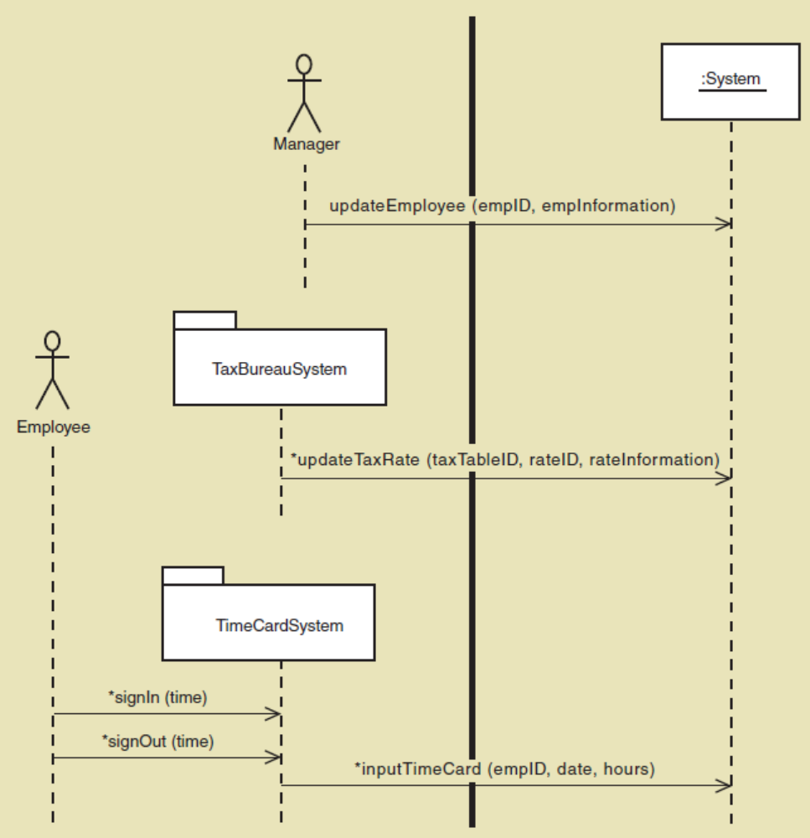
Defining System Inputs Details
  Sequence Diagram
  Details for messages
更新雇员信息（用户界面输入）
更新税率信息（系统输入）
输入时间卡信息（系统输入）
Introduction to Systems Analysis and Design, 6th Edition
© 2012 Cengage Learning. All Rights Reserved. This edition is intended for use outside of the U.S. only, with content that may be different from the U.S. Edition.
May not be scanned, copied, duplicated, or posted to a publicly accessible website, in whole or in part.
Notes:
支付系统用例的部分系统顺序图
贯穿系统简介的消息确定了输入
更新雇员信息（用户界面输入）
更新税率信息（系统输入）
输入时间卡信息（系统输入）

Slide 34
System Outputs
Detailed reports（详细报告） -- reports that contain specific information on business transactions
Summary reports（摘要报告） -- reports that summarize detail or recap periodic activity
Exception reports （异常报告）-- reports that provide details or summary information about transactions or operating results that fall outside a predefined normal range of values
Executive reports（执行报告） -- reports used by high level managers to assess overall organizational health and performance
Introduction to Systems Analysis and Design, 6th Edition
© 2012 Cengage Learning. All Rights Reserved. This edition is intended for use outside of the U.S. only, with content that may be different from the U.S. Edition.
May not be scanned, copied, duplicated, or posted to a publicly accessible website, in whole or in part.
Notes:
系统输出：
详细报告——包含有关业务交易的特定信息的报告
摘要报告——总结细节或回顾周期性活动的报告
异常报告——提供有关超出预定义正常值范围的事务或操作结果的详细信息或摘要信息的报告
执行报告——高级管理人员用来评估组织整体健康和绩效的报告

Slide 35
System Outputs
Internal outputs（内部输出） -- reports or other outputs produced for use within the organization
  Types of internal reports apply here（为组织或单位内部使用而生成的，如报表）
External outputs （外部输出）-- reports or other outputs produced for use by people outside the organization（为组织外部人员使用而生成的，如声明，通知，其他文档）
Turnaround documents（返回文档） -- external outputs that includes one or more parts intended to be returned with new data or information（提供给用户的文档中包含了可能返回的一部分，如账单）
© 2012 Cengage Learning. All Rights Reserved. This edition is intended for use outside of the U.S. only, with content that may be different from the U.S. Edition.
May not be scanned, copied, duplicated, or posted to a publicly accessible website, in whole or in part.
Notes:
内部输出：为组织或单位内部使用而生成的（刚才提到的报表）
外部输出：为组织外部人员使用而生成的（声明，通知，其他文档）
返回文档：提供给用户的文档中包含了可能返回的一部分（账单）

Slide 36
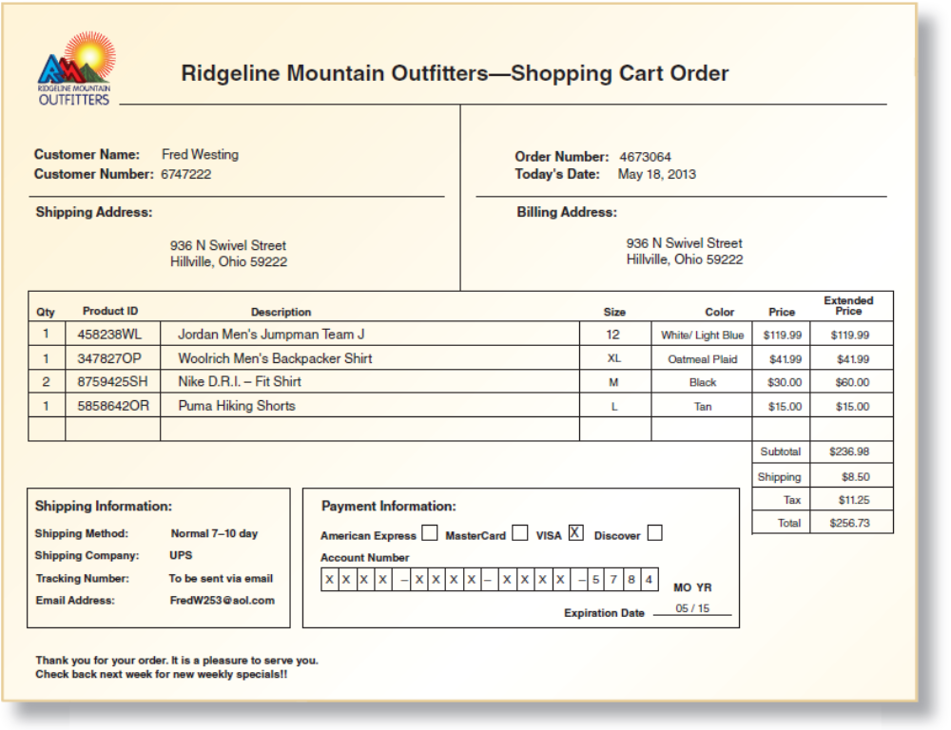
External Output Example
Introduction to Systems Analysis and Design, 6th Edition
© 2012 Cengage Learning. All Rights Reserved. This edition is intended for use outside of the U.S. only, with content that may be different from the U.S. Edition.
May not be scanned, copied, duplicated, or posted to a publicly accessible website, in whole or in part.
Notes:
给用户的订单信息输出

Slide 37
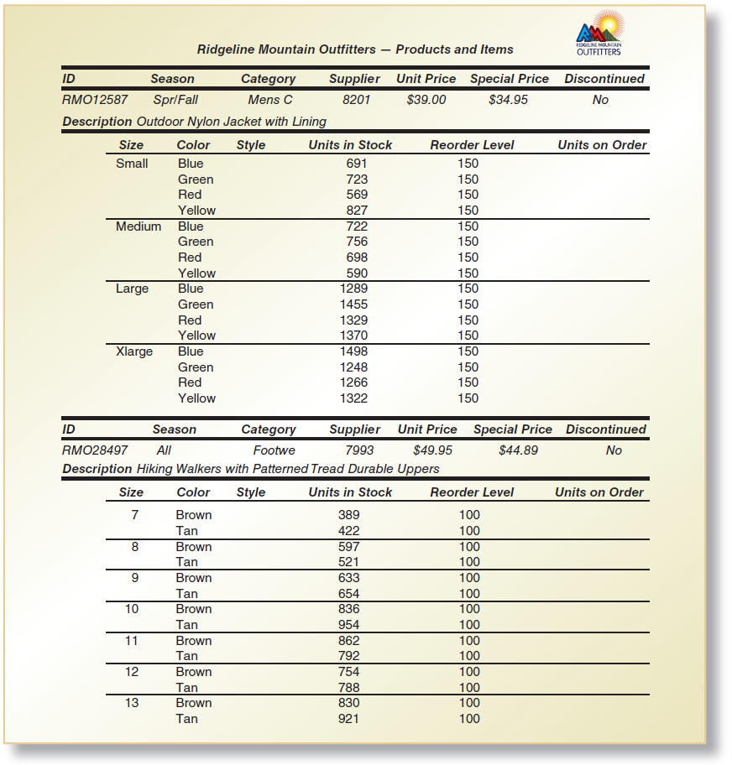
Internal
Output
Example
Detailed control break report
（控制终端详细报告）
Systems Analysis and Design in a Changing World, 6th Edition
Notes:
内部输出的例子：控制终端详细报告

Slide 38
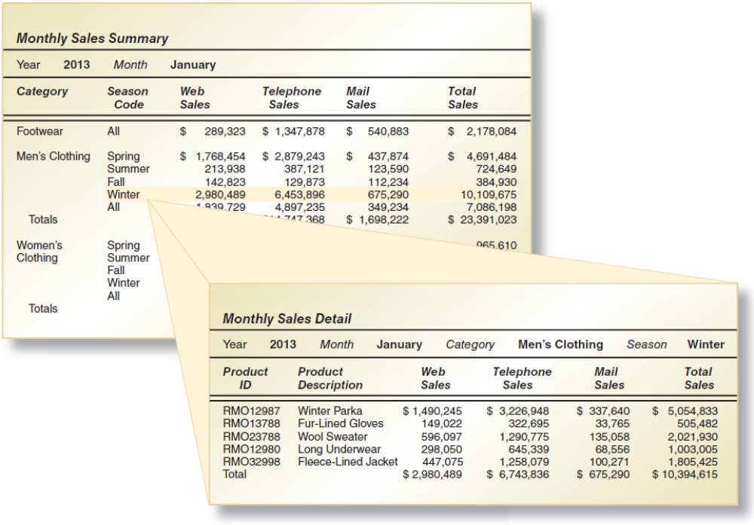
Drill Down Online Report
Summary and Detailed
Systems Analysis and Design in a Changing World, 6th Edition
© 2012 Cengage Learning. All Rights Reserved. This edition is intended for use outside of the U.S. only, with content that may be different from the U.S. Edition.
May not be scanned, copied, duplicated, or posted to a publicly accessible website, in whole or in part.
Notes:
深入在线报告
摘要和详细信息

Slide 39
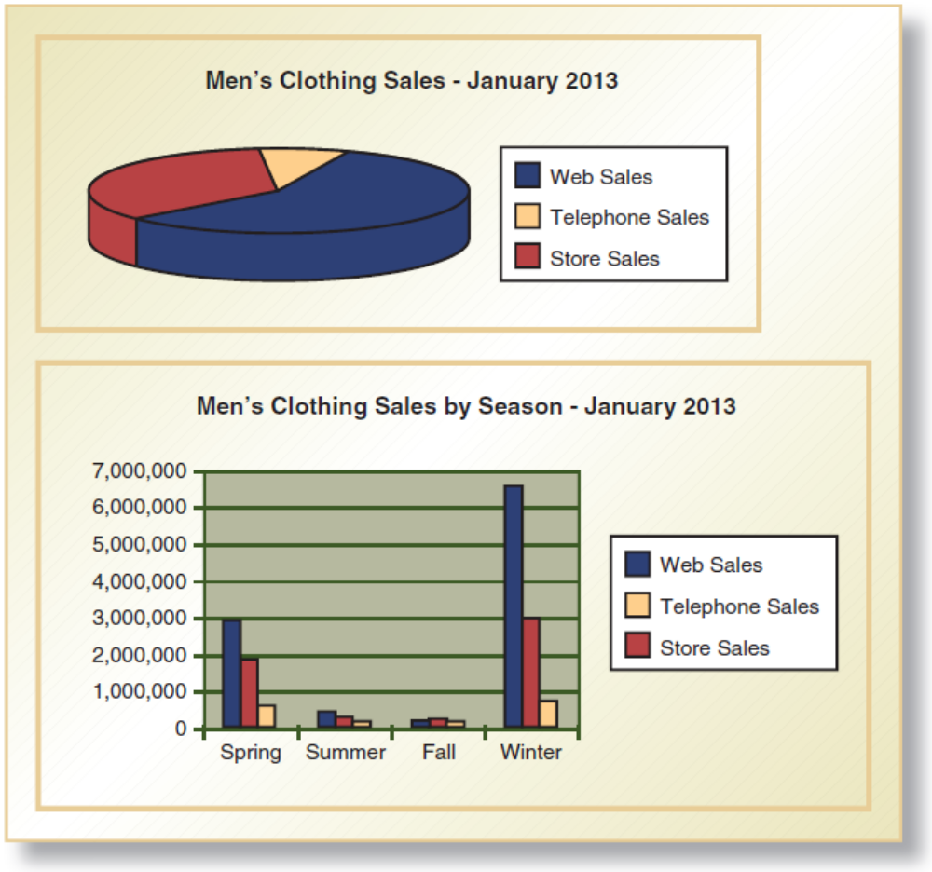
Graphical Outputs
Introduction to Systems Analysis and Design, 6th Edition
© 2012 Cengage Learning. All Rights Reserved. This edition is intended for use outside of the U.S. only, with content that may be different from the U.S. Edition.
May not be scanned, copied, duplicated, or posted to a publicly accessible website, in whole or in part.
Notes:
图形输出

Slide 40
Summary
There are two types of interfaces – user interfaces（用户接口） and system interfaces （系统接口）
User interfaces involve direct user interaction with the system（用户与系统的直接交互）. System interfaces require minimal or no user interaction
The design of the user interface has a long history as human computer interaction (HCI) and relies on user-centered design, which focuses early on users, evaluates designs to ensure usability, and uses iterative development（用户界面的设计作为人机交互(HCI)有着悠久的历史，它依赖于以用户为中心的设计）
Introduction to Systems Analysis and Design, 6th Edition
© 2012 Cengage Learning. All Rights Reserved. This edition is intended for use outside of the U.S. only, with content that may be different from the U.S. Edition.
May not be scanned, copied, duplicated, or posted to a publicly accessible website, in whole or in part.
Notes:
有两种类型的接口——用户接口和系统接口
用户界面涉及用户与系统的直接交互。系统接口只需要很少的用户交互，甚至不需要用户交互
用户界面的设计作为人机交互(HCI)有着悠久的历史，它依赖于以用户为中心的设计，即早期关注用户，评估设计以确保可用性，并使用迭代开发

Slide 41
Summary (continued)
Key user interface concepts include affordance（提示性） and visibility（可见性） for controls
Other key principles include consistency, shortcuts, feedback, dialog closure, error handling, reversal of actions, and reducing short term memory loads（其他准则：一致性、快捷方式、反馈、对话框关闭、错误处理、操作反转和减少短期记忆负荷）
Use cases are organized into one or more menu hierarchies to arrange functionality for users（窗体设计原则：界面布局，数据输入，导航与支持控件）
Guidelines are available for designing for Windows, Web browsers, and Handheld devices（手持设备：小屏幕，小键盘和触摸屏，有限的网络容量）
Introduction to Systems Analysis and Design, 6th Edition
© 2012 Cengage Learning. All Rights Reserved. This edition is intended for use outside of the U.S. only, with content that may be different from the U.S. Edition.
May not be scanned, copied, duplicated, or posted to a publicly accessible website, in whole or in part.
Notes:
关键的用户界面概念包括控件的提示性和可见性
其他准则：一致性、快捷方式、反馈、对话框关闭、错误处理、操作反转和减少短期记忆负荷
窗体设计原则：界面布局，数据输入，导航与支持控件
网页浏览器：一致性，性能
手持设备：小屏幕，小键盘和触摸屏，有限的网络容量

Slide 42
Summary (continued)
System interfaces include inputs and outputs to other systems, highly automated inputs and outputs, and inputs and outputs to external databases. （系统接口包括对其他系统的输入和输出、高度自动化的输入和输出以及对外部数据库的输入和输出。）
Designing system inputs involves identifying devices and mechanisms, identifying inputs and the data content, and determining the controls necessary（设计系统输入包括识别设备和机制，识别输入和数据内容，以及确定必要的控制）
Designing system outputs includes designing detailed reports, summary report, exception reports, and executive reports（设计系统输出包括设计详细报告、摘要报告、异常报告和执行报告）
Introduction to Systems Analysis and Design, 6th Edition
© 2012 Cengage Learning. All Rights Reserved. This edition is intended for use outside of the U.S. only, with content that may be different from the U.S. Edition.
May not be scanned, copied, duplicated, or posted to a publicly accessible website, in whole or in part.
Notes:
系统接口包括对其他系统的输入和输出、高度自动化的输入和输出以及对外部数据库的输入和输出。
设计系统输入包括识别设备和机制，识别输入和数据内容，以及确定必要的控制
设计系统输出包括设计详细报告、摘要报告、异常报告和执行报告

Slide 43
Summary (continued)
Outputs are also classified as internal, external, or turnaround（输出也分为内部、外部或周转）
Electronic reports and other outputs can include drill down, graphics, and multimedia（电子报告和其他输出可以包括深挖报告、图形和多媒体）
Introduction to Systems Analysis and Design, 6th Edition
© 2012 Cengage Learning. All Rights Reserved. This edition is intended for use outside of the U.S. only, with content that may be different from the U.S. Edition.
May not be scanned, copied, duplicated, or posted to a publicly accessible website, in whole or in part.
Notes:
输出也分为内部、外部或周转
电子报告和其他输出可以包括深挖报告、图形和多媒体

