Slide 1
Predicting Salary from NBA Player Statistics Stat 444 Final Project Presentation
Team Uwaterloo
Zizhou wang \ minghao Lu \ Zhaoyang wang

Slide 2
Introduction
Why?
Dataset
https://www.basketball-reference.com/contracts/players.html (salary)
https://stats.nba.com (all others, e.g. PPG, RPG, and APG)
Preprocessing
Duplicated salary for one player
Missing player salaries or stats
Outliers
Win Rate
Notes:
Why did we choose this topic?
Initially thinking to do projecting players’ upcoming year statistics based on current year statistics. After some research, realized that a lot of people have already done similar things. Wanted to try something different that not many people have done. First thing came into my mind is predicting salary.
Dataset:
Obtained from https://www.basketball-reference.com/contracts/players.html, https://stats.nba.com
Preprocessing:
Remove duplicated salary (players get waived then signed with another team)
Deleted records with missing data
Outliers such as Gordon Hayward, did not remove, used log transformation
We thought win rate when the player is playing could potentially be a factor, so we just did Win/Games Played

Slide 3
Smoothing
We divided player profile/stats into three categories
Offensive Stats
Defensive Stats
Miscellaneous Variates
We explored interactions within in each group
Offensive and defensive abilities are suspected to be independent
Some miscellaneous variates were also tested with the other two groups ( e.g. Minutes, Position )
We created a final model with by combining the models we fitted for each group

Slide 4
Random Forest
We would like to utilize random forest to determine the importance of explanatory variates.
Explanatory variables used:
PTS, REB, AST, TOV, STL, BLK, Team, WR, AGE, FGM, FGPER, TPM, TPPER, FTM, FTPER, PF, PLUSMINUS, Position, Country, MIN, and Draft Round

Slide 5
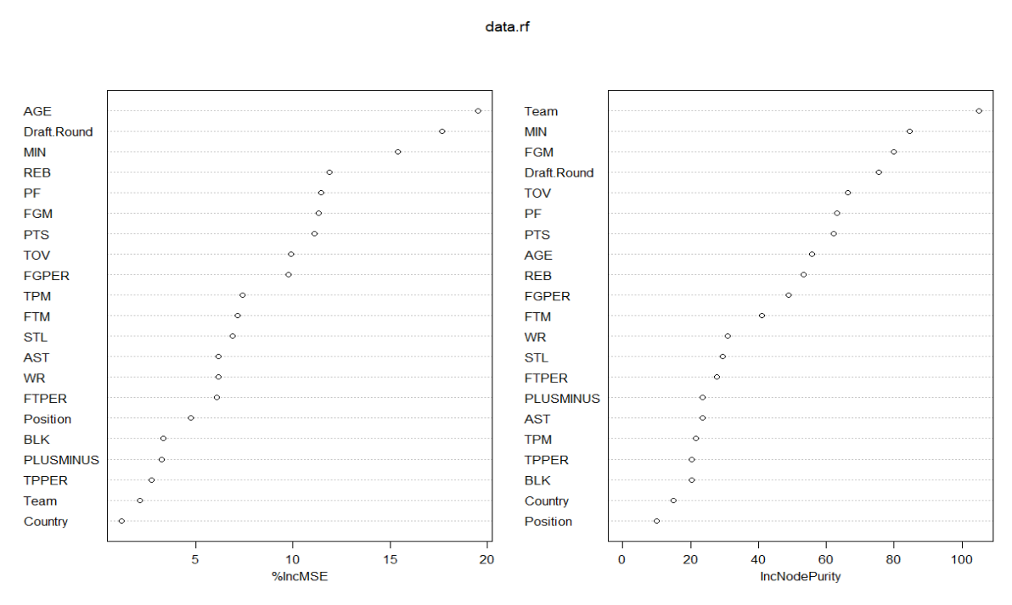
Notes:
- Plotted all these data against log(salary)
Turns out Team is the most significant factor, followed by MIN, FGM, Draft.Round, TOV
Note liability stats here such as TOV and PF means the more, higher the salary
Explain potential reasons why

Slide 6
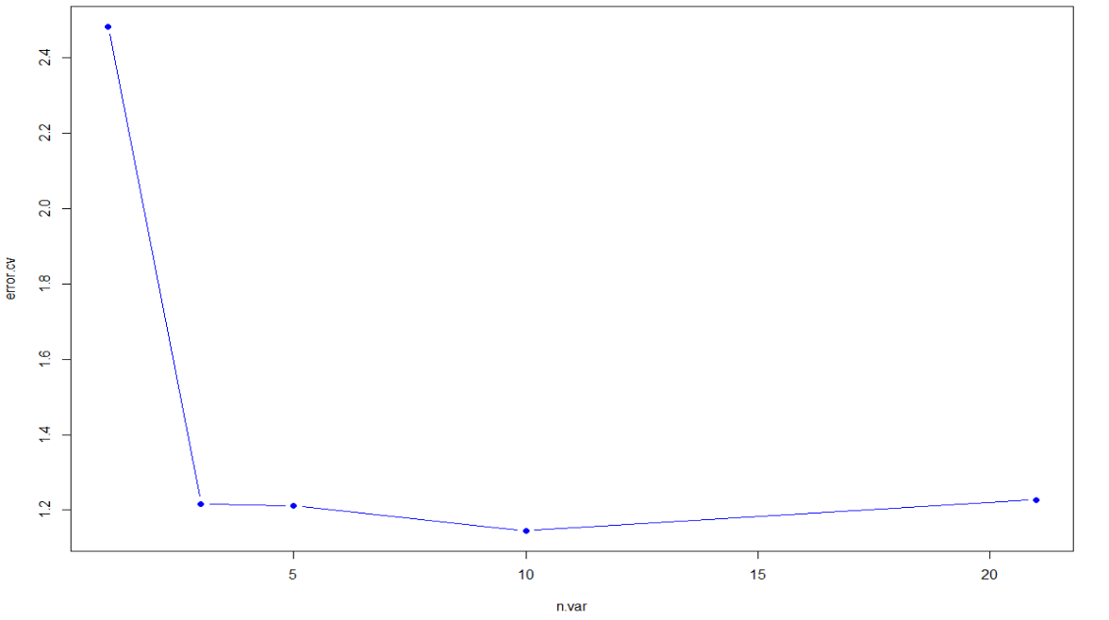
Notes:
cross validation is the lowest for 10 explanatory variates, at about 1.18
Try 10 variates, Team, MIN, FGM, Draft.Round, TOV, PF, PTS, AGE, REB, and FGPER

Slide 7
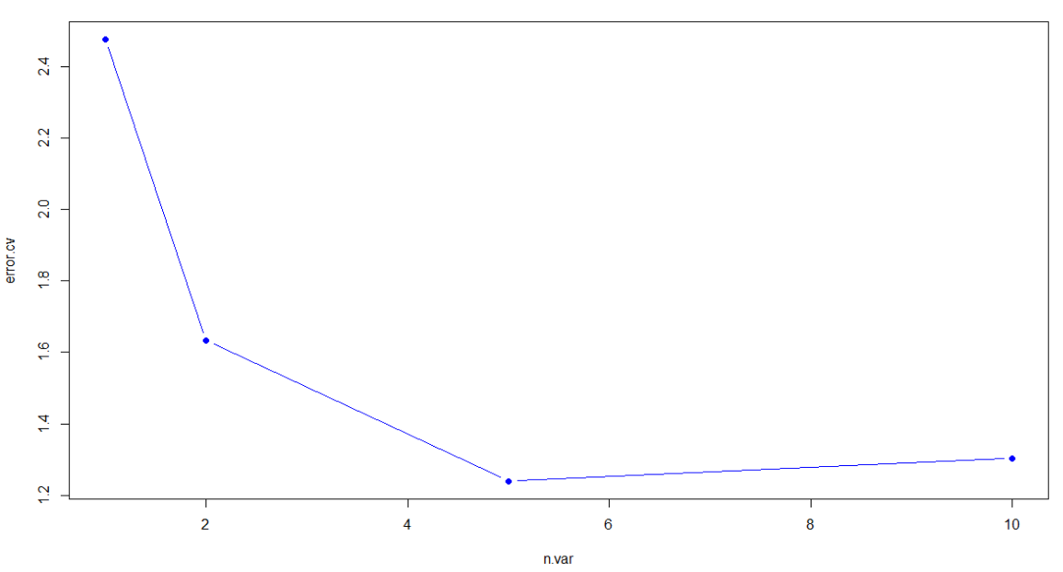
Notes:
Now 5 has the lowest cross validation error, at around 1.22
Try 5 variates, Team, MIN, FGM, PTS, and AGE

Slide 8
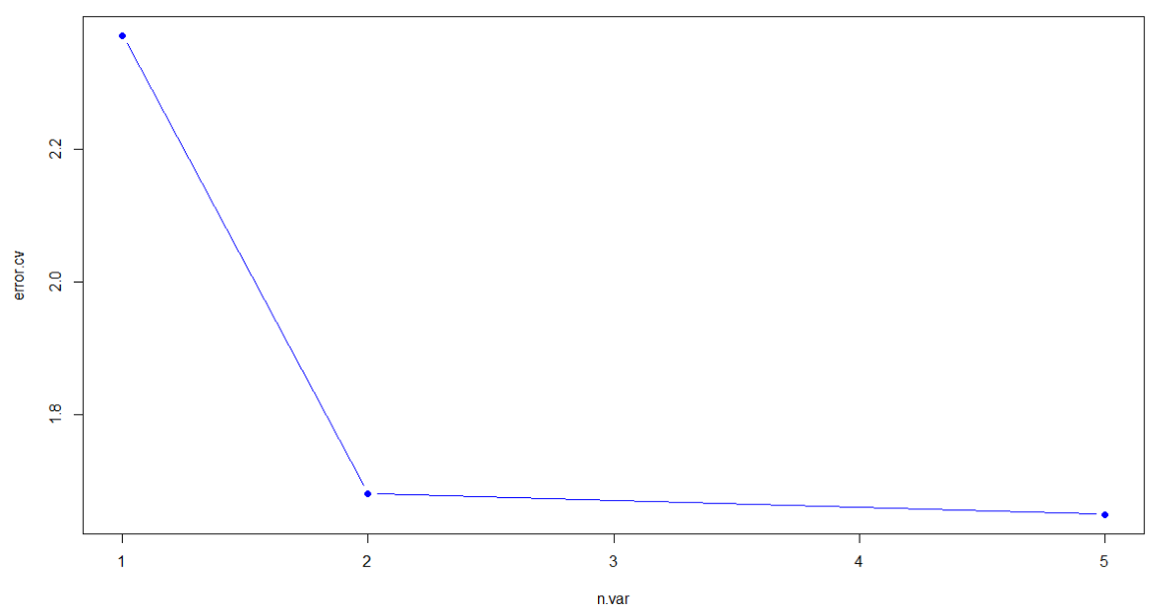
Notes:
- Confirms 5 has the lowest cross validation error, at about 1.64.

Slide 9
Random Forest (cont.)
Player self-evaluation and self-improvement in order to receive a higher pay.
Removed variables cannot be controlled by players
Team
MIN
Win Rate
AGE
Draft Round
PLUSMINUS
Redo the process

Slide 10
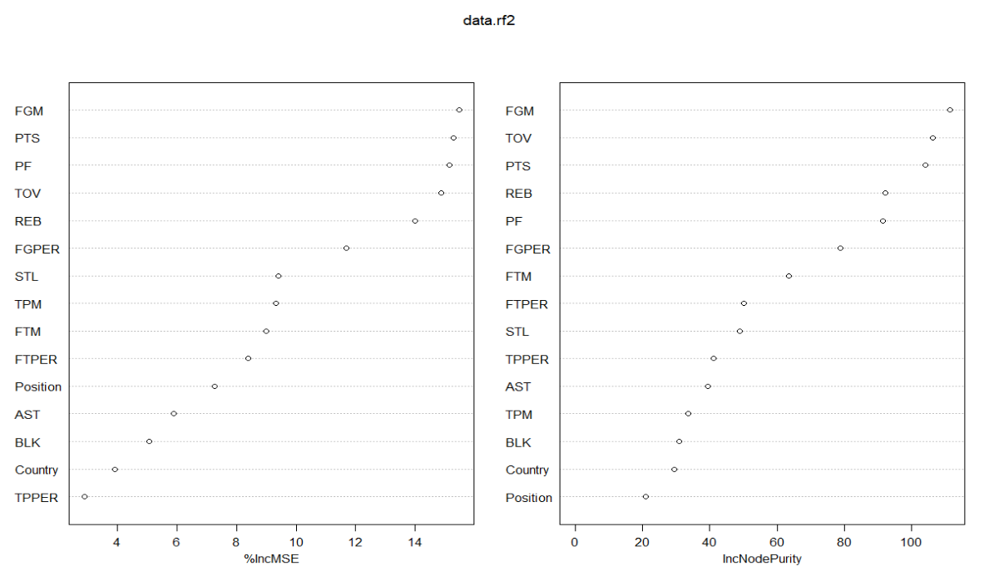

Slide 11
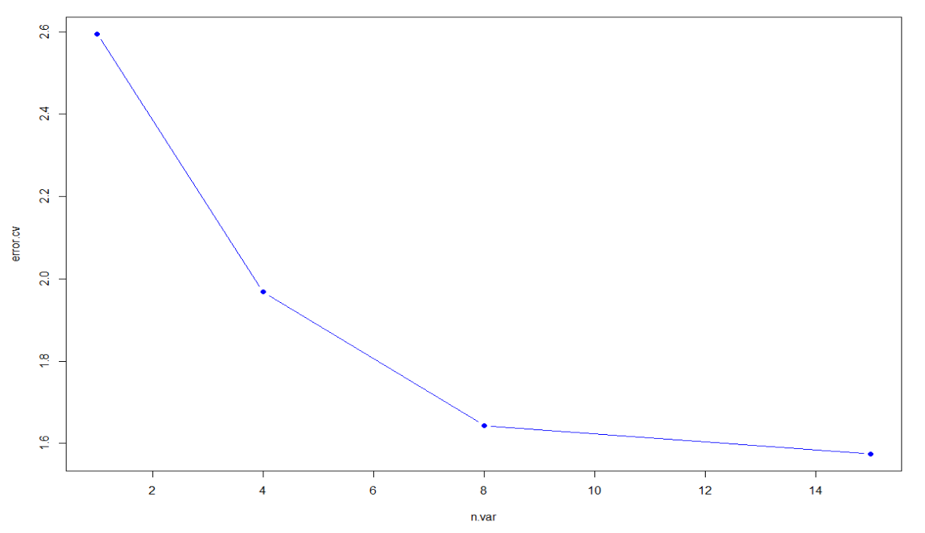
Notes:
- All the rest of the 15 variables are important, as the cross validation error is the lowest at 15, at 1.58.

Slide 13
Boosting
We then used the Gradient Boosting method to determine the importance of explanatory variates, and see if it shows a different result compared to Random Forest.
Explanatory variables used:
PTS, REB, AST, TOV, STL, BLK, Team, WR, AGE, FGM, FGPER, TPM, TPPER, FTM, FTPER, PF, PLUSMINUS, Position, Country, MIN, and Draft Round

Slide 14
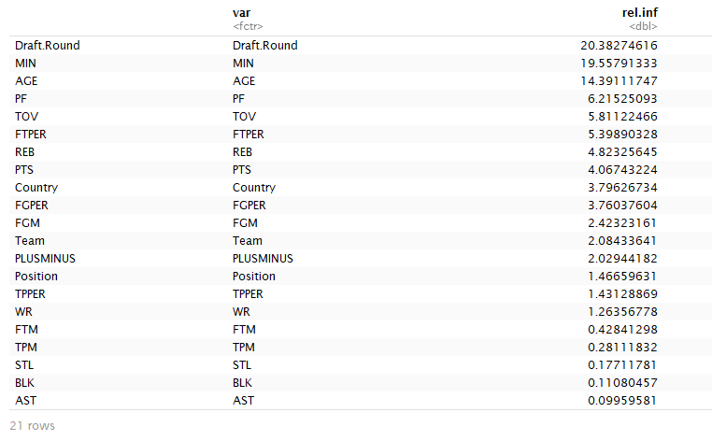
Notes:
Chose bag.fraction = 1 to remove randomness, if not, fraction of the (training) data will be selected at random to use on the next tree in the boost
Chose shrinkage = 0.05, we want to improve the model's generalization ability, did increase computation time by some time.

Slide 15
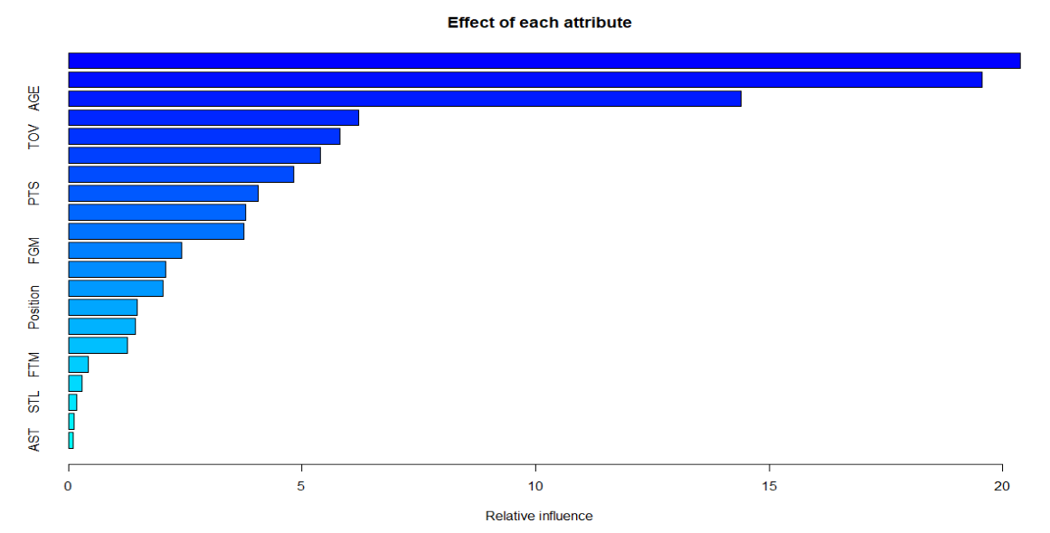

Slide 16
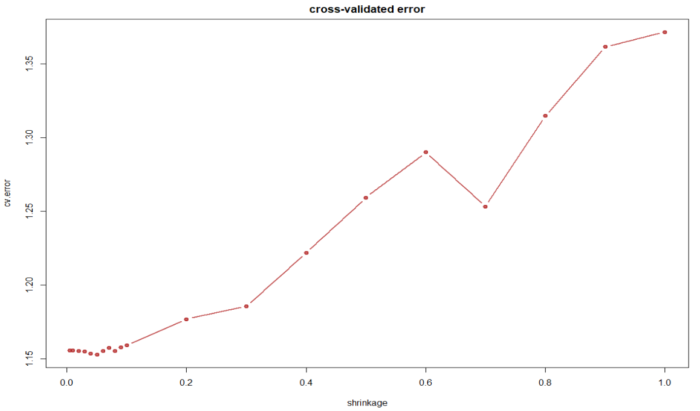
Notes:
We see that the best learning rate for these 21 explanatory variates is at around 0.06, with cv error around 1.15

Slide 17
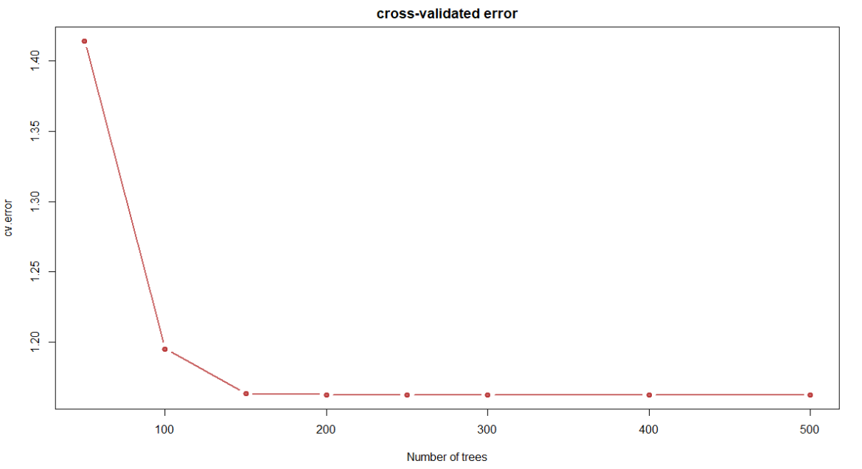
Notes:
We would like to evaluate the best value for M, the total number of trees to fit, in order to find the minimum number of iterations needed to get a reasonable result with small cv error
Turns out to be M = 150 at cv error 1.16, with diminishing returns for greater values.

Slide 18
Boosting (cont.)
Player self-evaluation and self-improvement in order to receive a higher pay.
Removed variables cannot be controlled by players
Team
MIN
WR
AGE
Draft.Round
PLUSMINUS
Redo the process

Slide 19
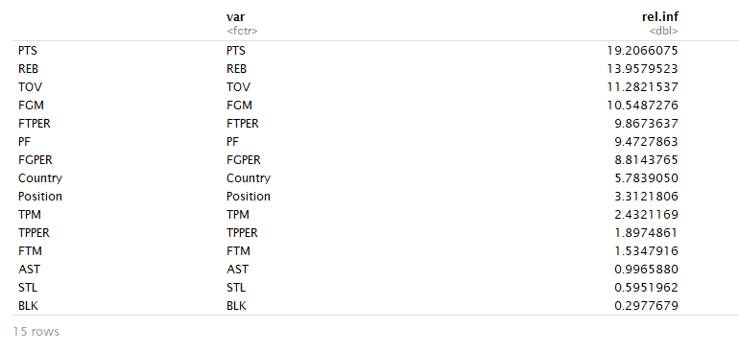
Notes:
Chose bag.fraction = 1 to remove randomness, if not, fraction of the (training) data will be selected at random to use on the next tree in the boost
Chose shrinkage = 0.05, we want to improve the model's generalization ability, did increase computation time by some time.

Slide 20
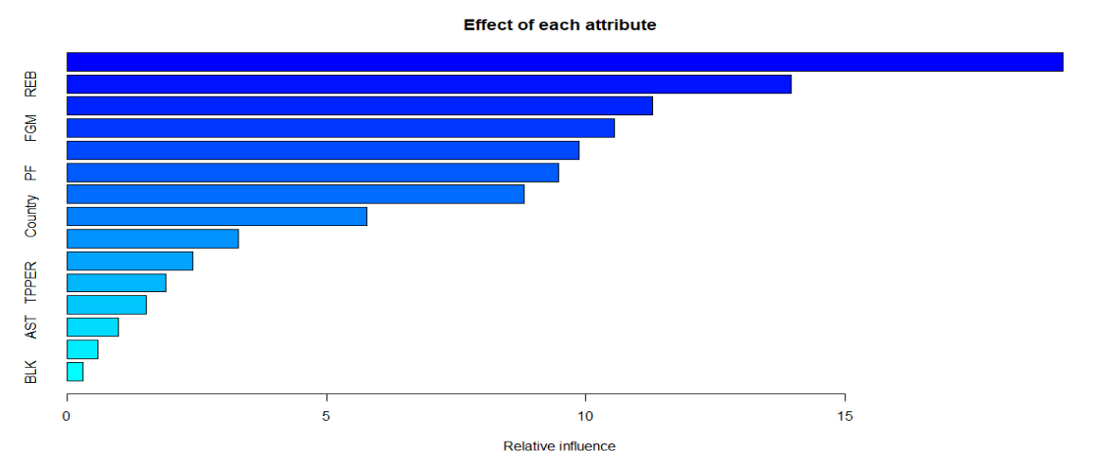

Slide 21
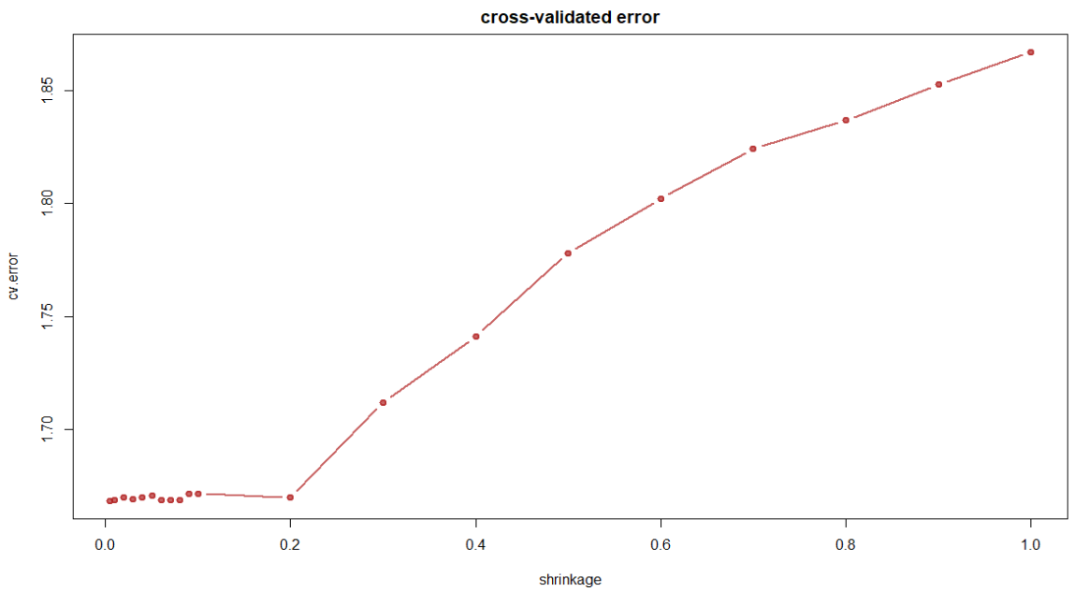
Notes:
We see that the best learning rate for these 15 explanatory variates is at around 0.06 – 0.08, with cv error around 1.66.

Slide 22
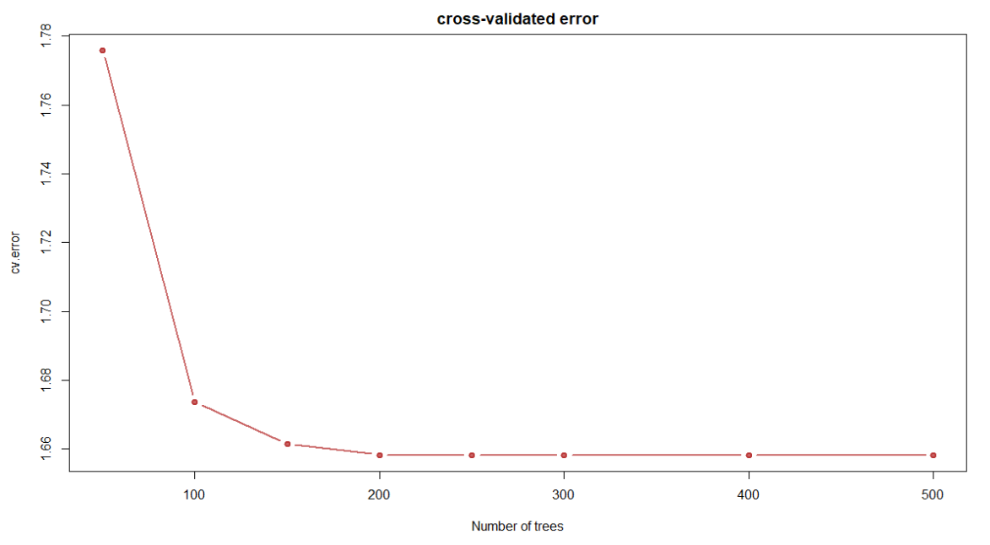
Notes:
We would like to evaluate the best value for M, the total number of trees to fit, in order to find the minimum number of iterations needed to get a reasonable result with small cv error
Turns out to be M = 200 at cv error 1.66., with diminishing returns for greater values.

Slide 23
Conclusion
Which method is better?
We tested the APSE of the three models with 5-fold CV
GAM with thin plate splines had the lowest APSE of 0.96
Splines was also the fastest to compute out of the three

Slide 24
Conclusion (cont.)
There are very significant factors( e.g. age ) what are outside of players control
Three most important aspect to work on includes
Increasing Field Goals
Reducing Turnovers
Increasing Rebound

Slide 25
Future Work
Win share over Plus or Minus
Plus or Minus heavily relies on teammates
Average players might have high Plus or Minus if their team is winning a lot
Win share relies a lot less than other people

Slide 26
Thank you

