Slide 1




Abundance and Biomass of Sand Prawn Kraussillichirus kraussi in Richards Bay Harbour.
Zizipho Mamfengu¹
Lungelo Nsibande¹ , Ntuthuko Masikane^{1,2}
¹Department of Zoology, University of Zululand, KwaDlangezwa 3886, South Africa
²South African Institute for Aquatic Biodiversity, Makhanda, South Africa

Slide 2

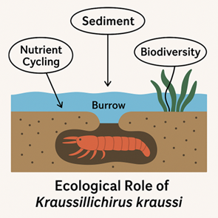
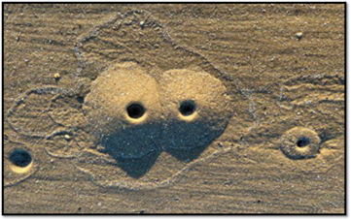
Introduction
Kraussillichirus kraussi is a small burrowing sand prawn, about 3–5 cm in length.
It is classified as macrobenthos, living within or on estuarine sediments.
It plays an important role in estuarine ecosystems.
It aerates sediments and enhances nutrient recycling.

Slide 3
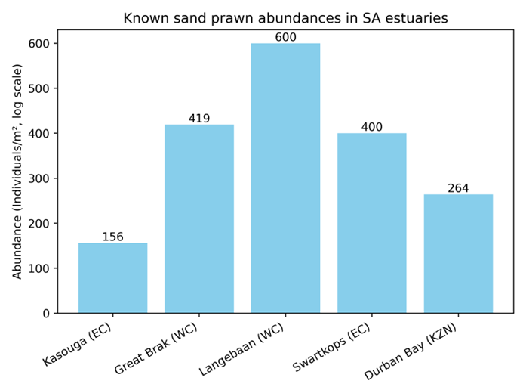
Introduction
Previous Studies
Temperature: High or low extremes reduce growth.
Salinity: Very high or low salinity decreases abundance.
Dissolved oxygen: Low oxygen limits survival, high oxygen allows active burrowing and higher biomass.
Estuary type: Permanently open estuaries favor stable populations.

Slide 4

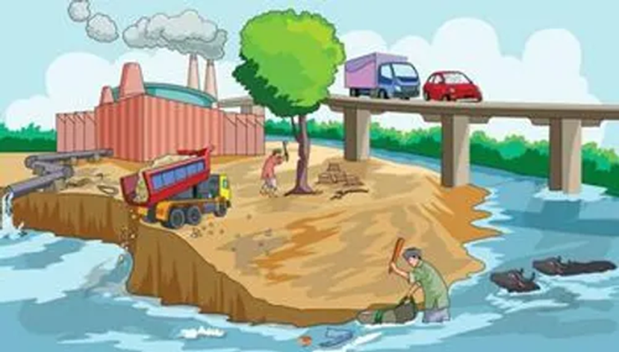
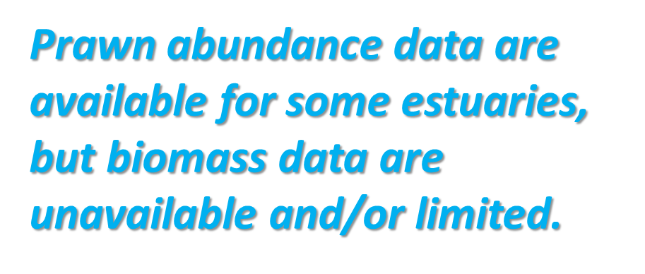
Problem statement
Prev
nnnnn

Slide 5
Aim and Objectives
Aim
The main aim of this study is to assess the abundance and biomass of Kraussillichirus kraussi in Richards Bay Harbour.
Objectives
The objectives of this study:
Quantify the abundance of Kraussillichirus kraussi at selected sites.
Determine biomass across high and low-flow seasons.
Relate these findings to sediment grain size and organic content.
Assess environmental stress using ABC curves.

Slide 6
Materials and Methods
Study Area
Richards Bay Harbour (28°48′ S, 32.°04′ E) is a subtropical estuarine bay in KwaZulu-Natal.
It is South Africa’s largest and busiest deep-water port, used for exporting coal and is popular for recreational fishing.
The harbour is earmarked for expansion.

Slide 7
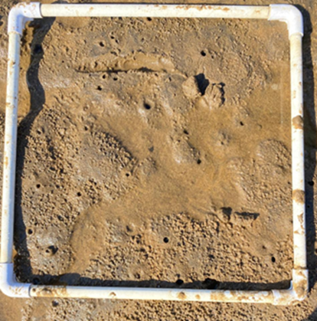

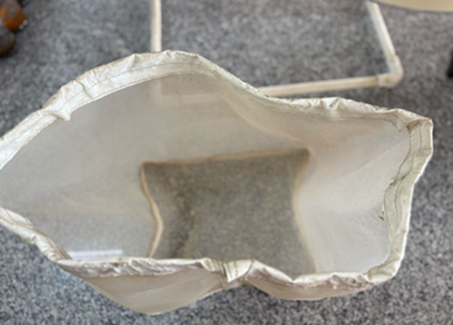
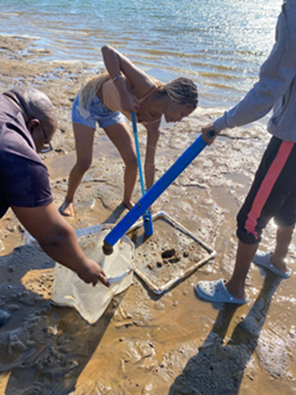
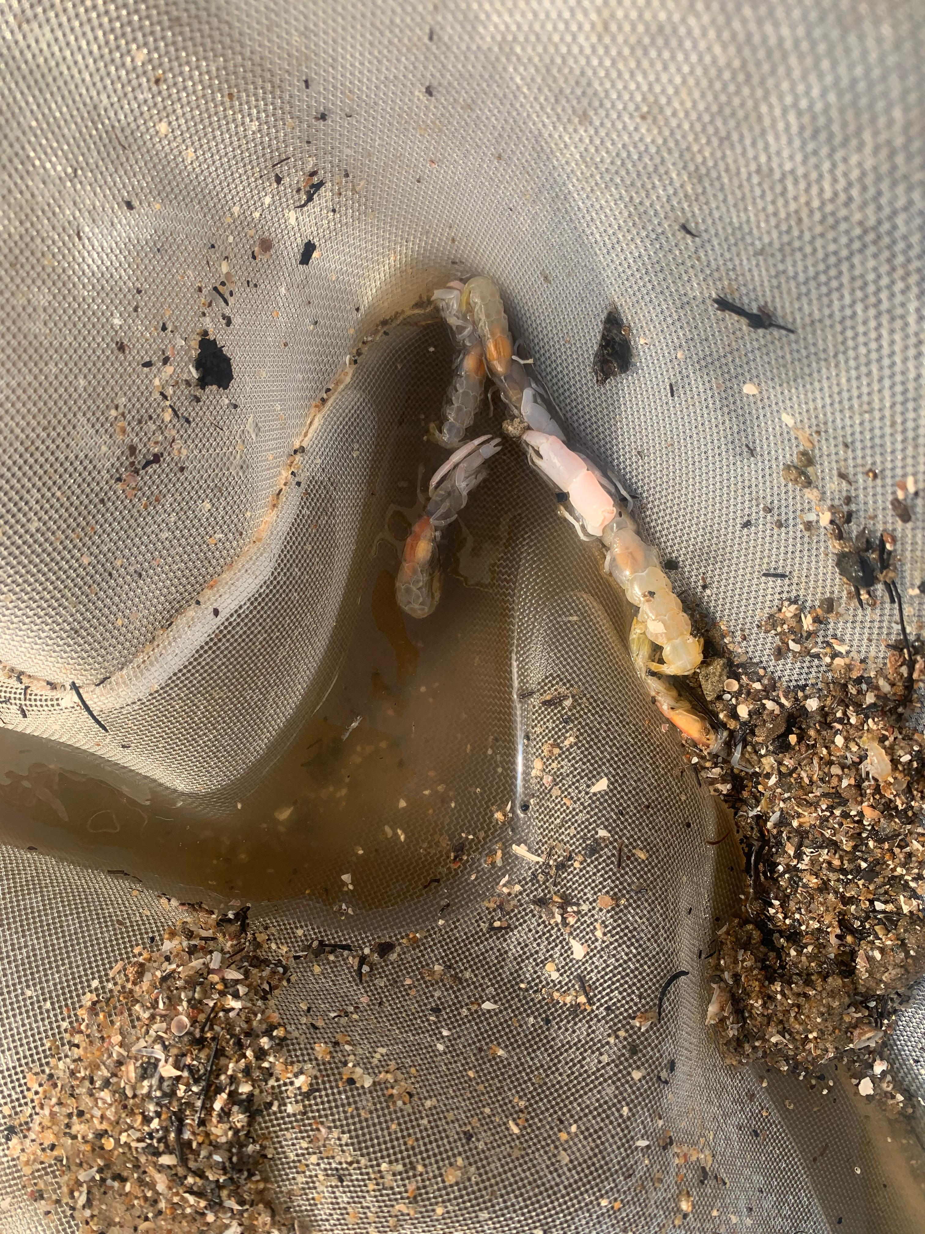
Materials and Methods
Field trip.
Sand prawns were collected using a prawn pump from triplicate quadrats (area: 1 m²) at three sites over 3 months.

Slide 8
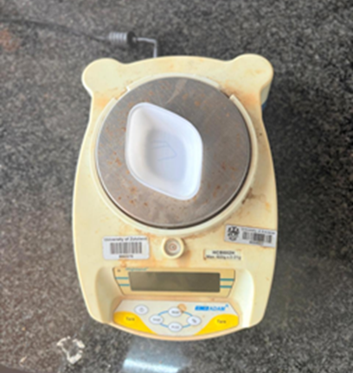
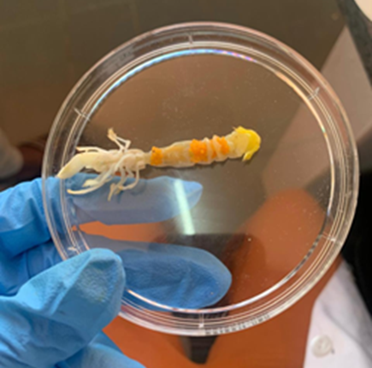
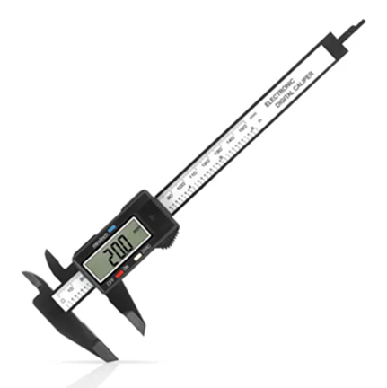
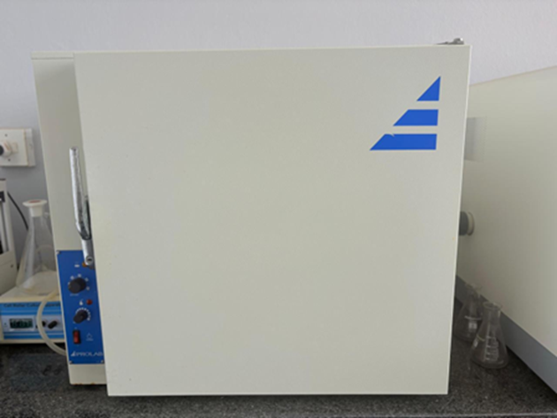
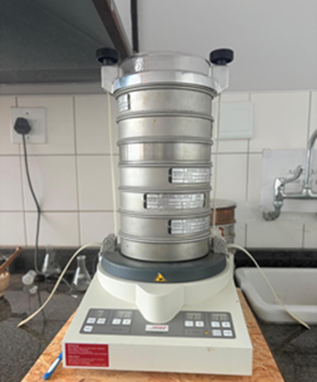
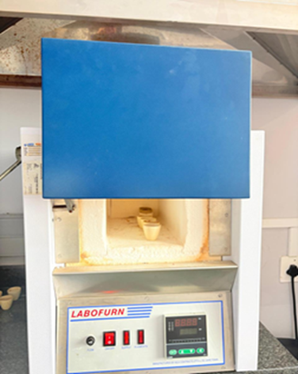
Materials and Methods
Abundance and biomass.
For prawns, carapace length, width and weight were measured, followed by an estimation of abundance and biomass.
Grain size and Total Organic Content.
Triplicate sediment samples were also collected for the analysis of grain size (dry sieving method) and TOC (loss on ignition method).
Data analysis and visualization were conducted using Programming Language and Gradistat v8.

Slide 9
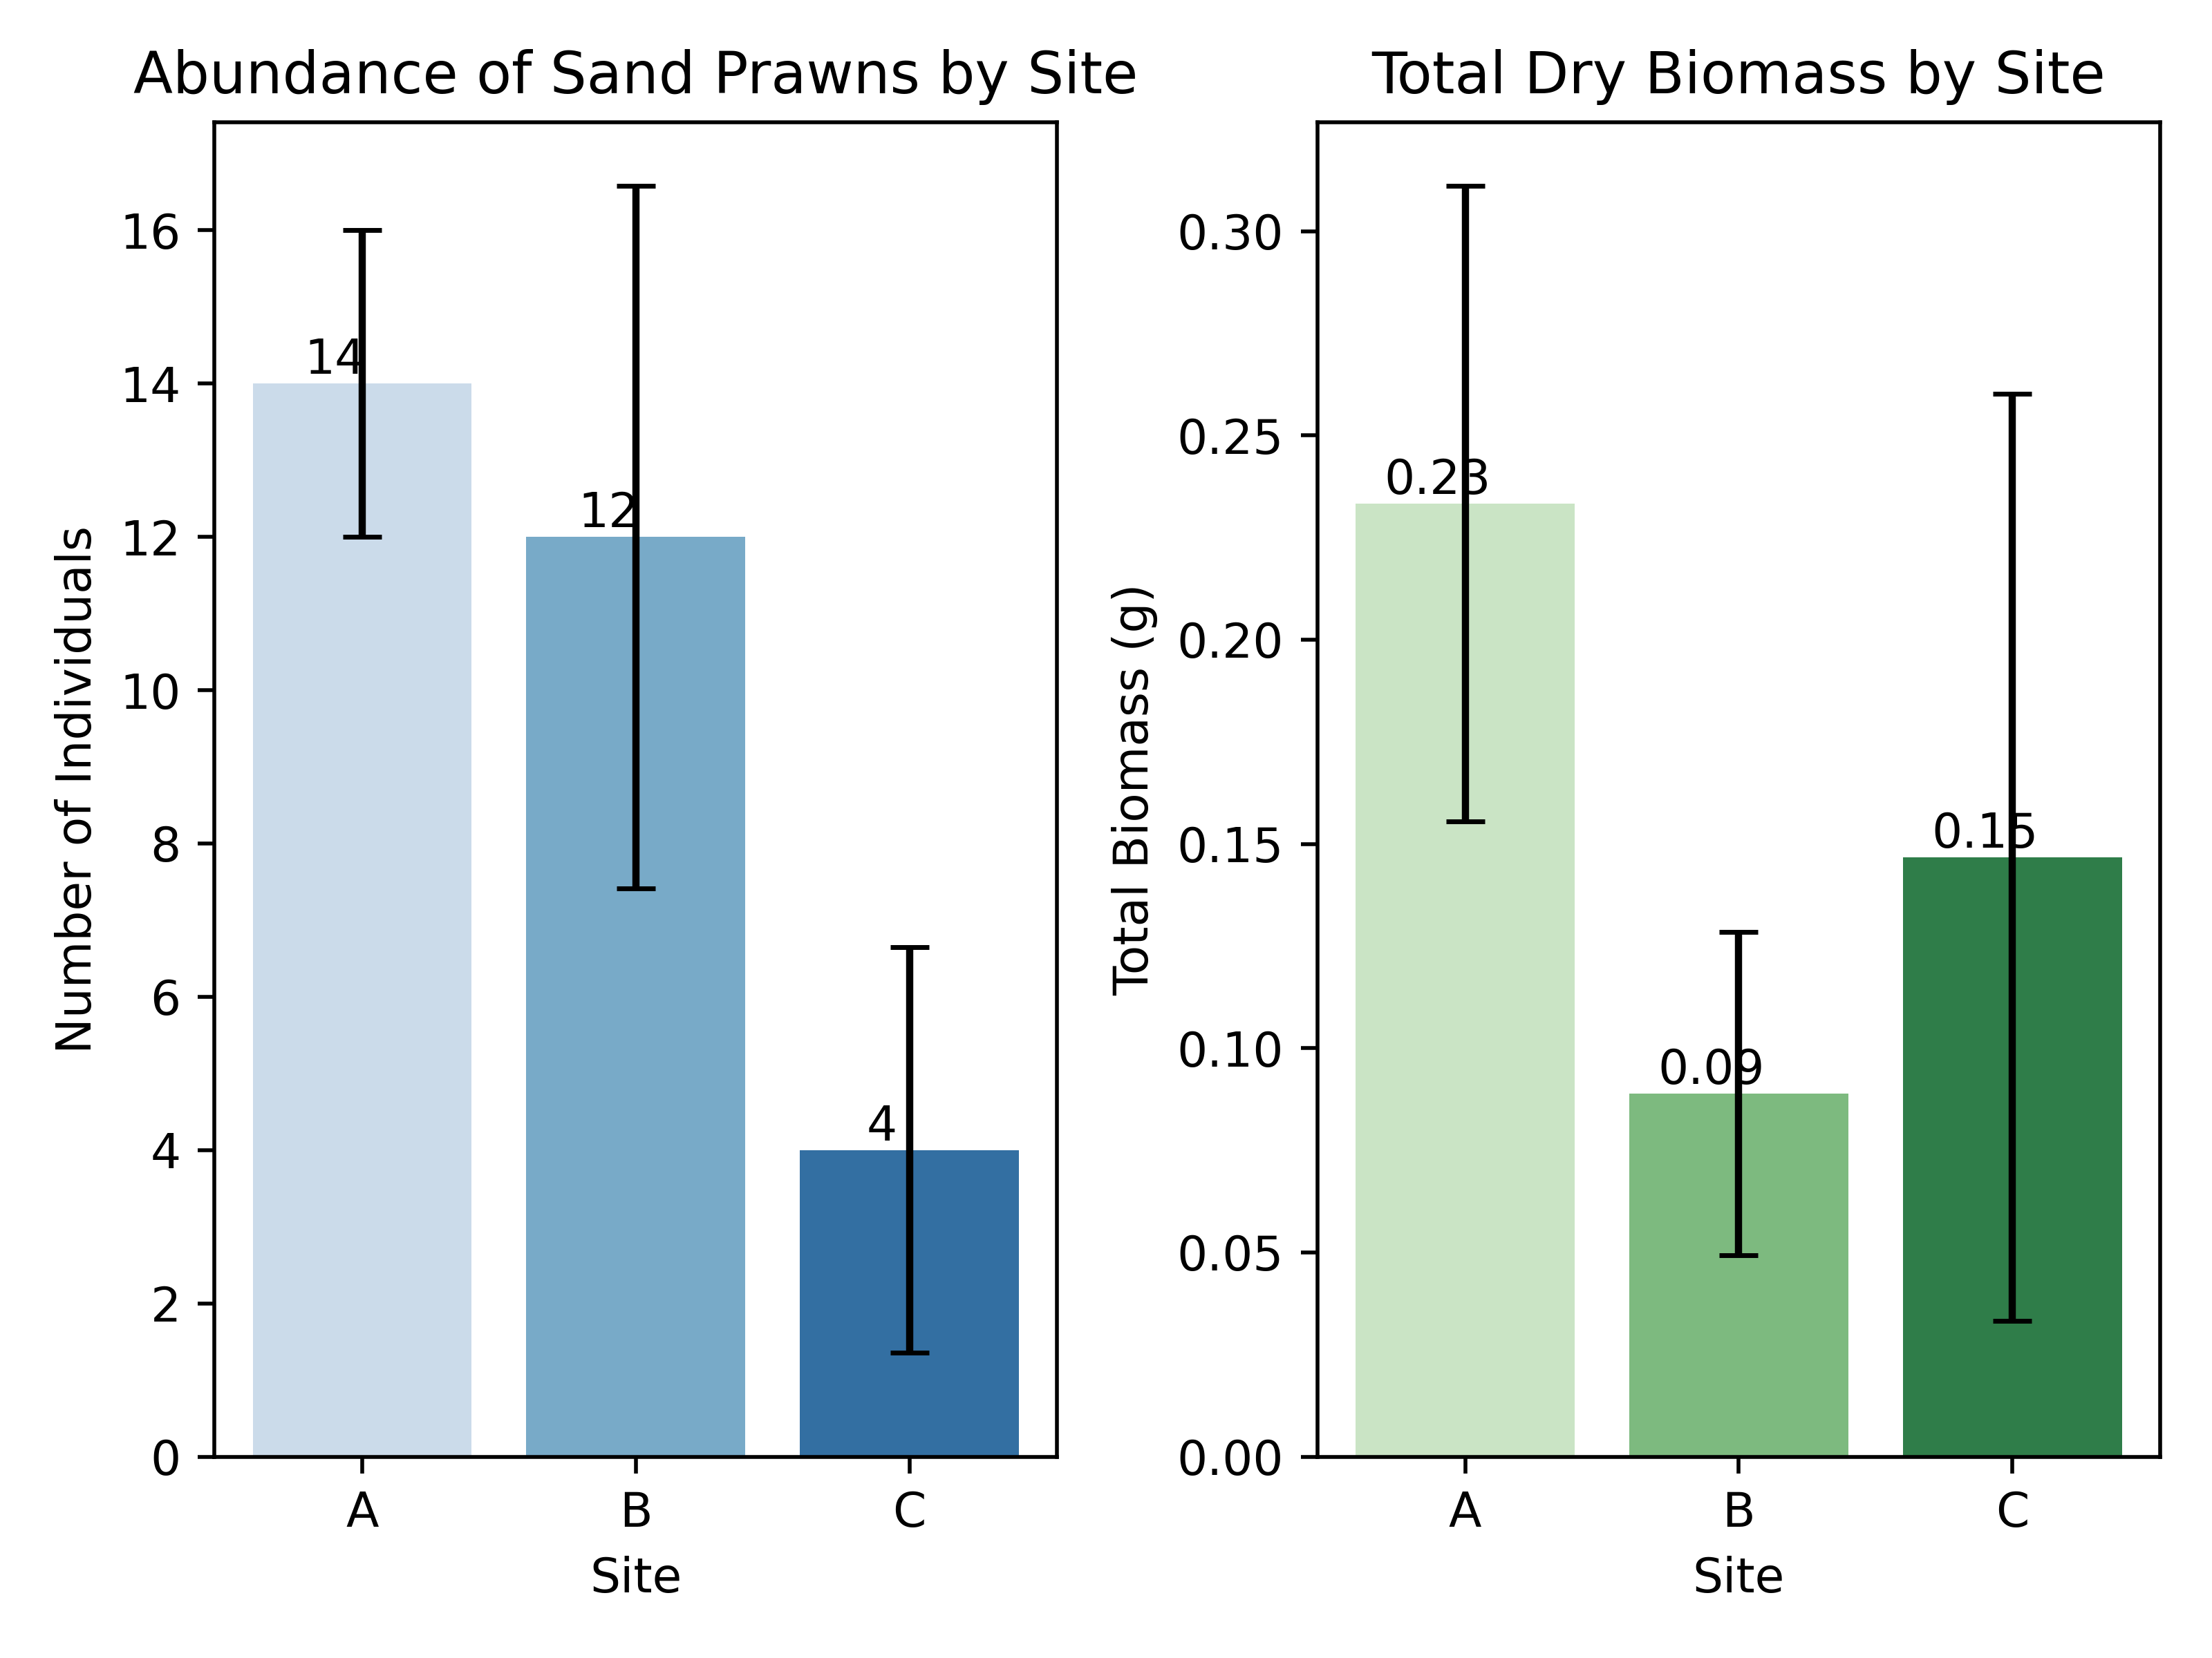
Results and Discussion
Abundance and Biomass
Abundance-Biomass Comparison curves showed that Sites A and B had higher biomass relative to abundance, indicating low disturbance.
Site C exhibited higher abundance than biomass, suggesting severe disturbance.
This may be attributed to overharvesting of prawns for bait, potential sediment contamination or recreational activities. Site C is situated on Pelican Island, a popular recreational destination.

Slide 10
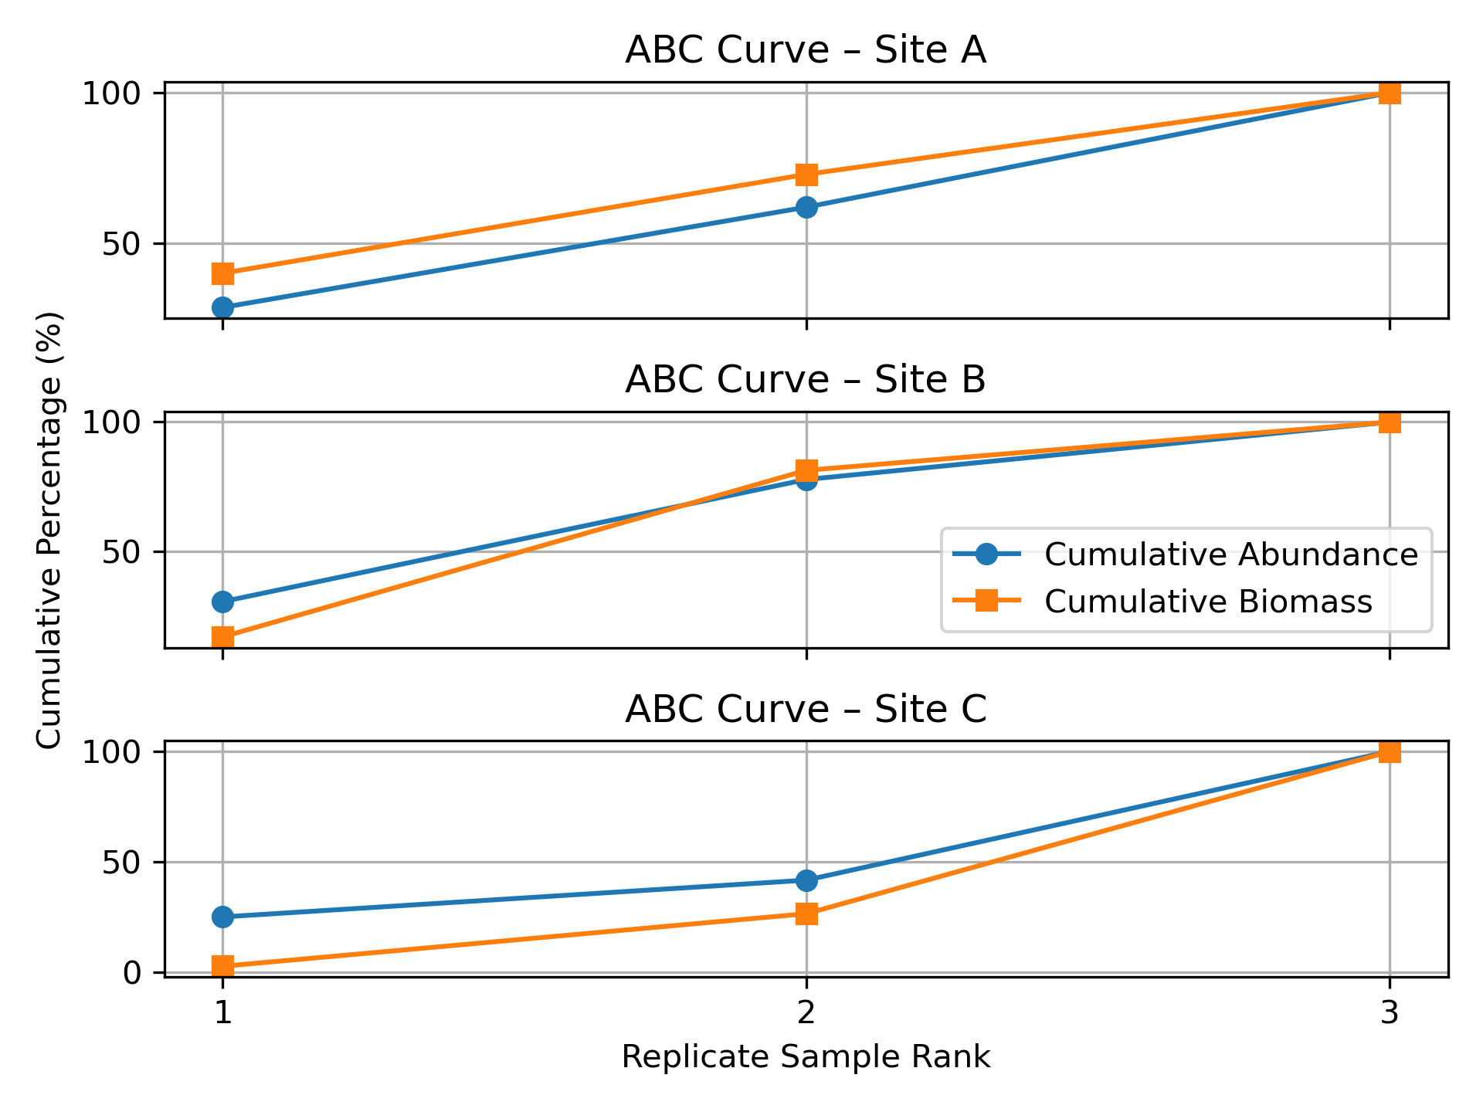
Results and Discussion
Abundance and Biomass
Abundance-Biomass Comparison curves showed that Sites A and B had higher biomass relative to abundance, indicating low disturbance.
Site C exhibited higher abundance than biomass, suggesting severe disturbance.
This may be attributed to overharvesting of prawns for bait, potential sediment contamination or recreational activities. Site C is situated on Pelican Island, a popular recreational destination.

Slide 11
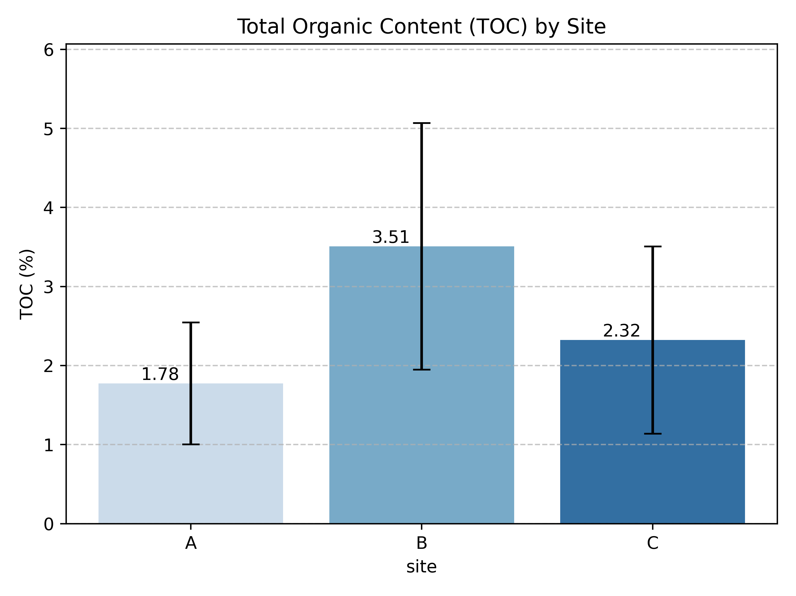
Results and Discussion
Abundance and Biomass
Abundance-Biomass Comparison curves showed that Sites A and B had higher biomass relative to abundance, indicating low disturbance.
Site C exhibited higher abundance than biomass, suggesting severe disturbance.
This may be attributed to overharvesting of prawns for bait, potential sediment contamination or recreational activities. Site C is situated on Pelican Island, a popular recreational destination.

Slide 12
Results and Discussion
Abundance and Biomass
Abundance-Biomass Comparison curves showed that Sites A and B had higher biomass relative to abundance, indicating low disturbance.
Site C exhibited higher abundance than biomass, suggesting severe disturbance.
This may be attributed to overharvesting of prawns for bait, potential sediment contamination or recreational activities. Site C is situated on Pelican Island, a popular recreational destination.

Slide 13
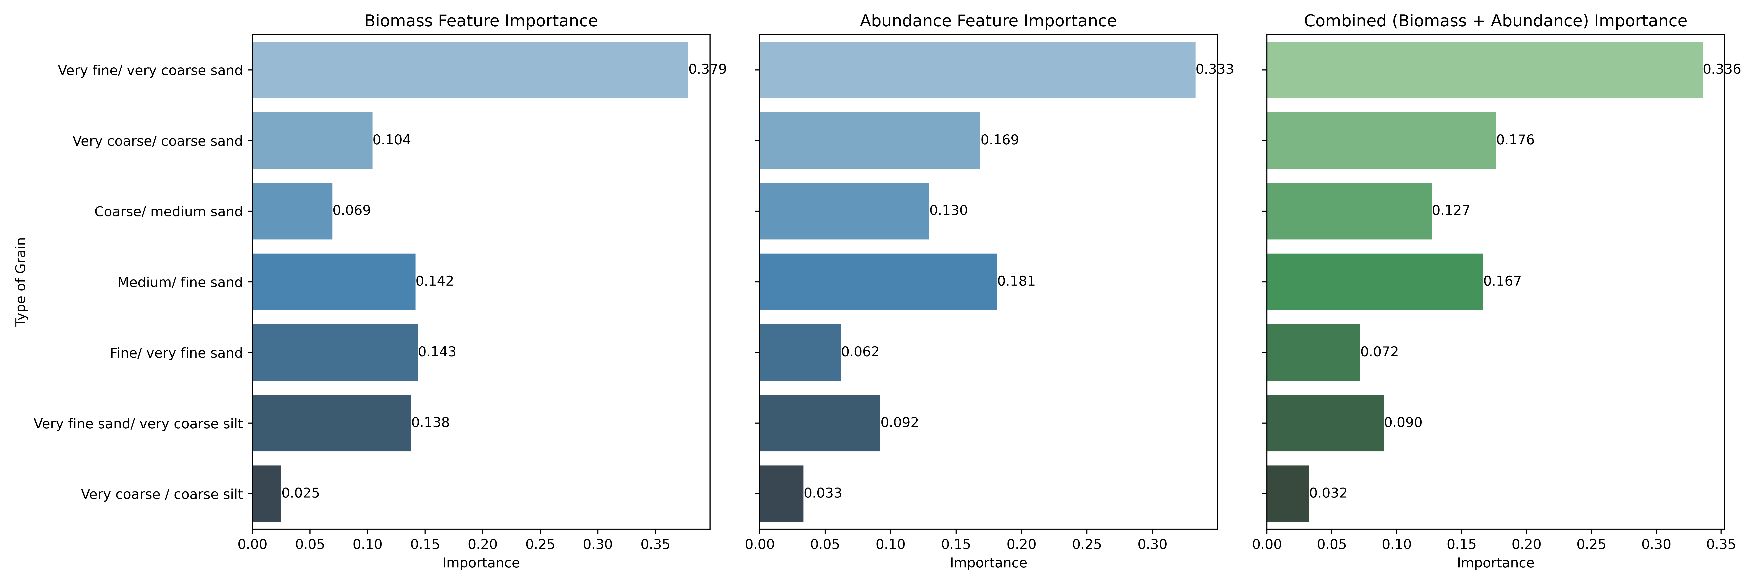
Results and Discussion
Sediment Characteristics in relation to population Patterns by medium and fine sand.
Site B, Random Forest analysis shows that ‘Very fine/very coarse sand’ and ‘Medium/fine sand’ are the key sediment fractions driving variability in macrobenthic biomass and abundance.
PC1-PC2 shows that the sediment grain size and TOC strongly influence Kraussillichirus kraussi abundance and biomass, with sites clustering according to sediment and macrobenthic characteristics.

