Slide 1
Terraform

Slide 2
Course Overview
Module 1: Introduction to Infrastructure as Code
Module 2: Terraform
Module 3: Terraform with AWS

Slide 3
Module 1: Introduction IaC

Slide 4
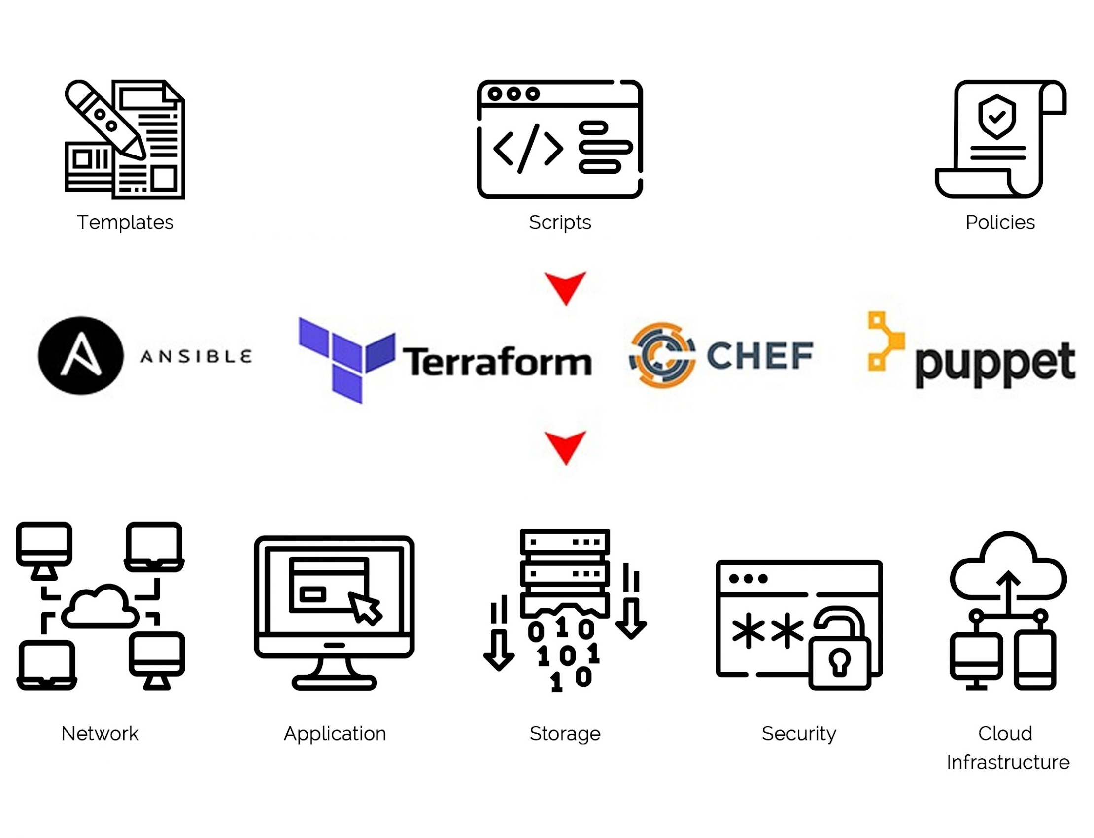
What is Infrastructure as Code?
Infrastructure as code (IaC) tools allow you to manage infrastructure with configuration files rather than through a graphical user interface.
IaC allows you to build, change, and manage your infrastructure in a safe, consistent, and repeatable way by defining resource configurations that you can version, reuse, and share.
It lets you define resources and infrastructure in human-readable, declarative configuration files, and manages your infrastructure lifecycle.

Slide 5


Before have IaC
Configure Software
Install DB
Prepare servers
Setup servers
Configure networking
Create routable
Install software

Slide 6
Before have IaC
Prepare servers
High human resources cost
More effort time
More human errors possible

Slide 7
Before have IaC
Prepare servers
Update versions
Deploy new release
DB backups/updates
Recover app
Add/recover servers
Maintenance
For multiple environments

Slide 8
Before have IaC
Prepare servers
Maintenance
For multiple environments

Slide 9
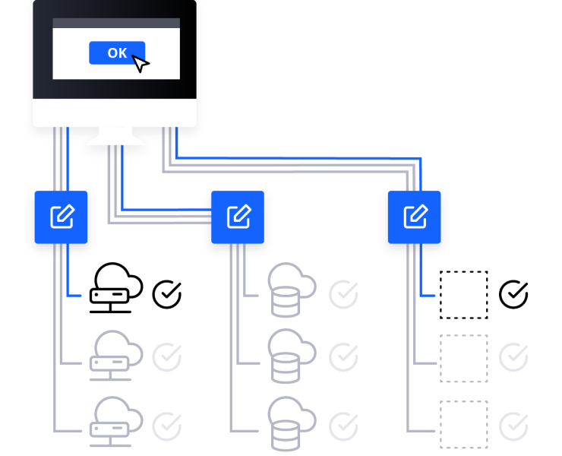
After have IaC
Automate complete process with
Infrastructure as Code (IaC)

Slide 10
3 main task categories
1) Infratructure Provisioning
1) Initial setup phase
2) Configuration of provisioned infrastructure
2) Maintaining phase
3) Deployment of Application

Slide 11
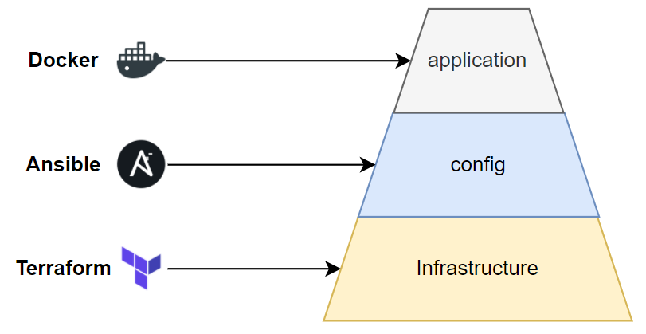

Slide 12
Distinction of phases
1) Initial setup phase
2) Maintianing phase
Provision infrastructure
Configure infrastructure
Adjustment to infrastructure
Add and remove servers
Initial installation of software
Initial configuration of software
Update software
Re-configuration of software

Slide 13


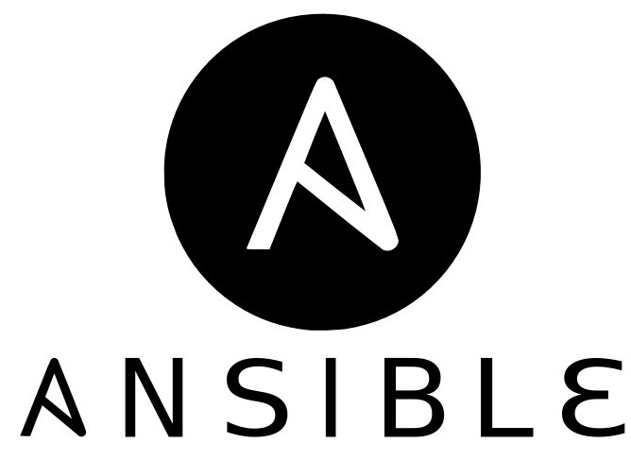
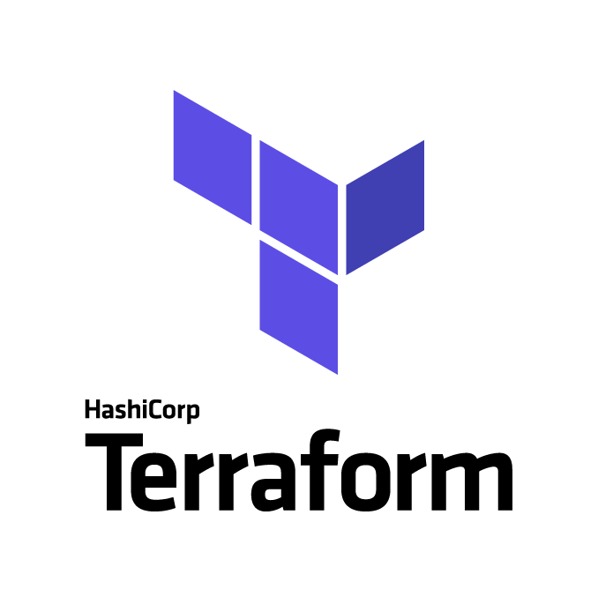
IaC tools
Initial Infrastructure Setup
Manage Infrastructure
Initial Application Setup
Manage Applications

Slide 14
Declarative
Procedural
Add 2 servers
Create a server
Add a server
Make this change

Slide 15
Declarative
Procedural
Mutable
Immutable
Changes
Replacing

Slide 16
Declarative
Procedural
Mutable
Immutable
Agent
Agentless

Slide 17
Module 2: Terraform

Slide 18
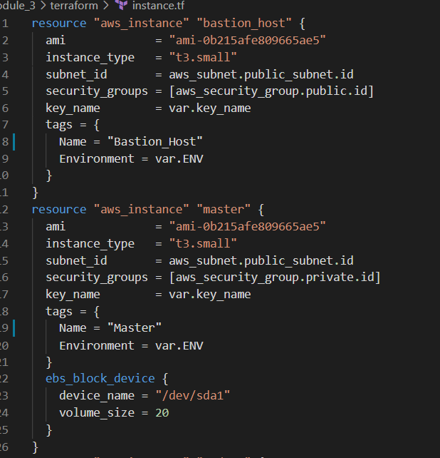
HashiCorp Configuration Language
The HashiCorp Configuration Language (HCL) is a configuration language authored by HashiCorp.
HCL is used with HashiCorp cloud infrastructure automation tools, such as Terraform.
The language was created with the goal of being both human and machine friendly.
It is JSON compatible, which means it is interoperable with other systems outside of the Terraform product line.

Slide 19
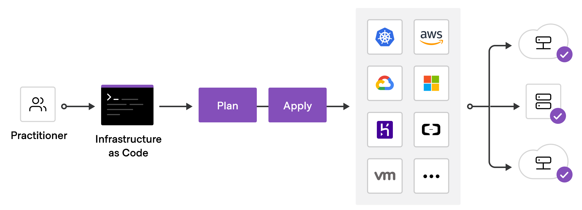
What is Terraform?
Automate and manage your infrastructure
Your platform
And services that run on that platform
Open source
Declarative
>> Define what end result you want

Slide 20
Difference Ansible vs Terraform?
Both: Infrastructure as Code
Both automate:
Provisioning, configuring, managing the infrastructure
Mainly a configuration tool
Configure that infrastructure
Deploy apps
Install/update software
Mainly infrastructure provisioning tool
Can deploy apps
More advanced in orchestration
Better: for configuring that infrastructure
Better: for infrastructure

Slide 21
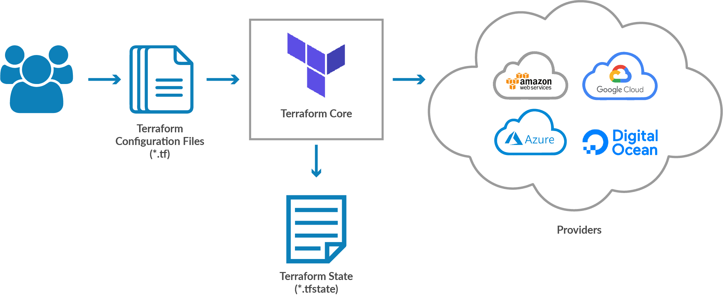
Easy with Terraform
Replicating infrastructure
Dev
Test
Prod
Create infrastructure
Changes to infrastructure
Over 100 provider
To over 1000 resources

Slide 22
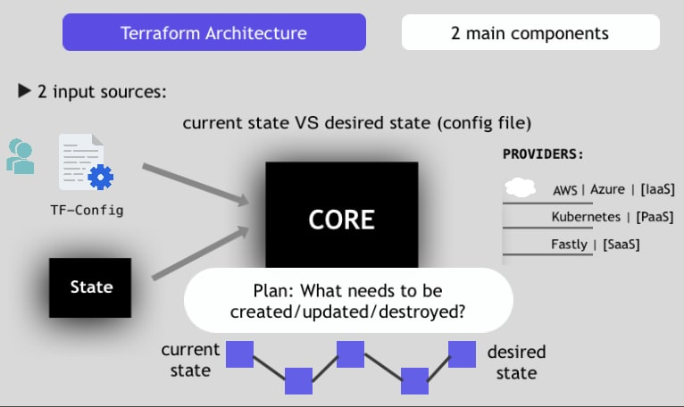

Slide 23
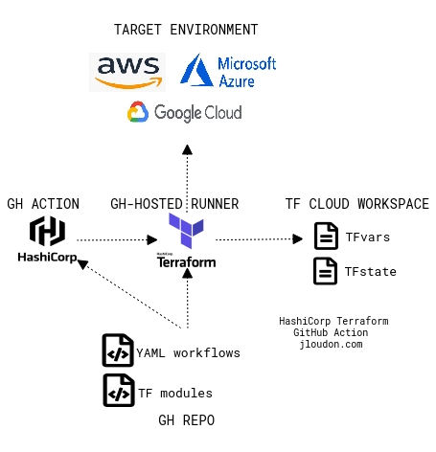

Slide 24
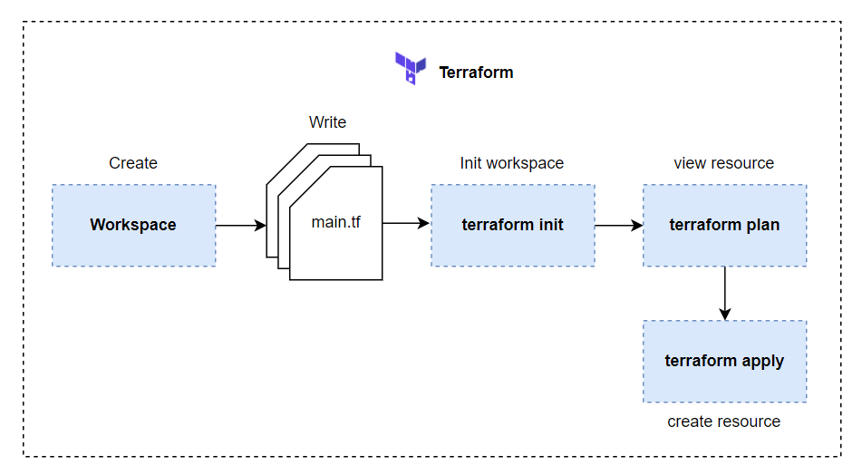

Slide 25
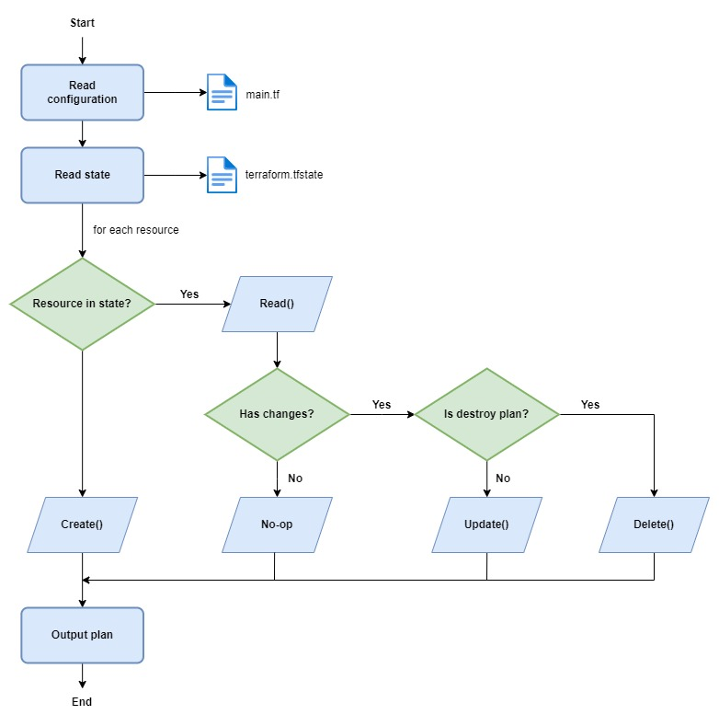
Terraform Life cycle
*** Resource drift

Slide 26
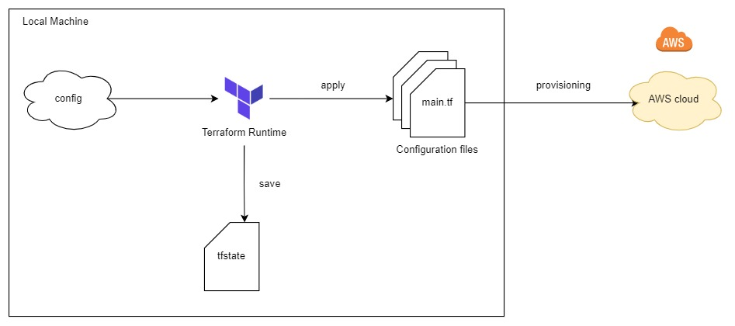
Terraform Backend
Local Backend

Slide 27
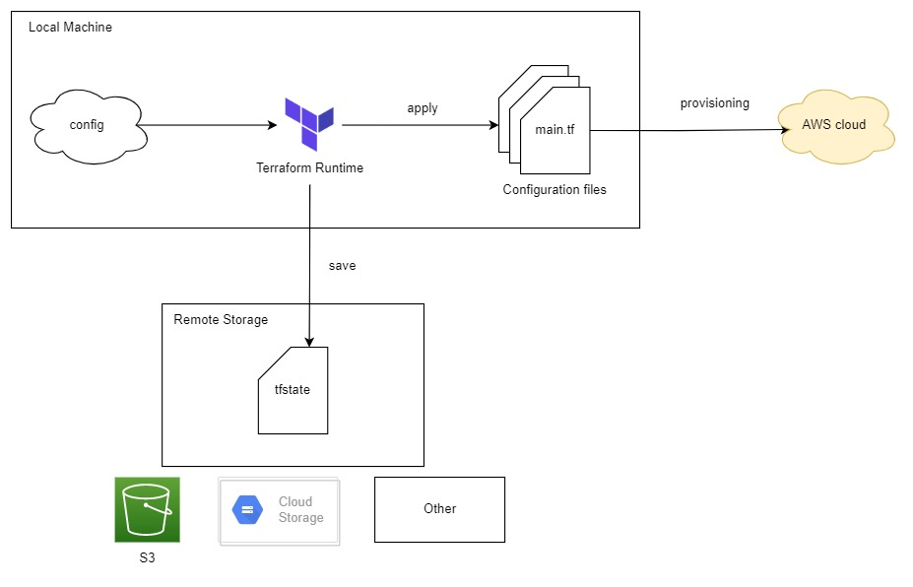
Terraform Backend
Standard Backend

Slide 28
Terraform Backend
Standard Backend

Slide 29
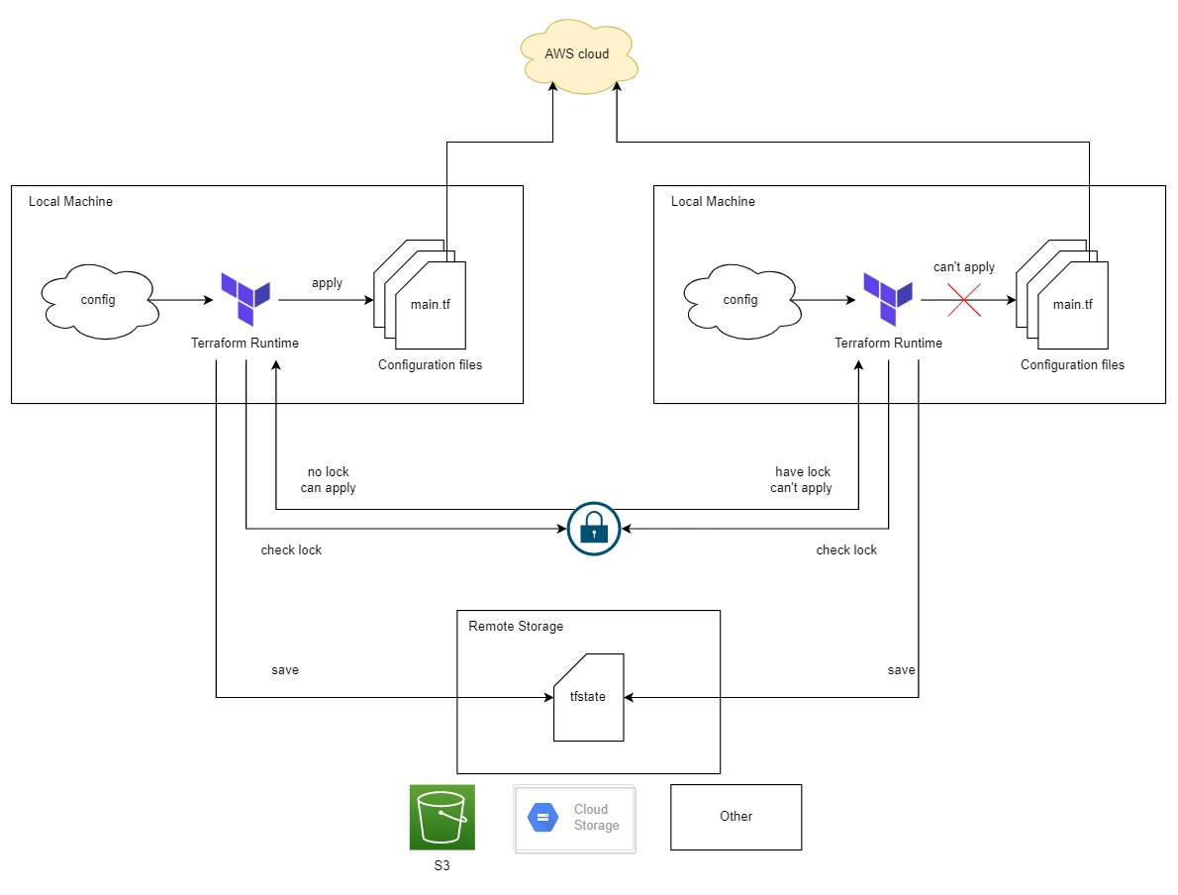
Terraform Backend
Standard Backend

Slide 30
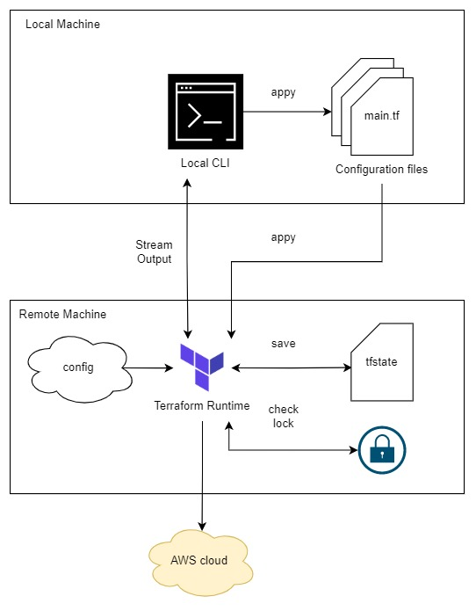
Terraform Backend
Remote Backend

Slide 31
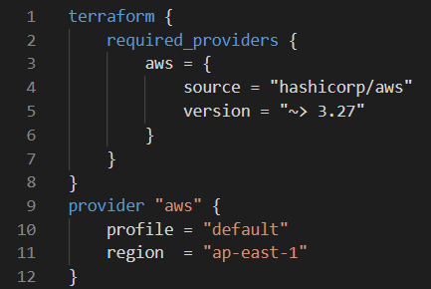
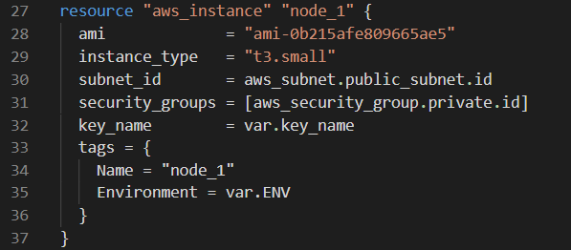
Example Configuration Files
Define provider and resource

Slide 32
Module 2: Terraform
Terraform Command
terraform init
Collect provider and installs
terraform fresh
Query infrastructure provider to get current state
terraform plan
Create an execution plan
terraform apply
Execute the plan
terraform output
Show resource info
terraform destroy
Destroy the resources/infrastructure

Slide 33
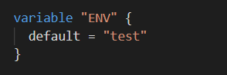
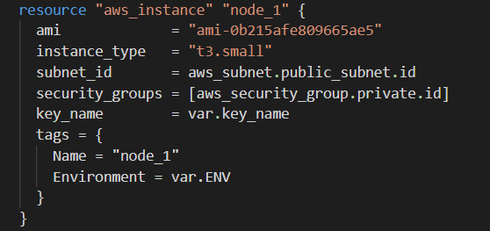
Variables
var.tf
instance.tf

Slide 34
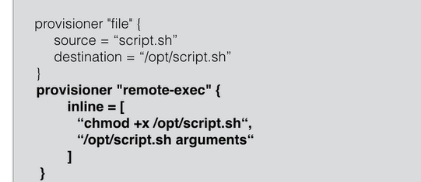
Provision software
There are 2 way to provision software on your instances:
You can build your own custom AMI and bundle your software with the image
Packer is a great tool to do this
Another way to boot standardized AMIs, and then install the software in it you need
Using file uploads
Using automation tools like chef, puppet, ansible
Using remote exec

Slide 35
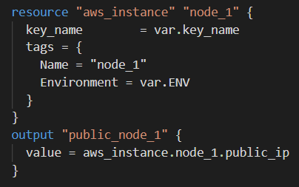
output
Terraform keeps attributes of all the resources you create
Ex: the aws_instance resource has the attribute public_ip
Those attributes can be queried and outputted
This can be useful just to output valuable information
or to feed information to external software
terraform output public_node_1

Slide 36
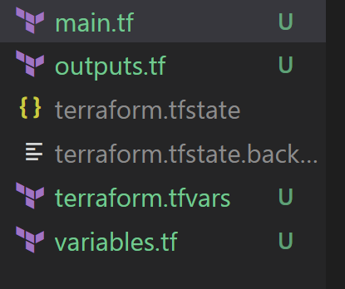
Remote State
Terraform keeps the remote state of infrastructure
It stores it in a file called terraform.tfstate
There is also a backup of the previous state in terraform.tfstate.backup
When you execute terraform apply, a new terraform.tfstate and backup is written
This is how terraform keeps track of the remote state
You can keep the terraform.tfstate in version control like git

Slide 37
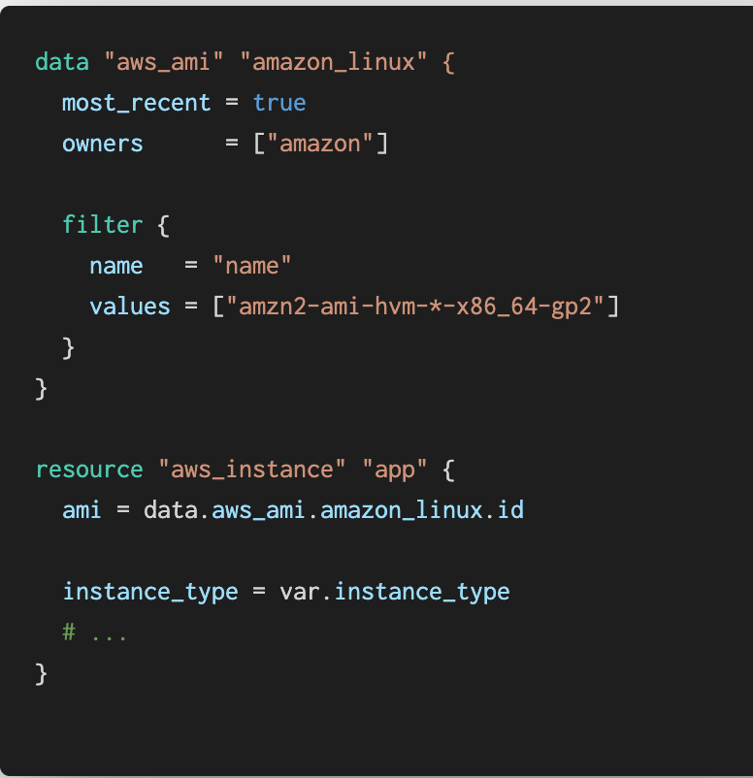
Datasources
For certain providers (like AWS), terraform providers datasources
Datasources provide you with dynamic information
A lot of data is available by AWS in a structured format using their API
Terraform also exposes this information using data sources
Examples:
List of AMIs
List of availability Zones

Slide 38
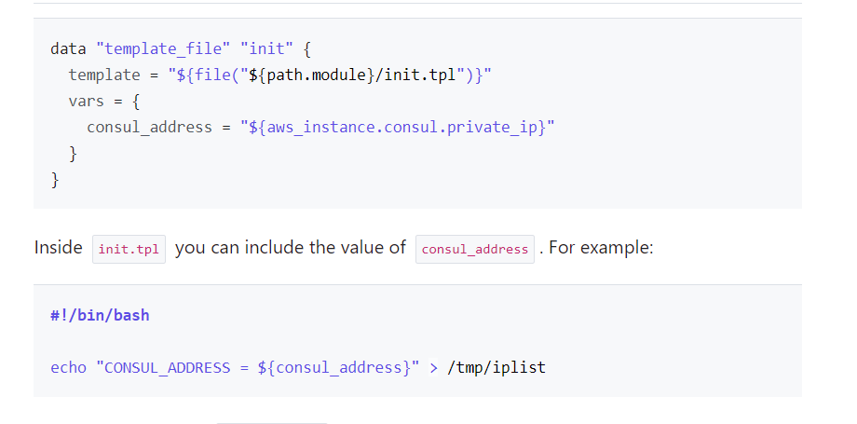
Template
init.tpl
The template provider can help creating customized configuration files
You can build templates based on variables from terraform resource attributes
The result is a string that can be used as a variable in terraform

Slide 39
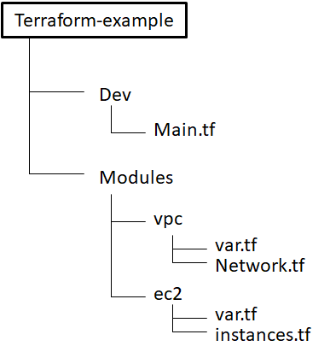
Modules
You can use modules to make your terraform more organized
Use third party modules
Reuse parts of your code
Modules from github
module "example" {
source = "github.com/abc/example"
}

Slide 40
Module 3: Terraform with AWS

Slide 41
Setup
Install Terraform
Install AWS CLI
Add AWS Configure

Slide 42
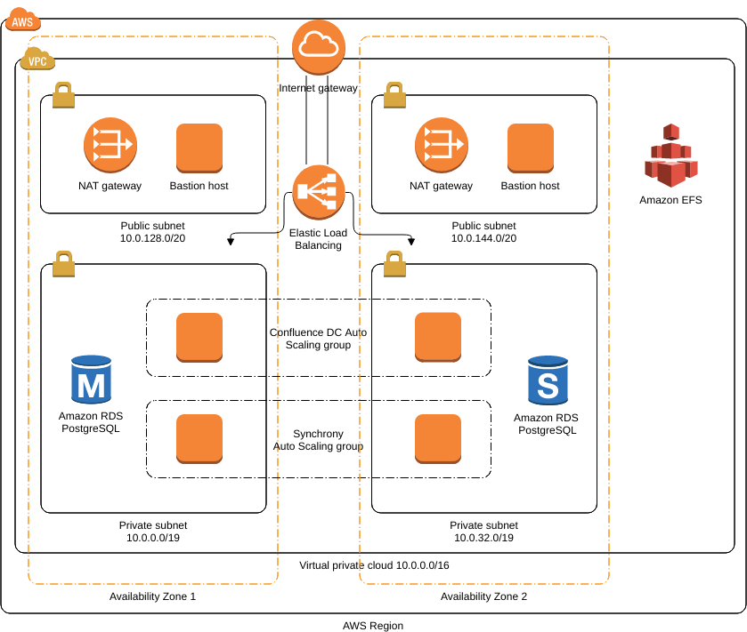
AWS Architecture

Slide 43
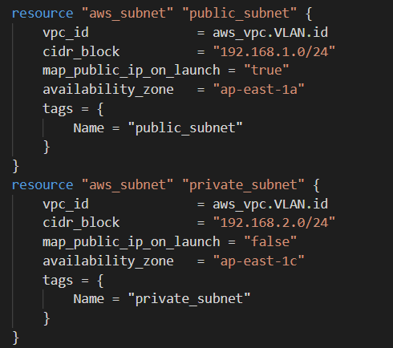
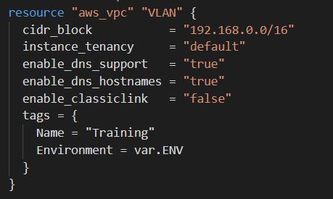
VPC & subnet

Slide 44
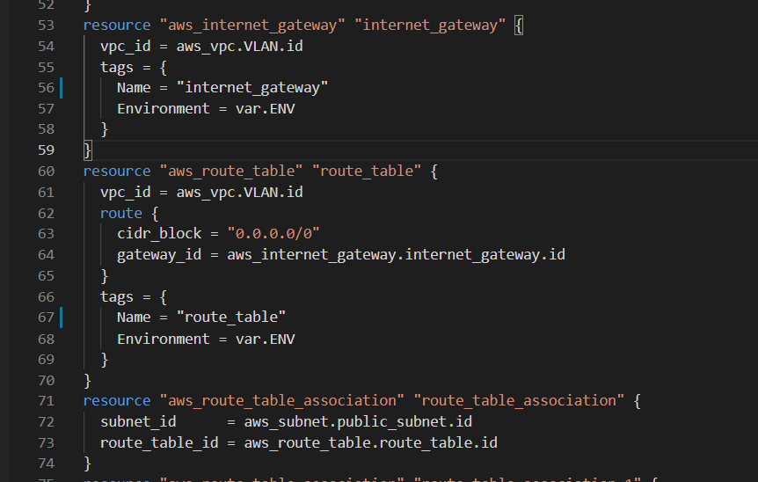
Internet Gateway & Route Table

Slide 45
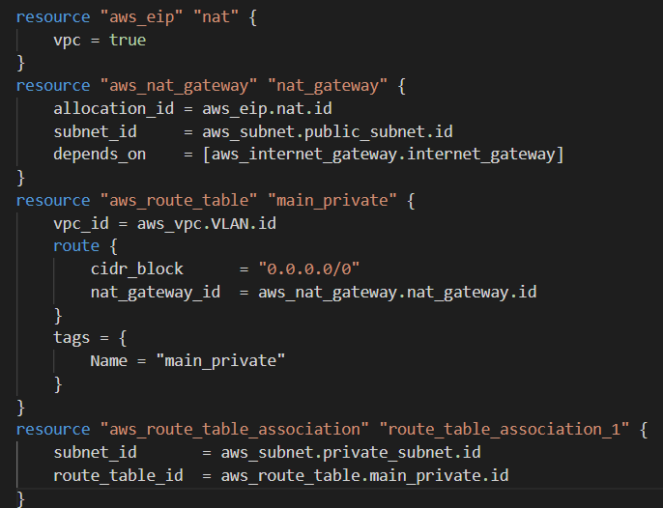
NAT

Slide 46
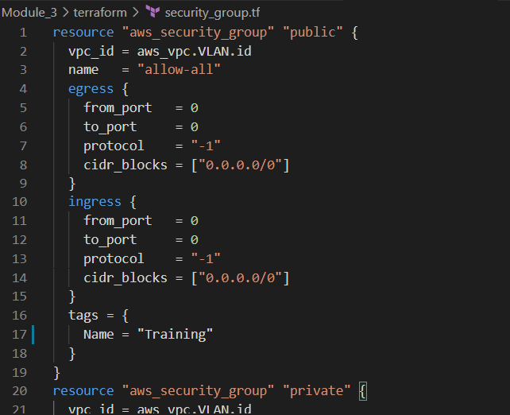
Security Group

Slide 47
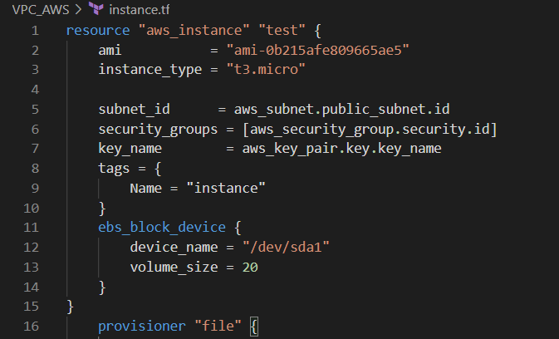
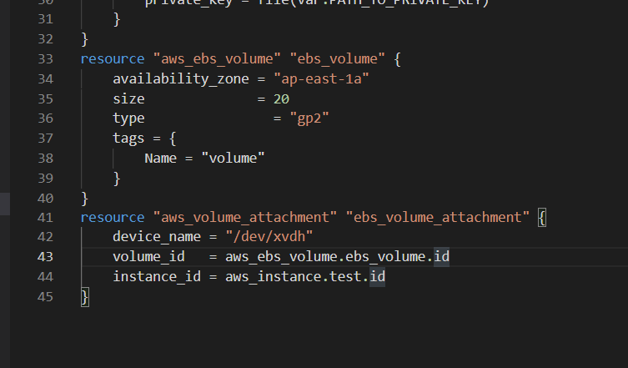
Instance

Slide 48
Reference
https://registry.terraform.io
https://freecontent.manning.com/the-lifecycle-of-a-terraform-resource

Slide 49
Thank you

