Slide 1


Microwave Imaging
Team Detectron

Slide 2
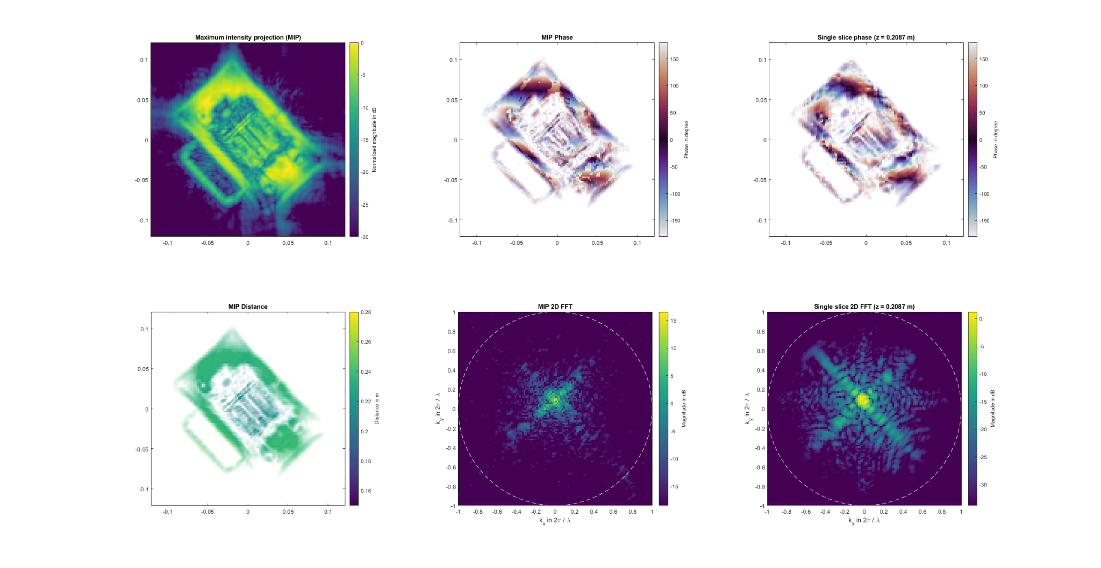
Challenge 1: Radar sensor alignment detection
Notes:
Radar position is being calculated by methods of 2D and 3D image processing techniques.

Slide 3
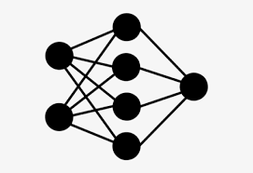
Approach
Reference Position
Estimated Pose
Pre-processing
Misalignment
Scanned Volume
Dummy Radar Dataset

Slide 4
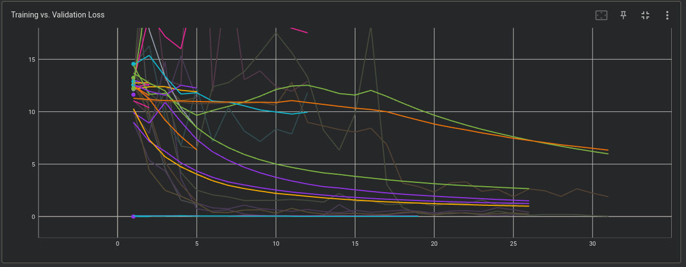
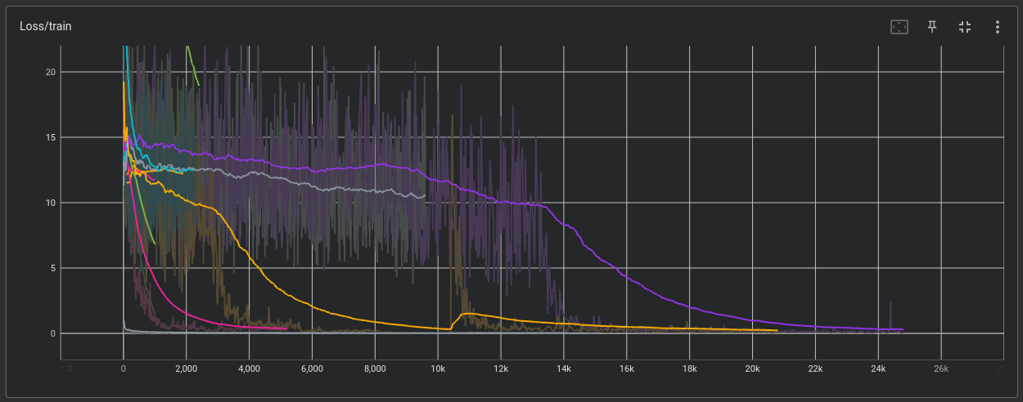
The Way

Slide 5
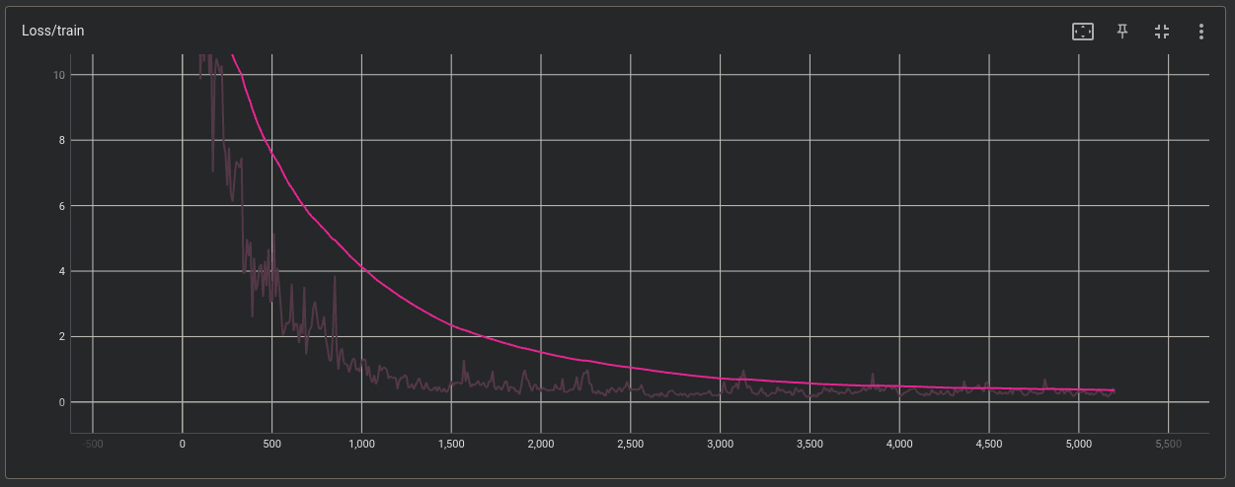
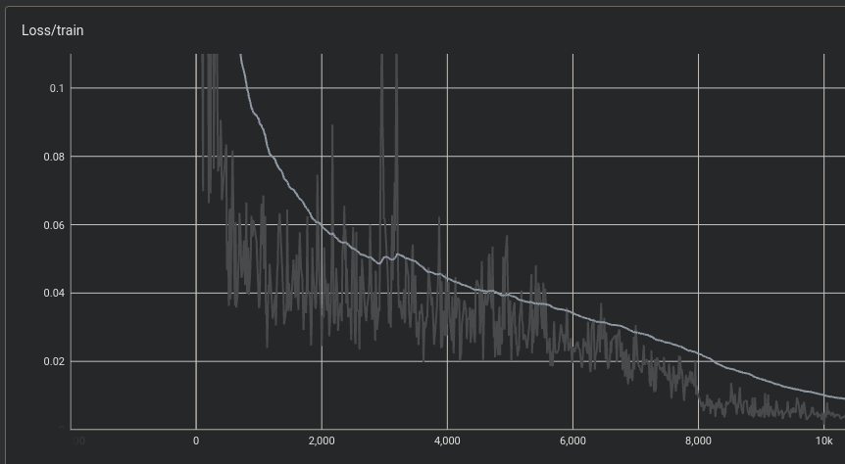
Best Model

Slide 6
Result
Demo GUI

Slide 7
Challenge 2: Parcel Fraud Detection
Approach
Pre-Processing
Binary Classification
Scanned Volume
Collected Dataset

Slide 8
Challenge 2: Parcel Fraud Detection

Slide 9
Check out our code at:
https://github.com/zizo1111/hackatum22-rs

Slide 10
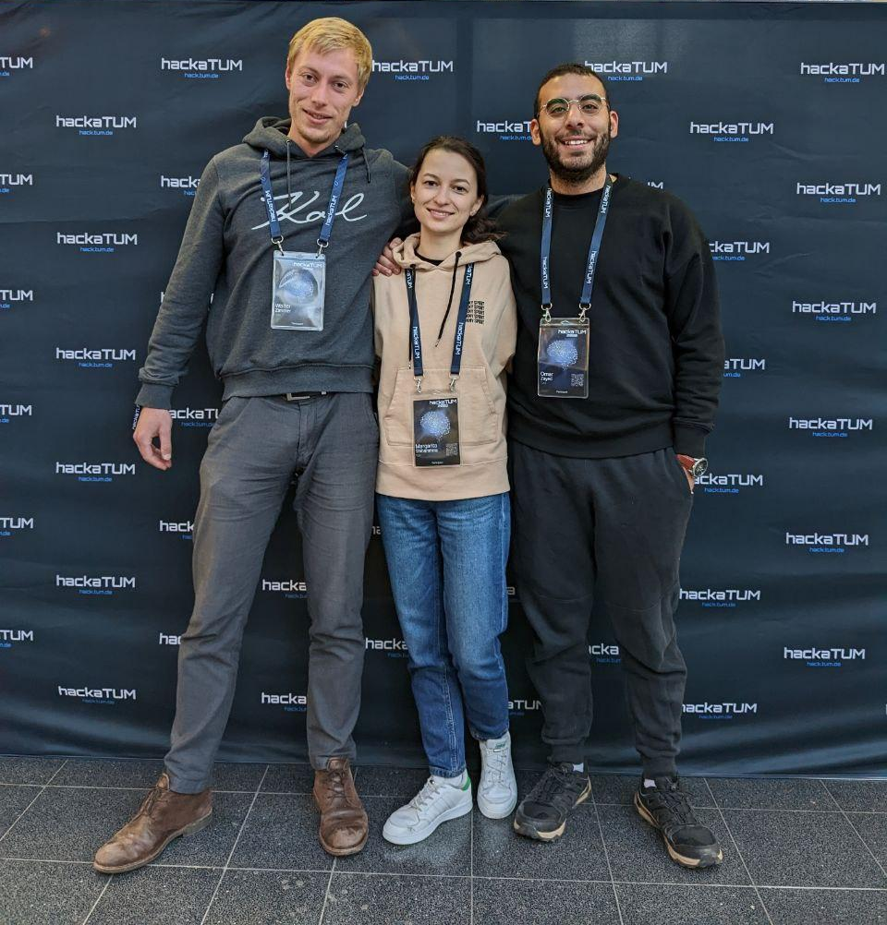
Team Detectron
Walter Zimmer
Margarita Shibarshina
Omar Zayed

