Slide 1

What Shapes Prices in Airbnb ?
- OCI Data Science in Action
Notes:
Agenda
Business Use Case description (6-8)
Machine Learning introduction (9-18)
AutoML – how it works, and did it help with our problem? (19-25)
OCI Data Science High Level Architecture (26-27)
Data Access, Exploration and Preprocessing (28 – 40)
What I did to enrich data (41-45)
Regression analysis & LASSO (46-51)
Airbnb – Recommendations based on analysis (52-59)

Slide 2
About Me – Tomasz Ziss
~15 years in IT industry
Poland, Warsaw
Cloud Advisory Innovation Principal - Accenture Enkitec Group
Oracle Ace Pro
Oracle Certified Master
Multi-cloud certifications – OCI, AWS, Azure, GCP
Postgraduated in Data Engineering and Machine Learning
Blogger -> https://tziss.wordpress.com
Notes:
And now a few words about me. My name is Tomasz Ziss.
I have been working in the IT industry for about 15 years. I am employee at Accenture Enkitec Group.
I am an Oracle Ace and an OCM. I deal with various things, but my main interest is data - databases and field topics data engineering.
I run my own blog where you can read various interesting things about Computer Science.

Slide 3
Agenda
Business use case – What shapes Prices in Airbnb?
Machine Learning Lifecycle, AutoML and ML Interpretability
Regression Analysis – quick guide
Airbnb – Data Analysis and Executive Summary
Summary
Notes:
During the presentation, we will focus on a business case where they will try to answer to the question "What determines prices on Airbnb?" using machine learning.
We will start with a quick on-boarding into the world of machine learning - what the process looks like, what AutoML is and whether it helped us solve our problem.
We will check whether a relatively new domain in machine learning – ML Interpratability – helped us with our problem.

Slide 4

Github Repo with Code (I)
https://github.com/zizu1985/ConTech2025

Slide 5
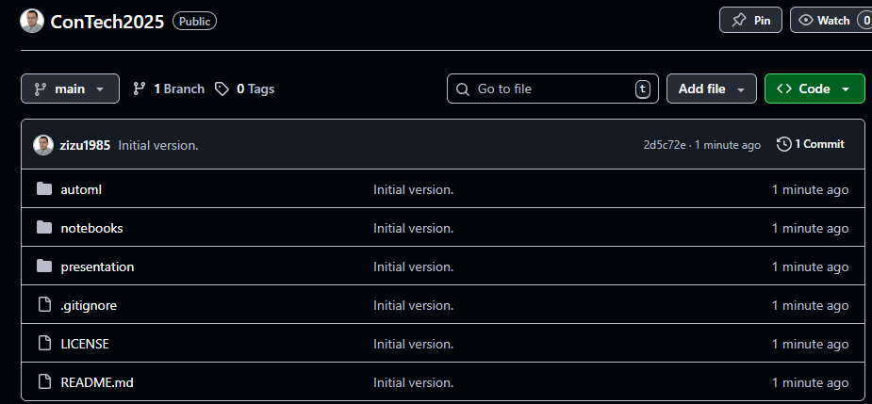
Github Repo with Code (II)

Slide 6

Business use case
Background: „Resident”, a real estate owners association is considering aggresive investment campaign in one of Europe cities, but would like to select a city (among 3 cities - Berlin, Munich, Prague) based on proper analysis. Short-rental (up to 3 days) is rental model.
Goal: provide a report on how AirBnB prices in each city are shaped by internal and external factors; Recommend city where „Resident” should invests first
Audience: „Resident” board of directors
Data source: http://insideairbnb.com/get-the-data.html
Notes:
Let's move on to our business question. The "Resident" company is planning large investments in Europe.
He intends to invest heavily in the short-term rental market.
Strategically, it must be only one city in Europe - it cannot be several because it would increase the size of the city it costs significantly.
Our goal is to help this company choose the best city for this investment. Our goal is to present a report that will show how rental prices
are shaped in each region city ​​by various factors. The source is data from Airbnb, which is additionally publicly available.
Resident is an international company specializing in the short-term rental market sector. The company’s goal is to maximize profit in this sector.
As a result of analyzed carried out by an external consulting company, the company decided to focus on the European market, and more precisely on a few indicated cities.
The investment is of a long-term nature, and the profit maximization goal should be achieved considering the investment period.
For strategic reasons, the investment may take place only in one of the indicated cities.
AirBnB was chosen from among the many platforms offering landlord-tenant
connectivity AirBnB has been operating on the market since 2008.
AirBnB, as part of internal project, provided data on rented apartments.
The data obtained in this way are the necessary source with which our company
conducted an analysis aimed at selecting a set of property attribute(s) that have impact on maximizing profits from short-term rental.

Slide 7
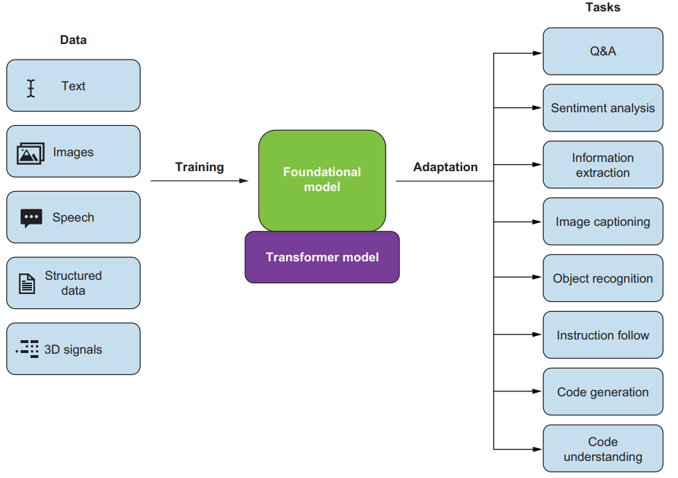
AI Fundational Models and Machine Learning
LLMs
Machine Learning

Slide 8
Machine Learning Lifecycle
START
Problem framing and data collection
Data preprocessing and feature engineering
ML algorithm and feature engineering
Service deployment and model monitoring
ML algorithm selection
Hyperparameter tuning
Model training and evaluation
Notes:
OCI Data Science Data Science Machine Learning let's you define pipelines and run an end-to-end machine learning orchestration covering all steps
of machine learning lifecycle. Pipeline is repeatable, continous ML pipeline.
Here we have typical steps for Machine Learning pipeline
Problem framing and data collection—Define the goal of the problem, such as what kinds of things you want to predict or what kinds of patterns you want to extract from the data. Specify what kind of paradigm the problem belongs to, such as supervised learning, unsupervised learning, and so on. Identify a way to reliably measure the success of your final model, such as the prediction accuracy in an image-classification problem. You may need domain-specific metrics in many cases. Collect data to help train and evaluate your model.
Data preprocessing and feature engineering—Process the data into a format suitable for feeding into an ML algorithm. Remove redundant features, and select or generate useful features, if needed, to help improve the performance of the algorithm. Think about how you will evaluate your model, and split the data into training, validation, and test sets to help with the evaluation process later.
ML algorithm selection—Select the proper ML algorithm based on your experience and prior knowledge of the problem. You may want to try out different ML algorithms iteratively and select the best one before applying it on the final test set and deploying it.
Model training and evaluation—Apply the ML algorithm to train an ML model, and evaluate it on the validation dataset based on your predefined measure.
Hyperparameter tuning—Improve the pipeline to achieve better performance by iteratively tuning its hyperparameters. To avoid overfitting, make sure not to use the test set to select the ML algorithm and tune the hyperparameters.
Service deployment and model monitoring—Deploy the final ML solution, and monitor its performance to continuously maintain and improve the pipeline.

Slide 9
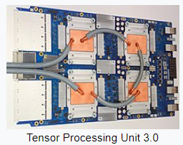



Machine Learning buzz words
Supervised vs Unsupervised learning
classification
„spam”, „not-spam”
clustering
which data is similar to
each other (assign label)
Parallel processing
Floating point arithmetics
Memory bandwith
regression
predicted value for sample is y
dimension reduction
Graphics Processing Unit (GPU)
describe data without lower numer
ff dimension
vs
Central Processing Unit (CPU)
Notes:
The basic division of problems we deal with in machine learning is supervised and unsupervised.
Most of the problems are definitely supervised, i.e. where we need to predict the value/label for the new one data samples.
For example, whether a given email is spam or not. Regression – i.e. predicting a value that is continuous.
For example, what will be the sales volume of a given product depending on the investment in advertising on television, radio and the Internet.
Unsupervised Machine Learning – this is a category of problems where we have no labels. For example, dividing data into data with similar proximity.
This is clustering. For example, customer segmentation in marketing.
Another example is dimension reduction - we want to describe the data with fewer attributes without much loss of information.
Fewer attributes mean faster and cheaper processing. In machine learning - especially in problems using neural networks (deep learning) - GPU processors are intensively used.
There are a lot of simple operations there (such as processing basic shapes in computer graphics). GPU enables parallelization these operations more efficiently than traditional units.
For example, Google has its TPU devices that enable machine learning to be delivered using their library – Tensorflow.
###########
###########
Podstawowy podział problemów jakimi zajmujemy się w uczeniu maszynowym to supervised i unsupervised.
Większość problemów to zdecydowanie supervised, czyli tam gdzie musimy przewidzieć wartość/etykietę dla nowej
próbki danych. Np. czy dany email to spam czy nie. Regresja – czyli przewidywanie wartości, która jest wartością ciągłą.
Na przykład – jakie będzie wielkość sprzedaży danego towaru w zależności od zainwestowania w reklamę w telewizji, radiu i internecie.
Unsupervised Machine Learning – to kategoria problemów gdzie nie mamy etykiet. Przykładowo podział danych na dane o podobnej bliskości.
To jest clustering. Np. segmentacja klientów w marketingu. Innym przykładem jest dimension reduction – chcemy opisać dane za pomocą
mniejszej liczby atrybutów bez dużej utraty informacji. Mniej atrybutów to bardziej szybsze i tańsze przetwarzanie.
W uczeniu maszynowym – zwłaszcza w problemach wykorzystujących sieci neuronowe (deep learning) – wykorzystuje się intensywnie procesory GPU.
Jest tam bardzo dużo prostych operacji (tak jak obróbka podstawowych kształtów w grafice komputerowej). GPU umożliwia zrównoleglenie
tych operacji w sposób wydajniejszy niż tradycyjne jednostki. Np. Google ma swoje urządzenia TPU, które umożlwiaja wydajene uczenie maszynowe
z wykorzystaniem ich bibilioteki – Tensorflow.

Slide 10
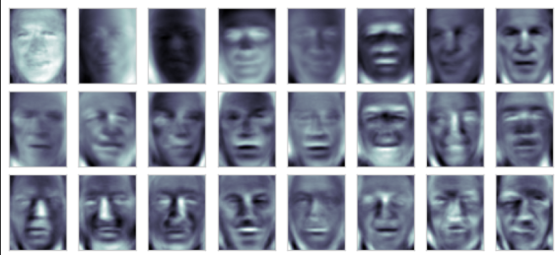

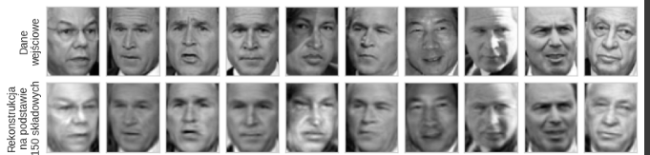
Machine Learning buzz words
Noise Reduction
Dimension reduction
(Using Principal Component Analysis Component algorithm)
https://vis-www.cs.umass.edu/lfw/
Notes:
Why do we need dimensionality reduction? There are many reasons, for example:
a) Multicolinearity – big data has many attributes.
It is unlikely that all of them are uncorrelated. If we do not filter this data, it may have an unstable model.
b) Curse of Dimensionality – Spare high-dimension space – For example, for 10 dimensions, only 2% of the data lies around central high-dimension normal distribution.
We are overuse a lot of resources which is not always needed.
3) Overfitting – too many predictors could lead to overfitting
4) Miss the Bigger Picture – too much data – we focus on the analysis, but we can lose the whole thing. An example would be noise reduction. Me dimensions – more expressively.
###########
###########
Dlaczego potrzebujemy redukcji wymiarów?
Przyczyn jest wiele, przykładowo:
Multicolinearity – duże zbiory danych mają wiele atrybutów. Jest małoprawdopodobne, że wszystkie z nich nieskorelowane.
Jeżeli nieodfiltrujemy tych danych to może mieć niestabilny model.
Curse of Dimensionality – Spare high-dimension space – For example, for 10 dimensions, only 2% of the data lies around central high-dimension normal distribution
We loosing a lot of resources which is not always needed.
3) Overfitting – too many predictors could lead to overfitting 4) Miss the Bigger Picture – zbyt dużo danych – skupiamy się na analizie, ale możemy zgubić całość.
Przykładem może być redukcja szumów. Mnie wymiarów – bardziej wyraziście.

Slide 11
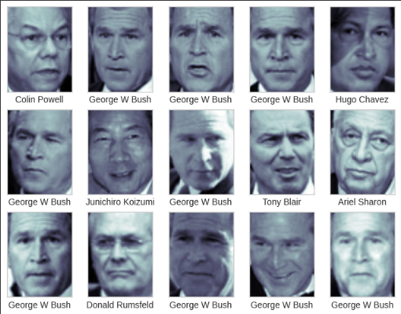
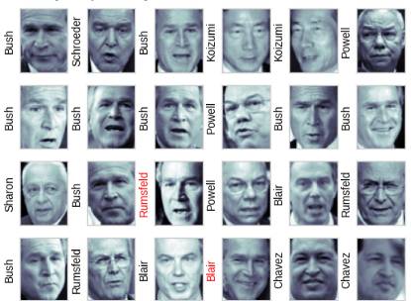
Machine Learning buzz words
Classification
Training data
New data
Notes:
Classification represents perhaps the most widespread task in data science, and the most profitable.
Classification – this is a supervised machine learning problem. The target is a finite set of values. Target value is categorical.
We train the algorithm on training data and then we use it to assign labels to new, unknown samples.
As example here we have faces and we have to assign proper politician name for given face.
###########
###########
Klasyfikacja – to problem nadzorowanego uczenia maszynowego. Targetem jest skończony zbiór wartości.
Uczymy algorytm na danych treningowych a następnie używamy do przypisywanie etykiet nowym, nieznanym próbkom
Danych.

Slide 12

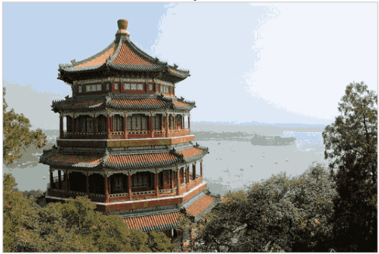
Machine Learning buzz words
Clustering
16 milions colors
16 colors
Compression ratio: 1mln !!!
Notes:
The clustering task seeks to identify groups of records which are similar.
For example, in a data set of credit card applicants, one cluster might represent younger, more educated customers, while another cluster might represent older, less educated customers.
The idea is that the records in a cluster are like other records in the same cluster, but different from the records in other clusters.
Finding workable clusters is useful in at least two respects:
your client may be interested in the cluster profiles, that is, detailed descriptions of the characteristics of each cluster, and
the clusters may themselves be used as inputs to classification or estimation models downstream.
For example we could use clustering for compression to achieve 1ml compression ratio for single image!
###########
###########

Slide 13
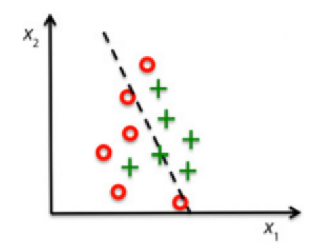
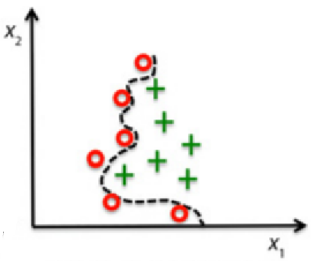

Machine Learning – overfitting
Decision Line
Too little suited to the training data. Low prediction power for new data and training set.
Too tightly suited to the training data. High
prediction accuracy for training data, but low
for new data.
Good prediction accuracy for training
data and new data.
Under-training
Overtraining
Life Example During exam: Professor, on wich lecture slide was this topic discussed?
Good Fit
Notes:
In machine learning, it is undesirable to overfit the model for educational data - overfitting.
You have to do this, the model will be damaged. It will be a weak power. Too tuned to training data.
If the model is poorly trained, it will have low predictive power.
There are various methods to combat the problem of overfitting, e.g.:
use more training data and eliminate statistical bias in the data (maybe 90% of the data is from group A)
reduce the complexity of the model by regularization and optimization of hyperparameters - algorithm parameters
use cross-validation to validate your model
Regarding overfitting example from real life - I was reminded of a friend who asked during an
operating systems exam professor regarding the task - which slide covered the topic needed to solve this problem ☺
###########
###########
W uczeniu maszynowym zjawiskiem niepożądanym jest zbytnie dopasowanie modelu do danych treningowych – overfitting.
Powoduje to, że model będzie zachowywał się źle. Będzie dawał słabą wydajność. Zbyt mocno dopasował się do danych treningowych.
Jeżeli model będzie źle wytrenowany to będzie miał małą moc przewidywania.
Istnieją różne metody walki z problem overfittingu, np.:
użyj więcej danych treningowych i wyeliminowanie statystycznego odchylenia w danych (może 90% danych jest z grupy A)
ogranicz złożonośc modelu przez regularyzacje i optymalizacja hiperparametrów – parametrów algorytmu
Użyj cross-walidacji do walidowania modelu
Odnośnie overfittingu z życia – przypomniał mi się kolega który podczas egzaminu z systemów operacyjnych zapytał
profesora odnośnie zadania – na którym slajdzie był poruszany temat potrzebny do rozwiązania tego problemu ☺

Slide 14
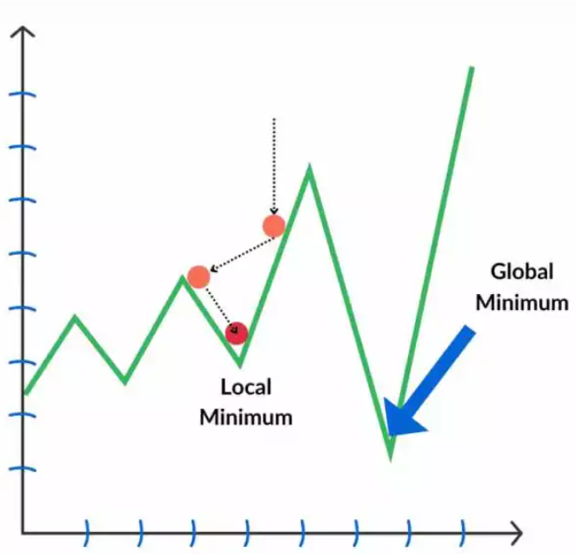
Global vs Local minimum during training
Important during
training phase
Solution
Training Goal
Stochastic Gradient Descend
Loss value
Minimize loss function
Add noise to gradient !
Iteration
Notes:
In Deep Learning problems we could face local minimum problem during training phase.
How can you avoid local minima to achieve the minimized loss function?
Ans: We can try to prevent our loss function from getting stuck in a local minima by providing a momentum value. So, it provides a basic impulse to the loss function in a specific direction and helps the function avoid narrow or small local minima.
Use stochastic gradient descent. The idea is to not use the exact gradient, but use a noisy estimate of the gradient, a random gradient whose expected value is the true gradient because we are using a noisy gradient, we can move in directions that are different from the gradient. This sometimes takes us away from a nearby local minimum, and can have the effect of preventing us from getting trapped in small local minimum.
Batch size in Neural Networks
This fits very well with training deep networks, because the true gradient depends on all the training data, and is very expensive to compute. By computing a gradient estimate using just some of the training data, we can much more efficiently produce a noisy estimate of the gradient.
###########
###########

Slide 15

Machine Learning buzz words
Models evaluation
Training
Test
Test
Training
Test
Training
cross-validation
New Data
Test
Training
Notes:
In classic aprproach we split dataset into training and test data (could be Pareto rule -> 80% - training, 20% - test).
The problem is that our model may be too biased towards graphical data and validation data.
The evaluation itself becomes biased because it depends entirely on our test dataset
One way to combat overfitting is to use a technique called crossvalidation.
We train and evaluate model on few set of training and test data. It gives better model.
###########
###########
In classic aprproach we split dataset into training and test data (could be Pareto rule -> 80% - training, 20% - test).
Problem jest taki że nasz model może zbyt mocno przystosować się do danych szkoleniowych i także do danych walidacji.
Jedną z metod walki z overfittingiem jest użycie techniki zwanej crossvalidation.
Athos method helps to mitigate the risk that a tuned model over-optimizes for the validation data.

Slide 16





Machine Learning Pipeline
Hyperparameters tuning
Problem framing and data collection
Data preprocessing and feature engineering
ML algorithm selection
Model training and evaluation
Service deployment model monitoring
Notes:
Machine Learning projects use common sequence of steps.
Sequence of steps is pipeline (common term in many fields in IT now – starting from processing following ITIL standard,
through DevOps and ending on Machine Learning).
This pipeline is human-in-the-loop process.
Steps:
Problem framing and data collection – frame the problem as an ML problem and collect the data you need
Data preprocessing and feature engineering – process the data into a suitable format that can be input into the ML algorithms.
Select or generate features that are related to the target output to improve the performance of the algorithms.
This step is usally done by first exploring the dataset to get a sense of its characteristics.
The operation should accommodate the specific ML algorithm you are considering
ML algorithm selection - Select ML algorithms appropriate for the task that you would like to test, based on your prior knowledge of the problem and your experience
Model training and evaluation - Apply the selected ML algorithm (or algorithms) to train an ML model with your training data, and evaluate its performance on the validation dataset
Hyperparameter tuning—Attempt to achieve better performance by iteratively tuning the model’s hyperparameters
Service deployment and model monitoring - Deploy the final ML solution, and monitor its performance so you can maintain and improve the pipeline continuously
###########
###########

Slide 17
Interpretability vs Flexibility
Subset Selection
High
Lasso
Least Squares
Generalized Additive Models
Trees
Interpretability
Bagging, Boosting
It sounds interesting!
Support Vector Machines
Deep Learning
Low
Low
Flexibility
High
Notes:
Trade-offs exists nearly everywhere where you have problem and you have to implement final solution.
This part of engineer’s life.
For example – last squares linear regression is relativly inflexible but is quite interpretable.
Lasso is a less flexible approacl than linear regression.
It is also more interpretable than linear regression, because in the final
model the response variable will only be related to a small subset of the
predictors—namely, those with nonzero coefficient estimates.
If we are mainly interested in inference, then restrictive models are much more interpretable.
Lasso seems to be what may be useful in our problem.
###########
###########

Slide 18
AutoML Goals
Automated Hyperparameters Tuning
Automated Pipeline Search
Automated Feature Engineering
Beneficial for newcomers
Fast prototyping ML models
Limit the burden of ML models configuration
Notes:
There is plenty of automation in IT.
So why not to try AutoML to solve our problem?
We can classify AutoML into the following three categories:
Automated Hyperparameter Tuning – aims to select the optimal hyperparameters for one or several components in the ML pipeline.
Generally, the tunable hyperparameters can include any hyperparameters in the ML pipeline, such as the model type, diffirent data preprocessing methods, the hyperparameters of the
optimization algorithm, and so on.
Automated Pipeline Search – aims to generate the entire ML pipeline based on the input and tasks we tell the AutoML system to perform, such as classification or regression.
We gave the input data and define what kind of ML tasks we would like to perform.
Automated Feature Engineering – often follows an interative process of feature generation and selection. It indends to automatically discover and discriminative feature for learning
the best ML models based on predefined selection criteria.
Beneficial for newcomers – aims to simulate how human experts solve ML problems and discover the optimal ML solutions for a given problem automatically, thereby
granting practioners without extensive experience access to off-the-shelf ML techniques.
Fast protyping ML models– first ML model to solve the problem
Limit the burden – AutoML relieve experts from data scientists of the burden of designing and configuring ML models
###########
###########

Slide 19
AutoML process
Select the next ML pipeline from the search space for observation based on the search algorithm
1. Generating
2. Observing
3.Updating
(Optional)
Update the search algorithm based on the
evaluation if needed
Search Strategy = oracle ☺
Train and evaluate the selected ML pipeline on the dataset.
Notes:
AutoML
Hyperparameter could be not only direct value (number, string and boolean), it could be numer of layers in neural network (TODO – kilka przykładów)
Steps in typical AutoML Process
Select an ML pipeline
from the search space for observation based on the search strategy. The search space defines the set of hyperparameters we want to tune and the ranges of each hyperparameter from which to select.
The search strategy explores the search space and selects a combination of hyperparameters in each iteration to instantiate a complete ML pipeline to be evaluated.
Train the selected ML pipeline on the training dataset and retrieve its performance evaluated on the validation set.
Update the search strategy if it is able to leverage the historical evaluations to accelerate the process of discovering better pipelines.
Core components:
Search space, search strategy and validation process.
Why should we use history-independent search method instead of history-dependent when method A is worse because it does not draw conclusions?
History-independent -> Random search
History-dependent -> Bayesian optimization, Aging evolution
Are they faster? Not necessarily, the time of a single iteration is comparable for each algorithm (Random search, Bayesian optimization, Aging evolution). There is no clear rule, but there are a few observations:
If search space is dominated by hyperparameters with continuous or ordinal values, we prefer to use the Bayesian optimization algorithm
If the hyperparameters are mostly categorical or there are many conditional hyperparameters, the evolutionary method would be a good choice
Random search is not a good choice for exploring continuous hyperparameters. However, could provide strong baseline when the number of trials you want
to explore is too few compared to the size of the search space.
###########
###########

Slide 20
AutoML limitations
There is no generic Tuner – differences in the model learning and validation process make it quite hard to combine shallow and deep models together
Automatic Feature Engineering works better for shallow models where automatic hyperparameter tuning is not crucial for deep models
No one perfect search strategy for find fast and the best hyperparameters sets.
Warm-starting the search space could speed up Search Space but requires domain-specific knowledge
Accuracy metric is only possible metric (edge devices or limiting memory consumption)
Quite problematic interpretation and transparency
Reproducibility – there are „hyper-hyperparameters” to control the search algorithm
No free lunch – if you don’t have typical ML task you have to perform extra work
Notes:
Measure the Performance of AutoML - Before doing AutoML, we need to clarify the objective we want to use to measure its performance. Although we used an accuracy metric to decide whether a model discovered by the AutoML algorithm is good, AutoML is not just about improving model accuracy. In practice, we may want or need to consider many objectives when applying AutoML. For example, we may want to select a deep learning model with a small model size (limiting memory consumption) or lower training/inference speed so that we can deploy it on edge devices. In this case, we might need to consider complexity measures, such as floating-point operations per second (FLOPS) during the search process
Interpretability and Transparency - AutoML should ultimately facilitate convenient usage for its users and lighten their burden. This requires the AutoML system to be human-centric, meaning that users should be involved in the search process in several ways. First, the results provided by the AutoML system should be interpretable to convince users of its efficacy and foster trust in the adoption of AutoML solutions for domain-specific applications, such as medical applications. Second, users should be able to adjust the search space or the objective to accelerate the search process, which requires visibility. Third, the search method should be transparent to users to help them better understand the search process and ensure that data privacy is protected and predictions are fair. Ensuring the interpretability and transparency of AutoML also requires a deeper theoretical understanding of different ML pipelines and AutoML search technique
The reproducibility of ML and the robustness of ML models are hot topics in the ML community. These issues are also important—and even more challenging—in the context of AutoML, because the AutoML system not only may control the training of multiple ML pipelines but also contains multiple “hyper-hyperparameters” that control the search algorithm. A difference in a single seed can lead to a huge difference in the training results of one ML pipeline and may also result in great variance in the hyperparameter sampling and the updating of the search algorithm. In addition, ML models, and especially deep learning models, are vulnerable to adversarial examples and human imperception perturbations. Ensuring the robustness of training and evaluating ML models and the robustness of hyperparameter sampling and search algorithm updates are indispensable for protecting the AutoML system.
###########
###########

Slide 21


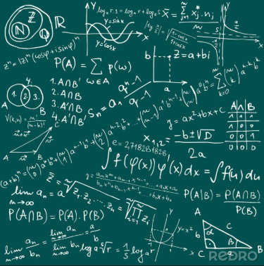

Model Interpretability
Data
Prediction
Why
Model
Explainable Artifical Inteligence
Notes:
Models – statistical and mathematical models provide predictions based on inputs.
Very often, the most important thing is the performance of the model. Any fraction of a percentage that results in improved model accuracy is often worth its weight in gold.
But model performance is not everything. Once the model is built, questions will arise about its predictions. Especially if you're probably one of them will seem strange
and I will argue at least with the experience of people participating in the process (their firefighters who extinguish fires).
The model and the entire solution will be criticized, nervous questions will begin – why do we need this model if it doesn’t work because we don’t understand it.
This problem is known in machine learning algorithms and there are helpful tools.
They are collectively known as XAI – Explainable Artificial Intelligence.
Someone may ask why we have to do redundant work - after all, we already did it in EDA, model tuning and validation.
There are two reasons - we will be under time pressure when business starts asking questions and business must understand our model from their perspectives. Using specialized machine learning terminology is not enough…..
Very often we have to win the trust of the business.
################################
################################
Modele – statystyczno-matematyczne stfory podają przewidywanie na podstawie wejść.
Bardzo często najważniejsza jest wydajność modelu. Każda część procenta powodująca lepszą dokładność modelu jest często na wagę złota.
Ale to wydajność modelu to nie wszystko. Po zbudowaniu modelu powstaną pytania o jego prognozy. Zwłaszcza jeżeli pewnie z nich
wydadzą się dziwne i będę się kłócić przynajmniej z doświadczeniem ludzi uczestniczących w procesie (np.: strażacy którzy gaszą pożary).
Zacznie się krytyka modelu i całego rozwiązania, zaczną się nerwowe pytania – po co nam ten model skoro nie działa bo go nie rozumiemy.
Ten problem jest znany w algorytmach uczenia maszynowego i istnieją pomocne narzędzia.
Zbiorczo określa się je terminem – XAI – Explainable Artifical Intelligence.
Ktoś może spytać dlaczego musimy robić nadmiarową/redundantną pracę – przecież już to robiliśmy w ramach EDA, strojeniu modelu i walidacji.
Są dwie przyczyny – będziemy pod presją czasu gdy biznes zacznie zadawać pytania oraz biznes musi zrozumieć nasz model ze swojej
perspektywy. Używanie specjalistycznej terminologii uczenia maszynowego nie wystarczy …..

Slide 22
Model Interpretability - SHAP
XAI implementations for Python is shap package (by Scott Lundberg)
Based on Game Theory („Beautiful Mind” – story of John Nash played by Russell Crowe)
What is the effect on the model’s prediction for each feature?
Relative contribution
Temperature | Relative humidity | Heat Index | Moisture Code | Area burned
23.1 | 97 | 22.95 | 3.0 | 57.9
11.3 | 33 | 18.37 | 106.7 | 0.0
8.2 | 51 | 22.59 | 26.2 | 0.0
Training data Rows
Temperature | Relative humidity | Heat Index | Moisture Code
42 | 26 | 22 | 10
Replace values from the dataset
36.4
Temperature | Relative humidity | Heat Index | Moisture Code
23.1 | 97 | 22.95 | 3.0
23.1 | 51 | 22.95 | 3.0
23.1 | 33 | 22.95 | 3.0
Predict
68.7
92.3
117.9
|68.7 – 92.3| = 23.6
|68.7 – 117.9| = 49.2
Predict
Marginal contribution
calculations
Predict
Notes:
SHAP (Shapley Additive Explanations) is most popular Python library in XAI implementation.
It is based on mathematical field – Game Theory.
Let’s try me with analogy - As with players in a team sport, if a match is the model itself and the features involved in training are the players, what is the effect on the match if one player is substituted for another?
How one player’s influence changes the outcome of the game is the basic question that shap is attempting to answer.
The high level mechanism is prestend on the slide here
For each sample we replace feature value with values (in loop) from entire dataset
We mesure the diffirence between initial prediction and prediction with changed values. Absolute value. Finally we get average value across all samples.
Finally we get atribute impact of each sample
################################
################################

Slide 23
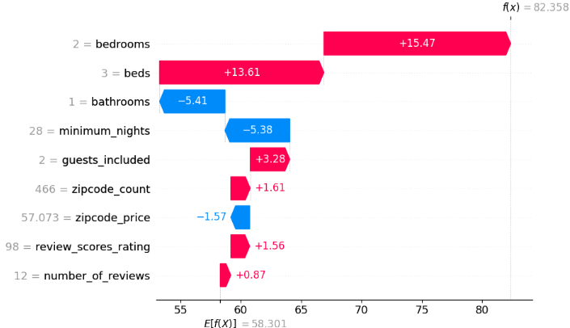
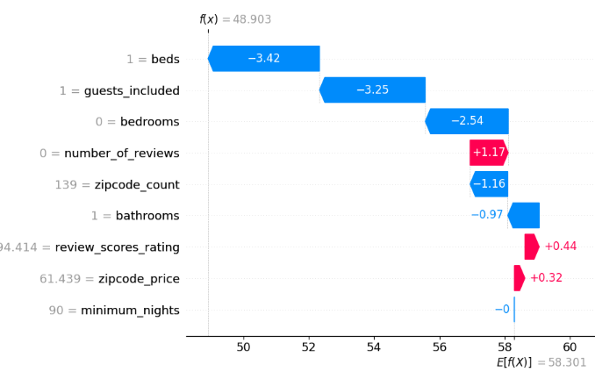
SHAP – Waterfall plot
Lot of computing time to generate (1h for 30000x12 dataframe)
Use for find the pattern for top samples (here maximum price)
Not easy to find feature importance for entire dataset
You need access to all data for new samples too
Notes:
The SHAP method is mainly used to find rules for the best or worst event samples according to some criterion.
When we are predicting the probability of fire relatively region, these will be samples for cases where the greatest damage occurred.
For Airbnb data there will be premises with the maximum rental price.
In each case, we will analyze which attributes contributed the most to the prediction.
Unfortunately, it is not always easy to find such a set. As you can see for the Airbnb samples for the city of Berlin, it is not easy to find this rule.
There are other problems with the SHAP method:
Lot of computing time to generate SHAP values ​​(it took 1h to generate waterfall plots for relatively small dataset 30k v 12 matrix).
For new samples you need to use the entire data set to generate a correct Waterfall plot
Unfortunately, it is quite difficult to find answers to global questions using this method.
And even if they do, they help more by exclusion – which attributes do not statistically contribute (positively/negatively) to the final prediction.
################################
################################
Metoda SHAP służy głównie do znajdowania reguł dla najlepszych lub najgorszych zdarzeń, próbek według jakiegoś kryterium.
Gdy zajmujemy się przewidywaniem prawdopodobieństwa pożaru w danym regionie będą to próbki dla przypadków gdy były największe zniszczenia.
Dla danych z Airbnb będą lokale z maksymalnym ceną za wynajem.
W każdym przypadku będziemy analizować które atrybuty przyczyniły się najbardziej do końcowego wyniku.
Niestety nie zawsze znalezienie takie zestawu jest łatwe. Jak widać dla próbek z Airbnb dla miasta Berlin nie jest łatwo znaleźć tą regułę.
Z metodą SHAP istnieją też inne problemy:
a) Lot of computing time to generate SHAP values (it took 1h to generate waterfall plots for relative small dataset 30k v 12 matrix).
b) Dla nowych próbek trzeba użyć całego zestawu danych do wygenerowania poprawnego Waterfall plot
Niestety, ale za pomocą tej metody jest dość trudno znaleźć odpowiedź na pytania w zakresie globalnym.
A jeżeli nawet to bardziej pomagają na zasadzie wykluczenia – które atrybuty nie przyczyniają się statystycznie (pozytywnie/negatywnie) do końcowego wyniku.

Slide 24
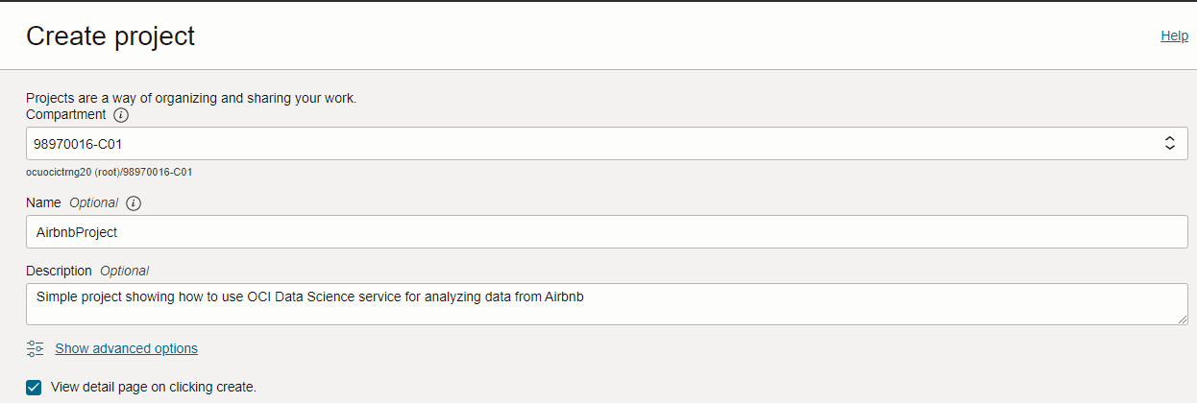
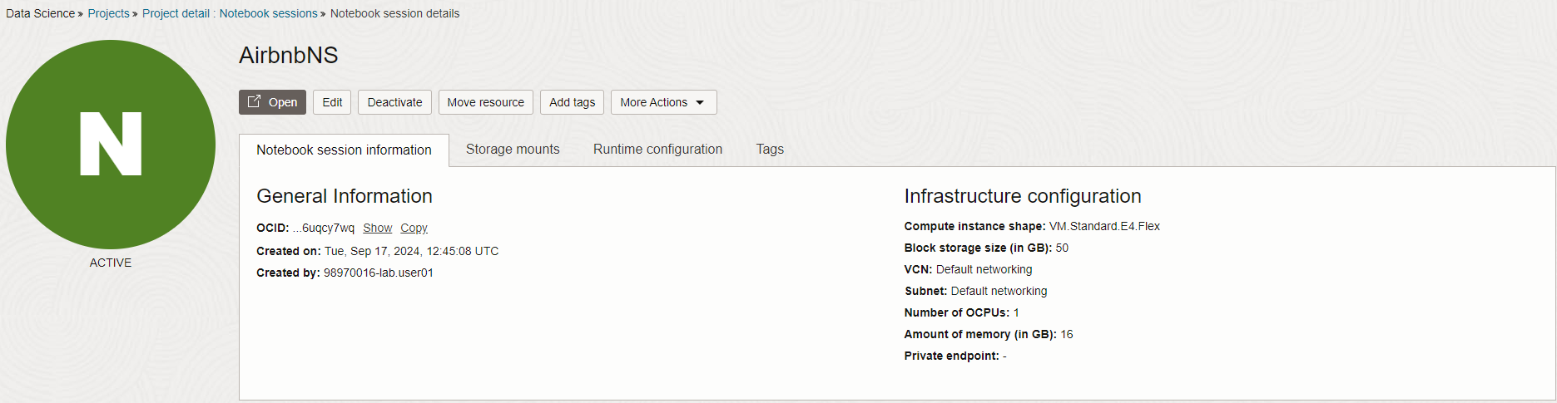
OCI Data Science Components
Project
Notebook Session
Notes:
Oracle Cloud Infrastructure delivers a complete computing solution problem for Data Science.
I create a project, then select the kernel (a set of Python libraries) which we will need to solve the problem.
We can also modify such a kernel by modifying modules.
###########
###########
Oracle Cloud Infrastructure dostarcza całościowe rozwiązanie związane z przetwarzaniem
problemu dla Data Science. Tworzymu projekt, następnie wybieramy kernel (zestaw bibliotek języka Python)
który będzie nam potrzebny do rozwiązania problemu. Taki kernel możemy też modyfikować poprzez modyfikację modułów.

Slide 25
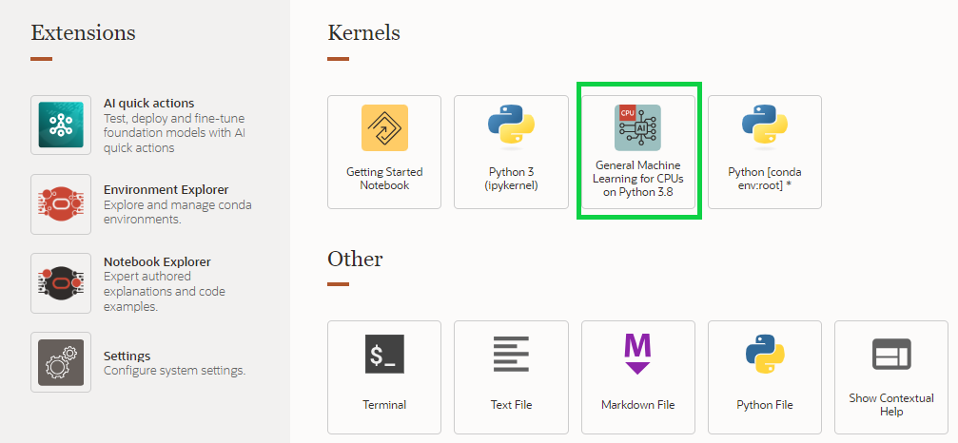
OCI Data Science Components
Notebook Session
Conda environment
Notes:
Finally, we work in Notebooks - a combination of places where you can write and run code. We also add comments.
Visually it looks very nice and can be done in a transparent way Present the results of our experiments,
research and the final model. Technologically, it is the Jupyter Notebook engine.
###########
###########
Finalnie pracujemy w Notebookach – połączeniu miejsca gdzie można pisać i uruchamiać kod.
Dodajemy także komentarze. Wizualnie wygląda to bardzo fajnie i można w przejrzystych sposób
Prezentować wyniki naszych eksperymentów, badań no i finalny model.
Technologicznie jest to silnik Jupyter Notebook.

Slide 26

Friendly pythonic interface for OCI DataScience related services
Read datasets from multiple sources (on-prem,cloud)
End-to-end orchestration
using ML Pipelines
Deploy model as HTTP endpoint
Store model in single registry
OCI DataScience Model Catalog
Tools for tuning models
Evaluation report for models

Slide 27
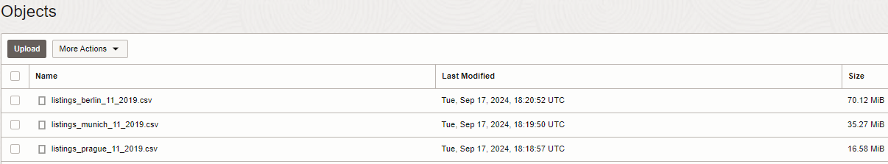
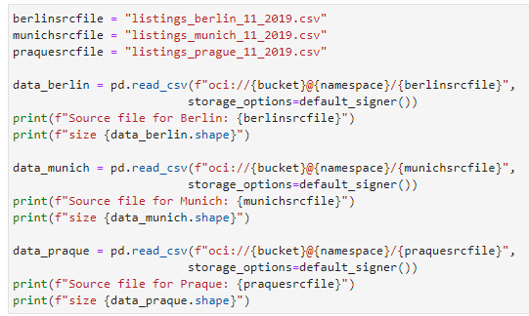

Data Access
OCI Object
Storage Buckets
Buckets - most popular in practice (easy to integration, flexibily in price)
OCIFS – Oracle library to access OCI bucket in Python
OCI ADS library offers special class ADSDataSet – enabled recommended transformation and quicker data exploration features
Notes:
In our case, the data was available in a popular format - CSV and placed in OCI Object Storage Buckets.
In Python there is a special library OCIFS that allows loading such data.
OCI has a special library – OCI Accelerated Data Science.
The important thing is that you use it its facilities, the data must be loaded into an object
of the ADSDataSet class - functionally it does not differ from the classic DataFrame known from many Python libraries.
###########
###########
W naszym przypadku dane były dostępne w popularnym formacie – CSV i umieszczone w
OCI Object Storage Buckets. In Python there is special library OCIFS, która umożliwa wczytywanie takich danych.
OCI posiada specjalną bibliotekę – OCI Accelereated Data Science. Ważne jest to że aby korzystać z
jej udogodnień, dane muszą być wczytanie do obiektu klasy ADSDataSet – funkcjonalnie nie różnie się on od klasycznego
DataFrame znanego z wielu bibliotek języka Python.

Slide 28

Data Exploration and Preparation (EDA)
“The only way humans can do BETTER than computers is to take a chance of doing WORSE than them.”
80 – 90%
Why does this stage matter?
Avoiding the GIGO symptom
Clean and transform data for optimal learning algorithm
Goal and strategy
Understanding datasets by using summary statistics and visualization
Notes:
But at the same time, it is a place where humans write better than machines, because on the science major and is able to interpret the results.
The purpose of this process is to: Understanding data through the use of summarization and visualization.
Cleaning and transforming data to obtain a good data model
###########
###########
Ale jednocześnie jest to miejsce gdzie człowiek spisuje się lepiej niż maszyna, ponieważ
to on ma wiedzę dziedzinową i potrafi interpretować wyniki.
Celem tego procesu to:
Zrozumienie danych poprzez używanie podsumowań i wizualizację
Czyszczenie i transformacja danych w celu uzyskania dobrego modelu danych

Slide 29
EDA subtasks
Complete observations or mark missing cases by appropriate features
Transform text or categorical variables
Create new features based on domain knowledge of the data problem
Have at hand a numeric dataset where rows are observations and columns are variables
Describe of your data
Closely explore data distributions
Understand the relations between variables
Notice unusual or unexpected situations
Place the data into groups
Notice unexpected patterns within groups
Eliminate outliners
Notes:
There are many possible procedures at this stage. For example, most machine learning algorithms only understand numerical attributes.
There is a procedure available within EDA for this purpose - one-hot encoding - conversion of text data from a set into numerical data.
If a sample deviates significantly from the norm, we should take a closer look at it and potentially eliminate it.
For example, it may happen that someone rented a room for two thousand dollars and the price was around $100-200?
If we do not eliminate such deviations, it will have a negative impact on the final result.
###########
###########
Na ten etap składa się wiele możliwych procedur.
Przykładowo większość algorytmów uczenia maszynowego rozumie tylko atrybuty numeryczne.
W ramach EDA jest dostępna procedura do tego – one-hot encoding – konwersja danych tekstowych ze zbioru na dane numeryczne.
Jeżeli jakaś próbka znacząco odbiega od normy to powinniśmy się jej przyjrzeć i potencjalnie wyeliminować.
Może się przykładowo zdarzyć że ktoś wynajął pokój za dwa tysiące dolarów przy cena w okolicach 100 – 200 dolarów?
Jeżeli nie wyelimujemy takich odchyleń będzie to miało negatywny wynik na finalny rezultat.

Slide 30

Airbnb project - Data Enrichment
Enrich data by calculate zip code relation to price
amenities_len -> value for comparing number of amenities across offers
zip_count -> number of offers in close location
zip_price -> average price for offers in the same location
5%
Notes:
In our Airbnb project we performer data enrichment by adding three new columns:
amenities_len – for comparing number of amenities across offers
zip_count – number of offers in close location
zip_price – average price for offers in the same location
This operation allows us to improve model accuracy by 5%.
###########
###########

Slide 31
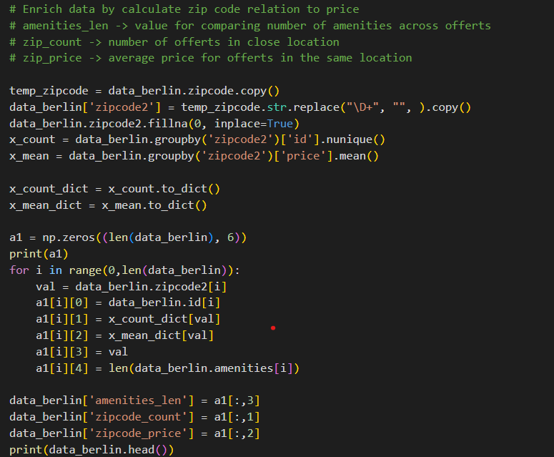
Airbnb project - EDA
Create new variables => data enrichment
Notes:
As part of EDA in our project, we had to convert all the values ​​at the beginning from string type to float – numeric type.
The most important thing is the rental price, expressed in the American format incl dollar sign.
In our project, the data was enriched by creating 3 additional attributes:
zipcode_count – number of objects at the same address represented by zipcode
zipcode_price –average price for a given address represented by zipcode
amenities_len – number of amenities in the premises This data enrichment greatly improved the accuracy of the model.
This data enrichment greatly improved the accuracy of the model. About 5%. In the world of machine learning, that's a lot.
###########
###########
W naszym projekcie dane zostały wzbogacone o stworzenie 3 dodatkowych atrybutów:
zipcode_count – liczba obiektów pod tym samym adresem reprezenotwanym przez zipcode
zipcode_price – średnia cena na dany adresem reprezentowanym przez zipcode
amenities_len – liczba udogodnień w lokalu
Takie wzbogacenie danych bardzo poprawiło dokładność modelu. Ok 5%. W świecie uczenia maszynowego to bardzo dużo.

Slide 32
Airbnb project - EDA
# Preprocessing - replace NaN values with mean from column
# With checking before and after replacement
print(data_berlin[cols].isna().sum())
data_berlin.fillna((data_berlin[cols].mean()), inplace=True)
print(data_berlin[cols].isna().sum())
Replace NaN values with means
Notes:
Missing data - in the project we replaced it with the average after the attributes.
There are various methods, but this is the most common.
###########
###########
Brakujące dane – w projekcie zastąpiliśmy jest średnią po atrybutach.
Istnieją różne metody, ale ta jest najczęstsza.

Slide 33
Airbnb project - EDA
# Preprocessing - get rid of outliers
print("99.7% properties have a price lower than {0: .2f}".format(np.percentile(data_berlin.price, 99.7)))
data_berlin = data_berlin[(data_berlin.price <= np.percentile(data_berlin.price, 99.7)) & (data_berlin.price > 0)]
Get rid of outliners
Notes:
Outliners – we remove samples with values ​​near the end with 0.3% margin.
###########
###########

Slide 34


Data Exploration and Preparation
show_in_notebook()
suggest_recommendations()
Oracle-ADS helps with automation – suggested recommendations and applying if needed
one-liners – do more with less code
Data profiling and visualisation
Loading/Converting a dataset with Oracle-ADS DataFactory can be much slower than simple reading Pandas dataframe
You are blocked if Oracle-ADS estimates allocated resources in OCI for processing are not enough
Not attempting to calculate correlations, too few cores (2) for wide dataset (96 columns) berlin_ds.suggest_recommendations()
Notes:
The OCI ADS library, mentioned earlier, has two functions that are very helpful in the data exploration and preparation phase:
show_in_notebook() – key data summaries and visualizations
suggest_recommendations() – recommended transformations on the data set
Unfortunately, OCI also introduces restrictions. If the estimation of resource use during the EDA process exceeds the resources of the environment,
then these operations will not be performed. In such a case, you need to increase the allocation of resources to the environment.
###########
###########
Biblioteka OCI ADS, wspomniana wcześniej, posiada dwie funkcje bardzo pomocne w fazie eksploracji i przygotowania danych:
show_in_notebook() – najważniejsze podsumowania danych i wizualizacje
suggest_recommendations() – zalecane transformacje na zbiorze danych
Niestety, ale OCI wprowadza też ograniczenia. Jeżeli estymacja użycia zasobów podczas procesu EDA przekracza wielkość zasobów środowiska,
to te operacje nie będą wykonane. Trzeba w takim przypadku zwiększyć przydział zasobów do środowiska.

Slide 35
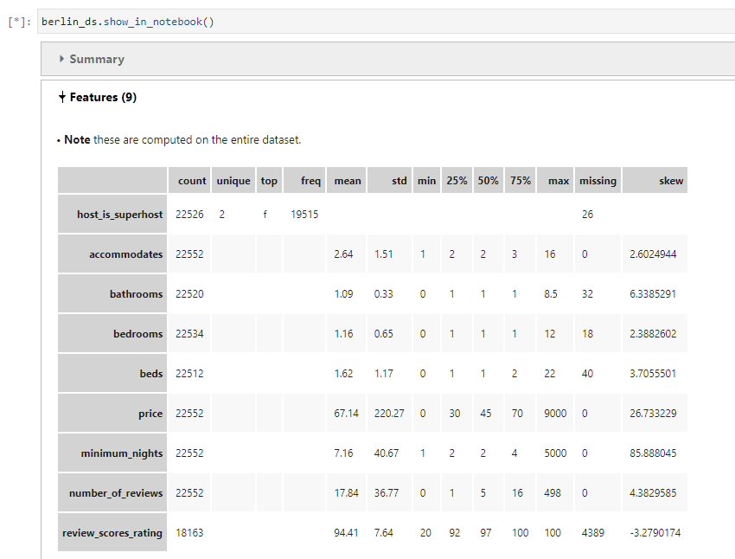
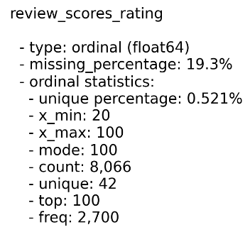
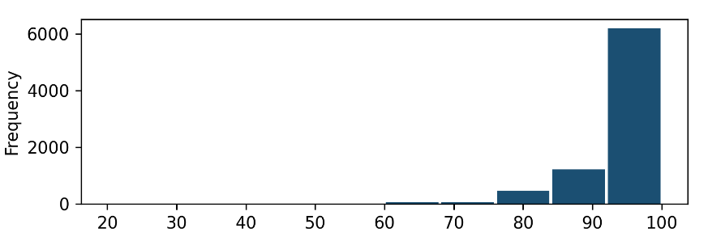
Data Exploration and Preparation
show_in_notebook()
Notes:
Here see example of summaries created by show_in_notebook method.
###########
###########

Slide 36
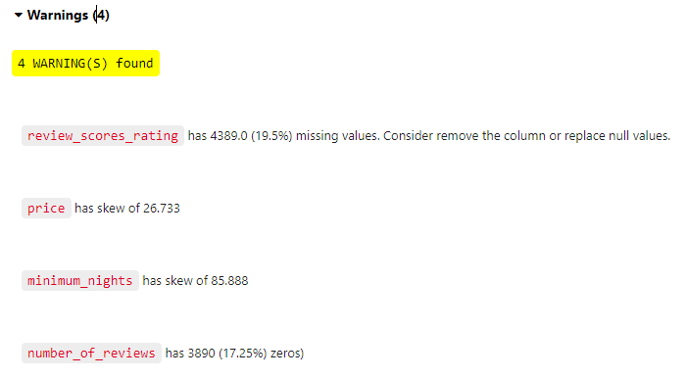

Data Exploration and Preparation
show_in_notebook()
Notes:
Some observations could have be warnings, and
later we could categorized this data -> for example missing, skew, zeros
###########
###########

Slide 37
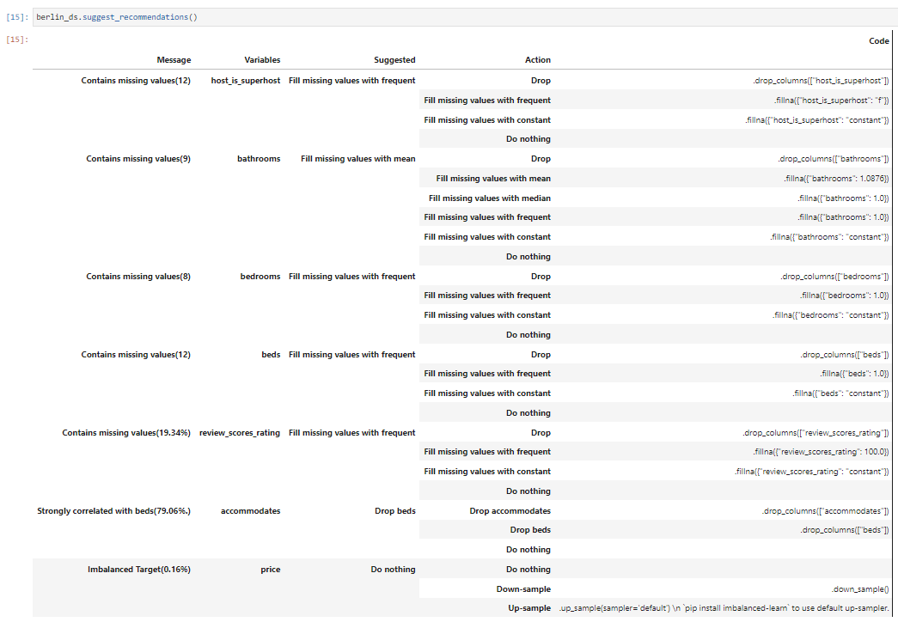
Data Exploration and Preparation
suggest_recommendations()
Notes:
suggest_recommendations() – for each finding we could have at least one action to perform.
We could apply them easily – in single-line of code – but only when we would like to apply all.
However in case we would like to choose other action than recommend we have to apply each one manually.
###########
###########

Slide 38
Data Exploration and Preparation
Manual
We could choose which recommendations
to implement
Code provided for implementation
suggest_recommendations()
Automatic
Oracle-ADS provides auto_transform function
All recommendation implemented (actions suggested)
Pick up recommendations – not possible
Notes:
We like automation and these both methods available for use togeter with OCI Data Science service
could make our EDA phase much easier.
###########
###########

Slide 39
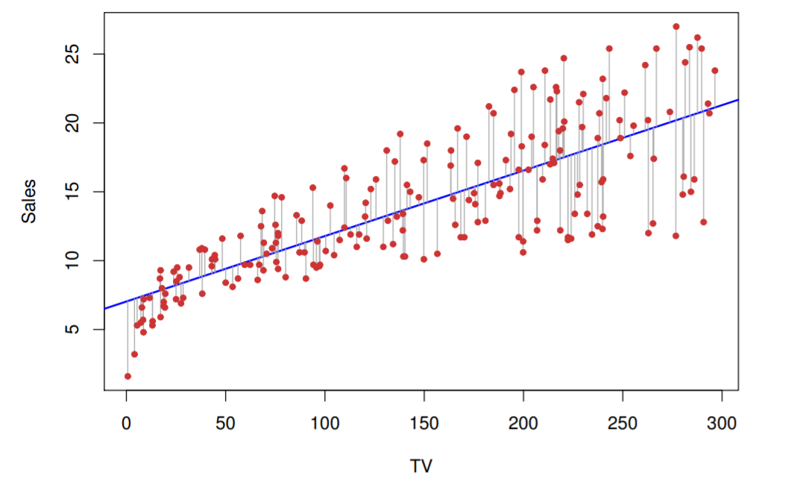
Modeling & Validation
Modeling
Validation
Find the best algorithms – maximize prediction / interpretaion / performance / resource usage / time to response
Training Process
Find the best parameters for algorithm – they are called hyperparameters
Interactive (within Notebook Session)
Batch/Job
Notes:
n machine learning, I look for a model that maximized what at least one of the goals:
Best classification/prediction of a value which is a number
Interpretation
Performance (we may have limited resources, e.g.: Edge devices)
Response time – we have a finite time to respond – good enough
A very important stage is model tuning - this is where AutoML can help us with its advanced methods of selecting the best candidates and reacting as we search for optimal values. We can build models interactively, but sometimes when it takes a long time we do this batch form – when it takes a lot of time and requires many resources. In machine learning, I look for a model that maximized what at least one of the goals: Best classification/prediction of a value which is a number Interpretation Performance (we may have limited resources, e.g.: Edge devices) Response time – we have a finite time to respond – good enough A very important stage is model tuning - this is where AutoML can help us with its advanced methods of selecting the best candidates and reacting as we search for optimal values. We can build models interactively, but sometimes when it takes a long time we do this batch form – when it takes a lot of time and requires many resources.
###########
###########
W uczeniu maszynowym szukam modelu, który maksymalizował co
najmniej jeden z celów:
Najlepsza klasyfikacja / przewidywanie wartości które jest numerem
Interpretacja
Wydajność (możemy mieć ograniczone zasoby, np.: Edge devices)
Czas odpowiedzi – mamy skończony czas na odpowiedź – good enough
Bardzo ważnym etapem jest strojenie modelu – tutaj może nam pomóc AutoML z zaawansowanymi metodami wybrania najlepszych kandydatów i reagowanie w miarę szukania optymalnych wartości.
Modele możemy budować interaktywnie, ale czasami gdy zajmuje to dużo czasu robimy to
formie batchy – gdy zajmuje to dużo czasu i wymaga wielu zasobów.

Slide 40


Deployment & Monitoring
Deployment
Monitoring
LoadBalancer
VM Instance Pool
HTTP request with Data
Model Artificat in Model Catalog
HTTP request with prediction
Client App
Conda environment
Logs
Notes:
###########
###########
Models don't live in isolation. We need to be somewhere installed and maintained.
Most often, such a model is available using the REST API. On the infrastructure side, I usually have scalable infrastructure - load balancer, instance pool, Kubernetes cluster.
###########
###########
Modele nie żyje w izolacji. Musimy być gdzie zainstalowany i utrzymywany.
Najczęściej – taki model jest dostępny za pomocą REST API.
Po stronie infrastruktury najczęściej mam skalowalną infrastrukturę – load balancer, instance pool,
Kubernetes cluster.

Slide 41

Regression analysis – Quick Theoretical Guide
Belongs to supervised category of machine learning algorithm. Unlike classification (think email -> spam or not spam, categories predefined, binary) – the second subcategory of supervised learning – regressive analysis is used to predict data continuously rather than through categorization class labels.
What will be the sales volume if we invest $400000 in television advertising?
Notes:
Linear regression is a type of problem that most of us have dealt with. In statistics, it is the equivalent of pliers in a toolbox.
We are looking for a model that is good at predicting a numerical value based on multiple attributes.
For example: what sales will be depending on how much we invest in advertising.
###########
###########
Regresja liniowa to rodzaj zagadnienia z którą większość z nas miała do czynienia.
W statystyce jest odpowiednikiem kombinerek w skrzynce z narzędziami.
Szukamy modelu dobrze przewidującego wartość numeryczną na podstawie wielu atrybutów.
Np.: jaka będzie sprzedaż w zależności od tego ile zainwestujemy w reklamę.

Slide 42

Regression analysis – Quick Theoretical Guide
Find values of coefficients which fit best for training data and achieve best accuracy for new data
Find coefficient(s) that has the greatest impact on the explained variable = change of its value change explained variable the most
Notes:
Okay. We know the basic goal. But we can also look for an alternative goal.
What factors have the greatest impact on the value we are looking for?
###########
###########
Ok. Znamy podstawowy cel. Ale możemy także poszukiwać alternatywnego celu.
Jakie współczynniki mają największy wpływ na wartość którą szukamy?

Slide 43
Regression Analysis – Algorithms by category
Regression Analysis
Last squares fit
Model’s Complexity Reduced
Tree based method
Linear Regression
LASSO
XGBoost
Nonlinear Regression
Principal Components Analysis
Precision vs Interpretation!
Ridge regression
Notes:
Within the linear regression category itself, there are several groups of algorithms: Linear regression Models based on model complexity reduction Tree models
(which are very useful for summary visualization) In our attribute search problem, we used a LASSO regression model.
###########
###########
W samej kategorii regresji liniowej istnieje kilka grup algorytmów:
Regresja liniowa
Modele oparte na redukcji złożoności modelu
Modele drzewowe (które są bardzo wdzięczne do sumarycznej wizualizacji)
W naszym problemie poszukiwania atrybutów użyliśmy model z regresją LASSO.

Slide 44


LASSO algorithm – that’s we used
Goal: Minimize Cost Function
Includes regularization part as response to overfitting problem
Regularization introduces penalty for complex model (mathematically = it tries to avoid large values of coefficients)
We use it when we have a lot of variables, we don’t really know which variables we want to use (for example - no domain knowledge)
Notes:
It is originally used to combat the phenomenon of overfitting in a model. The goal is to reduce the complexity of the model.
The complex model produces poor results. Mathematically, this involves introducing a penalty function
in the learning process - attribute values they shouldn't be big. Most often used with a large number of attributes.
###########
###########
Pierwotnie używa się do walki ze zjawiskiem nadmiernego dopasowania w modelu.
Celem jest ogranicznie źłożności modelu. Złożony model daje słabe wyniki.
Matematycznie polega to na wprowadzeniu funkcji kary w procesie uczenia się – wartości atrybutów
nie powinny być duże.
Najcześciej używany przy dużej liczbie atrybutów.

Slide 45
LASSO algorithm – that’s we used
Lasso - newer and better method than “classical” linear regression (origins in XVII century)
we are performing linear regression, but we add additional element ->
penalty added to list of coefficients
optimization goal is minimization of cost function J; LASSO enforces that absolute values of coefficients must be less than LAMBDA parameter
lower LAMBDA value then more coefficient will be zero so they will be eliminated from model
If coefficient is sooner eliminated from model, then less “impact” it has on explained variable
LASSO results could be very nicely visualized (“positive” impact and “negative” impact) are possible
Notes:
A huge advantage of the LASSO method is visualization, which allows you to quickly interpret the results On a global level - unlike the SHAPe method, known earlier.
###########
###########
Ogromną zaletą metody LASSO jest wizualizacja, która szybko pozwala zinterpretować wyniki
Na pozimie globalnym – w przeciwieństwie to metody SHAPe, poznanej wczęsniej.

Slide 46
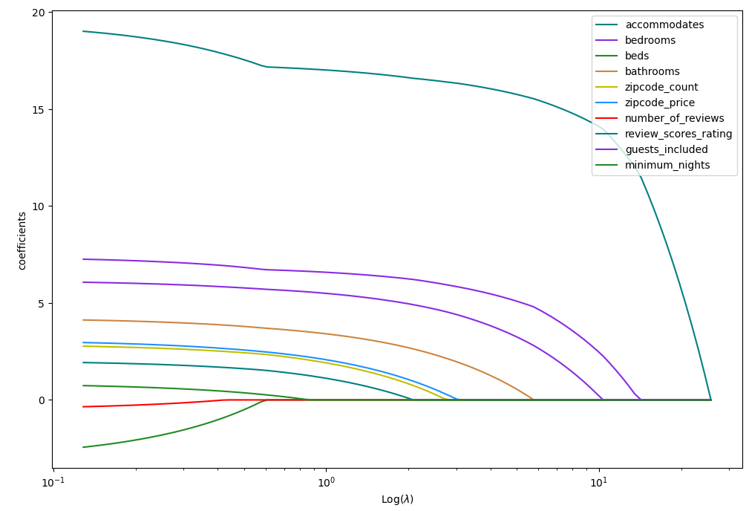
LASSO algoritm – practice
It shows how short-term price rent is related with various variables and value of LAMBDA parameter
(here is log(LAMBDA) is used on X axis for better visualization experience’)
Lower LAMBDA value then sum of coefficients. The coefficient with larger impact on price dies last.
Here for example, we see number of bedrooms has most impact on price and rating has negative impact on price (lower rating then lower price), but it has least impact on price among all variables provided.
Notes:
Let's look at the result for one of the cities. We see that the number of bedrooms has the greatest impact on price in this city.
We also see that a low rating of the premises has a very negative impact on the price.
But at the same time, this rating has the least impact compared to the other attributes.
##########
##########
Spójrzmy na wynik dla jednego z miast.
Widzimy, że liczba sypialni ma w tym mieście największy wpływa na cenę.
Widzimy też że niska ocena lokalu bardzo negatywnie wpływa na cenę.
Ale jednocześnie ta ocena ma najmniejszy wpływ w porównaniu do pozostałych atrybutów.

Slide 47
Airbnb project -> Data Analysis
Comparing 3 cities -> Berlin, Monachium i Praga
A small percentage of rejected values in each city (0.03%)
Praque – significant impact of the numer of comments on the rental price
Munich + Prague – greate influence of the location on the rental price
"Superhost" badge – marginal impact on rent price
Slightly affected by the number of bathrooms in the apartment
Notes:
In our task, we compared three European cities - Berlin, Munich and Prague. For Prague, we noticed that the number of comments has a significant impact on the price.
For Munich - Prague - the location of the property is very important. The "SuperHost" badge has virtually no impact on the price of the property.
The number of bathrooms is not a key attribute.
##########
##########
W naszym zadaniu porównaliśmy trzy miasta europejskie – Berlin, Monachium i Pragę.
Dla Pragi zauważyliśmy że liczba komentarzy ma znaczący wpływ na cenę.
Dla Monachium – Pragi – bardzo duże znaczenie ma lokalizacja nieruchomości.
Odznaka „SuperHost” prakrycznie nie wpływa na cenę nieruchomości.
Liczba łazienek nie jest kluczowym atrybutem.

Slide 48



Airbnb project -> Recommended city - Berlin
Business + Tourist Client
Competitors
Location independent
Notes:
Our recommended city for investment is Berlin because:
The competition is highly dispersed
The rental profit does not depend on location, which allows you to invest not only in the most expensive properties
Both businessmen and tourists come to Berlin - it is a very large customer base
##########
##########
Naszym rekomendowanym miastem do inwestycji jest Berlin, ponieważ:
Konkurencja jest mocna rozproszona
Zysk z najmu nie jest zależny od lokalizacji, co pozwala inwestować nie tylko w najdroższe nieruchomości
Do Berlina przyjeżdżają zarówno biznesmeni jak i turyści – jest to bardzo duża baza klientów

Slide 49
Airbnb -> Recommendations
Berlin is the best place for investments
Strategy „Buy metres, rent rooms”
We propose that the next step should be to enrich the analysis with economic information (inflation, prices of repair services, purchase prices, maintenance costs, taxes, possible length of long-term rental)
Notes:
(Read from slide)
##########
##########

Slide 50
Airbnb project -> Used methods and algorithms
Metrics for comparing regression models: P-value, R2, AIC
Regulated regression algorithms : LASSO
Notes:
(Read from slide)
##########
##########

Slide 51

Airbnb project -> Executive Summary
Berlin is the best city for investments from among the selected ones (Berlin, Munich and Prague)
Maximizing sleeping places in a good strategy to increase profits
Berlin has the most diffuse competition, allowing smaller players entering the market
Notes:
(Read from slide)
##########
##########

Slide 52
Summary I
Expert knowledge
Mathematics and Statistics knowledge
Programming skills
Dangerous Zone !
Scientific research
Data Science
Machine Learning
Notes:
This Vienna diagram came Mr. Conway web page and it is very important.
Data Science is very interdisciplinary science. You have to combine skills from 3 main areas – computer science skills, mathematics and statisics and doman knowledge.
##########
##########

Slide 53
Summary II
OCI ADS framework helps with time consuming task in Machine Learning Lifecycle
Integrates easily with OCI services
Data Science is interdisciplinary domain
Machine Learning is not only for prediction cases; sometimes it turns into interpretation cases
OCI benefit - total cost was 2.24 USD for whole work
Notes:
(Read from slide)
##########
##########

Slide 54
Thank you ☺ !

