Slide 1
HelpMe
Yifan Zhang
Jenny Wang
Minh Quang Tran

Slide 2
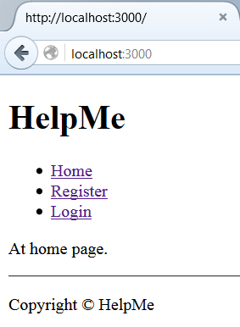
Home page
Currently
Title
Navigation
Explicit statement for homepage
Future
Show most recently posted jobs

Slide 3
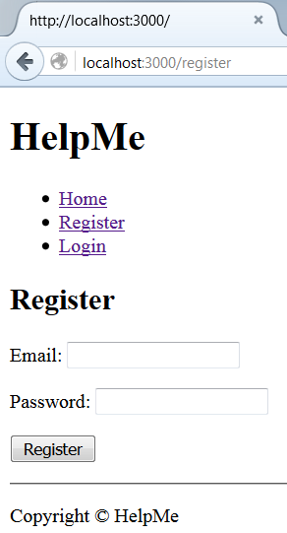
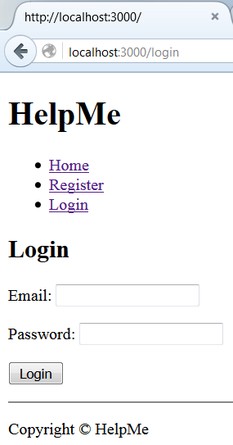
Register & Login

Slide 4
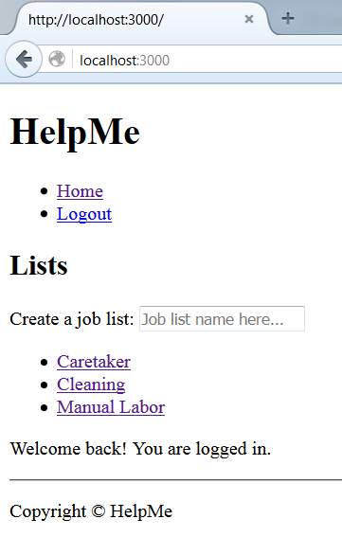
Job Lists
Job lists are broad categories
Any user can create a new list
Lists do not “belong” to a user
All lists are shown to all users

Slide 5
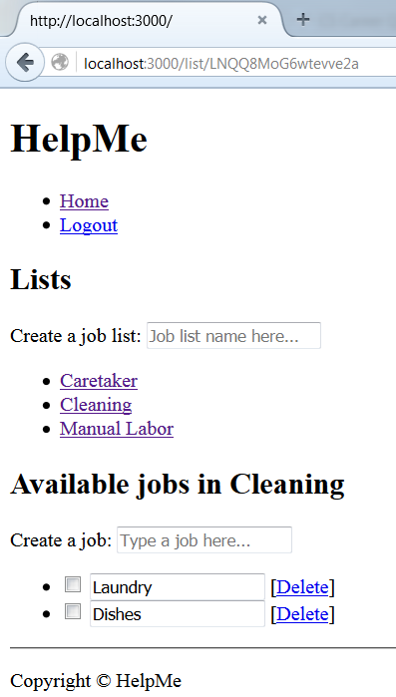
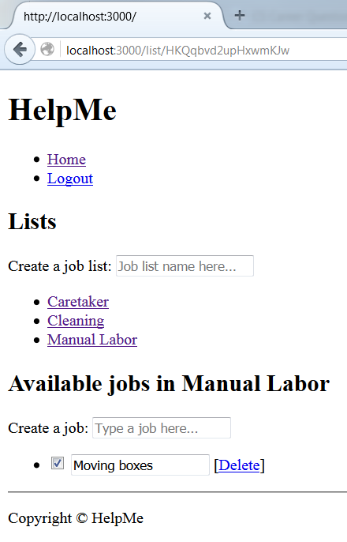
Jobs
Jobs belong to a job list
User that creates may
Edit
Delete
Other users may
Complete

Slide 6
Future additions
User Profile
Contains records of
Jobs posted
Jobs completed
Feedback
Feedback system
Allow users to rate each other
Job poster ratings based on
Payment
Description accuracy
Job worker ratings based on
Work done
Timeliness

