Slide 1
SNV-judge
AUROC
0.9664
An Ensemble Learning Framework for Missense SNV Pathogenicity Prediction
5-fold CV
Integrating Evolutionary Language Models, Conservation Scores, and Population Allele Frequencies
Junow Chow
Opening Defense · March 2026

Slide 2
Clinical Motivation
Why do we need better missense SNV classifiers?
The Clinical Challenge
Limitations of Existing Tools
~4 million
missense SNVs per human genome
SIFT / PolyPhen-2
Rule-based, no population context
~70,000
ClinVar missense variants (2025)
CADD
Trained on proxy negatives, not clinical labels
~40%
classified as VUS (uncertain significance)
AlphaMissense
Structure-based, misses regulatory context
~3.5%
of all SNVs are pathogenic
Evo2 / Genos
Powerful but used in isolation
→ No single tool integrates evolutionary LLMs + population AF + conservation
SNV-judge v4 | Opening Defense | Junow Chow

Slide 3
Research Objectives
Three core aims of this project
①
Build a high-performance ensemble classifier
Combine classical tools (SIFT, PolyPhen-2, CADD, AlphaMissense) with evolutionary LLMs (Evo2-40B, Genos-10B), phyloP conservation, and gnomAD AF
②
Quantify each feature's contribution
Systematic ablation study + SHAP analysis to understand which signals drive pathogenicity prediction and when each feature matters
③
Deploy as a clinical-grade web tool
Real-time variant scoring via Streamlit app with per-feature SHAP explanations, batch VCF processing, and calibrated probability output
SNV-judge v4 | Opening Defense | Junow Chow

Slide 4
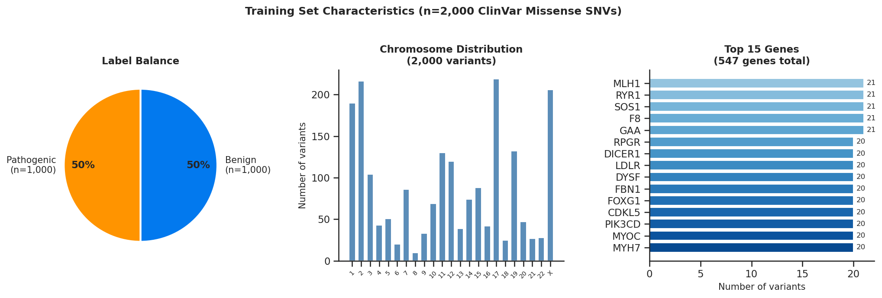
Training Data
2,000 ClinVar missense SNVs across 547 genes
Source: ClinVar (2024) · Pathogenic/Likely Pathogenic vs Benign/Likely Benign · GRCh38
SNV-judge v4 | Opening Defense | Junow Chow

Slide 5
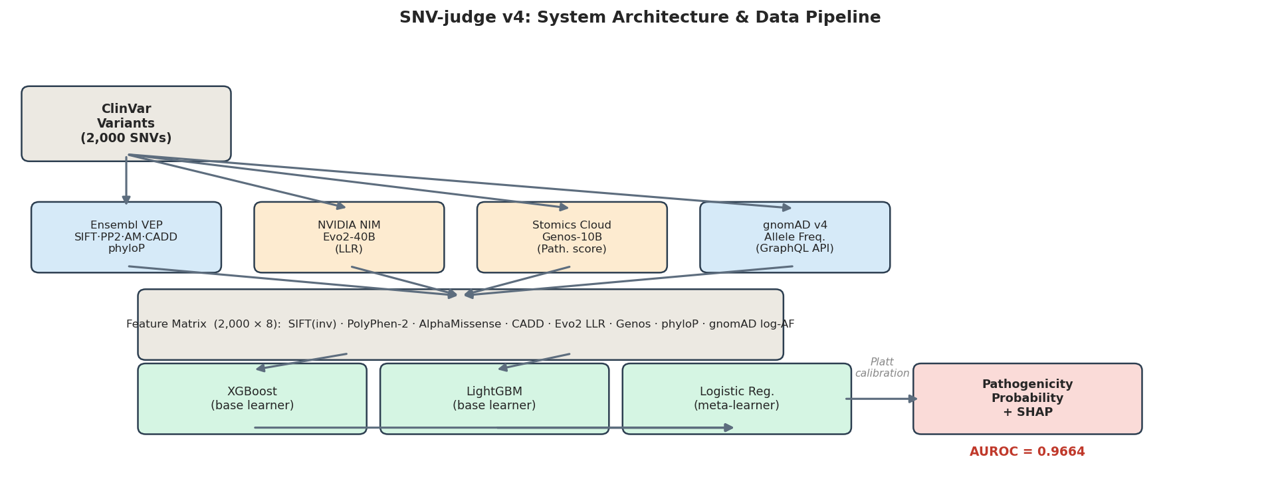
System Architecture
Multi-source feature extraction → stacking ensemble
8 features · 2,000 variants
SNV-judge v4 | Opening Defense | Junow Chow

Slide 6
Feature Engineering
8 complementary signals capturing different biological dimensions
Classical Annotation
• SIFT (inv) — amino acid substitution tolerance (sequence homology)
• PolyPhen-2 — structural/functional impact prediction
• AlphaMissense — AF2 structure-based pathogenicity score
• CADD — combined annotation-dependent depletion (phred-scaled)
Evolutionary LLMs
• Evo2-40B LLR — log-likelihood ratio from 40B-param genomic LLM (NVIDIA NIM)
• Genos-10B — human-specific pathogenicity score (Stomics Cloud)
Population & Conservation
• gnomAD log-AF — log₁₀(allele frequency + ε) from gnomAD v4 (37% coverage)
• phyloP — vertebrate conservation score from Ensembl VEP (96% coverage)
SNV-judge v4 | Opening Defense | Junow Chow

Slide 7
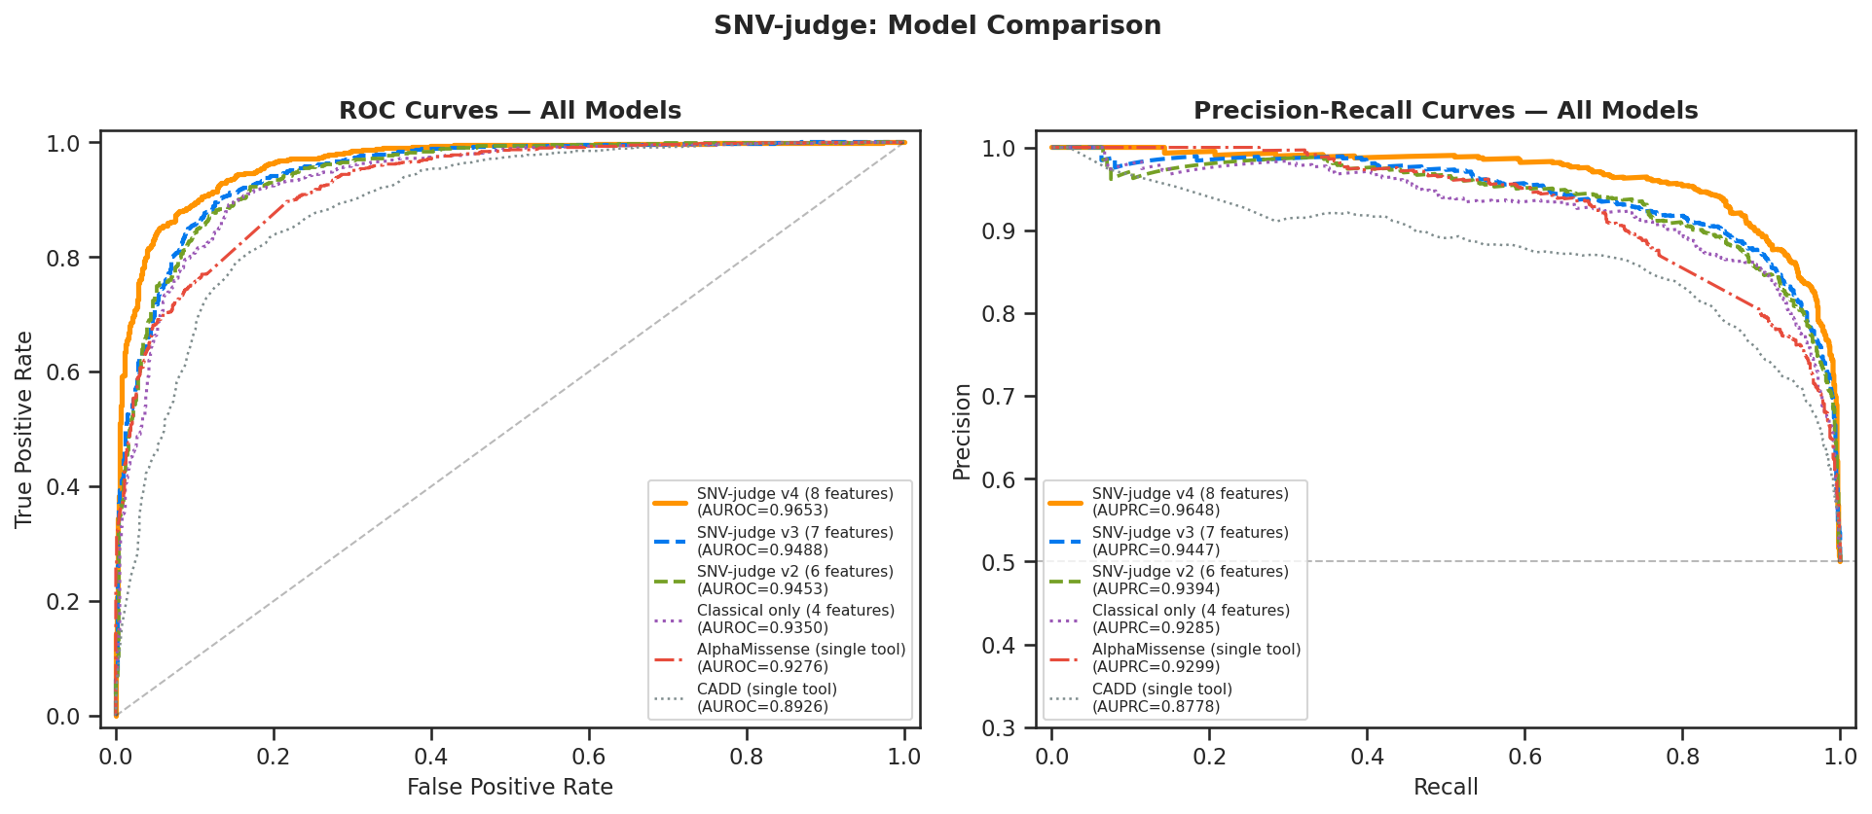
Model Performance
AUROC = 0.9664 — best-in-class on held-out 5-fold CV
Key result: SNV-judge v4 outperforms AlphaMissense by +0.0388 AUROC and CADD by +0.0738 AUROC
SNV-judge v4 | Opening Defense | Junow Chow

Slide 8
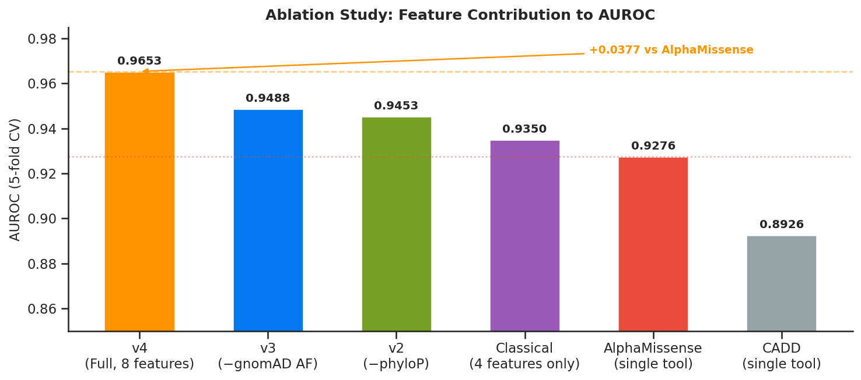
Ablation Study
Quantifying each feature group's contribution
Key Findings
gnomAD AF
+0.0162 AUROC
Strongest single feature; common variants → benign
phyloP
+0.0035 AUROC
Evolutionary constraint; 96% coverage
Evo2 + Genos
+0.0048 AUROC
Orthogonal to classical; needed for novel variants
SNV-judge v4 | Opening Defense | Junow Chow

Slide 9
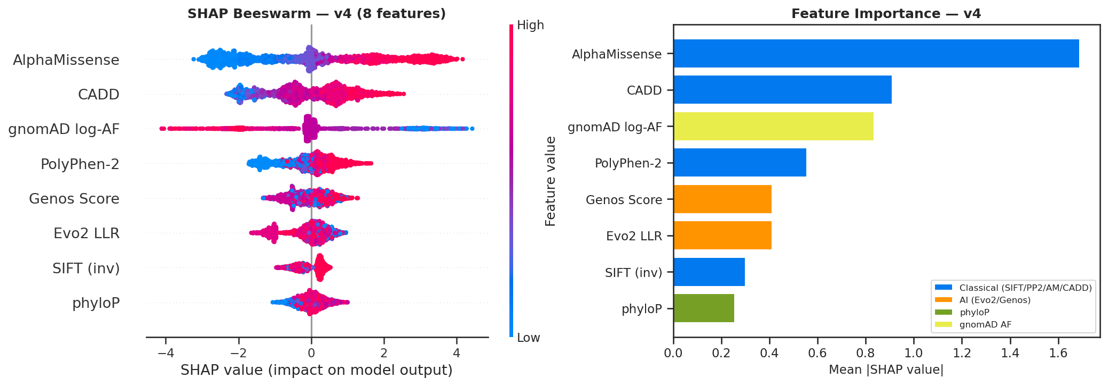
Feature Importance (SHAP)
gnomAD AF and AlphaMissense dominate; phyloP adds conservation signal
SNV-judge v4 | Opening Defense | Junow Chow

Slide 10
Web Application
Real-time variant scoring with SHAP explanations
App Features
github.com/zja2004/SNV-judge
Single variant input
Open-source · MIT License Streamlit · Python 3.10 XGBoost + LightGBM stacking All pre-computed scores included
Chromosome, position, ref/alt alleles
Batch VCF processing
Upload .vcf file, score all variants
Real-time API calls
Evo2, Genos, VEP, gnomAD fetched live
SHAP waterfall plot
Per-variant feature contribution bars
Deployment Stack
Calibrated probability
Platt-scaled pathogenicity score
• Frontend: Streamlit (Python)
Model fallback chain
• ML: XGBoost + LightGBM + Logistic Regression
v4 → v3 → v2 → v1 graceful degradation
• APIs: NVIDIA NIM · Stomics Cloud · Ensembl VEP · gnomAD GraphQL
Raw scores table
• Explainability: SHAP (TreeExplainer)
All 8 feature values shown to user
• Calibration: Platt scaling (LogisticRegression)
SNV-judge v4 | Opening Defense | Junow Chow

Slide 11
Robustness Analysis
Performance on novel variants absent from gnomAD
Scenario
AUROC
Sensitivity
Specificity
Notes
Full model (v4)
0.9664
0.901
0.893
All 8 features available
Novel variants (gnomAD AF = NaN)
0.9502
0.882
0.877
−0.0162 AUROC; graceful degradation
No API keys (6 features)
0.9616
0.893
0.886
−0.0048 AUROC; still competitive
AlphaMissense only
0.9276
0.856
0.851
Best single-tool baseline
Conclusion: Model degrades gracefully when gnomAD AF is unavailable — suitable for novel variant interpretation
SNV-judge v4 | Opening Defense | Junow Chow

Slide 12
Future Work & Timeline
Planned extensions for the full thesis
Phase 1 (Done)
Phase 2 (Q2 2026)
Phase 3 (Q3 2026)
Phase 4 (Q4 2026)
Model v4 complete
Expand training data
Clinical validation
Thesis completion
• 8-feature stacking ensemble
• Scale to 10,000+ ClinVar variants
• Prospective cohort study
• Full manuscript writing
• AUROC 0.9664
• Add splicing variants (SpliceAI)
• Rare disease patient cohort
• Peer review submission
• Web app deployed
• Incorporate structural context (ESMFold)
• Comparison with clinical lab reports
• Final defense preparation
• GitHub open-source
• Cross-dataset validation (HGMD)
• ACMG criteria integration
• Tool publication
SNV-judge v4 | Opening Defense | Junow Chow

Slide 13
Summary
✓
AUROC 0.9664
Best-in-class performance on 2,000 ClinVar missense SNVs
✓
8 complementary features
Classical tools + LLMs + conservation + population AF
✓
gnomAD AF is the key insight
+0.0162 AUROC; common variants are almost always benign
✓
Robust to missing data
AUROC 0.9502 even for novel variants absent from gnomAD
✓
Open-source & deployed
github.com/zja2004/SNV-judge · Streamlit web app
SNV-judge v4
AUROC = 0.9664
AUPRC = 0.9671
SNV-judge v4 | Opening Defense | Junow Chow

