Slide 1



The Cost of Dual-Platform Data Architecture
Snowflake + Databricks without open table formats
Data Duplication
Compute Duplication
Networking Cost & Latency
Dual Governance Overhead
Storing the same datasets in both platforms drives up storage costs.
Redundant queries and transformations run in Snowflake and Databricks.
Moving data between platforms adds egress fees and delays.
Policies, access controls, and lineage maintained separately in two systems.
These challenges compound as AI/ML use cases scale — making open table formats a prerequisite, not an optimization.

Slide 2


Use Cases Blocked Without Open Table Formats
Production readiness depends on a unified data layer
1. AIVA 2.0
2. MCP Gateway
All sub-agents need unified access across Snowflake and external systems.
Requires a consistent data access layer across platforms.
3. WRAP
4. Customer LTV
Needs streamlined data pipelines without duplication.
Cross-platform analytics depend on unified data.
5. AI Platform
6. Parts Kit Agent
Enterprise AI requires open, interoperable data as a foundation.
Agent workflows need real-time, governed data access.
Each use case depends on a unified, open data layer — without it, teams face fragmented data, duplicated effort, and delayed time-to-production.

Slide 3
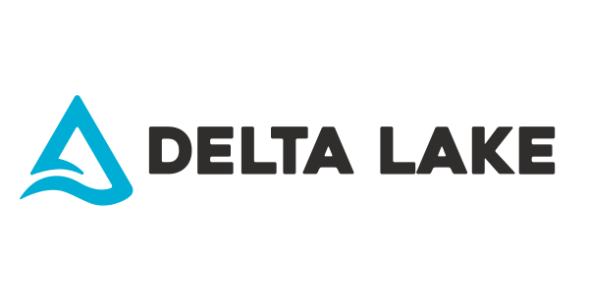
The Path Forward — Open Table Formats
Iceberg and Delta as the interoperability standard
• Prescribed architecture: adopt Iceberg (and/or Delta) as the open table format standard so Databricks can read directly from Snowflake-managed tables with minimal data movement.
Social proof
• Start with the gold layer: implement incrementally — begin with curated/gold datasets to limit disruption.
UHG (UnitedHealth Group) and John Deere exemplify enterprises that have moved toward open table formats and governed lakehouse patterns to scale analytics and AI.
• External client access: standardizing on Iceberg/Delta lets partners and clients read from Snowflake through open, portable interfaces.
• Customer references: major Databricks customers including UHG (UnitedHealth Group) and John Deere have adopted this interoperability pattern at scale.
Open table formats aren't just a technical decision — they're the foundation for a scalable, governed, AI-ready data platform.

Slide 4
Best Solution
Position UC as the Managing Catalog
Interop. Solution: Write directly to UC from SF
Architecture Flow
Summary
★ BEST: When customer has Unity Catalog. Enables both Databricks and Snowflake to read and write on same Iceberg table managed by UC.
▸ Unity Catalog (Metastore) → External Data Access + Grant External Use
▸ UC Managed Iceberg resides on external locations (S3/ADLS/GCS), not in Snowflake proprietary storage
▸ Snowflake Horizon (Account) → UC Catalog Integration + Linked Databases
▸ Reads and Writes on same UC table from both Snowflake and Databricks
▸ SF Warehouse → Write directly in UC from SF
▸ Customer gets Predictive Optimization benefits — auto-expires old snapshots, deletes unreferenced files, incrementally clusters via Liquid Clustering
▸ UC Managed Iceberg (UC Storage Root) ←→ Read/Write from Databricks
Cost
Metadata
Governance
① Enable external data access to Unity Catalog + Grant external use schema to the service principal
✅ Writes supported from both engines ✅ Cost depends on engine performing read/write
✅ Updated automatically and incrementally during a read or refresh
Managed by Unity Catalog
② Configure a catalog integration for Unity Catalog
③ Create catalog-linked database
④ Write directly to Databricks tables (AWS only at the moment)
⑤ Read and Write to the same table from Databricks

Slide 5
Best Solution
AWS
Move to Snowflake Managed Iceberg from Native Tables
Interop. Solution: Unity Catalog Federation to SF Horizon
Architecture Flow
Summary
★ Move native SF tables to Snowflake managed Iceberg tables
▸ Unity Catalog (Metastore) → Connection to Snowflake
▸ SF Managed Iceberg resides on external volumes (S3/ADLS/GCS), not Snowflake proprietary storage — UC can access it and avoid double compute
▸ External Location → Points to Snowflake storage (S3/ADLS/GCS)
▸ Read-only in Databricks
▸ Foreign Catalog → Created in UC using the connection + external location
⚠ SF Iceberg table read will fall back to JDBC if not present under authorized paths (costly due to double compute)
▸ Databricks Workspace → Queries SF tables via UC Federation
⚠ When creating a UC catalog, specify an external storage root — default root has known issues
▸ Object Storage (Managed Iceberg) ←→ SF Warehouse writes, DBX reads from storage
Cost
Metadata
Governance
① Create a connection to Snowflake on Unity Catalog
✅ Single Compute on DBX side ✅ Very small SF WH for Iceberg metadata ✅ No data replication — efficient storage
✅ Updated automatically and incrementally during a read or refresh
Managed by Snowflake Horizon; access controls also need to be applied in UC
② Create an External Location in UC pointing to Snowflake storage (create Storage Root location)
③ Create a foreign catalog in UC — add External Location as authorized path + specify external storage root
④ Query your Snowflake table in Databricks — Iceberg tables read directly from storage; native SF tables fall back to JDBC

