Slide 1

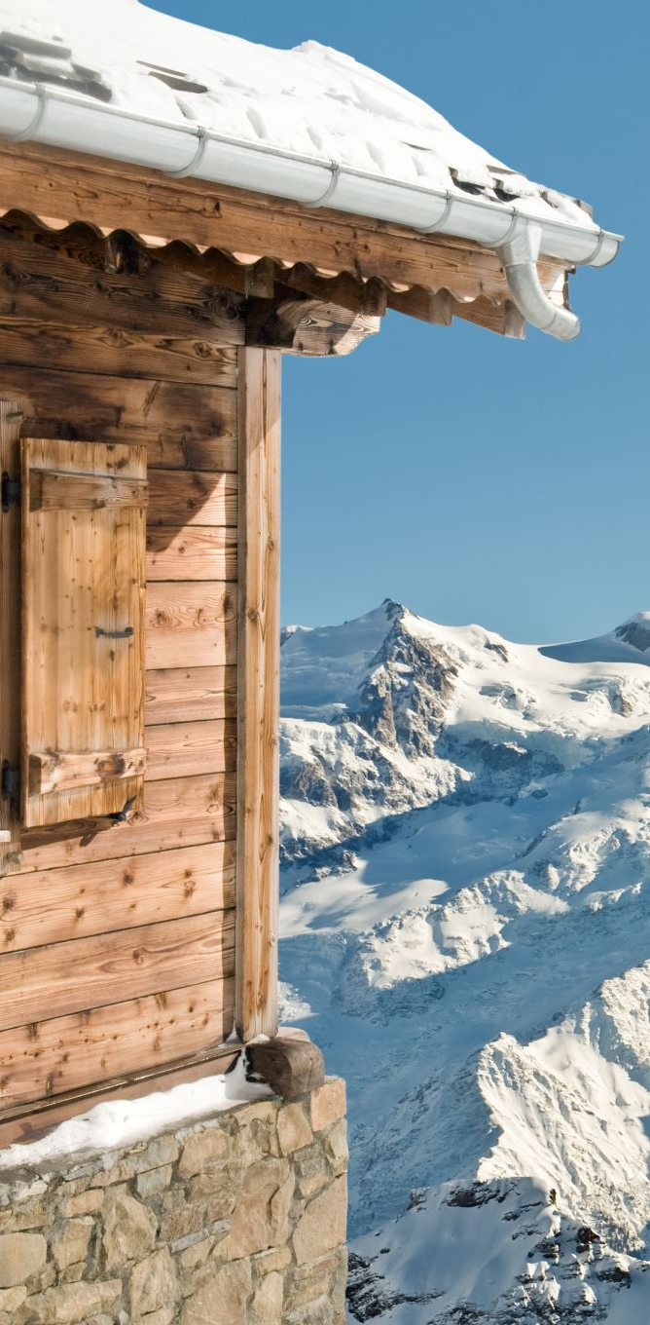
Big Mountain Resort Pricing Strategy
Zinab Jadidi
Springboard Guided Capstone Project

Slide 2
Problem Statement
Big Mountain Resort aims to evaluate whether its existing weekend rates accurately represent the value of its services.
​
Objective: Develop a predictive model incorporating facility and regional characteristics to inform pricing strategies and investment planning.

Slide 3
Recommendation & Key Findings
Big Mountain presently sets the adult weekend ticket price at $81.00.
​
Model forecasted price: $95.87 (derived from comparable resort data).
​
Variance: approximately $15, factoring in model MAE of $10.39.
​
Conclusion: Robust facility profile justifies a price adjustment upward.
​
Recommendation: Implement a moderate price increase to the $90–$95 range.
​
Additionally, enhance brand presence and strengthen customer engagement efforts.

Slide 4
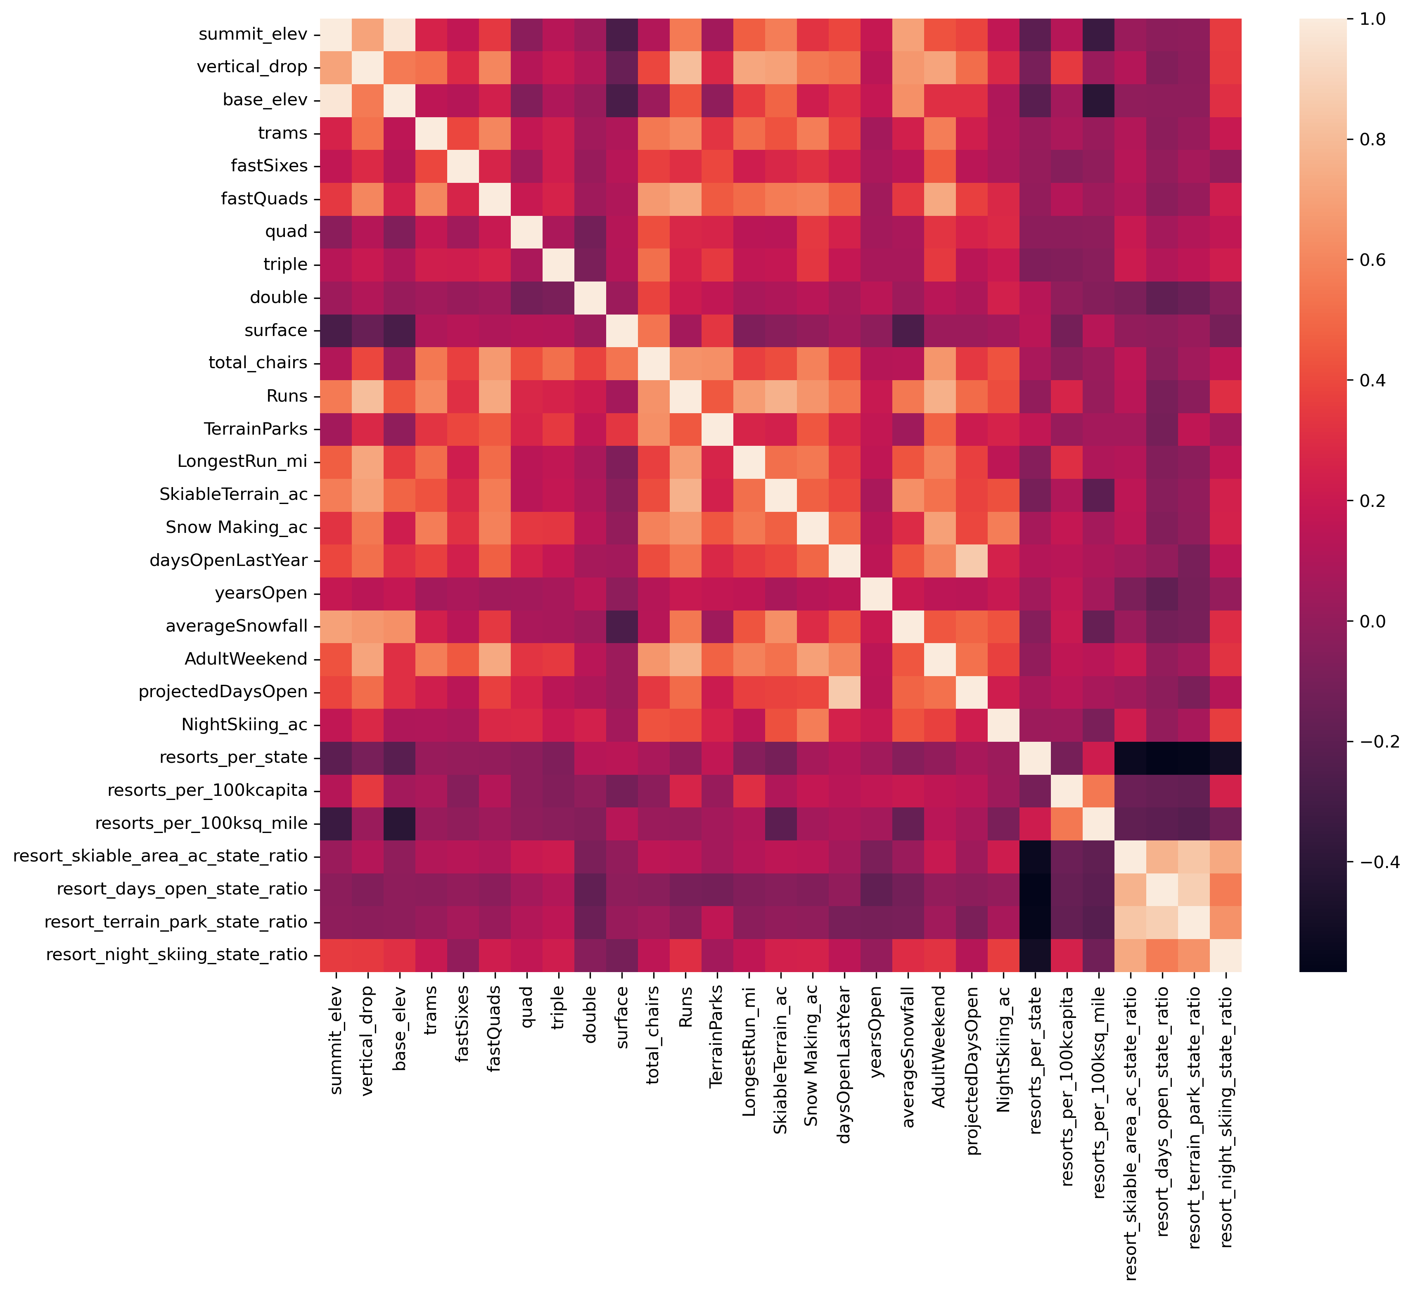
Exploratory Data Analysis
Significant correlations were identified with vertical_drop, Runs, fastQuads, and Snow Making_ac.
Optimizing state-context ratios enhanced the quality of the features.
Principal Component Analysis (PCA) showed no significant patterns in the raw state labels.

Slide 5
Feature Engineering & Preprocessing
Median imputation, scaling, and SelectKBest were applied for feature selection.
Notable engineered features:
- resort_skiable_area_ac_state_ratio
- fastQuads_skiable_ratio
- total_chairs_runs_ratio

Slide 6
Model Comparison
​
Linear Regression: MAE around $9 using the top 8 features.
​
Random Forest: MAE close to $8, demonstrating improved performance and consistency.
​
Best-performing model: Random Forest, selected for its accuracy and reliability.

Slide 7
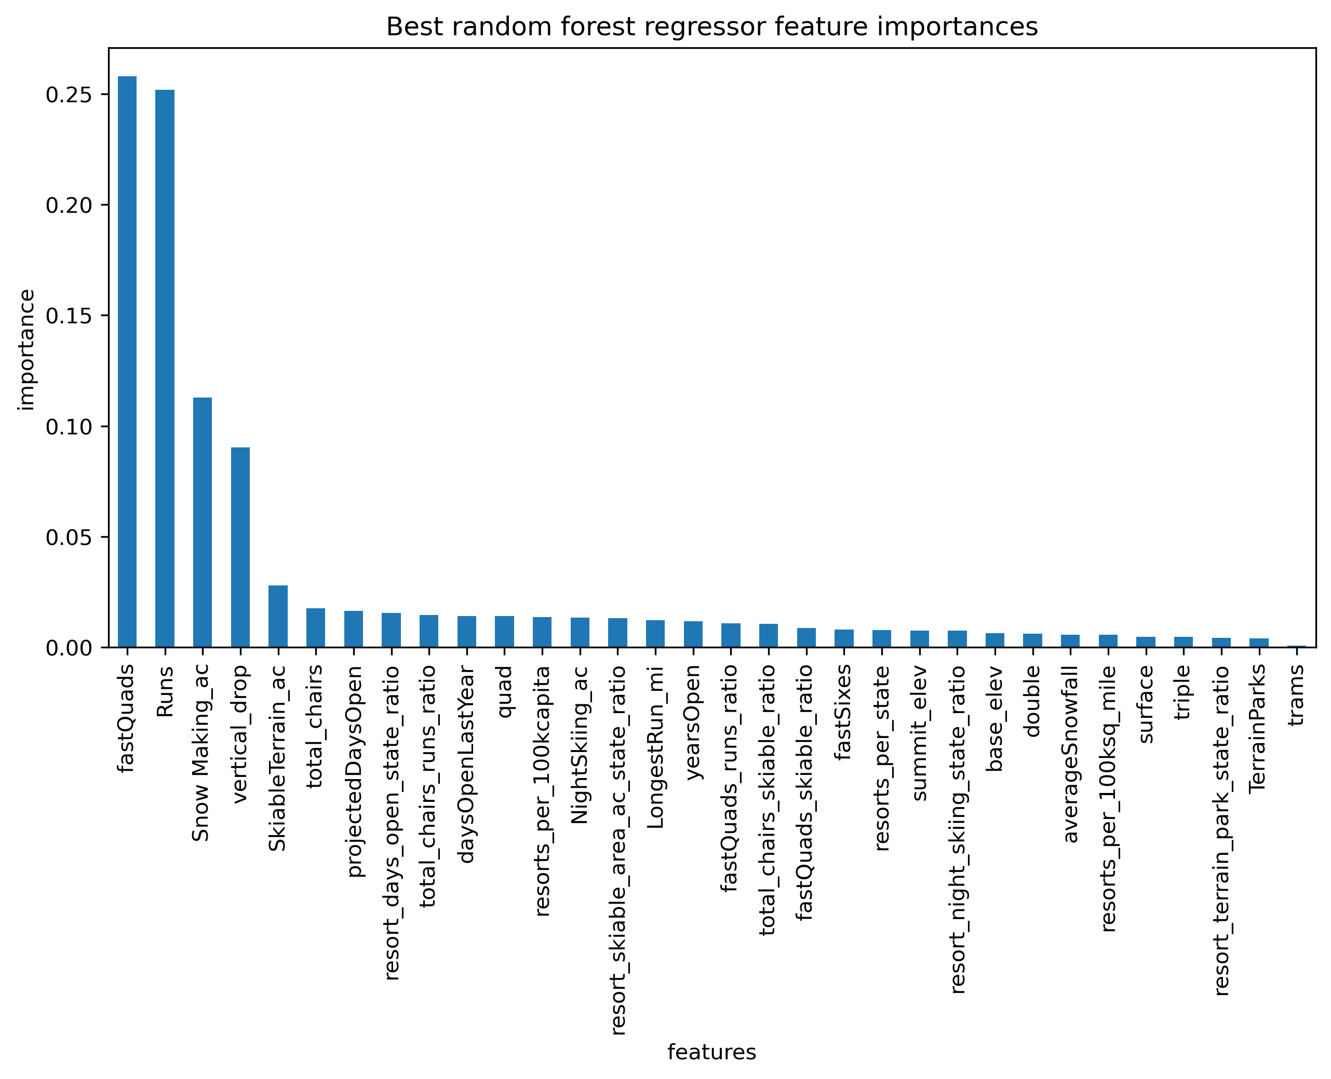
Feature Importance (Random Forest)
Key factors influencing price prediction include:
Vertical Drop
Snowmaking Capacity
Number of Chairs
High-Speed Quad Lifts

Slide 8
Conclusion & Next Steps
Big Mountain provides significant value, with potential for price increases.
The model facilitates data-informed pricing and investment strategies.
​
Future Directions:
Incorporate data on costs, profits, and customer satisfaction.
Develop a dashboard tailored for analysts.
Investigate clustering techniques for market segmentation.

