Slide 1

Modeling E‑Waste Recycling in Europe (2010–2020)
Zinab Jadidi
Springboard Data Science Bootcamp
December 2025

Slide 2
Problem & Objective
  E‑waste is one of the fastest‑growing waste streams globally.
  European policymakers need to understand which countries lead or lag in e‑waste recycling and why.
  Objective: describe trends, compare countries, and model country‑level recycling rates to support policy decisions.

Slide 3
Data & Scope
Our World in Data (OWID): E‑waste recycling rate (%).
  World Bank WDI: Population (SP.POP.TOTL) and GDP (NY.GDP.MKTP.CD).
  Geographic scope: 31 European countries (EU‑27, EEA/EFTA, UK, Balkans, Eastern Europe, microstates).
  Time window: 2010–2020 (depending on country coverage).
  Final panel: 271 country‑year observations.

Slide 4
Data Wrangling Overview
Standardized OWID columns to: country, country_code (ISO3), year, ewaste_recycling_rate_pct.
  Pulled WDI population and GDP via JSON API and reshaped into long format.
  Filtered to European ISO3 codes and removed regional aggregates.
  Merged OWID ↔ WDI on (country_code, year) to build a single panel.
  Dropped rows with missing recycling rate and restricted analysis to 2010–2020.

Slide 5
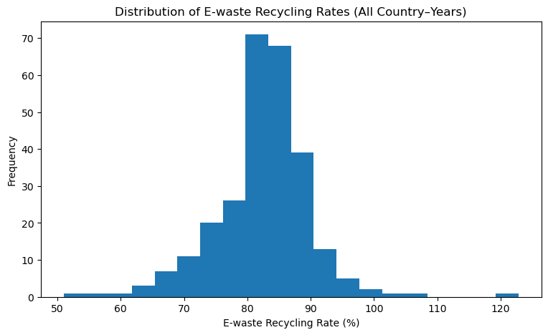
EDA – Distribution & Coverage
  Recycling rate histogram: most observations between ~75–90%, median ≈ 83%.
  Some values exceed 100%, likely due to reporting conventions (stockpiled e‑waste, etc.).
  Coverage table: number of years of data per country (n_years).
  Coverage bar chart highlights countries with strong vs sparse time coverage.

Slide 6
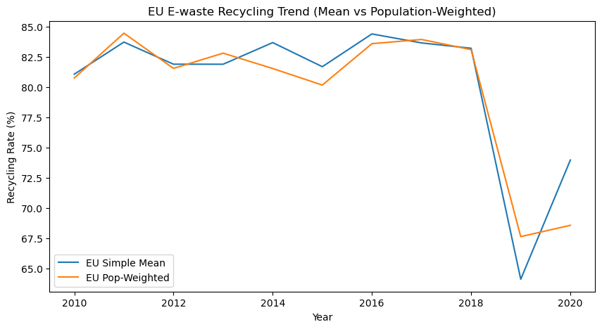
EDA – EU Trend (Mean vs Population‑Weighted)
  Constructed two series: simple mean and population‑weighted EU recycling rate.
  From 2010–2018, both series are relatively stable around 80–85%.
  Population‑weighted rate is consistently below the simple mean.
  Interpretation: larger countries tend to recycle slightly less than smaller high‑performers.
  Sharp dip around 2019 likely reflects data/reporting changes, not real system collapse.

Slide 7
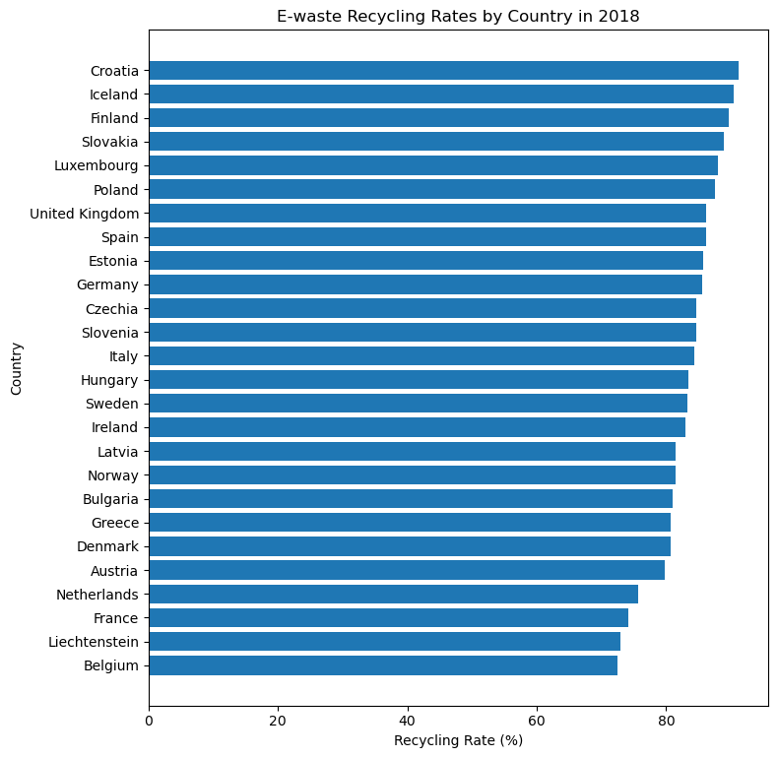
EDA – Country Rankings & Trends
  Chose 2018 as the latest common year with broad country coverage.
  Ranked countries by recycling rate in 2018 (horizontal bar chart).
  Leaders (e.g., Austria, Finland, Croatia, Slovakia, Netherlands) maintain high, stable rates.
  Some countries show volatility or sudden jumps/drops, often tied to small populations or reporting changes.

Slide 8
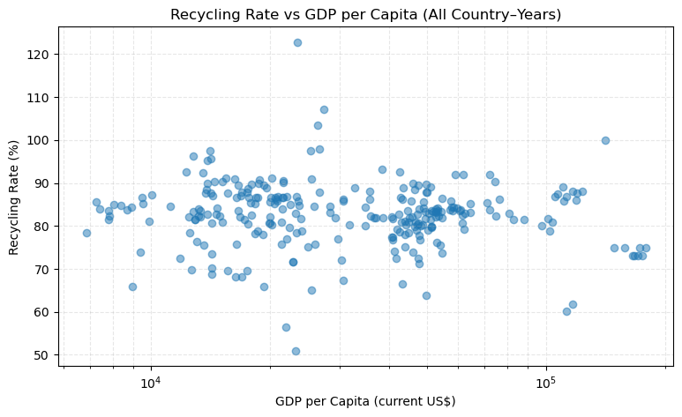
EDA – GDP per Capita vs Recycling
  Created gdp_per_capita and log_gdp_per_capita for modeling.
  Scatter plots (log scale) show a weak, slightly negative relationship.
  Pearson r ≈ −0.13 (all country‑years) and r ≈ −0.25 (country means).
  Conclusion: wealth alone does not predict higher e‑waste recycling performance.

Slide 9
Modeling Setup
  Features: year, population, log_gdp_per_capita, country_code (one‑hot encoded).
  Preprocessing: StandardScaler for numeric features and OneHotEncoder(drop='first') for country_code.
  Train/Validation/Test split: 60% / 20% / 20%, random_state=42 for reproducibility.

Slide 10
Models Evaluated
Baseline Mean Regressor – always predicts the training mean recycling rate.
  Linear Regression – captures linear relationships between scaled features and target.
  Random Forest Regressor – nonlinear model with interactions; tuned via GridSearchCV.

Slide 11
Model Performance (Validation)
  Baseline: MAE ≈ 4.46, RMSE ≈ 6.16, R² ≈ −0.00.
  Linear Regression: MAE ≈ 4.34, RMSE ≈ 6.45, R² ≈ −0.10.
  Random Forest (tuned): MAE ≈ 3.68, RMSE ≈ 5.32, R² ≈ 0.25.
  Random Forest is the only model with positive validation R² and clearly improves on MAE/RMSE.

Slide 12
Final Model & Test Performance
Selected tuned Random Forest as the final model based on validation performance.
  Refit on combined Train + Validation set, evaluated on held‑out Test set.
  Test MAE ≈ 5.46, RMSE ≈ 9.57, R² ≈ −0.46.
  Negative test R² reflects small dataset, strong country‑specific effects, and limited feature set.
  Model is still useful for understanding feature importance and relative patterns.

Slide 13
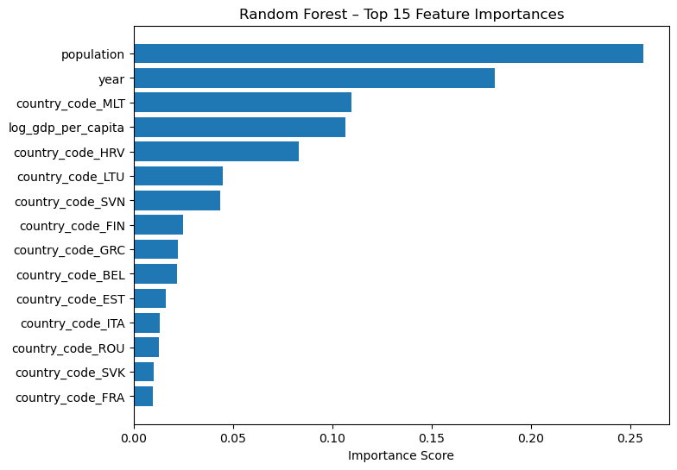
Feature Importance – Random Forest
  Top numeric features: population (~0.26), year (~0.18), log_gdp_per_capita (~0.11).
  Several country dummy variables have high importance (e.g., Malta, Croatia, Lithuania, Slovenia).
  Country identity is a strong driver, reflecting national systems, policy frameworks, and reporting practices.

Slide 14
Key Insights
EU e‑waste recycling performance is relatively high (around 80–85%) but mostly plateaued over the 2010s.
  Population‑weighted EU rates are lower than the simple mean, indicating that larger countries underperform relative to smaller leaders.
  GDP per capita has a weak, slightly negative association with recycling rate; wealth alone does not drive success.
  Country identity (systems, policies, culture, reporting) explains a large share of variation in recycling performance.

Slide 15
Recommendations
1) Focus on system and policy benchmarking rather than income: study high‑performing smaller countries to extract best practices.
2) Prioritize large underperforming countries for deeper investigation and targeted support, as improvements there have outsized EU‑level impact.
3) Invest in more consistent and harmonized reporting to reduce apparent 'shocks' caused by data artifacts and improve monitoring quality.

Slide 16
Limitations & Future Work
Small dataset (271 country‑years, 31 countries) limits model complexity and generalization.
  Feature set lacks direct policy variables (e.g., WEEE implementation details, collection system types).
  Future work: add policy and system design features, use time‑series cross‑validation, and analyze regional/policy clusters (Nordic, Western, Eastern, Southern Europe).

Slide 17
Conclusion
Built a European e‑waste recycling panel, performed EDA, and modeled recycling rates using socioeconomic context and country identity.
  Found that institutional design and national systems matter more than GDP alone for explaining performance.
  Random Forest provided the best (though imperfect) predictive performance and highlighted key drivers.
  Results offer a foundation for policy‑focused follow‑up analysis and improved data collection.

