Slide 1
ggplot2 Tutorial
Zjardyn Liera-Hood
Oct 24

Slide 2
About me
Diploma Biotechnology @ Durham College
BSc Molecular Genetics @ University of Guelph
MBinf @ University of Guelph
PhD student working on the Open Plastic project

Slide 3
My PhD project
Identify bacteria and enzymes directly involved in polyethylene and polystyrene biodegradation.
Waste site soil enrichments using plastic monomers; characterizing downstream utilization of plastic degradation products.
Incorporating functional metagenomics to identify plastic degradation genes.
Characterize plastic biodegradation; develop a standardized method

Slide 4
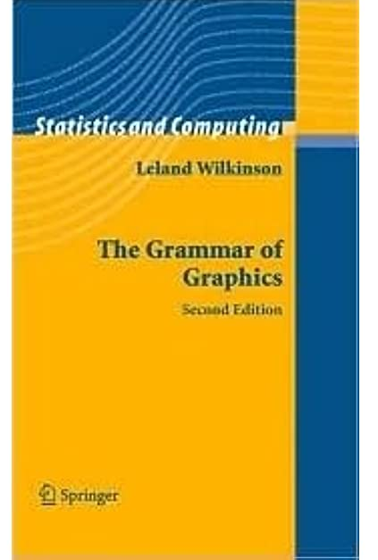
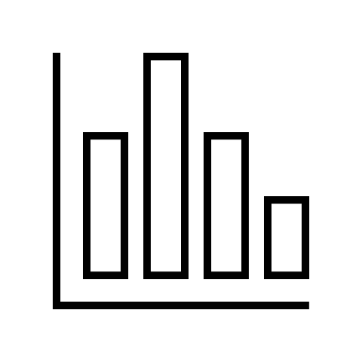
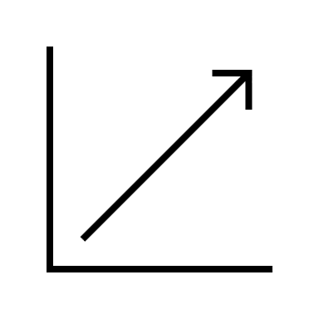
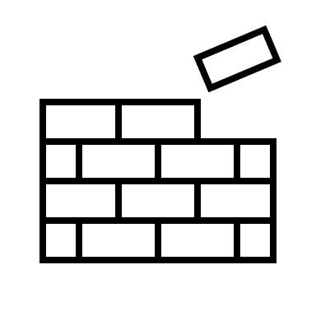
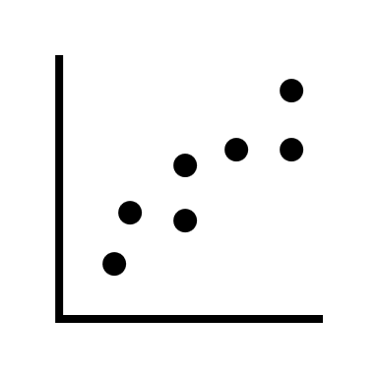
ggplot2
R package
Based on the Grammar of Graphics
Theoretical deconstruction of data graphics
Notes:
Data plotting used to be discrete functions to plots. The grammar of graphics sets out to generalize this by decomposing graphics into their constituents which can be used to describe any graph.

Slide 5

ggplot2
ggplot2 is an R package written by Hadley Wickham and is an implementation of the grammar of graphics.
ggplot2 can create a broad range of graphics with few lines of code and is highly extendable with other R packages (Bioinformatics).
There is a large community using ggplot2, which makes troubleshooting easy. Built-in documentation is a great resource.
Requirements: R, RStudio, access to R packages

Slide 6
The grammar of graphics
A graphic maps the data to aesthetics of geometric objects.
The plot may contain statistical transformations of the data and info about the plots coordinate system.
Faceting can be used to plot subsets of the data.
Theme
Coordinates
Statistics
Facets
Geometries
Aesthetics
Data

Slide 7
Data
Data is the foundation of data visualization.
Importing, manipulation, cleaning, etc. (Data wrangling)
Data should be "Tidy"
Properties of Tidy data:
Rows are observations/samples
Columns are variables
Each cell is a single value
Sample | Variable 1 | Variable 2 | Variable 3
1 | 0.2 | yes | 2
2 | 2.3 | no | NA
... | ... | ... | ...
20 | 7.6 | maybe? | 5
Notes:
There is a lot to talk about here

Slide 8
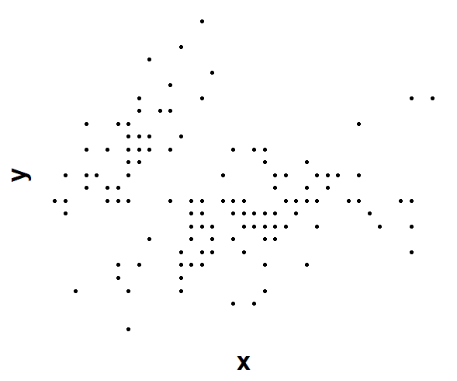
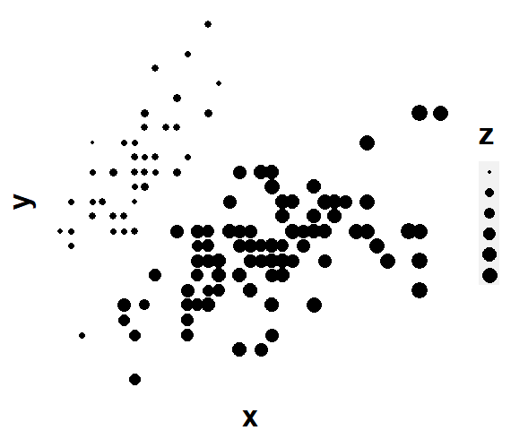
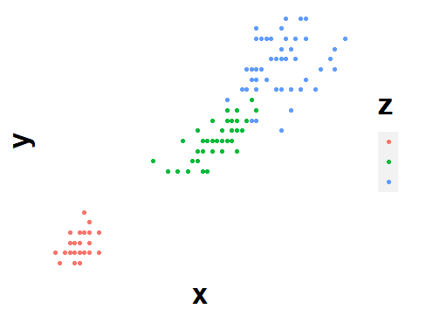
Aesthetics
What kind of plot?
(x, y, z are variables)
x and y scatterplot
Distribution of x as boxplot
Barplot of z, where each bar is a separate category of z.
x and y scatterplot, scale the points using z.
Links variables in the data to graphical properties in the geometry.
Scales map values in the data space to values in the aesthetic space, using colour, shape, size, position. Scales also draw the legend and axes (inverse mapping).
Examples:
Numbers -> Position
Numbers -> Size
Categories -> Colour
Notes:
Scales let you read the original data from the plot (inverse mapping)

Slide 9
Geometries
Takes the scales and mappings and interprets them in a certain way.
Building blocks:
Points, lines, polygons, bars, bubbles.
Plots are not confined to single geometries; they can be layered.
A layer is a collection of geometric elements and statistical transformations.
geom: What you see.
stat: How the data is summarized.
Notes:
minimum, first quartile, median, third quartile, and maximum
points, lines, polygons, etc.
binning and counting observations to create a histogram, or fitting a linear model.

Slide 10
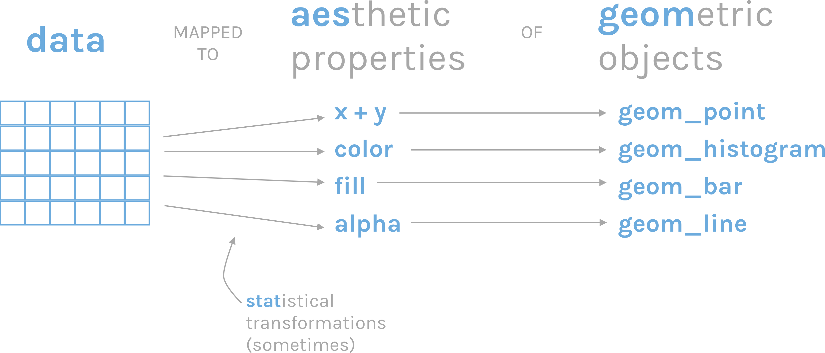
https://rfortherestofus.com/2019/07/a-short-overview-of-the-grammar-of-graphics/

Slide 11
Simple plot
Geometries
Aesthetics
Every ggplot object has 3 components
Data.
A set of aesthetic mappings between variables in your data and visual properties.
At least one layer which describes how to render each observation. Layers are normally created with the geom function.
Data

Slide 12
Statistics
Data may be in Tidy format, but not in the format we want to display. We apply transformations to the data to be plotted.
Examples:
Fitting a linear model to the data
Computing summary statistics for a boxplot.
Binning and counting observations for a histogram .
Stats are geom-specific and can be modified.
Statistics
Facets
Geometries
Aesthetics
Data
Notes:
minimum, first quartile, median, third quartile, and maximum

Slide 13
Facets
Specifies how to break and display subsets of data as small multiples. Also known as latticing/trellising.
You have a plotting area and you can split your data in multiples, allowing you to declutter data.
Panel layout can carry meaning, which helps explain your findings.
Example:
I want a scatterplot of x and y, but I want to separate points into subplots, based on the levels of a categorical variable z.
Statistics
Facets
Geometries
Aesthetics
Data

Slide 14

Coordinates
Data coordinates are mapped to the plane of the graphic and provides axes and gridlines to help read the plot.
This is the physical mapping onto the fabric you are plotting things into.
Normally a cartesian system with x and y axes.
Could be polar as well.
Coordinates
Statistics
Facets
Geometries
Aesthetics
Data
Notes:
Variables are mapped, scaled, transformed, and applied to a geometry, but the coordinate system is what defines the position of values.

Slide 15
Theme
Controls the finishing touches of the display:
Font size
Background colour
Gridlines
Simpler is better.
Theme
Coordinates
Statistics
Facets
Geometries
Aesthetics
Data

