Slide 1
Box office revenues/ Profits
Zane Brown

Slide 2
Proposal
Explore how the revenue generated by movies in different genres differ from each other. As well as revenue differences by month.
Create a model that can accurately predict what the revenue of a movie will be based on a variety of different independent variables.
Identify independent variables that could be significant in determining what a movies revenue could be.

Slide 3
Data collection
The Movie Database (TMDb): This is an API that I used to get data on popular/trending movies, as well as other movies provided from the IMDb file.
IMDb: Provided a large text file with over 1 million movie ids that allowed me to get more data from TMDb API. I was planning on using this more but only a paid version of the API was available.
Python: Used pandas library to extract various data from TMDb API and arrange them into a single data frame. Additionally, used to clean up the data and get rid of movies with null values.

Slide 4
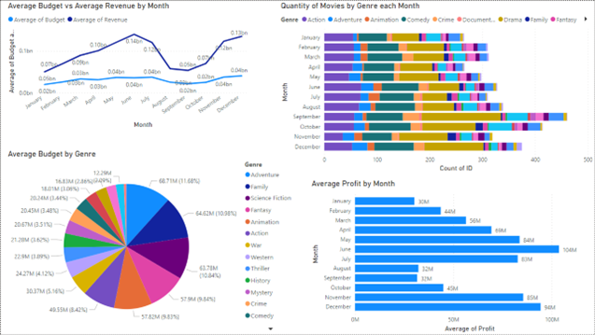
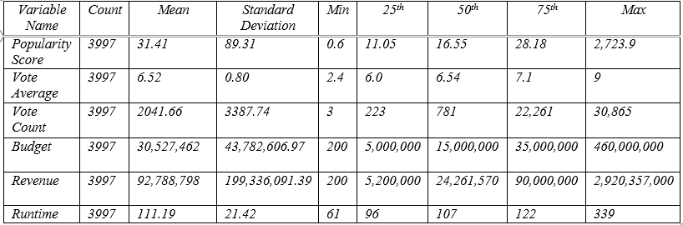
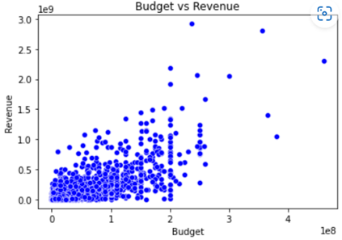
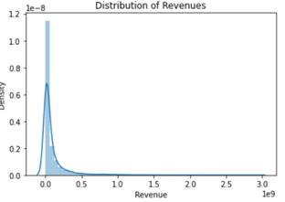
Data exploration

Slide 5
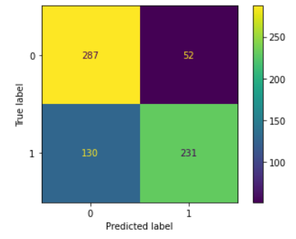
Predictive models
Revenue:
Multiple Linear Regression: .69 R-score, Mean Squared Error about 110 million.
Random Forrest: .746 R-score, 20 estimators, Mean Squared Error about 104 million.
Profit:
Logistic Regression: 74% accuracy score when predicting new/untrained data.
Random Forrest: 73.5% accuracy, 100 estimators
Decision Tree: 65% accuracy

Slide 6
Reflections
Mostly clean and understandable data. (API)
Data transformation with scaler.
Decent results for predictive models.
Wasn't able to get live data.
Time management.
IMDb API.

Slide 7
Summary
Logistic Regression identified as the most effective predictor
Strong positive correlations found between revenue and variables such as vote count and budget
Significance of audience engagement and financial investment in determining movie success
Limitations: absence of live data, challenges in acquiring sufficient data within a reasonable timeframe
Recommendations for future analyses: gather a larger sample of movies across genres, release dates, and budgets; incorporate variables such as marketing cost, social media presence, critical reviews, and competition; seek live data sources for up-to-date models reflecting market trends
Future plan: access IMDb API for analysis and prediction of IMDb ratings based on similar variables

Slide 8




Questions?

