Slide 1
Chessboard representation 1
 | @ | A | B | C | D | E | F | G
0
1 |  | 1 | 1
2 |  |  | 1
3
4
5
6
This is a chessboard example.

Slide 2
Chessboard representation 1
 | @ | A | B | C | D | E | F | G
0 | 0 | 0 | 0 | 0 | 0 | 0 | 0 | 0
1 | 0 | 1 | 1 | 0 | 0 | 0 | 0 | 0
2 | 0 | 0 | 1 | 0 | 0 | 0 | 0 | 0
3 | 0 | 0 | 0 | 0 | 0 | 0 | 0 | 0
4 | 0 | 0 | 0 | 0 | 0 | 0 | 0 | 0
5 | 0 | 0 | 0 | 0 | 0 | 0 | 0 | 0
6 | 0 | 0 | 0 | 0 | 0 | 0 | 0 | 0
For every space,
if there is a tile, the space is labeled as ‘1’, else ‘0’.
Memory array size: 32*32

Slide 3
Chessboard representation 2
 | @ | A | B | C | D | E | F | G
0
1 |  | 1 | 1
2 |  |  | 1
3
4
5
6
White Black
0
1
Color Code
01
10
00
11
Direction Code
Memory element:
Color Code + Direction Code

Slide 4
Chessboard representation 2
White Black
First element
 | @ | A | B | C | D | E | F | G
0
1 |  | 1 | 1
2 |  |  | 1
3
4
5
6
0
1
Color Code
01
11
00
10
Direction Code
Memory element: edge
Color Code + Direction Code + Position(row+column) + Path ID
Memory array:
Edges are stored counter clock-wisely. The first element is called pointer.

Slide 5
Chessboard representation 2
Memory element: edge
Color Code + Direction Code + Position(row+column)(optional) + Path ID
Memory array: contour
Edges are stored counter clock-wisely. The first element of contour is called pointer.
No. | 1 | 2 | 3 | 4 | 5 | 6 | 7 | 8
Color | 0 | 1 | 0 | 0 | 1 | 0 | 0 | 0
Direction | 11 | 10 | 11 | 10 | 00 | 00 | 01 | 01
Position(row) | 00001 | 00001 | 00010 | 00010 | 00010 | 00001 | 00001 | 00001
Position(column) | 00001 | 00001 | 00010 | 00010 | 00010 | 00010 | 00010 | 00001
Path ID | 000001 | 000010 | 000011 | 000011 | 000010 | 000100 | 000100 | 000001

Slide 6
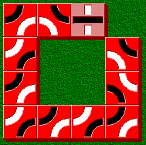
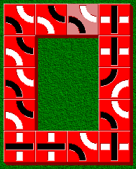
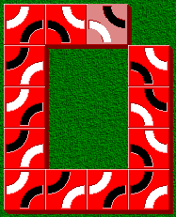
Chessboard representation 2
Multi-contour Situation
Situation 1: When (the new tile’s surrounding tile existence is 0001,0010,0100 or 1000) and (the
tile existence of the corner at the other side of the existing tile is 1) , a new contour appears.
Situation 2: When the new tile’s surrounding tile existence is 0101 or 1010, a new contour appears.
Contours are stored according to the order of their occurrence. The first element of contour is called
pointer.
Last Tile

Slide 7
Memory Architecture
Items | Memory size/bit | Content
Chessboard Repr. 1 | 1024(32*32) | Existence of tiles on chessboard
Chessboard Repr. 2 | 348(3*32*4)
Path list | ()

Slide 8
Process for updating chessboard
Start
Check 4 surrounding spaces(up, down, left, right) of the new tile, get the number of tiles, save as N.
Record the position for the first tile of the first row, save as P1.
Update representation 1. Add the new tile to the representation 1 according to its position. If the new tile is put at Row 0 or Column @ , shift the representation 1 and P1 to the right or down by one tile.
Match the elements of representation 2 in representation 1 in turns, starting from P1. If there is one element mismatched, stop matching.
Matching procedure
Update representation 2. If N=3, delete 3 edge and add 1. If N=2, delete 2 edge and add 2, If N=1, delete 1 edge and add 3.
Backup the current representation 1 & 2
Check surrounding tiles
Number of tiles

Slide 9
Process for matching
01
Y
11
00
Matching
First edge position : (X,Y)
X
10
Direction Code
Two continuous edges
Second Edge Position | X Y | X Y+1 | X Y | Nil | X-1 Y+1 | X+1 Y-1 | Nil | X-1 Y-1 | X-1 Y
Detecting position | X-1 Y | X-1 Y+1 | X Y+1 |  | X-1 Y | X-1 Y |  | X Y-1 | X-1 Y-1
Two continuous edges
New Edge Position | Nil | X+1 Y-1 | X Y-1 | X Y | X+1 Y+1 | X+1 Y | X Y | Nil
Detecting position |  | X+1 Y | X+1 Y-1 | X Y-1 | X Y+1 | X+1 Y+1 | X+1 Y

Slide 10
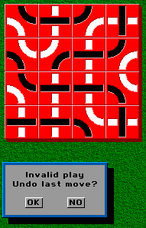
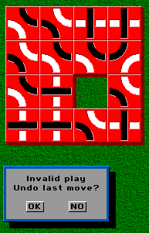
Invalid Move
When find one tile which has three edges of the same color, this is an invalid move.
Last Tile Placed by Player

Slide 11
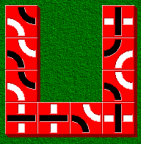
Dead cave

Slide 12
Input
Command
Board Representor
Main Processor
RAM
Move Translator
Output
Command

