Slide 1

By: Craig Hecock

Slide 2
What is NodeJS?
A JavaScript runtime environment running Google Chrome’s V8 engine
  a.k.a. a server-side solution for JS
  Compiles JS, making it really fast
Runs over the command line
Designed for high concurrency
  Without threads or new processes
Never blocks, not even for I/O
Uses the CommonJS framework
  Making it a little closer to a real OO language

Slide 3
Concurrency: The Event Loop
Instead of threads Node uses an event loop with a stack
Alleviates overhead of context switching

Slide 4
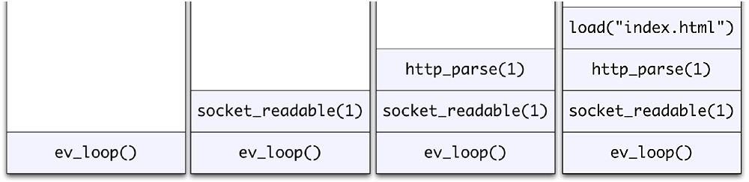
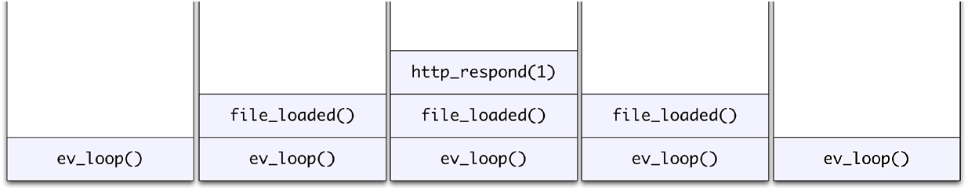
Event Loop Example
Request for “index.html” comes in
Stack unwinds and ev_loop goes to sleep
File loads from disk and is sent to the client

Slide 5
Non-blocking I/O
Servers do nothing but I/O
  Scripts waiting on I/O requests degrades performance
To avoid blocking, Node makes use of the event driven nature of JS by attaching callbacks to I/O requests
Scripts waiting on I/O waste no space because they get popped off the stack when their non-I/O related code finishes executing

Slide 6
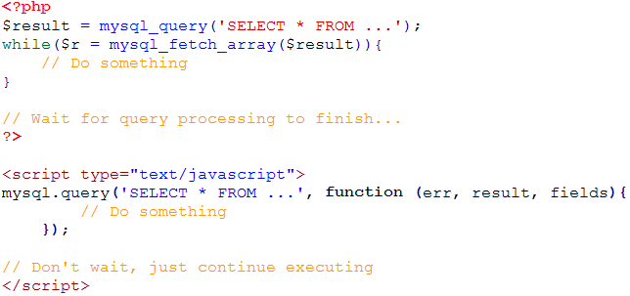
I/O Example

Slide 7
Drawbacks
Use of JS on both the client and server-side should remove need to “context switch”
  Client-side JS makes heavy use of the DOM, no access to files/databases
  Server-side JS deals mostly in files/databases, no DOM
    JSDom project for Node works for simple tasks, but not much else

Slide 8
Conclusion
Still in beta
Non-blocking nature takes some getting used to
Interesting API
  Can almost remake Dash!

Slide 9
References
http://nodejs.org/
http://nodejs.org/cinco_de_node.pdf
http://ajaxian.com/archives/google-chrome-chromium-and-v8
http://blog.chromium.org/2010/12/new-crankshaft-for-v8.html
http://news.softpedia.com/news/IE9-RC-vs-Chrome-10-9-vs-Opera-11-vs-Firefox-11-Performance-Comparison-183973.shtml

