Slide 1
Object-Oriented Technology
Notes:
© Dr. Jim Arlow 2000 v1.0

Slide 2
Content
Methodology
Concepts
Engineering
Notes:
© Dr. Jim Arlow 2000 v1.0

Slide 3
Content
Methodology
Concepts
Engineering
Notes:
© Dr. Jim Arlow 2000 v1.0

Slide 4
Methodology
OO is a methodology to understand the world:
The world is composed of objects
Every object has its own data and behavior
Objects can communicate or interact with each other
The OO world exists and operates in this way.

Slide 5
Methodology
Describe the things in the real world as objects
Objects are divided into classes, various hierarchical relationships may be constituted between various classes
Objects interact through messages
An object is an encapsulation of data and methods

Slide 6
Methodology
As to software, OO
Bases on object concept
Uses class and inheritance as organize mechanism
Utilizes polymorphism to provide flexibility
To understand, describe and build the world.

Slide 7
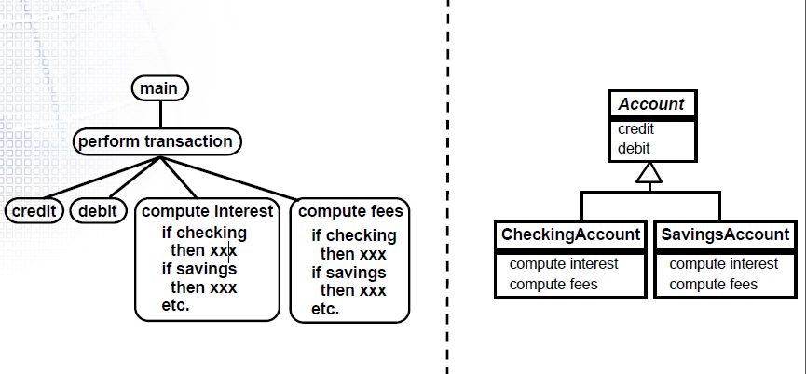
Methodology
Structured Method vs. OO Method

Slide 8
Principles
The object model encompasses the principles of
  abstraction
  encapsulation
  modularity
  hierarchy
  typing
  concurrency
  persistence

Slide 9
Advantages
Promotes abstract level
Simplifies software development process
Improves software’s structure
Supports software reusing

Slide 10
Content
Methodology
Concepts
Engineering
Notes:
© Dr. Jim Arlow 2000 v1.0

Slide 11
Concepts
Object
Class
Message
Inheritance
Polymorphism
…

Slide 12
What are objects?
Objects consist of data and function packaged together in a reusable unit.
Notes:
© Dr. Jim Arlow 2000 v1.0

Slide 13
What are objects?
Every object is an instance of some class which defines the common set of features (attributes and operations) shared by all of its instances. Objects have:
  Attribute values – the data part
  Operations – the behaviour part
Notes:
© Dr. Jim Arlow 2000 v1.0

Slide 14
What are objects?
All objects have:
  Identity: Each object has its own unique identity and can be accessed by a unique handle
  State: This is the actual data values stored in an object at any point in time
  Behaviour: The set of operations that an object can perform
Notes:
© Dr. Jim Arlow 2000 v1.0

Slide 15
Encapsulation
operations
attribute values
Data is hidden inside the object. The only way to access the data is via one of the operations
This is encapsulation or data hiding and it is a very powerful idea. It leads to more robust software and reusable code.
deposit()
withdraw()
number = "1243"
owner = "Jim Arlow"
balance = 300.00
getOwner()
setOwner()
An Account Object
Notes:
© Dr. Jim Arlow 2000 v1.0

Slide 16
Messaging
In OO systems, objects send messages to each other over links
These messages cause an object to invoke an operation
Bank Object
Account Object
message
withdraw( 150.00 )
the Bank object sends the message “withdraw 150.00” to an Account object.
the Account object responds by invoking its withdraw operation. This operation decrements the account balance by 150.00.
Notes:
© Dr. Jim Arlow 2000 v1.0

Slide 17

What are classes?
class
object
Every object is an instance of one class - the class describes the "type" of the object.
Notes:
© Dr. Jim Arlow 2000 v1.0

Slide 18
What are classes?
class
object
Classes allow us to model sets of objects that have the same set of features - a class acts as a template for objects:
  The class determines the structure (set of features) of all objects of that class
  All objects of a class must have the same set of operations, must have the same attributes, but may have different attribute values
Notes:
© Dr. Jim Arlow 2000 v1.0

Slide 19
What are classes?
class
object
Classification is one of the most important ways we have of organising our view of the world
Notes:
© Dr. Jim Arlow 2000 v1.0

Slide 20
What are classes?
class
object
Think of classes as being like:
  Rubber stamps
  Cookie cutters
Notes:
© Dr. Jim Arlow 2000 v1.0

Slide 21

Exercise - how many classes?
Notes:
© Dr. Jim Arlow 2000 v1.0

Slide 22
Classes and objects
Account
Objects are instances of classes
Instantiation is the creation of new instances of model elements
class
accountNumber : String
owner : String
balance : double
withdraw()
deposit()
«instantiate»
«instantiate»
«instantiate»
JimsAccount:Account
fabsAccount:Account
ilasAccount:Account
accountNumber : "801"
owner : "Jim"
balance : 300.00
accountNumber : "802"
owner : "Fab"
balance : 1000.00
accountNumber : "803"
owner : "Ila"
balance : 310.00
objects
objects are instances of classes
Notes:
© Dr. Jim Arlow 2000 v1.0

Slide 23
Classes and objects
Account
Most classes provide special operations called constructors to create instances of that class. These operations have class-scope i.e. they belong to the class itself rather than to objects of the class
class
accountNumber : String
owner : String
balance : double
withdraw()
deposit()
«instantiate»
«instantiate»
«instantiate»
JimsAccount:Account
fabsAccount:Account
ilasAccount:Account
accountNumber : "801"
owner : "Jim"
balance : 300.00
accountNumber : "802"
owner : "Fab"
balance : 1000.00
accountNumber : "803"
owner : "Ila"
balance : 310.00
objects
objects are instances of classes
Notes:
© Dr. Jim Arlow 2000 v1.0

Slide 24
Generalisation
A relationship between a more general element and a more specific element
The more specific element is entirely consistent with the more general element but contains more information
An instance of the more specific element may be used where an instance of the more general element is expected
Notes:
© Dr. Jim Arlow 2000 v1.0

Slide 25
Example: class generalisation
more general element
parent
superclass
base class
ancestor
generalisation
specialisation
Shape
“is kind of”
child
subclass
descendent
Square
Circle
Triangle
more specific elements
A generalisation hierarchy
Notes:
© Dr. Jim Arlow 2000 v1.0

Slide 26
Class inheritance
Semantically, inheritance denotes an “is a” relationship. For example
  a bear “is a” kind of mammal
Inheritance thus implies a generalization/specialization hierarchy, wherein a subclass specializes the more general structure or behavior of its superclasses.
  Indeed, this is the litmus test for inheritance: If B is not a kind of A, then B should not inherit from A.

Slide 27
Class inheritance
As we evolve our inheritance hierarchy, the structure and behavior that are common for different classes will tend to migrate to common superclasses.

Slide 28
Class inheritance
Shape
Subclasses inherit all features of their superclasses:
  attributes
  operations
  relationships
  stereotypes, tags, constraints
Subclasses can add new features
Subclasses can override superclass operations
We can use a subclass instance anywhere a superclass instance is expected
origin : Point = (0,0)
width : int {>0}
height : int {>0}
draw( g : Graphics )
getArea() : int
getBoundingArea() : int
Square
Circle
radius : int = width/2
{width = height}
But what’s wrong with
these subclasses
Substitutability Principle
Notes:
© Dr. Jim Arlow 2000 v1.0
The operations draw() and getArea() need to work differently for Square and Circle.

Slide 29
Overriding
Shape
draw( g : Graphics )
getArea() : int
getBoundingArea() : int
Square
Circle
draw( g : Graphics )
getArea() : int
draw( g : Graphics )
getArea() : int
width x height
π x radius²
Subclasses often need to override superclass behaviour
To override a superclass operation, a subclass must provide an operation with the same signature
  The operation signature is the operation name, return type and types of all the parameters
Notes:
© Dr. Jim Arlow 2000 v1.0

Slide 30
Abstract operations & classes
abstract class
Shape
draw( g : Graphics )
getArea() : int
getBoundingArea() : int
abstract
operations
concrete
operations
Square
Circle
concrete classes
draw( g : Graphics )
getArea() : int
draw( g : Graphics )
getArea() : int
We can’t provide an implementation for
Shape :: draw( g : Graphics ) or for
Shape :: getArea() : int
because we don’t know how to draw or calculate the area for a "shape"!
Operations that lack an implementation are abstract operations
A class with any abstract operations can’t be instantiated and is therefore an abstract class
Notes:
© Dr. Jim Arlow 2000 v1.0

Slide 31
Exercise
what’s wrong with this model?
Vehicle
JaguarXJS
Truck
Notes:
© Dr. Jim Arlow 2000 v1.0

Slide 32
Multiple inheritance
Sometimes a class may have more than one superclass
The "is kind of" and substitutability principles must apply for all of the classifications
Multiple inheritance is sometimes the most elegant way of modelling something.
Alarm
Dialler
IActivate
AutoDialler
in this example the AutoDialler sounds an alarm and rings the police when triggered - it is logically both a kind of Alarm and a kind of Dialler
Notes:
© Dr. Jim Arlow 2000 v1.0

Slide 33
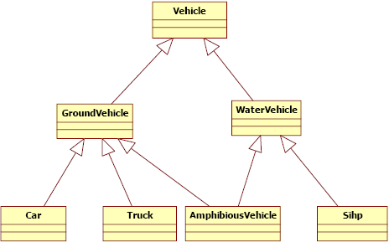
Multiple inheritance

Slide 34
Polymorphism
A Canvas object has a collection of Shape objects where each Shape may be a Square or a Circle
Polymorphism = "many forms"
  A polymorphic operation has many implementations
  Square and Circle provide implementations for the polymorphic operations Shape::draw() and Shape::getArea()
All concrete subclasses of Shape must provide concrete draw() and getArea() operations because they are abstract in the superclass
  For draw() and getArea() we can treat all subclasses of Shape in a similar way - we have defined a contract for Shape subclasses
Canvas
1
shapes
*
Shape
polymorphic
operations
draw( g : Graphics )
getArea() : int
getBoundingArea() : int
abstract superclass
Square
Circle
draw( g : Graphics )
getArea() : int
draw( g : Graphics )
getArea() : int
concrete subclasses
Notes:
© Dr. Jim Arlow 2000 v1.0

Slide 35
What happens?
Each class of object has its own implementation of the draw() operation
On receipt of the draw() message, each object invokes the draw() operation specified by its class
We can say that each object "decides" how to interpret the draw() message based on its class
s1:Circle
1.draw()
2.draw()
s2:Square
:Canvas
3.draw()
s3:Circle
4.draw()
s4:Circle
Notes:
© Dr. Jim Arlow 2000 v1.0

Slide 36
Polymorphism
Polymorphism allows instances of different classes to respond to the same message in different ways.

Slide 37
Content
Methodology
Concepts
Engineering
Notes:
© Dr. Jim Arlow 2000 v1.0

Slide 38
OOA
Produce an Analysis Model of the system’s desired behaviour:
  This model should be a statement of what the system does not how it does it
  We can think of the analysis model as a “first-cut” or “high level” design model
  It is in the language of the business
Inception
Elaboration
Construction
Transition
Notes:
© Dr. Jim Arlow 2000 v1.0

Slide 39
OOA
The analysis model:
-- is always in the language of the business;
-- captures the big picture;
-- contains artifacts that model the problem domain;
-- tells a story about the desired system;
-- is useful to as many of the stakeholders as possible.

Slide 40
How to OOA
Identify noun/verb phrases in use cases
Use a conceptual class category list
Domain analyze
CRC
…

Slide 41
OOD
Decide how the system's functions are to be implemented
Decide on strategic design issues such as persistence, distribution etc.
Create policies to deal with tactical design issues
Inception
Elaboration
Construction
Transition
Notes:
© Dr. Jim Arlow 2000 v1.0

Slide 42
OOD - Principles
Open/Closed Principle, OCP
Liskov Substitution Principle, LSP
Dependency Inversion Principle, DSP
Interface Segregation Principle, ISP

Slide 43
OOD - GRASP
GRASP( General Responsibility Assignment Software Patterns):
􀂄Information Expert
􀂄Creator
􀂄Low Coupling
􀂄High Cohesion
􀂄Controller
Polymorphism
􀂄Indirection
􀂄Pure Fabrication
􀂄Protected Variations

Slide 44
OOD - GoF Patterns
Creational patterns
  1. Abstract Factory
  2. Builder
  3. Factory Method
  4. Prototype
  5. Singleton

Slide 45
OOD - GoF Patterns
Structural patterns
􀂄1. Adapter
􀂄2. Bridge
􀂄3. Composite
􀂄4. Decorator
􀂄5. Facade
􀂄6. Flyweight
􀂄7. Proxy

Slide 46
OOD - GoF Patterns
Behavioral patterns
􀂄1. Chain of Responsibility
􀂄2. Command
􀂄3. Interpreter
􀂄4. Iterator
􀂄5. Mediator
􀂄6. Memento
􀂄7. Observer
􀂄8. State
9. Strategy
10. Template Method
11. Visitor

Slide 47
OOP
Simula,1967
Smalltalk,1960s
C++
Java
C#
Ada

Slide 48
Content
Methodology
Concepts
Engineering
Notes:
© Dr. Jim Arlow 2000 v1.0

