Slide 1
Course Review
Notes:
© Dr. Jim Arlow 2000 v1.0

Slide 2
Content
OO
UML
UP
Notes:
© Dr. Jim Arlow 2000 v1.0

Slide 3
OO
OO method vs. structured method?
OO essential concepts?
- Object
- Class
- Message
- Inheritance
- Polymorphism
…

Slide 4
UML
What is UML?
Why UML?
UML structure?

Slide 5
UML
structural thing
behavioral thing
thing
grouping thing
annotational thing
dependency
basic building block
relationship
association
generalization
realization
diagram
name
scope
rule
visibility
integrity
stereotype
execution
specification
tagged value
adornment
common mechanism
common division
constraint
extensibility mechanism
architecture -- 4+1 view

Slide 6
4+1 View of Architecture
vocabulary
functionality
system assembly
configuration management
Logical view
Implementation view
The 4+1 View of Architecture, Philippe Kruchten, IEEE Software, 12(6) Nov. 1995, p. 45-50
Use case view
behaviour
Process view
Deployment view
performance
scalability
throughput
system topology
distribution delivery
installation
Notes:
© Dr. Jim Arlow 2000 v1.0

Slide 7
Use case model
use case model? Used to?
Model elements of use case diagram?
Actor?
Use case?
Relationship?
Methods?

Slide 8
Class diagram
Class diagram? Used to?
Model elements?
Relationships? Notations?
Differences between aggregation and composition?
Methods?
OOD Principles?
-- OCP, LSP, DIP, ISP

Slide 9
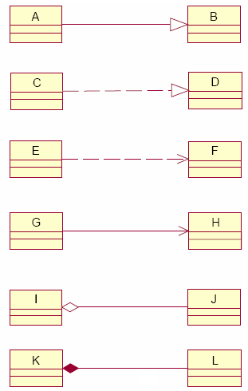
Relationships

Slide 10
Object diagram
Object diagram? Used to?
Model elements?

Slide 11
Package diagram
Package diagram? Used to?
Model elements?
Package? — grouping thing

Slide 12
Interaction diagram
Four types of interaction diagrams?
Model elements of Sequence diagrams?
Communication diagrams?
Interaction overview diagrams are a grafting together of?
Methods?
-- GRASP? Information Expert…

Slide 13
State machine diagram
State machine diagram? Used to?
Model elements?
Methods?

Slide 14
Activity diagram
Activity diagram? Used to?
Model elements?
Decision (branching) and fork?

Slide 15
Component diagram
Component diagram? Used to?
Model elements?
Component?

Slide 16
Deployment diagram
Deployment diagram? Used to?
Model elements?
Node?

Slide 17
UP
Process model?
Phases? Milestones?
Characteristics?

