Slide 1
Object Diagrams
Notes:
© Dr. Jim Arlow 2000 v1.0

Slide 2
Content
Overview
Concepts
Methods
Notes:
© Dr. Jim Arlow 2000 v1.0

Slide 3
Content
Overview
Concepts
Methods
Notes:
© Dr. Jim Arlow 2000 v1.0

Slide 4
Overview
An abstraction denotes the ideal essence of a thing; an instance denotes a concrete manifestation.
For a given abstraction, you can have innumerable instances. For a given instance, there is some abstraction that specifies the characteristics common to all such instances.

Slide 5
Overview
In the UML, you can represent abstractions and their instances.
Most of the time, you’ll work with them as abstractions.
When you want to model concrete manifestations, you’ll need to work with their instances.

Slide 6
Overview
Object diagrams model the instances of things contained in class diagrams.
An object diagram shows a set of objects and their relationships at a point of in time.
An object diagram is a snapshot of the objects in a system at a point in time.

Slide 7
Overview
You use object diagrams to model the static design view or static process view of a system.
Object diagrams are especially useful for modeling complex data structures.

Slide 8
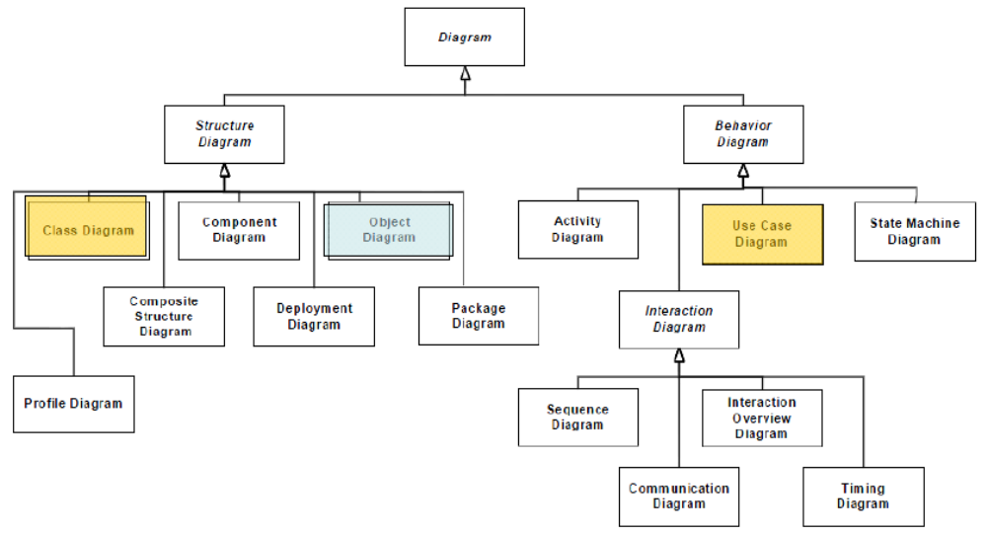
Overview

Slide 9
Content
Overview
Concepts
Methods
Notes:
© Dr. Jim Arlow 2000 v1.0

Slide 10
What are objects?
Objects consist of data and function packaged together in a reusable unit. Objects encapsulate data
Every object is an instance of some class which defines the common set of features (attributes and operations) shared by all of its instances. Objects have:
  Attribute values – the data part
  Operations – the behaviour part
All objects have:
  Identity: Each object has its own unique identity and can be accessed by a unique handle
  State: This is the actual data values stored in an object at any point in time
  Behaviour: The set of operations that an object can perform
Notes:
© Dr. Jim Arlow 2000 v1.0

Slide 11
UML Object Syntax
variants
(N.B. we've omitted the attribute compartment)
object
name
class
name
object identifier
(must be underlined)
object and
class name
jimsAccount : Account
name
compartment
jimsAccount : Account
accountNumber : String = "1234567"
owner : String = "Jim Arlow"
balance : double = 300.00
object name only
jimsAccount
attribute
compartment
class name only
: Account
attribute
name
attribute
type
attribute
value
an anonymous object
All objects of a particular class have the same set of operations. They are not shown on the object diagram, they are shown on the class diagram
Attribute types are often omitted to simplify the diagram
Naming:
  object and attribute names in lowerCamelCase
  class names in UpperCamelCase
Notes:
© Dr. Jim Arlow 2000 v1.0

Slide 12
Classes and objects
Account
Objects are instances of classes
Instantiation is the creation of new instances of model elements
Most classes provide special operations called constructors to create instances of that class. These operations have class-scope i.e. they belong to the class itself rather than to objects of the class
class
accountNumber : String
owner : String
balance : double
withdraw()
deposit()
«instantiate»
«instantiate»
«instantiate»
JimsAccount:Account
fabsAccount:Account
ilasAccount:Account
accountNumber : "801"
owner : "Jim"
balance : 300.00
accountNumber : "802"
owner : "Fab"
balance : 1000.00
accountNumber : "803"
owner : "Ila"
balance : 310.00
objects
objects are instances of classes
Notes:
© Dr. Jim Arlow 2000 v1.0

Slide 13
What is a link?
Links are connections between objects
  Think of a link as a telephone line connecting you and a friend. You can send messages back and forth using this link
Links are the way that objects communicate
  Objects send messages to each other via links
  Messages invoke operations
OO programming languages implement links as object references or pointers. These are unique handles that refer to specific objects
  When an object has a reference to another object, we say that there is a link between the objects
Notes:
© Dr. Jim Arlow 2000 v1.0

Slide 14
What is an association?
association
Club
Person
links instantiate associations
«instantiate»
«instantiate»
«instantiate»
link
bookClub:Club
chairman
jim:Person
Associations are relationships between classes
Associations between classes indicate that there are links between objects of those classes
A link is an instantiation of an association just as an object is an instantiation of a class
Notes:
© Dr. Jim Arlow 2000 v1.0

Slide 15
Class diagrams and object diagrams
A set of class diagrams can be used to completely specify the semantics of your abstraction and their relationships.
With object diagrams, you can’t completely specify the object structure of your system.
For a set of classes in relationship to one another, there may be a multitude of possible configurations of these objects.

Slide 16
Hierarchies and networks
hierarchy
network
A
0..*
B
0..*
0..1
0..*
a1:A
c1:B
b1:B
f1:B
b1:A
c1:A
d1:A
e1:B
d1:B
e1:A
f1:A
g1:A
a1:B
g1:B
an an association hierarchy, each object has zero or one object directly above it
in an association network, each object has zero or many objects directly above it
Notes:
© Dr. Jim Arlow 2000 v1.0

Slide 17
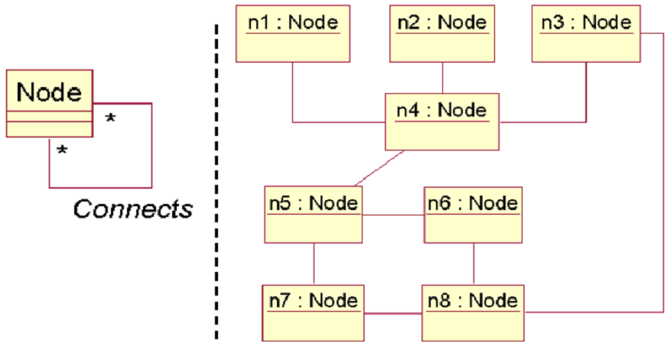
Object diagrams

Slide 18
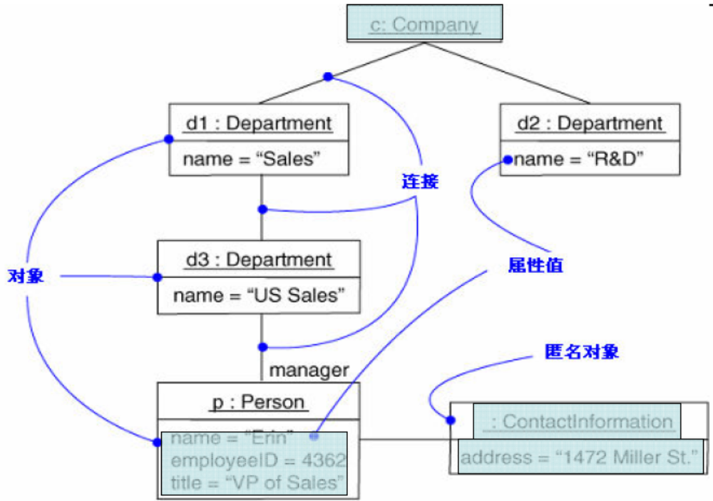
Object diagrams

Slide 19
Content
Overview
Concepts
Methods
Notes:
© Dr. Jim Arlow 2000 v1.0

Slide 20
Methods
If you freeze a running system or just imagine a moment of time in a modeled system, you’ll find a set of objects, each in a specific state and each in a particular relationship to other objects.
You can use object diagrams to visualize the structure of these snapshots.

Slide 21
Methods
Identify the classes, interfaces, and other elements.
Freeze the scenario at a moment in time, render each object that participates in the collaboration.
Expose the state and attribute values of each object as necessary.
Expose the links among these objects.

