Slide 1
Chapter 3 Pulse Modulation
CH3 Problems: (P239-246)
3.2 3.3 3.4 3.5 3.7 3.9 3.14
3.16 3.17 3.27 3.29 3.31 3.34

Slide 2
Chapter 3 Pulse Modulation
3.1 Introduction
3.2 Sampling Process
3.3 Pulse-Amplitude Modulation
3.4 Other forms of Pulse Modulation
3.5 Bandwidth-Noise Trade-off
3.6 Quantization Process
3.7 Pulse-code Modulation
3.8 Noise Considerations in PCM System
3.9 Time-Division Multiplexing
3.10 Digital Multiplexers
3.11Virtues,Limitations, and Modifications of PCM
3.12 Delta Modulations
3.13 Linear Prediction
3.14 Differential Pulse-Code Modulation
3.15 Adaptive Differential Pulse-Code Modulation

Slide 3
3.1 Introduction
What?
A digital Modulation method by using a pulse train as carrier wave.
How?
Some parameter of pulse trains is varied in accordance with the message signal.
Notes:
3.1 Introduction

Slide 4
Classify
  Analog pulse modulation
    use periodic pulse train
    Parameters varied in a continuous manner
    Information transmitted in analog form, but take place at decrete times.

Slide 5
  Digital pulse modulation
    use periodic pulse train
    Parameters varied in a continuous manner
    Information transmitted in digit form as a sequence of coded pulse, with no CW counterpart.
Application
A Basic ingredient in the application of digital communication

Slide 6
3.2 Sampling Process
Key Point:
  Sampling Process
  Reconstruction
  Sampling theorem
  Application
Notes:
3.1 Introduction

Slide 7
Sampling Process
Sampling Process is usually discussed in the time domain.
Basic to digital signal process & digital communication
Operation: Convert an anlog signal into a sequence of samples.
Practically: the sequence must have proper space in that to uiniquely defines the original signal.

Slide 8
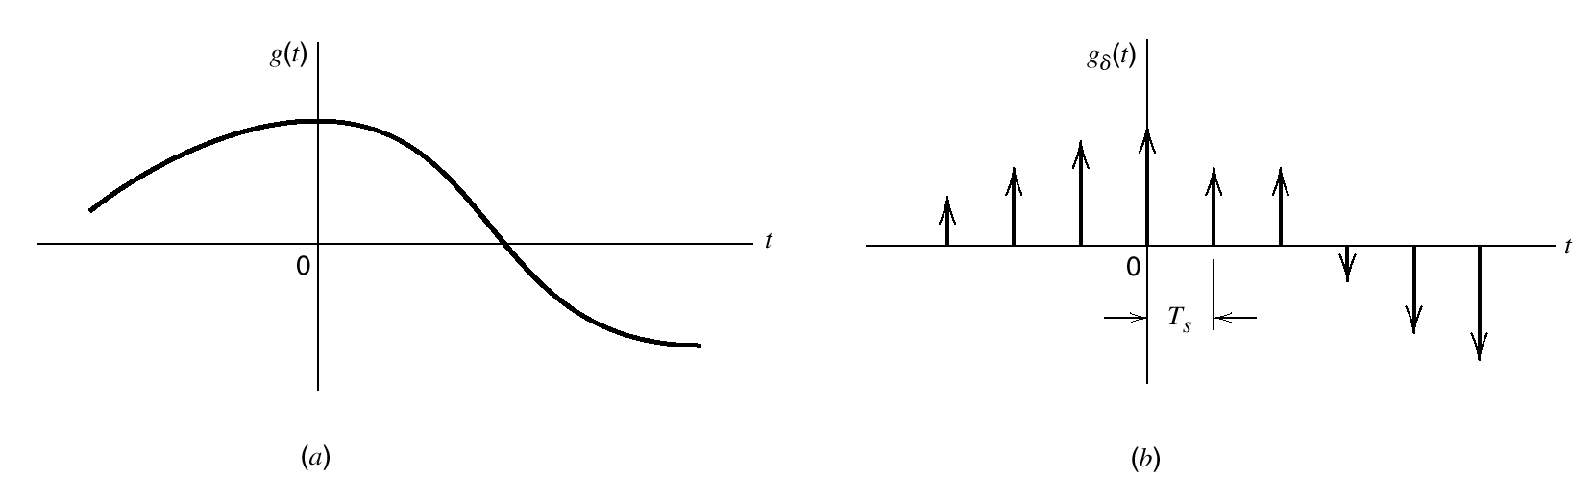
Ex: An arbitrary signal g(t) of finite energy, where t∈Ζ.
Suppose we sample g(t) at uniform rate,once T_{s} second,
We can obtain an infinite sequence with T_{s} second apart and denoted by {g(nT_{s})}, n∈Ζ.
T_{s} is called sampling period,F_{s} = 1/ T_{s} is called sampling rate.Thus,this ideal form of sampling is called instantaneous sampling.（瞬时抽样）. See Figure 3.1
(b) Instantaneously
sampled versions
of the analog signal
(a) Analog signal
Figure 3.1 The sampling process

Slide 9
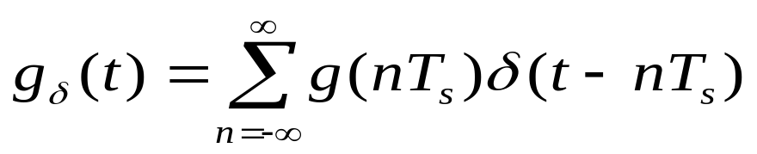
Let g(nT_{s}) multiplex with a periodic sequence of delta function spaced T_{s} second,we can get an ideal sampled signal:
(3.1)
g _{δ}(t) is called as ideal sampled signal. δ(t-nT)represent
a delta function posioned at time t = nT_{s}.
From the definition,we may infer the multiplexed delta function is closely approximated by a rectangular pulse of duration Δt and amplitude g(nT_{s})/ Δt, the smaller we make Δt,the better will be approxiamation.

Slide 10
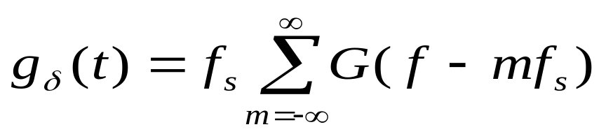
Using the Fourier-transform,we may get:
(3.2)
Where G(f) is Fourier transformation of the original signal g(t),and f_{s} is the sampling rate.
Equation (3.2)state:
The process of sampling a continuous-time signal of finite enerfy result in a periodic spectrum with a period equal to the sampling rate.
That is mean:
The spectrum of a sampled signal is made up of a sequence of periodic spectrum with a period equal to the sampling rate.

Slide 11
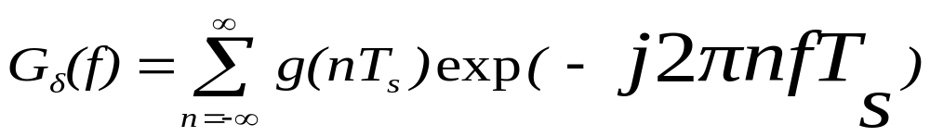
Another usuaful expression for Fourier transformation of the ideal sampled signal g _{δ}(t) is :
(3.3)
G _{δ}(f) denote the Fourier transformation of g _{δ}(t).
The relation defined (3.3) is called diacrete-time Fourier transformation. It may be view as a complex Fourier series representation of the periodic frequency function
G _{δ}(f) .
NOTE:
The relations derived above,apply to an continuous-time
signal g(t) of finite energy and infinite duration.

Slide 12
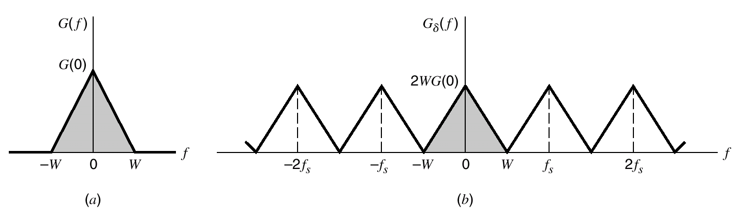
Suppose signal g(t) is strictly band_limited,with no frequency components higher than W Hz,then its Fourier transform G(f) has the property that: G(f) = 0 for | f | ≥W ,see Figure 3.2a.
Choose sampling rate T_{s} = ½ W. Then corresponding spectrum G _{δ}(f) of the signal g _{δ}(t) is as shown in Figure 3.2b.
Figure 3.2 (a) Spectrum of a strictly band-limitted signalg (t)
(b) Spetrum of a sampled version of g(t) for a sampling period T_{s}= ½ W

Slide 13
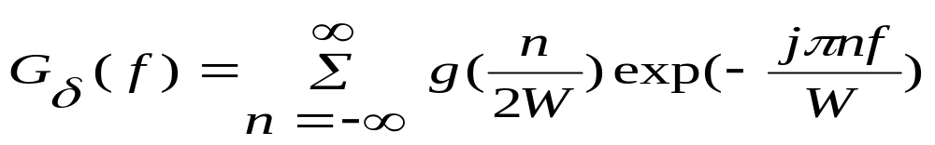
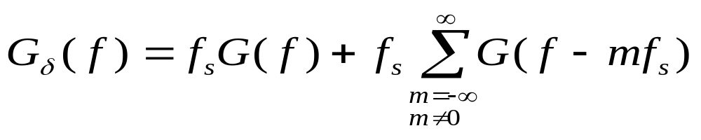
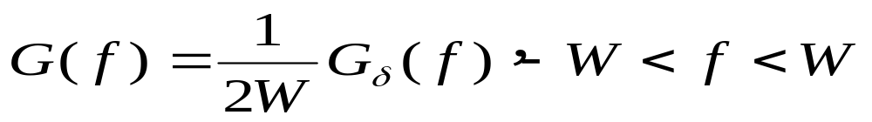
Putting T_{s} = ½ W in equation (3.3) yield
(3.4)
From Equation(3.2),we readily see that the Fourier transform of g _{δ}(t) may also be expressed as:
(3.5)
Using the following two conditions,
1. G(f ) =0 for ⎟ f⎟ ≥ W
2. f_{s} = 2W
We get from (3.5) that
(3.6)

Slide 14
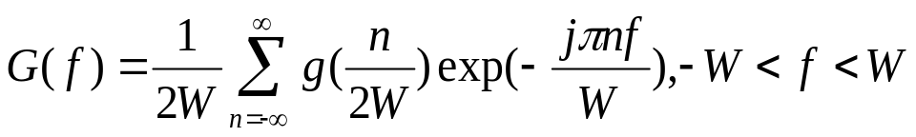
Substitude Equation (3.4) into (3.6), we may also write:
(3.7)
So,if the sampling value g(n/2W) of a signal g(t)are specified for all n,the Fourier transform G(f) of the signal is uniquely determined by the using discrete-time Fourier transform (3.7).
Because g(t) is related to G(f) by the reverse Fourier transform ,it follows that the signal g(t) is itself uniquely determined by the sample value g(n/2W).
That is mean,the sequence {g(n/2W)} has all the information contained in g(t).

Slide 15
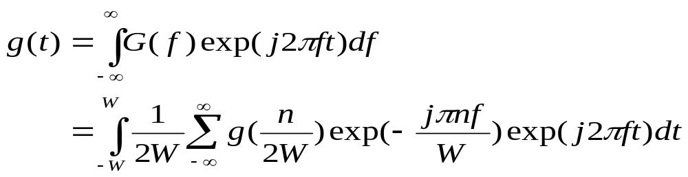
Reconstruction
Consider the problem of reconstructing the signal g(t) from the sequence of sampling values{g(n/2W)}.
Substituting (3.7) in the form of for the inverse Fourier transform defining g(t) in the terms of G(f),we get
Interchanging the order of summation and integration:

Slide 16
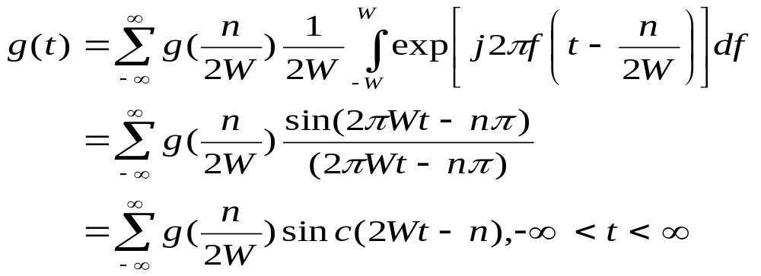
(3.9)
(3.9) provide an interpolation formula(插值公式) for
Reconstructing the original signal g(t) from {g(n/2W)},
sinc(2Wt) playing a role of an interpolation function.
Each sample is multiplied by a delayed version of the
Interpolation function,and all the resulting waveforms
Are added to obtain g(t).

Slide 17
Sampling theorem
sampling theorem :
for band-limited signals of finite energy in two equivalent parts,which apply to the transmitter and receiver of a pulse modulation system,respectively:
  A band-limited signal of finite energy,which has no frequency components higher than W Hertz,is completely described by specifying the values of the signal at instants of time separated by 1/2W seconds
  A band-limited signal of finite energy,which has no frequency components higher than W Hertz,may be recovered from a knowledge of its samples taken at the rate of 2W samples per seconds

Slide 18
The sampling rate of 2W samples per seconds.for a signal bandwidth of W Hertz, is called the Nyquist rate;its reciprocal 1/2W(measured in seconds) is called the Nyquist interval

Slide 19
Application
Problem in practice:
An information bearing signal is not strictly band limited.
So the sampling process may produced some aliasing
(混叠) .
Aliasing refers to the phenomenon of a high-frequency
Components in the spectrum of its sampled version.
See figure 3.3

Slide 20
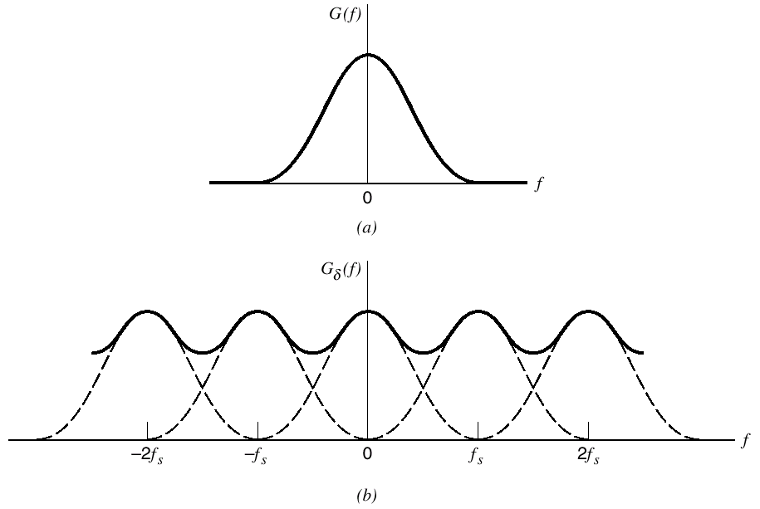
Figure 3.3 ( a) Spectrum of a signal. (b) Spectrum of an undersampled version of the signal exhibiting the aliasing phenomenon.

Slide 21
Two corrective measures
Prior to sampling,a low-pass anti-aliasing filter is used to attenuate(抑制) those high-frequency components of the signal that are not essential to the information being conveyed by the signal
The filter signal is sampled at a rate slightly higher than the Naquist rate.

Slide 22
The use of sampling rate higher than the Nyquist rate also
has the beneficial effect of easing the design of the recon-
struction filter used to recover the original signal from its
sampled version. See figure 3.4.We see
The reconstruction filter is low-pass with a passband extending from –W to W,which is itself determined by the anti-aliasing filter
The filter has a transition band extending(for positive frequencies) from W to f_{s}-W,where f_{s} is the sampling rate.
The fact that the reconstruction filter has a well-defined
transition band means that it is physically realizable.

Slide 23
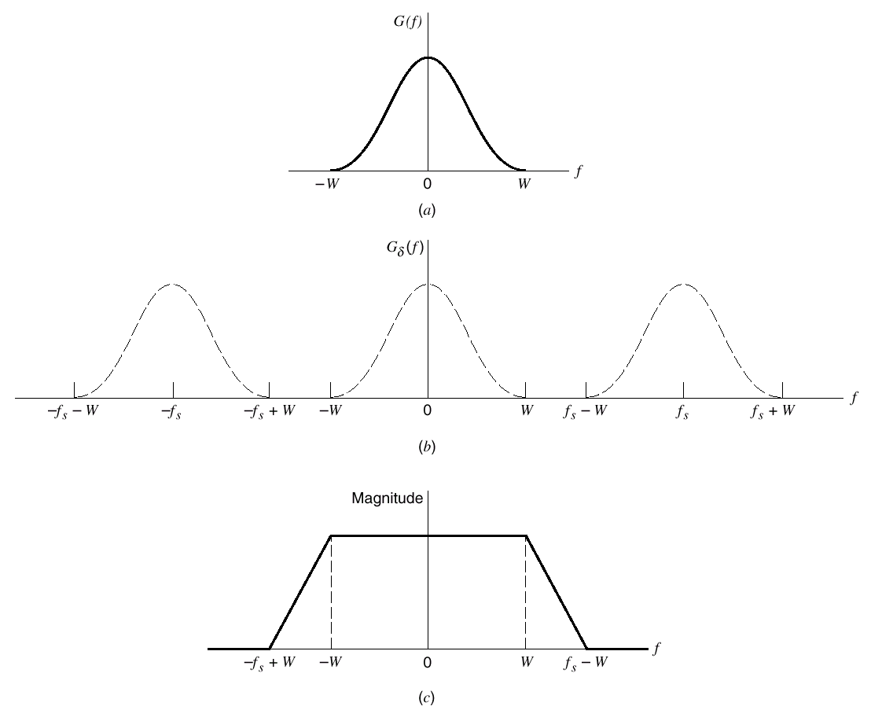
Figure 3.4 (a) Anti-alias filtered spectrum of an information-bearing signal. (b) Spectrum of instantaneously sampled version of the signal, assuming the use of a sampling rate greater than the Nyquist rate. (c) Magnitude response of reconstruction filter.

Slide 24
3.3 Pulse-Amplitude Modulation
Point
  The simplest and most basic form of analog pulse modulation.
  The amplitudes of regularly spaced pulses are varied in proportion to the corresponding sample values of a continuous message signal.
  The top of each modulated rectangular pulse is maintained flat.

Slide 25
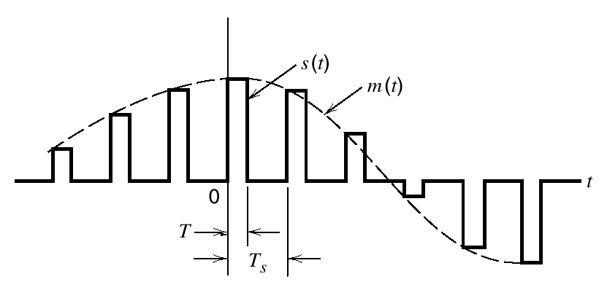
PAM Signal
The dashed curve depicts the waveform of message signal m(t),
The sequence of amplitude-modulated rectangular pulses shown as a solid lines represents the correspond PAM signal s(t).
Figure 3.5 Flat-top amples, representing an analog signal

Slide 26
PAM Sampling Process
Two opration involved in the generation of PAM signal.
Sampling（采样）
  Instantaneous sampling of the message signal m(t) every T_{s} second,where the sampling rate f_{s}=1/T_{s} is chosen in accordance with the sampl-ing theorem.
Hold（保持）
  Lengthening the duration of each sample so obtained to some constant value T.
  T must be chosen to avoid the use of excessive channel bandwidth.

Slide 27
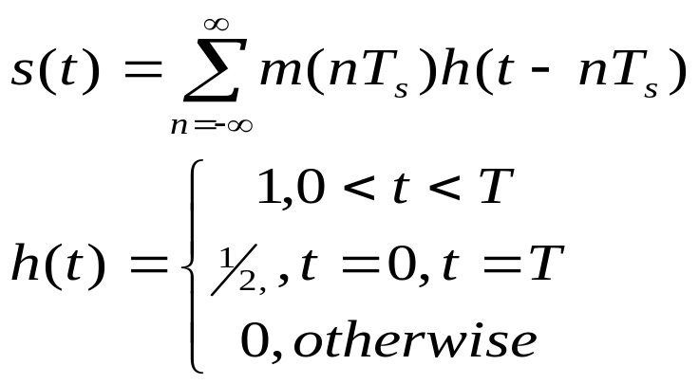
Calculation
See Figure 3.5,let PAM signal:
(3.10)
Let
(3.11)
Where T_{s} is the sampling period and m(nT_{s}) is the sample value of m(t) obtained at time t=nT_{s}.
h(t) is a standard rectangular pulse of unit amplitude and duration T,see Figure 3.6a

Slide 28
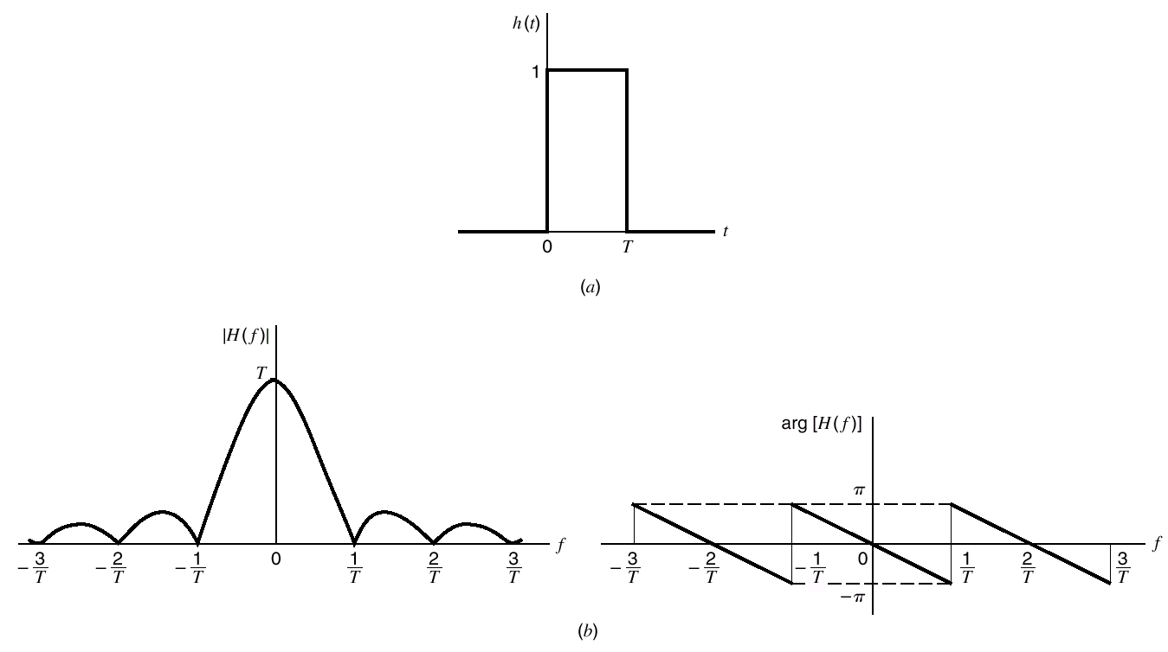
Figure 3.6 (a) Rectangular pulse h(t). (b) Spectrum H(f), made up of the magnitude |H(f)|, and phase arg[H(f)].

Slide 29
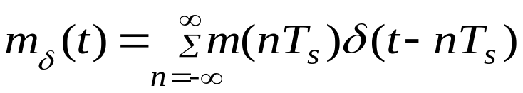
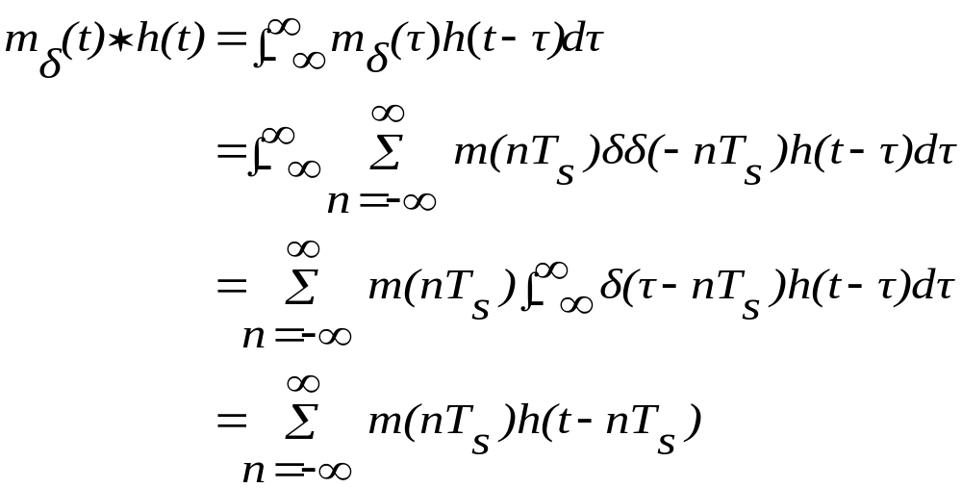
By definition,the instantaneously sampled version of m(t) is given by:
(3.12)
Where δ(t-nT_{s}) is a time shifted delta function, therefore, convolving m_{δ}(t) with the pulse h(t),we get
(3.13)
(3.14)

Slide 30

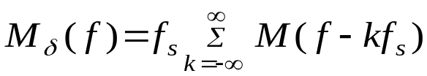
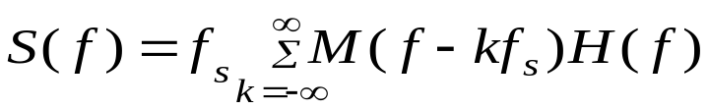
Taking the Fourier transform of both side of (1.15),we get:
(3.16)
Where S(f)=F[s(t)],M _{δ} (f)=F[m _{δ}(t)],andH(f)=F[h(t)],note,
(3.17)
Where fs is the sampling rate.therefore,substitution of Equation(3.17) into (3.16),we get:
(3.18)

Slide 31
PAM Reconstruction
Reconstruction filter
As stated in 3.2,We pay pass PAM sampling signal s(t) through a low-pass filter,whose frequency response is defined in figure 3.4c,and it is assumed that the message is limited to bandwidth W and the sampling rate fs is larger than the Nyquist rate 2W.
Equalizer
From figure 3.6b and (3.18),we see that by using flat-top samples to generate a PAM signal,we have introduced amplitude distortion(幅度失真) and a delay of T/2(时延).
This distortion can be corrected by an equalizer.See Figure 3.7.

Slide 32
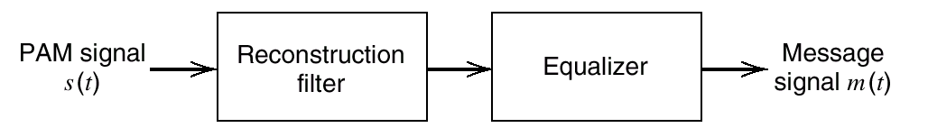
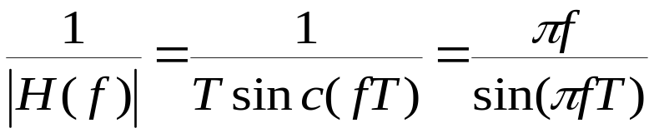
Figure 3.7 System for recovering message signal m(t) from PAM signal s(t).
The magnitude response of the equalizer is given by:
(3.20)
In practical,for a duty cycle T/T_{s} ≤0.01,the amplitude distortion is less than 0.5%,the need for a equalizer may be omitted.

Slide 33
3.4 Other forms of Pulse Modulation
By changing the pulse duration or position,we can get two other modulation modes.(see Figure 3.8)
  PDM
  where samples of the message signal are used to vary the duration of the individual pulses in the carrier.
  PPM
  Where the position of a pulse relative to its un-modulated time of occurrence is varied in accor-dance with the message signal.

Slide 34
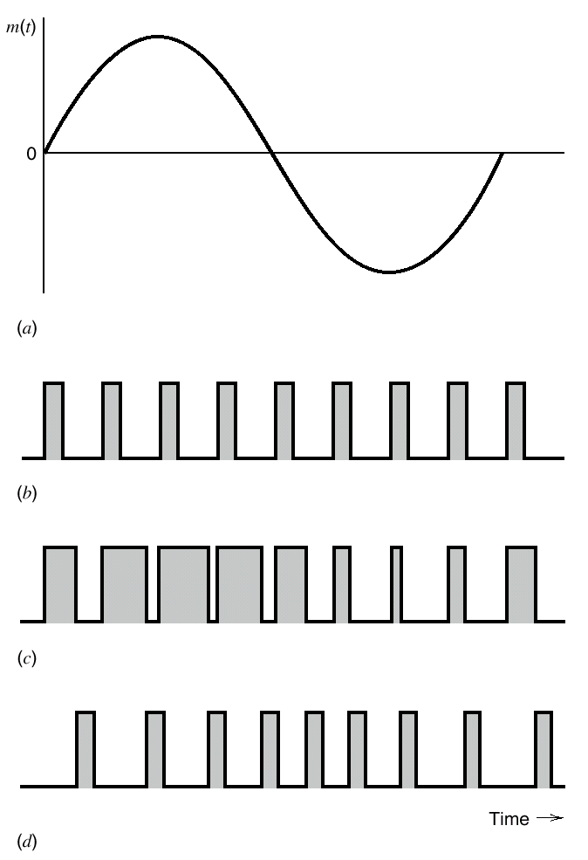
Figure 3.8 Illustrating two different forms of pulse-time modulation for the case of a sinusoidal modulating wave.
(a) Modulating wave. (b) Pulse carrier. (c) PDM wave. (d) PPM wave.

Slide 35
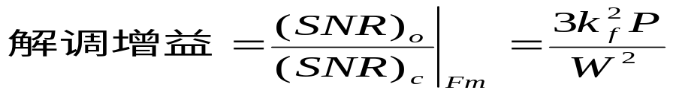
3.5 Bandwidth-Noise Trade-off
PPM Noise Property
  Similar noise property as FM
Both systems have a figure of merit proportional to the square of the transmission bandwidth normalized with respect to the message bandwidth.
Both systems exhibit a threshold effect as the signal-to-noise ratio is reduced.

Slide 36
Trade-off
  Increased transmission bandwidth for improved noise performance.
  Square law can do with CW modulation and analog pulse modulation systems.
If other method exist better than Square law?

Slide 37
PCM
  A basic form of digital pulse modulation known as pulse-code modulation PCM.
  A message signal is represented in discrete form in both time and amplitude
  Two fundamental processes are involved in the generation of a binary PCM wave:sampling and quantization.
  Sampling process takes care of the discrete-time representation of the message signal, follow the sampling theorem described in Section 3.2.
  quantization process takes care of the discrete amplitude representation of the message signal
  realize an exponential(指数) law for the bandwidth noise trade-off.

Slide 38
3.6 Quantization Process
Why
  No need to transmit the exact amplitudes of the samples.
  if the discrete amplitude levels with sufficiently close spacing, we may make the approximated signal practically indistinguishable from the original continuous signal.

Slide 39
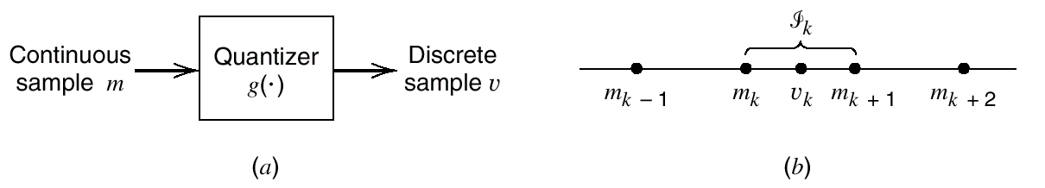
Definition
Amplitude quantization（幅值量化） is defined as the process of transforming the sample amplitude m(nT_{s}) of a message signal m(t) at time t =nT_{s}, into a discrete amplitude v(nT_{s}) taken from a finite set of possible amplitudes.
( Note: the following discussion is assume that the quantization process is memoryless（无记忆的） and instantaneous(瞬时的))
Figure 3.9 Description of a memoryless quantizer.

Slide 40
Basic concept
use the symbol m in place of m(nTs), as indicated in the block diagram of a quantizer shown in Figure 3.9a. Then, as shown in Figure. 3.9b, the signal amplitude m is specified by the index k if it lies inside the partition cell（分隔区间）：
（3.21）
where L is the total number of amplitude levels used in the quantizer. The discrete amplitudes m_{k}, k =1,2,...,L, at the quantizer input are called decision levels or decision thresholds.

Slide 41

At the quantizer output, the index k is transformed into an amplitude v_{k} that represents all amplitudes of the cell ϕ_{k}; the discrete amplitudes v_{k}, k = 1, 2,..., L, are
called representation levels or reconstruction levels, and the spacing between two adjacent representation levels is called a quantum or step-size.
Thus, the quantizer output v equals v_{k} if the input signal sample m belongs to the interval 3k. The mapping (see Figure 3.9a)
(3.22)
is the quantizer characteristic, which is a staircase function by definition.

Slide 42
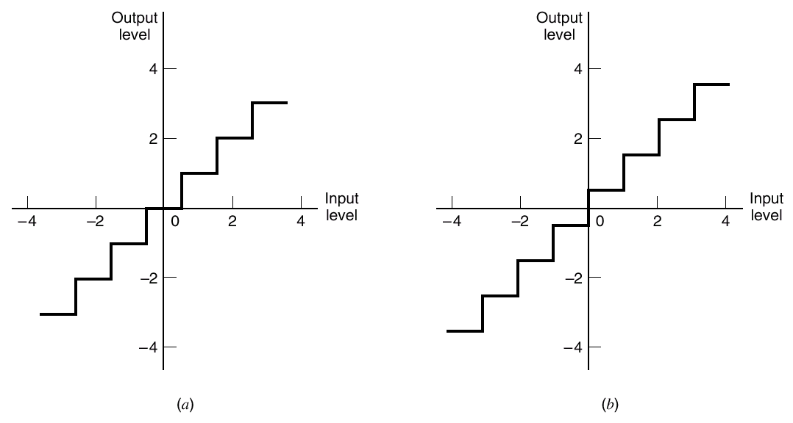
Figure 3.10
Two types of quantization: (a) midtread and (b) midrise.

Slide 43
Quantizer type
  uniform type（均匀量化）
  non-uniform type.（非均匀量化）
Quantizer characteristic
  mid-tread type（中平型）
  mid-rise type（中升型）

Slide 44
QUANTIZATION NOISE
Basic Concept
The error/difference between the input signal m and the quantizer output signal v is called quantization noise.(see Figure 3.11)
Let :
the quantizer input m be the sample value of a zero-mean random variable M.
A quantizer g(*) maps the input random variable M of continuous amplitude into a discrete ramdom variable .Their
respective sample values m and v are related by Equation (3.22)

Slide 45
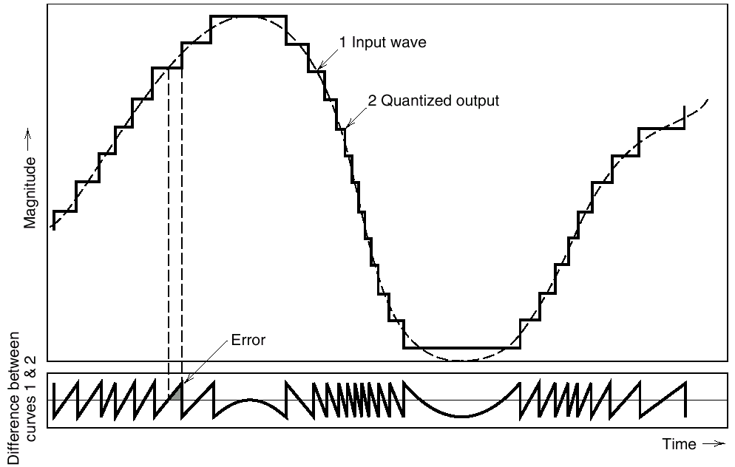
Figure 3.11 Illustration of the quantization process.

Slide 46


Let the quantization error be denoted by the random variable Q of sample value q. We may thus write
(3.23)
Or correspondingly,
(3.24)
Consider input M having zero mean, and the quantizer assumed to be symmetric as in Figure 3.10, it follows that the quantizer output V and therefore the quantization error Q, will also have zero mean.
Thus for a partial statistical characterization of the quantizer in terms of output signal-to-(quantization) noise ratio, we need only find the mean-square value of the quantization error Q.

Slide 47
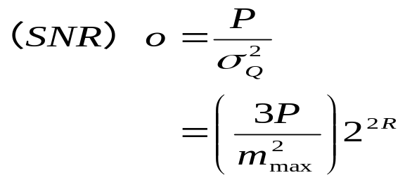
Quantization noise
Let P denote the average power of the message signal m(t). Then express the output signal-to-noise ratio of a uniform quantizer as:
(3.33)
It shows that the output signal-to-noise ratio of the quantizer increases exponentially with increasing number of bits per sample.

Slide 48
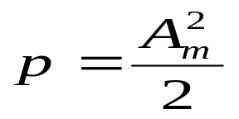
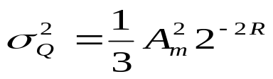
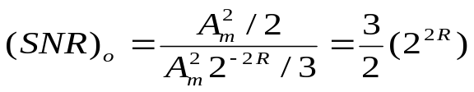
Ex 3.1 Sinusoidal Modulating Signal
Consider the special case of a full-load sinusoidal modulating signal of amplitude Am, which utilizes all the representation levels provided. The average signal power is (assuming a load
of 1 ohm):
The total range of the quantizer input is 2A_{m}, set mmax = Am, from Equation (3.32) ,it yields the average power (variance) of the quantization noise as:
Thus the output signal-to-noise ratio of a uniform quantizer, for a full-load test tone, is

Slide 49
Expressing the signal-to-noise ratio in decibels, we get
10 log10(SNR)o = 1.8 + 6R
Table 3.1 Signal-to-(quantization)noise ratio for varying number of
Representation levels for sinusoidal modulation
Number of representation levels,L | Number of Bits per sample,R | Signal-to-Noise Ratio
32 | 5 | 31.8
64 | 6 | 37.8
128 | 7 | 43.8
256 | 8 | 49.8

Slide 50
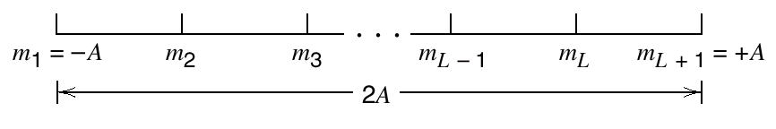
CONDITIONS FOR OPTIMALITY OF SCALAR QUANTIZERS
？How to select the representation levels and surrounding partition cells so as to minimize the average quantization power for a fixed number of representation levels.
Figure 3.12 illustrating the partitioning of the dynamic range −A ≤ m ≤ A of a message signal m(t) into a set of L cells.
In figure 3.12,m(t) is a message signal drawn from a stationary process M(t), -A ≤ m ≤ A denote the dynamic range of m(t),which
is partitioned into a set of L cells, The boundaries of the partition cells are defined by a set of real numbers m₁, m₂,, m_{L+l} that satisfy the following three conditions:m₁=-A,m_{L+1}=A,m_{k} ≤m_{k+1},for all k.

Slide 51
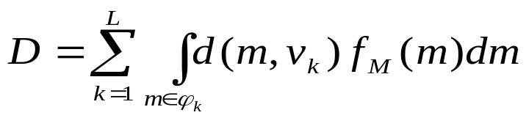

The kth partition cell is defined by: ϕ_{k}:m_{k}<m ≤m_{k+1,}for all k,
The quantizatinn values is denoted by v_{k}, k = 1, 2,..., L.
Assuming d{m, vk) denotes a distortion measure (失真量)for using v_{k} to represent all those values of the input m that lie inside the partition cell ϕ _{k}, the goal is to find the two sets,{v_{k}}^{L}_{k=1} and {ϕ _{k}}^{L}_{k=} that minimize the average distortion:
(3.37)
Where f_{M}(m) is the probability density function of the random variable M with sample value m,and
(3.38)

Slide 52
Structurally speaking, the quantizer consists of two components with Interrelated design parameters:
An encoder characterized by the set of partition ceils {ϕ _{k}}^{L}_{k=} , it is located in the transmitter.
A decoder characterized by the set of representation levels {v_{k}}^{L}_{k=1} ; it is located in the receiver.

Slide 53

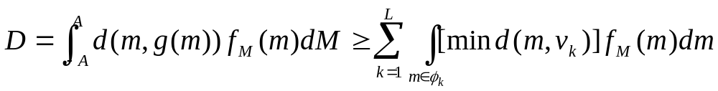

Condition I.Optimality of the Encoder for a Given Decoder
? Given a certain codebook :
Ψ : {v_{k}}^{L}_{k=1} , (3.39)
try to find the set of partition cells {ϕ _{k}}^{L}_{k=} ,that minimizes the average distortion D. That is, we wish to find the encoder defined by the nonlinear mapping :
(3.40)
Such that
(3.41)
So the necessary condition is:
Hold for all j ≠ k
(3.42)

Slide 54
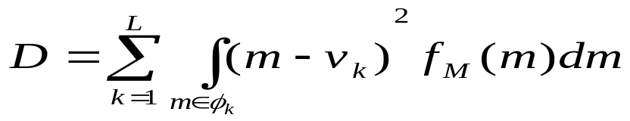
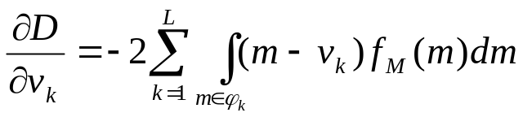
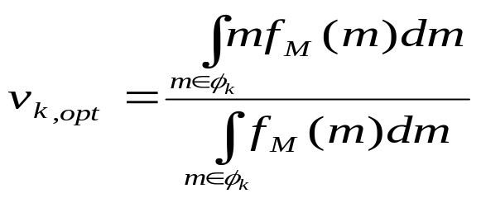
Condition П.Optimality of the Decoder for a Given Encoder
? Given a set of partition cells {ϕ _{k}}^{L}_{k=} ,to find the optimal codebook Ψ : {v_{k}}^{L}_{k=1} ,using average (mean-square) distortion criterion,we get:
(3.43)
differentiate D with respect to the representation level v_{k,}
(3.44)
Set ∂D/ ∂v_{k} equal to zero,we get
(3.45)

Slide 55
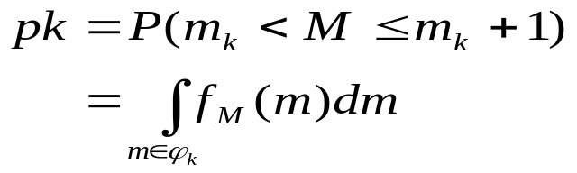

The denominator in Equation (3.45) is just the probability, P_{k}, that the random M with sample value m lies in the partition cell , ϕ _{k}, as shown by:
(3.46)
Accordingly, we may interpret the optimality condition of Equation (3.45) as choosing the representation level v_{k} to equal the condi-tional mean of the random variable M, given that M lies in the partition cell ϕ_{k}. We can thus formally state the condition for optimality of the decoder for a given encoder as follows:
(3.47)
where E is the expectation operator.

Slide 56
Practical design
  Optimizing the encoder in accordance with condition l,
  Then optimizing the decoder in accordance with condition II,
  and continuing in this manner until the average distortion D reaches a minimum.
(An optimum quantizer designed in this manner is called a Lloyd-Max quantizer?

Slide 57
3.7 Pulse-code Modulation
Definition
  A message signal is represented by a sequence of coded pulses, which is accomplished by repre-senting the signal in discrete form in both time and amplitude.
Basic operation
  Sampling
  Quantizing
  Encoding

Slide 58
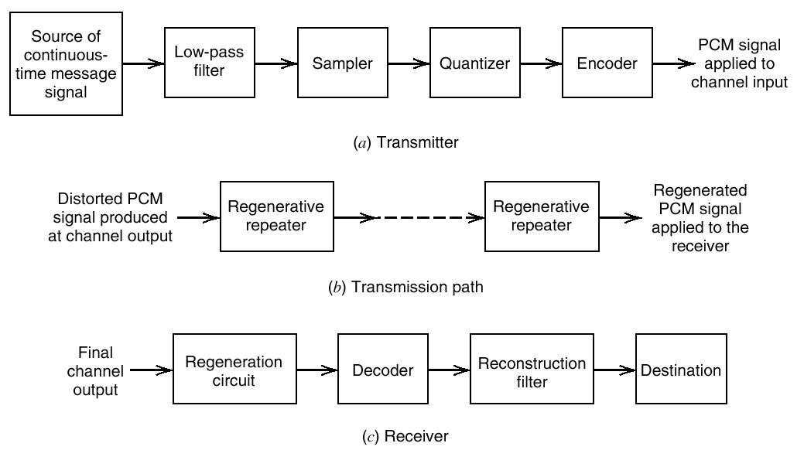
Figure 3.13 The basic elements of a PCM system

Slide 59
SAMPLING
  Using a train of narrow rectangular pulses
  the sampling rate must be greater than twice the highest frequency component W of the message signal.
Thus the application of sampling permits the reduction of the continuously varying message signal (of some finite duration) to a limited number of discrete values per second.

Slide 60
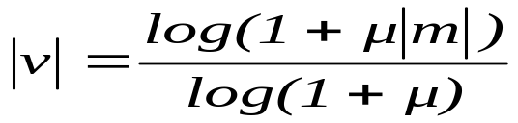
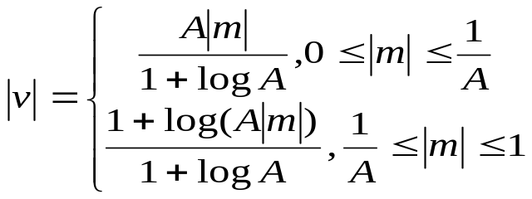
QUANTIZATION
  providing a new representation of the signal that is discrete in both time and amplitude.
  The quantization process may follow uniform law as described in Section 3.6
  Non-uniform quantizer is equivalent to passing the baseband signal through a compressor and then applying the compressed signal to a uniform quantizer.
μ-law
(3.48)
A-law
(3.51)

Slide 61
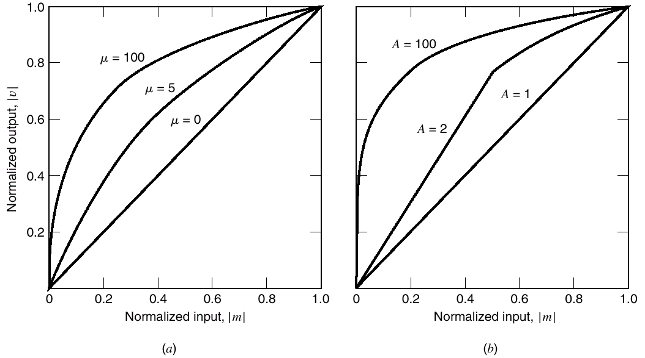
Figure 3.14 Compression laws. (a) μ -law. (b) A-law.

Slide 62
Encoding
  making the transmitted signal more robust to noise, interference and other channel impairments
  the process is to translate the discrete set of sample values to a more appropriate form of signal.
  any plan for representing each of this discrete set of values as a particular arrangement of discrete events is called a code.
    one of the discrete events in a code is called a code element or symbol
    A particular arrangement of symbols used in a code to represent a single value of the discrete set is called a code word or character
    Ex. Binary code

Slide 63
常见习题：
设语音信号的频率范围为：0~4KHz，幅度范围为：－4.8~4.8V，对模拟信号采用奈奎斯特抽样，其某一抽样值为：+1.275V。(或已知为＋1270标准量化单位)
1)采用13折线A律编码，求该抽样值的编码结果（段内码用自然二进制）；
2）求对应7位码的均匀量化11位码。

Slide 64
Line Codes
  any of several line codes can be used for the electrical representation of a binary data stream.
  Unipolar nonreturn-to-zero (NRZ) signaling
  Polar nonreturn-to-zero (NRZ) signaling
  Unipolar return-to-zero (RZ) signaling
  Bipolar return-to zero (BRZ) signaling
  Split-pbase (Mancbester code)c

Slide 65
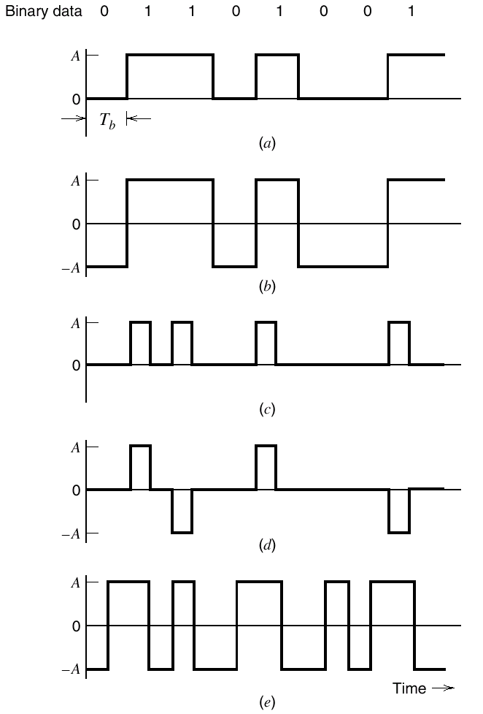
Figure 3.15 Line codes for the electrical representations of binary data.
(a) Unipolar NRZ signaling. (b) Polar NRZ signaling.
(c) Unipolar RZ signaling. (d) Bipolar RZ signaling. (e) Split-phase or Manchester code.

Slide 66
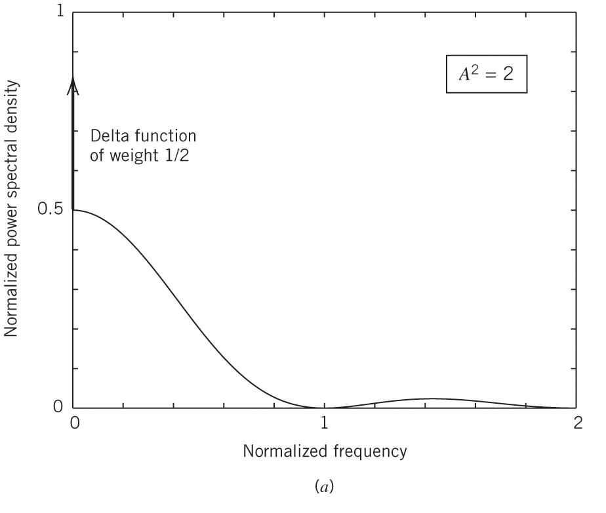
Figure 3.16a Power spectra of line codes: (a) Unipolar NRZ signal. The frequency is normalized with respect to the bit rate 1/T_{b}, and the average power is normalized to unity.
(b) Polar NRZ signal. The frequency is normalized with respect to the bit rate 1/T_{b}, and the average power is normalized to unity.

Slide 67
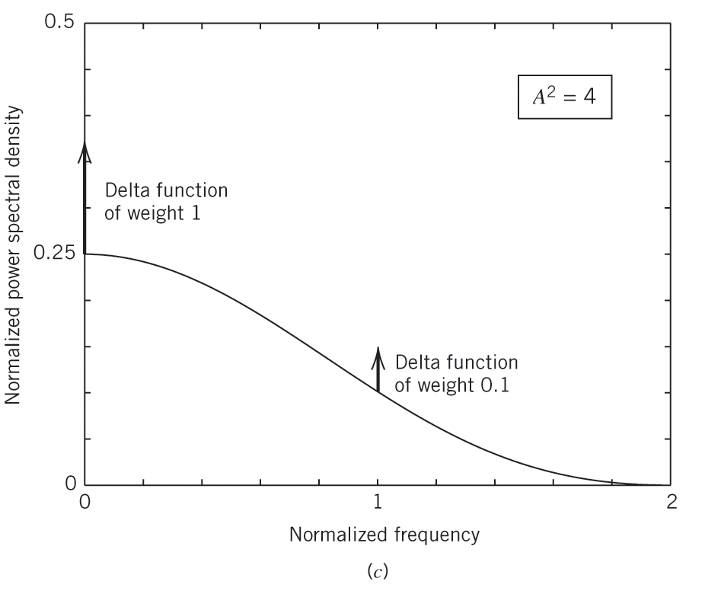
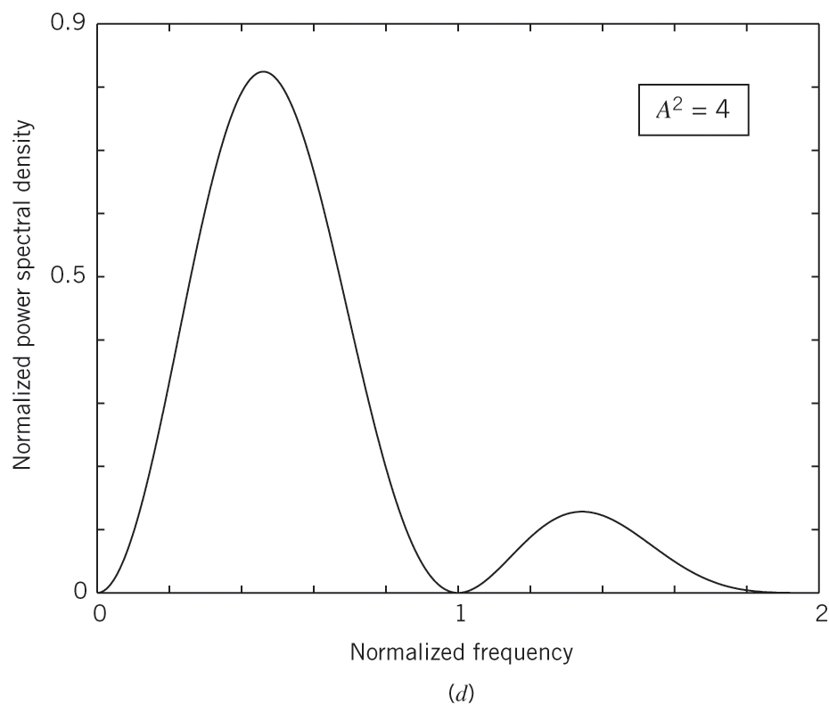
Figure 3.16b Power spectra of line codes: (c) Unipolar RZ signal.
The frequency is normalized with respect to the bit rate 1/T_{b}, and the average power is normalized to unity.
(d) Bipolar RZ signal. The frequency is normalized with respect to the bit rate 1/T_{b}, and the average power is normalized to unity

Slide 68
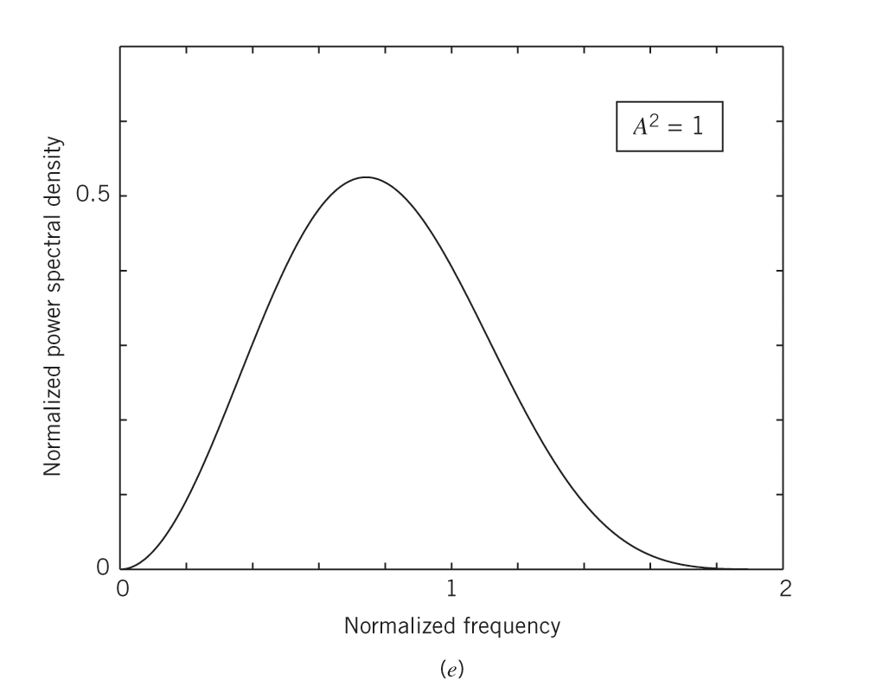
Figure 3.16c Power spectra of line codes: (e) Manchester-encoded signal. The frequency is normalized with respect to the bit rate 1/T_{b}, and the average power is normalized to unity.

Slide 69
Differential Encoding
  used to encode information in terms of signal transitions.
  In particular, a transition is used to designate symbol 0 in the incoming binary data stream, while no transition is used to designate symbol 1. see Figure 3.17

Slide 70
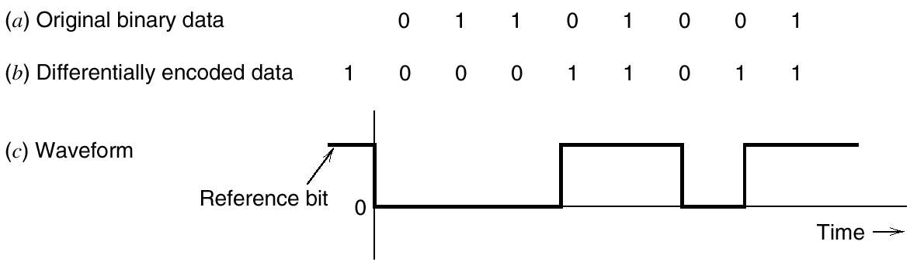
Figure 3.17 (a) Original binary data. (b) Differentially encoded data, assuming reference bit 1. (c) Waveform of differentially encoded data using unipolar NRZ signaling.

Slide 71
REGENERATION
  regenerative repeaters
    Equalization: The equalizer shapes the received pulse so as to compensate for the effects of amplitude and phase distortions produced by the nonideal transmission characteristics of the channel
    Timing: provides a periodic pulse train, derived from the received pulses, for sampling the equalized pulses at the instants of time where the signal-to-noise ratio is a maximum.
    Decision:Each sample so extracted is to a predetermined threshold in the decision-making device.

Slide 72
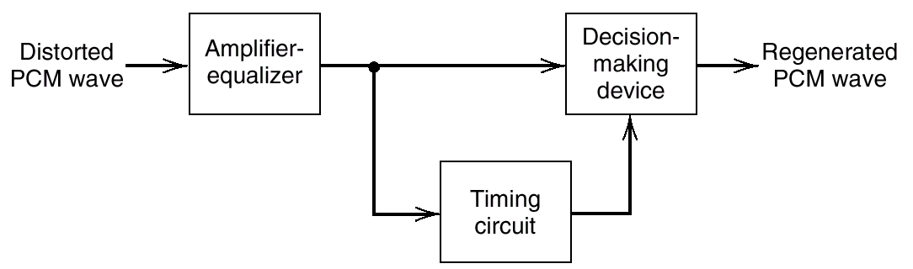
  In practice, the regenerated signal departs from the original signal for two main reasons
    The unavoidable presence of channel noise and inter-ference causes the repeater to make wrong decisions occasionally, thereby introducing bit errors into the re-generated signal.
    If the spacing between received pulses deviates from its assigned value, a jitter(抖动) is introduced into the re-generated pulse position, thereby causing distortion.
Figure 3.18 Block diagram of regenerative repeater.

Slide 73
DECODING
  first operation in the receiver is to regenerate (i.e., reshape and clean up) the received pulses one last time.
  then regrouped these clean pulses into code words and decoded(i.e., mapped back) into a quantized PAM signal.
  The decoding process involves generating a pulse the amplitude of which is the linear sum of all the pulses in the code word, with each pulse being weighted by its place value (2⁰,2¹, 2², ..., 2^{R-1}) in the code, where R is the number of bits per sample.

Slide 74
FILTERING
  recover the message signal by passing the decoder output through a low-pass reconstruction filter whose cutoff frequency is equal to the message bandwidth W.

Slide 75
3.8 Noise Considerations in PCM System
Noise types
  Channel noise
    which is introduced anywhere between the transmitter output and the receiver input. Channel noise is always present, once the equipment is switched on.
    introduce bit errors into the received signal.
    the average probability of symbol error or bit error rate (BER) is use to describe the probability that the reconstructed symbol at the receiver output differs from the transmitted binary symbol.
    it is customary to model the channel noise as additive, white, and Gaussian.

Slide 76
  Quantization noise
    be introduced in the transmitter and is carried all the way along to the receiver output.
    be signal dependent in the sense that it disappears when the message signal is switched off.
    under the designer's control
    It can be made negligibly small through the use of an adequate number of representation levels in the quantizer and the selection of a companding strategy matched to the characteristics of the type of message signal being transmitted.

Slide 77
ERROR THRESHOLD
  symbol error depends solely on E_{b}/N₀: defined as the ratio of the transmitted signal energy per bit E_{b}, to the noise spectral density N₀.
  For E_{b}/N₀ below the error threshold，the receiver performance involves significant numbers of errors, and above it，the effect of channel noise is practically negligible.
  For all practical purposes, the transmission requirements for a PCM link are almost independent of the physical length of the communication channel.
  If an adequate margin over the error threshold, a PCM system is robust to channel noise and interference

Slide 78
E_{b}/N₀ | Probability of Error P_{e} | For a Bit Rate of 100Kb/s, this is about One Error Every
4.3 dB | 10⁻² | 10⁻³ Second
8.4 | 10⁻⁴ | 10⁻¹ Second
10.6 | 10⁻⁶ | 10 Second
12.0 | 10⁻⁸ | 20 minutes
13.0 | 10⁻¹⁰ | 1day
14.0 | 10⁻¹² | 3 months
Table 3.3 Influence of E_{b}/N₀ on the probability of error

Slide 79
3.9 Time-Division Multiplexing
TDM system
  enables the joint utilization of a common communication channel by a plurality of independent message sources without mutual interference among them.
  synchronization is essential for a satisfactory operation of the system.
  be highly sensitive to dispersion(弥散) in the common channel.

Slide 80
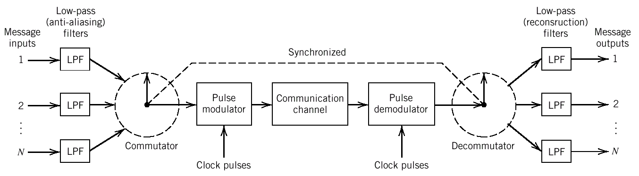
Figure 3.19 Block diagram of TDM system.

Slide 81
TDM System Construction
  a low-pass anti-aliasing filter，to remove the frequencies that are nonessential to an adequate signal representation.
  Commutator(合成器)，
    to take a narrow sample of each of the N input messages at a rate f_{s} that is slightly higher than 2W
    to sequentially interleave these N samples inside the sampling interval T_{s}

Slide 82
  a pulse modulator, to transform the multiplexed signal into a form suitable for transmission over the common channel
  a pulse demodulator, performs the reverse operation of the pulse modulator.
  Decommutator（分路器）
  low-pass reconstruction filters

Slide 83
SYNCHRONIZATION
  The local clock at the receiver keep the same time as a distant standard clock at the transmitter
  set aside a code element or pulse at the end of a frame and to transmit this pulse every other frame only to keep synchronization.
  by setting up an orderly procedure for detecting the synchronizing pulse to carrying out a synchronization process.
EXAMPLE 3.2 The TI System

Slide 84
3.10 Digital Multiplexers
Basic Concept
  the multiplexing of digital signals at different bit rates.
  combine several digital signals, such as computer outputs, digitized voice signals, digitized facsimile, and television signals, into a single data stream (at a considerably higher bit rate than any of the inputs).

Slide 85
Digital multiplex process
  using a bit-by-bit interleaving procedure with a selector switch that sequentially takes a bit from each incoming line and then applies it to the high-speed common line.
  At the receiving end of the system the output of this common line is separated out into its low-speed individual components and then delivered to their respective destinations.

Slide 86

Figure 3.20 Conceptual diagram of multiplexing-demultiplexing.

Slide 87
two major groups Digital multiplexers
  one is used to take relatively low bit-rate data streams originating from digital computer and multiplex them for TDM transmission over the public switched telephone network.
  the second group of digital multiplexers forms part of the data transmission service provided by telecommunication carriers such as AT&T. In particular, these multiplexers constitute a digital hierarchy that time-division multiplexes low-rate bit streams into much higher-rate bit streams.

Slide 88
Ex. North American digital TDM hierarchy
  The first-level hierarchy combines twenty-four DS0 bit streams to obtain a digital signal one (DS1) at 1.544 Mb/s, which is carried on the T1 system described in Example 3.2
  The second-level multiplexer combines four DS1 bit streams to obtain a digital signal two (DS2) at 6.312 Mb/s.
  The third-level multiplexer combines seven DS2 bit streams to obtain a digital signal three (DS3) at 44.736 Mb/s.
  The fourth-level multiplexer combines six DS3 bit streams to obtain a digital signal four (DS4) at 274.176 Mb/s.
  The fifth-level multiplexer, the final one in the hierarchy, combines two DS4 bit streams to obtain a digital signal five (DSS) at 560.160 Mb/s.

Slide 89
Digital Multiplexer Design
  Digital signals cannot be directly interleaved into a format that allows for their eventual separation unless their hit rates are locked to a common clock. Rather, provision has to be made for synchronization of the incoming digital signals, so that they can be properly interleaved.
  The multiplexed signal must include some form of framing so that its individual components can be identified at the receiver.
  The multiplexer has to handle small variations in the bit rates of the incoming digital signals.

Slide 90
Bit Stuffing
  To tailor the requirements of synchronization and rate adjustment to accommodate small variations in the input data rates.
  the idea is to have the outgoing bit rate of the multiplexer slightly higher than the sum of the maximum expected bit rates of the input channels by stuffing in additional non information carrying pulses.
Example 3.2 Signal Format of the AT&T MI2 Multiplexer

Slide 91
3.11Virtues,Limitations, and Modifications of PCM
Advantages
  Robustness to channel noise and interference.
  Efficient regeneration of the coded signal along the transmission path.
  Efficient exchange of increased channel bandwidth for improved signal-to-noise ratio, obeying an exponential law.
  A uniform format for the transmission of different kinds of baseband signals, hence their integration with other forms of digital data in a common network.
  Comparative ease with which message sources may be dropped or reinserted in a time-division multiplex system.
  Secure communication through the use of special modulation schemes or encryption;

Slide 92
Limitations and Modifications
  System Complexity
    using cost-effective commercially available and/or custom-made very-large-scale integrated (VLSI) chips.
    use delta modulation as an alternative to pulse-code modulation.
  Channel Bandwidth
    the increasing availability of wideband communication channels
    using sophisticated data compression techniques.

Slide 93
3.12 Delta Modulations
an incoming message signal is oversampled (i.e., at a rate much higher than the Nyquist rate) to purposely increase the correlation between adjacent samples of the signal.
The principal virtue of delta modulation is its simplicity.
two types of quantization error
  slope overload distortion (斜率过载失真)
  granular noise（颗粒噪声）

Slide 94

Figure 3.22 Illustration of delta modulation.

Slide 95


Figure 3.23
DM system.
(a) Transmitter. (b) Receiver.

Slide 96

Figure 3.24 Illustration of the two different forms of quantization error in delta modulation.

Slide 97
DELTA-SIGMA MODULATION
  Integrating the message signal prior to delta modulation
  The low-frequency content of the input signal is pre emphasized.
  Correlation between adjacent samples of the delta modulator input is increased, which tends to improve overall system performance by reducing the variance of the error signal at the quantizer input.
  Design of the receiver is simplified.

Slide 98

Figure 3.25
Two equivalent versions of delta-sigma modulation system.

Slide 99

3.13 Linear Prediction
Consider a finite-duration impulse response (FIR) discrete-time filter configured as in Figure 3.26:
  Set of p unit-delay elements, each of which is represented by z⁻¹.
  Set of multipliers involving the filter coefficients w₁, w₂, . .,W_{p}.
  Set of “adders” used to sum the scaled versions of the delayed inputs x[n - 1],x[n – 2], …, x[n-p] to produce the output ŷ[n]. The filter output ŷ[n] or more precisely, the linear prediction of the input, is thus defined by the convolution sum.
（3.59）
Where p,the number of unit-delay elements,is called prediction order

Slide 100

Figure 3.26
Block diagram of a linear prediction filter of order p.

Slide 101


The actual sample at time nT_{s}, is x[n],
The prediction error, denoted by e[n], is defined as:
（3.60）
Object
choose the filter coefficients w₁, w₂,..., w_{p} so as to minimize an index of performance(性能指数), J, defined as the mean-square error:
（3.61）

Slide 102



Wiener-Hopf equations and its matrix form
（3.64）
Let:
Get:
（3.65）

Slide 103


assume that the autocorrelation matrix Rx is nonsingular,
（3.66）
The minimum mean-square value of the prediction error is obtained:
（3.67）
the optimum linear predictor defined by Equation (3.67) is always less than the variance σ²_{x} of the input sample that is being predicted.

Slide 104
Toeplitz Matrix
  Definition
    all the elements on the main diagonal of the autocorrelation matrix Rx are equal to Rx[0] = σ²_{x}
    the elements on any other diagonal parallel to the main diagonal are equal.
  Significance
    the correlation matrix R_{x} is uniquely defined by the set of autocorrelation values R_{x}[0], R_{x}[l], ...,R_{x}[p - 1].
    The autocorrelation vector r_{x} is defined by the set of autocorrelation values R_{x}[1], R_{x}[2],..., R_{x}[p].

Slide 105
LINEAR ADAPTIVE PREDICTION
  Computation of the tap weights w_{k}, k = 1, 2,..., p, proceeds in a "recursive” manner, starting from some arbitrary initial values of the tap weights.
  The algorithm used to adjust the tap weights (from one iteration to the next) is "self-designed," operating solely on the basis of available data.
  The aim of the algorithm is to find the minimum point of the bowl-shaped error surface that describes the dependence of the cost function J on the tap weights.
  successively adjust the tap-weights of the predictor in the direction of the steepest descent of the error surface, that is, in a direction opposite to the gradient vector (梯度矢量)

Slide 106



gradient vector：
(3.68)
Let w_{k}[n] denote the value of the kth tap-weight at iteration n. Then the updated value of this weight at iteration n+1 is defined by:
(3.69)
where μ is a step-size parameter that controls the speed of adaptation, and the factor 1/2 is included for convenience of presentation. Differentiating the cost function J of Equation (3.63) with respect to wk we readily find that :
(3.70)

Slide 107



Using instantaneous values as estimates of the autocorrelation functions Rx[k] and Rx[k –j], may express the corresponding estimate of g_{k} at iteration as:
(3.71)
substituting Equation (3.71) into (3.69) and factoring the common term x[n - k],
(3.72)
Where :
(3.73)
ŵ_{k} is an estimate of the kth tap-weight to distinguish it from the actual value w_{k}.

Slide 108
least-mean-square (LMS) algorithm
  Constituted by Equations (3.72) and (3.73)
  Its operation is depicted in Figure 3.27. the computational complexity of the algorithm, measured in terms of the number of additions and multiplications, is linear in the prediction order p.
  a stochastic adaptive filtering algorithm. stochastic means it start from the initial condition defined by{wk[0]}^{p}_{k=1}, and seeks to find the minimum point of the error surface by following a zig-zag path. Moreover, it never finds this mini-mum point exactly. Rather, it executes a random motion around the minimum point of the error surface, once steady-state conditions are established.

Slide 109

Figure 3.27
Block diagram illustrating the linear adaptive prediction process.

Slide 110
3.14 Differential Pulse-Code Modulation.
High degree of correlation in sampled signal
  the signal does not change rapidly from one sample to the next, and the difference between adjacent samples has a variance that is smaller than the variance of the signal itself.
  the resulting encoded signal contains redundant information.

Slide 111
Differential pulse-code modulation.(DPCM)
  removing the redundant information before encoding, and obtain a more efficient coded signal
  using a linear prediction filter to produce predicted a future value of the signal. as in Figure 3.28a, By encoding the quantizer output, we obtain a variant of PCM known as differential pulse-code modulation (DPCM).
  Differential pulse-code modulation includes delta modulation as a special case.
  is subject to slope-overload distortion and quantization noise.

Slide 112

Figure 3.28 DPCM system. (a) Transmitter. (b) Receiver.

Slide 113


PROCESSING GAIN
The output signal-to-noise ratio of the DPCM system shown in Figure 3.28 is defined as:
(3.79)
where σ²_{M} is the variance of the original input sample m[n], assumed to be of zero mean, and σ²_{Q} is the variance of the quantization error q[n]. We may rewrite Equation (3.79) as the product of two factors as follows:
(3.80)
where σ²_{E} is the variance of the prediction error. The factor (SNR)_{Q} is the signal-to-quantization noise ratio, defined by:

Slide 114


(3.81)
The other factor G_{p} is the processing gain produced by the differential quantization scheme; it is defined by
(3.82)
The quantity G_{p}, when greater than unity, represents a gain in signal-to-noise ratio that is due to the differential quantization scheme of Figure 3.28. Now, for a given baseband (message) signal, the variance σ²_{M} is fixed, so that G_{p} is maximized by minimizing the variance σ²_{E} of the prediction error e[n].

Slide 115
Conclusions:
  In the case of voice signals, the optimum signal-to-quantization noise advantage of DPCM over standard PCM is in the neighborhood of 4 to 11 dB.
  For a constant signal-to-quantization noise ratio, and a 8 kHz sampling rate, the use of DPCM may provide a saving of about 8 to 16 kb/s (i.e., 1 to 2 bits per sample) compared to the standard PCM.

Slide 116
3.15 Adaptive Differential Pulse-Code Modulation
Background
  limited channel bandwidth
  need for coding at low bit rates, while maintaining acceptable fidelity or quality of reproduction.
Design Philosophy
  To remove redundancies from the speech signal as far as possible.
  To assign the available bits to code the non-redundant parts of the speech signal in a perceptually efficient manner.

Slide 117
ADPCM
  Use of adaptive quantization and adaptive prediction;
  Coding rate of speech at 32 kb/s, the number of eight bits per sample required in the standard PCM is thereby reduced to four.
  Now accepted internationally as a standard coding technique for voice signals, along with 64 kb/s using standard PCM.

Slide 118
Adaptive Quantization
  quantizer operates with a time-varying step-size Δ [n]
  Adaptive quantization with forward estimation (AQF), in which unquantized samples of the input signal are used to derive forward estimates of σ _{M}[n].
  Adaptive quantization with backward estimation (AQB), in which samples of the quantizer output are used to derive backward estimates of σ _{M}[n].

Slide 119

Figure 3.29 Adaptive quantization with backward estimation (AQB).

Slide 120
Adaptive Prediction
  Adaptive prediction with forward estimation (APF), in which unquantized samples of the input signal are used to derive estimates of the predictor coefficients.
  Adaptive prediction with backward estimation (APB), in which samples of the quantizer output and the prediction error are used to derive estimates of the predictor coefficients.

Slide 121

Figure 3.30 Adaptive prediction with backward estimation (APB).

Slide 122
3.16 Computer Experiment:Adaptive Delta Modulation
ADM Algorithms Principle
  If successive errors are of opposite polarity, then the delta modulator is operating in its granular mode; in this case, it may be advantageous to reduce the step size.
  If successive errors are of the same polarity, then the delta modulator is operating in its slope-overload mode; in this second case, the step size should be increased.

Slide 123

Figure 3.31 Adaptive delta modulation system: (a) Transmitter. (b) Receiver.

Slide 124

Figure 3.31 shows the block diagram of an ADM based on increasing or decreasing the step size by a factor of 50 percent at each iteration of the adaptive process. The algorithm for adaptation of the step size is defined by:
(3.84)
where Δ[n] is the step size at iteration (time step) n of the algorithm, and m_{q}[n] is the 1-bit quantizer output that equals ±1.

Slide 125
Experiment Purpose
  using a sinusoidal input signal to demonstrate the reconstruction performance of the ADM algorithm based on Equation (3.84)
  Compare it to the performance of a linear delta modulator (LDM).

Slide 126



Experiment Details
  Input signal:
where amplitude A=10, frequency f_{m}= f_{s}/l00, and f_{s}= sampling frequency.
Linear delta modulation (LDM):
Adaptive delta modulation (ADM):

Slide 127
Conclusion
  ADM tracks changes in the sinusoidal input signal much better than LDM.This improvement is due to adaptation of the step size in successive iterations of the algorithm.
  In particular, the reduced step size of the ADM results in smaller quantization errors near the extremities of the input signal than the LDM. However, both modulation schemes produce comparable quantization errors in regions of the input signal where the slope is moderately high.
  The improved tracking performance of the ADM results in an output signal with a much lower bit rate, on the average, than the LDM.

Slide 128

Figure 3.32 Waveforms resulting from the computer experiment on delta modulation: (a) Linear delta modulation. (b) Adaptive delta modulation.

Slide 129
3.17 MPEG Audio Coding Standard
本节自学

