Slide 1
Problems: (P300-308)
Chapter 4 Baseband Pulse Transmission
4.1 4.2 4.3 4.5 4.6 4.8 4.11 4.14 4.16 4.17 4.19 4.21 4.22 4.25 4.34 4.37

Slide 2
Chapter 4 Baseband Pulse Transmission
The matched filter, which is the optimum system for detecting a known signal in additive white Gaussian noise.
Calculation of the bit error rate due to the presence of channel noise.
Inter symbol interference, which arises when the channel is dispersive as is commonly the case in practice.
Nyquist's criterion for distortionless baseband data transmission.
Correlative-level coding or partial-response signaling for combating the effects of intersymbol interference.
Digital subscriber lines
Equalization of a dispersive baseband channel.
The eye pattern for displaying the combined effects of intersymbol interference and channel noise in data transmission.

Slide 3
4.1 Introduction
Transmission of digital data over a baseband channel
  Digital data have a broad spectrum with a significant low-frequency content.
  Requires the use of a low-pass channel with a bandwidth large enough to accommodate the essential frequency content of the data stream
Source of Noise
  Intersymbol interference (ISI).
  Channel noise
How to detect a pulse signal of known waveform that is immersed in additive white noise?

Slide 4
4.2 Matched Filter
What ?
  A linear-time-invariant filter, for its impulse response is matched to the pulse signal.
  For detecting a pulse transmitted over a channel that is corrupted by channel noise (i.e., additive noise at the front end of the receiver).

Slide 5


Consider then the receiver model shown in Figure 4.1
(4.1)
Where T is an arbitrary observation interval. The pulse signal g(t) may represent a binary symbol 1 or 0 in a digital communication system. The w(t) is the sample function of a white noise process of zero mean and power spectral density N₀/2.
The function of the receiver is to detect the pulse signal g(t) in an optimum manner, given the received signal x(t). So we have to optimize the design of the filter so as to minimize the effects of noise at the filter output in some statistical sense, and thereby enhance the detection of the pulse signal g(t). Since the filter is linear, the resulting output y(t) may be expressed as
(4.2)
where g_{o}(t) and n(t) are produced by the signal and noise components of the input x(t), respectively.

Slide 6
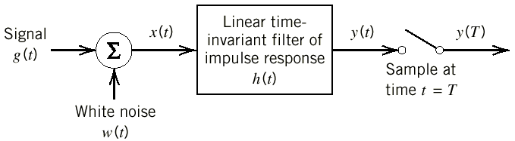
Figure 4.1 Linear receiver.

Slide 7
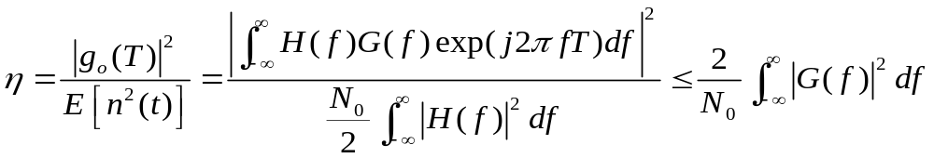
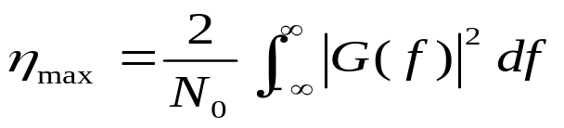
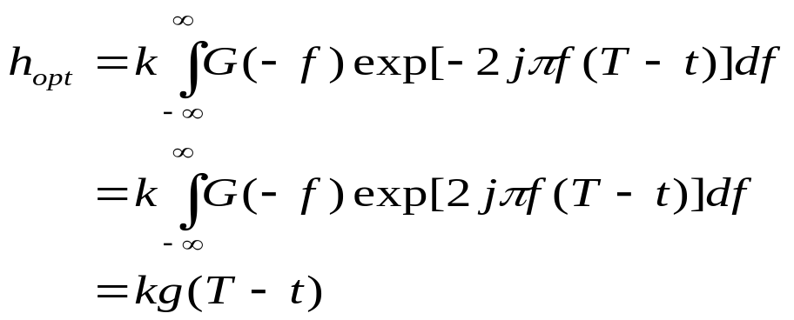
the peak pulse signal-to-noise ratio at time t = T is defined as:
then
(4.13)
So the impulse response of the optimum filter is as:
(4.15)
for a real signal g(t) we have G'(f) = G(-f), we may get:
(4.16)

Slide 8
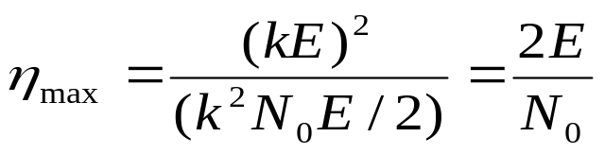
Properties of Matched Filters
  The peak pulse signal-to-noise ratio of a matched filter depends only on the ratio of the signal energy to the power spectral density of the white noise at the filter input.
(4.20)
E/N_{o} is refer to as the signal energy-to-noise spectral density ratio.
It can be seen that dependence on the waveform of the input g(t) has been completely removed by the matched filter.
Accordingly, for all signals with same energy, the ability of
matched-filter receiver to combat additive white noise are equally effective.

Slide 9
Example 4.1 Matched Filter for Rectangular Pulse
  signal g(t) is a rectangular pulse of amplitude A and duration T, the impulse response h(t) of the matched filter has exactly the same waveform as the signal itself, as shown in Figure 4.2a.
  The output signal go(t) of the matched filter produced in response to the input signal g(t) has a triangular waveform, as shown in Figure 4.2b.
  The maximum value of the output signal g_{o}(t) is equal to kA²T, which is the energy of the input signal g(t) scaled by the factor h; this maximum value occurs at t - T, as indicated in Figure 4.2b.
  For the special case of a rectangular pulse, the matched filter may be implemented using a circuit known as the integrate-and-dump circuit, as shown in Figure 4.3

Slide 10
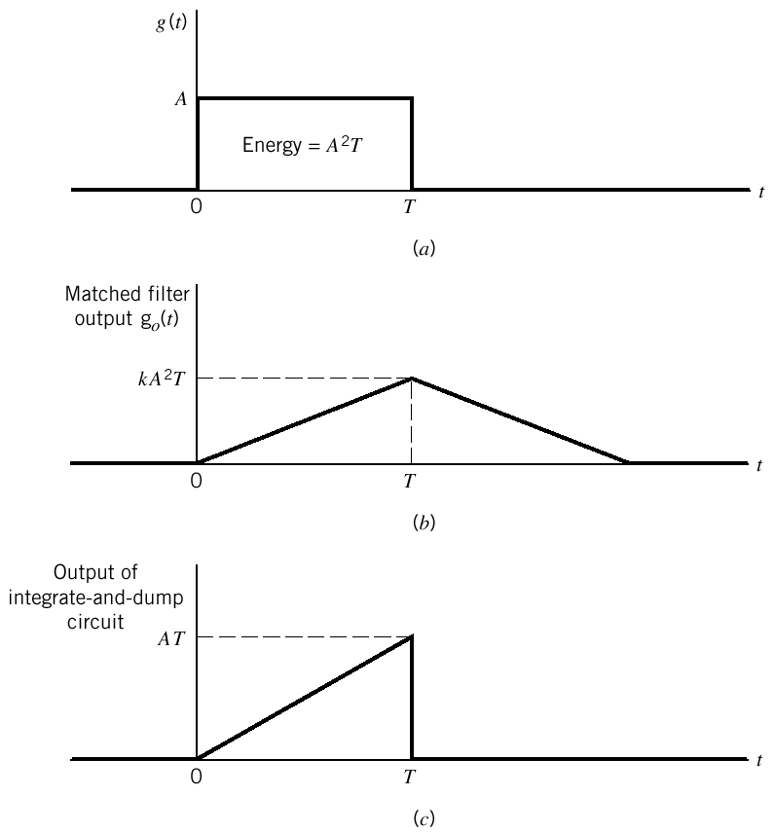
Figure 4.2 (a)Rectangular pulse.
(b) Matched filter output. (c) Integrator output.

Slide 11
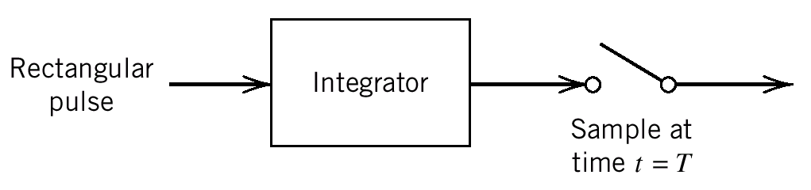
Figure 4.3 Integrate-and-dump circuit.

Slide 12
4.3 Error Rate Due to Noise
With the matched filter as the optimum detector of a known pulse in additive white noise, we are ready to derive a formula for the error rate in such a system due to noise.

Slide 13
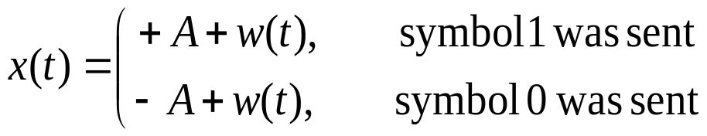
consider a binary PCM system based on polar non-return-to-zero (NRZ) signaling
  symbols 1 and 0 are represented by positive and negative rectangular pulses of equal amplitude and equal duration.
  The channel noise is modeled as additive white Gaussian noise w(t) of zero mean and power spectral density N_{o}/2.
In the signaling interval 0≤t ≤T_{b}, the received signal is thus written as follows:
(4.21)
where T_{b} is the bit duration, and A is the transmitted pulse amplitude.
The structure of the receiver used to perform this decision making process is shown in Figure 4.4.

Slide 14
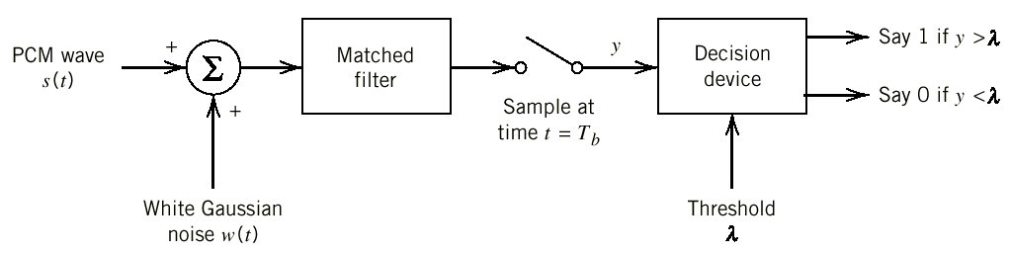
Figure 4.4 Receiver for baseband transmission of binary-encoded PCM wave using polar NRZ signaling.

Slide 15
Two possible kinds of error be considered
  Symbol 1 is chosen when a 0 was actually transmitted; we refer to this error as an error of the first kind.
  Symbol 0 is chosen when a 1 was actually transmitted; we refer to this error as an error of the second kind.

Slide 16
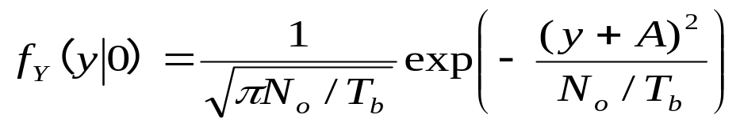
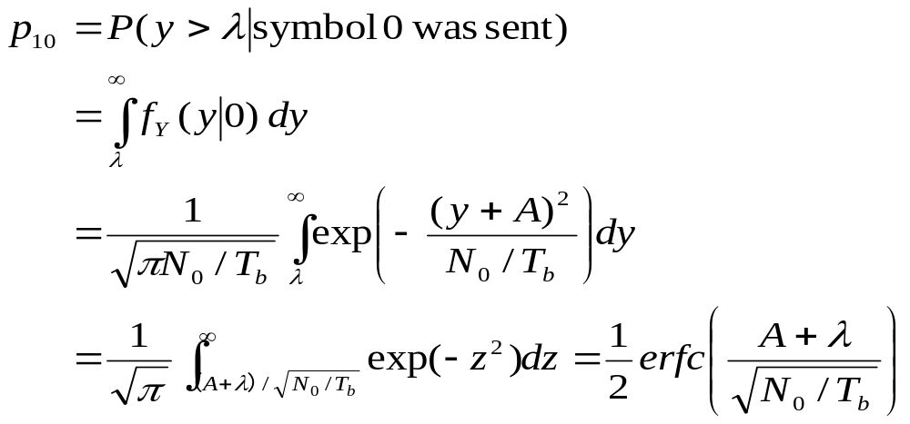
The conditional probability density function of the random variable Y, given that symbol 0 was sent, is
(4.27)
The probability of this error, conditional on sending symbol 0, is defined by
(4.28)
(4.31)
As shown in Figure 4.5, P₁₀ denote the conditional probability of error, given that symbol 0 was sent

Slide 17
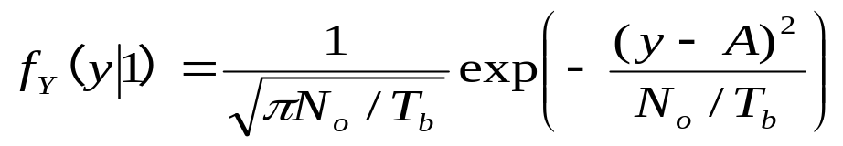
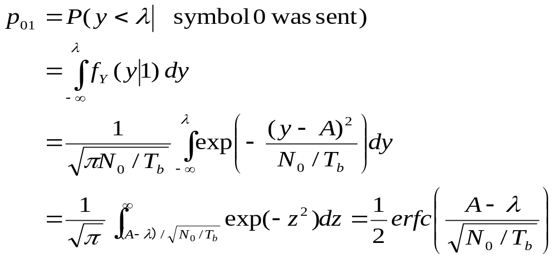
The conditional probability density function of the random variable Y, given that symbol 1 was sent, is
(4.32)
The probability of this error, conditional on sending symbol 0, is defined by
(4.33)
(4.34)
As shown in Figure 4.5, P₀₁ denote the conditional probability of error, given that symbol 1 was sent

Slide 18
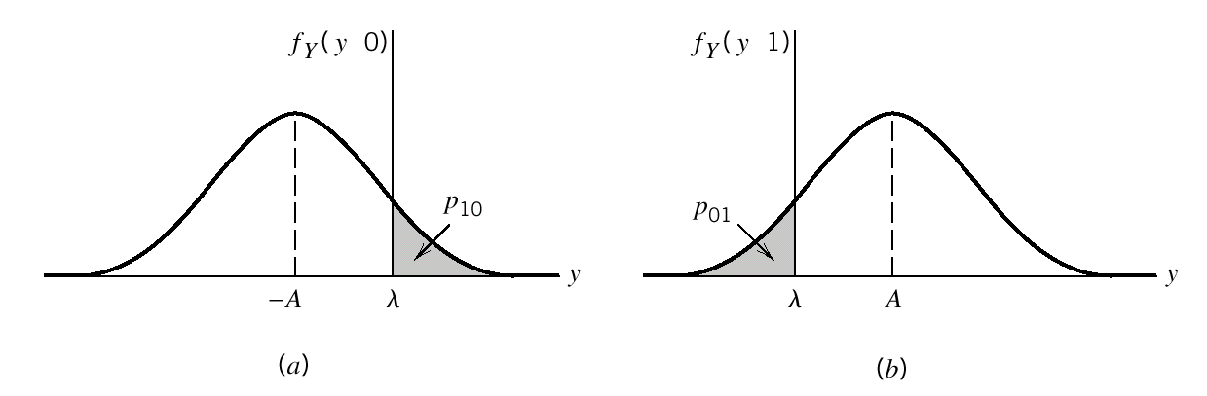
Figure 4.5 Noise analysis of PCM system. (a) Probability density function of random variable Y at matched filter output when 0 is transmitted. (b) Probability density function of Y when 1 is transmitted.

Slide 19
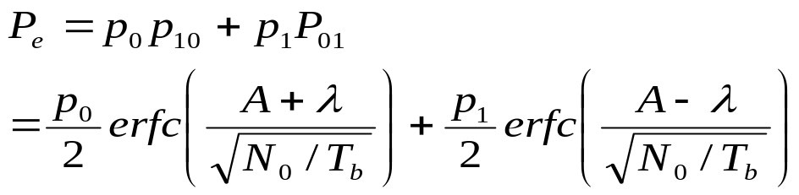
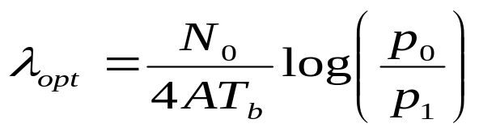
Let Po and Pi denote the a priori probabilities of transmitting symbols 0 and 1, respectively. Hence, the average probability of symbol error P_{e} in the receiver is given by:
(4.35)
From Equation (4.35) we see that P_{e} is in fact a function of the threshold λ, which immediately suggests the need for formulating an optimum threshold that minimizes P_{e}. use Leibniz's rule,we get
(4.37)

Slide 20
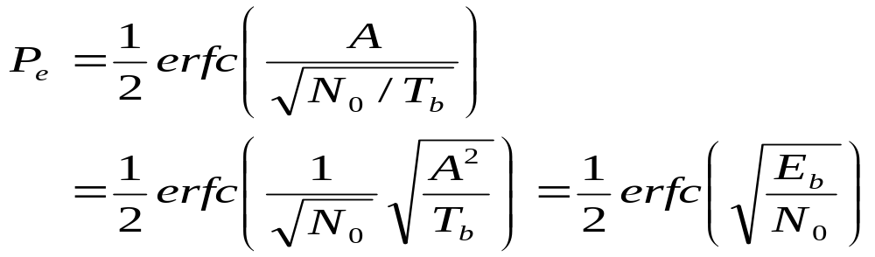
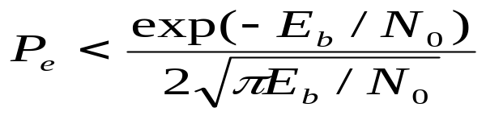
for the special case when symbols 1 and 0 are equiprobable,we have
Correspondingly, the average probability of symbol error in Equation (4.35) reduces to:
(4.38)
(4.40)
(4.41)
It shows that the average probability of symbol in a binary symmetric channel depends solely on E_{b}/N_{o}, the ratio of the transmitted signal energy per bit to the noise spectral density.

Slide 21
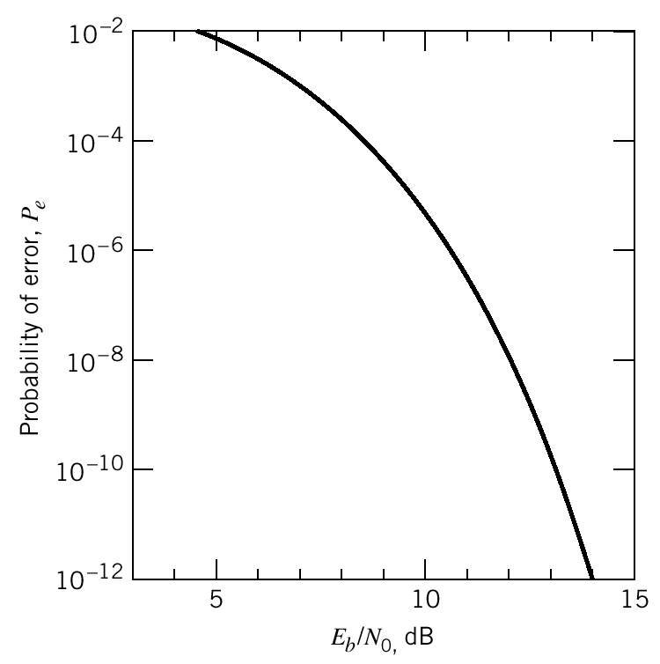
Figure 4.6 Probability of error in a PCM receiver.

Slide 22
4.4 Intersymbol Interference
The other source of bit errors in a baseband-pulse transmission system.
When the signal-to-noise ratio is high, as is the case in a telephone system, the operation of the system is largely limited by ISI rather than noise.

Slide 23
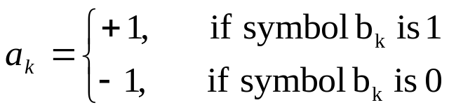
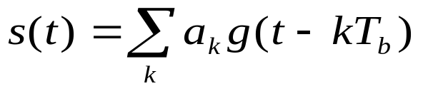
Consider then a baseband binary PAM system, a generic form of which is shown in Figure 4.7
  The incoming binary sequence {b_{k}} consists of symbols 1 and 0, each of duration T_{b}.
  The pulse-amplitude modulator modifies this binary sequence into a new sequence of short pulses (approximating a unit impulse), whose amplitude a_{k} is represented in the polar form
(4.42)
The sequence of short pulses so produced is applied to a transmit filter of impulse response g(t), producing the transmitted signal:
(4.43)

Slide 24
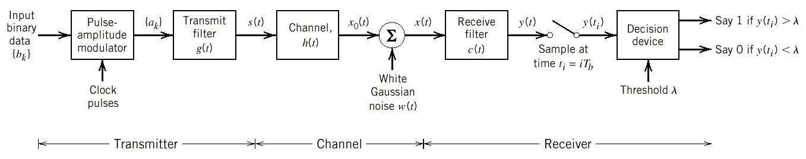
Figure 4.7 Baseband binary data transmission system.

Slide 25
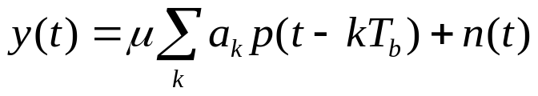

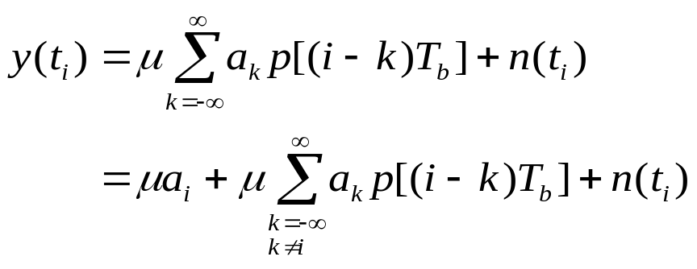
The receive filter output is written as
(4.44)
where μ is a scaling factor, the scaled pulse μ p(t) is obtained by a double convolution involving the impulse response g(t) of the transmit filter, the impulse response h(t) of the channel, and the impulse response c(t) of the receive filter, as shown by
(4.44)
assume that the pulse p(t) is normalized by setting p(0) =1,and the receive filter output y(t) is sampled at time t_{i} = iT_{b} (with i taking on integer values), yielding:
(4.48)

Slide 26
4.5 Nyquist's Criterion for Distortionless Baseband Binary Transmission
Problem
  to determine the frequency responses of the transmit and receive filters so as to reconstruct the original binary data sequence {b_{k}}.

Slide 27
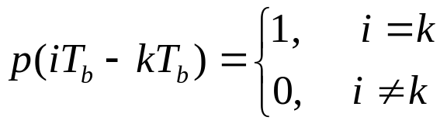

If we control the overall pulse p(t) as
(4.49)
where p(0)= 1.
If p(t) satisfies the conditions of Equation (4.49), the receiver output y(t_{i}) given in Equation (4.48) simplifies to (ignoring the noise term)
It implies zero intersymbol interference. Hence, the two conditions of Equation (4.49) ensure perfect reception in the absence of noise.

Slide 28
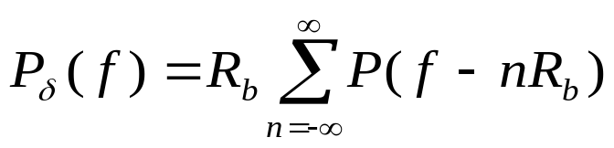
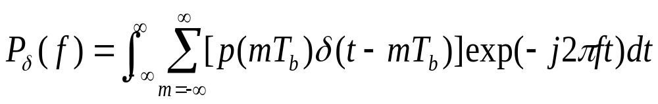
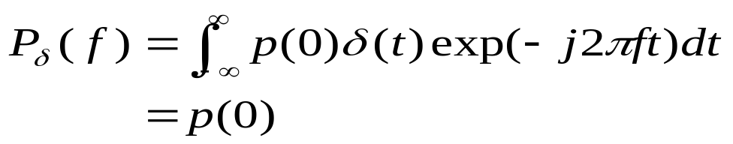
Consider then the sequence of samples {p(nT_{b})}, where n = 0, ± 1, ± 2,. From Chapter 3, sampling in the time domain produces periodicity in the frequency domain,so we may write:
(4.50)
where R_{b} = l/T_{b} is the bit rate in bps; P_{δ}(f) is the Fourier transform of an infinite periodic sequence of delta functions of period T_{b}, whose individual areas are weighted by the respective sample values of p(t). That is, P_{δ}(f) is given by
(4.51)
Let the integer m = I- k, imposing the conditions of Equation (4.49) on the sample values of p(t) in the integral of Equation (4.51),
(4.52)

Slide 29
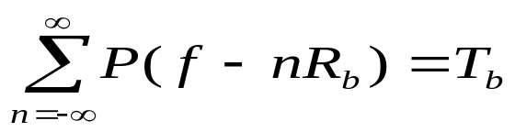
It follows from Equations (4.50) and (4.52) that the condition for zero intersymbol interference is satisfied if
(4.53)
Nyquist criterion⁴ for distortionless base band trans-mission in the absence of noise:
  The frequency function P(f) eliminates intersymbol interference for samples taken at intervals T_{b} provided that it satisfies Equation (4.53).
Note that P(f) refers to the overall system, incorporating the transmit filter, the channel, and the receive filter in accordance with Equation (4.47).

Slide 30
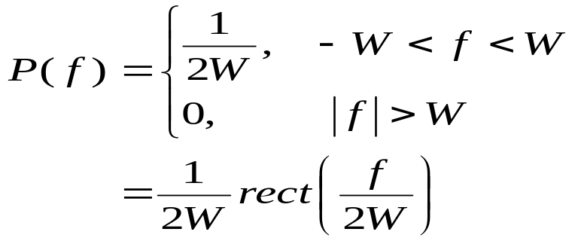
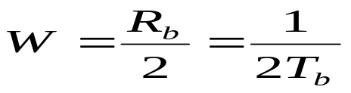
IDEAL NYQUIST CHANNEL
The simplest way of satisfying Equation (4.53) is to specify the frequency function P(f) to be in the form of a rectangular function:
(4.54)
where rect(f) stands for a rectangular function of unit amplitude and unit support centered on f = 0, and the overall system band-width W is defined by:
(4.55)

Slide 31
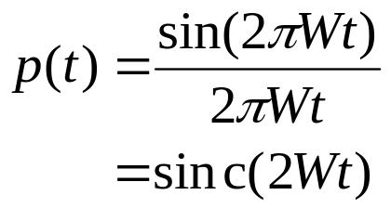
According to Equations (4.54) and (4.55), no frequencies of absolute value exceeding half the bit rate are needed. Hence, from Fourier-transform pair2, we find that a signal waveform that produces zero intersymbol interference is defined by the sinc function:
(4.56)
The special value of the bit rate R_{b} = 2W is called the Nyquist rate, and W is itself called the Nyquist bandwidth. Correspondingly, the ideal baseband pulse transmission system described by Equation (4.54) in the frequency domain or, equivalently, Equation (4.56) in the time domain, is called the ideal Nyquist channel

Slide 32
Figures 4.8a and 4.8b show plots of P(f) and p(t)
  In Figure 4.8a, shows the normalized form of the frequency function P(f) for positive and negative frequencies.
  In Figure 4.8b, included the signaling intervals and the corresponding centered sampling instants.

Slide 33
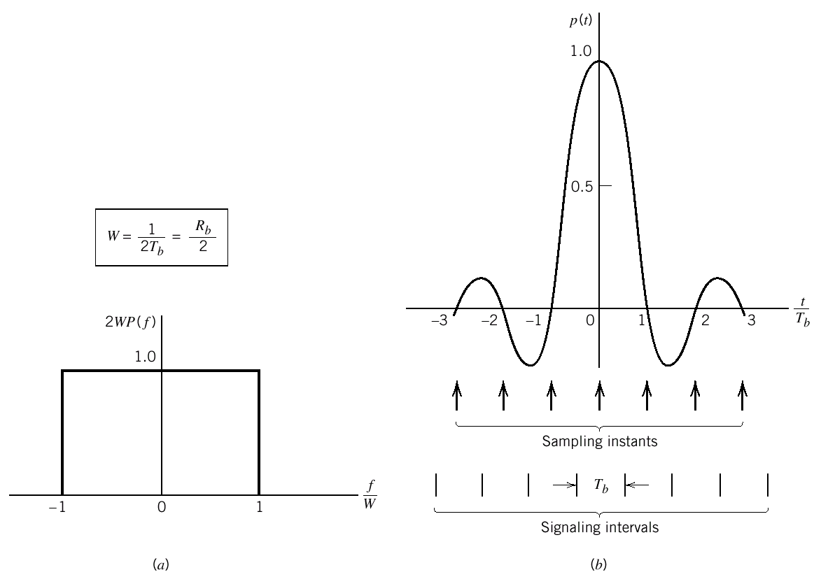
Figure 4.8 (a) Ideal magnitude response. (b) Ideal basic pulse shape.

Slide 34
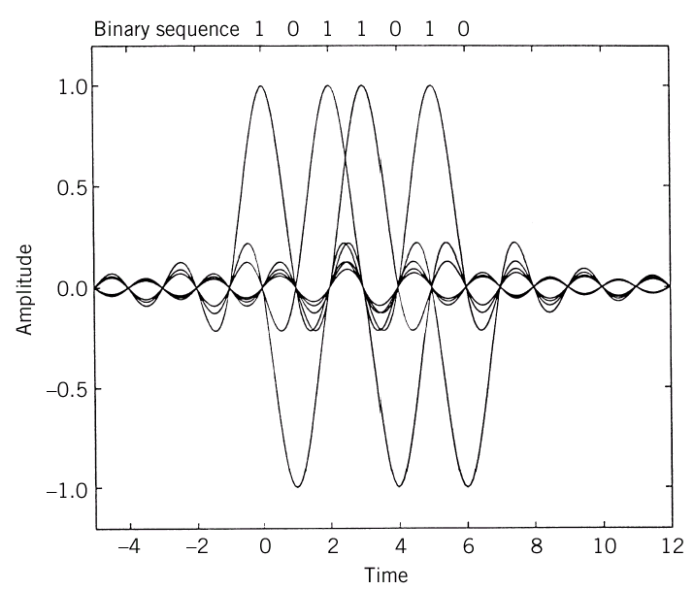
Figure 4.9
A series of sinc pulses corresponding to the sequence 1011010.

Slide 35
Two practical difficulties
  It requires that the magnitude characteristic of P(f) be flat from W to W, and zero elsewhere. This is physically unrealizable because of the abrupt transitions at the band edges ±W.
  The function p(t) decreases as 1/|t| for large |t|, resulting in a slow rate of decay.This is also caused by the discontinuity of P(f) at ±W. Accordingly, there is practically no margin of error in sampling times in the receiver.

Slide 36
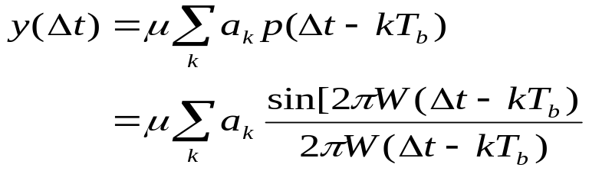
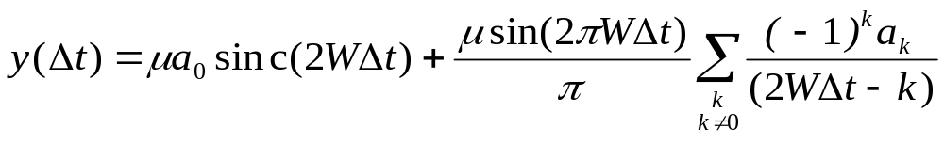
Timing error evaluate
Consider the sample of y(t) at t = Δ t, where Δ t is the timing error. To simplify the exposition, we may put the correct sampling time t_{i} =0. In the absence of noise, we thus have:
(4.57)
For 2WT_{b} = 1, we may rewrite Equation (4.57) as
(4.58)
The first term defines the desired symbol, whereas the remaining series represents the intersymbol interference caused by the timing error Δt in sampling the output y(t). Unfortunately, it is possible for this series to diverge, thereby causing erroneous decisions in the receiver.

Slide 37
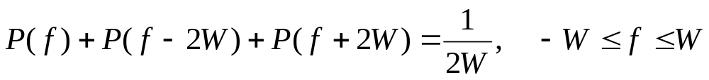
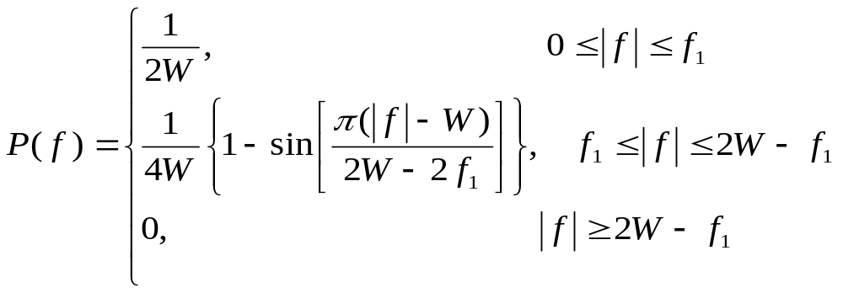
RAISED COSINE SPECTRUM
We may overcome the practical difficulties encountered with the ideal Nyqinst channel by extending the bandwidth from the minimum value W = R_{b}/2 to an adjustable value between W and 2W, specifically,the overall frequency response P(f) to satisfy a condition more elaborate than that for the ideal Nyquist channel
(4.59)
A particular form of P(f) that embodies above features is provided by a raised cosine spectrum. See figure 4.10a.
(4.60)

Slide 38
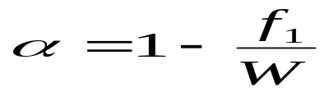
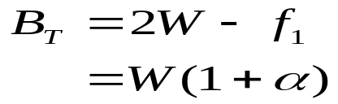
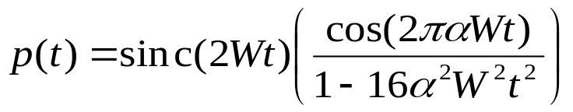
The frequency parameter f₁ and bandwidth W are related by
(4.61)
The parameter a is called the rolloff factor; it indicates the excess bandwidth over the ideal solution W. Specifically, the transmission bandwidth B_{T} is defined by
The time response p(t) is the inverse Fourier transform of the frequency response P(f).(see Figure 4.10b)
(4.62)

Slide 39
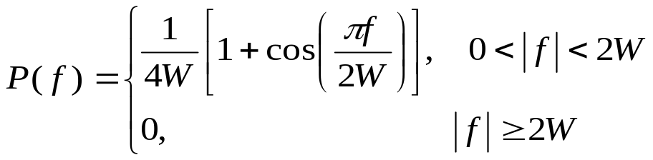
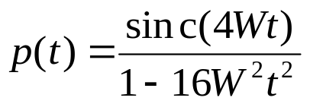
The special case with a = 1 (i.e., f₁=0) is known as the full-cosine rolloff characteristic, Its frequency response and time response are:
(4.63)
(4.64)
This time response exhibits two interesting properties:
At t = ± T_{b}/2 = ± l/4W, we have p(t) = 0.5; that is, the pulse width measured at half amplitude is exactly equal to the bit duration T_{b}.
There are zero crossings at t = ± 3T_{b}/2, ± 5T_{b}/2, ,,, in addition to the usual zero crossings at the sampling times t = ± T_{b}, ± 2T_{b} ….

Slide 40
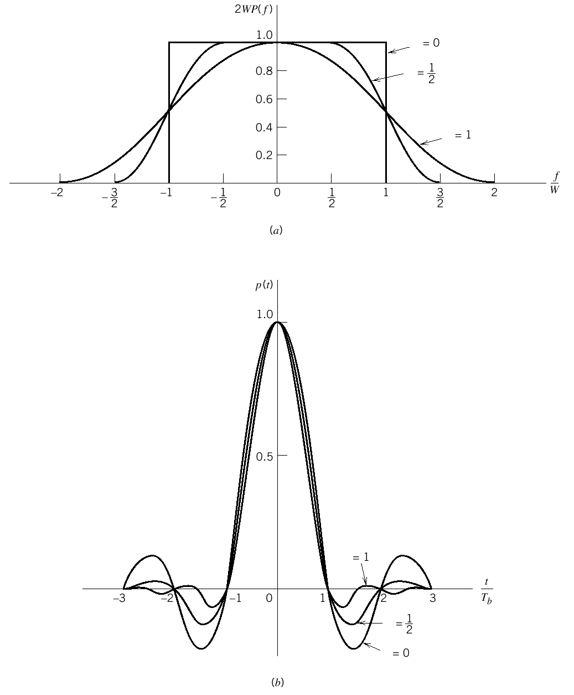
Figure 4.10Responses for different rolloff . (a) Frequency response. (b) Time response.

Slide 41
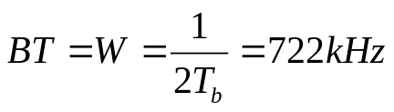
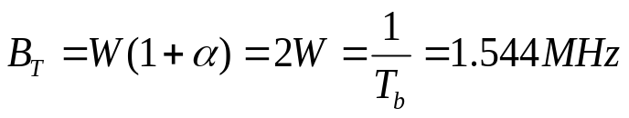
Example 4.2
  Bandwidth Requirement of the TI System
In Example 3.2 of Chapter 3, we described the signal format for the T₁ carrier system that is used to multiplex 24 independent voice inputs, based on an 8-bit PCM word. It was shown that the bit duration of the resulting time-division multiplexed signal (including a framing bit) is
T_{b} = 0.647 μs
Assuming the use of an ideal Nyquist channel, it follows that the minimum transmission bandwidth B_{T} of the T1 system is (for α=0)
for α=1:

Slide 42
4.6 Correlative-Level Coding
WHAT ?
By adding intersymbol interference to the transmitted signal in a controlled manner, it is possible to achieve a signaling rate equal to the Nyquist rate of 2W symbols per second in a channel of bandwidth W Hertz.
Such schemes are called correlative-level coding or partial-response signaling schemes.

Slide 43
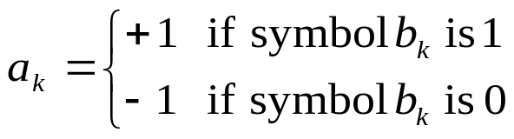
DUOBINARY SIGNALING
  "duo" implies doubling of the transmission capacity of a straight binary system.
  be also called class I partial response.
Consider a binary input sequence {b_{k}} consisting of uncorrelated binary symbols 1 and 0, each having duration T_{b}. Apply this sequence to a pulse-amplitude modulator will producing a two-level sequence of short pulses (approximating a unit impulse), whose amplitude a_{k} is defined by
(4.50)
When this sequence is applied to a duobinary encoder, it is converted into a three-level output, namely, -2, 0, and +2.see Figure 4.11

Slide 44
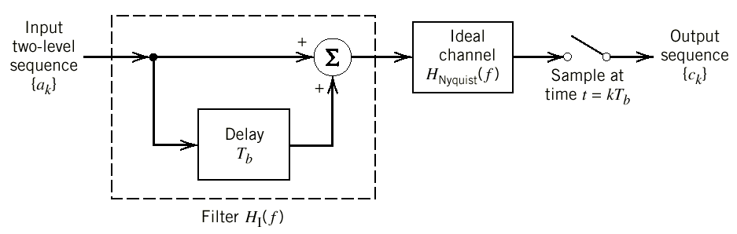
Figure 4.11 Duobinary signaling scheme.

Slide 45

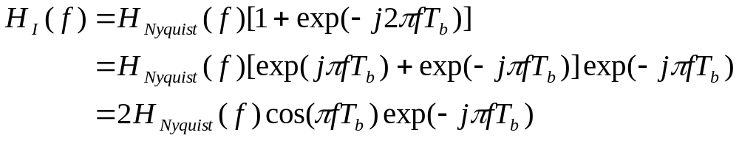

the duobinary coder output c_{k} as the sum of the present input pulse a_{k} and its previous value a_{k-1}, as shown by
(4.66)
the overall frequency response of this filter connected in cascade with an ideal Nyquist channel is:
(4.67)
Where the subscript Ⅰ in H_{Ⅰ}(f) indicates the pertinent class of partial response. For an ideal Nyquist channel of bandwidth W = l/2T_{b}, we have (ignoring the scaling factor T_{b})
(4.68)

Slide 46
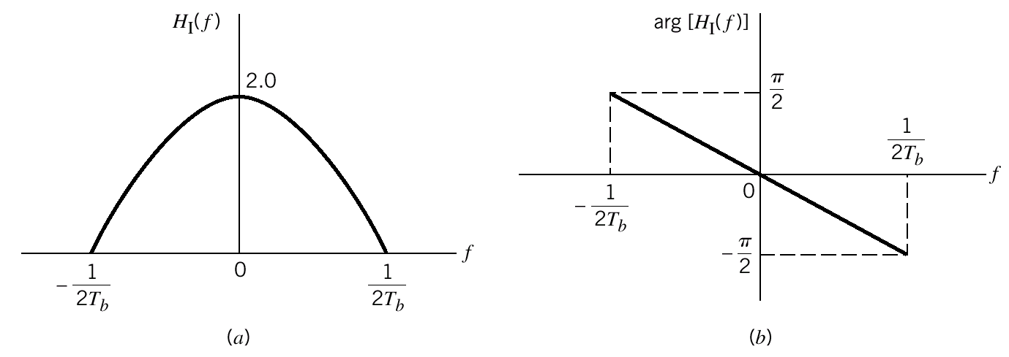
Figure 4.12 Frequency response of the duobinary conversion filter.
(a) Magnitude response. (b) Phase response.

Slide 47


Thus the overall frequency response of the duobinary signaling scheme has the form of a half-cycle cosine function as
(4.69)
Its magnitude response and phase response are as shown in Figures 4.12a and 4.12b, respectively.
From Equation (4.67) and (4.68), we find that the impulse response corresponding to the frequency response H_{Ⅰ}(f) , consists of two sine (Nyquist) pulses that are time-displaced by T_{b} seconds with respect to each other, as shown by:
(4.70)

Slide 48

Figure 4.13
Impulse response of the duobinary conversion filter.

Slide 49
See Figure 4.13:
  only two distinguishable values at the sampling instants.
  The response to an input pulse is spread over more than one signaling interval. That is ,the response in any signaling interval is "partial.“
  the tails of h_{Ⅰ}(t) decay as l/Itl², which is a faster rate of decay than the l/Itl encountered in the ideal Nyquist channel.

Slide 50

Error-Propagation
Let the original two-level sequence {a_{k}} be detected from the duobinary-coded sequence {c_{k}} by using of Equation (4.66). Specifically, let â_{k} represent the estimate of the original pulse a_{k} as conceived by the receiver at time t = kt_{b}. Then, subtracting the previous estimate â_{k-1} from c_{k}, we get
(4.71)
The technique of using a stored estimate of the previous symbol is called decision feedback.
It can be inferred that once errors are made, they tend to propagate through the output.

Slide 51


Precoding
  use precoding before the duobinary coding can avoiding the error-propagation phenomenon.
As shown in Figure 4.14, precoding the binary data sequence {b_{k}} ,converts it into another binary sequence {d_{k}} by:
(4.72)
Where the symbol ⊕ denotes modulo-two addition of the binary digits b_{k} and d_{k} . which is performed as follows:
(4.73)

Slide 52

Figure 4.14 A precoded duobinary scheme;
details of the duobinary coder are given in Figure 4.11.

Slide 53



Apply the precoded binary sequence {d_{k}} to a pulse-amplitude modulator, producing a two-level sequence of short pulses {a_{k}}, where a_{k} = ±1 as before. Then apply {a_{k}} to the duobinary coder, thereby producing the sequence {c_{k}} as follows:.
(4.74)
Note: The precoding described by Equation (4.72) is nonlinearly.
The combined use of Equations (4.72) and (4.74) yields
(4.75)
From Equation (4.75) we deduce the following decision rule for detecting the original binary sequence {b_{k}} from {ck}:
(4.76)

Slide 54

Figure 4.15 Detector for recovering original binary sequence from the precoded duobinary coder output.
When |c_{k}| = 1, the receiver simply makes a random guess in favor of symbol 1 or 0. According to this decision rule, the detector consists of a rectifier, the output of which is compared in a decision device to a threshold of 1.
A useful feature of this detector is that no knowledge of any input sample other than the present one is required. Hence, error propagation cannot occur in the detector of Figure 4.15.

Slide 55
EXAMPLE 4.3 Duobilnary Coding with Precoding
Consider the binary data sequence 0010110.
Precode this sequence, using Equation (4.73), we find that the sequence {d_{k}} {c_{k}} is as shown in Table 4.1. This result shows that, in the absence of noise, the original binary sequence is detected correctly.
Table 4.1 Illustrating Example 4.3 on duobinary coding
Binary sequence{b_{k}} |  | 0 | 0 | 1 | 0 | 1 | 1 | 0
Precoded sequence{d_{k}} | 1 | 1 | 1 | 0 | 0 | 1 | 0 | 0
Two-level sequence {a_{k}} | +1 | +1 | +1 | -1 | -1 | +1 | -1 | -1
Duobinary coder output {c_{k}} |  | +2 | +2 | 0 | -2 | 0 | 0 | -2
Binary sequence obtained by applying Eq.4.76 |  | 0 | 0 | 1 | 0 | 1 | 1 | 0

Slide 56
Modified Duobilnary Signaling
In the duobinary signaling technique the frequency response H(f), and consequently the power spectral density of the transmitted pulse, is nonzero at the origin.
Using the class IV partial response or modified duobinary technique to overcome it.

Slide 57

Figure 4.16 Modified duobinary signaling scheme.

Slide 58



See Figure 4.16. The precoder involves a delay of 2T_{b}, seconds. The output of the modified duobinary conversion filter is related to the input two-level sequence {a_{k}} at the pulse-amplitude modulator output as follows:
(4.77)
It generates a three-level signal, With a_{k} = ±1, c_{k} takes on one of three values: +2, 0, and -2.
The overall frequency response of the delay-Iine filter connected in cascade with an ideal Nyquist channel, as in Figure 4.16, is:
(4.78)
where the subscript Ⅵ in H_{Ⅵ}(f) indicates the pertinent class of partial response and H_{Nyquist}(f) is as defined in Equation (4.68). The overall frequency response is in the form of a half-cycle sine function, as shown by
(4.79)

Slide 59

Figure 4.17 Frequency response of the modified duobinary conversion filter. (a) Magnitude response. (b) Phase response.

Slide 60

From the first line of Equation (4.78) and the definition of H_{Nyquist}(f) in Equation (4.68). we find that the impulse response of the modified duohinary coder consists of two sinc (Nyquist) pulses that are time-displaced by 2T~, seconds with respect to each other, as shown by (except for a scaling factor)
(4.80)
This impulse response is plotted in Figure 4.18
It has three distinguishable levels at the sampling instants.
As with duobinaty signaling, the tails of h_{Ⅵ}(t) for the modified duobinary signaling decay as l/ltl².

Slide 61

Figure 4.18
Impulse response of the modified duobinary conversion filter.

Slide 62


Error Propagation
use a precoding procedure similar to that used for the duobinary case.
Prior to the generation of the modified duobinary signal, a modulo-two logical addition is used on signals 2T_{b} seconds apart, as :
(4.81)
where {b_{k}} is the incoming binary data sequence and {d_{k}} is the sequence at the precoder output.
decision rule:
(4.82)

Slide 63

Conclusion for Modified duobinary signaling
  In the absence of channel noise, the detected binary sequence { } is exactly the same as the original binary sequence {b_{k}} at the transmitter input.
  The use of Equation (4.81) requires the addition of two extra bits to the precoded sequence {a_{k}}. The composition of the decoded sequence { } using Equation (4.82) is invariant to the selection made for these two bits.

Slide 64

GENERALIZED FORM OF CORRELATIVE-LEVEL CODING
different classes of partial-response signaling schemes may be achieved by using a weighted linear combination of N ideal Nyquist (sinc) pulses, as shown:
(4.83)
As shown in Figure 4.19, where w₀, w₁, …, w_{N-1} are tap-weights
Table 4.2 presents the specific details of five different classes of partial-response signaling schemes.
For example, in the duobinary case {class I partial response}:
W₀=+1
W₁=+1
And W_{n}=0 for all n ≥2

Slide 65

Figure 4.19
Generalized correlative coding scheme.

Slide 66
Table 4.2 Different classes of partial-response signaling schemes referring to Figure 4.19
Type of class | N | W₀ | W₁ | W₂ | W₃ | W₄ | Comments
Ⅰ | 2 | 1 | 1 |  |  |  | Duobinary coding
Ⅱ | 3 | 1 | 2 | 1
Ⅲ | 3 | 2 | 1 | -1
Ⅳ | 3 | 1 | 0 | -1 |  |  | Modified duobinary coding
Ⅴ | 5 | -1 | 0 | 2 | 0 | -1

Slide 67
Conclusion
Binary data transmission over a physical baseband channel can be accomplished at a rate close to the Nyquist rate, using realizable filters with gradual cutoff characteristics.
Different spectral shapes can be produced, appropriate for the application at hand.
Price: A larger signal-to-noise ratio is required to yield the same average probability of symbol error in the presence of noise as in the corresponding binary PAM systems because of an increase in the number of signal levels used.

Slide 68
4.7 Baseband M-ary PAM Transmission
In a baseband M-ary PAM system, the pulse amplitude modulator produces one of M possible amplitude levels with M > 2
The symbol duration T of the M-ary PAM system is related to the bit duration Tb of the equivalent binary PAM system as T = T_{b}㏒₂ M
For M much larger than 2 and an average probability of symbol error small compared to 1, the transmitted power must be increased by the factor M²/ ㏒₂ M, compared to a binary PAM system.

Slide 69

Figure 4.20
Output of a quaternary system. (a) Waveform. (b) Representation of the 4 possible digits, based on Gray encoding.

Slide 70
4.8 Digital Subscriber Lines
DSL operates over a local loop (less than1.5 km) that provides a direct connection between a user terminal (e.g., computer) and a telephone company's central office (CO), as illustrated in Figure 4.21.
DSL use twisted pairs configured to provide a high data-rate, full duplex, digital trans-mission capability.

Slide 71

Figure 4.21
Block diagram depicting the operational environment of digital subscriber lines.

Slide 72
DSL Operation Modes
  Time compression (TC) multiplexing, where data transmission in the two opposite directions on the common line are separated in time. See Figure 4.22a.
  Echo-cancellation mode, which supports the simultaneous flow of data along the common line in both directions. See Figure 4.22b.

Slide 73


Figure 4.22
Full-duplex operation using (a) time compression multiplexing, and (b) echo-cancellation.

Slide 74

Figure 4.23
Simplified circuit of hybrid transformer. For the bridge to be balanced, the reference impedance Z_{ref} should equal the line impedance z_{l}.

Slide 75
Transmission Medium Impairments
intersymbol interference
crosstalk
  Near-end crosstalk (NEXT), which is generated by transmitters located at the same end of the cable as the receiver, as illustrated in Figure 4.24a.
  Far-end crosstalk (FEXT), which is generated by transmitters located further away from the receiver, as illustrated in Figure 4.24b.

Slide 76

Figure 4.24
(a) Near-end crosstalk (NEXT). (b) Far-end crosstalk (FEXT).

Slide 77

Figure 4.25 Model of twisted-pair channel.

Slide 78
LINE CODES FOR DSL
spectrum property of a transmitted signal
  The power spectral density of the transmitted signal should be zero at zero frequency.
  The power spectral density of the transmitted signal should be low at high frequencies for the following reasons:
    Transmission attenuation in a twisted pair is most severe at high frequencies.
    Crosstalk between adjacent twisted pairs Increases dramatically at high frequencies because of increased capacitive coupling.

Slide 79
Line Codes Types
Manchester code, which is simple and has zero DC component.
Modified duobinary code, which has zero DC, is moderately spectrally efficient, and causes minimal intersymbol interference.
Bipolar code, in which successive 1s are represented alternately by positive and negative but equal levels, and symbol 0 is represented by a zero level.
2B1Q code, which stands for two binary digits encoded into one quaternary symbol.[North American standard for DSL]

Slide 80
ASYMMETRIC DIGITAL SUBSCRIBER LINES
A local transmission system designed to simul-taneously support three services on a single twisted-wire pair:
  Data transmission downstream (toward the subscriber) at bit rates of up to 9 Mb/s.
  Data transmission upstream (away from the subscriber) at bit rates of up to 1 Mb/s.
  Plain old telephone service (POTS).
“asymmetric” means for the downstream bit rate is much higher than the upstream bit rate.
ADSL is designed to accommodate "video-on-demand”?

Slide 81

Figure 4.26
(a) Illustrating the different band allocations for an FDM-based ADSL system. (b) Block diagram of splitter performing the function of multiplexer or demultiplexer. Note: both filters in the splitter are bidirectional filters.

Slide 82
4.9 Optimum Linear Receiver
Two channel conditions discussed above
  Channel noise acting alone, which led to formulation of the matched filter receiver.
  lntersymbol interference acting alone, which led to formulation of the pulse-shaping transmit filter so as to realize the Nyquist channel.
channel noise and ISI act together condition
  zero-forcing equalizer
  minimum-mean square error (MMSE) equalizer.

Slide 83
zero-forcing equalizer
  have the "intersymbol interference forced to zero" at all the instants t = kT at which the channel output is sampled, except for k = 0 where the symbol of interest is assumed to occur.
  ignores the effect of the channel noise w(t).
MMSE
  the cascade connection of two basic components:
    A matched filter whose impulse response is q(-t), where q(t) = g(t) ★ b(t).
    A transversal (tapped-delay-line) equalizer whose frequency response is the inverse of the periodic function S_{q}(f) + (N₀/2).

Slide 84
PRACTICAL CONSIDERATIONS
  The MMSE receiver of Figure 4.27 works well in the laboratory, where we have access to the system to be equalized.
  In a real-life telecommunications environment, the channel is usually time varying.
  Consequently, the use of a fixed pair of matched filter and equalizer designed on the basis of average channel characteristics may not adequately reduce the effects of intersymbol interference and channel noise.
  An adaptive receiver is needed, which provides for the adaptive implementation of both the matched filter and the equalizer in a combined manner.

Slide 85

Figure 4.27
Optimum linear receiver consisting of the cascade connection of matched filter and transversal equalizer.

Slide 86
4.10 Adaptive Equalization
Adjust the equalizer coefficients
A typical telephone channel changes little during an average data call
Training mode(PN sequence)----Tracking mode

Slide 87

Figure 4.28
Block diagram of adaptive equalizer.

Slide 88

Figure 4.29
Signal-flow graph representation of the LMS algorithm involving the kth tap weight.

Slide 89

Figure 4.30
Illustrating the two operating modes of an adaptive equalizer: For the training mode, the switch is in position 1; and for the tracking mode, it is moved to position 2.

Slide 90

Figure 4.31
Impulse response of a discrete-time channel, depicting the precursors and postcursors.

Slide 91

Figure 4.32
Block diagram of decision-feedback equalizer.

Slide 92
4.11 Computer Experiment :
Eye Patterns
Be defined as the synchronized superposition of all possible realizations of the signal of interest (e.g., received signal, receiver output) viewed within a particular signaling interval.
The width of the eye opening defines the time interval over which the received signal can be sampled without error from intersymbol interference; it is apparent that the preferred time for sampling is the instant of time at which the eye is open the widest.
The sensitivity of the system to timing errors is determined by the rate of closure of the eye as the sampling time is varied.
The height of the eye opening, at a specified sampling time, defines the noise margin of the system.

Slide 93

Figure 4.33 Interpretation of the eye pattern.

