Slide 1
Ch.5 Signal-Space Analysis
Problems: (P338-343)
5.2 5.5 5.8 5.11 5.13 5.16 5.19

Slide 2
Ch.5 Signal-Space Analysis
5.1 Introduction
5.2 Geometric Representation of Signals
5.3 Conversion of the Continuous AWGN Channel into a Vector Channel
5.4 Likelihood Functions
5.5 Coherent Detection of Signals in Noise: Maximum Likelihood Decoding
5.6 Correlation Receiver
5.7 Probability of Error
5.8 Summary and Discussion

Slide 3

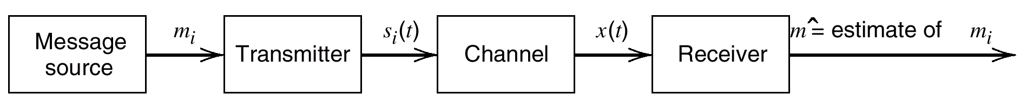
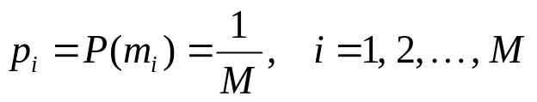
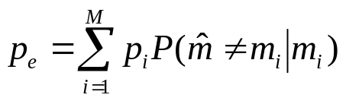
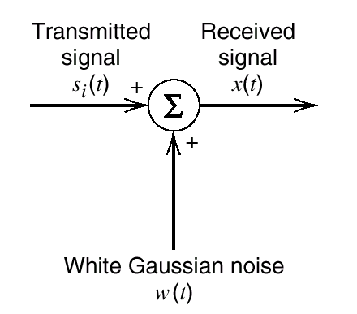
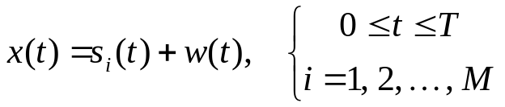
5.1 Introduction
Minimizing p_{e} ⇒ Optimum receiver in the minimum probability of error sense
Fig. 1. Block diagram of a generic digital communication system.

Slide 4
5.2 Geometric Representation of Signals
Orthonormal basis functions
  Schwarz inequality
Gram-Schmidt orthogonalization procedure
  2B1Q Code

Slide 5
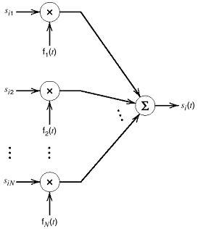
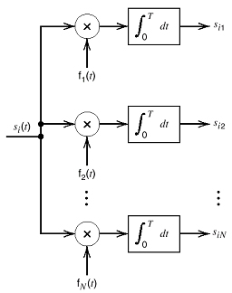
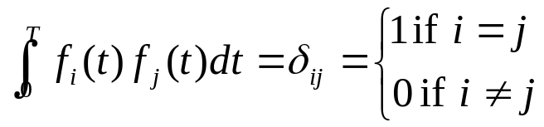
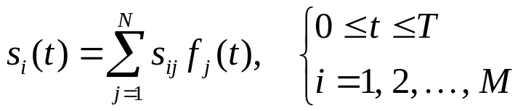
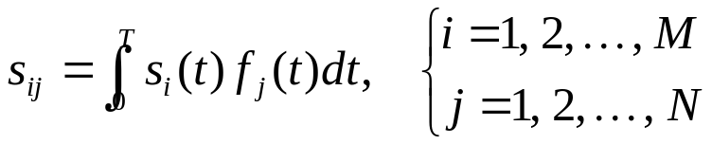
Orthonormal Basis Functions
Fig. 2. Geometric representation of signals.

Slide 6
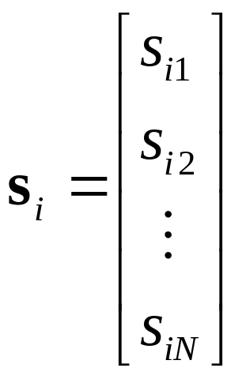
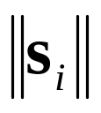
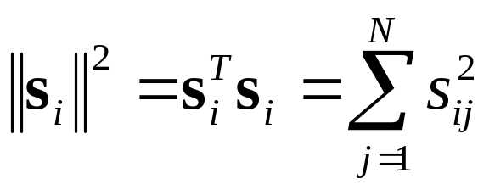
Orthonormal Basis Functions (cont’d)
The signal vector s_{i}
  s_{i}(t) is completely determined by s_{i}
  , length (or “absolute value”, “norm” of s_{i}

Slide 7
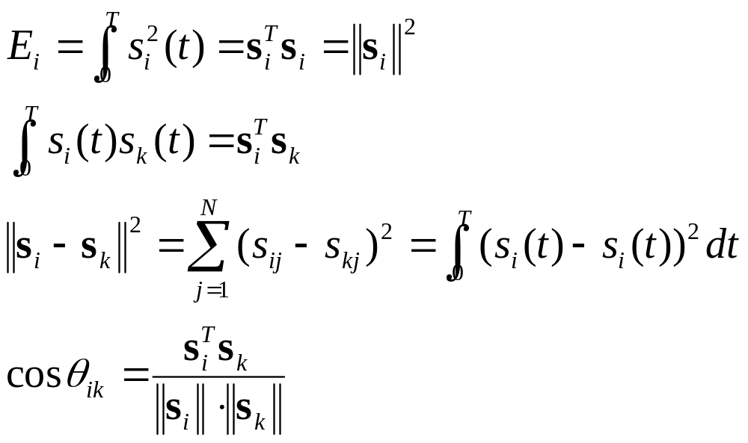
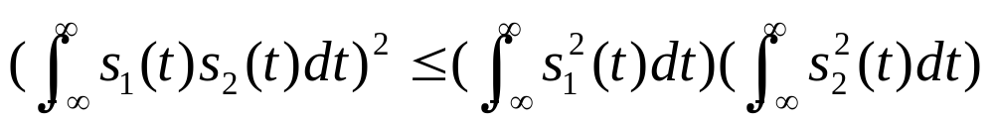
Orthonormal Basis Functions (cont’d)
Euclidean distance between s_{i} and s_{k}
Angle between s_{i} and s_{k}
Schwarz Inequality:

Slide 8
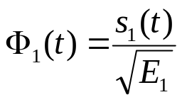
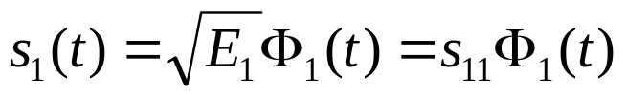
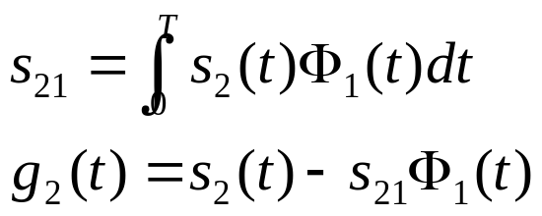
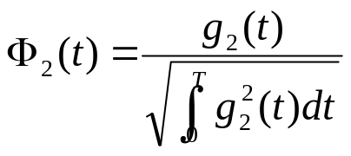
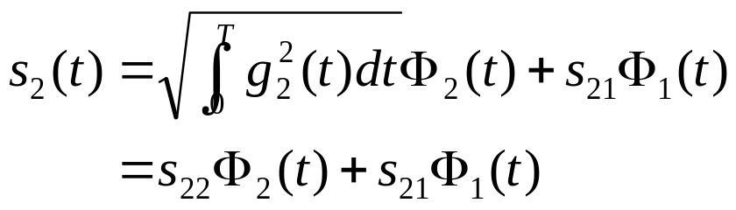
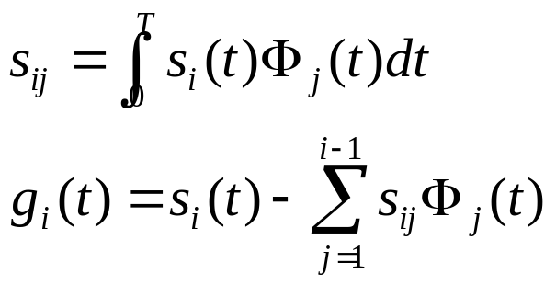

Gram-Schmidt Orthogonalization Procedure
今天交CH4习题！

Slide 9
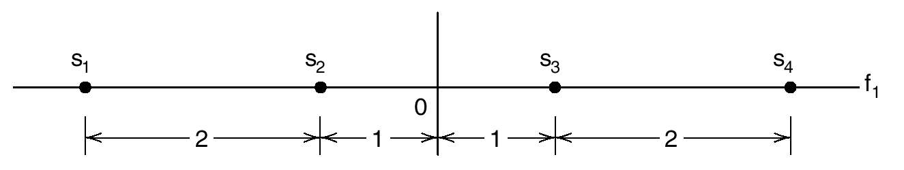
Gram-Schmidt Orthogonalization Procedure (cont’d)
An Example: 2B1Q Code
Fig. 3. Signal-space representation of the 2B1Q code.

Slide 10
5.3 Conversion of the Continuous AWGN Channel into a Vector Channel
In this section, we show that:
  In an AWGN channel, only the projections of the noise onto the basis functions of the signal set affect the sufficient statistics of the signal detection; the remainder of the noise is irrelevant.

Slide 11
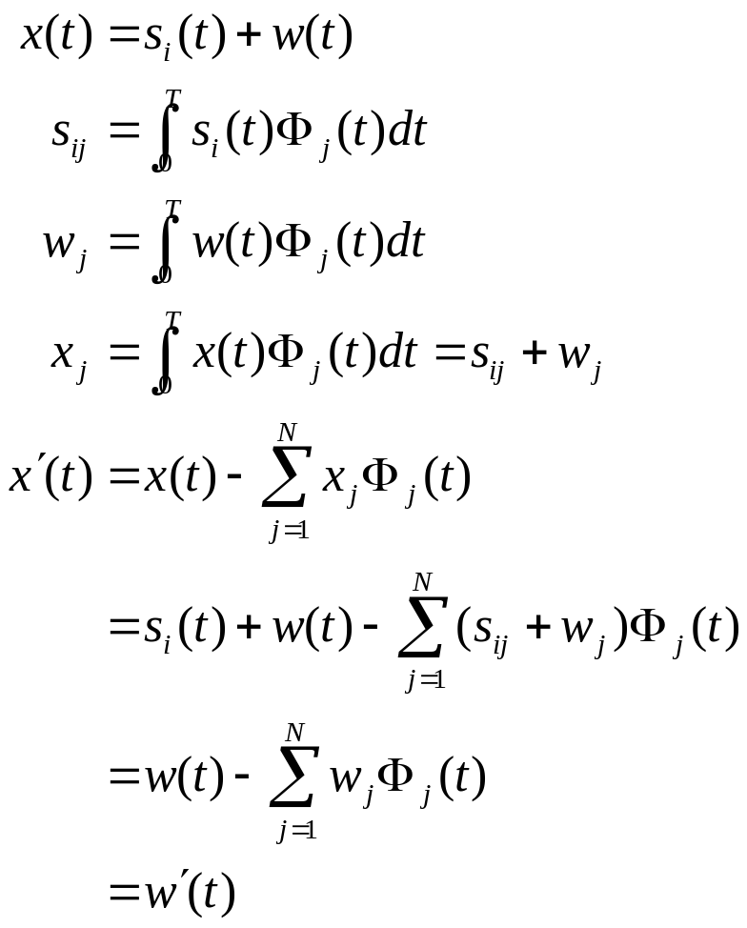
Signal Analysis with AWGN Channel
Noise element affecting signal detection
Irrelevant noise element
Fig. 4. The AWGN Channel.

Slide 12
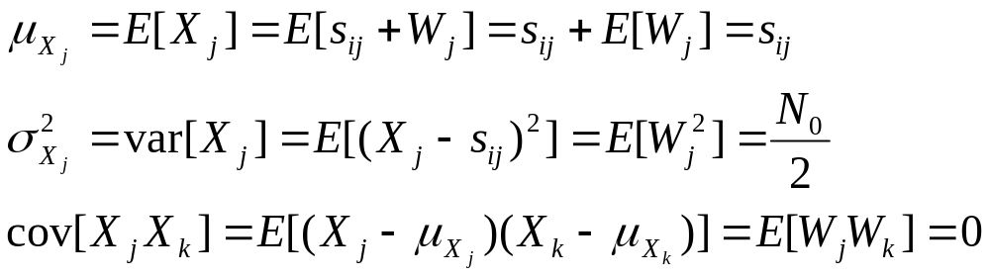
Statistical Characterization
X(t), W(t) : Random Processes
x(t), w(t) : Sample Functions
X_{j}, W_{j} : Random Variables
x_{j}, w_{j} : Sample Values

Slide 13
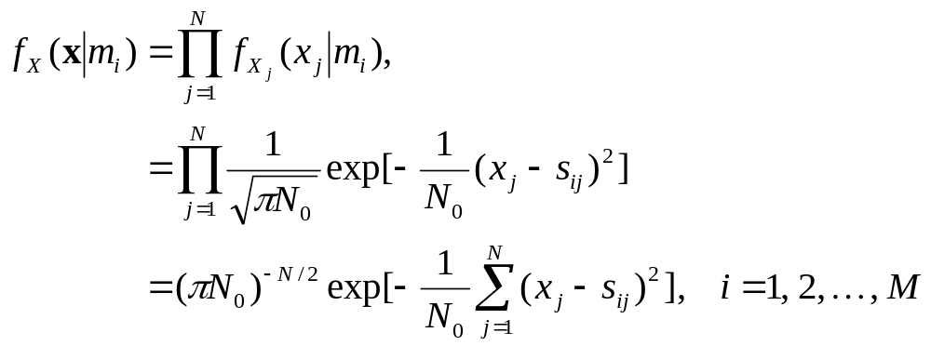
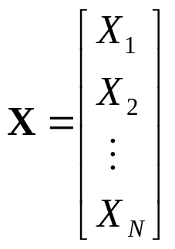
Statistical Characterization (cont’d)

Slide 14


Theorem of Irrelevance
Insofar as signal detection in AWGN is concerned, only the projections of the noise onto the basis functions of the signal set affects the sufficient statistics of the detection problem; the remainder of the noise is irrelevant.
The AWGN channel
The vector channel

Slide 15
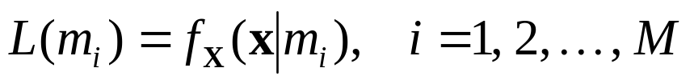

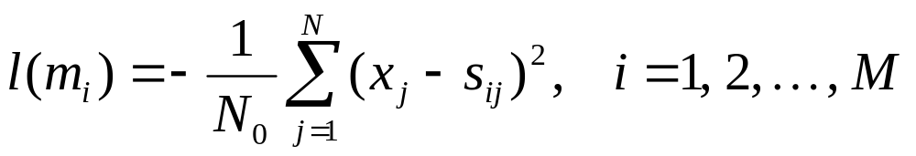
5.4 Likelihood Functions
?
Given the observation vector x, which message symbol m_{i} is transmitted
Likelihood function:
Log-likelihood function:
AWGN channel:

Slide 16
5.5 Coherent Detection of Signals in Noise: Maximum Likelihood Decoding
The signal constellation
The signal detection problem
The optimal decision rule

Slide 17


The Signal Constellation
Set of N orthonormal basis functions
A Euclidean space of dimension N
The set of message points in this space corresponding to the set of transmitted signals is called a signal constellation.
The observation vector x is represented by a received signal vector in the same Euclidean space

Slide 18
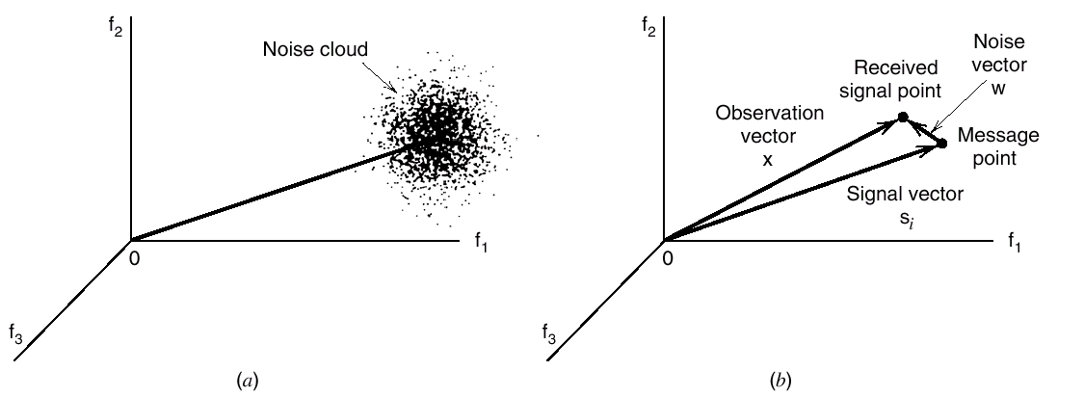
The Signal Constellation (cont’d)
Fig. 4. Illustrating the effect of noise perturbation, depicted in (a), on the location of the received signal point, depicted in (b).

Slide 19


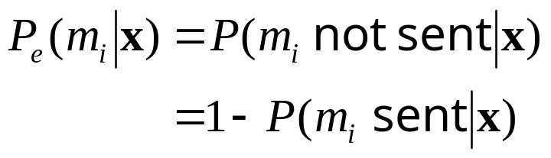
The Signal Detection Problem
Given the observation vector x, perform a mapping from x to an estimate of the transmitted symbol, m_{i}, in a way that would minimize the probability of error in the decision-making process.
Probability of error when make the decision:

Slide 20
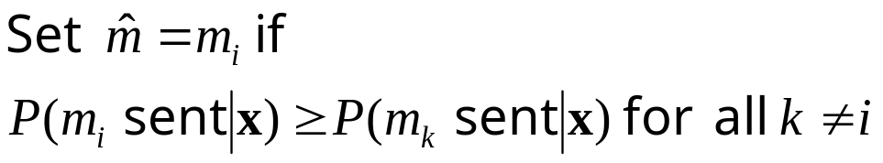
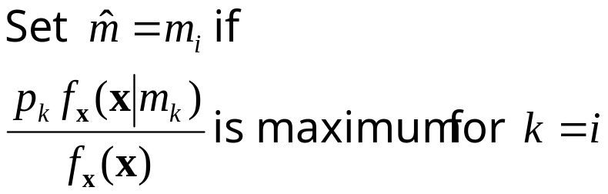

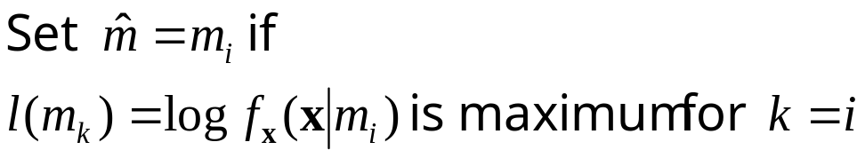
The Optimum Decision Rule
The maximum a posteriori probability (MAP) rule:
The maximum likelihood rule:

Slide 21
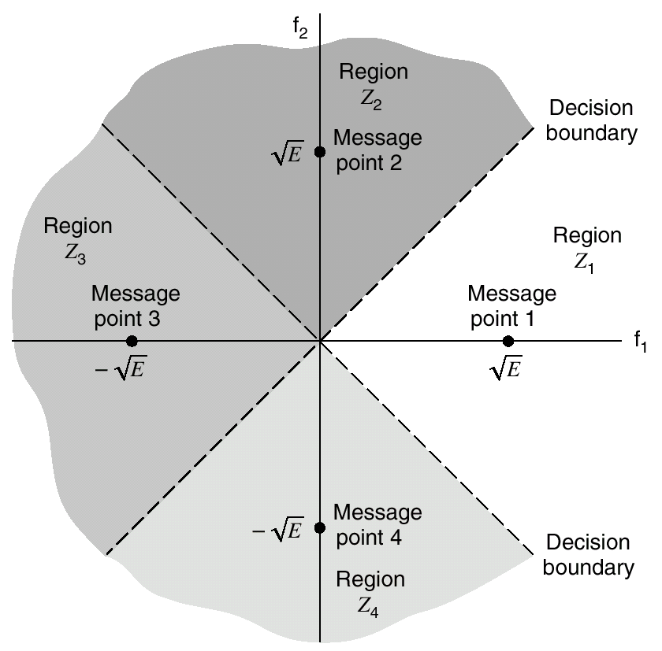

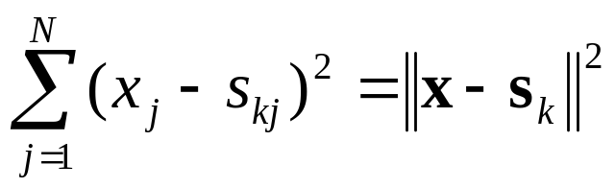
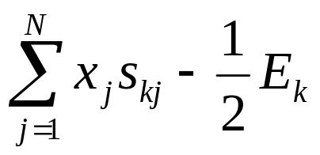
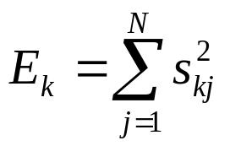

The Optimum Decision Rule (cont’d)
With AWGN channel:
Maximizing:
Equals minimizing:
Equals maximizing:
Fig. 5. An illustration of the decision rule with AGWN channel.

Slide 22
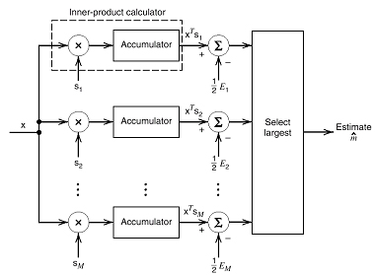
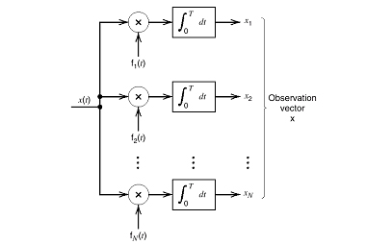
5.6 Correlation Receiver
Fig. 6. The optimal receiver (1).

Slide 23
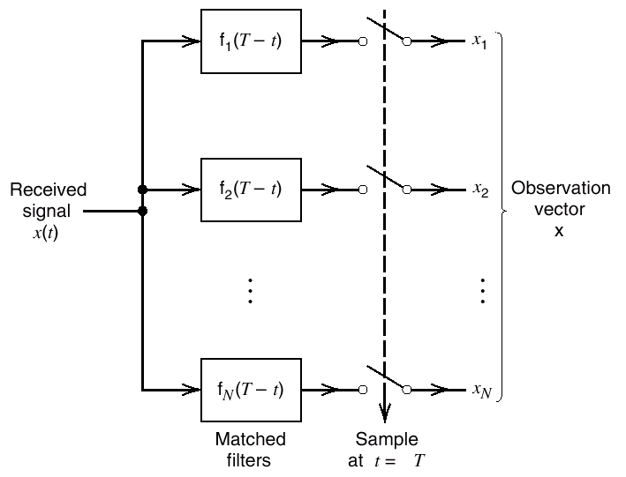
5.6 Correlation Receiver (cont’d)
Fig. 7. The optimal receiver (2).

Slide 24
5.7 Probability of Error
Average probability of symbol error
Invariance of the probability of error to rotation and translation
Minimum energy signals
Union bound on the probability of error
Bit versus symbol error probabilities

Slide 25
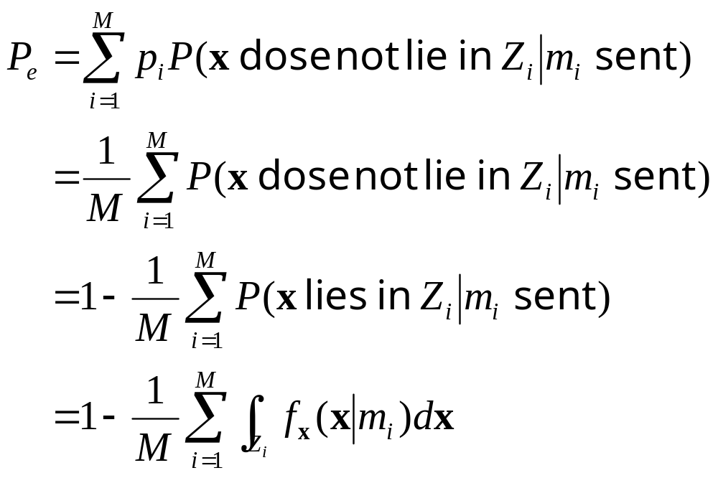
Average Probability of Symbol Error
Z_{i}: Region in the observation space corresponding to decision m_{i}.

Slide 26
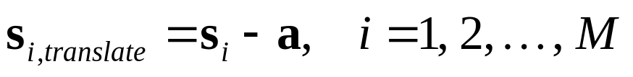
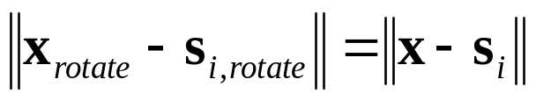
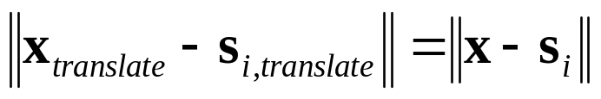
Invariance of the Probability of Error to Rotation and Translation
Rotation:
Translation:
Distance invariance:
Maximum likelihood detection
AWGN channel
Error probability invariance

Slide 27
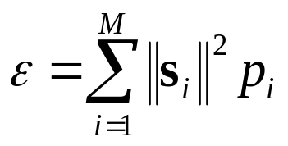
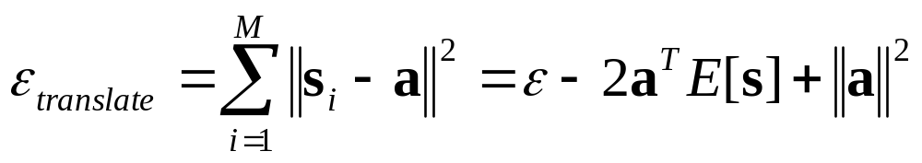
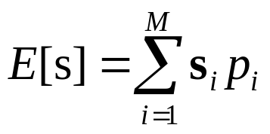
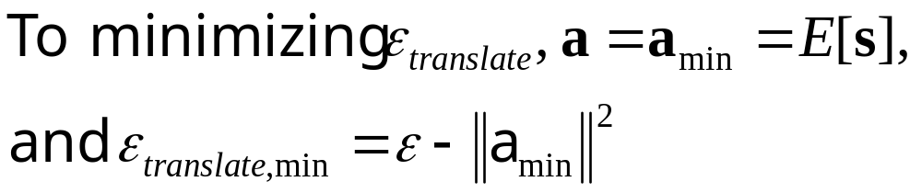
Minimum Energy Signals
Energy of a signal constellation:
Translating the signal constellation by a vector amount a:
where

Slide 28
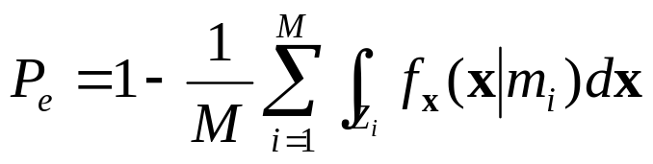
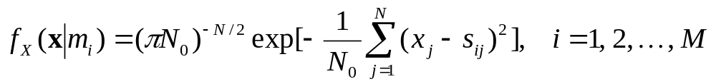
Union Bound on the Probability of Error
For AWGN channel, the symbol error probability is:
where
The above formulations are impractical to calculate
Using bounds
Union bound: one of the bounds, made by simplifying the integral in the top formulation

Slide 29




Union Bound (cont’d)
The probability of x is closer to s_{k} than s_{i}, when s_{i} is sent is:
and
Fig. 8. Illustrating the union bound.
(a) Constellation of four message points. (b) Three constellations with a common message point and one other message point retained from the original constellation.

Slide 30




Union Bound (cont’d)
The signal constellation is circularly symmetric about the origin
Using the minimum distance d_{min}

Slide 31


Bit Versus Symbol Error Probabilities
In general, there are no unique relationships between symbol error probability and Bit Error Rate (BER).
In the following two special cases, there are some relationships.
Case 1: Gray Coding
Case 2: M = 2^{K}, and equal symbol error probability

Slide 32
5.8 Summary and Discussion
Signal space analysis: representing each signals by an N-dimensional orthonormal vector.
Maximum likelihood detection: deducing the most likely transmitted symbol from the channel output.
Symbol error probability
  The union bound
  The relationship to BER

