Slide 1
Ch.6 Passband Data Transmission
Problems: (P468-478)
6.2 6.4 6.15 6.16 6.22 6.30 6.33 6.35 6.37

Slide 2
Ch.6 Passband Data Transmission
6.1 Introduction
6.2 Passband Transmission Model
6.3 Coherent Phase-Shift Keying
6.4 Hybrid Amplitude/Phase Modulation Schemes
6.5 Coherent Frequency-Shift Keying
6.6 Detection of Signals with Unknown Phase
6.7 Noncoherent Orthogonal Modulation
6.8 Noncoherent Binary Frequency-Shift Keying
6.9 Differential Phase-Shift Keying
6.10 Comparison of Digital Modulation Schemes Using a Single Carrier
6.11 Voiceband Modulation
6.12 Multichannel Modulation
6.13 Discrete Multitone
6.14 Synchronization
6.15 Computer Experiments: Carrier Recovery and Symbol Timing
6.16 Summary and Discussion

Slide 3
6.1 Introduction
Digital Passband Transmission
Hierarchy of Digital Modulation Techniques
Some Basic Concepts
  Probability of error
  Power spectra
  Bandwidth efficiency

Slide 4
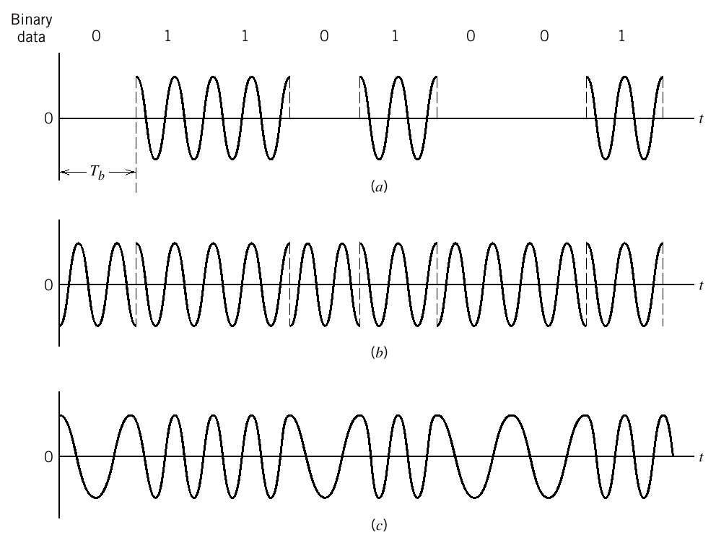
Digital Passband Transmission
Date transmission by modulating a carrier (usually sinusoidal)
“Keying” – Switching the amplitude, frequency, or phase of a sinusoidal carrier
  ASK
  PSK
  FSK
Fig. 1. Illustrative waveforms for the three basic forms of signaling binary information.
(a) Amplitude-shift keying. (b) Phase-shift keying. (c) Frequency-shift keying with continuous phase.

Slide 5
Hierarchy of Digital Modulation Techniques
M-ary signaling schemes
  M-ary ASK (M-ASK), M-ary PSK (M-PSK), and M-ary FSK (M-FSK)
  M-ary QAM (M-QAM) – a special case of M-ary APK (M-APK)
  Reduction in transmission bandwidth over binary schemes
Constant and non-constant envelope modulation schemes
Coherent and noncoherent systems
  Coherent systems: synchronized in both frequency and phase (M-PSK, M-QAM, M-FSK)
  Noncoherent systems (M-DPSK and M-FSK)

Slide 6
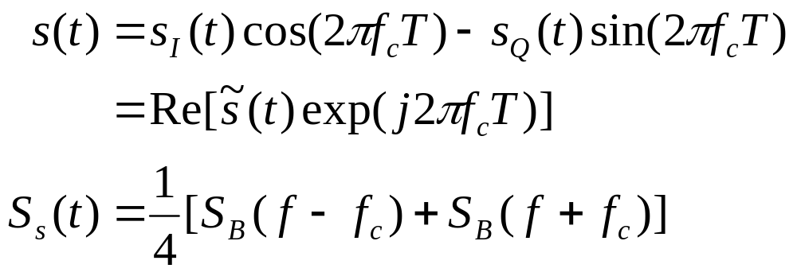
Some Basic Concepts
Probability of error
  Minimizing average symbol error probability in AWGN channels
  Exact formulas or the union bound
Power spectra

Slide 7
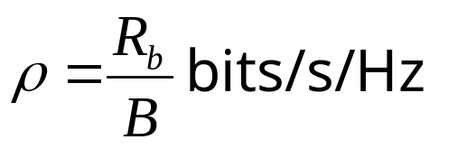
Some Basic Concepts (cont’d)
Bandwidth efficiency
  Definition: The ratio of data rate to the effectively utilized channel bandwidth
  Objectives:
    Maximizing ρ
    Using minimum average power (or SNR)
  Two factors affecting ρ
    Multilevel encoding
    Spectral shaping

Slide 8
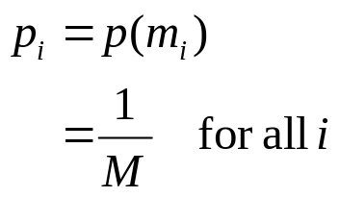
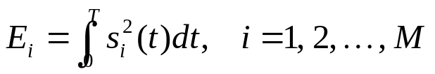
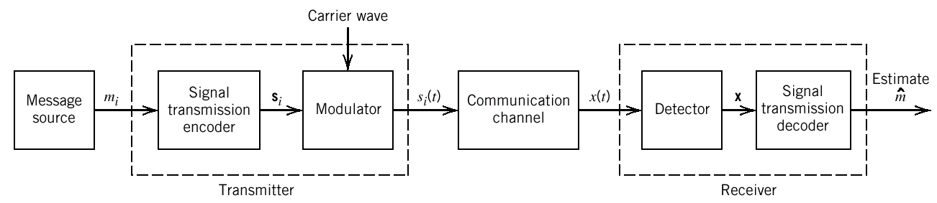
6.2 Passband Transmission Model
Fig. 2. Functional model of passband data transmission system.

Slide 9
6.3 Coherent Phase-Shift Keying
Schemes covered
  Binary PSK (BPSK)
  QPSK and its variants
  M-PSK
Contents
  Signal-space diagram
  Error probability
  Generation and detection of signals
  Power spectra

Slide 10
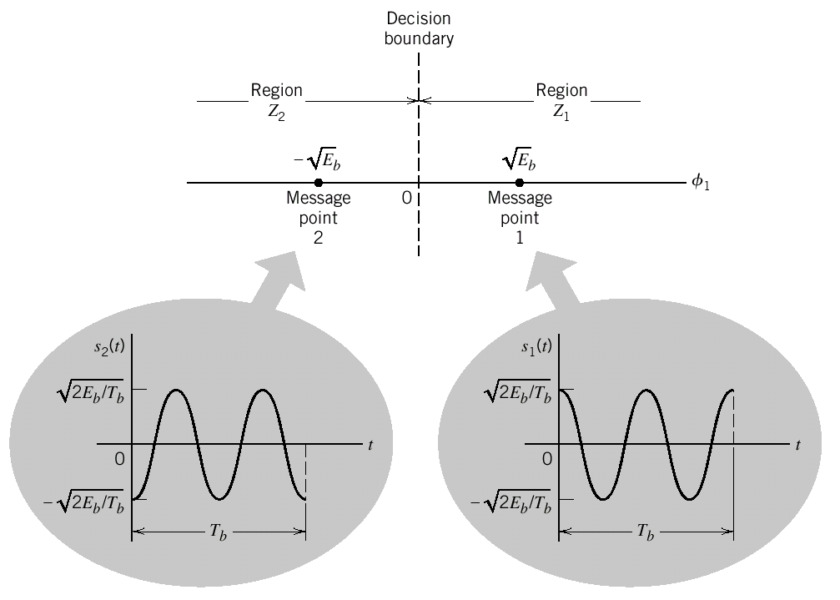
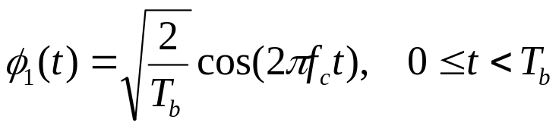
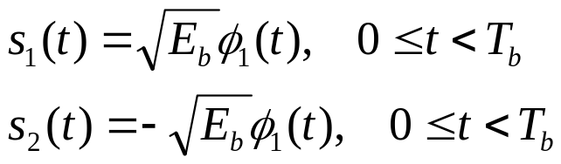
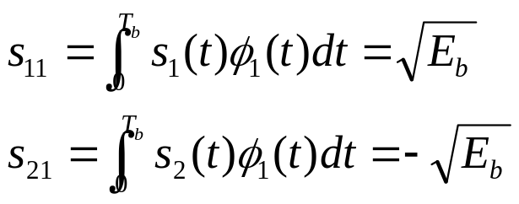
BPSK – Signal-Space Diagram
Fig. 3. Signal-space diagram for coherent BPSK system. The waveforms depicting the transmitted signals s₁(t) and s₂(t), displayed in the inserts, assume n_{c} = 2.

Slide 11

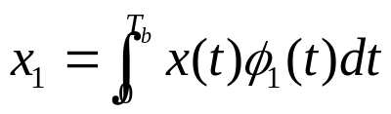
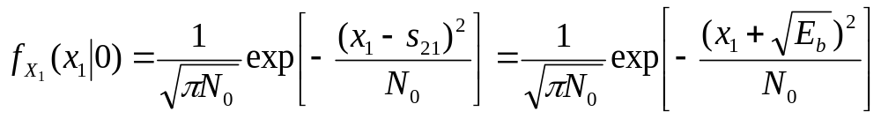
BPSK – Error Probability
The decision region associated with symbol 1
The observable element
The conditional pdf of X₁, given that symbol 0 was transmitted

Slide 12
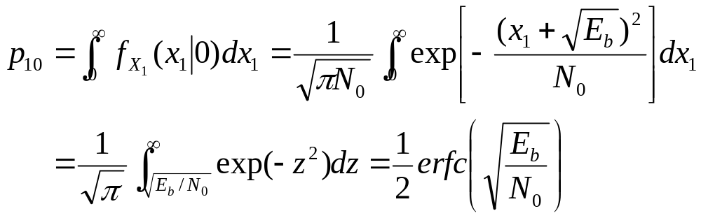
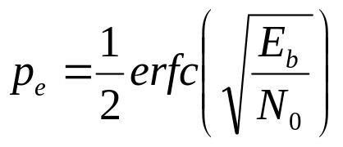
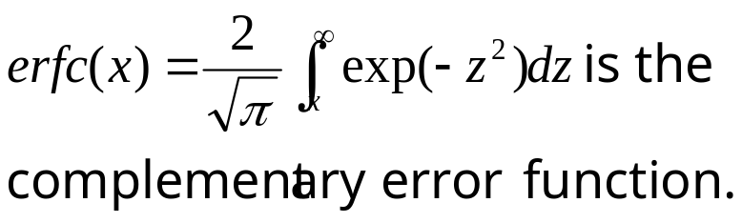
BPSK – Error Probability (cont’d)
The conditional probability of the receiver deciding in favor of symbol 1, given that symbol 0 was transmitted
The overall average symbol error probability (in the case of BPSK, also the Bit Error Rate (BER))

Slide 13
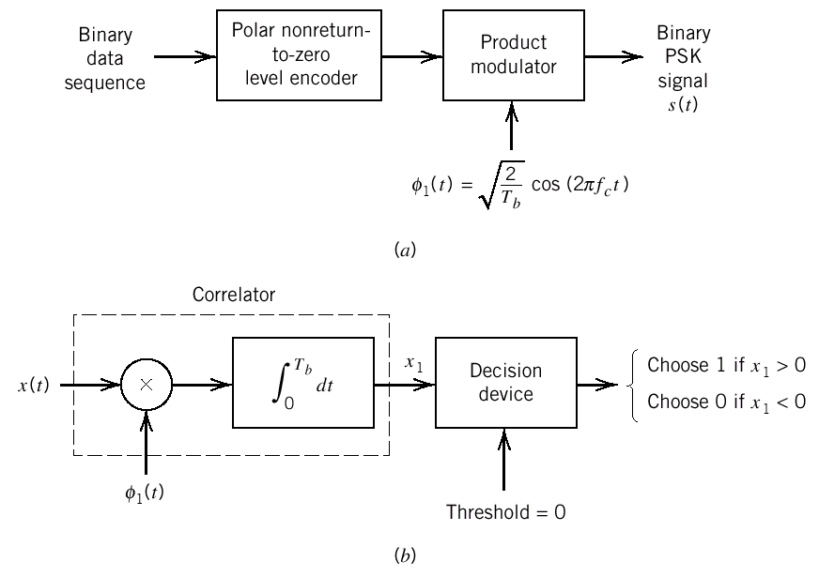
BPSK – Generation and Detection of Coherent BPSK Signals
Fig. 4. Block diagrams for (a) binary PSK transmitter and (b) coherent binary PSK receiver.

Slide 14
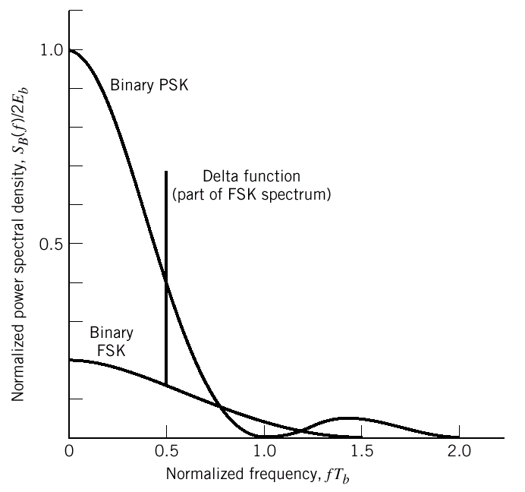
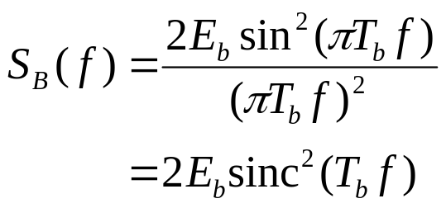
BPSK – Power Spectra
Fig. 5. Power spectra of binary PSK and FSK signals.

Slide 15
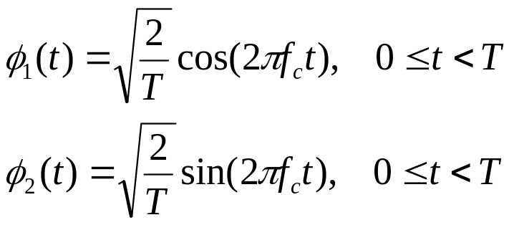
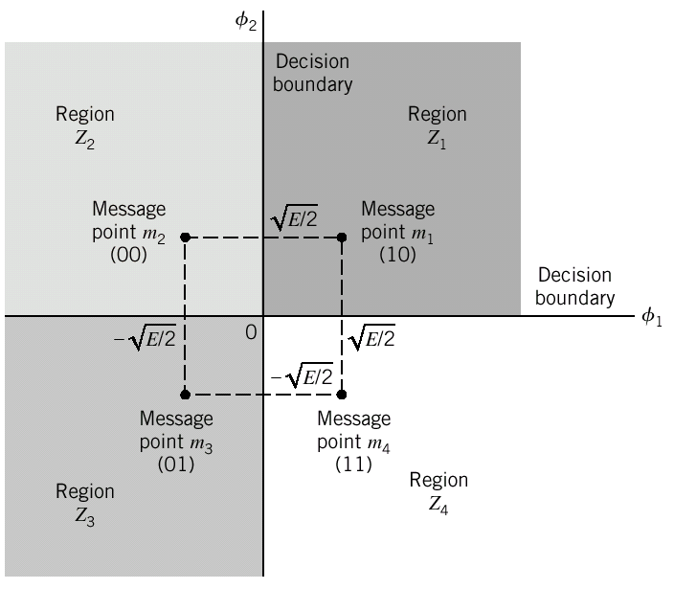
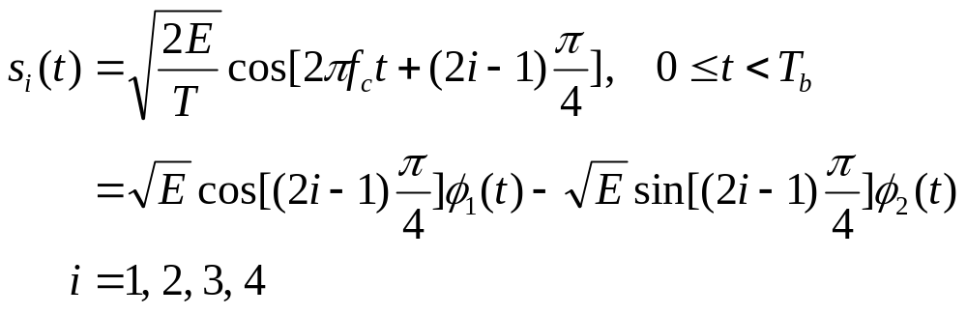
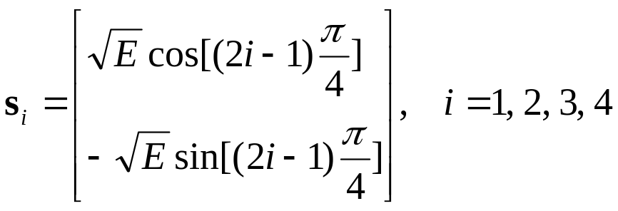
QPSK – Signal-Space Diagram
Fig. 6. Signal-space diagram of coherent QPSK system.

Slide 16
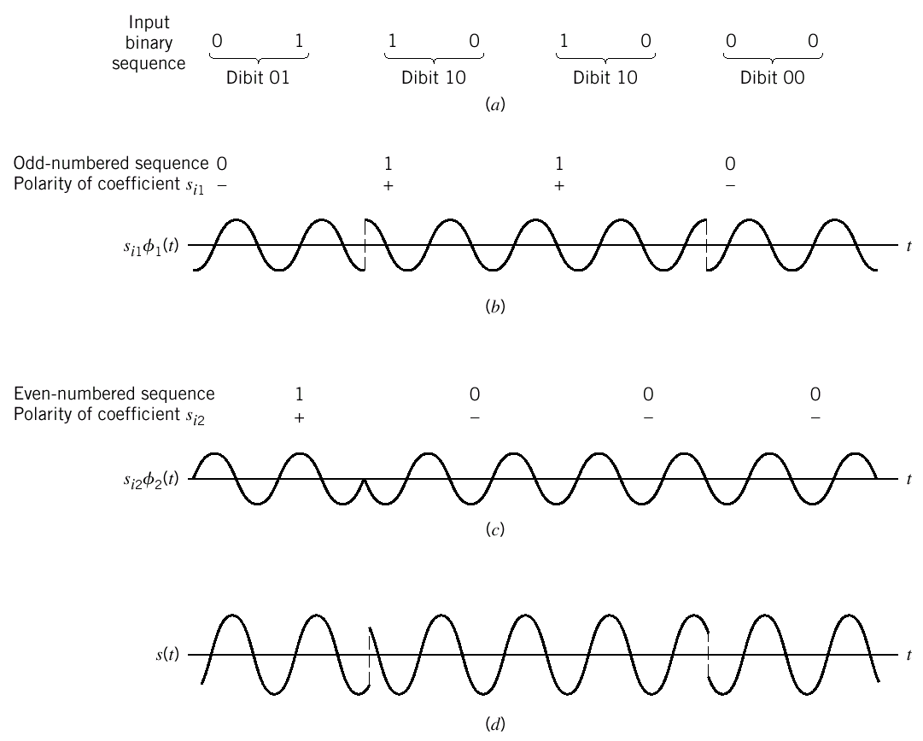
QPSK – An Example
Fig. 7. (a) Input binary sequence. (b) Odd-numbered bits of input sequence and associated binary PSK wave. (c) Even-numbered bits of input sequence and associated binary PSK wave. (d) QPSK waveform defined as s(t) = s_{i1}f₁(t) + s_{i2}f₂(t).

Slide 17
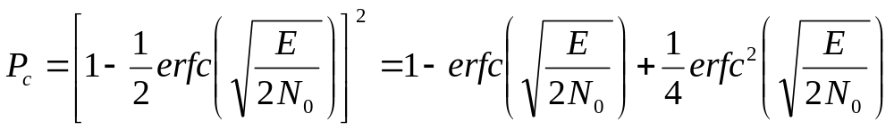
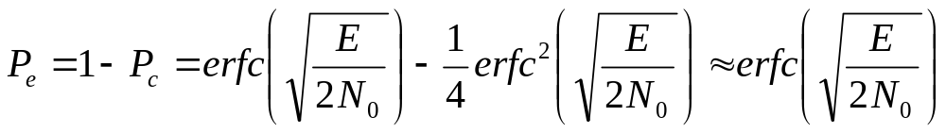
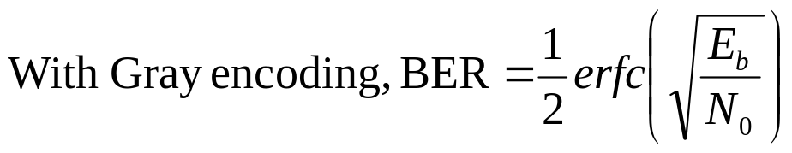
QPSK – Error Probability
A QPSK system = Two BPSK systems
( P_{e} can also be derived by using the Union Bound)

Slide 18
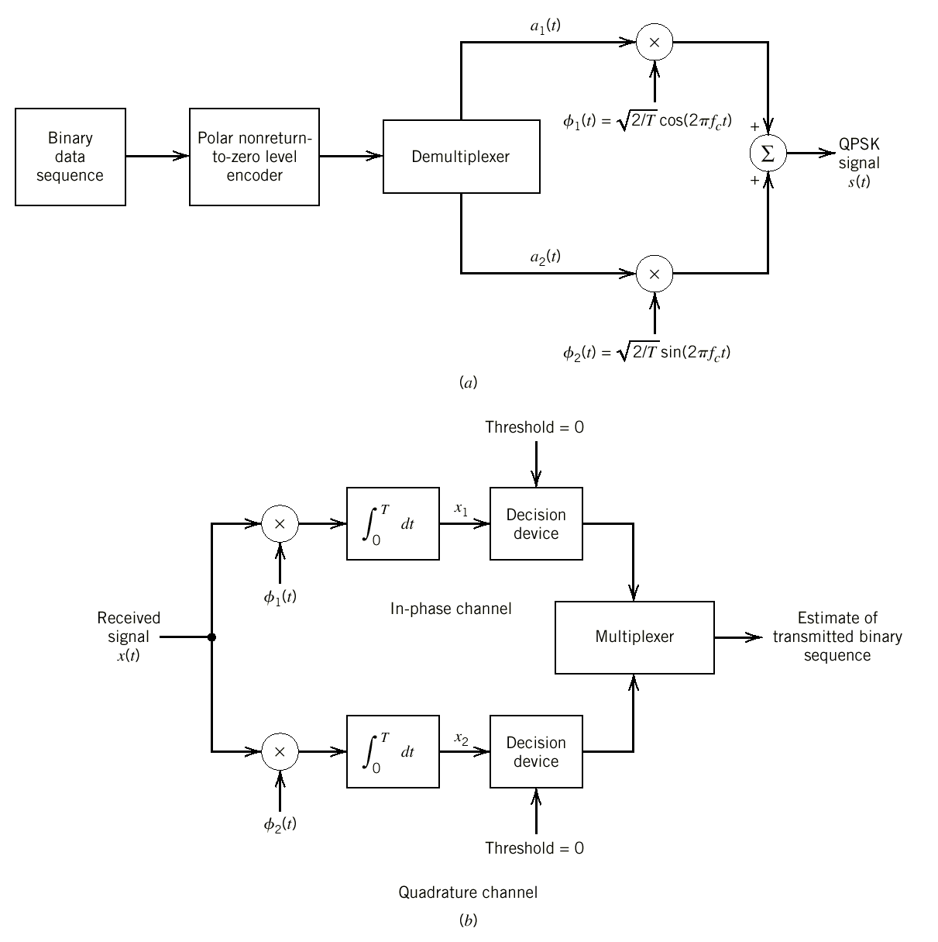
QPSK – Generation and Detection of Coherent QPSK Signals
Fig. 8. Block diagrams of (a) QPSK transmitter and (b) coherent QPSK receiver.

Slide 19
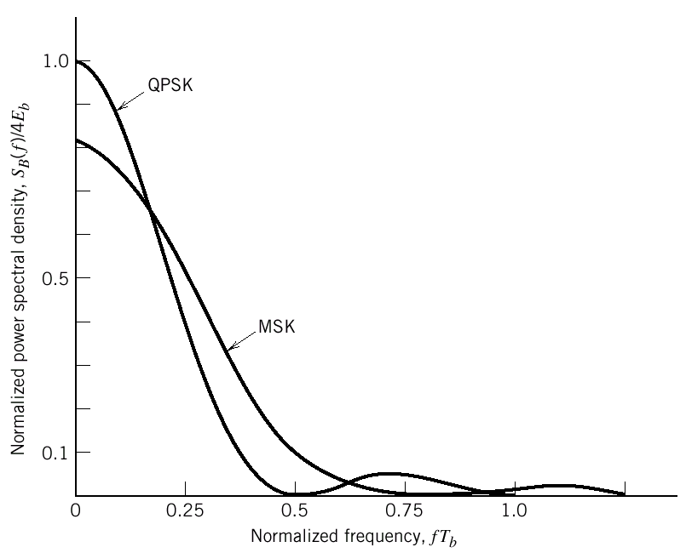
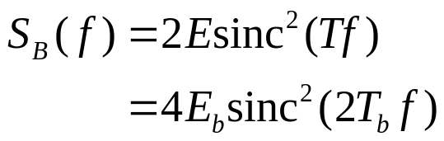
QPSK – Power Spectra
Fig. 9. Power spectra of QPSK and MSK signals.

Slide 20
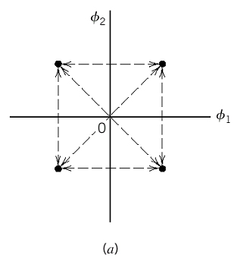
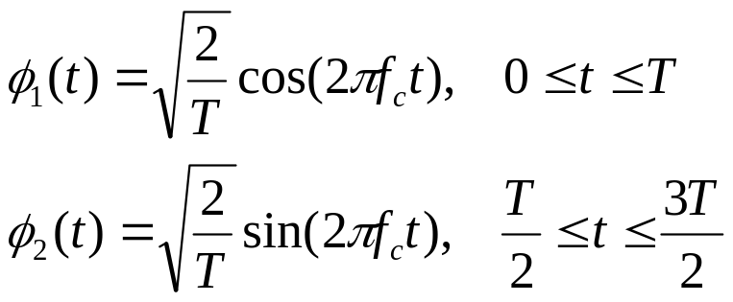
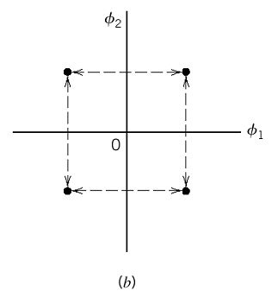
Offset QPSK
Phase transitions are confined to ±90°
  Compared to QPSK, amplitude fluctuations due to filtering is reduced
The same error probability with QPSK
Fig. 10. Possible paths for switching between the message points in (a) QPSK and (b) offset QPSK.

Slide 21
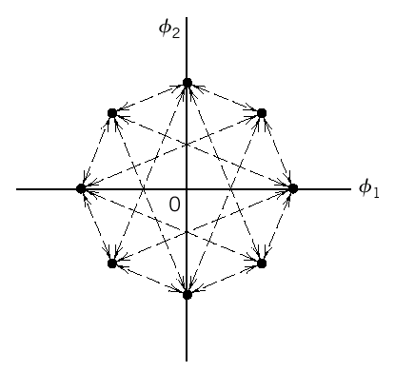
π/4-Shifted QPSK
Having 8 possible phase states and possible phase changes are π/4, 3π/4, -3π/4, and -π/4
Compared to QPSK, envelope variations due to filtering are significantly reduced
Compared to offset QPSK, can be noncoherently detected
Fig. 11. Eight possible phase states for the π/4-shifted QPSK modulator.

Slide 22
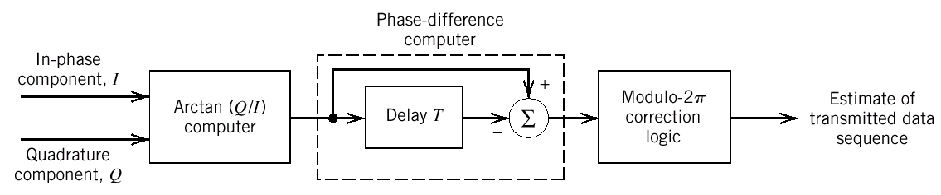
π/4-Shifted QPSK (cont’d)
Fig. 12. Block diagram of the π/4-shifted DQPSK detector.

Slide 23
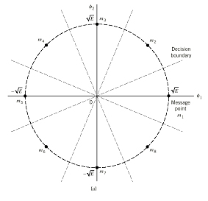
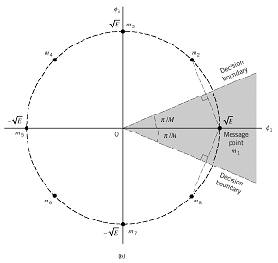
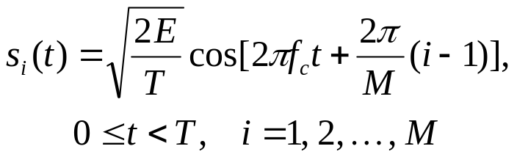
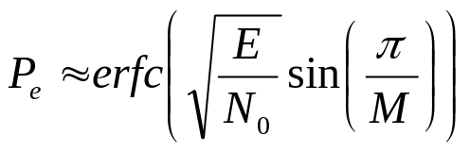
M-PSK – Signal-Space Diagram and Error Probability
Fig. 13. (a) Signal-space diagram for 8-PSK. The decision boundaries are shown as dashed lines. (b) Signal-space diagram illustrating the application of the union bound for 8-PSK.

Slide 24
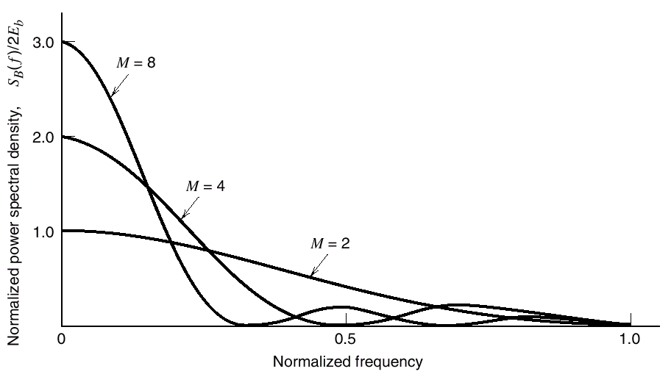
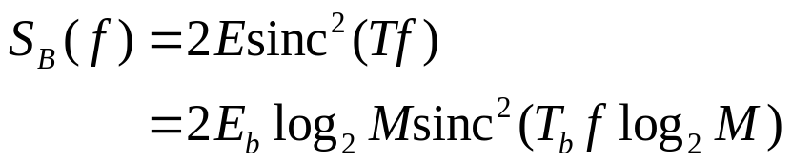
M-PSK – Power Spectra
Fig. 14. Power spectra of M-ary PSK signals for M = 2, 4, 8.

Slide 25
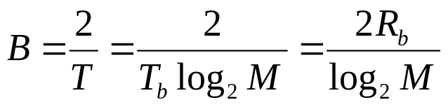
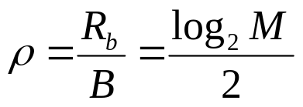
M-PSK – Bandwidth Efficiency
Table 1. Bandwidth efficiency of M-PSK signals
M 2 4 8 16 32 64
ρ (bits/s/Hz) 0.5 1 1.5 2 2.5 3
Error performance
(Require more E_{b}/N₀)
M
ρ

Slide 26
6.4 Hybrid Amplitude/Phase Modulation Schemes
Phase modulation schemes (M-PSK)
  The envelop is constant
Hybrid amplitude/phase modulation schemes (QAM and CAP)
  The in-phase and quadrature component are independent, so that the envelop will not be constant
  QAM and CAP have the same signal constellations and performance

Slide 27

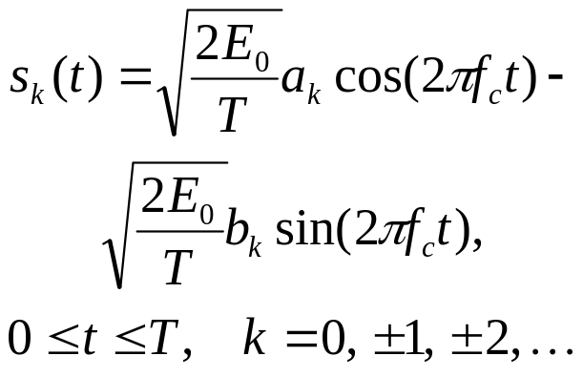
M-QAM
M-QAM stands for “M-ary quadrature amplitude modulation” – is a two dimensional generalization of M-PAM
Two types of QAM constellations (assuming M = 2^{n})
  Square constellation (n is an even number)
  Cross constellation (n is an odd number)

Slide 28
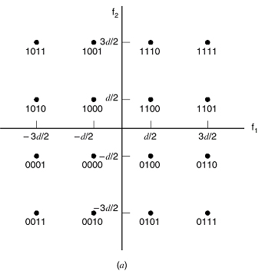
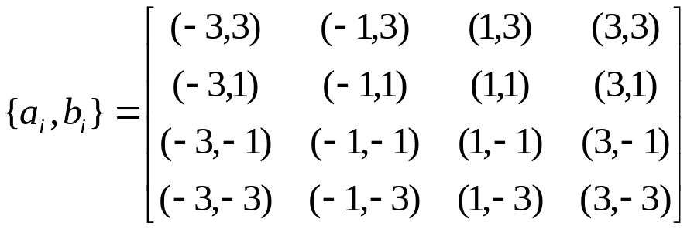
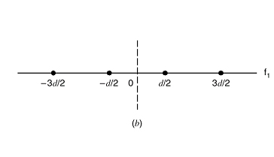
QAM Square Constellation – Signal-Space Diagram
Fig. 15. Signal-space diagram of (a) 16-QAM with Gray-encoding (b) the corresponding 4-PAM signal.

Slide 29
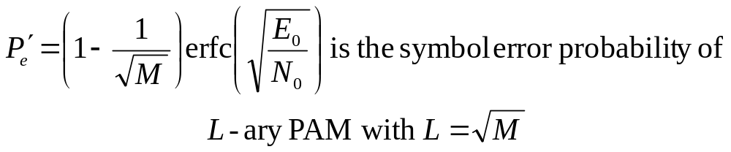
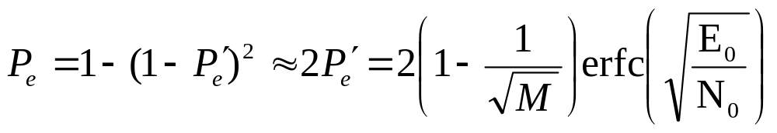
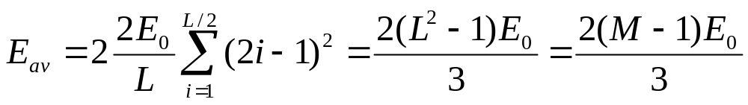
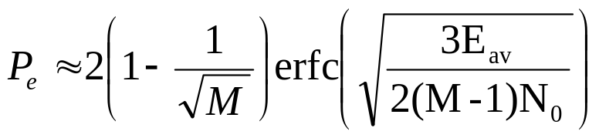
QAM Square Constellation –
Error Probability

Slide 30


QAM Cross Constellation
Perfect Gray coding is not possible.
Fig. 16. Illustrating how a square QAM constellation can be expanded to form a QAM cross-constellation.

Slide 31


CAP - Definition

Slide 32




CAP – Definition (cont’d)

Slide 33




CAP – Properties
Property 1
Property 2
Property 3
Makes it possible for a CAP receiver to separate the transmitted real and imaginary symbols from the channel output

Slide 34




CAP – Bandwidth-Efficient Spectral Shaping
Using baseband raised-cosine shaping filter
rolloff factor α = 0.2.
Fig. 17. The baseband pulse g(t).
Fig. 18. (a) In-phase pulse p(t), and
(b) quadrature pulse .

Slide 35

CAP – Generation and Detection of CAP Signals
Fig. 19. Block diagram of CAP transmitter.

Slide 36


CAP – Generation and Detection of CAP Signals (cont’d)
(a)
(b)
Fig. 20. Block diagram of CAP receivers (a) for an AWGN channel and (b) for a noisy and dispersive channel.

Slide 37

CAP – Generation and Detection of CAP Signals (cont’d)
Fig. 21. Digital implementation of the CAP receiver. (a) Using an A/D converter. (b) Replacement of the matched filter/equalizer pairs with equivalent (digitally implemented) FIR filters.

Slide 38
6.5 Coherent Frequency-Shift Keying
Coherent FSK is a nonlinear modulation scheme
  M-PSK and M-QAM are linear modulation schemes
Schemes covered in this section
  Binary FSK (BFSK)
  Minimum shift keying (MSK)
  Gaussian-filtered MSK (GMSK)
  M-ary FSK (M-FSK)

Slide 39






BFSK – Signal-Space Diagram
Fig. 22. Signal-space diagram for binary FSK system. The diagram also includes two inserts showing example waveforms of the two modulated signals s₁(t) and s₂(t).

Slide 40



BFSK – Error Probability
Compared to coherent BPSK, coherent B-FSK requires double SNR for the same performance.

Slide 41

BFSK – Generation and Detection of Coherent BFSK Signals
Fig. 23. Block diagrams for (a) binary FSK transmitter and (b) coherent binary FSK receiver.

Slide 42

BFSK – Power Spectra
Fig. 5. Power spectra of binary PSK and FSK signals.

Slide 43


MSK - Definition
Continuous Phase FSK (CPFSK)
h is named as “deviation ratio.” The minimum value of h that allow two FSK signals for symbols 1 and 0 to be coherently orthogonal is 1/2. A CPFSK signal with h = 1/2 is referred to as MSK.

Slide 44


MSK – Phase Trellis
Fig. 25. Phase trellis of MSK; boldfaced path represents the sequence 1101000.
Fig. 24. Phase tree of CPFSK.

Slide 45



MSK – Signal-Space Diagram

Slide 46




MSK – Signal-Space Diagram (cont’d)
Fig. 26. Signal-space diagram for MSK system.

Slide 47


MSK – An Example
Fig. 27. (a) Input binary sequence. (b) Waveform of scaled time function s₁φ₁(t). (c) Waveform of scaled time function s₂φ₂(t). (d) Waveform of the MSK signal s(t) obtained by adding s₁φ₁(t) and s₂φ₂(t) on a bit-by-bit basis.

Slide 48

MSK – Error Probability
MSK has the same error probability with BPSK and QPSK
With MSK, decision is made based on observations over 2T_{b} intervals

Slide 49

MSK – Generation and Detection of MSK Signals
Fig. 28. Block diagrams for (a) MSK transmitter and (b) coherent MSK receiver.

Slide 50

MSK – Power Spectra
Fig. 9. Power spectra of QPSK and MSK signals.

Slide 51


GMSK - Definition
GMSK is MSK with a baseband pulse-shaping filter, whose impulse response is defined by a Gaussian function.
GMSK has better out-of-band spectral characteristics than MSK.
The impulse response
The transfer function

Slide 52


GMSK – The Frequency Shaping Pulse
The time-bandwidth product WT_{b} is a design factor.
Fig. 29. Frequency-shaping pulse g(t) shifted in time by 2.5T_{b} and truncated at ±2.5T_{b} for varying time-bandwidth product WT_{b}.

Slide 53

GMSK – Power Spectra
Fig. 30. Power spectra of MSK and GMSK signals for varying time-bandwidth product. (Reproduced with permission from Dr. Gordon Stüber, Georgia Tech.)

Slide 54



GMSK – Error Performance
Fig. 31. Theoretical E_{b}/N₀ degradation of GMSK for varying time-bandwidth product. (Taken from Murata and Hirade, 1981, with permission of the IEEE.)

Slide 55

GMSK – Application in GSM
WT_{b} = 0.3
Bandwidth for each channel is 200 KHz
Data rate is 271 kb/s
99% of the radio frequency power is confined to a bandwidth of 250 KHz
Co-channel interference is negligible.
Fig. 32. Power spectrum of GMSK signal for GSM wireless communications.

Slide 56


M-FSK

Slide 57

M-FSK – Power Spectra
Fig. 33 Power spectra of M-ary FSK signals for M = 2, 4, 8.

Slide 58


M-FSK – Bandwidth Efficiency
Table 2. Bandwidth efficiency of M-FSK signals
M 2 4 8 16 32 64
ρ (bits/s/Hz) 1 1 0.75 0.5 0.3125 0.1875
M
ρ

Slide 59
6.6 Detection of Signals with Unknown Phase
In some cases, carrier phase recovery is difficult
  Variable multipath channels
  Rapidly varying delays
A digital receiver without carrier phase recovery is said to be “noncoherent”
An optimum quadratic receiver and its two equivalent forms

Slide 60




Optimum Quadratic Receiver
I₀(x) is the modified Bessel function of zero order.

Slide 61


Optimum Quadratic Receiver (cont’d)
Since I₀(x) is a monotonically increasing function, comparison between L(s_{i}) is equivalent to comparison between l_{i}, and also to that of l_{i}².
The decision rule:
Fig. 34. Quadrature receiver using correlators.

Slide 62



Two Equivalent forms of the
Quadratic Receiver
(a)
(b)
Fig. 35. Noncoherent receivers. (a) Quadrature receiver using matched filters. (b) Noncoherent matched filter.
Fig. 36. Output of matched filter for a rectangular RF wave: (a) θ = 0, and (b) θ = 180°.

Slide 63
6.7 Noncoherent Orthogonal Modulation
Noncoherent orthogonal modulation
  The signals s₁(t) and s₂(t) are orthogonal and have the same energy.
  The channel shifts the carrier phase of the signals, and the shifted signals g₁(t) and g₂(t) are also orthogonal and have the same energy.
  Generalized binary receivers and average error probability
  Noncoherent BFSK and DPSK

Slide 64



Generalized Binary Receivers
Fig. 37. (a) Generalized binary receiver for noncoherent orthogonal modulation. (b) Quadrature receiver equivalent to either one of the two matched filters in part (a); the index i = 1, 2.

Slide 65



6.8 Noncoherent BFSK
The transmitted signal:
Bit error rate:
Fig. 38. Noncoherent receiver for the detection of BFSK signals.

Slide 66



6.9 Differential Phase-Shift Keying (DPSK)
DPSK is a noncoherent version of PSK
  At the transmitter: differential encoding + phase-shift keying
  At the receiver: retrieving data from relative phase difference between two successive bit intervals
An example of noncoherent orthogonal modulation with T = 2T_{b} and E = 2E_{b}
Bit error rate:

Slide 67

Generation of DPSK Signals
Table 3. Illustrating the generation of DPSK signals
{b_{k}} 1 0 0 1 0 0 1 1
{d_{k-1}} 1 1 0 1 1 0 1 1
{d_{k}} 1 1 0 1 1 0 1 1 1
Transmitted phase 0 0 π 0 0 π 0 0 0
Fig. 39. Block diagram of DPSK transmitter.

Slide 68


Detection of DPSK Signals
Fig. 40. Block diagram of DPSK receiver.
Fig. 41. Signal-space diagram of received DPSK signal.

Slide 69
6.10 Comparison of Digital Modulation Schemes Using a Single Carrier
Probability of error (BER) of
  coherent schemes including BPSK, QPSK, BFSK, and MSK and
  noncoherent schemes including noncoherent BFSK and DPSK
Bandwidth efficiency of M-PSK, M-QAM, and M-FSK

Slide 70





Comparison of BER over AWGN Channels
Coherent BPSK, QPSK, and MSK
Coherent BFSK
DPSK
Noncoherent BFSK
Fig. 42. Comparison of the noise performance of different PSK and FSK schemes.

Slide 71
Comparison of Bandwidth Efficiency
Higher order M-PSK schemes have higher bandwidth efficiency, but require more power.
  Among the M-PSK schemes, QPSK offers the best trade-off between power and bandwidth requirements, and thus widely used in practice.
M-QAM outperforms M-PSK in error performance for M > 4
  M-QAM requires that the channel is free of nonlinearities.
M-FSK schemes behave in an opposite manner to that of M-PSK schemes

Slide 72
Stop Here This Term!

Slide 73
6.11 Voiceband Modems
Modem
  A contraction of modulator-demodulator
  A conversion device for transmission and reception of data over the Public Switched Telephone Network (PSTN)
We focus on modems providing communications between a user and an Internet Service Provider (ISP)
  Two classes of configurations: symmetric and asymmetric

Slide 74

Two Classes of Modem Configurations
Fig. 43. (a) Environmental overview of symmetric modem configuration: the upstream and downstream data rates are equal. (b) Environmental overview of “asymmetric” modem configuration: data rate downstream is higher than upstream.

Slide 75
Symmetric Modem Configurations
The configuration is symmetric in that:
  Modems at both the user end and the ISP end are the same (the analog modem)
  The downstream (from the ISP to the user) and upstream (from the user to the ISP) data rates are the same
Including a large number of modem types with data rates ranging from 300 b/s to 36600 b/s
In the following, taking the popular V.32 standard as an example (carrier frequency = 1800 Hz, modulation rate = 2400 bauds, and data rate is up to 9600 b/s)

Slide 76

The V.32 Standard
Two modulation schemes
  Nonredundant coding (16-QAM)
  Trellis coding (Convolutional encoding + 32-QAM)
    4 dB effective coding gain
    SNR must be high enough
Employing differential encoding in both schemes
  90°rotational invariance is mandated
Fig. 44. Gray encoding of the four quadrants and dibits in each quadrant for the V.32 modem. The dashed arrows illustrate the 90°rotational invariance.

Slide 77

The V.32 Standard (cont’d)
Fig. 45. Block diagrams of V.32 modem. (a) Nonredundant coding. (b) Trellis coding.

Slide 78

The V.32 Standard (cont’d)
Fig. 46. Signal constellation of V.32 modem using (a) nonredundant coding. (b) trellis coding.

Slide 79
Asymmetric Modem Configurations
The PSTN is almost digital except the local loop, which is analog
  A digital PSTN uses PCM for voice signal transmission
  64 kb/s data signaling rate (8 kHz sampling rate and 8-bit coding for each sample)
Analog modem at the user end and digital modem at the ISP end
  No ADC between the ISP’s digital modem and the digital PSTN
  Downstream data rate can be higher than upstream data rate

Slide 80
Digital and Analog Modems
Digital modem
  Bandwidth of the baseband filter is about 3.5 kHz
  Achievable data rate is up to 56 kb/s
Analog modem
  The same baseband filter as that of digital modem
  Performance is limited by quantization noise
  The V.34 modem achieves data rate up to 33.6 kb/s
V.90 modem
  Includes both digital and analog modems

Slide 81
6.12 Multichannel Modulation
Multichannel modulation
  Dividing a wideband channel with severe intersymbol interference into a large number of subchannels, each may be viewed effectively as an AWGN channel
This subsection introduces
  Capacity of AWGN channel
  Continuous-time channel partitioning
  The concept of geometric SNR
  Loading

Slide 82


Capacity of AWGN Channel
The channel capacity:
Γ: signal-to-noise ratio gap
P: transmitted signal power
σ²: channel noise variance measured over the bandwidth B
The realistic data rate:

Slide 83

Continuous-Time Channel Partitioning
Fig. 47. Staircase approximation of an arbitrary magnitude response |H(f)|; only positive-frequency portion of the response is shown.

Slide 84




Continuous-Time Channel Partitioning (cont’d)
The passband basis functions:
Fig. 48. Block diagram of multichannel data transmission system.

Slide 85



Continuous-Time Channel Partitioning (cont’d)
Properties of the passband basis functions:
Property 1
Property 2
Property 3

Slide 86



Geometric Signal-to-Noise Ratio

Slide 87




Loading
Taking into account the effect of channel:
With the constraint that

Slide 88

Loading (cont’d)
Fig. 49. Water-filling interpretation of the loading problem.

Slide 89
6.13 Discrete Multitone
Discrete MultiTone (DTM)
  Transforming a wideband channel into a set of N subchannels operating in parallel
  The transformation is discrete in both time and frequency
  The communication system has a linear matrix representation, and Discrete Fourier Transform (DFT) (as well as Fast Fourier Transform (FFT)) can be used for system implementation
  Having applications in Asymmetric Digital Subscriber Lines (ADSL) and Very-high-rate Digital Subscriber Lines (VDSL)
  A closely relative technology is Orthogonal Frequency Division Multiplexing (OFDM)

Slide 90






Matrix Representation of a DMT system
A circulant matrix, spectral decomposition (and therefore DFT) is possible
Fig. 50. Discrete-time representation of multichannel data transmission system.

Slide 91


DFT/IDFT
The analysis function
The synthesis function
X is the DFT of x, and x is the IDFT (Inverse DFT) of X.

Slide 92





DFT/IDFT (cont’d)
Spectral decomposition
Q is an orthonormal matrix or unitary matrix

Slide 93





Frequency-Domain Description of the Channel
IDFT of S
Transmitter input in frequency domain
DFT of x

Slide 94

DFT-Based DMT System
Fig. 51. Block diagram of the DMT data-transmission system.

Slide 95
Applications of DMT
ADSL
  Transmission over twisted pairs
  Date rates: 1.544 Mb/s downstream and 160 kb/s upstream
VDSL
  Transmission over twisted pairs emanating from an optical network unit within 1 km
  Data rates: 13 – 26 Mb/s downstream and 2 –3 Mb/s upstream
Advantages of using DMT for ADSL and VDSL
  The ability to maximize the transmitted bit rate
  Adaptivity to changing line conditions
  Reduced sensitivity to impulse noise

Slide 96

Comparison of xDSL and Voiceband Modems
Fig. 52. (a) Voiceband modem environment. (b) xDSL environment, where x stands for A in ADSL and V in VDSL.

Slide 97
OFDM
OFDM is very similar to DMT
OFDM is used for wireless communications
  Since the channel varies rapidly, loading is not used by OFDM
  Upconverter/downconverter is used for frequency translation
  Typical applications
    4G wireless communications
    Digital audio broadcasting

Slide 98
6.14 Synchronization
Synchronization is the process of making and maintaining the transmitter and receiver synchronous.
Two aspects of synchronization
  Carrier recovery (carrier synchronization)
  Clock recovery (symbol synchronization)
Classification of synchronization methods
  Data-aided synchronization
  Nondata-aided synchronization
Two approaches
  Classical approach
  Algorithmic (modern) approach (This section discusses nondata-aided algorithmic approach for M-PSK.)

Slide 99


Decision-Directed Recursive Algorithm for Phase Recovery
Steps
  Formulating the log-likely hood function l(θ) for the carrier phase θ;
  Determining ∂ l(θ)/ ∂ θ;
  Finding a recursive algorithm for computing a maximum likelyhood estimate of θ.

Slide 100



Decision-Directed Recursive Algorithm for Phase Recovery (cont’d)
Fig. 53. Recursive Costas loop.
Fig. 54. Second-order digital filter.

Slide 101




Nondata-Aided Recursive Algorithm for Symbol Timing
Fig. 55. Nondata-aided early-late delay synchronizer.

Slide 102
6.15 Computer Experiments: Carrier Recovery and Symbol Timing
Illustrating the operations of the recursive Costas loop and nondata-aided early-late delay synchronizer
  Coherent QPSK system
  Channel response: raised cosine with rolloff factor α = 0.5
  First-order digital filter with transfer function H(z) = 1/(z-(1-γA))
  Loop bandwidth B_{L} = 2% of the symbol rate 1/T

Slide 103



Experiment 1: Carrier
Phase Recovery
Fig. 56. Scheme for measuring the S-curve for carrier phase recovery.
Fig. 57. Illustrating the effect of carrier phase θ on a state of the QPSK signal.

Slide 104

Experiment 1: Carrier
Phase Recovery (cont’d)
Fig. 58. Performance of recursive Costas loop. (a) S-curve for (E/N₀) = ∞. (b) S-curve for (E/N₀) = 10 dB.

Slide 105

Experiment 1: Carrier
Phase Recovery (cont’d)
Fig. 59. Effects of varying the step-size parameter on convergence behavior of the recursive Costas loop.

Slide 106

Experiment 1: Carrier
Phase Recovery (cont’d)
Fig. 60. Convergence behavior of the recursive Costas loop for varying E/N ₀.

Slide 107

Experiment 1: Carrier
Phase Recovery (cont’d)
Fig. 61. Comparison of the measured tracking-error variance of the recursive Costas loop against theory for varying E/N ₀.

Slide 108

Experiment 2: Symbol
Timing Recovery
Fig. 62. Scheme for measuring the S-curve for the recursive early-late-delay synchronizer.

Slide 109


Experiment 2: Symbol
Timing Recovery (cont’d)
Fig. 64. Comparison of tracking-error variance of the NDA-ELD synchronizer against theory for varying E/N₀ and two step-size parameters.
Fig. 63. S-curve of NDA-ELD synchronizer measured under noiseless and noisy conditions.

Slide 110
6.16 Summary and Discussion
Modulation schemes discussed
  PSK (BPSK, QPSK, M-PSK, and DPSK)
  QAM
  FSK (BFSK, M-FSK, MSK, and GMSK)
  CAP
  DMT/OFDM
Synchronization
  Carrier phase recovery
  Symbol timing recovery

