Slide 1
INST 798/808: A.I.-Powered Research Assistants
Basics of Embedding Spaces

Slide 2

Thus Far
Language modeling via next word prediction “unlocks magic”.
The history:
Ngrams
Count based modeling
Learning instead of counting

Slide 3
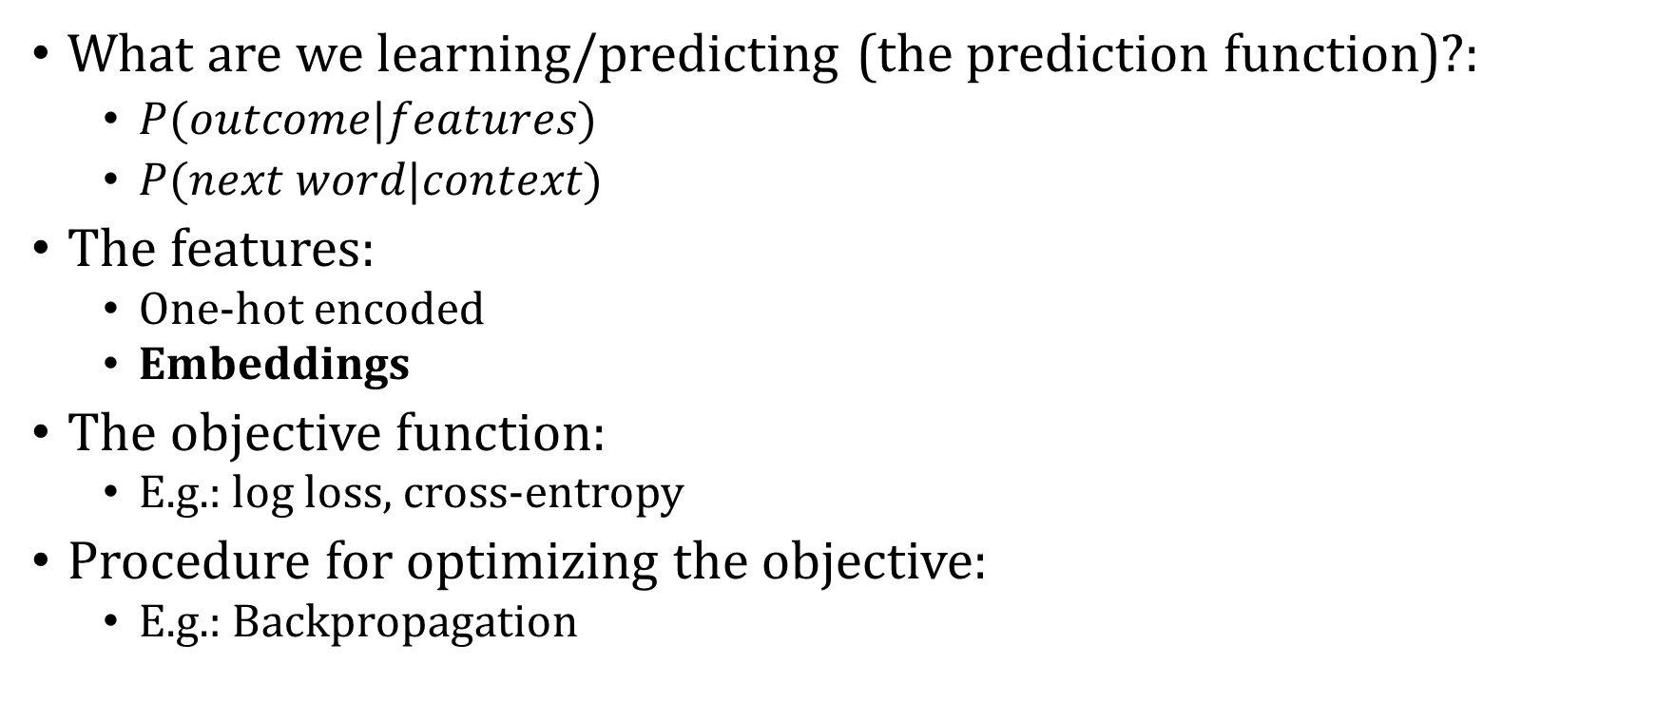
Dimensions of a learning algorithm
What are we learning/predicting (the prediction function)?:
$P(outcome|features)$
$P(next word|context)$
The features:
One-hot encoded
Embeddings
The objective function:
E.g.: log loss, cross-entropy
Procedure for optimizing the objective:
E.g.: Backpropagation

Slide 4
Today
Relate vector and matrix operations to neural networks (NN)
How hidden layer solves the XOR problem
i.e. how do NNs learn interactions?
Embedding spaces in word2vec skipgram model

Slide 5
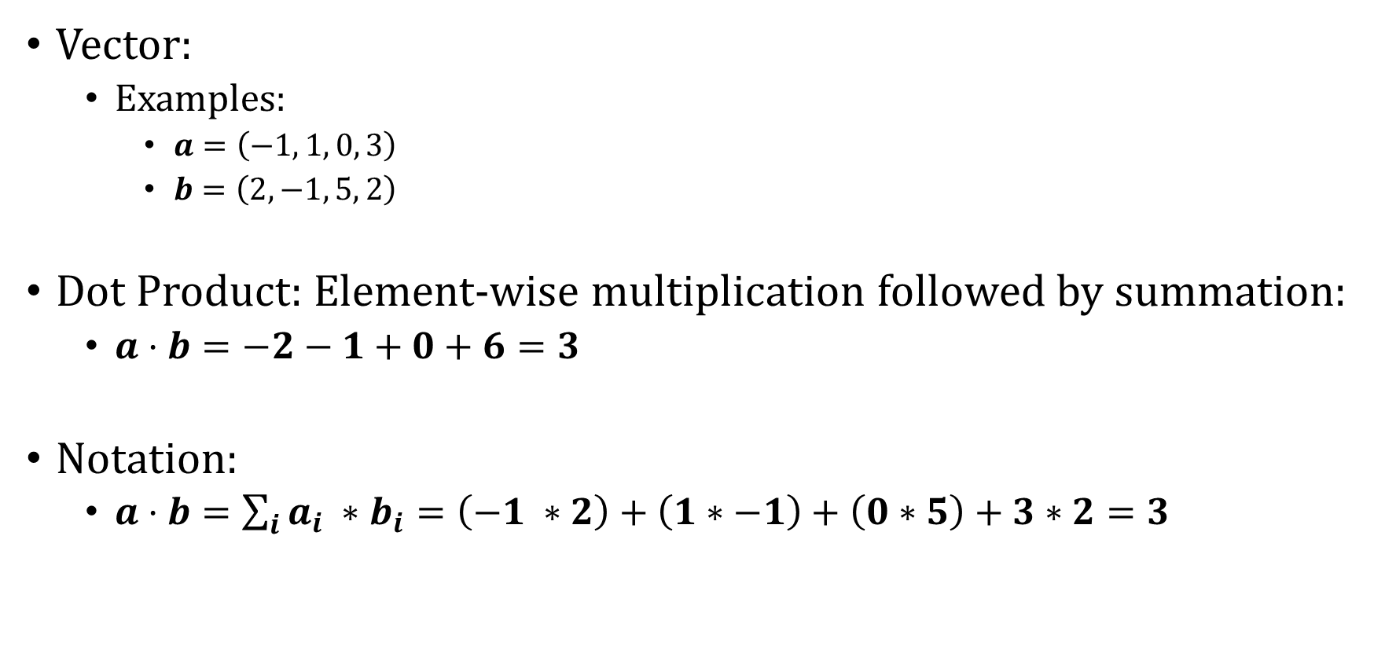
Preliminaries
Vector:
Examples:
$a=\left(−1, 1, 0, 3\right)$
$b=\left(2, −1, 5, 2\right)$
Dot Product: Element-wise multiplication followed by summation:
$a⋅b=−2−1+0+6=3$
Notation:
$a⋅b=\sum_{i}{a_{i} ∗b_{i}}=\left(−1 ∗2\right)+\left(1∗−1\right)+\left(0∗5\right)+3∗2=3$

Slide 6
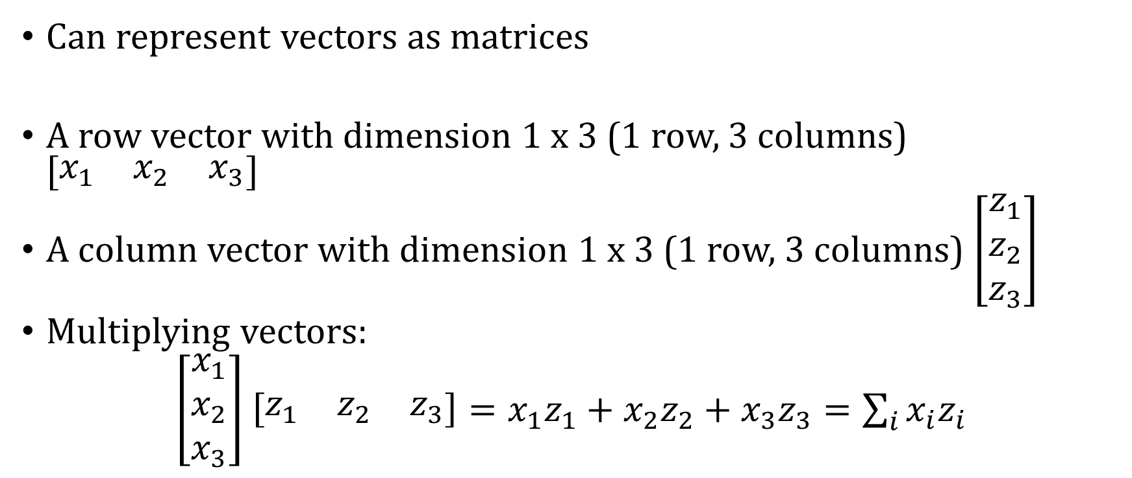
Row and Column Vectors
Can represent vectors as matrices
A row vector with dimension 1 x 3 (1 row, 3 columns) $\left[\begin{matrix}x_{1} & x_{2} & x_{3}\end{matrix}\right]$
A column vector with dimension 1 x 3 (1 row, 3 columns) $\left[\begin{matrix}z_{1} \\ z_{2} \\ z_{3}\end{matrix}\right]$
Multiplying vectors:
$\left[\begin{matrix}x_{1} \\ x_{2} \\ x_{3}\end{matrix}\right]$ $\left[\begin{matrix}z_{1} & z_{2} & z_{3}\end{matrix}\right]=x_{1}z_{1}+x_{2}z_{2}+x_{3}z_{3}=\sum_{i}{x_{i}z_{i}}$

Slide 7
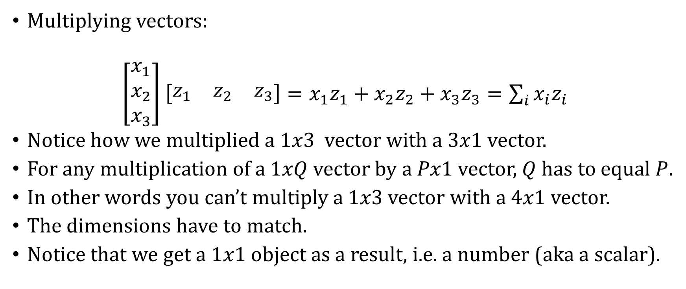
Row and Column Vectors
Multiplying vectors:
$\left[\begin{matrix}x_{1} \\ x_{2} \\ x_{3}\end{matrix}\right]$ $\left[\begin{matrix}z_{1} & z_{2} & z_{3}\end{matrix}\right]=x_{1}z_{1}+x_{2}z_{2}+x_{3}z_{3}=\sum_{i}{x_{i}z_{i}}$
Notice how we multiplied a $1x3$ vector with a $3x1$ vector.
For any multiplication of a 1$xQ$ vector by a $Px1$ vector, $Q$ has to equal $P$.
In other words you can’t multiply a $1x3$ vector with a $4x1$ vector.
The dimensions have to match.
Notice that we get a $1x1$ object as a result, i.e. a number (aka a scalar).

Slide 8
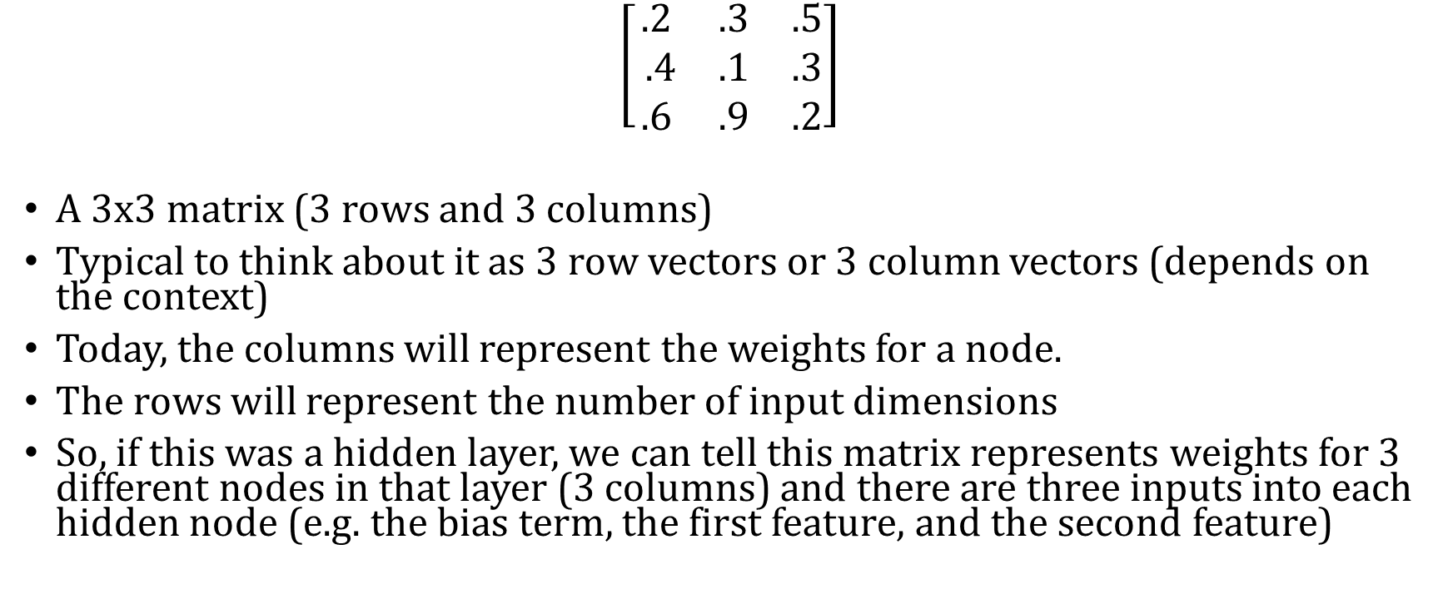
Matrices
$$\left[\begin{matrix}.2 & .3 & .5 \\ .4 & .1 & .3 \\ .6 & .9 & .2\end{matrix}\right]$$
A 3x3 matrix (3 rows and 3 columns)
Typical to think about it as 3 row vectors or 3 column vectors (depends on the context)
Today, the columns will represent the weights for a node.
The rows will represent the number of input dimensions
So, if this was a hidden layer, we can tell this matrix represents weights for 3 different nodes in that layer (3 columns) and there are three inputs into each hidden node (e.g. the bias term, the first feature, and the second feature)

Slide 9
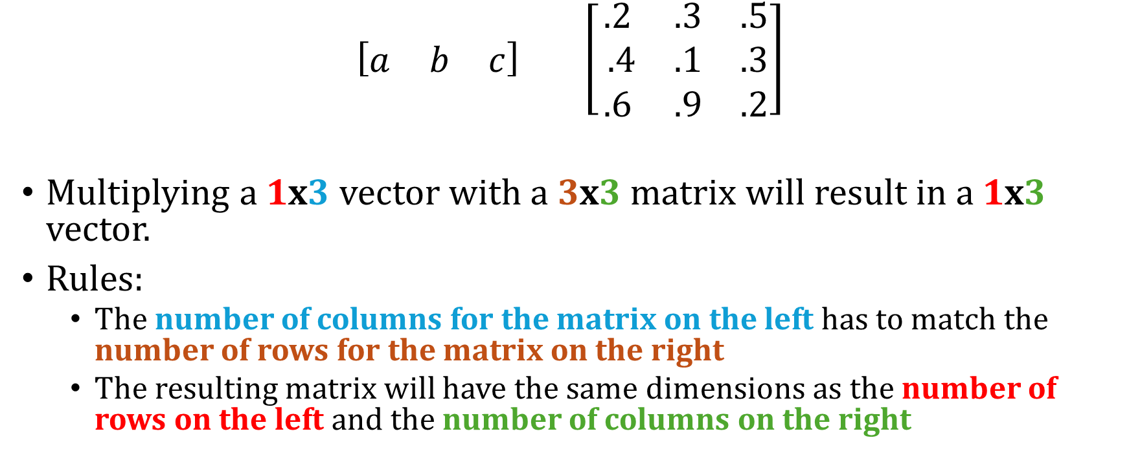
Multiply vector and matrix
$$\left[\begin{matrix}a & b & c\end{matrix}\right] \left[\begin{matrix}.2 & .3 & .5 \\ .4 & .1 & .3 \\ .6 & .9 & .2\end{matrix}\right]$$
Multiplying a 1x3 vector with a 3x3 matrix will result in a 1x3 vector.
Rules:
The number of columns for the matrix on the left has to match the number of rows for the matrix on the right
The resulting matrix will have the same dimensions as the number of rows on the left and the number of columns on the right

Slide 10
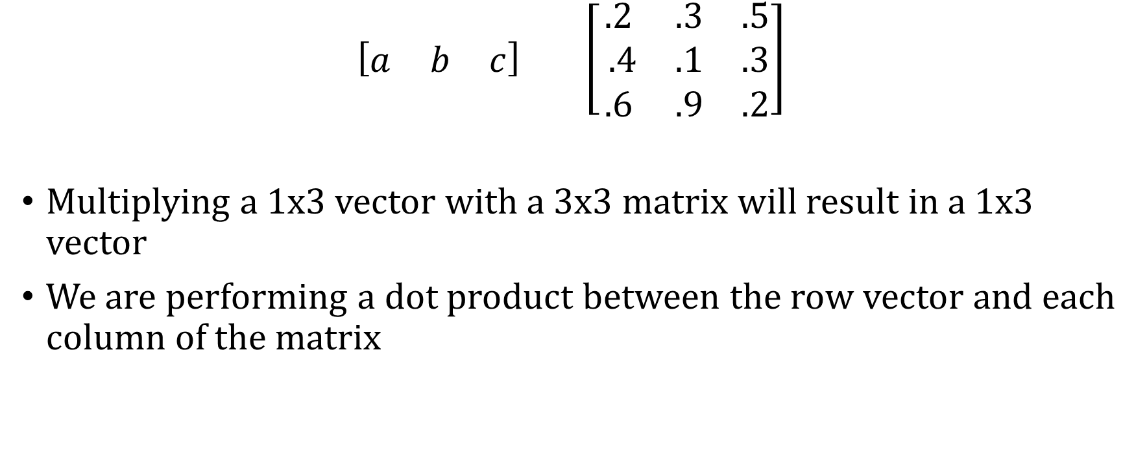
Multiply vector and matrix
$$\left[\begin{matrix}a & b & c\end{matrix}\right] \left[\begin{matrix}.2 & .3 & .5 \\ .4 & .1 & .3 \\ .6 & .9 & .2\end{matrix}\right]$$
Multiplying a 1x3 vector with a 3x3 matrix will result in a 1x3 vector
We are performing a dot product between the row vector and each column of the matrix

Slide 11
Multiply vector and matrix
$$\left[\begin{matrix}a & b & c\end{matrix}\right] \left[\begin{matrix}.2 & .3 & .5 \\ .4 & .1 & .3 \\ .6 & .9 & .2\end{matrix}\right]$$
Multiplying a 1x3 vector with a 3x3 matrix will result in a 1x3 vector
We are performing a dot product between the row vector and each column of the matrix

Slide 12
Multiply vector and matrix
$$\left[\begin{matrix}a & b & c\end{matrix}\right] \left[\begin{matrix}.2 & .3 & .5 \\ .4 & .1 & .3 \\ .6 & .9 & .2\end{matrix}\right]$$
Multiplying a 1x3 vector with a 3x3 matrix will result in a 1x3 vector
We are performing a dot product between the row vector and each column of the matrix

Slide 13
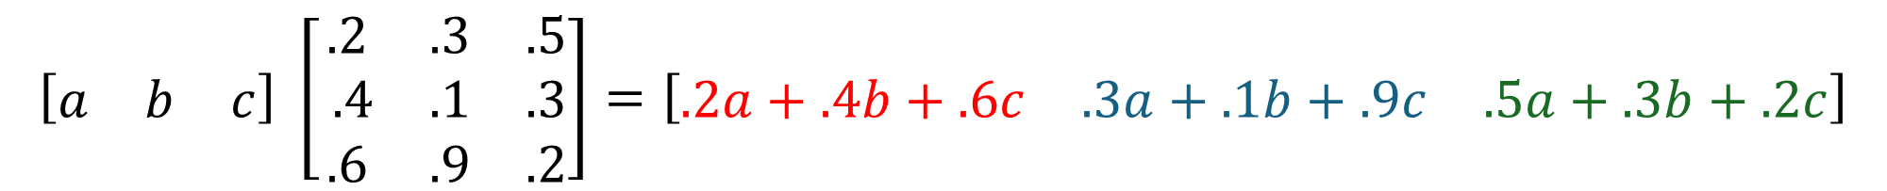
Multiply vector and matrix
$$\left[\begin{matrix}a & b & c\end{matrix}\right] \left[\begin{matrix}.2 & .3 & .5 \\ .4 & .1 & .3 \\ .6 & .9 & .2\end{matrix}\right]=\left[\begin{matrix}.2a+.4b+.6c & .3a+.1b+.9c & .5a+.3b+.2c\end{matrix}\right]$$
Multiplying a 1x3 vector with a 3x3 matrix will result in a 1x3 vector

Slide 14
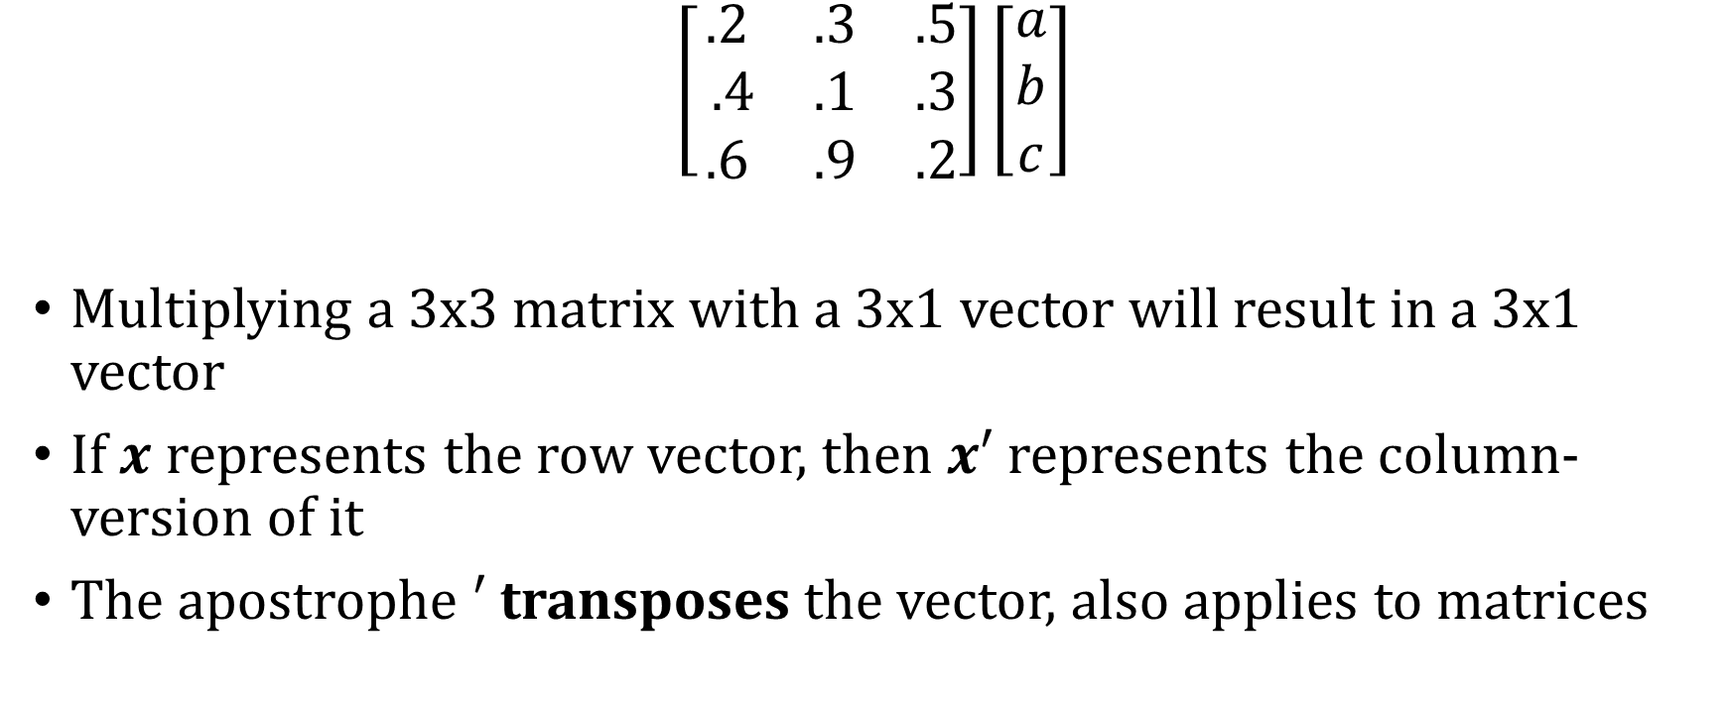
Multiply vector and matrix
$$\left[\begin{matrix}.2 & .3 & .5 \\ .4 & .1 & .3 \\ .6 & .9 & .2\end{matrix}\right]\left[\begin{matrix}a \\ b \\ c\end{matrix}\right]$$
Multiplying a 3x3 matrix with a 3x1 vector will result in a 3x1 vector
If $x$ represents the row vector, then $x′$ represents the column-version of it
The apostrophe $′$ transposes the vector, also applies to matrices

Slide 15

Multiply vector and matrix
$$\left[\begin{matrix}.2 & .3 & .5 \\ .4 & .1 & .3 \\ .6 & .9 & .2\end{matrix}\right]\left[\begin{matrix}a \\ b \\ c\end{matrix}\right]$$
Multiplying a 3x3 matrix with a 3x1 vector will result in a 3x1 vector

Slide 16
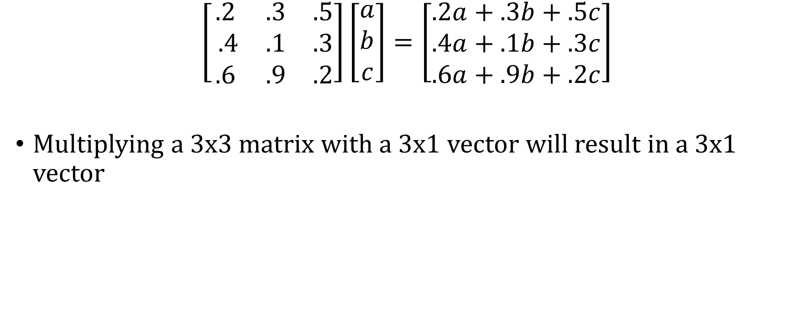
Multiply vector and matrix
$$\left[\begin{matrix}.2 & .3 & .5 \\ .4 & .1 & .3 \\ .6 & .9 & .2\end{matrix}\right]\left[\begin{matrix}a \\ b \\ c\end{matrix}\right]=\left[\begin{matrix}.2a+.3b+.5c \\ .4a+.1b+.3c \\ .6a+.9b+.2c\end{matrix}\right]$$
Multiplying a 3x3 matrix with a 3x1 vector will result in a 3x1 vector

Slide 17
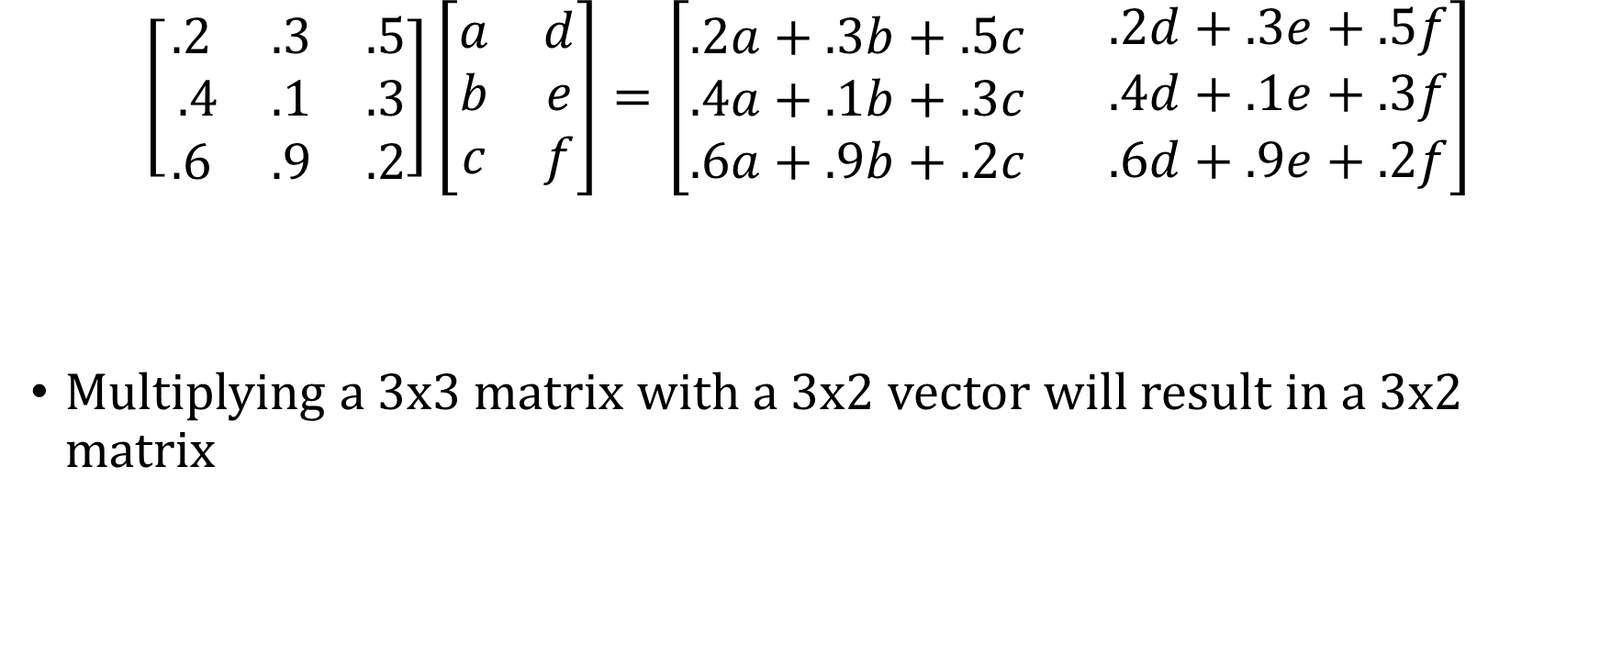
Multiply vector and matrix
$$\left[\begin{matrix}.2 & .3 & .5 \\ .4 & .1 & .3 \\ .6 & .9 & .2\end{matrix}\right]\left[\begin{matrix}a & d \\ b & e \\ c & f\end{matrix}\right]=\left[\begin{matrix}.2a+.3b+.5c \\ .4a+.1b+.3c \\ .6a+.9b+.2c\end{matrix} \begin{matrix}.2d+.3e+.5f \\ .4d+.1e+.3f \\ .6d+.9e+.2f\end{matrix}\right]$$
Multiplying a 3x3 matrix with a 3x2 vector will result in a 3x2 matrix

Slide 18


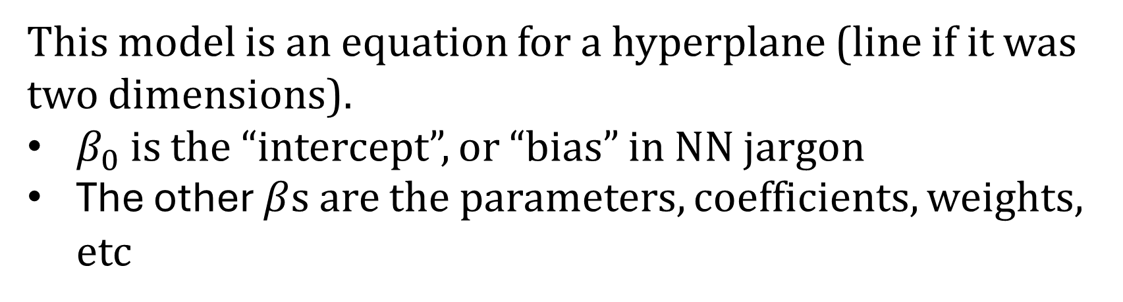
Learning: From linear models to neural networks
OLS Model
$$y=β_{0}+β_{1}x_{1}+β_{2}x_{2}$$
$$states=β_{0}+β_{1} united+β_{2} states$$
This model is an equation for a hyperplane (line if it was two dimensions).
$β_{0}$ is the “intercept”, or “bias” in NN jargon
The other $β$s are the parameters, coefficients, weights, etc

Slide 19

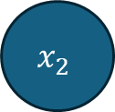

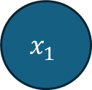





Learning: From linear models to neural networks
Input
Output
OLS Model
$$1$$
$$β_{0}$$
$$y=β_{0}+β_{1}x_{1}+β_{2}x_{2}$$
$$x_{1}$$
$$β_{1}$$
$$∑$$
$$y=β_{0}+β_{1}x_{1}+β_{2}x_{2}$$
$$β_{2}$$
$$x_{2}$$

Slide 20


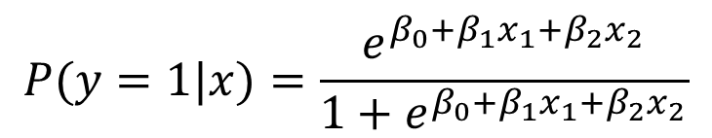



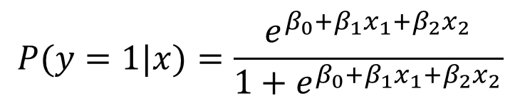


Logistic Regression as a Neural Network
Input
Output
Logit Model
$$1$$
$$β_{0}$$
$$P(y=1|x)=\frac{e^{β_{0}+β_{1}x_{1}+β_{2}x_{2}}}{1+e^{β_{0}+β_{1}x_{1}+β_{2}x_{2}}}$$
$$β_{1}$$
$σ$
$$x_{1}$$
$$β_{2}$$
$$P(y=1|x)=\frac{e^{β_{0}+β_{1}x_{1}+β_{2}x_{2}}}{1+e^{β_{0}+β_{1}x_{1}+β_{2}x_{2}}}$$
$$x_{2}$$

Slide 21


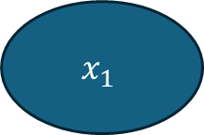
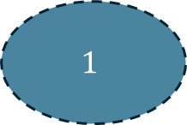

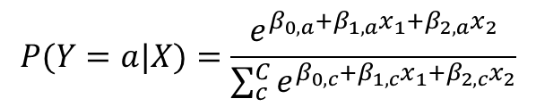




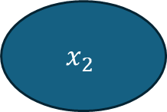


Multinomial Logistic Regression as NN
Input
Output
Multinomial Logit Model
(when we have more than two
Outcomes to predict)
$$1$$
a
$$β_{0,a}$$
$$β_{0,b}$$
$$β_{0,c}$$
$$P(Y=a|X)=\frac{e^{β_{0,a}+β_{1,a}x_{1}+β_{2,a}x_{2}}}{\sum_{c}^{C}{e^{β_{0,c}+β_{1,c}x_{1}+β_{2,c}x_{2}}}}$$
$$x_{1}$$
$$β_{1,a}$$
b
$$β_{1,b}$$
$$β_{1,c}$$
$$β_{2,a}$$
$$β_{2,b}$$
c
$$x_{2}$$
$$β_{2,c}$$

Slide 22

“Softmax”
A term we’ll see a lot
$$P(Y=a|X)=\frac{e^{β_{0,a}+β_{1,a}x_{1}+β_{2,a}x_{2}}}{\sum_{c}^{C}{e^{β_{0,c}+β_{1,c}x_{1}+β_{2,c}x_{2}}}}$$
Each $β_{0,⋅}+β_{1,⋅}x_{1}+β_{2,⋅}x_{2}$ is called a “logit”
Generically, the softmax is:
$$\frac{e^{z_{i}}}{\sum_{j}{e^{z_{j}}}}$$

Slide 23
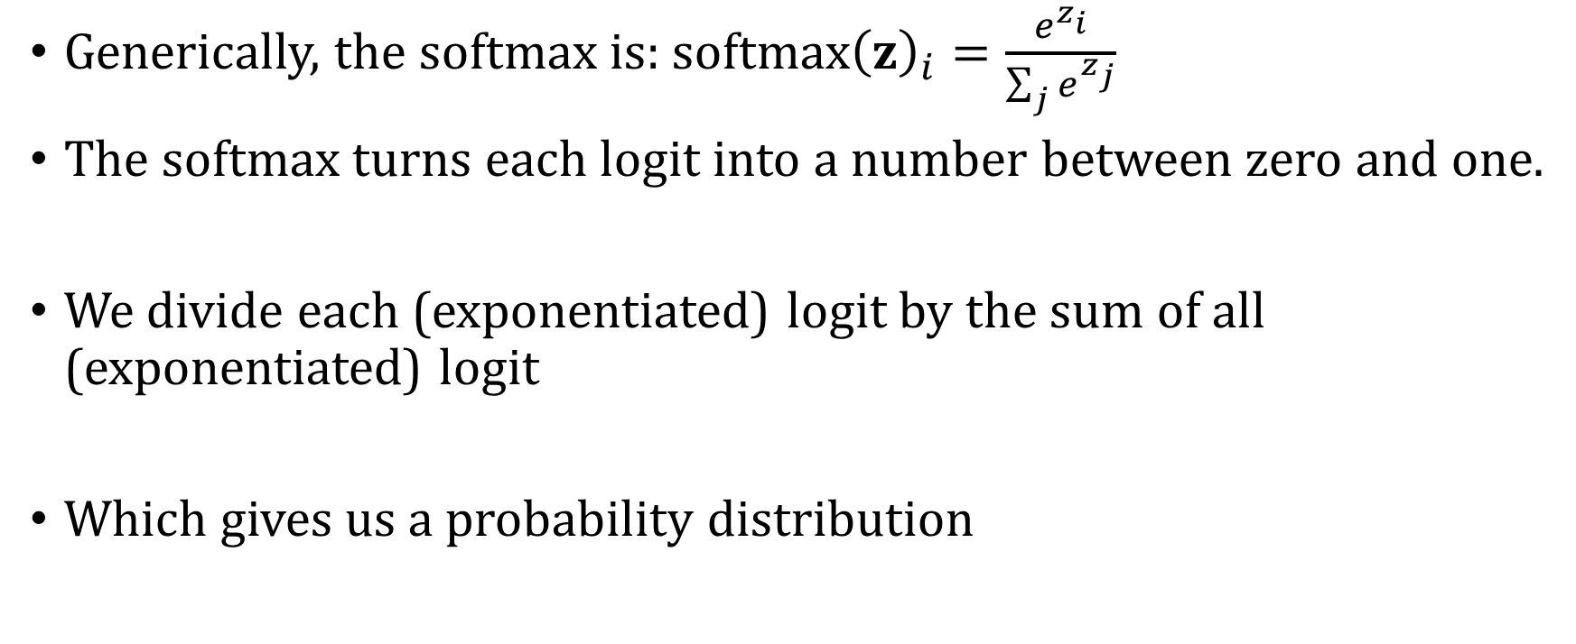
“Softmax”
Generically, the softmax is: $softmax{\left(z\right)}_{i}=\frac{e^{z_{i}}}{\sum_{j}{e^{z_{j}}}}$
The softmax turns each logit into a number between zero and one.
We divide each (exponentiated) logit by the sum of all (exponentiated) logit
Which gives us a probability distribution

Slide 24


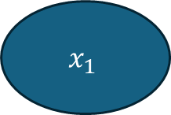
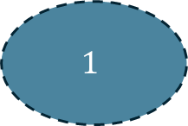

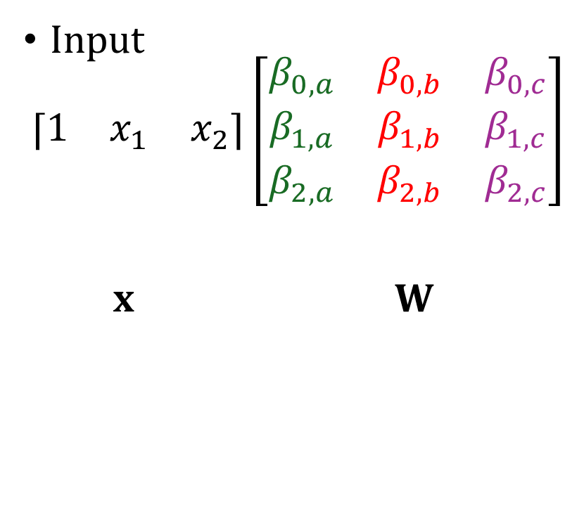




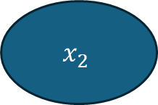


Matrix representation
Input
Input
$$\left\lceil \begin{matrix}1 & x_{1} & x_{2}\end{matrix}\right\rceil \left[\begin{matrix}β_{0,a} & β_{0,b} & β_{0,c} \\ β_{1,a} & β_{1,b} & β_{1,c} \\ β_{2,a} & β_{2,b} & β_{2,c}\end{matrix}\right]$$
x W
$$1$$
a
$$β_{0,a}$$
$$β_{0,b}$$
$$β_{0,c}$$
$$x_{1}$$
$$β_{1,a}$$
b
$$β_{1,b}$$
$$β_{1,c}$$
$$β_{2,a}$$
$$β_{2,b}$$
c
$$x_{2}$$
$$β_{2,c}$$

Slide 25
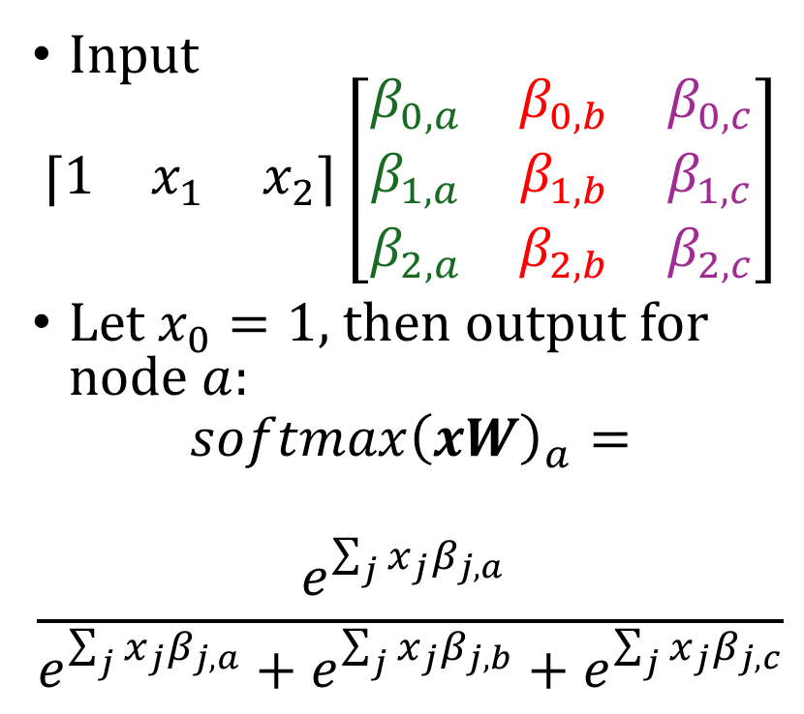
Matrix representation
Input
Input
$$\left\lceil \begin{matrix}1 & x_{1} & x_{2}\end{matrix}\right\rceil \left[\begin{matrix}β_{0,a} & β_{0,b} & β_{0,c} \\ β_{1,a} & β_{1,b} & β_{1,c} \\ β_{2,a} & β_{2,b} & β_{2,c}\end{matrix}\right]$$
Let $x_{0}=1$, then output for node $a:$
$$softmax{\left(xW\right)}_{a}=$$
$$\frac{e^{\sum_{j}{x_{j}β_{j,a}}} }{e^{\sum_{j}{x_{j}β_{j,a}}}+e^{\sum_{j}{x_{j}β_{j,b}}}+e^{\sum_{j}{x_{j}β_{j,c}}}}$$
$$1$$
a
$$β_{0,a}$$
$$β_{0,b}$$
$$β_{0,c}$$
$$x_{1}$$
$$β_{1,a}$$
b
$$β_{1,b}$$
$$β_{1,c}$$
$$β_{2,a}$$
$$β_{2,b}$$
c
$$x_{2}$$
$$β_{2,c}$$

Slide 26
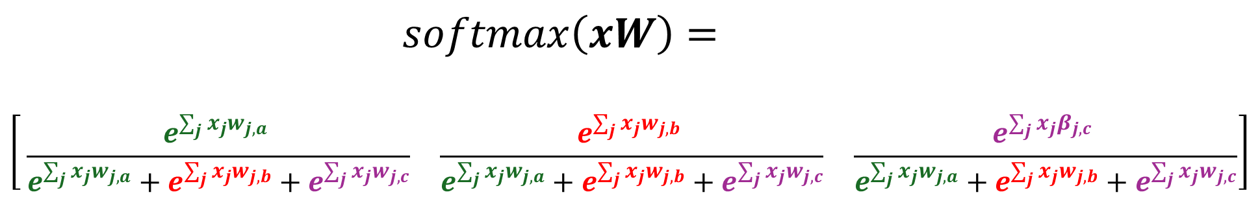

Matrix representation
All three probabilities (replacing $β$ with $w$ for consistency):
$$softmax\left(xW\right)=$$
$$\left[\begin{matrix} \\ \\ \end{matrix}\begin{matrix}\frac{e^{\sum_{j}{x_{j}w_{j,a}}} }{e^{\sum_{j}{x_{j}w_{j,a}}}+e^{\sum_{j}{x_{j}w_{j,b}}}+e^{\sum_{j}{x_{j}w_{j,c}}}} & \frac{e^{\sum_{j}{x_{j}w_{j,b}}} }{e^{\sum_{j}{x_{j}w_{j,a}}}+e^{\sum_{j}{x_{j}w_{j,b}}}+e^{\sum_{j}{x_{j}w_{j,c}}}} & \frac{e^{\sum_{j}{x_{j}β_{j,c}}} }{e^{\sum_{j}{x_{j}w_{j,a}}}+e^{\sum_{j}{x_{j}w_{j,b}}}+e^{\sum_{j}{x_{j}w_{j,c}}}}\end{matrix}\right]$$

Slide 27









Solving the XOR Problem
Simple Neural Network is a hyperplane
Input
Output
(0,1)
(1,1)
$$1$$
$$β_{0}$$
$$X_{2}$$
$$x_{1}$$
$$β_{1}$$
$$y=β_{0}+β_{1}x_{1}+β_{2}x_{2}$$
(0,0)
(1,0)
$$β_{2}$$
$$X_{1}$$
$$x_{2}$$

Slide 28


Solving the XOR Problem
Simple Neural Network is a hyperplane
Input
Output
(0,1)
(1,1)
$$x_{1}$$
$$X_{2}$$
$$β_{1}$$
$$y=β_{1}x_{1}+β_{2}x_{2}$$
(0,0)
(1,0)
$$β_{2}$$
$$X_{1}$$
$$x_{2}$$

Slide 29
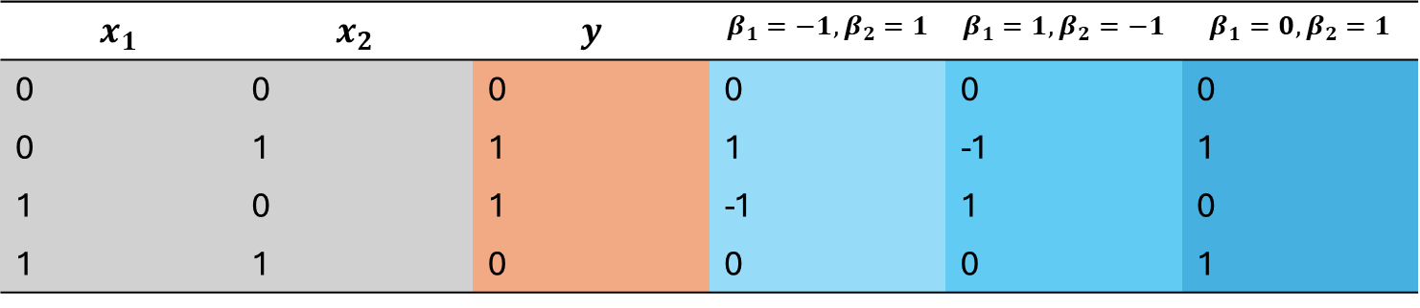
Not separable
$$x_{1}$$ | $$x_{2}$$ | $$y$$ | $$β_{1}=−1, β_{2}=1$$ | $$β_{1}=1, β_{2}=−1$$ | $$β_{1}=0, β_{2}=1$$
0 | 0 | 0 | 0 | 0 | 0
0 | 1 | 1 | 1 | -1 | 1
1 | 0 | 1 | -1 | 1 | 0
1 | 1 | 0 | 0 | 0 | 1
When $β_{1}=−1, β_{2}=1$, then for $x_{1}=0$ and $x_{2}=1$ we have: $0 ∗−1+1∗1=1$

Slide 30










Solving the XOR Problem
Hidden Layer
Input
Hidden
Output
(0,1)
(1,1)
$$x_{1}$$
$$γ_{1,1}$$
$$h_{1}$$
$$X_{2}$$
$$γ_{1,2}$$
$$β_{1}$$
(0,0)
(1,0)
$$γ_{2,1}$$
$$β_{2}$$
$$x_{2}$$
$$h_{2}$$
$$X_{1}$$
$$γ_{2,2}$$

Slide 31






Solving the XOR Problem
Hidden Layer
Input
Hidden
Output
(0,1)
(1,1)
$$x_{1}$$
$$1$$
$$h_{1}$$
$$X_{2}$$
$$−1$$
$$1$$
(0,0)
(1,0)
$$−1$$
$$1$$
$$x_{2}$$
$$h_{2}$$
$$X_{1}$$
$$1$$

Slide 32



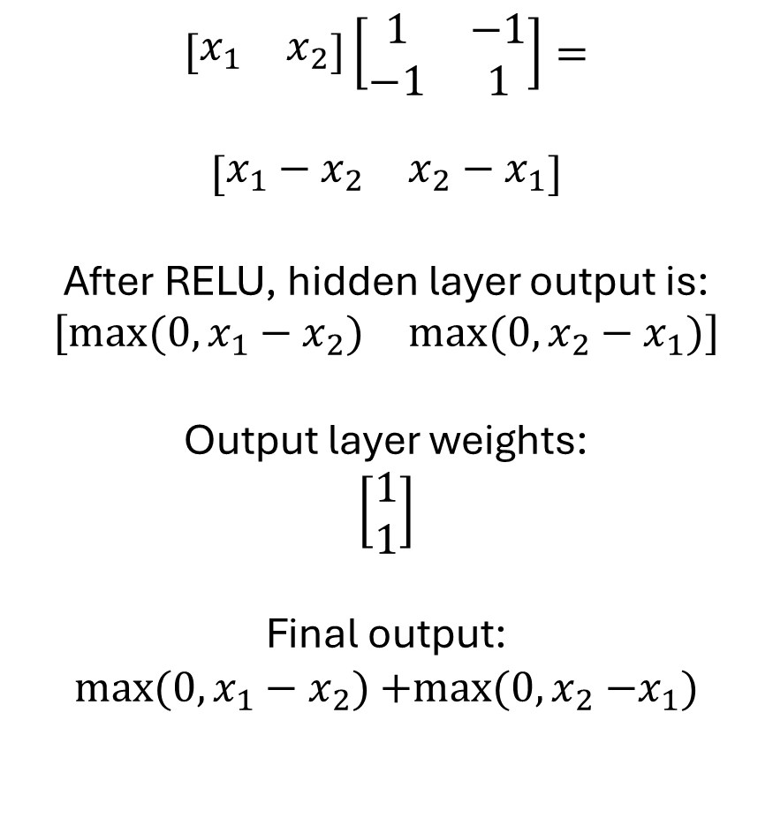

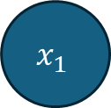





Practice with matrix operations
$$\left[\begin{matrix}x_{1} & x_{2}\end{matrix}\right]\left[\begin{matrix}1 & −1 \\ −1 & 1\end{matrix}\right]=$$
$$\left[\begin{matrix}x_{1}−x_{2} & x_{2}−x_{1}\end{matrix}\right]$$
After RELU, hidden layer output is:
$$\left[\begin{matrix}max⁡(0,x_{1}−x_{2}) & max⁡(0,x_{2}−x_{1})\end{matrix}\right]$$
Output layer weights:
$$\left[\begin{matrix}1 \\ 1\end{matrix}\right]$$
Final output:
$${max⁡(0, x}_{1}−x_{2}){+max⁡(0, x}_{2}−x_{1})$$
Input
Hidden
Output
$$x_{1}$$
$$1$$
$$h_{1}$$
$$−1$$
$$1$$
$$−1$$
$$1$$
$$x_{2}$$
$$h_{2}$$
$$1$$

Slide 33
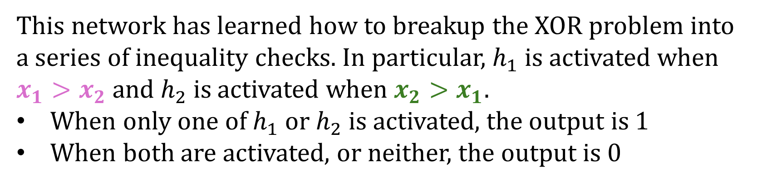
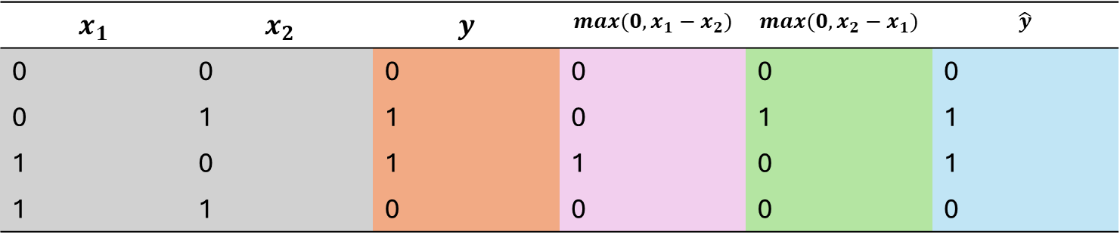
Separable
$$x_{1}$$ | $$x_{2}$$ | $$y$$ | $${max(0, x}_{1}−x_{2})$$ | $${max(0, x}_{2}−x_{1})$$ | $$\hat{y}$$
0 | 0 | 0 | 0 | 0 | 0
0 | 1 | 1 | 0 | 1 | 1
1 | 0 | 1 | 1 | 0 | 1
1 | 1 | 0 | 0 | 0 | 0
This network has learned how to breakup the XOR problem into a series of inequality checks. In particular, $h_{1}$ is activated when $x_{1}>x_{2}$ and $h_{2}$ is activated when $x_{2}>x_{1}$.
When only one of $h_{1}$ or $h_{2}$ is activated, the output is 1
When both are activated, or neither, the output is 0

Slide 34


A new “space”
Hidden Layer
Input
Hidden
Output
(0,1)
$$x_{1}$$
$$1$$
$$h_{1}$$
$$h_{2}$$
$$−1$$
$$1$$
(1,1)
(0,0)
(1,0)
$$−1$$
$$1$$
$$x_{2}$$
$$h_{2}$$
$$h_{1}$$
$$1$$

Slide 35




Solving the XOR Problem
Input Layer Space
Hidden Layer Space
(0,1)
(1,1)
(0,1)
$$X_{2}$$
$$h_{2}$$
(1,1)
(0,0)
(1,0)
(0,0)
(1,0)
$$X_{1}$$
$$h_{1}$$

Slide 36
Solving the XOR Problem
Input Layer Space
Hidden Layer Space
(0,1)
(1,1)
(0,1)
$$X_{2}$$
$$h_{2}$$
(1,1)
(0,0)
(1,0)
(0,0)
(1,0)
$$X_{1}$$
$$h_{1}$$

Slide 37
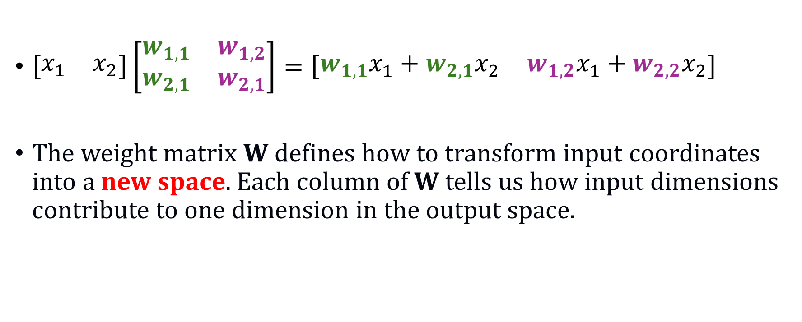
Multiplying by a matrix of weights
$\left[\begin{matrix}x_{1} & x_{2}\end{matrix}\right]\left[\begin{matrix}w_{1,1} & w_{1,2} \\ w_{2,1} & w_{2,1}\end{matrix}\right]=\left[\begin{matrix}w_{1,1}x_{1}+w_{2,1}x_{2} & w_{1,2}x_{1}+w_{2,2}x_{2}\end{matrix}\right]$
The weight matrix W defines how to transform input coordinates into a new space. Each column of W tells us how input dimensions contribute to one dimension in the output space.

Slide 38


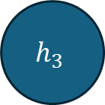


word2vec
ace
ace
box
$$h_{1}$$
box
dash
dash
$$h_{2}$$
$$⋅ ⋅ ⋅$$
$$⋅ ⋅ ⋅$$
rise
rise
test
$$h_{3}$$
test
zero
zero

Slide 39
word2vec
Two versions:
Continuous bag of words:
Use the context to predict the target word
Skipgram
Use the target word to predict the context
We’ll use skipgram as our running example today
Takes V dimensional input (one-hot vectors) and compresses them down into D dimensions. The construction of the D dimensions is driven by how well the target word predicts the words around it.

Slide 40
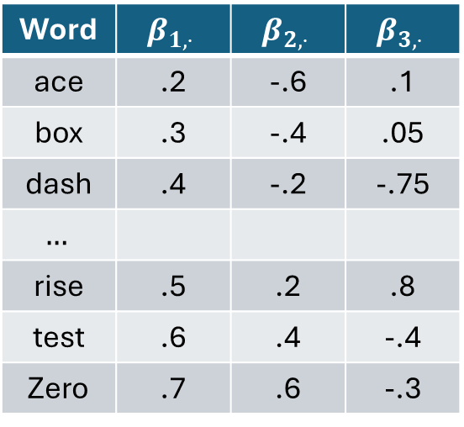
word2vec
ace
ace
box
$$h_{1}$$
box
Word | $$β_{1,⋅}$$ | $$β_{2,⋅}$$ | $$β_{3,⋅}$$
ace | .2 | -.6 | .1
box | .3 | -.4 | .05
dash | .4 | -.2 | -.75
$$…$$
rise | .5 | .2 | .8
test | .6 | .4 | -.4
Zero | .7 | .6 | -.3
dash
dash
$$h_{2}$$
$$⋅ ⋅ ⋅$$
$$⋅ ⋅ ⋅$$
rise
rise
test
$$h_{3}$$
test
zero
zero

Slide 41
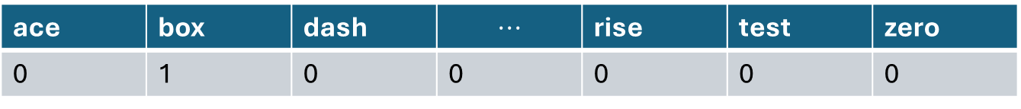
Predicting the context of “box”
This means the model tries to predict the context word given the focal word.
“box” is the second word in the vocabulary.
As input, it is represented by a one-hot vector with the third element 1 and the rest 0
ace | box | dash | $$⋅⋅⋅$$ | rise | test | zero
0 | 1 | 0 | 0 | 0 | 0 | 0

Slide 42
word2vec
ace
ace
box
$$h_{1}$$
box
dash
dash
$$h_{2}$$
$$⋅ ⋅ ⋅$$
$$⋅ ⋅ ⋅$$
rise
rise
test
$$h_{3}$$
test
zero
zero

Slide 43
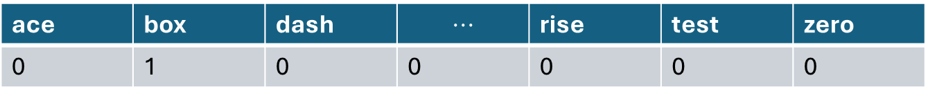

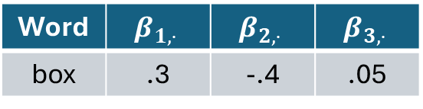
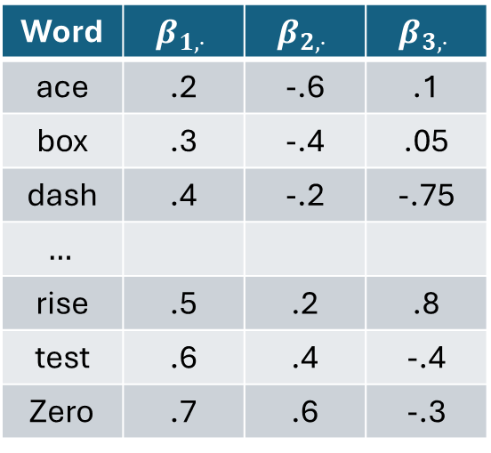
ace | box | dash | $$⋅⋅⋅$$ | rise | test | zero
0 | 1 | 0 | 0 | 0 | 0 | 0
Word | $$β_{1,⋅}$$ | $$β_{2,⋅}$$ | $$β_{3,⋅}$$
ace | .2 | -.6 | .1
box | .3 | -.4 | .05
dash | .4 | -.2 | -.75
$$…$$
rise | .5 | .2 | .8
test | .6 | .4 | -.4
Zero | .7 | .6 | -.3
Multiplying “box” vector with the weight matrix gives us:
$1xV⋅ Vx3=1x3$
Word | $$β_{1,⋅}$$ | $$β_{2,⋅}$$ | $$β_{3,⋅}$$
box | .3 | -.4 | .05

Slide 44

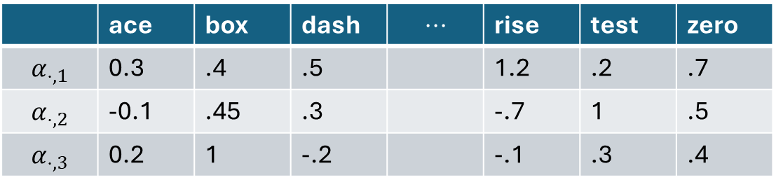

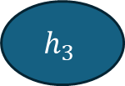
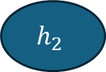
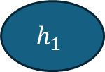
word2vec
ace
ace
box
$$h_{1}$$
box
dash
dash
$$h_{2}$$
$$⋅ ⋅ ⋅$$
$$⋅ ⋅ ⋅$$
rise
rise
test
$$h_{3}$$
test
zero
zero
 | ace | box | dash | $$⋅⋅⋅$$ | rise | test | zero
$$α_{⋅,1}$$ | 0.3 | .4 | .5 |  | 1.2 | .2 | .7
$$α_{⋅,2}$$ | -0.1 | .45 | .3 |  | -.7 | 1 | .5
$$α_{⋅,3}$$ | 0.2 | 1 | -.2 |  | -.1 | .3 | .4

Slide 45



From Hidden Layer to Output
Multiplying “box” vector with the weight matrix gives us
$1x3⋅ 3xV=1xV$
 | ace | box | dash | $$⋅⋅⋅$$ | rise | test | zero
$$α_{⋅,1}$$ | 0.3 | .4 | .5 |  | 1.2 | .2 | .7
$$α_{⋅,2}$$ | -0.1 | .45 | .3 |  | -.7 | 1 | .5
$$α_{⋅,3}$$ | 0.2 | 1 | -.2 |  | -.1 | .3 | .4
Word | $$β_{1,⋅}$$ | $$β_{2,⋅}$$ | $$β_{3,⋅}$$
box | .3 | -.4 | .05
 | ace | box | dash | $$⋅⋅⋅$$ | rise | test | zero
score | $$.3∗.3+.4 ∗.1+.05∗.2$$

Slide 46

word2vec
Does not use non-linear activation function in hidden layer
Maintains two sets of weights for each word.
Input embedding $βs$
Output embeddings $αs$

Slide 47

Input versus Output Embedding
If we want “cheap” and “frugal” to be close to each other in embedding space:
$p\left(price | cheap\right)=σ\left(β_{c,1}α_{1,p}+β_{c,2}α_{2,p}+β_{c,3}α_{3,p}\right)$
$p\left(price | frugal\right)=σ(β_{f,1}α_{1,p}+β_{f,2}α_{2,p}+β_{f,3}α_{3,p})$
In order for these two probabilities to be similar, then $β_{c,⋅}$ should be similar to $β_{f,⋅}$

Slide 48

Input versus Output Embedding
Difference in what they capture?
Consider:
$p\left(arm | the\right)=σ\left(β_{t,1}α_{1,a}+β_{t,2}α_{2,a}+β_{t,3}α_{3,a}\right)$
$p\left(the | arm\right)=σ(β_{a,1}α_{1,t}+β_{a,2}α_{2,t}+β_{a,3}α_{3,t})$
The input embeddings capture features about the word itself
The output embeddings capture features about the context the word appears in
Being predictive of a word is not the same as being predicted by that word

