Slide 1
INST 414: Data Science Techniques Regression

Slide 2
Estimating P(Y|X) directly

Slide 3
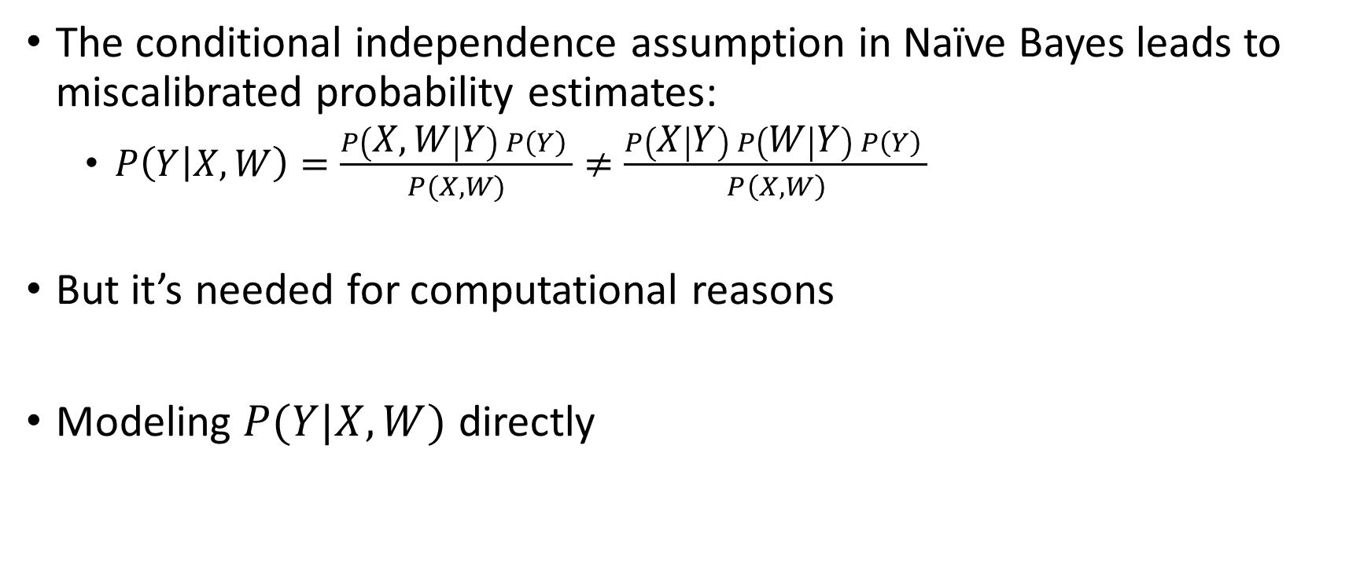
From Naïve Bayes to Regression
The conditional independence assumption in Naïve Bayes leads to miscalibrated probability estimates:
$P\left(Y | X,W\right)=\frac{P\left(X, W | Y\right) P\left(Y\right) }{P(X,W)}≠\frac{P\left(X | Y\right) P\left(W | Y\right) P\left(Y\right) }{P\left(X,W\right)}$
But it’s needed for computational reasons
Modeling $P(Y|X, W)$ directly

Slide 4
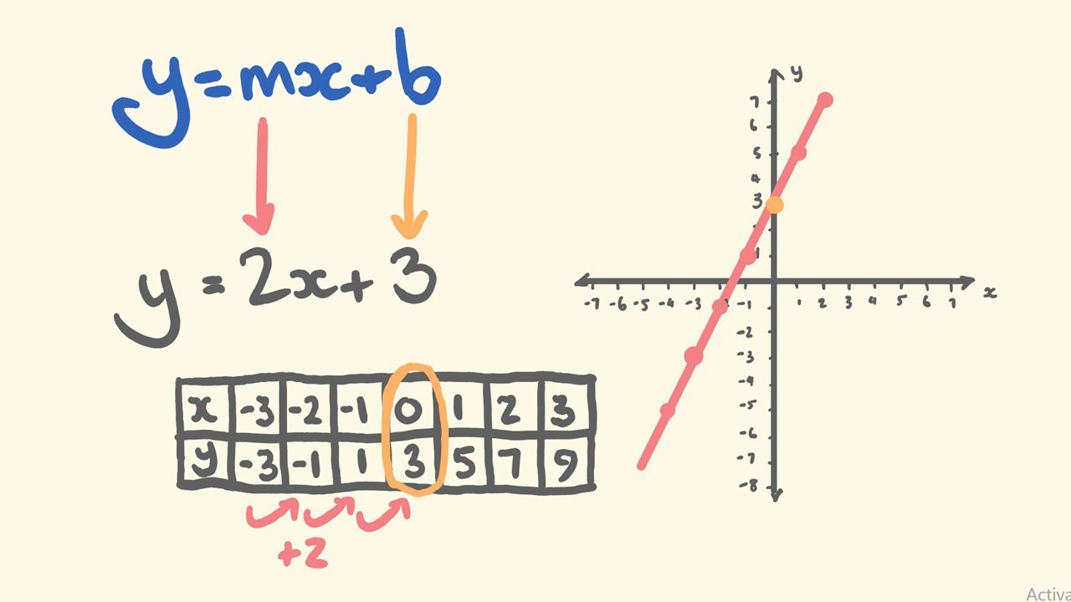

Equation for a Line
$y=mx+b$
$m$ is the slope
$b$ is the intercept

Slide 5

Equation for a Line
$y=mx+b$
$m$ is the slope
$b$ is the intercept
Alter in two ways
$y=b+ mx$
$y=β_{0}+β_{1}x$

Slide 6
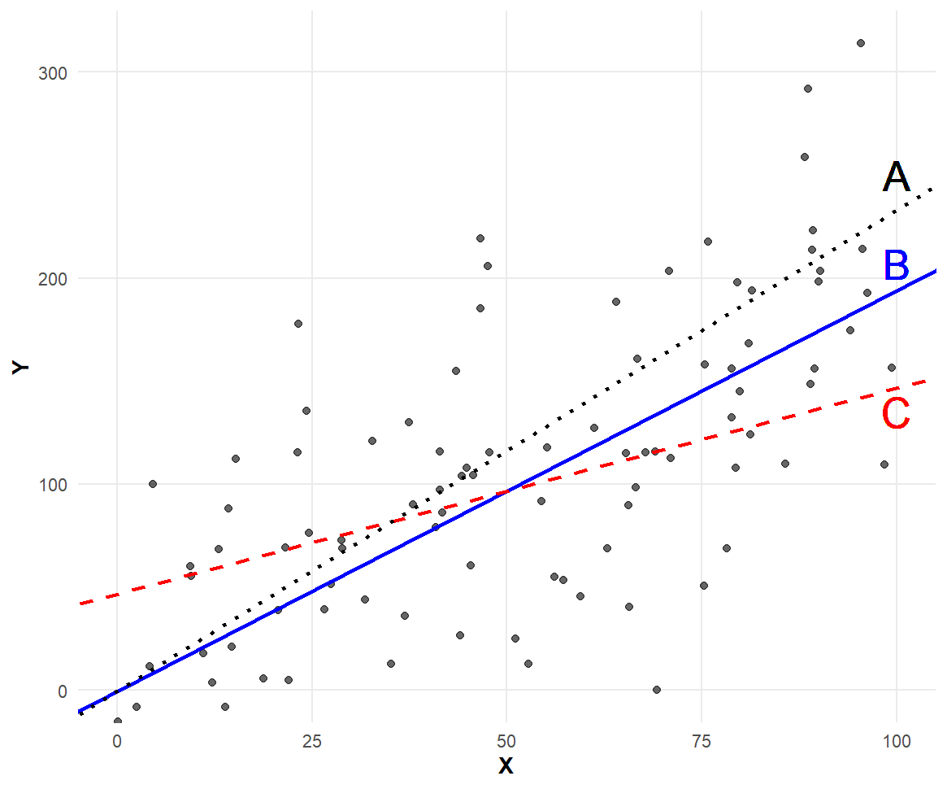

Linear Regression
Intercept
Slope
$Y_{i}=β_{0}+β_{1}x_{i }$
Goal:
Fit the above
equation to the data
What should criteria be?

Slide 7
What’s our objective?
Three hypothetical lines
Which one fits data best?
What do you like about it?

Slide 8
What’s our objective?
What do you like about it?
Two potential objectives
The vertical distance
between the line and the points
is smallest
The perpendicular distance
is smallest

Slide 9
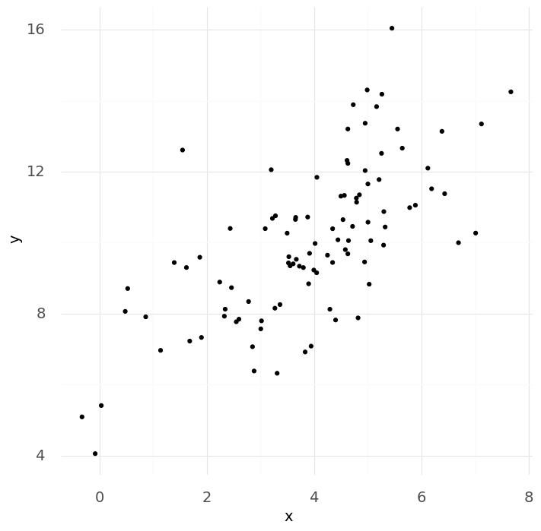
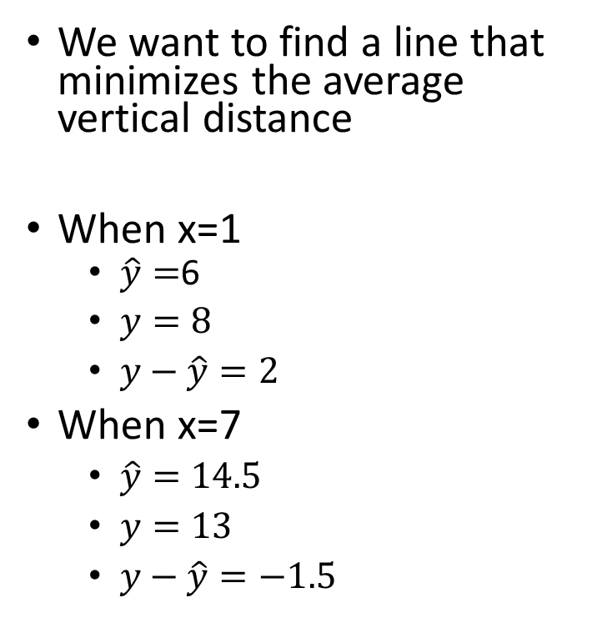
Objective: Target Vertical distance
We want to find a line that minimizes the average vertical distance
When x=1
$\hat{y}=$6
$y=8$
$y−\hat{y}=2$
When x=7
$\hat{y}=14.5$
$y=13$
$y−\hat{y}=−1.5$

Slide 10
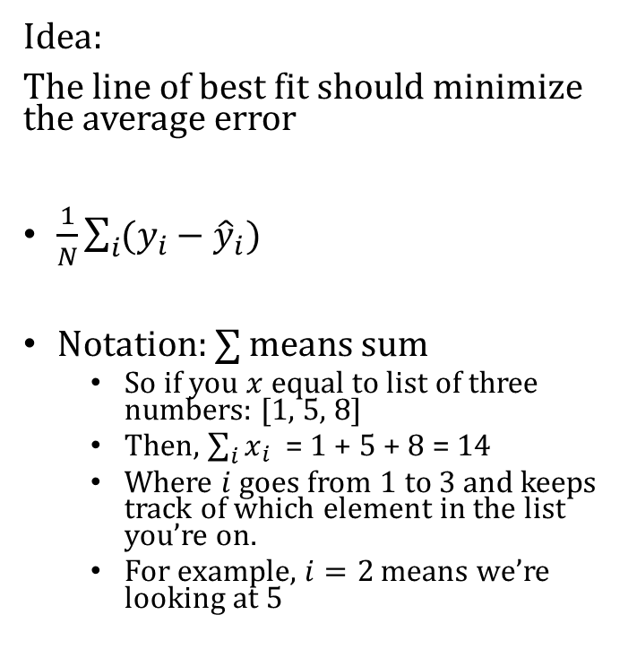
Objective: Target Vertical distance
Idea:
The line of best fit should minimize the average error
$\frac{1}{N}\sum_{i}{(y_{i}−{\hat{y}}_{i}) }$
Notation: $∑$ means sum
So if you $x$ equal to list of three numbers: [1, 5, 8]
Then, $\sum_{i}{x_{i}}$= 1 + 5 + 8 = 14
Where $i$ goes from 1 to 3 and keeps track of which element in the list you’re on.
For example, $i=2$ means we’re looking at 5

Slide 11
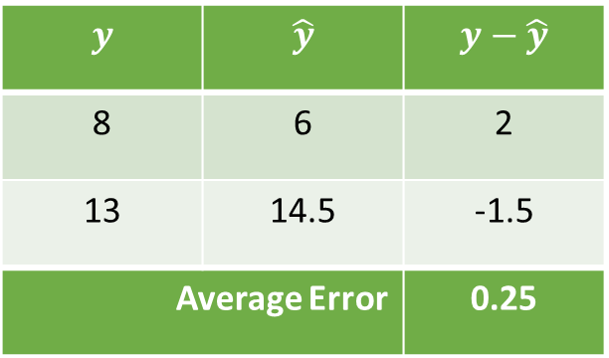
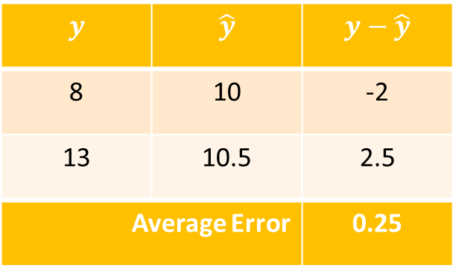
Objective: Target Vertical distance
$$y$$ | $$\hat{y}$$ | $$y−\hat{y}$$
8 | 6 | 2
13 | 14.5 | -1.5
Average Error |  | 0.25
$$y$$ | $$\hat{y}$$ | $$y−\hat{y}$$
8 | 10 | -2
13 | 10.5 | 2.5
Average Error |  | 0.25

Slide 12
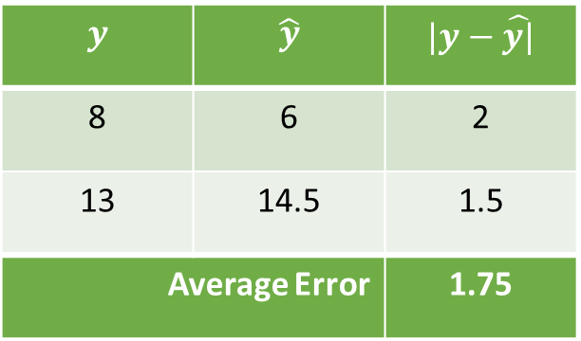
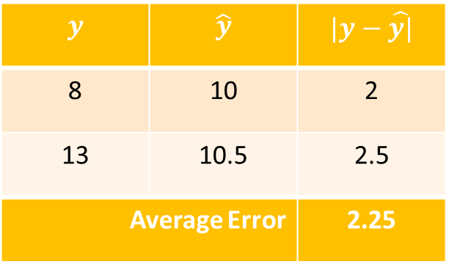
Objective: Target Vertical distance
$$y$$ | $$\hat{y}$$ | $$|y−\hat{y|}$$
8 | 6 | 2
13 | 14.5 | 1.5
Average Error |  | 1.75
$$y$$ | $$\hat{y}$$ | $$|y−\hat{y|}$$
8 | 10 | 2
13 | 10.5 | 2.5
Average Error |  | 2.25

Slide 13
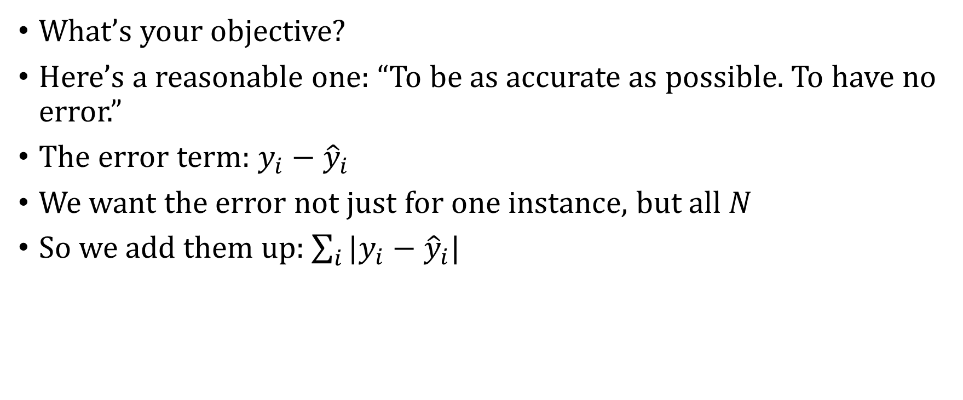
Recap: Objective Function
What’s your objective?
Here’s a reasonable one: “To be as accurate as possible. To have no error.”
The error term: $y_{i}−{\hat{y}}_{i}$
We want the error not just for one instance, but all $N$
So we add them up: $\sum_{i}{|y_{i}−{\hat{y}}_{i}|}$

Slide 14
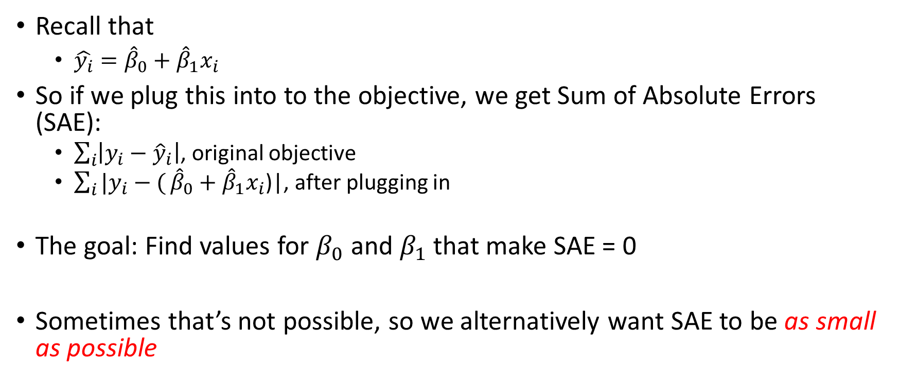

But How Do We Get the ${\hat{y}}_{i}$?
Recall that
$\hat{y_{i}}={\hat{β}}_{0}+{\hat{β}}_{1}x_{i}$
So if we plug this into to the objective, we get Sum of Absolute Errors (SAE):
$\sum_{i}{\left|y_{i}−{\hat{y}}_{i}\right|}$, original objective
$\sum_{i}{|y_{i}−(}{\hat{β}}_{0}+{\hat{β}}_{1}x_{i}$)|, after plugging in
The goal: Find values for $β_{0}$ and $β_{1}$ that make SAE = 0
Sometimes that’s not possible, so we alternatively want SAE to be as small as possible

Slide 15
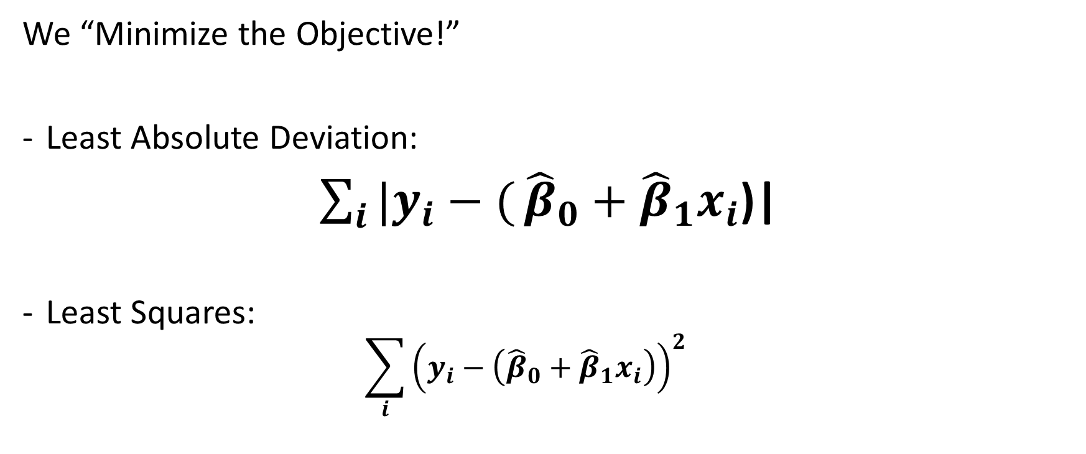

But How Do We Get ${\hat{β}}_{0}$and ${\hat{β}}_{1}$?
We “Minimize the Objective!”
Least Absolute Deviation:
$\sum_{i}{|y_{i}−(}{\hat{β}}_{0}+{\hat{β}}_{1}x_{i}$)|
Least Squares:
$$\sum_{i}{{\left(y_{i}−\left({\hat{β}}_{0}+{\hat{β}}_{1}x_{i}\right)\right)}^{2}}$$

Slide 16
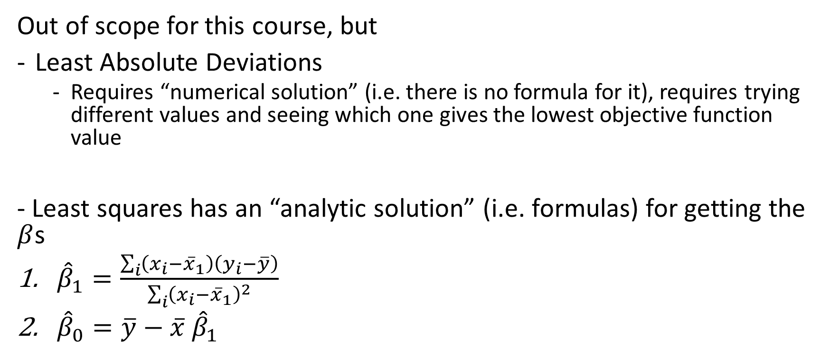
Minimizing the Objective
Out of scope for this course, but
Least Absolute Deviations
Requires “numerical solution” (i.e. there is no formula for it), requires trying different values and seeing which one gives the lowest objective function value
- Least squares has an “analytic solution” (i.e. formulas) for getting the $β$s
${\hat{β}}_{1}=\frac{\sum_{i}{\left(x_{i}−{\overline{x}}_{1}\right)\left(y_{i}−\overline{y}\right)}}{\sum_{i}{{\left(x_{i}−{\overline{x}}_{1}\right)}^{2}}}$
${\hat{β}}_{0}=\overline{y}−\overline{x} {\hat{β}}_{1}$

Slide 17
Modeling P(Y|X) Directly

Slide 18




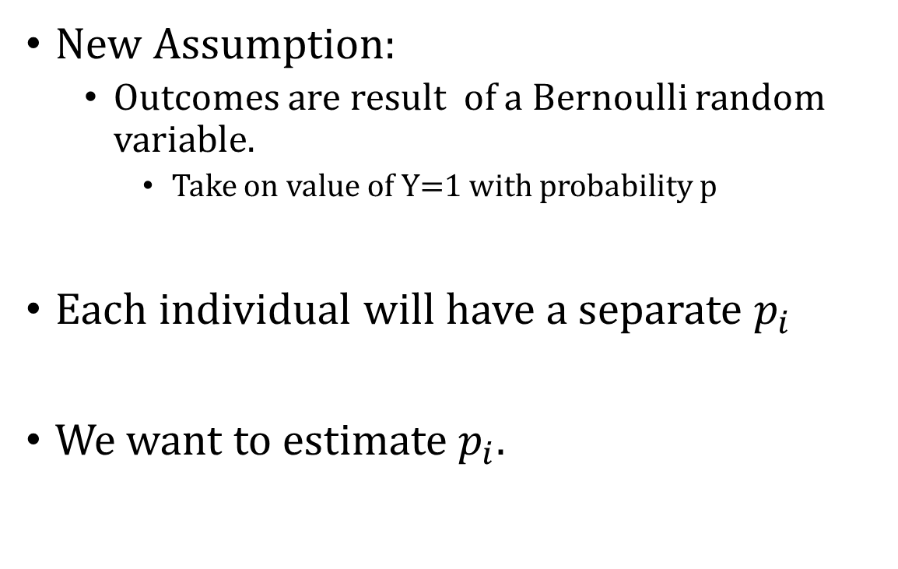


Modeling Conditional Probabilities Directly
New Assumption:
Outcomes are result of a Bernoulli random variable.
Take on value of Y=1 with probability p
Each individual will have a separate $p_{i}$
We want to estimate $p_{i}.$
$$p_{1}$$
$$p_{2}$$
$$p_{3}$$
$$p_{4}$$

Slide 19
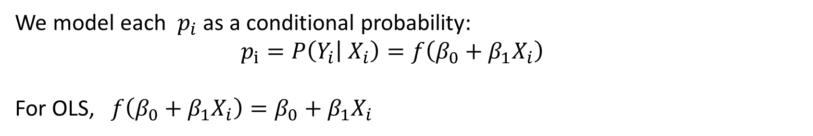
Individual Outcomes Are “Modeled” as the Outcome of a Coin Toss
We model each $p_{i}$ as a conditional probability:
$$p_{i}=P\left(Y_{i} | X_{i}\right)=f\left(β_{0}+β_{1}X_{i}\right)$$
For OLS, $f\left(β_{0}+β_{1}X_{i}\right)=β_{0}+β_{1}X_{i}$

Slide 20
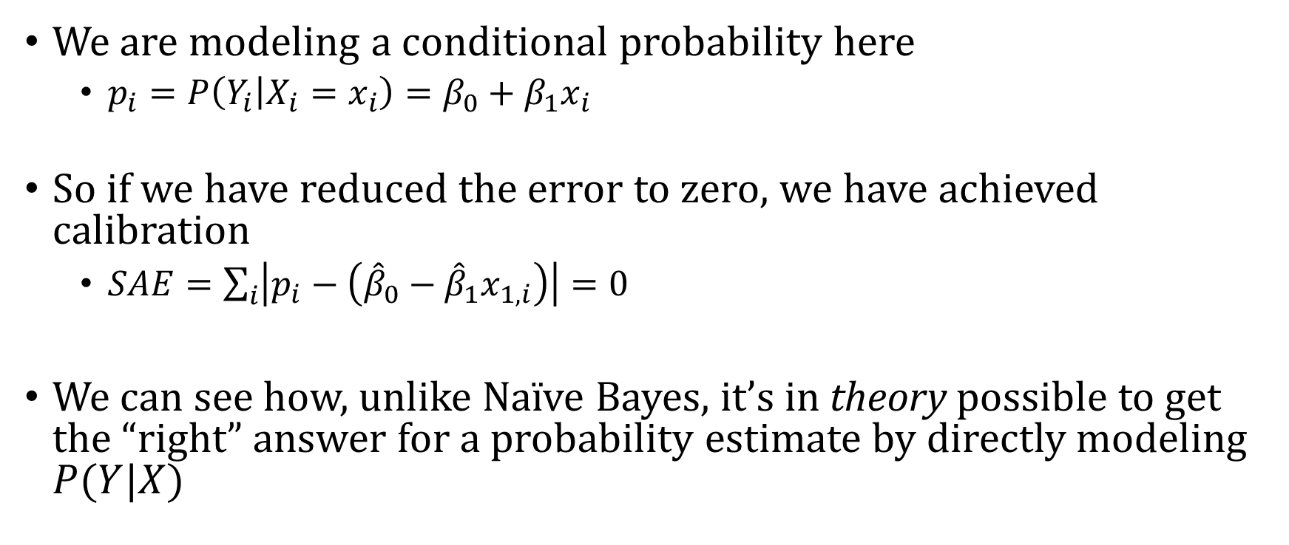
So What?
We are modeling a conditional probability here
$p_{i}=P\left(Y_{i} | X_{i}=x_{i}\right)=β_{0}+β_{1}x_{i}$
So if we have reduced the error to zero, we have achieved calibration
$SAE=\sum_{i}{\left|p_{i}−\left({\hat{β}}_{0}−{\hat{β}}_{1}x_{1,i}\right)\right|=0}$
We can see how, unlike Naïve Bayes, it’s in theory possible to get the “right” answer for a probability estimate by directly modeling $P(Y|X)$

Slide 21
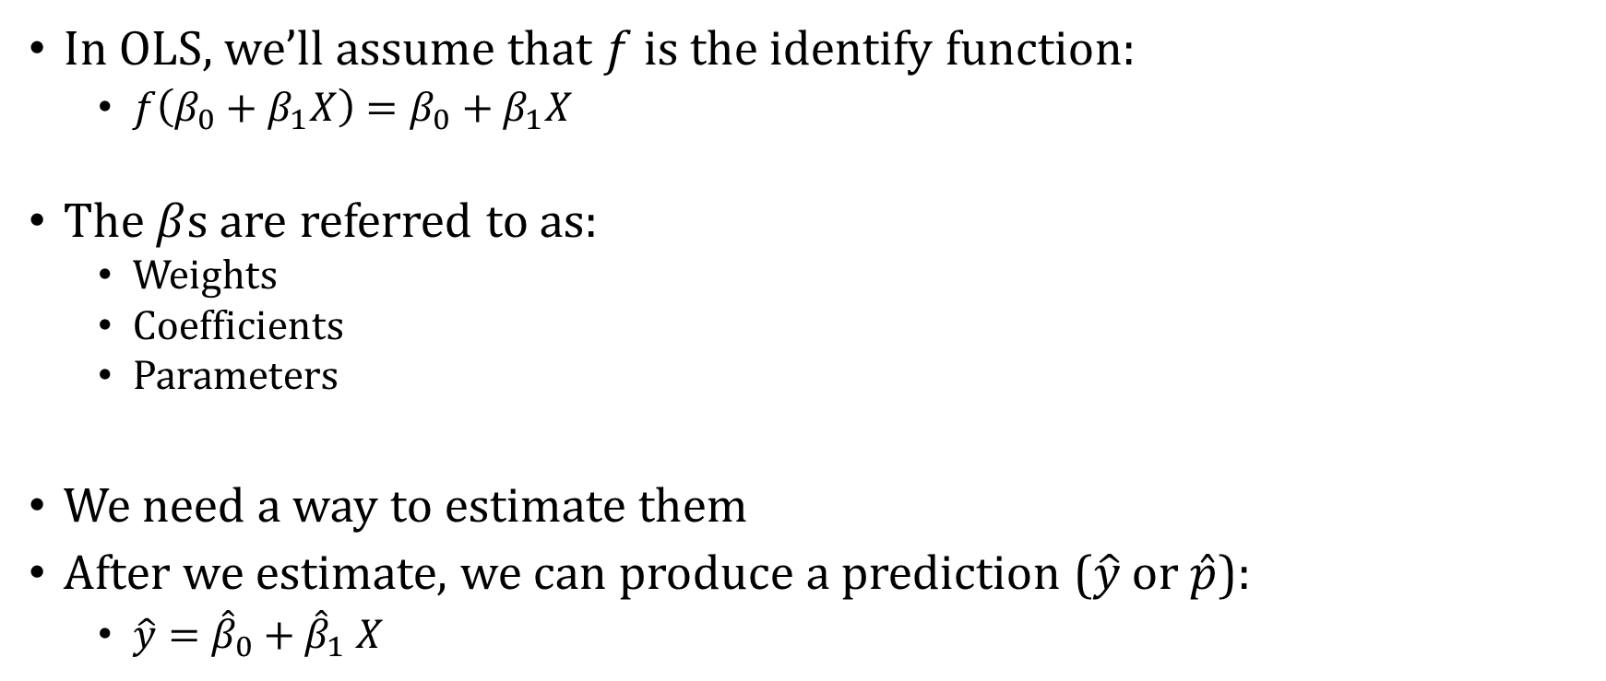
Ordinary Least Squares (OLS) Regression
In OLS, we’ll assume that $f$ is the identify function:
$f\left(β_{0}+β_{1}X\right)=β_{0}+β_{1}X$
The $β$s are referred to as:
Weights
Coefficients
Parameters
We need a way to estimate them
After we estimate, we can produce a prediction ($\hat{y}$ or $\hat{p}$):
$\hat{y}={\hat{β}}_{0}+{\hat{β}}_{1} X$

Slide 22
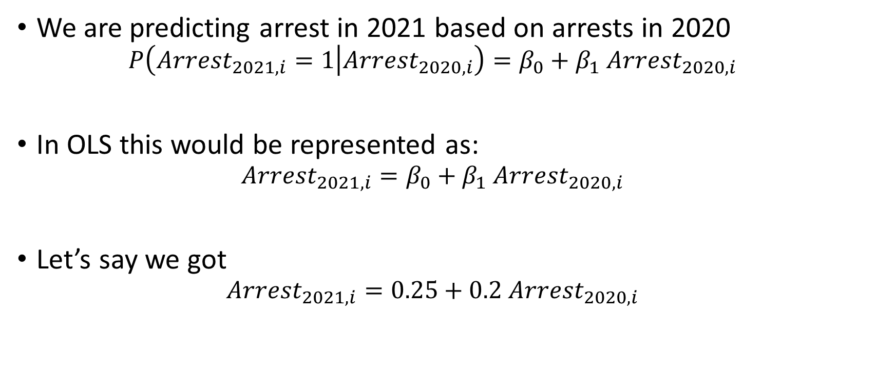
Interpretation
We are predicting arrest in 2021 based on arrests in 2020
$$P\left(Arrest_{2021,i}=1 | Arrest_{2020,i}\right)=β_{0}+β_{1} Arrest_{2020,i}$$
In OLS this would be represented as:
$$Arrest_{2021,i}=β_{0}+β_{1} Arrest_{2020,i}$$
Let’s say we got
$$Arrest_{2021,i}=0.25+0.2 Arrest_{2020,i}$$

Slide 23
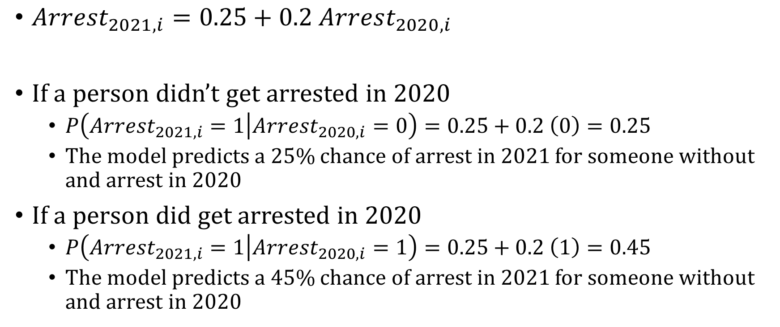
Interpretation
$Arrest_{2021,i}=0.25+0.2 Arrest_{2020,i}$
If a person didn’t get arrested in 2020
$P\left(Arrest_{2021,i}=1 | Arrest_{2020,i}=0\right)=0.25+0.2 \left(0\right)=0.25$
The model predicts a 25% chance of arrest in 2021 for someone without and arrest in 2020
If a person did get arrested in 2020
$P\left(Arrest_{2021,i}=1 | Arrest_{2020,i}=1\right)=0.25+0.2 \left(1\right)=0.45$
The model predicts a 45% chance of arrest in 2021 for someone without and arrest in 2020

Slide 24
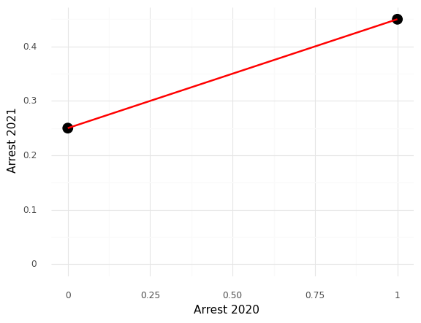
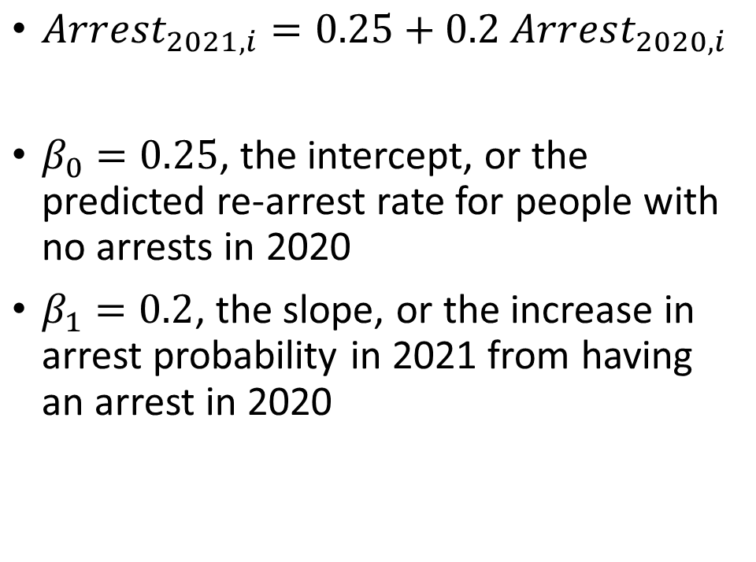
Interpretation
$Arrest_{2021,i}=0.25+0.2 Arrest_{2020,i}$
$β_{0}=0.25$, the intercept, or the predicted re-arrest rate for people with no arrests in 2020
$β_{1}=0.2$, the slope, or the increase in arrest probability in 2021 from having an arrest in 2020

Slide 25
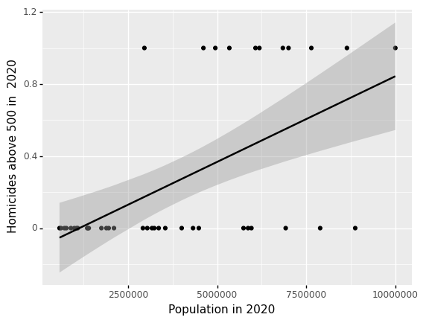
Shortcoming of Linear Probability Model
Plot shows relationship b/w state-level population in 2020 versus if there were more than 500 homicides.
What is the P(Y|Population<1million)?
Less than zero

Slide 26
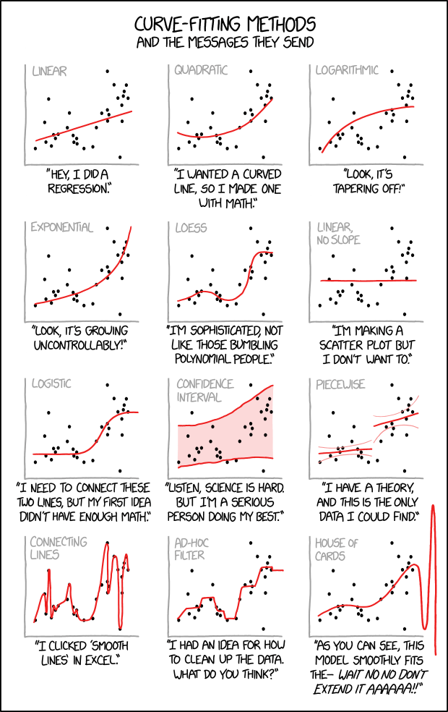
Logistic Regression

Slide 27
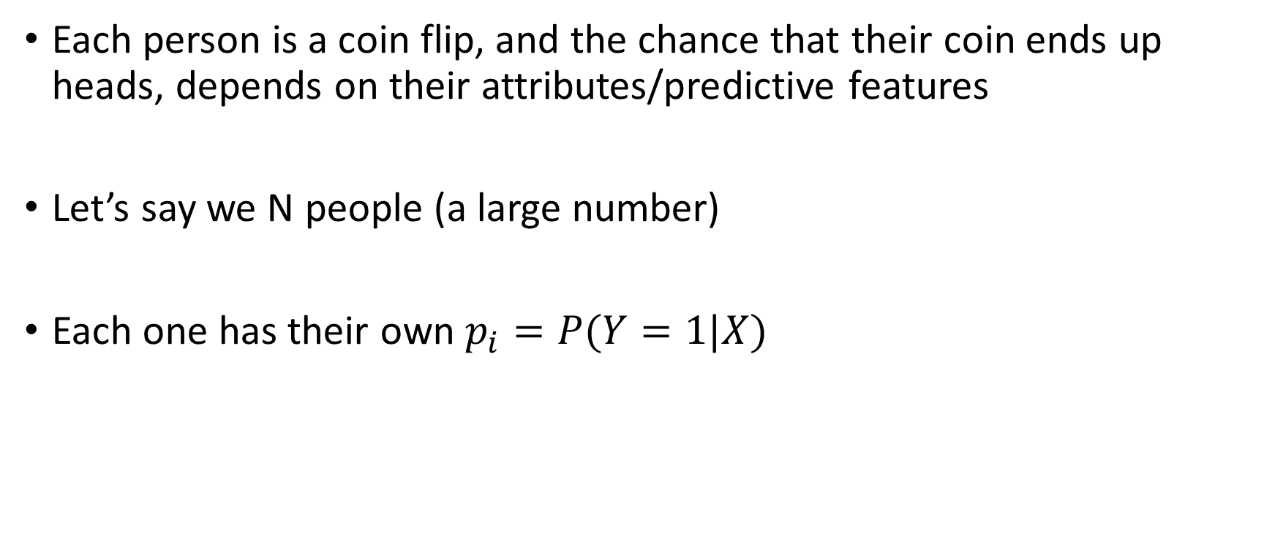
Same starting assumption as linear regression
Each person is a coin flip, and the chance that their coin ends up heads, depends on their attributes/predictive features
Let’s say we N people (a large number)
Each one has their own $p_{i}=P(Y=1|X)$

Slide 28
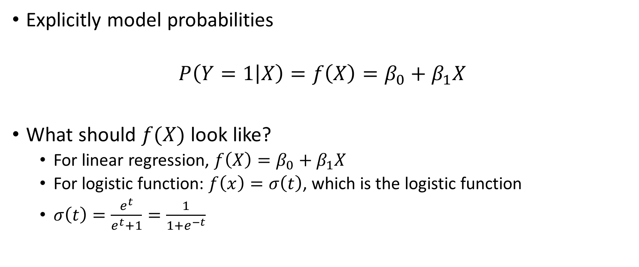
Linear Regression
Explicitly model probabilities
$$P\left(Y=1 | X\right)=f\left(X\right)=β_{0}+β_{1}X$$
What should $f(X)$ look like?
For linear regression, $f\left(X\right)=β_{0}+β_{1}X$
For logistic function: $f\left(x\right)=σ\left(t\right)$, which is the logistic function
$σ\left(t\right)=\frac{e^{t}}{e^{t}+1}=\frac{1}{1+e^{−t}}$

Slide 29
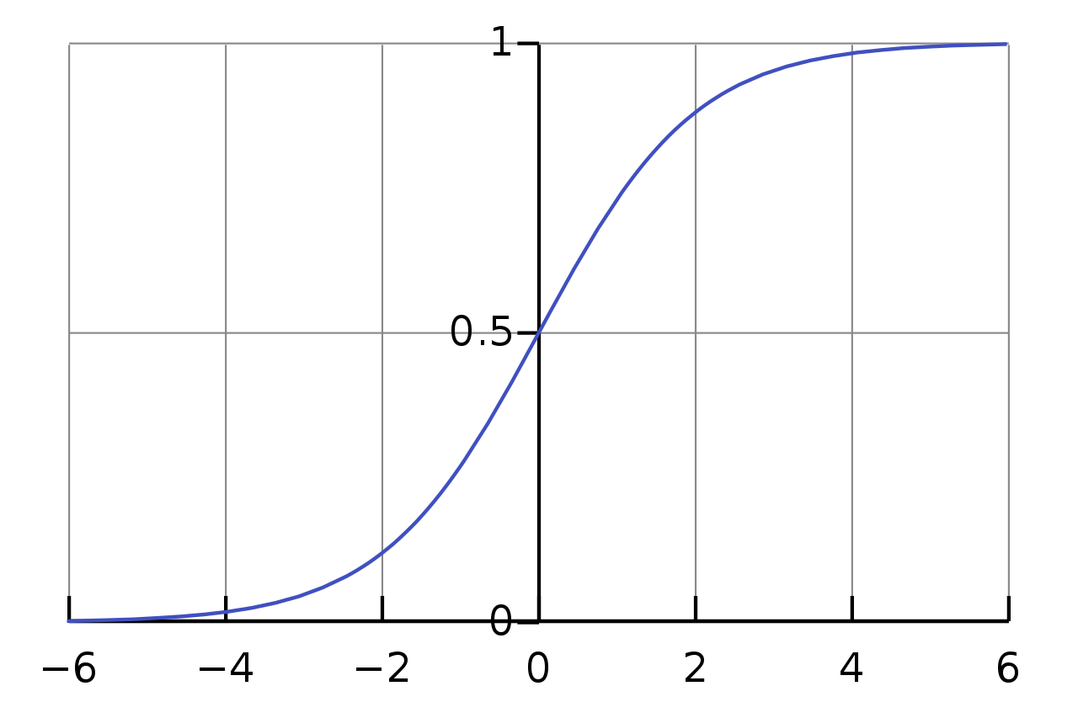
Logistic function
Compare to linear relationship
At intermediate values, when we move in the X-direction, the predicted probability has bigger changes
At extreme values on the X-axis, when we move in the X-direction, the predicted probability has smaller changes

Slide 30
How Does Logistic Regression Achieve Calibration?
We’ll talk about this in class

