Slide 1
INST 414: Data Science Techniques Lecture 9 Random Forest

Slide 2
Recap Overfitting + Decision Trees

Slide 3
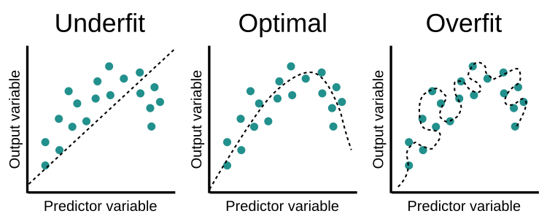
Overfitting/Underfitting

Slide 4
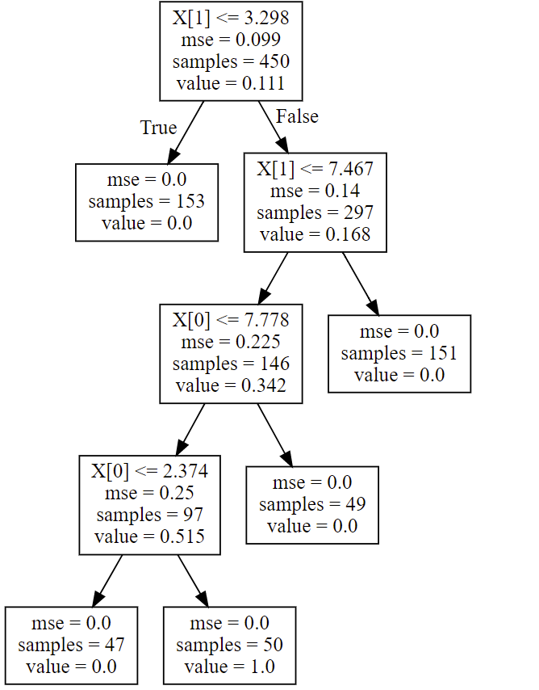
Pros + Cons of Trees
Advantages:
Automatically detect interactions
Easy to explain
Handle both categorical and numeric features
No need to rescale
Disadvantages:
Tend to be outperformed by other methods
Brittle
Can’t extrapolate

Slide 5
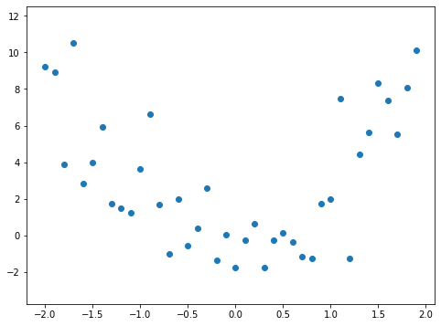
Decision Trees Can’t Extrapolate
Training Data

Slide 6
Decision Trees Can’t Extrapolate
Training Data

Slide 7
Decision Trees Can’t Extrapolate
Training Data

Slide 8
Let’s Predict
Training Data
If X < -1.6, then predicted Y is around 8

Slide 9
Let’s Predict
Training Data
If X < -1.6, then predicted Y is around 8
If X is between -1.6 and -0.7, then predicted Y is around 4

Slide 10
Let’s Predict
Training Data
If X < -1.6, then predicted Y is around 8
If X is between -1.6 and -0.7, then predicted Y is around 4
If X is greater than -0.7, then predicted Y is around 0

Slide 11
Let’s Predict on Unseen Data
Training Data
What will be predicted for unseen data with X > 0?
The decision tree model learned that if the X value is greater than -0.7, then the prediction should be around 0

Slide 12
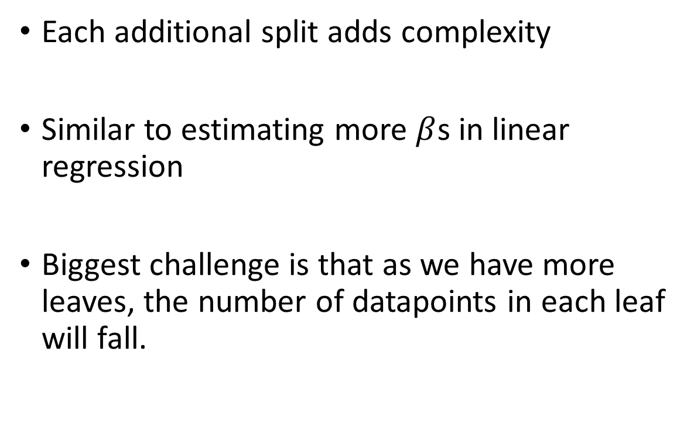
Why Do Decision Trees Tend to Overfit?
Each additional split adds complexity
Similar to estimating more $β$s in linear regression
Biggest challenge is that as we have more leaves, the number of datapoints in each leaf will fall.

Slide 13
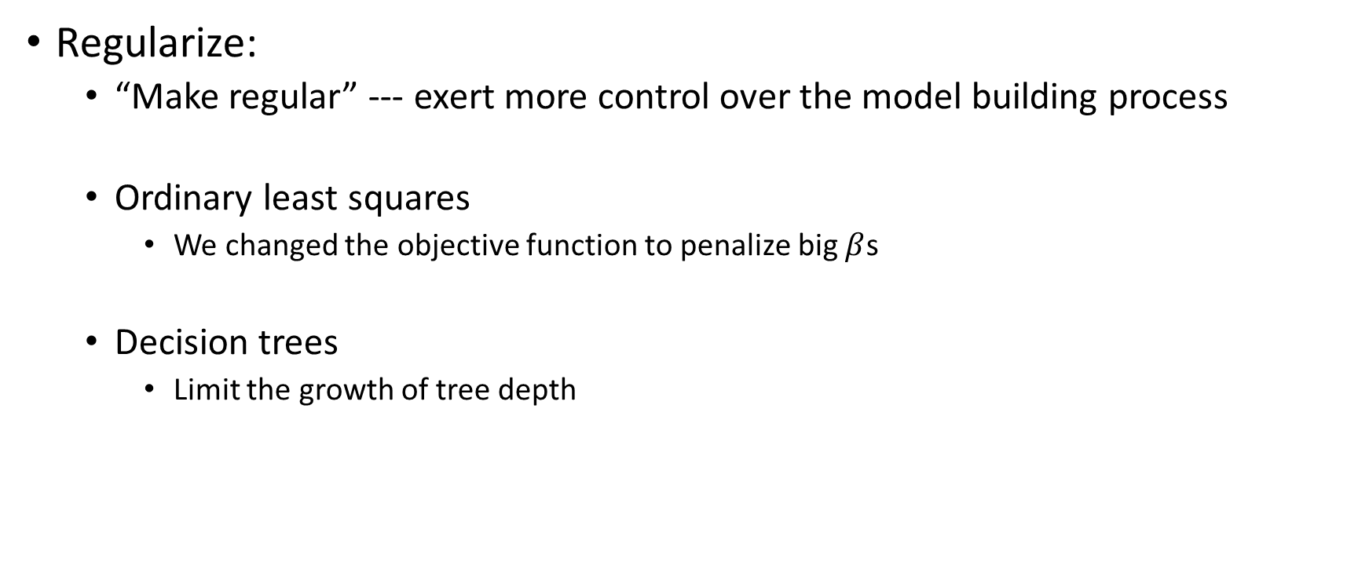
How Do We Reduce/Prevent Over-fitting?
Regularize:
“Make regular” --- exert more control over the model building process
Ordinary least squares
We changed the objective function to penalize big $β$s
Decision trees
Limit the growth of tree depth

Slide 14
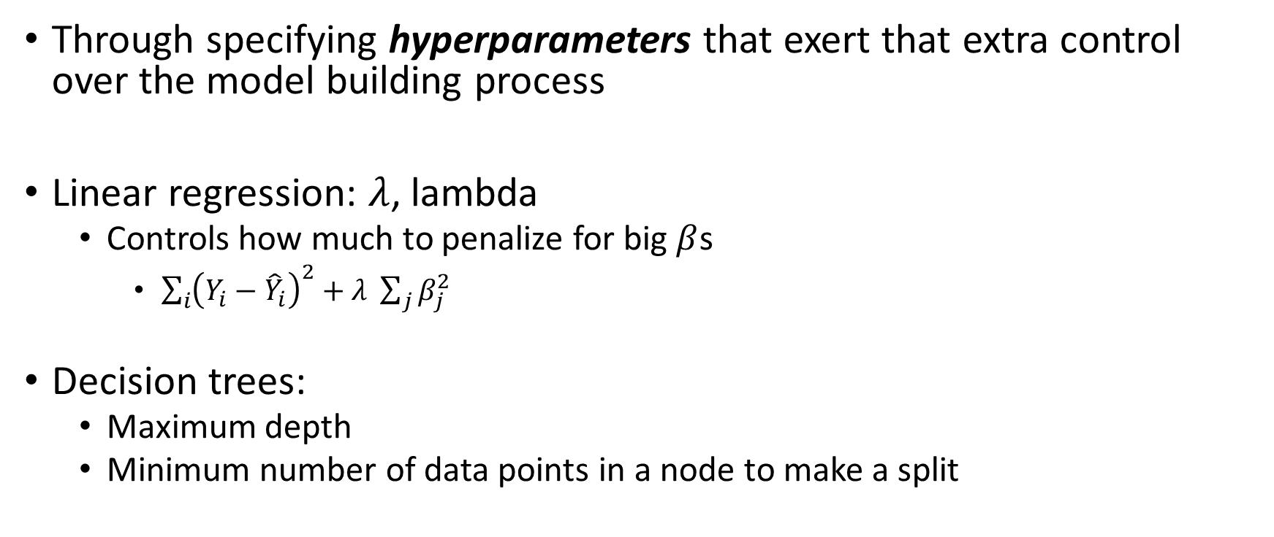
How Do We Regularize
Through specifying hyperparameters that exert that extra control over the model building process
Linear regression: $λ$, lambda
Controls how much to penalize for big $β$s
$\sum_{i}{{\left(Y_{i}−{\hat{Y}}_{i}\right)}^{2}}+λ \sum_{j}{β_{j}^{2}}$
Decision trees:
Maximum depth
Minimum number of data points in a node to make a split

Slide 15
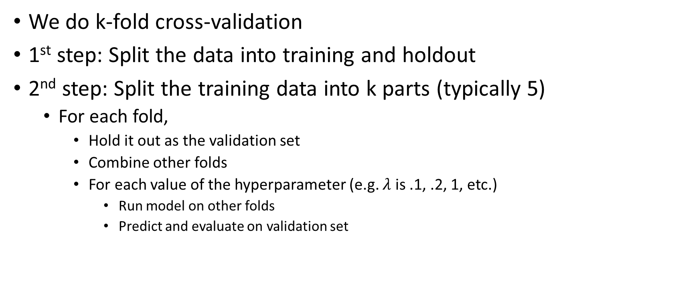
How Do We Select the Hyperparameter?
We do k-fold cross-validation
1st step: Split the data into training and holdout
2nd step: Split the training data into k parts (typically 5)
For each fold,
Hold it out as the validation set
Combine other folds
For each value of the hyperparameter (e.g. $λ$ is .1, .2, 1, etc.)
Run model on other folds
Predict and evaluate on validation set

Slide 16
Overfitting With Decision Trees

Slide 17
Decision Tree Algorithm
Starting at the root node:
Consider all variables and thresholds
Pick variable that minimizes Gini impurity

Slide 18
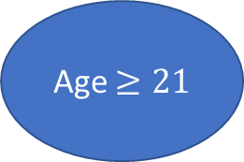
Decision Tree Algorithm
Starting at the root node:
Consider all variables and thresholds
Pick variable that minimizes Gini impurity
Repeat the process at each child node
Age $≥21$

Slide 19
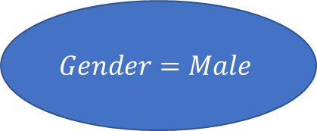
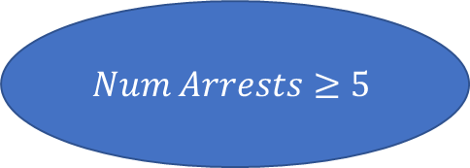
Decision Tree Algorithm
Starting at the root node:
Consider all variables and thresholds
Pick variable that minimizes Gini impurity
Repeat the process at each child node
Age $≥21$
$$Num Arrests≥5$$
$$Gender=Male$$

Slide 20
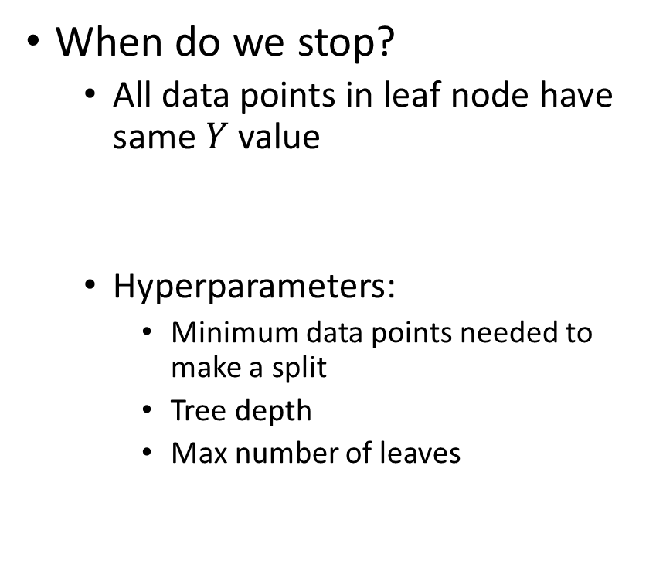
Decision Tree Algorithm
When do we stop?
All data points in leaf node have same $Y$ value
Hyperparameters:
Minimum data points needed to make a split
Tree depth
Max number of leaves
Age $≥21$
$$Num Arrests≥5$$
$$Gender=Male$$

Slide 21
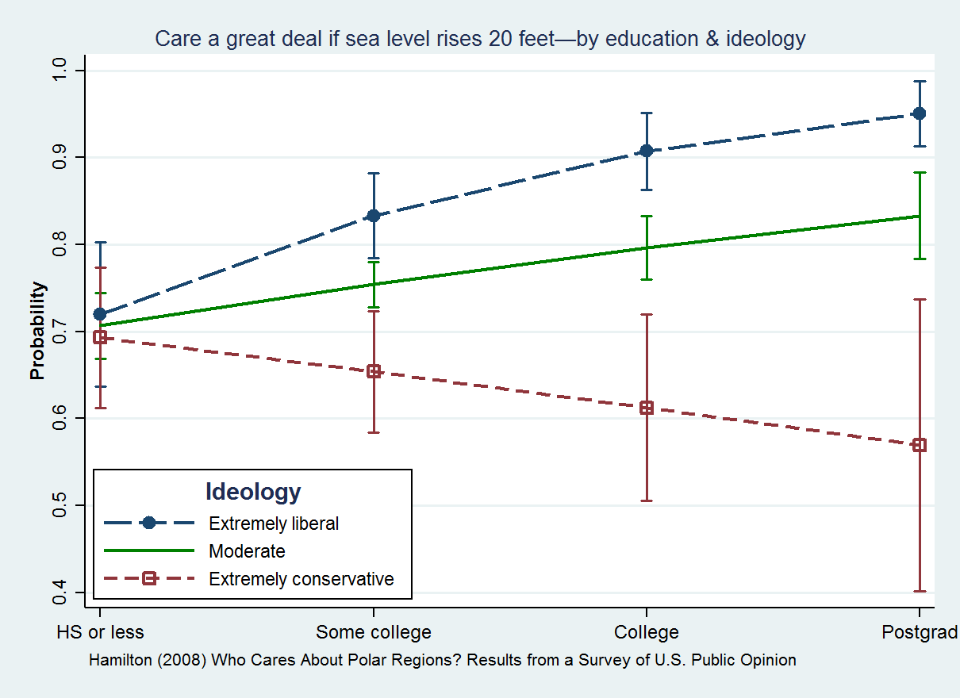
Statistical Interaction
Relationship between 2 variables depends on third
Sea Level Concerns
Education
Different patterns for different political ideologies

Slide 22

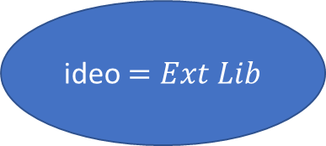

Decision Tree Example
ideo $=Ext Lib$
False
True
$$Edu>Some college$$
$$Edu>H.S.$$
False
True
False
True

Slide 23
Bias-Variance Tradeoff for Decision Trees
Setup: Run many models with different samples. Look at the predictions across models.
High bias: On average, the predictions are systematically different from the true values
High variance: On average, get very different predictions for the same data point

Slide 24
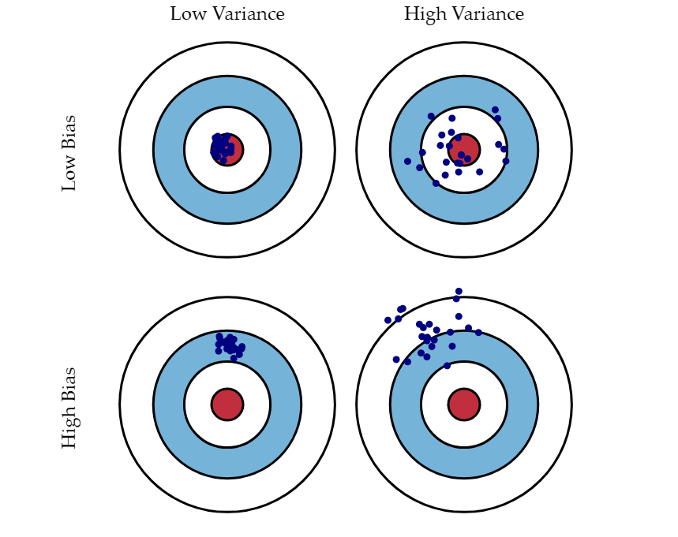
Bias-Variance Tradeoff
Source

Slide 25
Random Forest

Slide 26
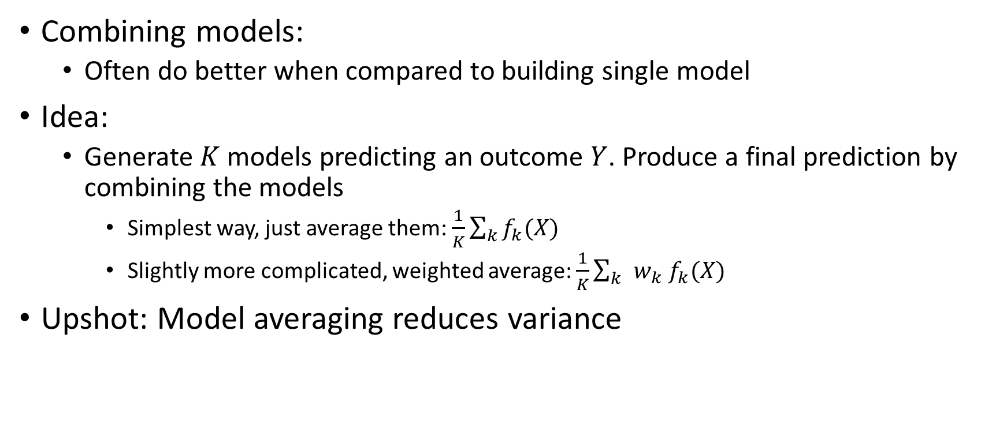
Reducing Variance via Ensemble Learning
Combining models:
Often do better when compared to building single model
Idea:
Generate $K$ models predicting an outcome $Y$. Produce a final prediction by combining the models
Simplest way, just average them: $\frac{1}{K}\sum_{k}{f_{k}(X)}$
Slightly more complicated, weighted average: $\frac{1}{K}\sum_{k }{w_{k} f_{k}(X)}$
Upshot: Model averaging reduces variance

Slide 27
A Note on Random Forest
First illustration of the real power of machine learning
Smash a bunch of apparently “dumb” things together to get a very predictive model
In the process, we’ll move away from transparency
Random forest is hard to visualize

Slide 28
Applying This Idea to Decision Trees
Build many trees and average their predictions
BUT, we only have one dataset, so how do we prevent each tree from being identical?
Introduce some randomness

Slide 29
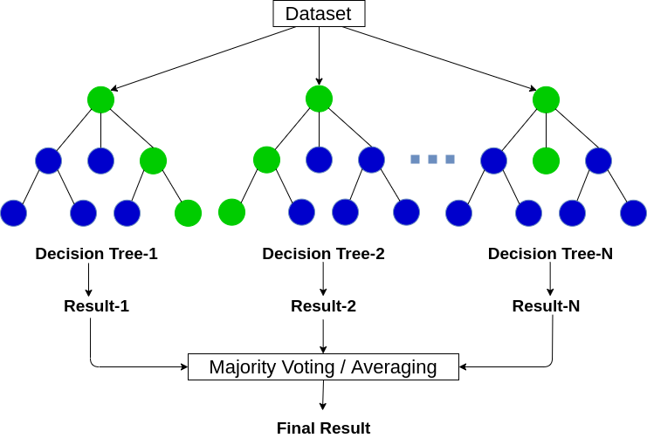
Source

Slide 30
Bagging
Randomness 1
When building each tree take a bootstrap sample of all datapoints
A bootstrap sample will be the same size as the original sample, but we are sampling with replacement.
Example:
[1, 4, 5, 7]
Bootstrap Sample 1: [1, 1, 5, 7]
Bootstrap Sample 2: [1, 4, 5, 7]
Bootstrap Sample 3: [1, 1, 1, 1]

Slide 31
Bootstrap
Same data points will show up more than once
On average, a data point will be in 2/3rd of trees
Notice that there are datapoints that are not in a particular tree
These are called Out of Bag (OOB)
You can use OOB data points to obtain out of sample performance estimates
Alternative to Cross-Validation

Slide 32
Randomness 2
At each node sample some proportion of the features.
A commonly used proportion is the square root of the number of features, but you can treat this value as a hyperparameter
Upshot: You are not considering EACH FEATURE at EACH SPLIT

Slide 33
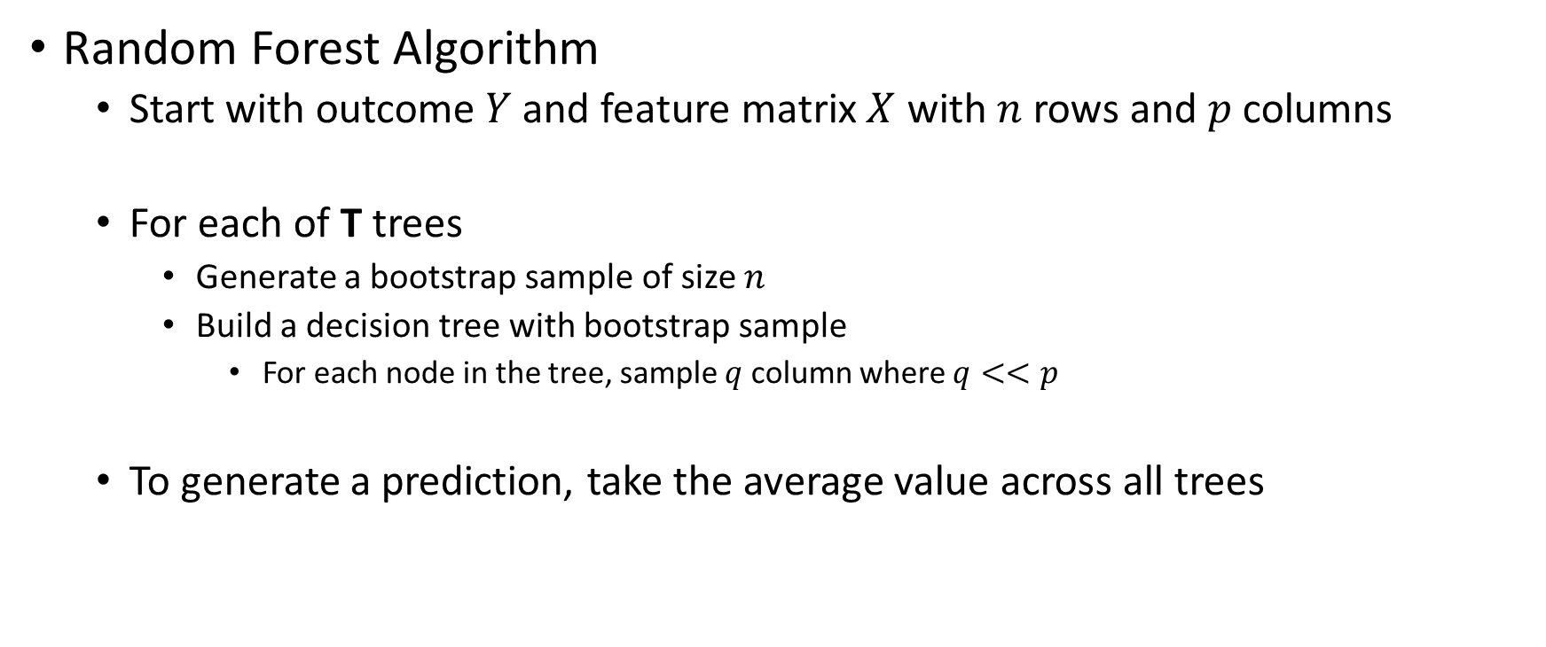
Putting It All Together
Random Forest Algorithm
Start with outcome $Y$ and feature matrix $X$ with $n$ rows and $p$ columns
For each of T trees
Generate a bootstrap sample of size $n$
Build a decision tree with bootstrap sample
For each node in the tree, sample $q$ column where $q<<p$
To generate a prediction, take the average value across all trees

Slide 34
Hyperparameters in Random Forest
Specific to Random Forest
Number of trees
Percentage of columns to sample for each node
Common with Decision Tree
Max depth for each tree
Minimum samples for splitting
Minimum samples in leaf
There are hyperparameters but these are the most commonly tuned

Slide 35
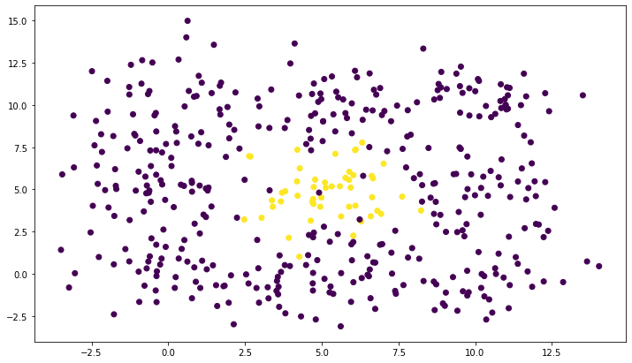



Compare Decision Tree to Random Forest
N = 450
Y = 1, 50
Base Rate = $\frac{50}{450}=\frac{1}{9}$
$$X_{2}$$
$$X_{1}$$

Slide 36
Stumps
Stumps are trees that only split once
Can’t model interactions
Compare a decision stump
With a forest of stumps

Slide 37
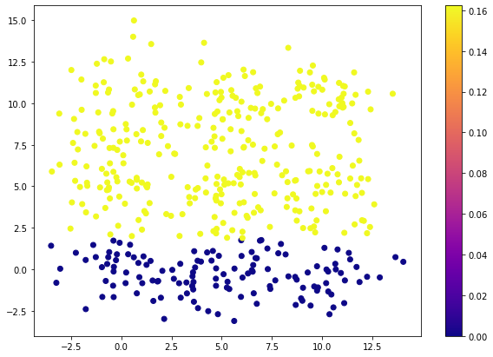


Under-fitting with a Decision Stump
$$X_{2}$$
$$X_{1}$$

Slide 38
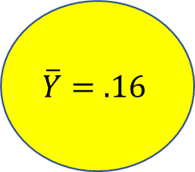
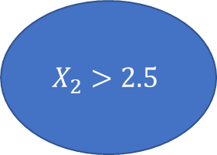
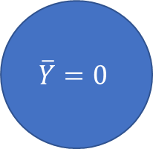
Decision Stump Model
$$X_{2}>2.5$$
True
False
$$\overline{Y}=.16$$
$$\overline{Y}=0$$

Slide 39
Average Underfit Stumps w/ Random Forest

Slide 40
7.5
2.5
2.5
7.5

Slide 41
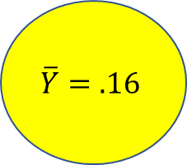
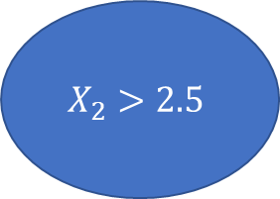
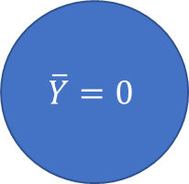
$$X_{2}>2.5$$
7.5
True
False
2.5
$$\overline{Y}=.16$$
$$\overline{Y}=0$$
2.5
7.5

Slide 42

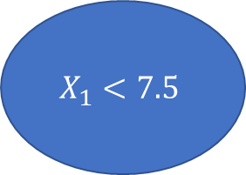

$$X_{1}<7.5$$
7.5
True
False
2.5
$$\overline{Y}=.16$$
$$\overline{Y}=0$$
2.5
7.5

Slide 43

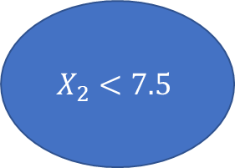

$$X_{2}<7.5$$
7.5
True
False
$$\overline{Y}=.16$$
$$\overline{Y}=0$$
2.5
2.5
7.5

Slide 44
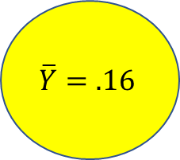
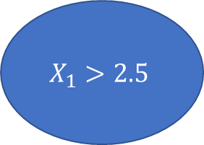
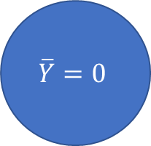
$$X_{1}>2.5$$
7.5
True
False
$$\overline{Y}=.16$$
$$\overline{Y}=0$$
2.5
2.5
7.5

Slide 45
7.5
7.5
2.5
2.5
2.5
7.5
2.5
7.5
7.5
7.5
2.5
2.5
2.5
7.5
2.5
7.5

Slide 46
2
3
2
How often does a region fall in True branch of a split?
7.5
3
4
3
2.5
2
3
2
2.5
7.5

Slide 47
50%
75%
50%
How often does a region fall in True branch of a split?
7.5
75%
100%
75%
2.5
50%
75%
50%
2.5
7.5

Slide 48
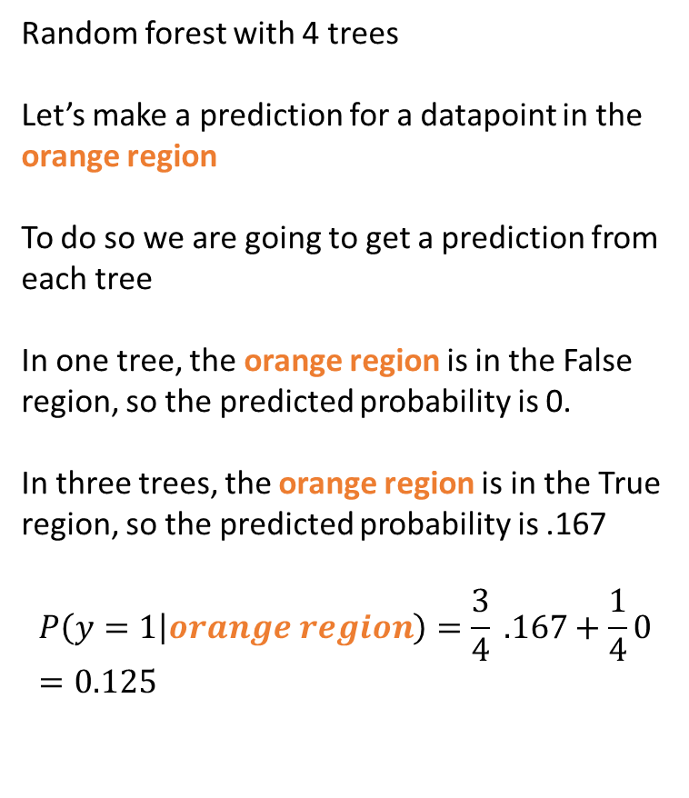
50%
75%
50%
Random forest with 4 trees
Let’s make a prediction for a datapoint in the orange region
To do so we are going to get a prediction from each tree
In one tree, the orange region is in the False region, so the predicted probability is 0.
In three trees, the orange region is in the True region, so the predicted probability is .167
$$P\left(y=1 | orange region\right)=\frac{3}{4} .167+\frac{1}{4}0=0.125$$
7.5
75%
100%
75%
2.5
50%
75%
50%
2.5
7.5

Slide 49
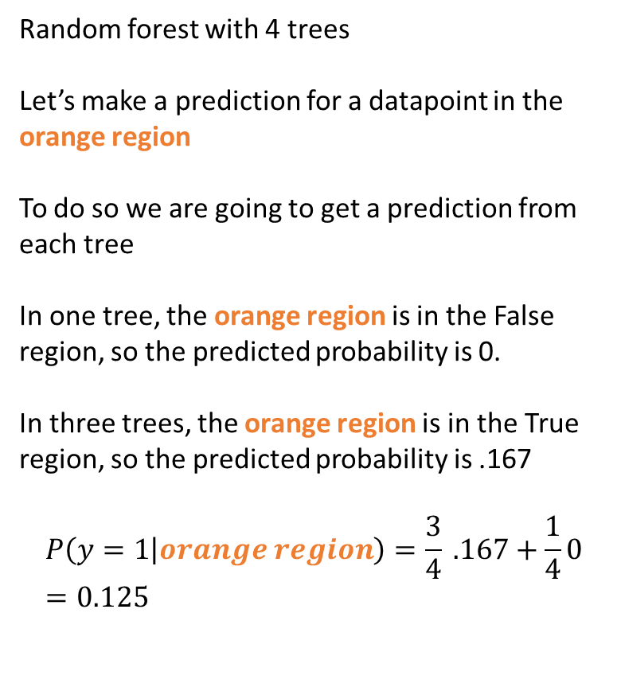
Random forest with 4 trees
Let’s make a prediction for a datapoint in the orange region
To do so we are going to get a prediction from each tree
In one tree, the orange region is in the False region, so the predicted probability is 0.
In three trees, the orange region is in the True region, so the predicted probability is .167
$$P\left(y=1 | orange region\right)=\frac{3}{4} .167+\frac{1}{4}0=0.125$$

Slide 50
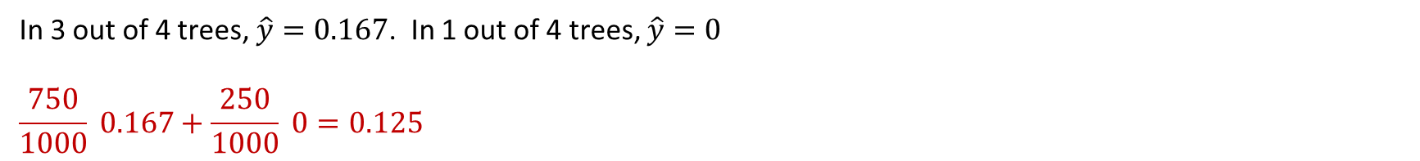
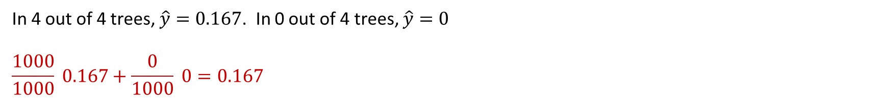
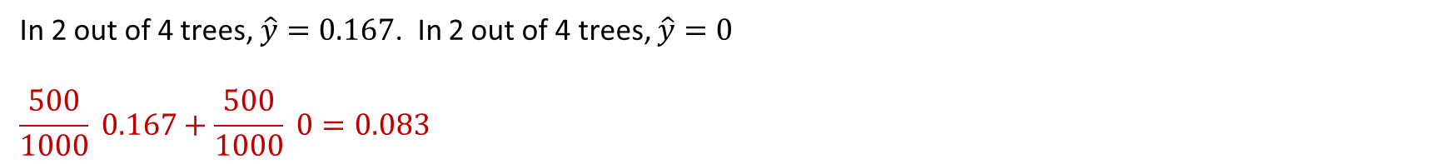
Predictions in Each Region After 1,000 Trees
100%
In 4 out of 4 trees, $\hat{y}=0.167$. In 0 out of 4 trees, $\hat{y}=0$
$$\frac{1000}{1000} 0.167+\frac{0}{1000} 0=0.167$$
75%
In 3 out of 4 trees, $\hat{y}=0.167$. In 1 out of 4 trees, $\hat{y}=0$
$$\frac{750}{1000} 0.167+\frac{250}{1000} 0=0.125$$
50%
In 2 out of 4 trees, $\hat{y}=0.167$. In 2 out of 4 trees, $\hat{y}=0$
$$\frac{500}{1000} 0.167+\frac{500}{1000} 0=0.083$$

Slide 51
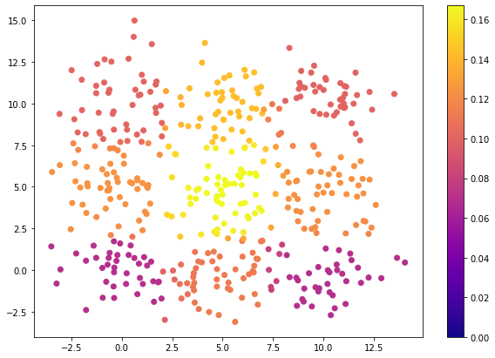
Predicting With a Forest of Stumps
Notice 2 things:
The model is not calibrated
Data points that are y=1 have a predicted probability of being y=1 of 0.167
The model does a great job ranking Y=1 versus Y=0
We will come back to this when we talk about performance metrics

Slide 52
Algorithms We’ve Seen
Algorithm | Calibrated | Interactions | Performance
Naïve Bayes | Usually No | N/A | Not the best
Linear Regression | Yes (Logistic Regression) | Manual | Decent
Decision Trees | Usually No | Automatic | Not the best
Random Forest | Usually No | Automatic | Best

