Slide 1
INST 414: Data Science Techniques Interactions

Slide 2
Recap of Ordinary Least Square and Logistic Regression

Slide 3
Predict Admission
In the next slide, we’ll see the relationship between a student’s test score and whether they got admitted into college (this is made up data)
We’ll also see a prediction model that comes from running Ordinary Least Squares on this data

Slide 4
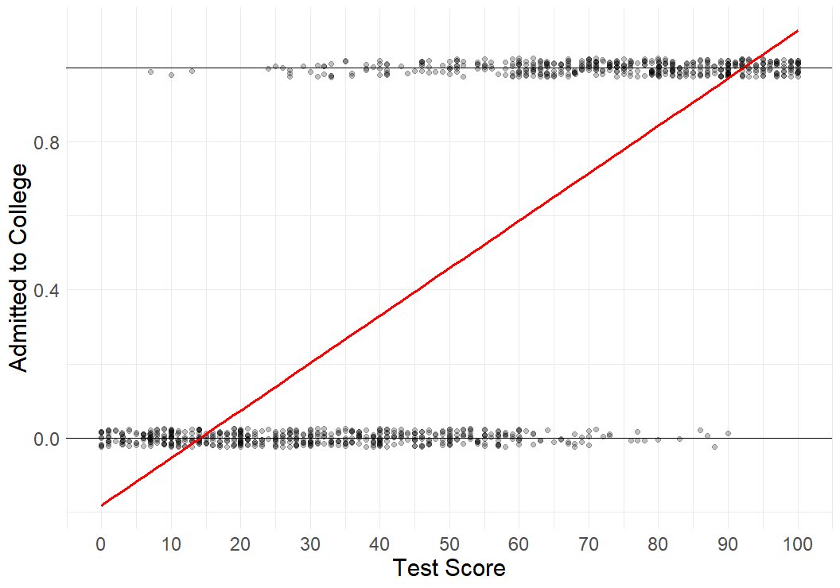
$$Admitted=−0.18+0.01 ∗ TestScore$$

Slide 5

Chart shows relationship between Test Score and being admitted to college.
We ran a regression (OLS) on this data.
We see that while the regression captures the relationship, it generates probabilities that are nonsensical (less than zero and greater than one)
$$Admitted=−0.18+0.01 ∗ TestScore$$

Slide 6
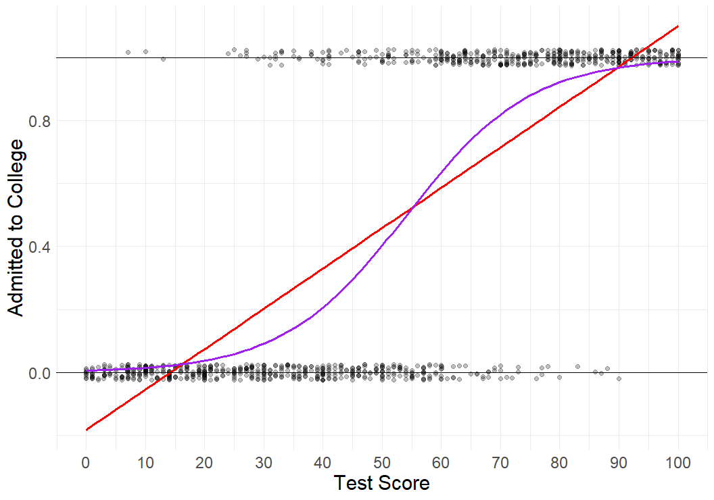
Logistic Regression

Slide 7
How can we visualize calibration using a chart like this?
Logistic Regression

Slide 8
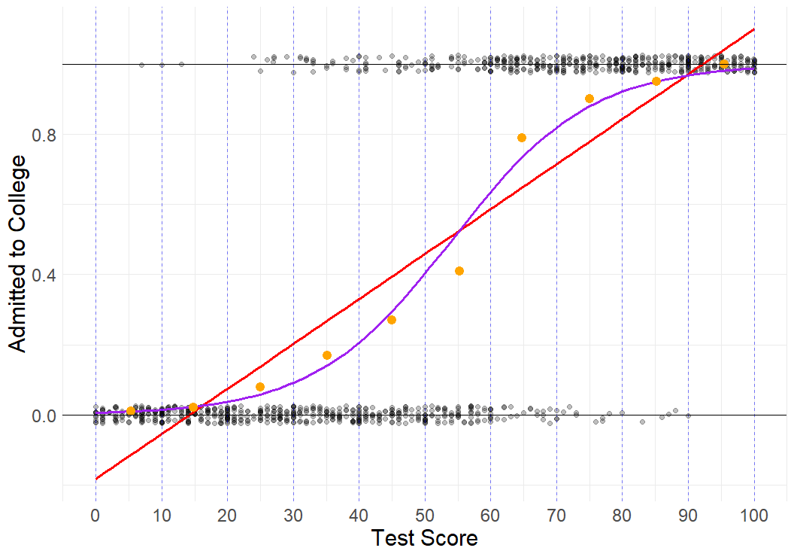

Slide 9
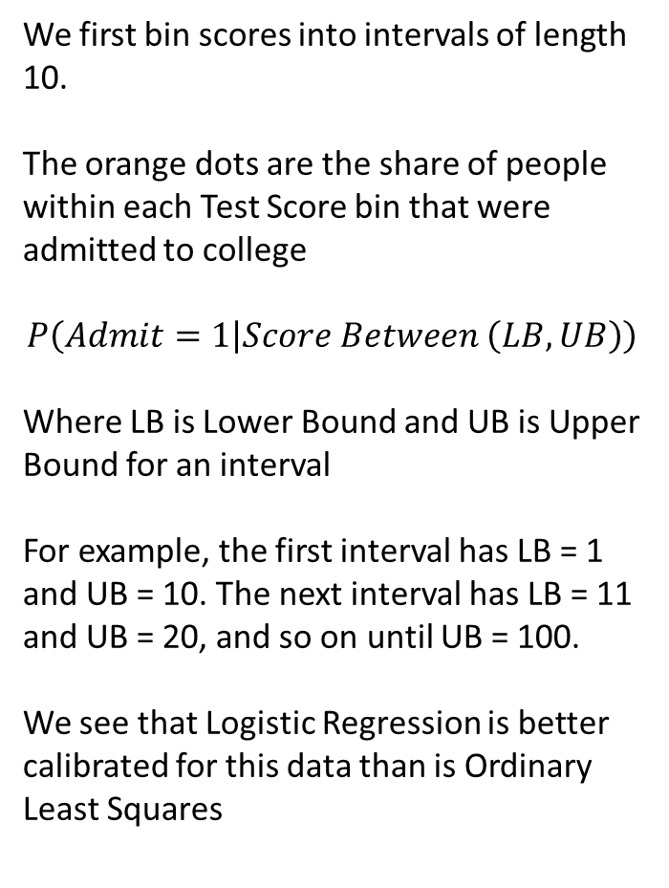
We first bin scores into intervals of length 10.
The orange dots are the share of people within each Test Score bin that were admitted to college
$$P\left(Admit=1 | Score Between \left(LB, UB\right)\right)$$
Where LB is Lower Bound and UB is Upper Bound for an interval
For example, the first interval has LB = 1 and UB = 10. The next interval has LB = 11 and UB = 20, and so on until UB = 100.
We see that Logistic Regression is better calibrated for this data than is Ordinary Least Squares

Slide 10
Limits of Linear/Logistic Regression

Slide 11
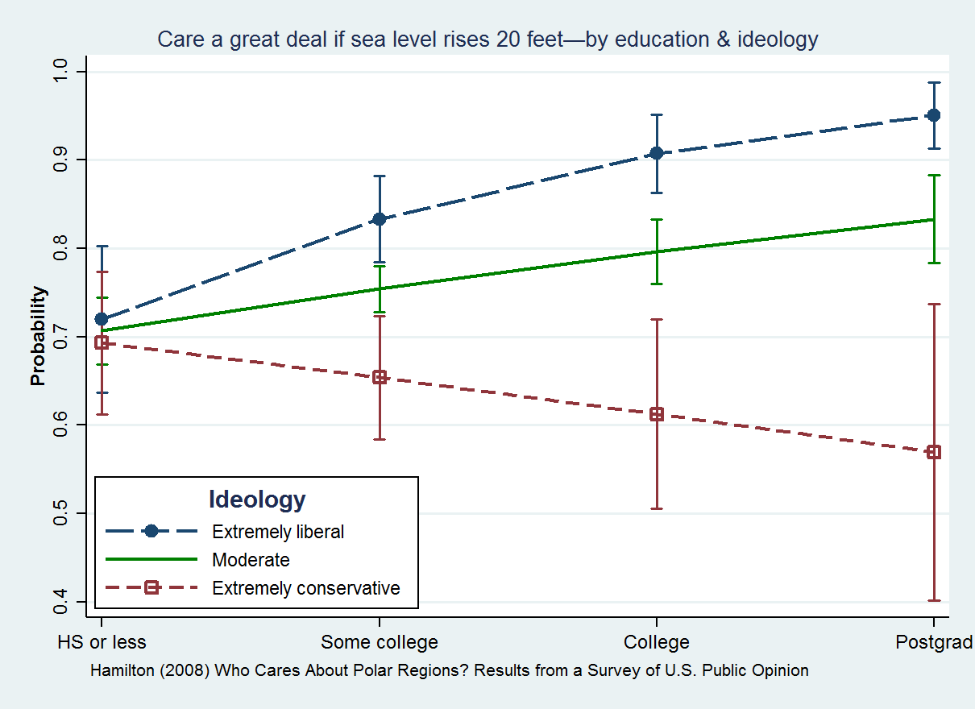
Statistical Interaction
Relationship between 2 variables depends on third
Sea Level Concerns
Education
Different patterns for different political ideologies

Slide 12
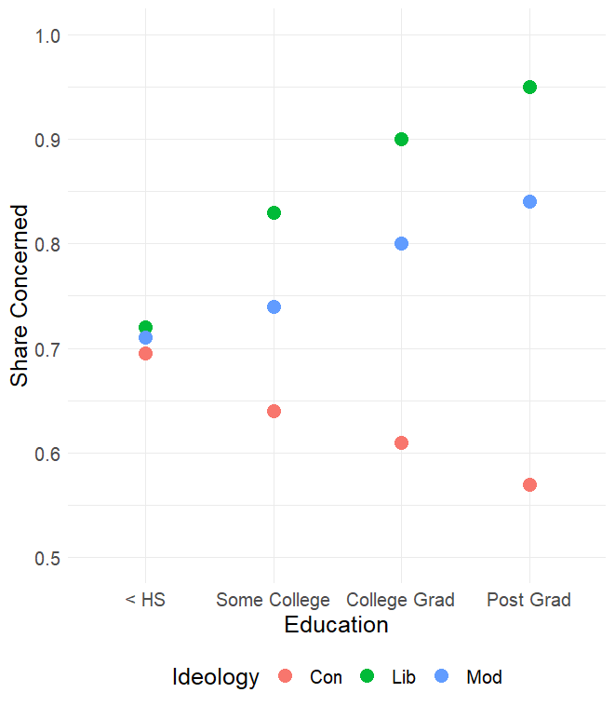
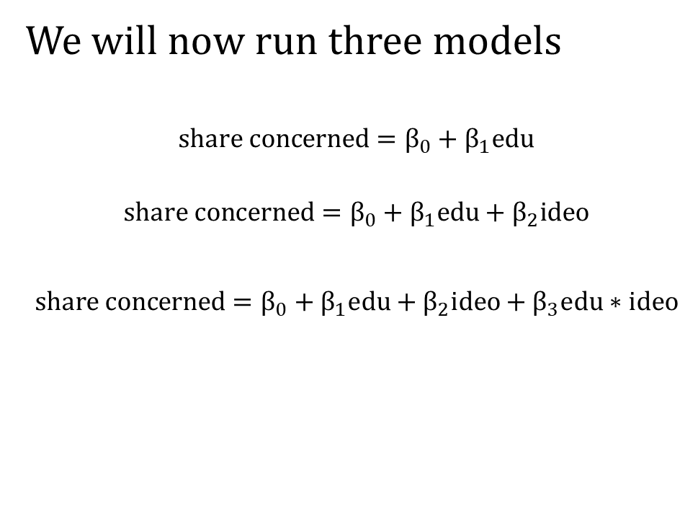
Interactions
We will now run three models
$$share concerned=β_{0}+β_{1}edu$$
$$share concerned=β_{0}+β_{1}edu+β_{2}ideo$$
$$share concerned=β_{0}+β_{1}edu+β_{2}ideo+β_{3}edu∗ideo$$

Slide 13
What does the dataset look like?
Share Concerned | Education | Ideology | Education Ideology
0.695 | < HS | Con | < HS & Con
0.64 | Some College | Con | Some College & Con
0.61 | College Grad | Con | College Grad & Con
0.57 | Post Grad | Con | Post Grad & Con
0.71 | < HS | Mod | < HS & Mod
0.74 | Some College | Mod | Some College & Mod
0.8 | College Grad | Mod | College Grad & Mod
0.84 | Post Grad | Mod | Post Grad & Mod
0.72 | < HS | Lib | < HS & Lib
0.83 | Some College | Lib | Some College & Lib
0.9 | College Grad | Lib | College Grad & Lib
0.95 | Post Grad | Lib | Post Grad & Lib

Slide 14
What does the dataset look like for Python?
Share Concerned | SC | CG | PG | Mod | Lib | SC*Mod | CG*Mod | PG*Mod | SC*Lib | CG*Lib | PG*Lib
0.695 | 0 | 0 | 0 | 0 | 0 | 0 | 0 | 0 | 0 | 0 | 0
0.64 | 1 | 0 | 0 | 0 | 0 | 0 | 0 | 0 | 0 | 0 | 0
0.61 | 0 | 1 | 0 | 0 | 0 | 0 | 0 | 0 | 0 | 0 | 0
0.57 | 0 | 0 | 1 | 0 | 0 | 0 | 0 | 0 | 0 | 0 | 0
0.71 | 0 | 0 | 0 | 1 | 0 | 0 | 0 | 0 | 0 | 0 | 0
0.74 | 1 | 0 | 0 | 1 | 0 | 1 | 0 | 0 | 0 | 0 | 0
0.8 | 0 | 1 | 0 | 1 | 0 | 0 | 1 | 0 | 0 | 0 | 0
0.84 | 0 | 0 | 1 | 1 | 0 | 0 | 0 | 1 | 0 | 0 | 0
0.72 | 0 | 0 | 0 | 0 | 1 | 0 | 0 | 0 | 0 | 0 | 0
0.83 | 1 | 0 | 0 | 0 | 1 | 0 | 0 | 0 | 1 | 0 | 0
0.9 | 0 | 1 | 0 | 0 | 1 | 0 | 0 | 0 | 0 | 1 | 0
0.95 | 0 | 0 | 1 | 0 | 1 | 0 | 0 | 0 | 0 | 0 | 1

Slide 15

Dataset for $share concerned=β_{0}+β_{1}edu$
Share Concerned | SC | CG | PG
0.695 | 0 | 0 | 0
0.64 | 1 | 0 | 0
0.61 | 0 | 1 | 0
0.57 | 0 | 0 | 1
0.71 | 0 | 0 | 0
0.74 | 1 | 0 | 0
0.8 | 0 | 1 | 0
0.84 | 0 | 0 | 1
0.72 | 0 | 0 | 0
0.83 | 1 | 0 | 0
0.9 | 0 | 1 | 0
0.95 | 0 | 0 | 1

Slide 16
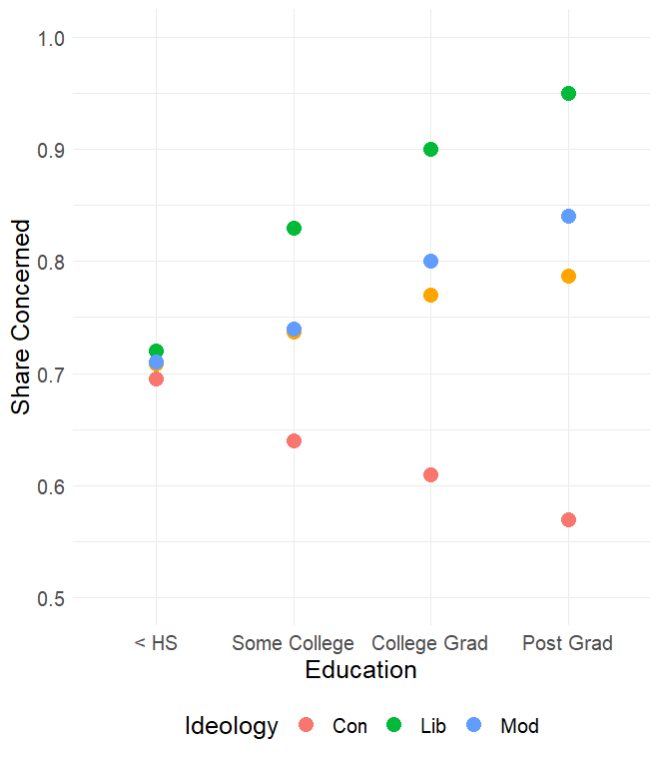
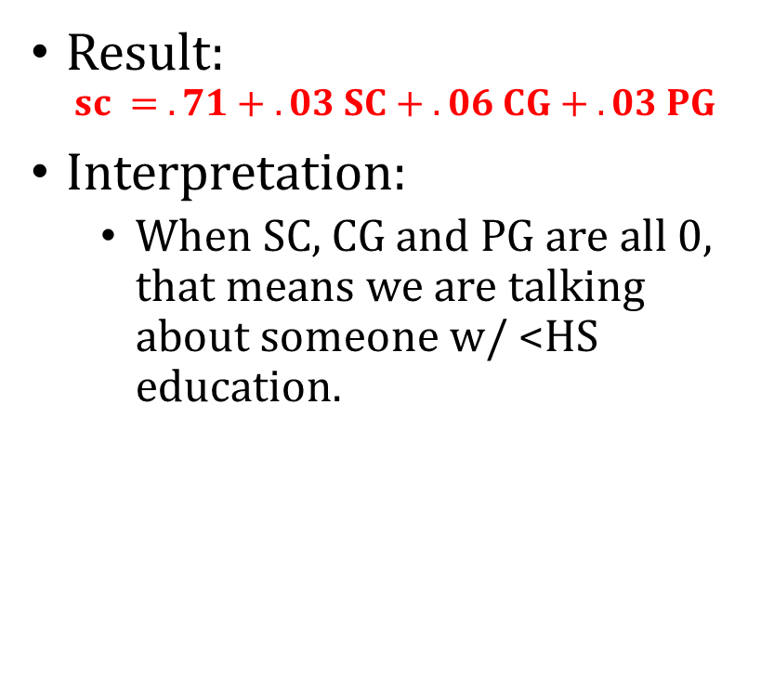
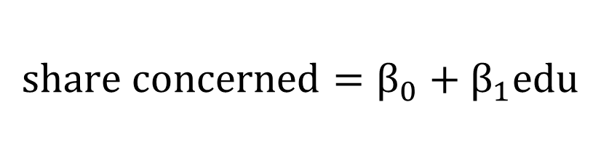
$$share concerned=β_{0}+β_{1}edu$$
Result:
$$sc = .71 + .03 SC + .06 CG + .03 PG$$
Interpretation:
When SC, CG and PG are all 0, that means we are talking about someone w/ <HS education.

Slide 17
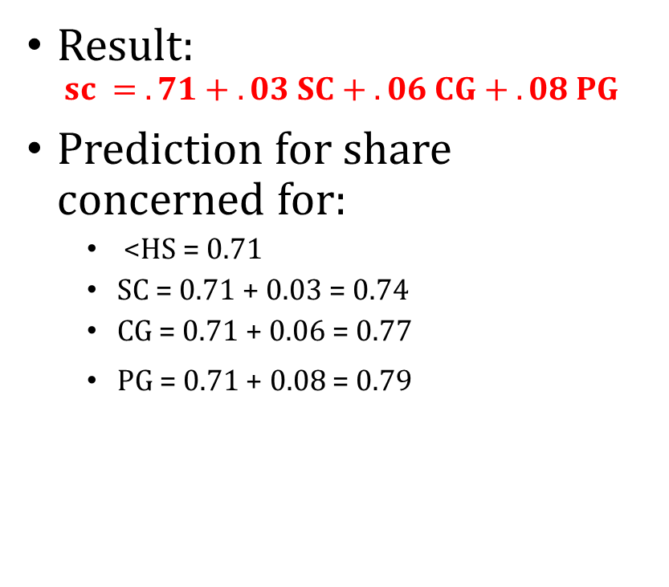
$$share concerned=β_{0}+β_{1}edu$$
Result:
$$sc = .71 + .03 SC + .06 CG + .08 PG$$
Prediction for share concerned for:
<HS = 0.71
SC = 0.71 + 0.03 = 0.74
CG = 0.71 + 0.06 = 0.77
PG = 0.71 + 0.08 = 0.79

Slide 18

Dataset for $share concerned=β_{0}+β_{1}edu+β_{2}ideo$
Share Concerned | SC | CG | PG | Mod | Lib
0.695 | 0 | 0 | 0 | 0 | 0
0.64 | 1 | 0 | 0 | 0 | 0
0.61 | 0 | 1 | 0 | 0 | 0
0.57 | 0 | 0 | 1 | 0 | 0
0.71 | 0 | 0 | 0 | 1 | 0
0.74 | 1 | 0 | 0 | 1 | 0
0.8 | 0 | 1 | 0 | 1 | 0
0.84 | 0 | 0 | 1 | 1 | 0
0.72 | 0 | 0 | 0 | 0 | 1
0.83 | 1 | 0 | 0 | 0 | 1
0.9 | 0 | 1 | 0 | 0 | 1
0.95 | 0 | 0 | 1 | 0 | 1

Slide 19
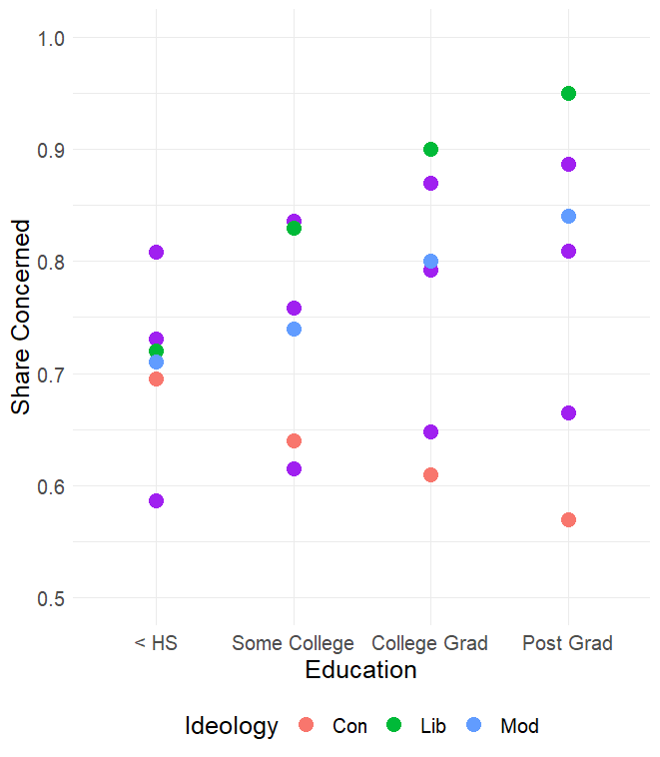

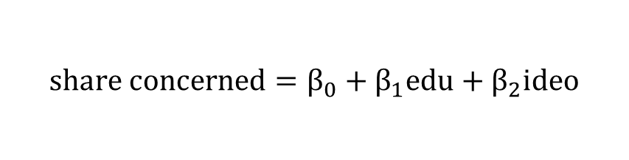
$$share concerned=β_{0}+β_{1}edu+β_{2}ideo$$
Result:
$$sc =0.59 + .03 SC + .06 CG + .08 PG+0.14 Mod+0.22 Lib$$

Slide 20
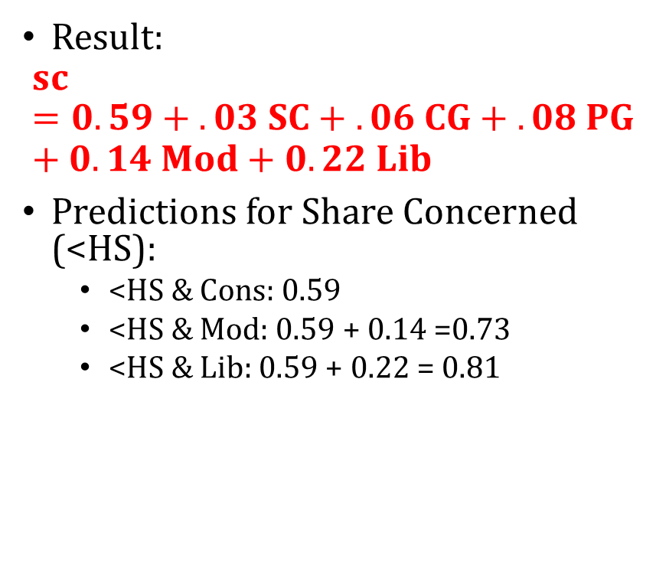
$$share concerned=β_{0}+β_{1}edu+β_{2}ideo$$
Result:
$$sc =0.59 + .03 SC + .06 CG + .08 PG+0.14 Mod+0.22 Lib$$
Predictions for Share Concerned (<HS):
<HS & Cons: 0.59
<HS & Mod: 0.59 + 0.14 =0.73
<HS & Lib: 0.59 + 0.22 = 0.81

Slide 21

$$share concerned=β_{0}+β_{1}edu+β_{2}ideo$$
Result:
$$sc =0.59 + .03 SC + .06 CG + .08 PG+0.14 Mod+0.22 Lib$$
Predictions for Share Concerned (Post Grad):
PG & Cons: 0.59 + .08 = 0.67
PG & Mod: 0.59 + .08 + 0.14 =0.81
PG & Lib: 0.59 + .08 + 0.22 = 0.89

Slide 22

Dataset for $share concerned=β_{0}+β_{1}edu+β_{2}ideo+β_{3}edu∗ideo$
Share Concerned | SC | CG | PG | Mod | Lib | SC*Mod | CG*Mod | PG*Mod | SC*Lib | CG*Lib | PG*Lib
0.695 | 0 | 0 | 0 | 0 | 0 | 0 | 0 | 0 | 0 | 0 | 0
0.64 | 1 | 0 | 0 | 0 | 0 | 0 | 0 | 0 | 0 | 0 | 0
0.61 | 0 | 1 | 0 | 0 | 0 | 0 | 0 | 0 | 0 | 0 | 0
0.57 | 0 | 0 | 1 | 0 | 0 | 0 | 0 | 0 | 0 | 0 | 0
0.71 | 0 | 0 | 0 | 1 | 0 | 0 | 0 | 0 | 0 | 0 | 0
0.74 | 1 | 0 | 0 | 1 | 0 | 1 | 0 | 0 | 0 | 0 | 0
0.8 | 0 | 1 | 0 | 1 | 0 | 0 | 1 | 0 | 0 | 0 | 0
0.84 | 0 | 0 | 1 | 1 | 0 | 0 | 0 | 1 | 0 | 0 | 0
0.72 | 0 | 0 | 0 | 0 | 1 | 0 | 0 | 0 | 0 | 0 | 0
0.83 | 1 | 0 | 0 | 0 | 1 | 0 | 0 | 0 | 1 | 0 | 0
0.9 | 0 | 1 | 0 | 0 | 1 | 0 | 0 | 0 | 0 | 1 | 0
0.95 | 0 | 0 | 1 | 0 | 1 | 0 | 0 | 0 | 0 | 0 | 1

Slide 23
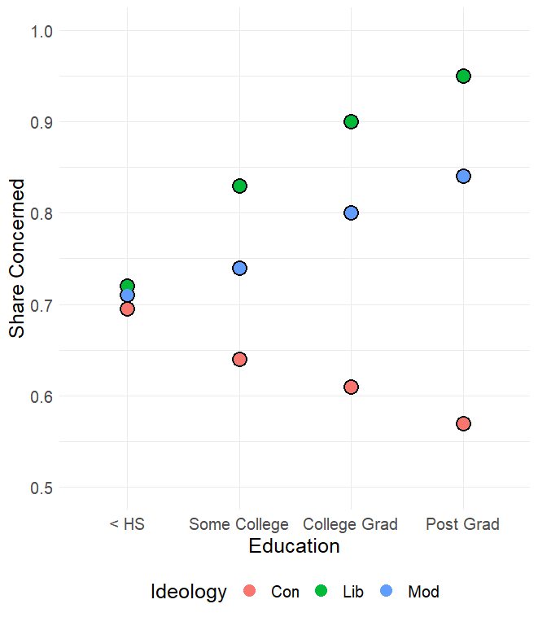
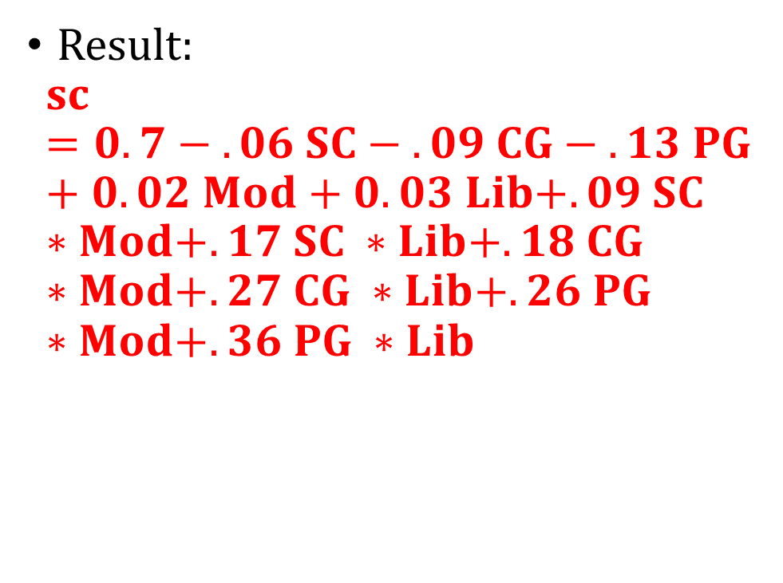
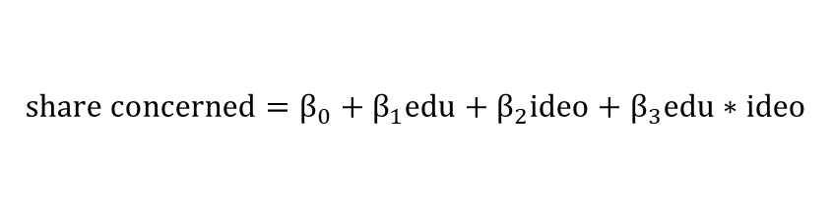
$$share concerned=β_{0}+β_{1}edu+β_{2}ideo+β_{3}edu∗ideo$$
Result:
$$sc =0.7 − .06 SC − .09 CG − .13 PG+0.02 Mod+0. 03 Lib+.09 SC ∗Mod+.17 SC ∗Lib+.18 CG ∗Mod+.27 CG ∗Lib+.26 PG ∗Mod+.36 PG ∗Lib$$

Slide 24
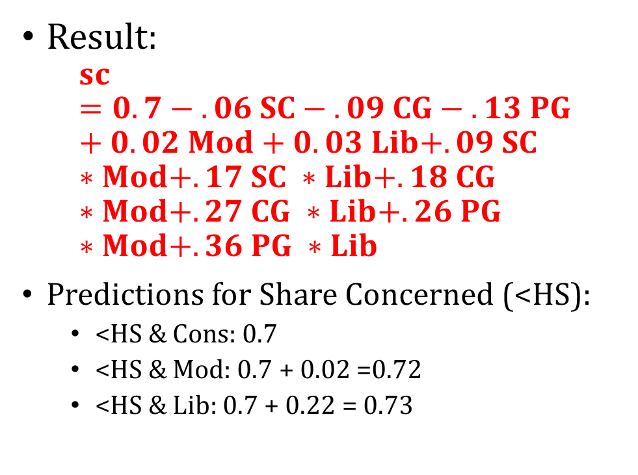
$$share concerned=β_{0}+β_{1}edu+β_{2}ideo+β_{3}edu∗ideo$$
Result:
$$sc =0.7 − .06 SC − .09 CG − .13 PG+0.02 Mod+0. 03 Lib+.09 SC ∗Mod+.17 SC ∗Lib+.18 CG ∗Mod+.27 CG ∗Lib+.26 PG ∗Mod+.36 PG ∗Lib$$
Predictions for Share Concerned (<HS):
<HS & Cons: 0.7
<HS & Mod: 0.7 + 0.02 =0.72
<HS & Lib: 0.7 + 0.22 = 0.73

Slide 25
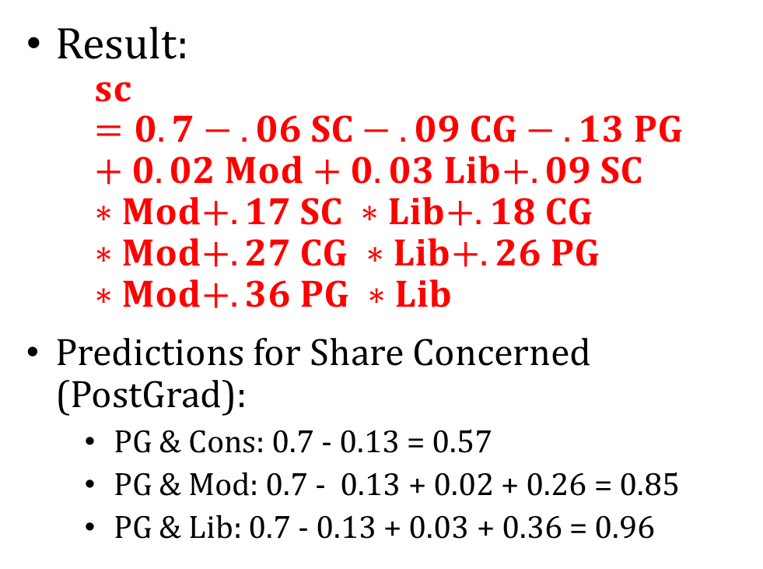
$$share concerned=β_{0}+β_{1}edu+β_{2}ideo+β_{3}edu∗ideo$$
Result:
$$sc =0.7 − .06 SC − .09 CG − .13 PG+0.02 Mod+0. 03 Lib+.09 SC ∗Mod+.17 SC ∗Lib+.18 CG ∗Mod+.27 CG ∗Lib+.26 PG ∗Mod+.36 PG ∗Lib$$
Predictions for Share Concerned (PostGrad):
PG & Cons: 0.7 - 0.13 = 0.57
PG & Mod: 0.7 - 0.13 + 0.02 + 0.26 = 0.85
PG & Lib: 0.7 - 0.13 + 0.03 + 0.36 = 0.96

Slide 26
Statistical Interaction
Definition: When the outcome differs based on value of more than one predictor AT THE SAME TIME
For example, the true value of share concerned for liberals with post graduate degree is 0.95
A model that includes by education and ideology, but without an interaction would predict 0.89
A model that interacts education and ideology would predict the correct value of 0.95
Because the model can now distinguish these types of people from people who just have a post graduate degree, or are just Liberals

Slide 27
Interactions are hard for Linear Regression
We had to create 6 variables that captured the possible interactions between education and ideology
We usually don’t know what the relationship is beforehand
So we in theory would need to test for each possible interaction

Slide 28
Interactions are hard for Linear Regression
What if we had 2 binary variables, how many pair-wise interactions are there between the two?
1, when both variables are equal to 1
What about 3 binary variables (A, B, and C)?
3 pair-wise interactions (A * B, B * C, and A * C)
What about 4?
General formula is N choose 2, so here it is 4 choose 2 = 6
What about 100?
4,950
A data scientist would have to create all of these variables before running a model. Is there a better way?

