Slide 1
CCJS 418E: Coding for Criminology Lecture 1 Introduction

Slide 2

About Me
Assistant Professor at the iSchool and CCJS
Ph.D. in Computer Science from NYU in 2017
Before UMD:
Research areas:
ML in public policy, particularly criminal justice
Record linkage
Science of science
You can refer to me by:
Professor Jelveh, Dr. Jelveh, or Zubin

Slide 3
This Course
Class:
Tuesdays: Virtual
Thursdays: In person
Keep your cameras on Tuesdays
https://link.springer.com/article/10.1007/s10639-022-11380-2
https://onlinelibrary.wiley.com/doi/full/10.1111/dsji.12309
https://www.sciencedirect.com/science/article/abs/pii/S0360131523002634
Bring your laptop to class
Office Hours: TBD + By Appointment

Slide 4
Why Learn to Code in 2025?
2

Slide 5
AI in the workplace
23% of employees were using generative AI in their jobs at least once per week, according to a report from the Federal Reserve Bank of St. Louis.
Jobs most likely to be impacted:
Customer service representatives
Administrative assistants and data entry clerks
Copywriters and content creators
Retail and warehouse workers
Financial analysts and junior accountants
Software engineers

Slide 6
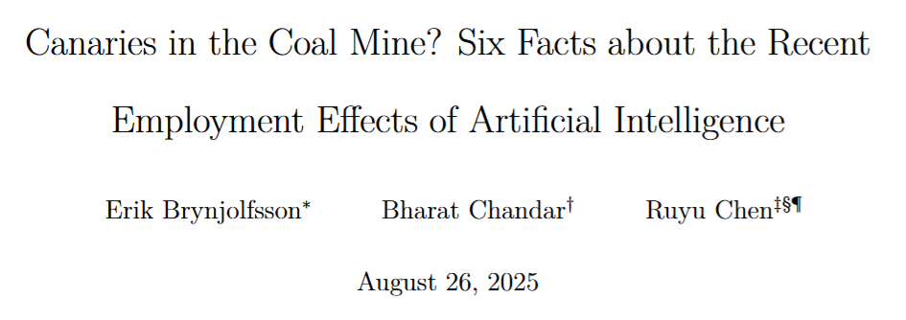
A Recent Paper

Slide 7
Study
Data from ADP, a payroll services company
monthly, individual-level payroll records for millions of workers acros tens of thousands of firms.
Defined jobs AI-exposed or not:
Automation
Augmentation
Compared:
22 to 25 year olds vs.
30+ year olds
Time period:
After 2022

Slide 8
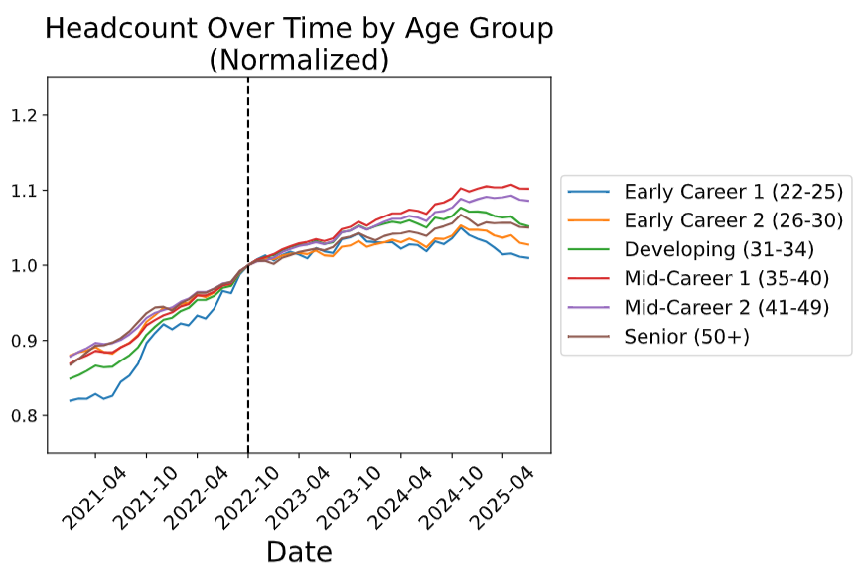
Overall

Slide 9
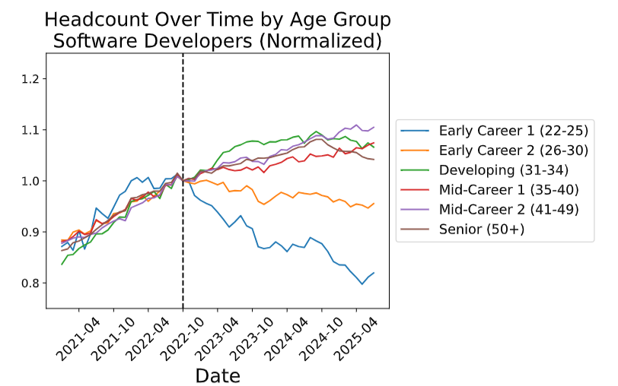
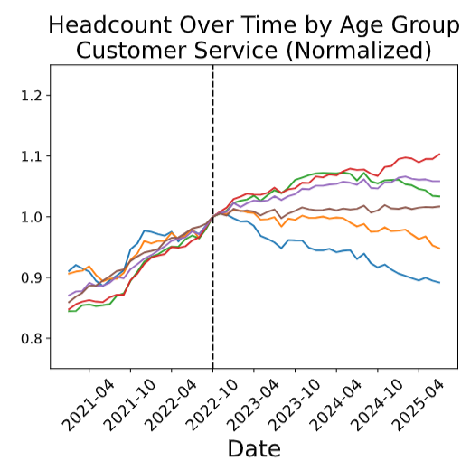
Occupations in Trouble

Slide 10
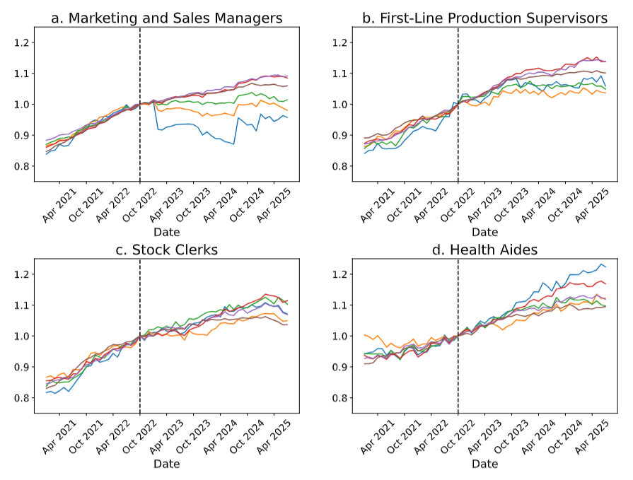

Slide 11
What This Means For You
Coding ability largely becomes a commodity
Still important to understand how it works but economic benefit of coding is reduced
Domain knowledge and real-world context become competitive advantage
AI can generate code, but it can't understand bail hearings, interpret recidivism patterns, or know when crime data might be biased

Slide 12
Philosophy of This Course
We’ll start with talking about “Computational Thinking”
Method for tackling problems
It was introduced as a way to help program
But it’s also very useful for interacting with LLMs via prompt engineering
We’ll use AI as a learning partner, not crutch
Use AI from day one - it's becoming industry standard
But learn to verify, modify, and explain what it produces
"Trust but verify" approach to AI-generated code
Goal: Learn to direct AI, not be replaced by it

Slide 13
Course Overview
Syllabus: https://zjelveh.github.io/teaching/ccjs_418e_2025_fall

Slide 14
Getting Started - Practical Setup
AI Tools (Choose one (or more) for free):
TerpAI: https://terpai.umd.edu
ChatGPT: https://chat.openai.com (free tier available)
Claude: https://claude.ai (free tier available)
Google Gemini: https://gemini.google.com (free with Google account)

Slide 15
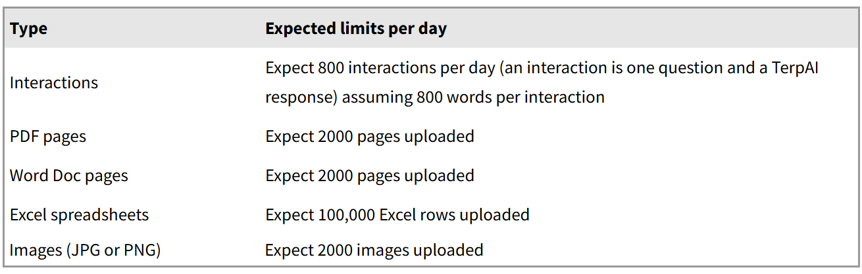
Usage Limits on TerpAI

Slide 16
Computational Thinking
2

Slide 17
Data + Code in Criminal Justice System
Risk Assessment Tools
COMPAS scores influence bail and sentencing decisions
How is data used to assess "risk“?
Predictive Policing
PredPol, ShotSpotter, and similar systems guide patrol deployment
How can you use data to evaluate the accuracy of these tools?
Case Management & Efficiency
Analyzing case backlogs to prioritize resources
Identifying patterns in prosecutorial decisions
Research & Policy Evaluation
Body camera footage analysis at scale
Measuring effectiveness of intervention programs
Understanding sentencing disparities across demographics
You don't need to build these systems, but you need to understand and evaluate them

Slide 18
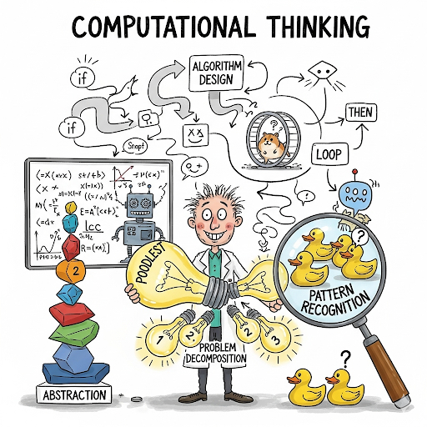
Four Pillars
Decomposition: Breaking big problems into smaller pieces
Pattern Recognition: Finding similarities and trends
Abstraction: Focusing on what matters, ignoring noise
Algorithms: Creating step-by-step solutions

Slide 19
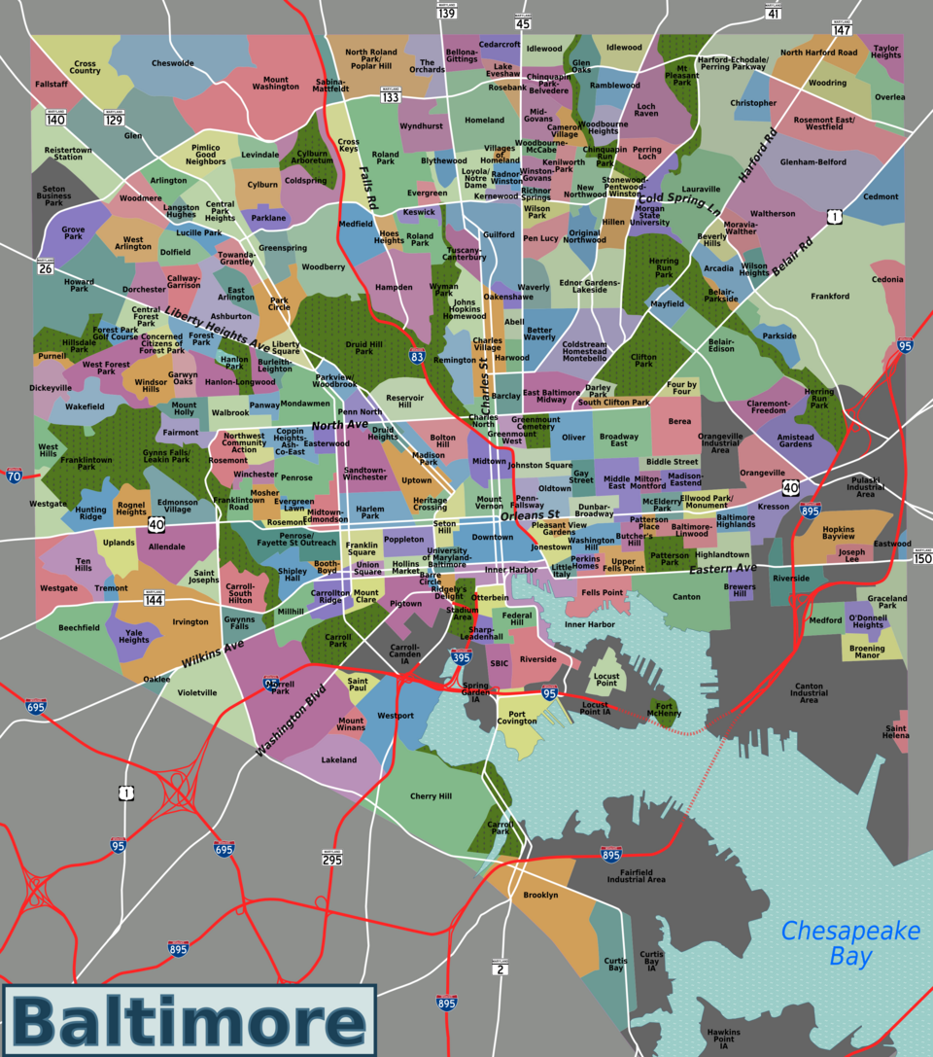

Example
Which Baltimore neighborhoods need increased patrols this weekend?

Slide 20
Decomposition
What might influence where crime might happen?

Slide 21
Big question -> Smaller questions
Where were crimes last weekend?
Which crimes are weekend specific?
What’s the weather forecast?
Are there major events happening?

Slide 22
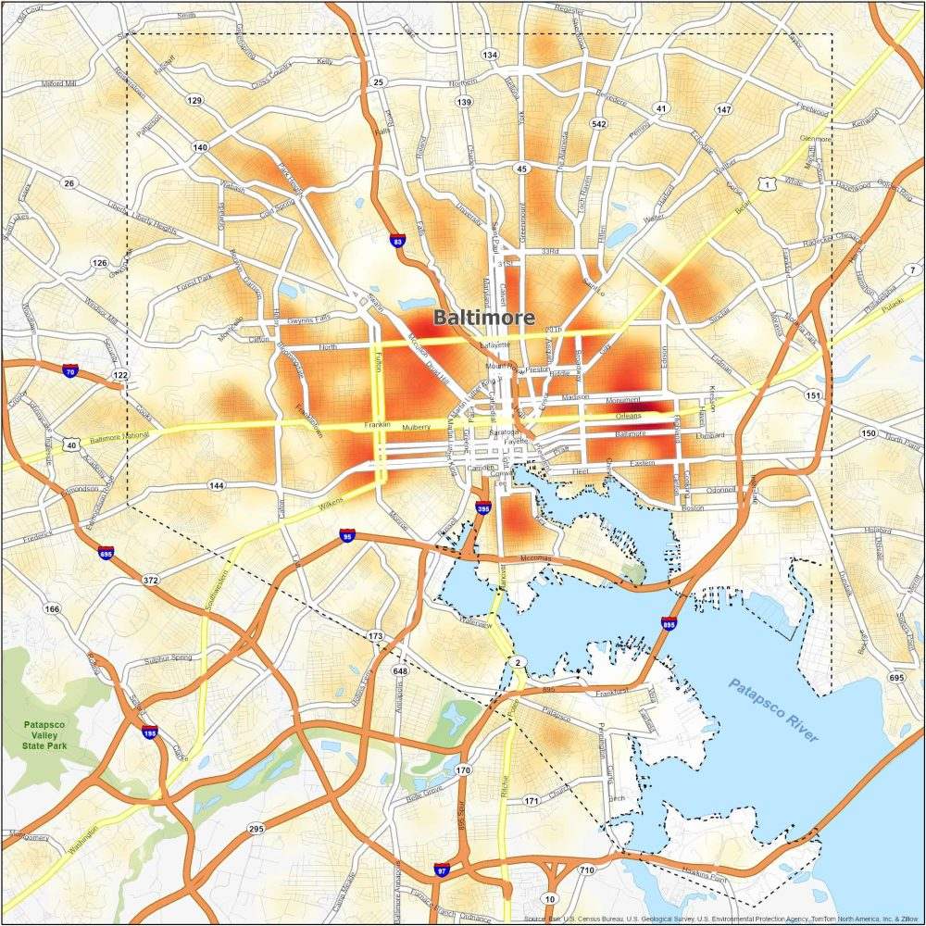
Pattern Recognition
Time patterns: Friday night spikes
Location patterns: Near bars/entertainment
Weather patterns: More assaults when warm

Slide 23
Abstraction
All this data is overwhelming!
What actually matters for patrol decisions?
Recent trends (not 5-year-old data)
Serious crimes (not noise complaints)
Predictable patterns (not random events)

Slide 24
Solution/Algorithm
Get last month's weekend crime data
Filter to serious crimes only
Identify top 10 hotspots
Check for special events
Assign patrol increases
Monitor and adjust

Slide 25
This is Programming
Our algorithm:
Get crime data
Filter to weekends
Find hotspots
Python Code:
df = pd.read_csv(“crime_data.csv”)
df[df.day.isin([‘Fri’, ‘Sat’, ‘Sun’])
df.groupby(‘location’).count()

Slide 26
This Is Also Prompt Engineering
Bad prompt: “Analyze crime data”
Better prompt:
"Load Baltimore crime data from last month“
"Filter to weekends only“
"Group by neighborhood and count incidents“
"Identify top 10 areas with most crimes“
"Create patrol deployment recommendation“
Goal is to direct the AI

Slide 27
Next week
Introduction to Jupyter notebook
Introduction to Python

